Slide 1

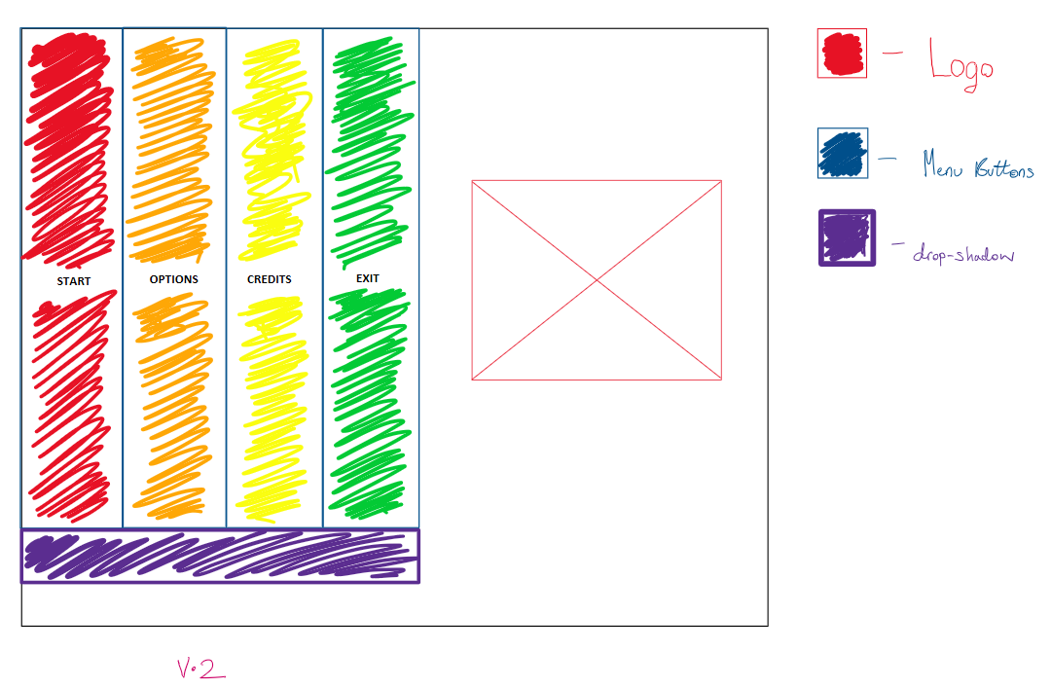
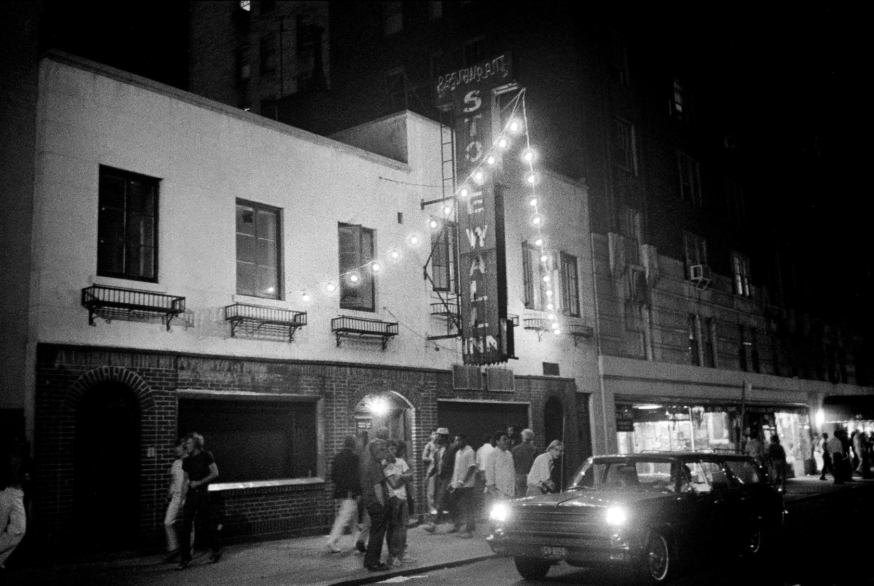
Gamifying Digital Heritage – LGBTQ+ History Cait Ridge-Sykes
Introduction
Design and Prototyping
Applications and Importance
The LGBTQIA+ community have been prominent in both recent times and history. Though the meaning of the abbreviation has been discussed, and the meaning can be left to interpretation, the generally accepted meaning is “Lesbian, Gay, Bisexual, Transgender, Queer, Questioning, Intersex, Asexual” with the ‘plus’ acting as a placeholder in case of identities not currently covered.¹
Similarly, the concept of gamification, has also been notable throughout recent history, used to educate its users on various topics by making the learning game-like. Recent examples include Duolingo, the app where you learn new languages through games like matching words and their translations together.
The process of gamification interesting to me, and as someone who is LGBTQ+, this is also an interesting topic to investigate and educate about via gamification.
Before developing the game, low-fidelity prototypes were created to provide a visualisation as to what the GUI would look like. A key focus in terms of theming was for it to be bright and colourful, but also accessible to users.
The UIs were then created in Godot and tested with a minimalistic approach, the idea being to see how well they were used. Other aspects not reflected in the current design that were considered, were font-size, intuitive placement, audio cues, and overall appearance.
Gamification can be applied to just about any topic, providing a new way to educate and inform about important topics, beyond textbooks and presentations.
Research done in conjunction with the University of Toronto, found that out of 51 students, 76% of them found gamification elements to be beneficial in their learning, through aspects like the competition element of competing with their peers and improving assignment completion time.
Gamification can be applied to just about any topic, and in this case, the aim is to educate about the struggles of LGBTQ people, and how they got to where they are now in terms of rights
Discussion
The low-fidelity prototype for the chosen menu design
Background Information
Implementation
The main event covered in my game, is the events of The Stonewall Riots, which took place in 1969, in America. This was a significant event in the history of LGBTQ+ Heritage, partly due to the laws in place at the time.
People who were LGBTQ+ were highly looked down upon in 1969 and had to deal with restrictions such as being unable to be served alcohol, unable to dress like those of the opposite sex, and unable to openly exhibit any kind of behaviour that was deemed not to be the usual done thing.²
Implementation initially took place by using the latest stable release of Godot 4, and the Godot addon for Visual Studio Code. During development, I was facing several issues with Visual Studio Code (VSC), so I instead moved to JetBrain's Rider, an IDE better suited for C# development
The duration of development ran over from the start of semester 1, in September, right through until early April, and included the designs of assets, drafting of pseudocode, and loosely following Agile principles.
Key systems, such as the dialogue and object interaction scripts, were focused on first as they were key aspects for the game to work, and required the largest amount of time dedicated to them as they were significantly more complicated than other scripts.
Acknowledgements
Advisor, Christina Moir
Undergraduate Lead, Mike Crabb
My boyfriend, Adam
A picture of the Stonewall Inn in 1969

