Slide 1

Nashville City Cemetery If you were buried here...
If you were buried here between the 1840s and 1970s
What would have been the cause of death on your tombstone?

Slide 2
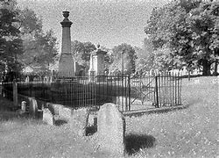
Consumption
Consumption is the leading cause of death across age groups. Accounting for over 55% of burials for 19–25-year-olds.
Cholera
Cholera is the next probable cause of death for 23% of people aged 26-40
Pneumonia
If you made it past consumption and cholera, pneumonia is the next likely cause of your demise
Flux
The 4th highest cause of death and slightly more likely if you are 41-64 years ago.
4 Top causes of death for ages 19-64

Slide 3
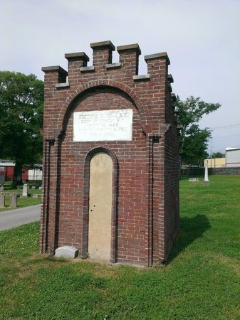
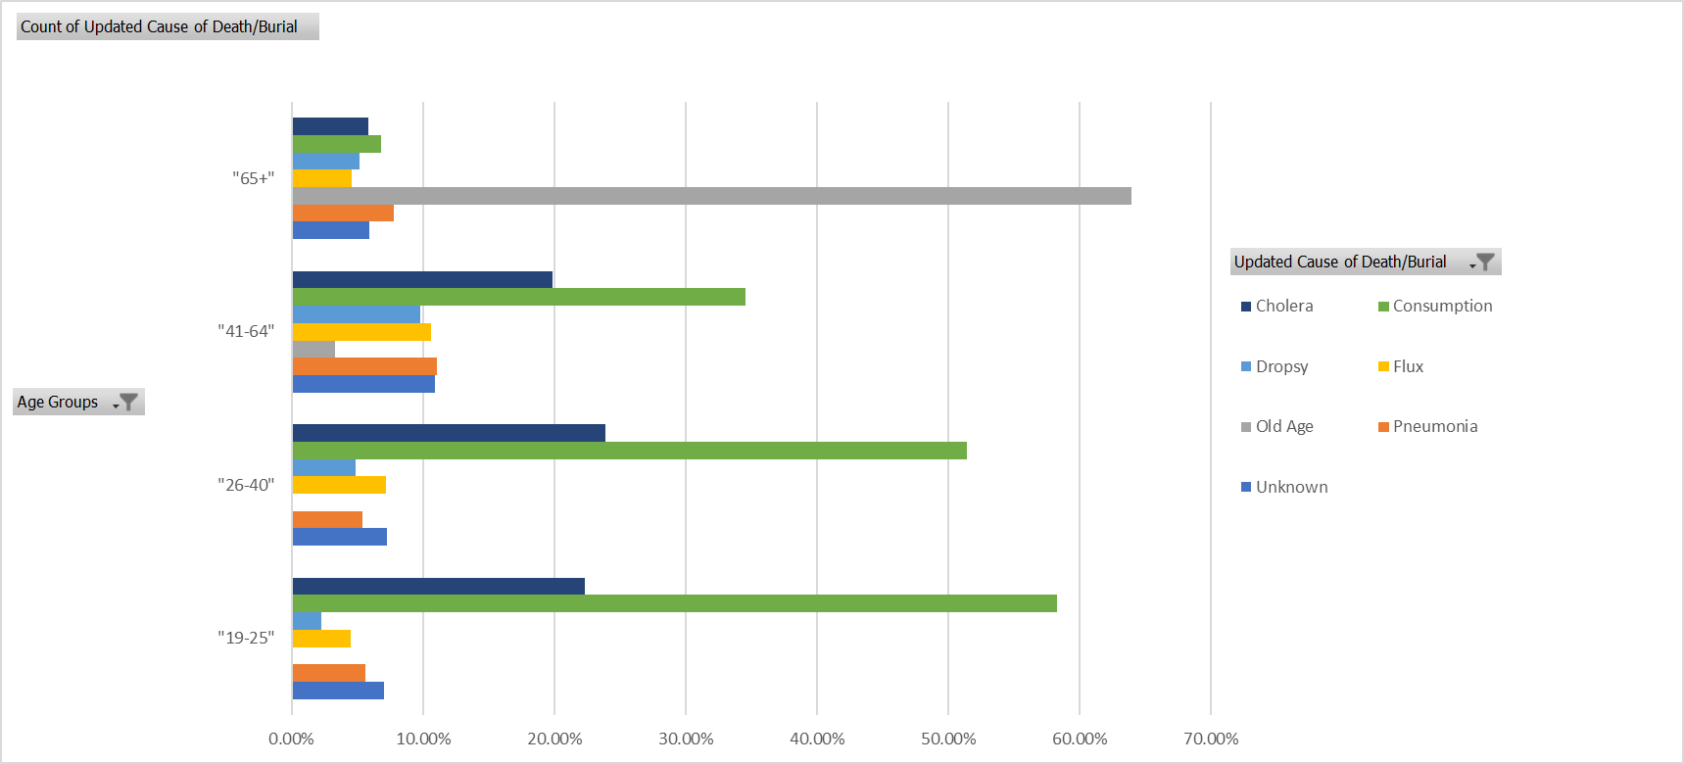
If you have made it to or past age 65, good news! You have most likely to have died from old age.

