Slide 1



Presentation title slide
The measurement of consumer emotions
Applying Rasch theory to guide product design
Procter & Gamble, 03/03/20
Caitlin Chalk, Brian Henson, Philip Bowtell, Sam Whitehead
Notes:
In this presentation I will talk about Rasch measurement theory, and how it can be used to obtain insightful attitudes and information from consumer data. First I will provide some theory behind the Rasch model, before discussing its application to laundry product survey data provided by Procter and Gamble. I will then show you examples of the sort of information that we can obtain with the Rasch model, which can be used to conduct more efficient surveys and ultimately inform product design and development.
I’m undertaking this research as part of my LIDA internship, alongside Dr Brian Henson from the School of Mechanical Engineering, and Sam and Phil from Procter and Gamble (who are the industrial partner in this project).
To give you a brief summary of my background, I have completed a PhD in the numerical modelling of geophysical flows in the School of Computing here at Leeds. Whilst finishing my PhD, I also worked with Procter and Gamble as a research officer, in the numerical simulation department. I’m currently undertaking an internship as a Data Scientist with the Leeds Institute for Data Analytics, where I’ve been given the opportunity to work with Procter and Gamble again, this time in the department of consumer research. I’m undertaking this research alongside Dr Brian Henson from the School of Mechanical Engineering, and Sam and Phil from Procter and Gamble.

Slide 2
Contents
Rasch measurement theory and the application to consumer data
Laundry product survey analysis
Longitudinal shaving survey analysis

Slide 3

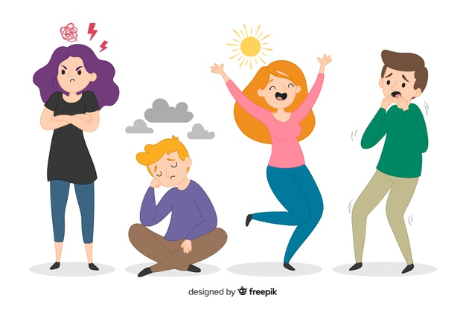
Categorical data
Latent variable
Notes:
The Rasch model is applied to categorical data, such as responses to an exam or a questionnaire, in order to measure a single latent variable. A latent variable is a variable that cannot be directly measured, which includes emotions and attitudes. The most common application of Rasch theory is the assessment of people, either in the context of education or health, and it has only recently been applied to consumer data. I’m going to briefly explain the theory behind Rasch measurement in the context of one of the traditional applications.

Slide 4
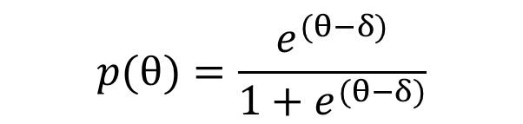
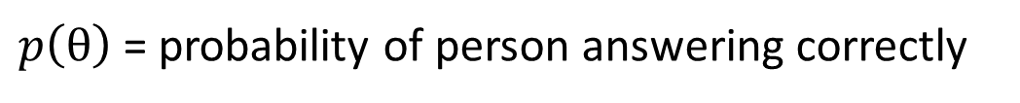
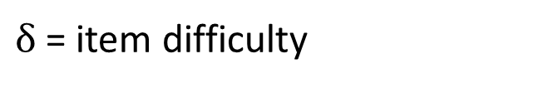
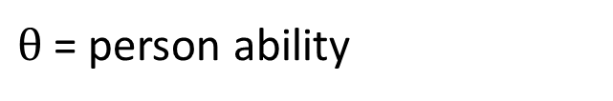
Rasch Measurement Theory
$θ$ = person ability
$$p(θ)=\frac{e^{(θ−δ)}}{1+e^{(θ−δ)}}$$
$δ$ = item difficulty
$p\left(θ\right)$= probability of person answering correctly
Notes:
For example, let’s consider the analysis of maths exam results, where the latent trait or the thing you want to measure is “the attitude of students towards maths”. According to the Rasch model, the probability of a student answering a given question correctly is calculated according to this simple equation shown here, which depends on the technical ability of that person and the difficulty of that question only. In the Rasch model, the questions are referred to as items.
The abilities and difficulties of each person and item respectively are calculated using a maximum likelihood method, under the assumption that the data conform to a Guttmann pattern.

Slide 5
Rasch Measurement Theory
$θ$ = person ability
$$p(θ)=\frac{e^{(θ−δ)}}{1+e^{(θ−δ)}}$$
$δ$ = item difficulty
$p\left(θ\right)$= probability of person answering correctly
Easiest item
Hardest item
 | Item 1 | Item 2 | Item 3 | Item 4 | Item 5 | Item 6
Person 1 | Correct | Incorrect | Incorrect | Incorrect | Incorrect | Incorrect
Person 2 | Correct | Correct | Incorrect | Incorrect | Incorrect | Incorrect
Person 3 | Correct | Correct | Correct | Incorrect | Incorrect | Incorrect
Person 4 | Correct | Correct | Correct | Correct | Incorrect | Incorrect
Person 5 | Correct | Correct | Correct | Correct | Correct | Incorrect
Person 6 | Correct | Correct | Correct | Correct | Correct | Correct
Lowest ability
Highest ability
Notes:
The Guttmann pattern looks something like this, where people with higher abilities are able to answer all of the questions correctly, while people with lower abilities are only able to answer the easier questions correctly. So in the Rasch model, we analyse the data to see whether or not it conforms to this sort of pattern. In other words, the data is fit to the model, as opposed to classic techniques where models are fit to the data.

Slide 6
Application to consumer data
Latent variable
Endorsement of product
Item difficulty
Likelihood of statement to be endorsed
Person ability
Likelihood to endorse product
Notes:
In this context, the latent trait that we are measuring with the Rasch model is the ‘endorsement of usual laundry product’. The survey statements are the Rasch items, and the item difficulty corresponds to the likelihood of that specific statement to be endorsed. Similarly, the person ability can be considered as the likelihood of an individual to endorse their usual laundry product. A person with a higher ability is more likely to endorse their product than a person of a lower ability.
I’ve used specific Rasch measurement software to assess the fit of the data to the Rasch model. The fit of the data can be determined according to several fit statistics that reveal how closely the data follows the expected pattern.

Slide 7

Data set 1: Usual laundry product survey
999 participants
10 laundry products
Ariel Low Suds (LS)
Ariel High Suds (HS)
Omo LS
Omo HS
Persil LS
Persil HS
Tide LS
Tide HS
Bonux HS
Xtra HS

Slide 8
Data set 1: Usual laundry product survey
18 Rating Statements
16 Agreement Statements
Rating for cleaning laundry overall…
This product gives excellent cleaning overall…
Excellent
Very good
Good
Fair
Poor
Strongly agree
Agree
Somewhat agree
Disagree
Strongly disagree

Slide 9
Laundry product analysis: aims
Assess the fit of the consumer survey data to the Rasch model
Identify misfitting participants and statements
Determine which products are most popular
Compare the results between different consumer demographics – age, nationality, size of household etc

Slide 10
Individual person fit
999 participants
729 participants
Notes:
Similarly, we are also able to analyse each statement to determine whether or not it fits the model

Slide 11
Individual item fit
Excellent value
Cleaning overall
Removing tough stains
Providing bright whites
Keeping dark clothes dark
Providing vivid colours
Overall scent
Good level of suds
Removing bad odours
Product appearance
Not leaving residues
Trusted brand
Makes me feel proud
Package quality
Worth the price
I would recommend this product
Notes:
A significant item fit residual can tell us if a statement is redundant – so it doesn’t tell us any new information, or whether a statement is measuring something else other than the latent variable of interest.

Slide 12
Individual item fit
Excellent value
Cleaning overall
Removing tough stains
Providing bright whites
Keeping dark clothes dark
Providing vivid colours
Overall scent
Good level of suds
Removing bad odours
Product appearance
Not leaving residues
Trusted brand
Makes me feel proud
Package quality
Worth the price
I would recommend this product
Notes:
Once we have identified which items don’t fit the model, these can then be removed and we are able to analyse the remaining items and people that do fit the model.

Slide 13
Excellent value
Removing tough stains
Providing bright whites
Providing vivid colours
Overall scent
Good level of suds
Removing bad odours
Product appearance
Not leaving residues
Trusted brand
Notes:
Once our data do fit the Rasch model we are then able to analyse the remaining people and items. Looking at the ordering of item difficulties, we can determine which items the consumers find easiest to endorse.

Slide 14
Excellent value
Removing tough stains
Providing bright whites
Providing vivid colours
Overall scent
Good level of suds
Removing bad odours
Product appearance
Not leaving residues
Trusted brand
Removing bad odours
Excellent value
Good level of suds
Overall scent
Trusted brand
Providing vivid colours
Product appearance
Not leaving residues
Providing bright whites
Removing tough stains
Notes:
Here the items have been re-ordered in terms of their difficulty, and we can see that item 9 – this product is excellent at removing bad odours – is the easiest item, which translates as the statement that is most likely to be endorsed overall. Item 3 – this product is excellent at removing tough stains – is the most difficult item and therefore the least likely to be endorsed. This information suggests that overall the consumers are most satisfied with the performance of their laundry product in terms of removing bad odours, and least satisfied with its ability to remove tough stains.

Slide 15
Most likely to be endorsed
Removing bad odours
Excellent value
Good level of suds
Overall scent
Trusted brand
Providing vivid colours
Product appearance
Not leaving residues
Providing bright whites
Removing tough stains
Least likely to be endorsed
Notes:
Here the items have been re-ordered in terms of their difficulty, and we can see that item 9 – this product is excellent at removing bad odours – is the easiest item, which translates as the statement that is most likely to be endorsed overall. Item 3 – this product is excellent at removing tough stains – is the most difficult item and therefore the least likely to be endorsed. This information suggests that overall the consumers are most satisfied with the performance of their laundry product in terms of removing bad odours, and least satisfied with its ability to remove tough stains.
In addition to information about the people and the statements, we can extract further information regarding the attitudes towards specific products and brands.

Slide 16
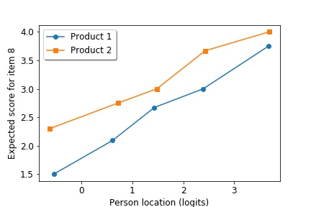
Product analysis
Excellent value
Removing tough stains
Providing bright whites
Providing vivid colours
Overall scent
Good level of suds
Removing bad odours
Product appearance
Not leaving residues
Trusted brand
Ariel LS
Tide LS
Expected score for item 8
Person ability (logits)
Notes:
Shown here on the horizontal axis is the person ability, where a higher location corresponds to a higher likelihood of product endorsement. On the vertical axis is the expected score for item 8, where a higher score corresponds to a more positive response to this item. Plotted are the results for 2 out of the 10 different laundry products.
We can see that product 2, corresponding to the orange line, is located significantly higher than the blue line representing product 1. This means that people who use product 2 generally have a higher score for item 8 than people who use product 1, who have the same location on the logit scale. This tells us that regardless of how likely a person is to endorse their usual laundry product overall, product 1 is considerably less popular than product 2 in terms of the suds experience of the consumer. Such information is really valuable in terms of finding specific areas for improvement in the product development process.

Slide 17
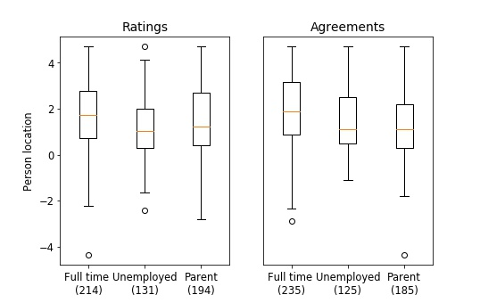
Demographic analysis
Person location (logits)

Slide 18
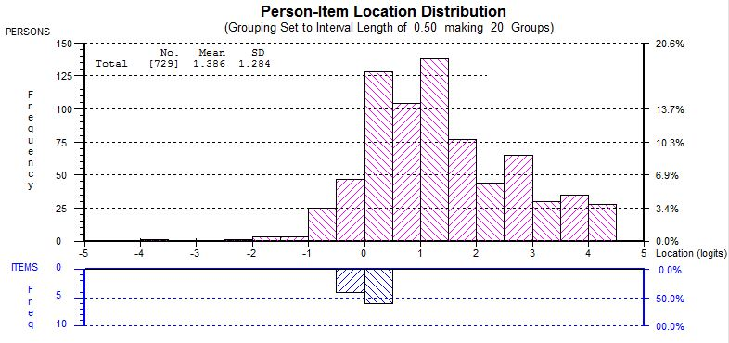
Survey target

Slide 19
Laundry product analysis: Conclusions
Participants (and statements) who don’t provide any useful information can be easily identified and removed
Statement 9 (bad odours) is most likely to be endorsed (in the Agreements analysis)
Statement 3 (tough stains) is least likely to be endorsed (in the Agreements analysis)
There is significant variation in the consumer attitude to suds experience – people who use Tide are most satisfied, people who use Ariel are least satisfied
The attitudes of people from different demographics can be compared – full time workers are most likely to endorse their usual laundry products than unemployed people or full time parents
The average person ability is considerably higher than the average item difficulty, and there is little variation for the latter

Slide 20

Data set 2: Longitudinal razor product survey
93 participants
10 statements
39 test products
6 test aspects (chemistry, blade etc)
2 control products
2-10 shaves
Up to 9 tests (06/16 – 11/18)

Slide 21
Shaving analysis: aims
Use Rasch measurement theory to track the survey participants over time
Track the statement function over time
Compare the performance of different shaving products over time

Slide 22
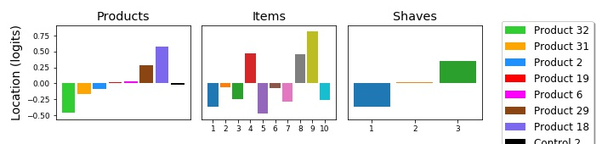
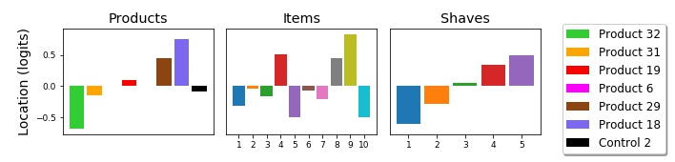
Product, item and shave scores: a “multi-facet” approach
Shaves 1-3

Slide 23
Product, item and shave scores: a “multi-facet” approach
Shaves 1-5

Slide 24
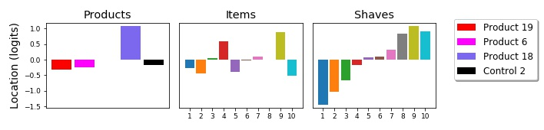
Product, item and shave scores: a “multi-facet” approach
Shaves 1-10

Slide 25
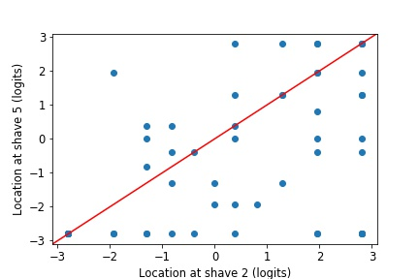
Person scores over shaves: an “anchored” approach

Slide 26
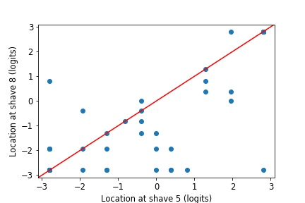
Person scores over shaves: an “anchored” approach

Slide 27
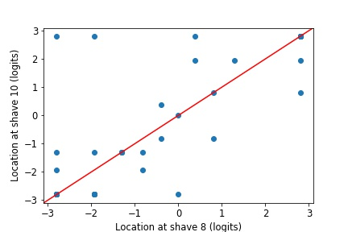
Person scores over shaves: an “anchored” approach

Slide 28
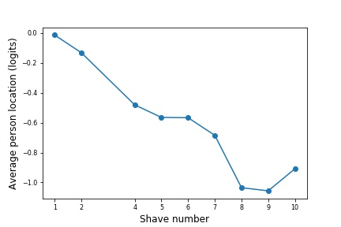
Person scores over shaves: an “anchored” approach

Slide 29
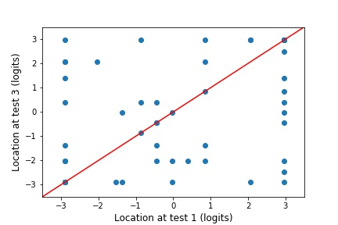
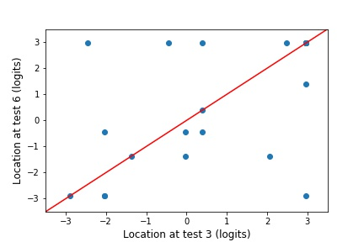
Person scores over tests
Tests 1 and 3
Tests 3 and 6

Slide 30
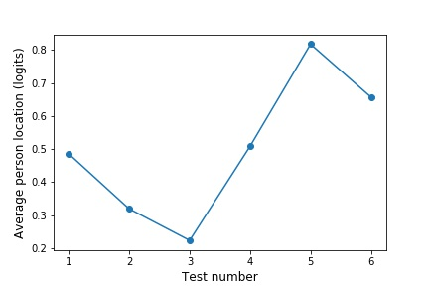
Person scores over tests

Slide 31
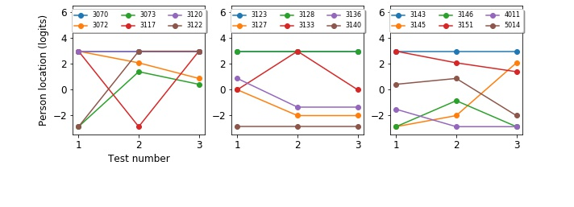
Person scores over tests

Slide 32
Shaving analysis: Conclusions
Overall, the participants become more critical with shave
Product 18 is the least popular product of the Chemistry aspect
Product 32 is the most popular product of the Chemistry aspect
Statements 9 and 4 are the least likely to be endorsed
There is no significant change in ability with test, for most participants
Participants who do become more critical with each test can be easily identified

