Slide 1

Notes:
Procter and Gamble is one of the oldest and largest consumer goods companies worldwide. The company owns over 100 brands, and specialises in a wide range of health care, home care and hygiene products.
Lots of data generated
In order to achieve this, it’s essential to analyse the thoughts and opinions of consumers towards the range of products that are available, through the use of targeted consumer surveys. But how can we accurately capture consumer sentiments with survey data? Classic approaches involve statistically modelling the data to spot the overall trends and patterns regarding consumer opinions. Today I’m going to discuss an alternative approach which is capable of capturing a richer set of information than classic methods.

Slide 2
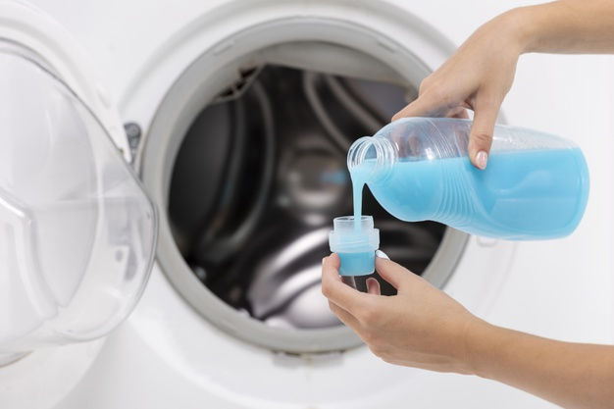



Notes:
Procter and Gamble is one of the oldest and largest consumer goods companies worldwide. The company owns over 100 brands, and specialises in a wide range of health care, home care and hygiene products. Products that we use every single day.
Lots of data generated
In order to achieve this, it’s essential to analyse the thoughts and opinions of consumers towards the range of products that are available, through the use of targeted consumer surveys. But how can we accurately capture consumer sentiments with survey data? Classic approaches involve statistically modelling the data to spot the overall trends and patterns regarding consumer opinions. Today I’m going to discuss an alternative approach which is capable of capturing a richer set of information than classic methods.

Slide 3

Notes:
Procter and Gamble is one of the oldest and largest consumer goods companies worldwide. The company owns over 100 brands, and specialises in a wide range of health care, home care and hygiene products. Products that we use every single day.
Lots of data generated
In order to achieve this, it’s essential to analyse the thoughts and opinions of consumers towards the range of products that are available, through the use of targeted consumer surveys. But how can we accurately capture consumer sentiments with survey data? Classic approaches involve statistically modelling the data to spot the overall trends and patterns regarding consumer opinions. Today I’m going to discuss an alternative approach which is capable of capturing a richer set of information than classic methods.

Slide 4


Presentation title slide
The measurement of consumer emotions
Applying Rasch theory to consumer survey data
Caitlin Chalk
Supervisory team: Brian Henson, Philip Bowtell, Sam Whitehead
Notes:
In this presentation I will talk about Rasch measurement theory, and how it can be used to obtain insightful attitudes and information from consumer data. First I will provide some theory behind the Rasch model, before discussing its application to laundry product survey data provided by Procter and Gamble. I will then show you examples of the sort of information that we can obtain with the Rasch model, which can be used to conduct more efficient surveys and ultimately inform product design and development.
I’m undertaking this research as part of my LIDA internship, alongside Dr Brian Henson from the School of Mechanical Engineering, and Sam and Phil from Procter and Gamble (who are the industrial partner in this project).

Slide 5
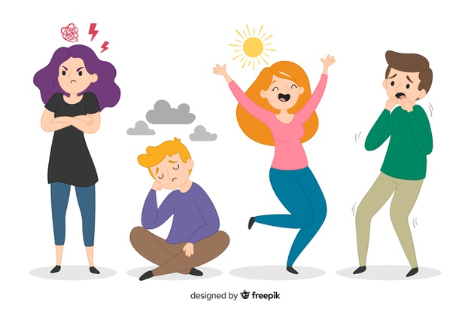

Categorical data
Latent variable
Notes:
The Rasch model is applied to categorical data, such as responses to an exam or a questionnaire, in order to measure a single latent variable. A latent variable is a variable that cannot be directly measured, which includes emotions and attitudes. The most common application of Rasch theory is the assessment of people, either in the context of education or health, and it has only recently been applied to consumer data. I’m going to briefly explain the theory behind Rasch measurement in the context of one of the traditional applications.

Slide 6
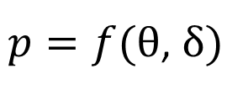
Rasch Measurement Theory
Probability of answering correctly
Person ability
Question (item) difficulty
Notes:
For example, let’s consider the analysis of maths exam results, where the latent trait or the thing you want to measure is “the attitude of students towards maths”. According to the Rasch model, the probability of a student answering a given question correctly is calculated according to this simple equation shown here, which depends on the technical ability of that person and the difficulty of that question only. In the Rasch model, the questions are referred to as items.
The abilities and difficulties of each person and item respectively are calculated using a maximum likelihood method, under the assumption that the data conform to a Guttmann pattern.

Slide 7
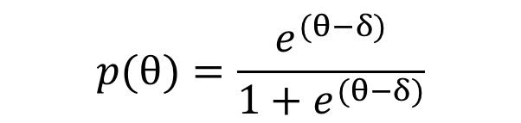
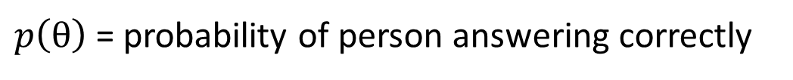
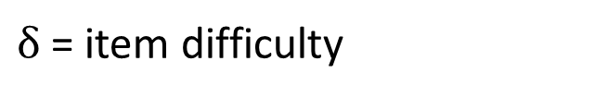
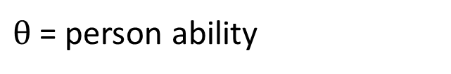
Rasch Measurement Theory
$θ$ = person ability
$$p(θ)=\frac{e^{(θ−δ)}}{1+e^{(θ−δ)}}$$
$δ$ = item difficulty
$p\left(θ\right)$= probability of person answering correctly
Easiest item
Hardest item
 | Item 1 | Item 2 | Item 3 | Item 4 | Item 5 | Item 6
Person 1 | Correct | Incorrect | Incorrect | Incorrect | Incorrect | Incorrect
Person 2 | Correct | Correct | Incorrect | Incorrect | Incorrect | Incorrect
Person 3 | Correct | Correct | Correct | Incorrect | Incorrect | Incorrect
Person 4 | Correct | Correct | Correct | Correct | Incorrect | Incorrect
Person 5 | Correct | Correct | Correct | Correct | Correct | Incorrect
Person 6 | Correct | Correct | Correct | Correct | Correct | Correct
Lowest ability
Highest ability
Notes:
The Guttmann pattern looks something like this, where people with higher abilities are able to answer all of the questions correctly, while people with lower abilities are only able to answer the easier questions correctly. So in the Rasch model, as analyse the data to see whether or not it conforms to this sort of pattern. In other words, the data is fit to the model, as opposed to classic techniques where models are fit to the data.

Slide 8

999 participants
Notes:
The aim of the current research is apply the Rasch model to consumer data. The data that I have consist of 999 individuals that responded to a number of different statements about their usual laundry product, such as ‘This product gives excellent cleaning overall’, and the response options ranged from ‘strongly disagree’ to ‘strongly agree’.

Slide 9

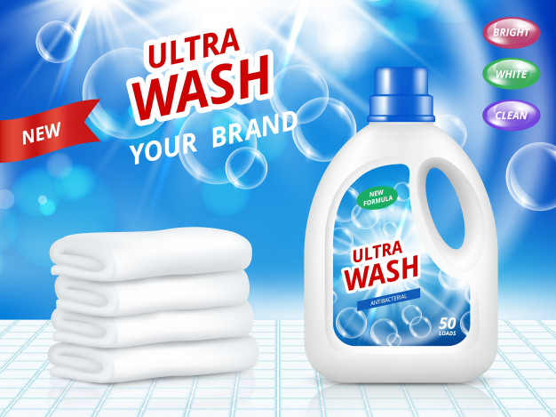

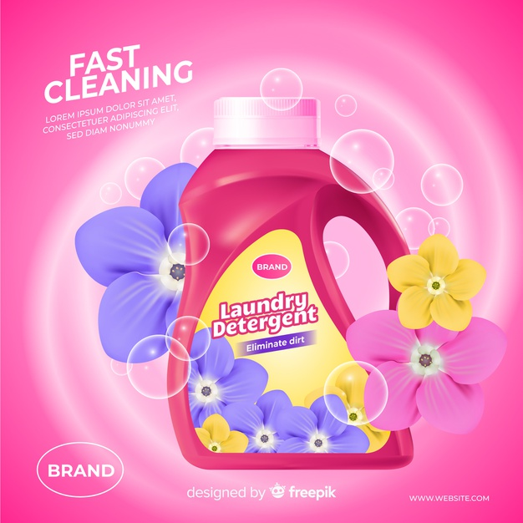

999 participants
10 laundry products
Notes:
The aim of the current research is apply the Rasch model to consumer data. The data that I have consist of 999 individuals that responded to a number of different statements about their usual laundry product, such as ‘This product gives excellent cleaning overall’, and the response options ranged from ‘strongly disagree’ to ‘strongly agree’.

Slide 10
Rasch Measurement Theory
Endorsement of usual laundry product
Latent variable
Item difficulty
Likelihood of statement to be endorsed
Person ability
Likelihood to endorse usual laundry product
Notes:
In this context, the latent trait that we are measuring with the Rasch model is the ‘endorsement of usual laundry product’. The survey statements are the Rasch items, and the item difficulty corresponds to the likelihood of that specific statement to be endorsed. Similarly, the person ability can be considered as the likelihood of an individual to endorse their usual laundry product. A person with a higher ability is more likely to endorse their product than a person of a lower ability.
I’ve used specific Rasch measurement software to assess the fit of the data to the Rasch model. The fit of the data can be determined according to several fit statistics that reveal how closely the data follows the expected pattern.

Slide 11
999 participants
Notes:
Firstly, we are able to examine the people themselves, where each person has a fit residual. The closer the residual is to zero, the more closely the person fits the Rasch model. Significant fit residuals can reveal if a person’s responses are too predictable, where they might just be selecting the same response for all items. Similarly, we are also able to see if a person’s responses are too random and meaningless. We can then remove these misfitting people – who don’t give us meaningful information – from the analysis.

Slide 12
999 participants
729 participants
Notes:
Similarly, we are also able to analyse each statement to determine whether or not it fits the model

Slide 13
Individual item fit
Excellent value
Cleaning overall
Removing tough stains
Providing bright whites
Keeping dark clothes dark
Providing vivid colours
Overall scent
Good level of suds
Removing bad odours
Product appearance
Not leaving residues
Trusted brand
Makes me feel proud
Package quality
Worth the price
I would recommend this product
Notes:
A significant item fit residual can tell us if a statement is redundant – so it doesn’t tell us any new information, or whether a statement is measuring something else other than the latent variable of interest.

Slide 14
Individual item fit
Excellent value
Cleaning overall
Removing tough stains
Providing bright whites
Keeping dark clothes dark
Providing vivid colours
Overall scent
Good level of suds
Removing bad odours
Product appearance
Not leaving residues
Trusted brand
Makes me feel proud
Package quality
Worth the price
I would recommend this product
Notes:
Once we have identified which items don’t fit the model, these can then be removed and we are able to analyse the remaining items and people that do fit the model.

Slide 15
Excellent value
Removing tough stains
Providing bright whites
Providing vivid colours
Overall scent
Good level of suds
Removing bad odours
Product appearance
Not leaving residues
Trusted brand
Notes:
Once our data does fit the Rasch model we are then able to analyse the remaining people and items. Looking at the ordering of item difficulties, we can determine which items the consumers find easiest to endorse.

Slide 16
Excellent value
Removing tough stains
Providing bright whites
Providing vivid colours
Overall scent
Good level of suds
Removing bad odours
Product appearance
Not leaving residues
Trusted brand
Removing bad odours
Excellent value
Good level of suds
Overall scent
Trusted brand
Providing vivid colours
Product appearance
Not leaving residues
Providing bright whites
Removing tough stains
Notes:
Here the items have been re-ordered in terms of their difficulty, and we can see that item 9 – this product is excellent at removing bad odours – is the easiest item, which translates as the statement that is most likely to be endorsed overall. Item 3 – this product is excellent at removing tough stains – is the most difficult item and therefore the least likely to be endorsed. This information suggests that overall the consumers are most satisfied with the performance of their laundry product in terms of removing bad odours, and least satisfied with its ability to remove tough stains.

Slide 17
Most likely to be endorsed
Removing bad odours
Excellent value
Good level of suds
Overall scent
Trusted brand
Providing vivid colours
Product appearance
Not leaving residues
Providing bright whites
Removing tough stains
Least likely to be endorsed
Notes:
Here the items have been re-ordered in terms of their difficulty, and we can see that item 9 – this product is excellent at removing bad odours – is the easiest item, which translates as the statement that is most likely to be endorsed overall. Item 3 – this product is excellent at removing tough stains – is the most difficult item and therefore the least likely to be endorsed. This information suggests that overall the consumers are most satisfied with the performance of their laundry product in terms of removing bad odours, and least satisfied with its ability to remove tough stains.
In addition to information about the people and the statements, we can extract further information regarding the attitudes towards specific products and brands.

Slide 18
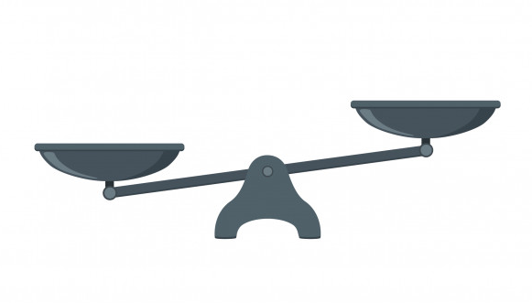
Which brand is best?
Notes:
As we know which product each participant is rating, we can include that product as additional information in the Rasch model. We are then able to conduct a two-way analysis of variance for every item and compare the different scores across each product, to see if there is any significant variation in how people who use the different products react to each item. One item in which we have found significant response variation is statement number 8 – this product gives a good level of suds throughout the wash.

Slide 19
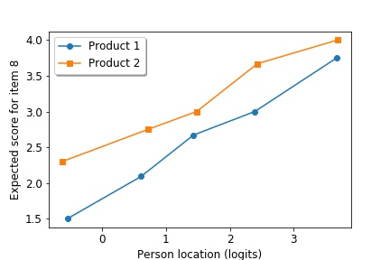
Excellent value
Removing tough stains
Providing bright whites
Providing vivid colours
Overall scent
Good level of suds
Removing bad odours
Product appearance
Not leaving residues
Trusted brand
Expected score for item 8
Person ability (logits)
Notes:
Shown here on the horizontal axis is the person ability, where a higher location corresponds to a higher likelihood of product endorsement. On the vertical axis is the expected score for item 8, where a higher score corresponds to a more positive response to this item. Plotted are the results for 2 out of the 10 different laundry products.
We can see that product 2, corresponding to the orange line, is located significantly higher than the blue line representing product 1. This means that people who use product 2 generally have a higher score for item 8 than people who use product 1, who have the same location on the logit scale. This tells us that regardless of how likely a person is to endorse their usual laundry product overall, product 1 is considerably less popular than product 2 in terms of the suds experience of the consumer. Such information is really valuable in terms of finding specific areas for improvement in the product development process.

Slide 20


Notes:
What I’ve discussed today are just a few examples of the sort of really specific information that can be obtained with the Rasch model. Thank you for listening to this presentation, and I’d just like to finish by summarising that we have demonstrated for the first time that Rasch measurement theory can be used to assess the quality of real consumer research data.
By fitting the data to the Rasch model, as opposed to modelling the data, we are able to obtain rich and detailed information about the people, the statements and the products. This information can be used by Procter and Gamble to conduct more efficient surveys, improve marketing techniques and ultimately guide product design and development.
Finally, the fact that we are able to identify persons and statements that are not contributing useful information to the analysis has the potential to reduce costs for businesses in general, as the size of surveys and samples used in consumer research can be reduced, whilst improving the quality of information.

