Slide 1
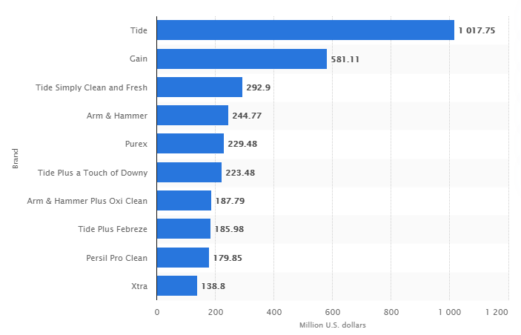



Liquid laundry detergent sales in the US in 2018 (in million US dollars)
Tide
1017.75
Gain
581.11
Tide Simply Clean and Fresh
292.9
Arm & Hammer
244.77
Purex
229.48
Tide Plus a Touch of Downy
223.48
Arm & Hammer Plus Oxi Clean
187.79
Tide Plus Febreze
185.98
Persil Pro Clean
179.85
Xtra
138.8
https://www.statista.com/statistics/188716/top-liquid-laundry-detergent-brands-in-the-united-states/
Notes:
Procter and Gamble, founded in 1837, is one of the largest and oldest consumer goods companies world wide. The company owns 105 brands, and specialises in a wide range of health care, home care and hygiene products. In particular, Procter and Gamble are consistently the largest provider of laundry products in the world, of which they have 13 different brands. However, competing companies, such as Unilever, Henkel and Johnson and Johnsons, are constantly working on new formulas, packaging and marketing techniques to make their products stand out.
Site: https://www.statista.com/statistics/188716/top-liquid-laundry-detergent-brands-in-the-united-states/

Slide 2
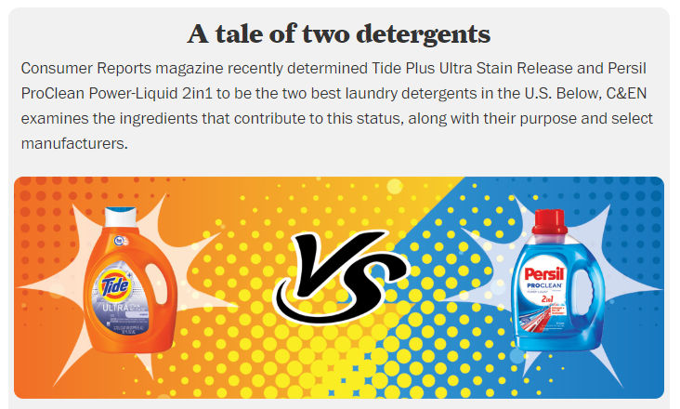
https://cen.acs.org/articles/95/i4/PG-Henkel-head-head-laundry.html
Notes:
Shown here is a snippet of an online article in a chemical and engineering news website, discussing the ingredients of the 2 most popular detergents at that time (2016) – Tide by Procter and Gamble, and Persil by Henkel. Persil was ranked as the best performing US detergent by Consumer Reports magazine.
To keep up with the competition and continue to provide superior products, its essential for Procter and Gamble to analyse consumer thoughts and opinions towards the range of available laundry products, which are obtained via targeted consumer surveys. However, the process of designing and conducting surveys is time consuming and expensive, as the surveys usually have to be re-designed and repeated as products are changed and developed. The attitudes and opinions expressed in consumer surveys are also emotional responses, which are difficult to measure and quantify. Descriptive statistics are often incorrectly applied to survey data, producing meaningless results. One way to overcome these problems is to use Rasch measurement theory to analyse consumer data. This is a probabilistic technique, which is used to convert emotional responses to linear measurements. I’m going to talk about the application of Rasch theory to consumer laundry product data, provided by Procter and Gamble. First I will introduce Rasch measurement theory. I’ll then present the application of Rasch to the consumer data, and discuss how the results inform the design of surveys and products. I’m undertaking this research in collaboration with Procter and Gamble, who are the industrial partner of my first project here at LIDA.
REF for image
https://cen.acs.org/articles/95/i4/PG-Henkel-head-head-laundry.html

Slide 3


Presentation title slide
The measurement of consumer emotions
Applying Rasch theory to guide product design
Caitlin Chalk
Supervisory team: Brian Henson, Sam Whitehead, Philip Bowtell
Notes:
Is the subtitle okay?

Slide 4
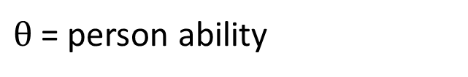
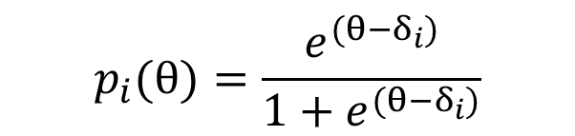
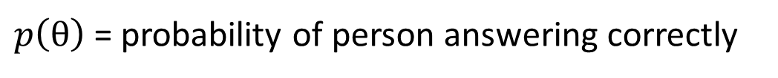
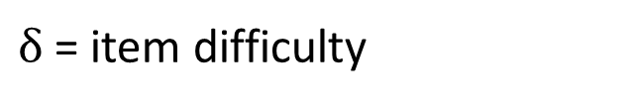
Rasch Measurement Theory
$θ$ = person ability
$$p_{i}(θ)=\frac{e^{(θ−δ_{i})}}{1+e^{(θ−δ_{i})}}$$
$δ$ = item difficulty
$p\left(θ\right)$= probability of person answering correctly

Slide 5
Rasch Measurement Theory
$θ$ = person ability
$$p_{i}(θ)=\frac{e^{(θ−δ_{i})}}{1+e^{(θ−δ_{i})}}$$
$δ$ = item difficulty
$p\left(θ\right)$= probability of person answering correctly
Easiest item
Hardest item
 | Item 1 | Item 2 | Item 3 | Item 4 | Item 5 | Item 6
Person 1 | Correct | Incorrect | Incorrect | Incorrect | Incorrect | Incorrect
Person 2 | Correct | Correct | Incorrect | Incorrect | Incorrect | Incorrect
Person 3 | Correct | Correct | Correct | Incorrect | Incorrect | Incorrect
Person 4 | Correct | Correct | Correct | Correct | Incorrect | Incorrect
Person 5 | Correct | Correct | Correct | Correct | Correct | Incorrect
Person 6 | Correct | Correct | Correct | Correct | Correct | Correct
Lowest ability
Highest ability
Notes:
To mention:
Latent variable – unidimensionality
Fit the data to the model, rather than the other way around in classical methods
Units - logits
Wikipedia:
The Rasch model is often considered to be the 1PL IRT model. However, proponents of Rasch modeling prefer to view it as a completely different approach to conceptualizing the relationship between data and theory.^{[13]} Like other statistical modeling approaches, IRT emphasizes the primacy of the fit of a model to observed data,^{[14]} while the Rasch model emphasizes the primacy of the requirements for fundamental measurement, with adequate data-model fit being an important but secondary requirement to be met before a test or research instrument can be claimed to measure a trait.^{[15]} Operationally, this means that the IRT approaches include additional model parameters to reflect the patterns observed in the data (e.g., allowing items to vary in their correlation with the latent trait), whereas in the Rasch approach, claims regarding the presence of a latent trait can only be considered valid when both (a) the data fit the Rasch model, and (b) test items and examinees conform to the model. Therefore, under Rasch models, misfitting responses require diagnosis of the reason for the misfit, and may be excluded from the data set if one can explain substantively why they do not address the latent trait.^{[16]} Thus, the Rasch approach can be seen to be a confirmatory approach, as opposed to exploratory approaches that attempt to model the observed data

Slide 6

999 participants

Slide 7
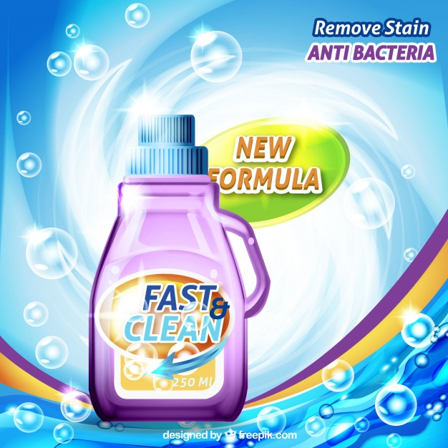
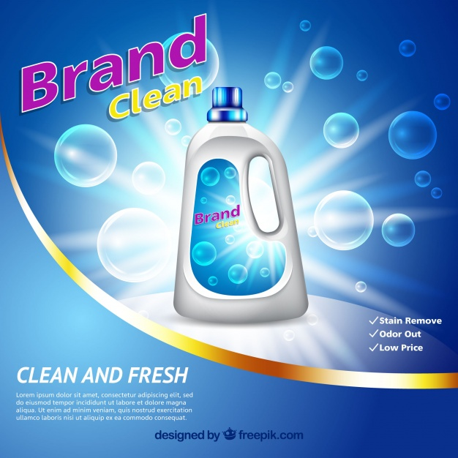
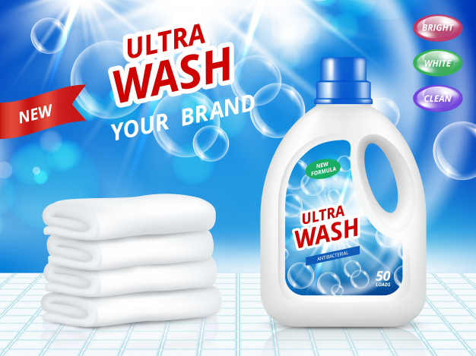
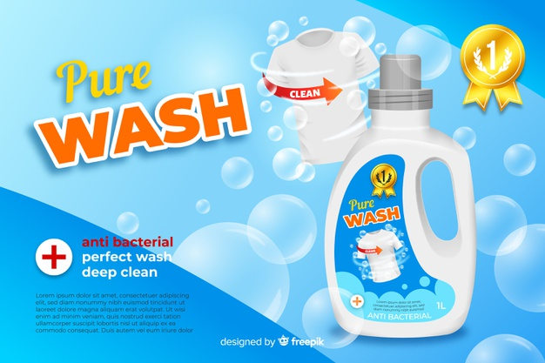
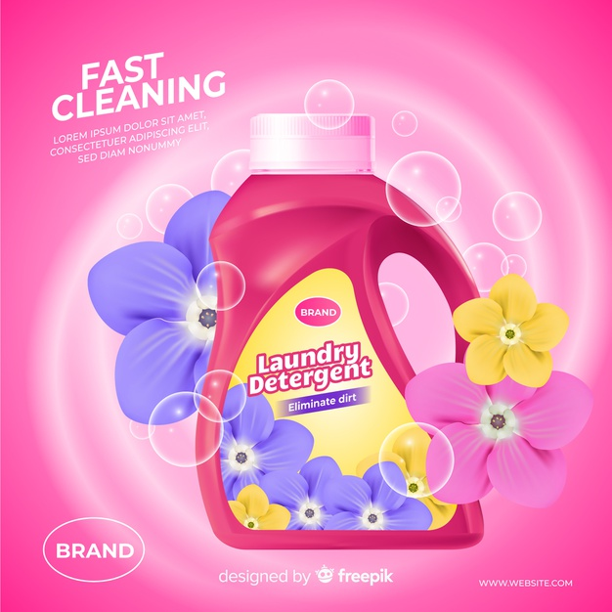
999 participants
10 laundry products

Slide 8
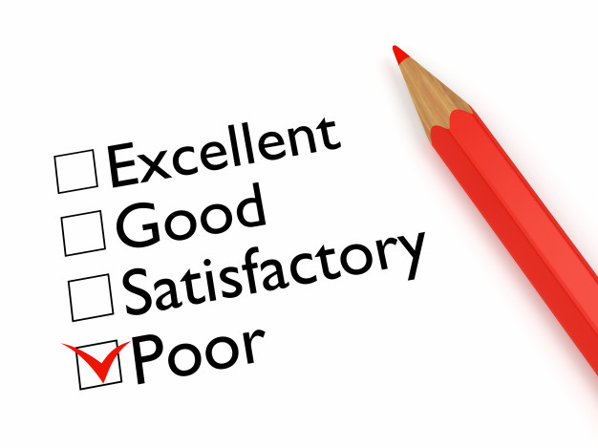
Rating Statements

Slide 9
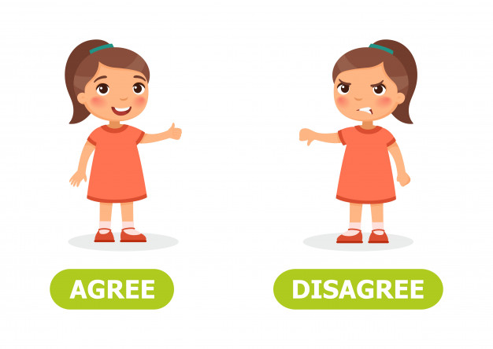
Rating Statements
Agreement Statements

Slide 10
Individual item fit (Agreements)
Excellent value
Cleaning overall
Removing tough stains
Providing bright whites
Keeping dark clothes dark
Providing vivid colours
Overall scent
Good level of suds
Removing bad odours
Product appearance
Not leaving residues
Trusted brand
Makes me feel proud
Package quality
Worth the price
I would recommend this product
Notes:
What can we get from the data?
Remove misfitting people – people who don’t add any information (different people were removed from the two types of analyses)
Remove misfitting items – items that are either redundant and don’t tell us anything, or items that often have random responses, suggesting that they might be confusing or misleading to the consumer
Ordering of item ability – which ones are the easiest and which ones are the most difficult to endorse
Person-item distributions – not well targeted for this sample and the statements are generally too easy to endorse
Laundry product scores (and other demographics)
ANOVA & DIF – laundry products
ANOVA & DIF – other demographics

Slide 11
Individual item fit (Agreements)
Excellent value
Cleaning overall
Removing tough stains
Providing bright whites
Keeping dark clothes dark
Providing vivid colours
Overall scent
Good level of suds
Removing bad odours
Product appearance
Not leaving residues
Trusted brand
Makes me feel proud
Package quality
Worth the price
I would recommend this product
Notes:
What can we get from the data?
Remove misfitting people – people who don’t add any information (different people were removed from the two types of analyses)
Remove misfitting items – items that are either redundant and don’t tell us anything, or items that often have random responses, suggesting that they might be confusing or misleading to the consumer
Ordering of item ability – which ones are the easiest and which ones are the most difficult to endorse
Person-item distributions – not well targeted for this sample and the statements are generally too easy to endorse
Laundry product scores (and other demographics)
ANOVA & DIF – laundry products
ANOVA & DIF – other demographics

Slide 12
Excellent value
Cleaning overall
Removing tough stains
Providing bright whites
Keeping dark clothes dark
Providing vivid colours
Overall scent
Good level of suds
Removing bad odours
Product appearance
Not leaving residues
Trusted brand
Makes me feel proud
Package quality
Worth the price
I would recommend this product
Notes:
What can we get from the data?
Remove misfitting people – people who don’t add any information (different people were removed from the two types of analyses)
Remove misfitting items – items that are either redundant and don’t tell us anything, or items that often have random responses, suggesting that they might be confusing or misleading to the consumer
Ordering of item ability – which ones are the easiest and which ones are the most difficult to endorse
Person-item distributions – not well targeted for this sample and the statements are generally too easy to endorse
Laundry product scores (and other demographics)
ANOVA & DIF – laundry products
ANOVA & DIF – other demographics

Slide 13
Excellent value
Cleaning overall
Removing tough stains
Providing bright whites
Keeping dark clothes dark
Providing vivid colours
Overall scent
Good level of suds
Removing bad odours
Product appearance
Not leaving residues
Trusted brand
Makes me feel proud
Package quality
Worth the price
I would recommend this product
Notes:
What can we get from the data?
Remove misfitting people – people who don’t add any information (different people were removed from the two types of analyses)
Remove misfitting items – items that are either redundant and don’t tell us anything, or items that often have random responses, suggesting that they might be confusing or misleading to the consumer
Ordering of item ability – which ones are the easiest and which ones are the most difficult to endorse
Person-item distributions – not well targeted for this sample and the statements are generally too easy to endorse
Laundry product scores (and other demographics)
ANOVA & DIF – laundry products
ANOVA & DIF – other demographics

Slide 14
Excellent value
Removing tough stains
Providing bright whites
Providing vivid colours
Overall scent
Good level of suds
Removing bad odours
Product appearance
Not leaving residues
Trusted brand
Notes:
What can we get from the data?
Remove misfitting people – people who don’t add any information (different people were removed from the two types of analyses)
Remove misfitting items – items that are either redundant and don’t tell us anything, or items that often have random responses, suggesting that they might be confusing or misleading to the consumer
Ordering of item ability – which ones are the easiest and which ones are the most difficult to endorse
Person-item distributions – not well targeted for this sample and the statements are generally too easy to endorse
Laundry product scores (and other demographics)
ANOVA & DIF – laundry products
ANOVA & DIF – other demographics

Slide 15
Excellent value
Removing tough stains
Providing bright whites
Providing vivid colours
Overall scent
Good level of suds
Removing bad odours
Product appearance
Not leaving residues
Trusted brand
Removing bad odours
Excellent value
Good level of suds
Overall scent
Trusted brand
Providing vivid colours
Product appearance
Not leaving residues
Providing bright whites
Removing tough stains
Notes:
What can we get from the data?
Remove misfitting people – people who don’t add any information (different people were removed from the two types of analyses)
Remove misfitting items – items that are either redundant and don’t tell us anything, or items that often have random responses, suggesting that they might be confusing or misleading to the consumer
Ordering of item ability – which ones are the easiest and which ones are the most difficult to endorse
Person-item distributions – not well targeted for this sample and the statements are generally too easy to endorse
Laundry product scores (and other demographics)
ANOVA & DIF – laundry products
ANOVA & DIF – other demographics

Slide 16
Most likely to be endorsed
Removing bad odours
Excellent value
Good level of suds
Overall scent
Trusted brand
Providing vivid colours
Product appearance
Not leaving residues
Providing bright whites
Removing tough stains
Least likely to be endorsed
Notes:
What can we get from the data?
Remove misfitting people – people who don’t add any information (different people were removed from the two types of analyses)
Remove misfitting items – items that are either redundant and don’t tell us anything, or items that often have random responses, suggesting that they might be confusing or misleading to the consumer
Ordering of item ability – which ones are the easiest and which ones are the most difficult to endorse
Person-item distributions – not well targeted for this sample and the statements are generally too easy to endorse
Laundry product scores (and other demographics)
ANOVA & DIF – laundry products
ANOVA & DIF – other demographics

Slide 17
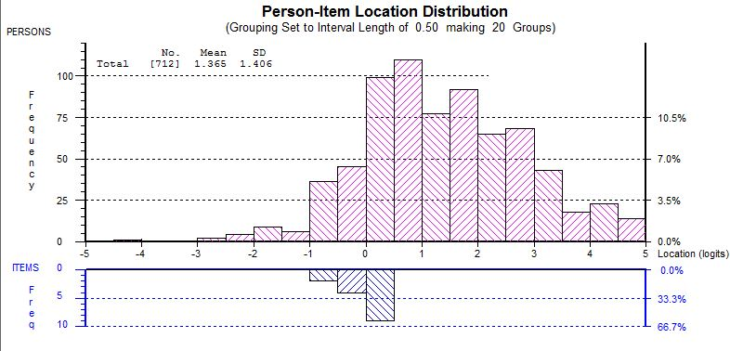
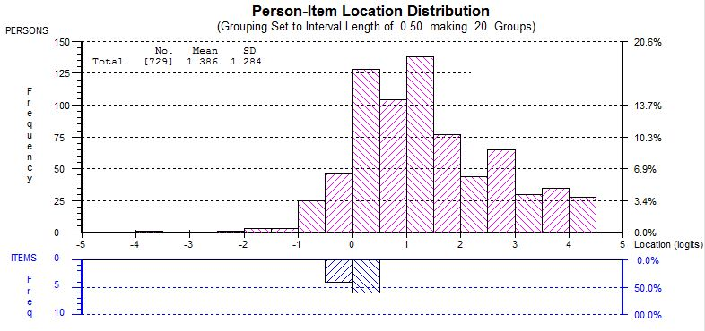
Ratings
Agreements

Slide 18
Ratings
Cleaning overall
Removing stains overall
Removing shirt cuff stains
Providing garment durability
Providing bright whites
Keeping dark clothes dark
Enduring freshness
Removing bad odours
Providing vivid colours
Product appearance
Not leaving residues
Providing fabric softness
Gentle to sensitive skin
Overall suds experience
Easy to rinse

Slide 19
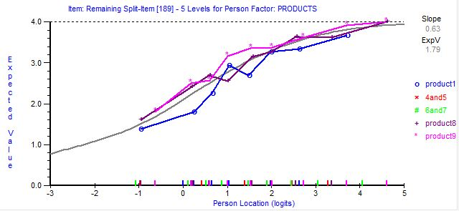
Ratings
Cleaning overall
Removing stains overall
Removing shirt cuff stains
Providing garment durability
Providing bright whites
Keeping dark clothes dark
Enduring freshness
Removing bad odours
Providing vivid colours
Product appearance
Not leaving residues
Providing fabric softness
Gentle to sensitive skin
Overall suds experience
Easy to rinse
Expected score for item 16
o product 1
+ product 8
* product 9
Person ability

Slide 20
Summary
Thanks for listening!
c.m.chalk@leeds.ac.uk
Notes:
To-do:
Difference between item response theory and Rasch – why do some people distinguish themselves from IRT
How the item difficulties etc are calculated – maximum likelihood method

