Slide 1
Leeds Institute for Data Analytics Using Rasch Model Theory to Guide Consumer Product Design
Caitlin Chalk, PhD

Slide 2



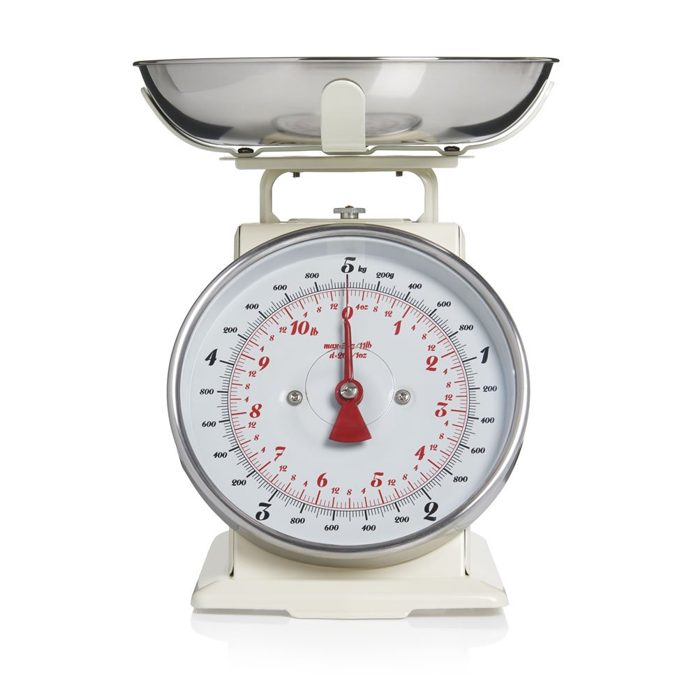
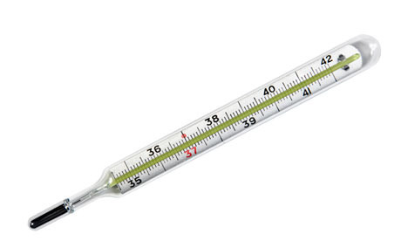
The Science of Measurement
Nominal measurement
Ordinal scale
small – medium – large
happy – sad
Interval measurement
Ratio measurement
Notes:
In data analytics, a variable of interest has one of four different levels of measurement – nominal, ordinal, interval and ratio. Nominal measurements are used to classify the data only, such as the nationality or gender of a person.
Proper measurement is essential for most data analyses,
Difficulty – interpretation of scores in ordinal surveys – e.g. health, assessment, consumer opinion. The difference between responses may not be consistent, “the whole may not equal the sum of the parts”.

Slide 3
The Science of Measurement
Statements | Never | Sometimes | Often
I feel anxious | 1 | 2 | 3
I have a high energy level | 1 | 2 | 3
I feel excited about the future | 1 | 2 | 3
Total score = 7?
Raw scores from ordinal scales are unreliable, and often meaningless.
Meaningful statistics cannot be calculated from ordinal scale data.

Slide 4
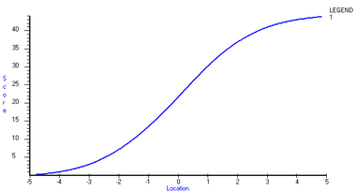
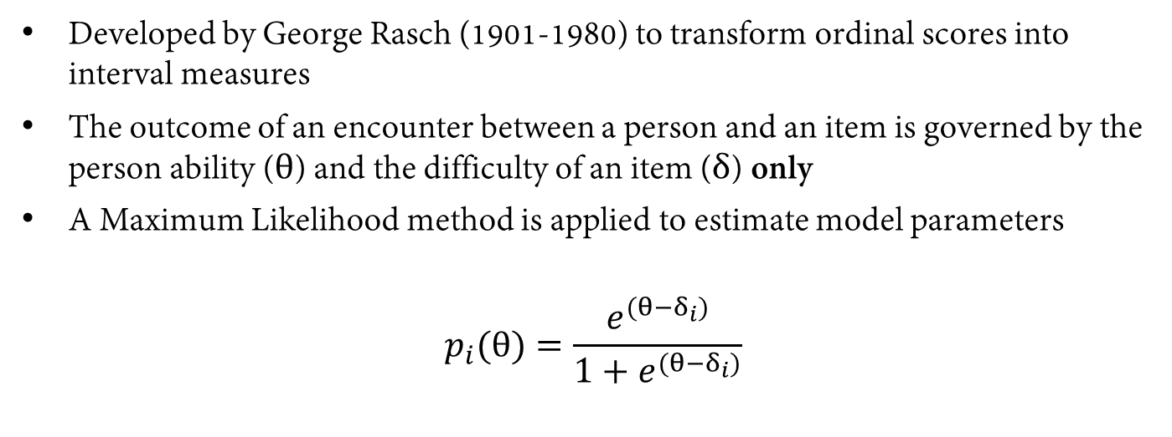
Rasch Model Theory – converting ordinal to interval
Developed by George Rasch (1901-1980) to transform ordinal scores into interval measures
The outcome of an encounter between a person and an item is governed by the person ability ($θ$) and the difficulty of an item ($δ$) only
A Maximum Likelihood method is applied to estimate model parameters
$$p_{i}(θ)=\frac{e^{(θ−δ_{i})}}{1+e^{(θ−δ_{i})}}$$

Slide 5
Rasch Model Theory – the Guttman Pattern
A Maximum Likelihood method is applied to estimate model parameters (i.e. person ability and item difficulty)
Outcomes are expected to follow a Guttman Pattern
Easiest item
Hardest item
Lowest ability
 | Item 1 | Item 2 | Item 3 | Item 4
Person 1 | Correct | Incorrect | Incorrect | Incorrect
Person 2 | Correct | Correct | Incorrect | Incorrect
Person 3 | Correct | Correct | Correct | Incorrect
Person 4 | Correct | Correct | Correct | Correct
Highest ability

Slide 6


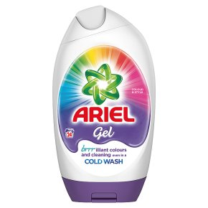
Rasch Model Theory – application to consumer data
Used to measure latent variables, which cannot be directly observed
Measures emotional opinions related to the product
Aids the construction and calibration of an effective questionnaire
I think this product is… | Score
Very new and different | 5
Somewhat new and different | 4
About the same as other products | 3
Not very new and different | 2
Not at all new and different | 1
Notes:
Items – statement/question regarding the product
Person ability – likelihood of that person to endorse the product.

