Slide 1





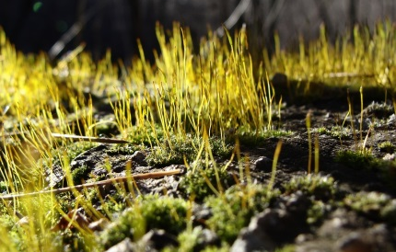
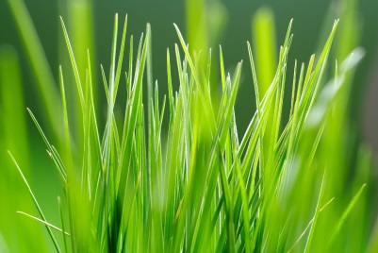
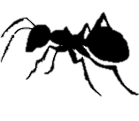
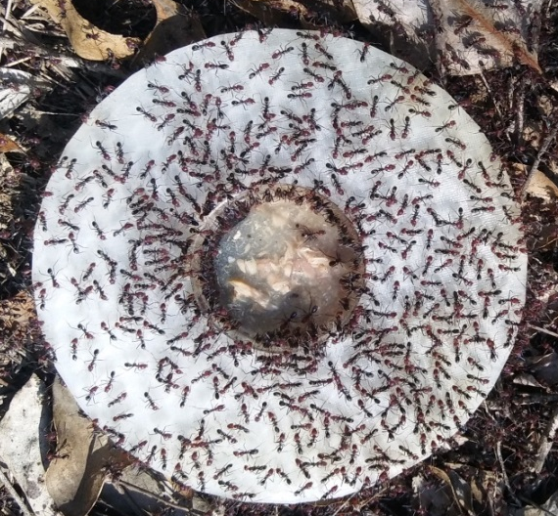
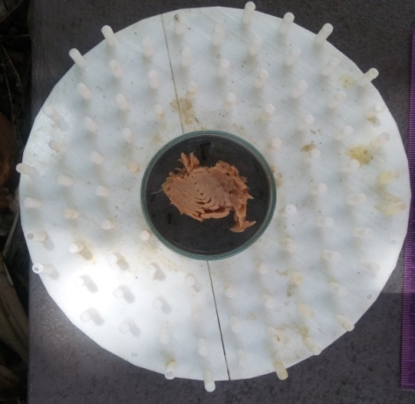
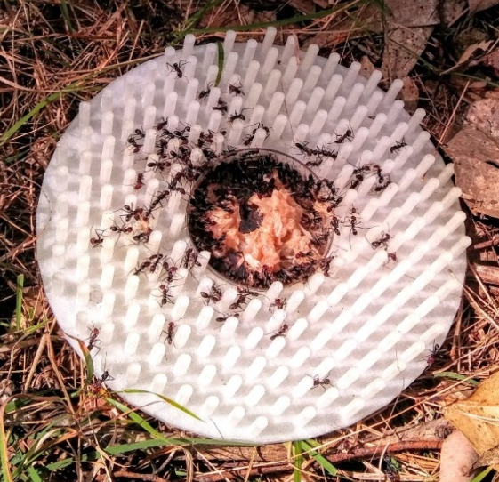
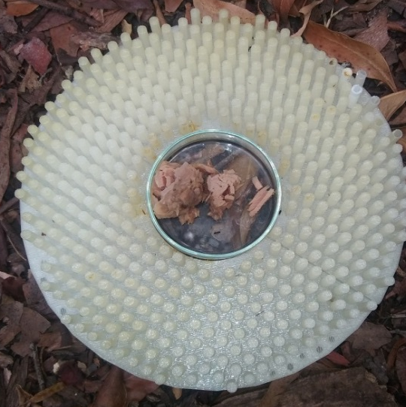
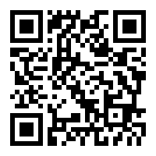
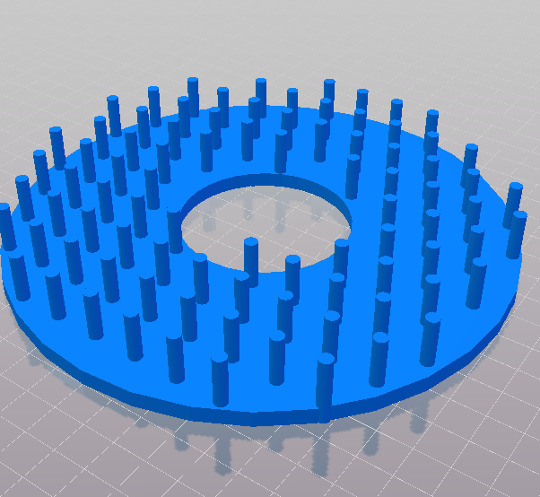
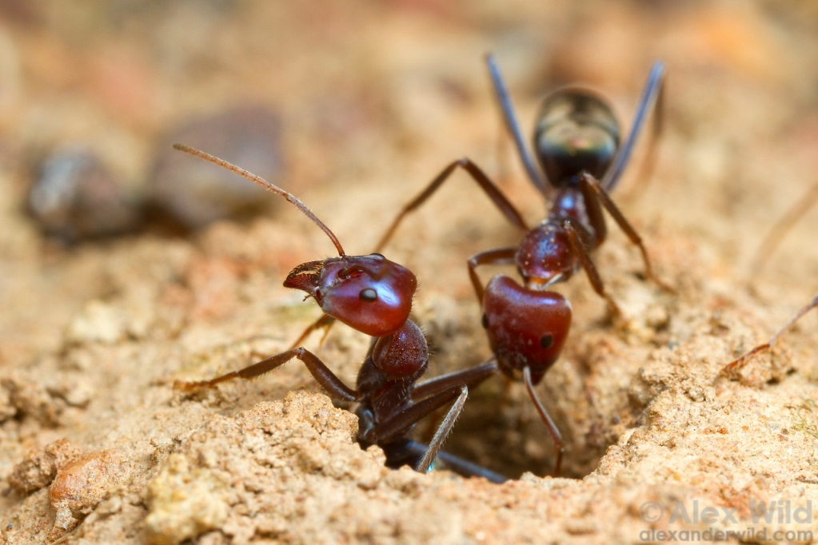
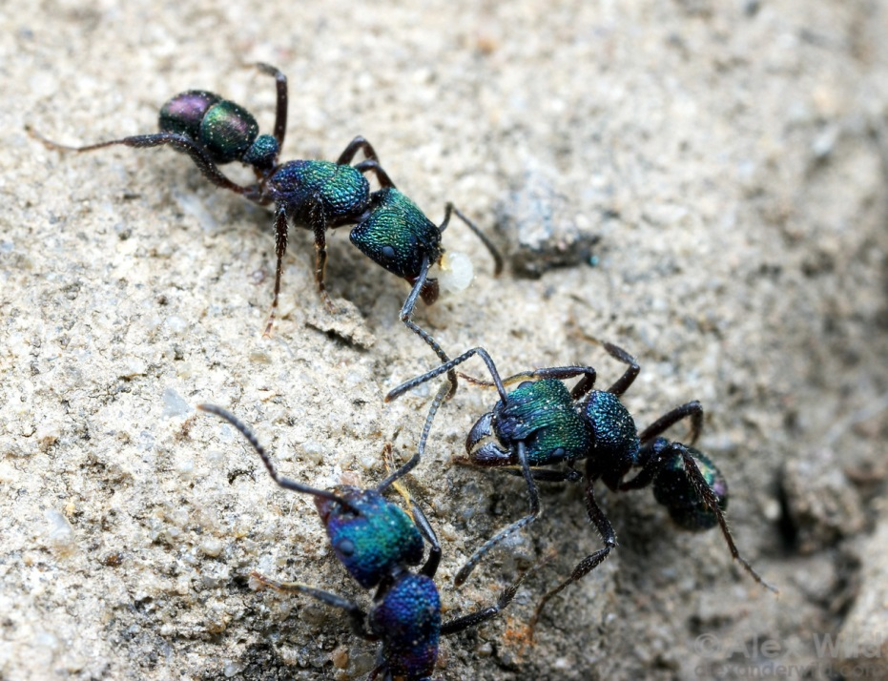
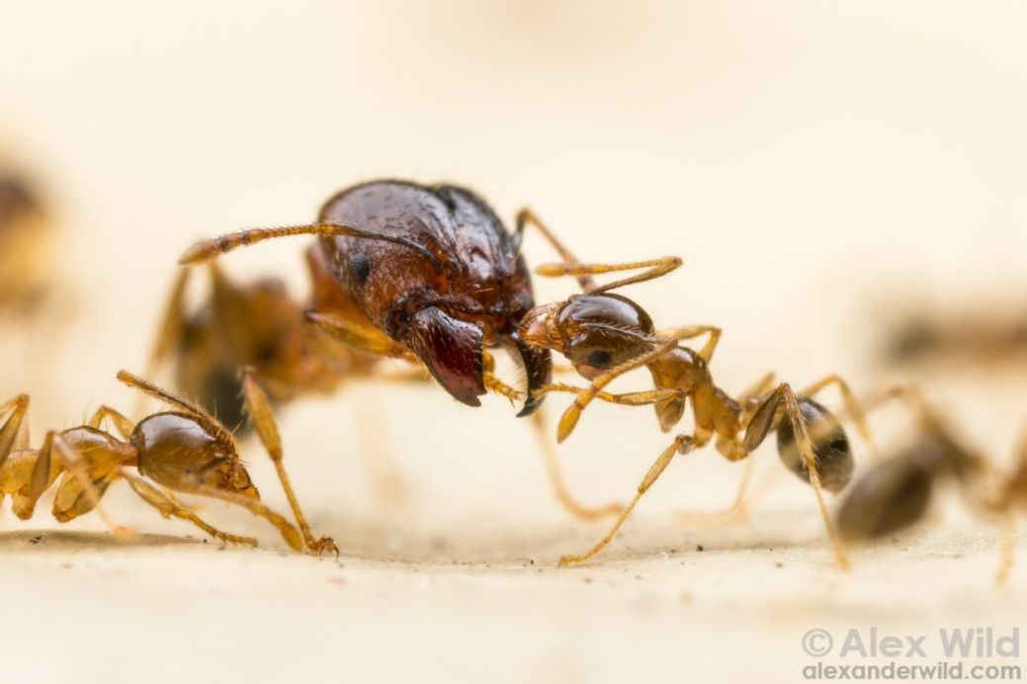
How does complexity impact foraging decisions in ants?
Caitlyn Drayton-Taylor, Tanya Latty, Dieter Hochuli
Caitlyn.Drayton-Taylor@sydney.edu.au
@BambiraptorDT
Ant foraging choice can be mediated by structural complexity, potentially due to:
Variation in ant species’ size
Recruitment behaviour
Habitat preferences
How can we effectively replicate structural complexity in the natural environment?
How does complexity impact foraging choice in ant species?
1cm
1cm
1cm
1cm
3D printed discs - 4 treatments, from simple to complex, baited with tuna
Ant visitors to baits counted, collected and identified
Interested in STL files?
Iridomyrmex purpureus
Increased presence (GLM z=-2.47, p=0.1351) and abundance (ANOVA, f(1,38)=8.82, p=0.005) with decreased complexity
Persisted on all discs they were found on
Rhytidoponera metallica
Increased presence (GLM, z=2.91, p=0.0037) and abundance (ANOVA, f(1,38)=10.93, p=0.002) with increased complexity
Did not persist on complex treatments
Pheidole spp.
Intermediary response to complexity in terms of abundance (ANOVA f(1,38)=0.03, p=0.869) and presence (GLM z=1.83, p=0.0667)
A non-linear effect on species richness was seen
Recruitment mechanisms and dominance behaviour (not size of ants) are likely drivers of foraging choice in complex environments
I. purpureus
R. metallica
Pheidole spp.
Other spp.
Gap size (mm)
Speed Talk: November 27th Track 4: Drought impacts and thermal tolerance 13:30-13:35
Iridomyrmex purpureus
Pheidole spp.
Rhytidoponera metallica
Photo credits: Alex Wild

