Slide 1


Python coding: Resources and Libraries
By: Caivil Ndobela

Slide 2
Python library
A library = tools ready-made for specific tasks (e.g., data science, web, math)
Top 90+ Python Libraries - Flexiple – Flexiple

Slide 3
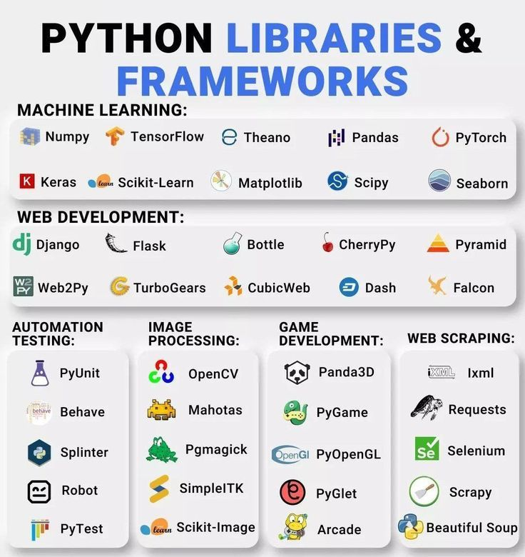
Python library
a short list of python libraries just to name a few

Slide 4
Python resource
YouTube videos
https://www.learnpython.org
https://www.coursera.org/learn/python (Python for Everybody by University of Michigan; course content is free, certificate is paid)
https://developers.google.com/edu/python (Google's Python Class)
https://www.python.org/about/gettingstarted/ (Official Python beginner resources)
https://www.youtube.com/watch?v=K5KVEU3aaeQ (FreeCodeCamp Python full course on YouTube)
https://www.khanacademy.org/computing/computer-programming/programming (Khan Academy Python course)
https://www.netacad.com/courses/python-essentials-1 (Cisco Networking Academy Python Essentials 1)
https://www.udacity.com/course/introduction-to-python--ud1110 (Udacity Introduction to Python Programming)
https://www.practicepython.org/ (PracticePython exercises)
https://exercism.org/tracks/python (Exercism Python track)

Slide 5
Python communities
Best Python Programmers' Communities Online

