Slide 1
Key Features
Customizable Timetable
Auto Reply SMS System
Sleep Mode
Notes:
Good Morning Judges, my name is Wei Rong. Today, I will be touching on the key features of the application, the interface, and lastly a demonstration on the applciation.
First, let’s us start with the key features. Diamlah! has customizable timetable feature, auto reply sms and sleep mode features.

Slide 2
Customizable Timetable
Students can add, modify and remove any schedules.
Flexibility
Students might skip lessons
Students might attend lessons not reflected in the system.
Students might add other weekly events beside lessons.
Notes:
We begin with the customizable timetable. For this application, we would want it to be as flexible for the students as possible. Besides getting the stduents schedules from the api, it would be better for students to add, modify and delete any of the schedules in the timetable. We want the flexibility because students might skip lesson. There have been situations in which students change their tutorial lesson and not reflected in the official timetable. Students might also add their personal events such as CCAs, meetings etc…

Slide 3
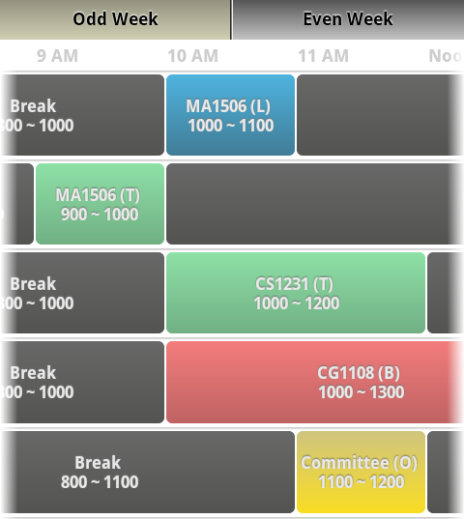
Customizable Timetable
Coloured Schedules
Differentiates between types of lessons
Timeline-feel Timetable
Starts at 8am and ends at 12mn
Students do not have to scroll a lot
Separated into odd & even weeks
Notes:
Here are some of the things you will see in the timtable.
1. The lessons are colored according to the lesson types for easy reference.
2. It is easy to navigate as the timetable resembles a timeline-feel. Timetable begins at 8am and ends at 12mn.
3. The timetables are seperated into odd and even weeks as some lessons are only held in alternate weeks.

Slide 4
Auto Reply SMS System
Once silent mode is activated, students might not be aware of incoming call.
Auto Reply SMS system sends a SMS message to caller.
SMS message customizable.
Option to set frequency of auto-reply SMS.
Notes:
Next, we have also came up with an automatic reply sms system. Imagine if a student called john is in the middle of the lesson. He might not be awared of incoming call during lessons. Hence, an automatic sms system sends a sms message to the caller lets call jane. Once jane received the sms, she will be aware of john is in a lesson and she will call him later. You might be thinking what if jane is those people who doesn’t stop calling a person. Worry not! There will be options to set the frequency of auto-reply sms system that john can choose from.

Slide 5
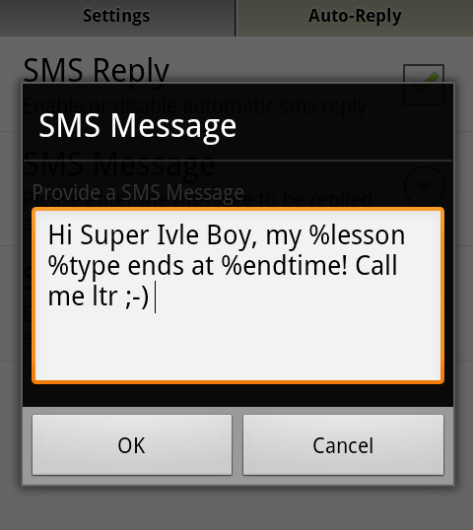
Tokens
Tokens provide information for the caller.
%starttime
%endtime
%lesson
%frequency
%type
Notes:
We tried to think further. How about making a sms more dynamic? Hence, we came up with this tokens. In the auto reply sms system message, john can key in pre-assigned keywords to further provide jane with the information.

Slide 6
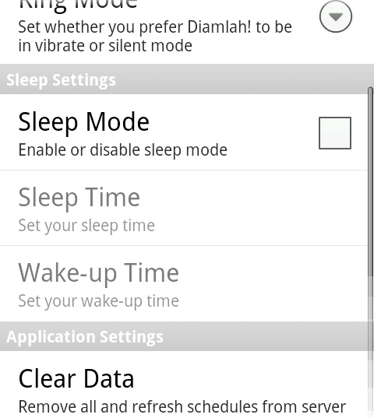
Sleep Mode
Phone to be in silent mode throughout the sleep mode.
Not a weekly event.
For students who do not wish to pick up call at certain period of the day
E.g. In laboratory
Notes:
Thirdly, we have sleep mode feature. When sleep mode is activated, the phone will remain in silent mode between the sleep time and wakeup time. Sleep mode is useful esp for students who do not wish to be disturbed at certain period of the day such as in the lab.

Slide 7
Interface

Slide 8
Interface
Built to follow Android UI Pattern closely.
Easy navigation for Android users.
Not much learning needed for an average user.
Notes:
We know that an average user might not have the time to learn or understand to use a more complex system.
Hence, Diamlah interface follows Android UI pattern very closely. We wish to make the app as easy to navigate and follow as possible.
Here are some of the Android UI pattern we have used:

Slide 9
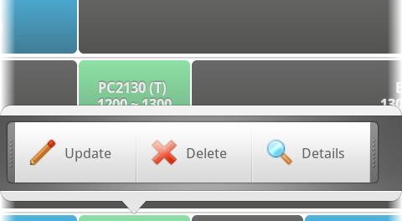
Quick Action Dialog
Notes:
QA dialog is a very easy and fun way to show an option menu.

Slide 10
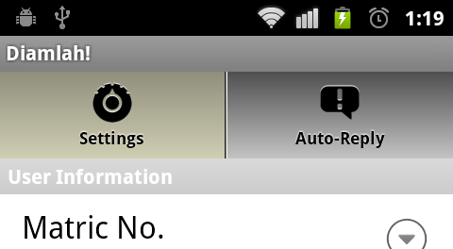
Tab Views
Notes:
Tab views to seperated different kinds of settings.

Slide 11
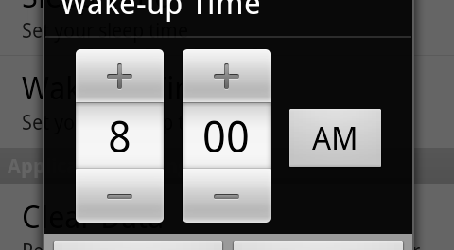
Time Picker
Notes:
Time picker for easy and convenient input of time.

Slide 12
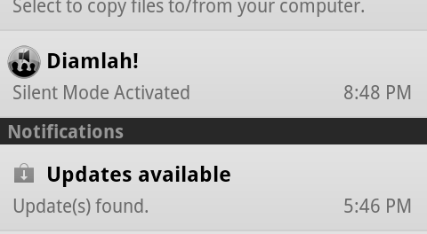
Notification System
Notes:
Notification System to inform students that the app is activated.

Slide 13
Demonstration

Slide 14
What makes us different?

