Slide 1

DiamLah!
By Super IVLE Boy

Slide 2
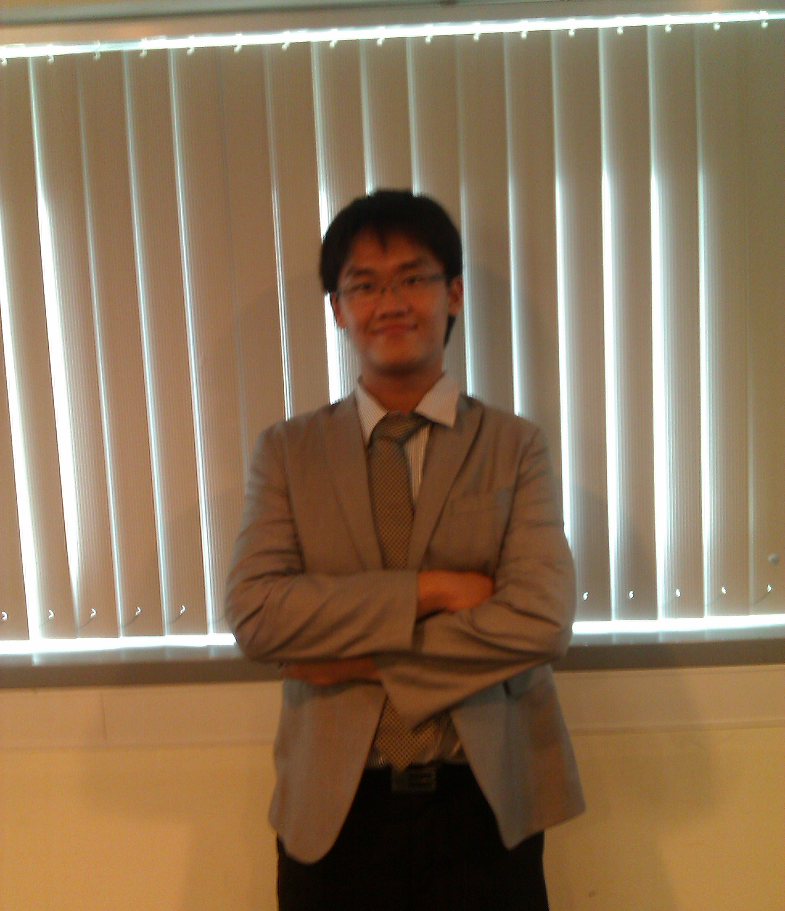
Chai Zheng Xin (CEG2)
I/C Alarm and notifications
Covering later…
Rationale
Brief summary

Slide 3
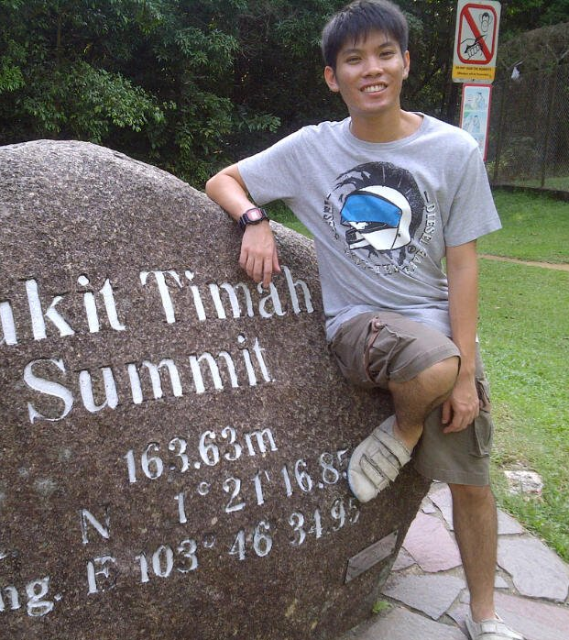
Yap Wei Rong (CEG2)
I/C User Interface
Covering later…
Key Features
Interface
Demonstration

Slide 4
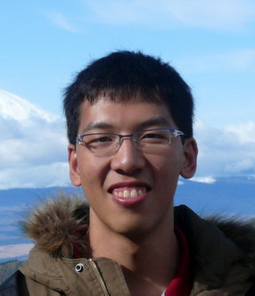
Damien Tan (CEG2)
I/C Database
Currently overseas

Slide 5
Concepts

Slide 6
Rationale
Absence of IVLE Android apps.
Mobile community not properly accounted for.
Therefore, we wanted to create an app that is unique and easy to use.

Slide 7
Why DiamLah! ?
It is common to see students forgetting to silent their phones during lessons.
Annoyance to both teacher and other students.
Then some students will ask you to diam lah(shut up)!
But not their fault, it is so troublesome that they may forget.

Slide 8
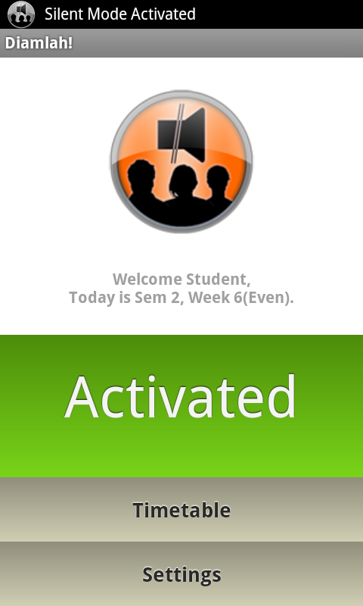
What is DiamLah! ?
An app that silences the phone according to a student’s timetable from Student Info API.
Automates the repeated task of silencing and unsilencing of phone.

Slide 9
Usefulness
The user only have to run the application one time and everything will be handled by the app.
The user do not need to access the application, unless he/she wants to change the settings

Slide 10
Originality
No such Android app in the market,
Not your typical IVLE app (You can just go IVLE website),
Instead of providing information , DiamLah! uses this information to make life more convenient.

Slide 11
Platform
Support Android 1.6 or later.
Alarm Manager to schedule silencing and unsilencing.
SQLite database to store schedules.
Notification Manager to display notifications of current lesson.

Slide 12
X-Factor
Intuitive (May not even need a how-to-use section!)
Neat User Interface
Has a clear purpose
Notes:
-Intuitive, have a how to use section but may not even need it
-UI revolves around dashboard, will not get lost
-Allow student to identify the app and know what it is meant for instantly

Slide 13
Key Features
Customizable Timetable
Auto Reply SMS System
Sleep Mode
Notes:
Good Morning Judges, my name is Wei Rong. Today, I will be touching on the key features of the application, the interface, and lastly a demonstration on the applciation.
First, let’s us start with the key features. Diamlah! has customizable timetable feature, auto reply sms and sleep mode features.

Slide 14
Customizable Timetable
Students can add, modify and remove any schedules.
Flexibility
Students might skip lessons (not encouraged though)
Students might attend lessons not reflected in the system.
Students might add other weekly events beside lessons.
Notes:
We begin with the customizable timetable. For this application, we would want it to be as flexible for the students as possible. Besides getting the stduents schedules from the api, it would be better for students to add, modify and delete any of the schedules in the timetable. Three reasons why fleibility is important. First, students might skip lesson. There have been situations in which students change their tutorial lesson and not reflected in the official timetable. Students might also add their personal events such as CCAs, meetings etc…

Slide 15
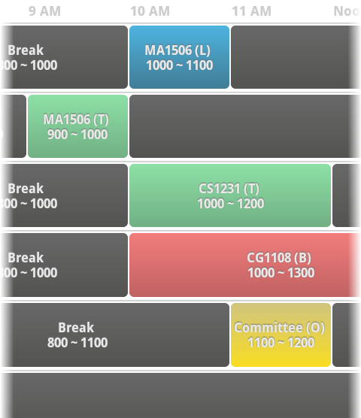
Some Features in the Timetable
Coloured Schedules
Differentiates between types of lessons
Timeline-feel Timetable
Starts at 8am and ends at 12mn
Students do not have to scroll a lot
Notes:
Here are some of the things you will see in the timtable.
1. The lessons are colored according to the lesson types for easy reference.
2. It is easy to navigate as the timetable resembles a timeline-feel. Timetable begins at 8am and ends at 12mn.

Slide 16
Auto Reply SMS System
Once silent mode is activated, students might not be aware of incoming call.
Auto Reply SMS system sends a SMS message to caller.
SMS message customizable.
Option to set frequency of auto-reply SMS.
Notes:
Next, we have also came up with an automatic reply sms system. Once the silent mode is activated, students might not be aware of the incoming call. Hence, auto reply sms system is designed to send a sms message to the caller. The sms message is customiable by the user. User can also have the option to set the freq of the autoreply sms.

Slide 17
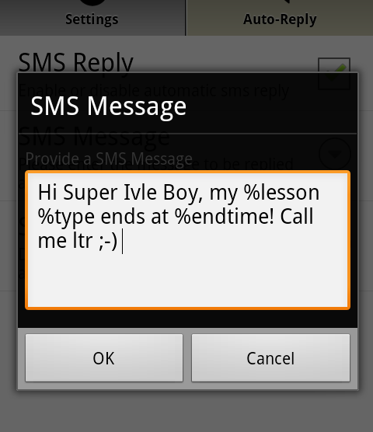
Tokens IN Auto Reply SMS System
Tokens provide information to the caller.
%starttime
%endtime
%lesson
%frequency
%type
Notes:
We tried to think further. How about making a sms more dynamic? Hence, we came up with this tokens. In the auto reply sms system message, user can key in pre-assigned keywords to further provide callerwith the information.

Slide 18
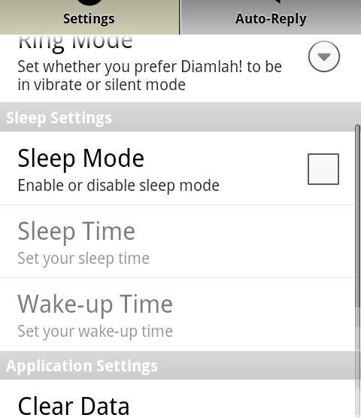
Sleep Mode
Phone to be in silent mode throughout the sleep mode.
Not a weekly event.
For students who do not wish to pick up call at certain period of the day
E.g. In laboratory
Notes:
Thirdly, we have sleep mode feature. When sleep mode is activated, the phone will remain in silent mode between the sleep time and wakeup time. Sleep mode is useful esp for students who do not wish to be disturbed at certain period of the day such as in the lab.

Slide 19
Interface

Slide 20
Interface
Built to follow Android UI Pattern closely.
Easy navigation for Android users.
Not much learning needed for an average user.
Notes:
We know that an average user might not have the time to learn or understand to use a more complex system.
Hence, Diamlah interface follows Android UI pattern very closely. We wish to make the app as easy to navigate and follow as possible.
Here are some of the Android UI pattern we have used:

Slide 21
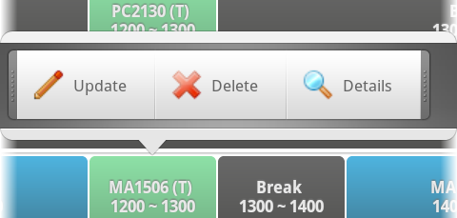
Quick Action Dialog
Notes:
QA dialog is a very easy and fun way to show an option menu.

Slide 22
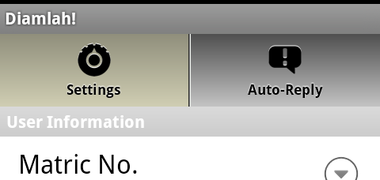
Tab Views
Notes:
Tab views to seperated different kinds of settings.

Slide 23
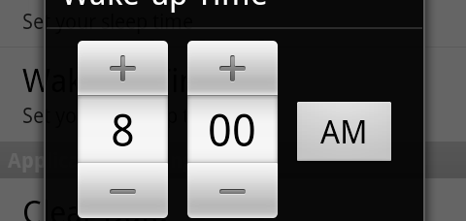
Time Picker
Notes:
Time picker for easy and convenient input of time.

Slide 24
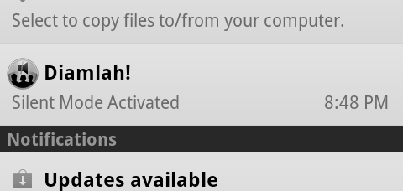
Notification System
Notes:
Notification System to inform students that the app is activated.

Slide 25
Demonstration

Slide 26
“The simplest things are often the truest.”
– Richard Bach
Notes:
Here I;ve a quote from an American writer, Richard Bach(Bark) and he says that the simplest things are often the truest. We hope that this simple app can improve the lives of NUS students. We hope that they will find the app useful and personal to use; and will not treat the app as another typical app. With that, I have finished my presentation. I would like to thank the judges and orgainsers for giving us the opportunity to present our app. Thank you.

Slide 27
Q & A

