Slide 1

Classical Optimization
Algorithms for
Lasso Regression
A Review and Empirical Comparison
I Background | II Algorithms | III Results
CAI Yangxiao XUE Pengyu ZHANG Kejia ZHOU Xiyu
26023041R 26022951R 26049131R 26025265R
COMP6704 Group 9
Notes:
SLIDE 1 | Classical Optimization Algorithms for Lasso Regression
Suggested time: 35 seconds | 00:00–00:35 | Total planned: 23:00
English and Chinese are alternatives. Read one language only.
ENGLISH SCRIPT
Hello everyone. Our presentation reviews and compares classical optimization algorithms for Lasso regression. We will first explain why Lasso produces sparse models and how its objective is structured. We will then introduce three solvers and a common experimental protocol. Finally, we will examine their fitted results and computational costs. Our central question is how the same optimization problem behaves under different solution methods.
中文讲解稿
大家好，我们今天汇报的主题是 Lasso 回归的经典优化算法及其实验比较。首先，我们会介绍 Lasso 为什么能够产生稀疏模型，以及它的目标函数结构。然后，我们会介绍三种求解方法和统一的实验方案。最后，通过实验比较它们的拟合结果与计算成本。整个汇报围绕一个问题展开：对于同一个优化问题，不同算法的求解表现有什么差别？
讲图提示（不朗读）
介绍完整汇报的三部分；无需逐字读副标题或姓名。

Slide 2
PART I
Background
CAI Yangxiao
26023041R
COMP6704 Group 9
Notes:
SLIDE 1 | Classical Optimization Algorithms for Lasso Regression
Suggested time: 35 seconds | 00:00–00:35 | Total planned: 23:00
English and Chinese are alternatives. Read one language only.
ENGLISH SCRIPT
Hello everyone. Our presentation reviews and compares classical optimization algorithms for Lasso regression. We will first explain why Lasso produces sparse models and how its objective is structured. We will then introduce three solvers and a common experimental protocol. Finally, we will examine their fitted results and computational costs. Our central question is how the same optimization problem behaves under different solution methods.
中文讲解稿
大家好，我们今天汇报的主题是 Lasso 回归的经典优化算法及其实验比较。首先，我们会介绍 Lasso 为什么能够产生稀疏模型，以及它的目标函数结构。然后，我们会介绍三种求解方法和统一的实验方案。最后，通过实验比较它们的拟合结果与计算成本。整个汇报围绕一个问题展开：对于同一个优化问题，不同算法的求解表现有什么差别？
讲图提示（不朗读）
介绍完整汇报的三部分；无需逐字读副标题或姓名。

Slide 3

Why study Lasso?
Lasso combines variable selection with a convex, nonsmooth objective.
Known coefficients in our synthetic data
50
candidate features
5
generating variables
Zero coefficients simplify
the fitted linear model.
Feature number
Sparse modeling provides a clear setting for comparing optimization methods.
Source: Group 9 report, Sections 1, 2.4 and 4.1. Chart shows the generating coefficients, not estimated coefficients.
2
Notes:
SLIDE 2 | Why study Lasso?
Suggested time: 60 seconds | 00:35–01:35 | Total planned: 23:00
English and Chinese are alternatives. Read one language only.
ENGLISH SCRIPT
Why study Lasso? Regression uses candidate predictors to explain a numerical response. When many predictors are available, a model with fewer nonzero coefficients can be easier to interpret. This figure shows how our synthetic data were generated: there are fifty candidate features, but only five have nonzero generating coefficients. These are known inputs to the experiment, rather than coefficients recovered by an algorithm. Lasso encourages sparsity by shrinking coefficients and allowing exact zeros. A zero coefficient removes that predictor from the fitted linear model. Its objective is also convex but nonsmooth, making it a useful setting for comparing optimization methods. However, a sparse fitted model alone does not guarantee recovery of the true generating variables.
中文讲解稿
为什么研究 Lasso？回归模型利用候选特征来解释一个数值型响应。当候选特征较多时，只有少量非零系数的模型通常更容易解释。图中展示的是我们生成合成数据时的设定：一共有五十个候选特征，但只有五个特征的生成系数非零。这里画的是实验已知的生成系数，还不是算法估计出来的结果。Lasso 通过收缩系数，并允许系数精确等于零，来鼓励稀疏性。一个系数变为零，就相当于从拟合模型中移除了相应特征。同时，Lasso 的目标函数具有凸但非光滑的结构，适合用来比较不同优化方法。不过，模型稀疏本身并不保证找回真实的生成变量。
讲图提示（不朗读）
指向50个候选特征和5个非零生成系数；区分数据生成设定与估计结果。

Slide 4
The Lasso training problem
The same training objective underlies every solver in our comparison.
minimize F(w) = g(w) + λ‖w‖₁
over w ∈ ℝᵈ
Squared training loss
L1 regularization
g(w) = ‖Xw − y‖₂² / (2n)
λ‖w‖₁ = λ Σⱼ |wⱼ|
Measures prediction error
on the training data.
λ controls regularization.
Larger λ strengthens the penalty.
X: n × d training features y: centered responses w: coefficients
Use training statistics for centering and scaling. Keep the intercept unpenalized.
Source: Group 9 report, Section 2.1, Equation 1. Tibshirani (1996).
3
Notes:
SLIDE 3 | The Lasso training problem
Suggested time: 75 seconds | 01:35–02:50 | Total planned: 23:00
English and Chinese are alternatives. Read one language only.
ENGLISH SCRIPT
All three solvers minimize the objective shown here. X contains n training samples and d features, y contains centered responses, and w contains the coefficients. The objective has two parts. The squared loss measures training prediction error, with the normalization one over two n. The L1 penalty adds the sum of absolute coefficient values, multiplied by lambda. A larger lambda strengthens regularization and changes the balance between fit and coefficient shrinkage. Feature scaling matters because coefficient magnitudes depend on the units of the predictors. We therefore center and standardize features using training statistics, then apply the same transformation to test data. We also center the responses and recover an unpenalized intercept for prediction. Fixing the data, preprocessing, and lambda ensures that every solver faces the same optimization problem. Differences in computation can then be compared meaningfully.
中文讲解稿
这里是三种求解器共同最小化的目标函数。X 包含 n 个训练样本和 d 个特征，y 是中心化后的响应，w 是待估计的系数。目标函数由两部分组成。第一部分是平方损失，衡量训练数据上的预测误差，并使用二 n 分之一作为归一化系数。第二部分是 L1 惩罚，也就是所有系数绝对值之和，再乘以 lambda。lambda 越大，正则化越强，拟合误差与系数收缩之间的权衡也随之改变。特征尺度同样重要，因为系数大小依赖特征的计量单位。因此，我们只使用训练集统计量进行中心化和标准化，再把同样的变换用于测试集。响应也进行中心化，预测时恢复不受惩罚的截距。只有固定数据、预处理和 lambda，才能让各求解器解决同一个问题，从而有意义地比较计算成本。
讲图提示（不朗读）
先指损失，再指L1惩罚；预处理只讲原则，不展开公式。

Slide 5
Related regression models
The same squared loss can be paired with different penalties.
Model | Penalty added to g(w) | Typical behavior
Ridge | (α/2)‖w‖₂² | Shrinks coefficients Usually retains a dense model
Lasso | λ‖w‖₁ | Shrinks coefficients Can produce exact zeros
Elastic Net | λ‖w‖₁ + (α/2)‖w‖₂² | Encourages grouped selection of correlated predictors
α, λ > 0. The loss is the same. The penalty changes the model.
Our experiments compare solvers for a fixed Lasso objective.
Source: Group 9 report, Section 2.5, Table 2. Hoerl and Kennard (1970), Tibshirani (1996), Zou and Hastie (2005).
4
Notes:
SLIDE 4 | Related regression models
Suggested time: 50 seconds | 02:50–03:40 | Total planned: 23:00
English and Chinese are alternatives. Read one language only.
ENGLISH SCRIPT
Ridge, Lasso, and Elastic Net can use the same squared loss while adding different penalties. Ridge uses a quadratic penalty. It shrinks coefficients and usually retains a dense model. Lasso uses the L1 norm and can produce exact zeros. Elastic Net combines the two penalties and encourages grouped selection of correlated predictors. All three objectives are convex for the positive parameters shown here. Changing the penalty changes the statistical model. In the experiments that follow, we keep the Lasso objective fixed and compare how efficiently different algorithms solve it.
中文讲解稿
Ridge、Lasso 和 Elastic Net 可以使用相同的平方损失，但它们的惩罚项不同。Ridge 使用二次惩罚，会收缩系数，但通常仍保留一个稠密模型。Lasso 使用 L1 范数，可以产生精确为零的系数。Elastic Net 结合这两种惩罚，并鼓励把相关特征成组选择。在这里给出的正参数条件下，三种目标函数都是凸的。改变惩罚项，会改变统计模型。接下来的实验固定 Lasso 目标函数，比较不同算法求解这个目标的效率。
讲图提示（不朗读）
每行讲一个差异；最后落到固定Lasso模型比较算法。

Slide 6
Convexity and sparse optimality
Convexity supports global optimization. The L1 penalty permits exact zeros.
Convexity
Squared loss and the L1 norm are convex.
Every local minimum is global.
Subgradient of |u|
Constrained form: minimize g(w)
subject to ‖w‖₁ ≤ t
For a penalized optimum, choose t = ‖w*‖₁.
Optimality at w*
0 ∈ ∇g(w*) + λ∂‖w*‖₁
w*ⱼ = 0: |∇ⱼg(w*)| ≤ λ
u
∂|0| = [−1, 1]
A gradient interval permits exact zeros.
Source: Group 9 report, Sections 2.2–2.4. Optimality conditions apply jointly at w*.
5
Notes:
SLIDE 5 | Convexity and sparse optimality
Suggested time: 90 seconds | 03:40–05:10 | Total planned: 23:00
English and Chinese are alternatives. Read one language only.
ENGLISH SCRIPT
The squared loss and the L1 norm are convex, so their sum is convex. Every local minimum is therefore global, although convexity alone does not guarantee a unique coefficient vector. Lasso also has a constrained interpretation: minimize the loss under an L1 budget. For a penalized optimum, choosing the budget as that optimum's L1 norm gives a corresponding constrained problem. Now look at the subgradient graph. Absolute value has slope minus one on the negative side and plus one on the positive side. At zero, its subgradient contains the entire interval between them. The optimality condition says that the loss gradient must balance an allowed penalty subgradient. For a zero coefficient at an optimum, the corresponding loss gradient can lie anywhere between minus lambda and plus lambda. This interval makes exact zeros compatible with optimality. The condition must hold jointly at the optimal vector, because the loss gradient depends on all coefficients. We cannot use it as an isolated rule while ignoring the other variables.
中文讲解稿
平方损失和 L1 范数都是凸函数，因此两者之和也是凸函数。这意味着每个局部最优解都是全局最优解，但凸性本身并不保证系数向量唯一。Lasso 还有一个约束形式：在 L1 范数预算之内最小化损失。对于惩罚形式的一个最优解，把预算设为这个解的 L1 范数，就能得到相应的约束问题。下面看右侧的次梯度图。绝对值函数在负半轴上的斜率是负一，在正半轴上是正一；在零点，次梯度则包含负一到正一之间的整个区间。最优性条件要求损失梯度与某个允许的惩罚次梯度相互抵消。对于最优解中的一个零系数，对应损失梯度只要位于负 lambda 到正 lambda 之间，就能满足这一条件。正是这个区间，使精确为零的系数可以符合最优性要求。需要注意，这些条件必须在整个最优向量上共同成立，因为损失梯度依赖所有系数，不能脱离其他变量单独判断。
讲图提示（不朗读）
指零点的次梯度区间，再对应零系数梯度条件；不展开证明。

Slide 7
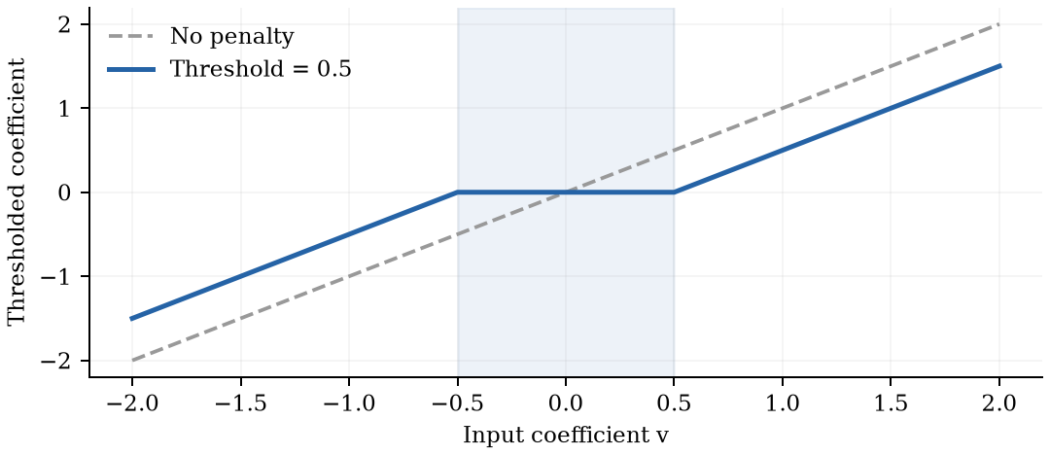
Soft thresholding
Small inputs become zero. Larger inputs shrink toward zero.
Sτ(v) = sign(v) max(|v| − τ, 0)
Example with τ = 0.5
Input v | S₀.₅(v)
1.2 | 0.7
−0.8 | −0.3
0.2 | 0
Scalar proximal solution: arg minᵤ ½(u − v)² + τ|u|
Source: Group 9 report, Section 2.4, Equation 6 and Figure 1. Original package figure. Threshold τ = 0.5.
6
Notes:
SLIDE 6 | Soft thresholding
Suggested time: 80 seconds | 05:10–06:30 | Total planned: 23:00
English and Chinese are alternatives. Read one language only.
ENGLISH SCRIPT
Soft thresholding turns this idea into a concrete operation. It solves the scalar proximal problem at the bottom: stay close to an input value while paying an absolute-value penalty. The operation subtracts the threshold from the input's magnitude, then clips the result at zero. Inputs inside the threshold interval become exactly zero. Larger inputs retain their sign but shrink toward zero. Both the plot and examples use a threshold of zero point five. One point two becomes zero point seven; minus zero point eight becomes minus zero point three; and zero point two becomes zero. The middle flat segment in the plot therefore corresponds to coefficients being removed. With appropriately normalized orthogonal features, applying soft thresholding gives the complete Lasso solution directly. For general feature matrices, the variables interact, so we need iterative algorithms. Soft thresholding then becomes a repeated building block, rather than a complete one-step solution.
中文讲解稿
软阈值把刚才的机制变成了一个具体操作。它求解页面底部这个标量近端问题：一方面尽量接近输入值，另一方面支付绝对值惩罚。具体做法是，从输入的绝对值中减去阈值，再把负的结果截断为零。因此，阈值区间内的输入会直接变成零；区间外的输入保留符号，但向零收缩。图和例子中的阈值都是零点五：一点二变成零点七，负零点八变成负零点三，而零点二变成零。图中间的水平段，就对应系数被直接移除。对于经过适当归一化的正交特征，软阈值可以直接给出完整的 Lasso 解。但一般特征矩阵中的变量会相互影响，因此仍需要迭代算法。这时，软阈值是反复调用的基本步骤，而不是一次操作就能解决整个问题。
讲图提示（不朗读）
先指图中间的水平段，再讲三个数值例子；强调一般设计需要迭代。

Slide 8
Scope and comparison question
Scope: convex squared-loss Lasso for linear regression.
Same data, preprocessing and λ
ISTA
FISTA
Cyclic CD
Gradient step
and thresholding
Extrapolation
and thresholding
Exact minimization
of one coordinate
Daubechies et al. (2004)
Beck & Teboulle (2009)
Friedman et al. (2010)
How much computation is needed to reach a common accuracy target?
We examine how feature relationships and dimension change the cost.
Next: algorithm updates and the common experimental protocol.
Sources: Group 9 report, Sections 1.1 and 3. Daubechies et al. (2004), Beck and Teboulle (2009), Friedman et al. (2010).
7
Notes:
SLIDE 7 | Scope and comparison question
Suggested time: 30 seconds | 06:30–07:00 | Total planned: 23:00
English and Chinese are alternatives. Read one language only.
ENGLISH SCRIPT
Our scope is convex squared-loss Lasso for linear regression. We compare ISTA, FISTA, and cyclic coordinate descent using the same data, preprocessing, and lambda. The question is how much computation they need to reach a common stopping target, and how feature relationships and dimension change that cost. Next, we examine their updates and the experimental protocol.
中文讲解稿
我们的研究范围是线性回归中的凸平方损失 Lasso。实验在相同数据、预处理和 lambda 下，比较 ISTA、FISTA 与循环坐标下降法。核心问题是：达到共同停止标准需要多少计算，以及特征之间的关系和特征维度如何影响计算成本。接下来，我们介绍三种算法的更新方式和实验方案。
讲图提示（不朗读）
只点名三个算法，自然转入第8页；不提前讲更新公式。

Slide 9
PART II
Algorithms
XUE Pengyu
26022951R
COMP6704 Group 9
Notes:
SLIDE 1 | Classical Optimization Algorithms for Lasso Regression
Suggested time: 35 seconds | 00:00–00:35 | Total planned: 23:00
English and Chinese are alternatives. Read one language only.
ENGLISH SCRIPT
Hello everyone. Our presentation reviews and compares classical optimization algorithms for Lasso regression. We will first explain why Lasso produces sparse models and how its objective is structured. We will then introduce three solvers and a common experimental protocol. Finally, we will examine their fitted results and computational costs. Our central question is how the same optimization problem behaves under different solution methods.
中文讲解稿
大家好，我们今天汇报的主题是 Lasso 回归的经典优化算法及其实验比较。首先，我们会介绍 Lasso 为什么能够产生稀疏模型，以及它的目标函数结构。然后，我们会介绍三种求解方法和统一的实验方案。最后，通过实验比较它们的拟合结果与计算成本。整个汇报围绕一个问题展开：对于同一个优化问题，不同算法的求解表现有什么差别？
讲图提示（不朗读）
介绍完整汇报的三部分；无需逐字读副标题或姓名。

Slide 10

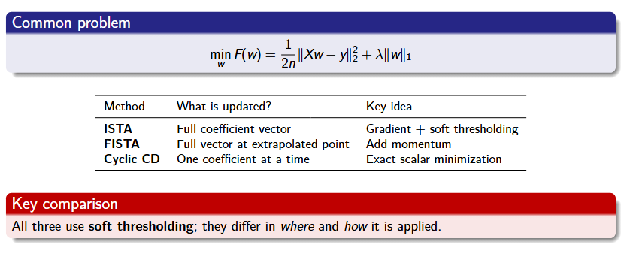
Three Solvers, One Lasso Objective
8
Notes:
SLIDE 8 | Three Solvers, One Lasso Objective
Suggested time: 35 seconds | 07:00–07:35 | Total planned: 23:00
English and Chinese are alternatives. Read one language only.
ENGLISH SCRIPT
We now move from the model to the algorithms. All three solvers minimize exactly the same Lasso objective. ISTA updates the full coefficient vector using a gradient step followed by soft thresholding. FISTA applies a similar update at an extrapolated point. Cyclic coordinate descent updates one coefficient at a time. The shared building block is soft thresholding; the difference is where it is applied and how the next update is chosen.
中文讲解稿
下面从模型进入求解算法。三种方法最小化的都是同一个 Lasso 目标函数。ISTA 对整个系数向量先做梯度更新，再做软阈值处理；FISTA 在一个外推点上做类似更新；循环坐标下降则一次只更新一个系数。它们共同使用软阈值，区别在于把软阈值用在哪里，以及怎样确定下一步更新。
讲图提示（不朗读）
先指共同目标，再按表格三行介绍；本页只建立总览，公式留到下一页。

Slide 11
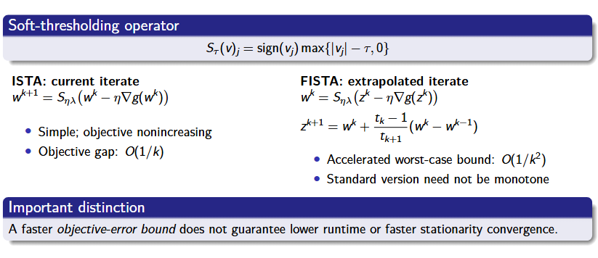
ISTA vs. FISTA: Proximal Gradient Updates
9
Notes:
SLIDE 9 | ISTA vs. FISTA: Proximal Gradient Updates
Suggested time: 110 seconds | 07:35–09:25 | Total planned: 23:00
English and Chinese are alternatives. Read one language only.
ENGLISH SCRIPT
This slide compares the two proximal gradient methods. Start with ISTA on the left. We first evaluate the gradient of the smooth squared loss at the current coefficient vector. We move in the negative gradient direction, then apply soft thresholding to each coordinate. The threshold is the step size times lambda. In our experiment the step size is one over L, where L is the largest eigenvalue of X transpose X divided by n. With this choice, the ISTA objective is nonincreasing. Its standard objective-gap bound decreases at order one over k. Now look at FISTA on the right. Instead of using only the current coefficient vector, FISTA constructs an extrapolated point using information from the previous updates. It then takes the same kind of gradient and thresholding step at that point. The additional variables control the momentum. This improves the standard worst-case objective-gap bound to order one over k squared. However, standard FISTA does not guarantee a decreasing objective at every step. We must keep the quantity in that bound clear: it is objective error. Our experiment stops using a stationarity residual and measures elapsed time. A better objective-error bound therefore does not automatically imply fewer residual checks or a shorter runtime.
中文讲解稿
这一页比较两种近端梯度方法。先看左边的 ISTA。我们在当前系数向量上计算平方损失的梯度，沿负梯度方向走一步，然后对每个坐标做软阈值处理。这里的阈值是步长乘以 lambda。实验中，步长取 L 的倒数，L 是 X 转置乘 X 再除以 n 的最大特征值。采用这个步长，ISTA 的目标函数值不会上升，它的标准目标误差界按一除以 k 的量级下降。再看右边的 FISTA。它先利用前后两次更新的信息构造一个外推点，再在这个点上进行梯度更新和软阈值处理。额外的变量用于控制动量，使标准最坏情形的目标误差界改善到一除以 k 平方。不过，标准 FISTA 不保证每一步的目标函数值都下降。这里需要明确，理论界描述的是目标函数误差；而本实验用最优性残差判断停止，并测量实际耗时。因此，更好的目标误差界，并不自动意味着更少的残差检查次数或更短的运行时间。
讲图提示（不朗读）
左侧用“梯度一步＋软阈值”解释ISTA；右侧指外推公式。O(1/k)和O(1/k²)只比较目标误差界。

Slide 12
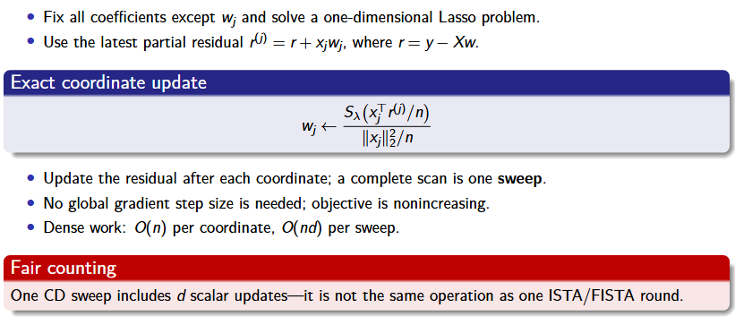
Cyclic Coordinate Descent: One Variable at a Time
10
Notes:
SLIDE 10 | Cyclic Coordinate Descent: One Variable at a Time
Suggested time: 95 seconds | 09:25–11:00 | Total planned: 23:00
English and Chinese are alternatives. Read one language only.
ENGLISH SCRIPT
Coordinate descent takes a different approach. It fixes every coefficient except one and solves the resulting one-dimensional problem exactly. To update coefficient j, we use the partial residual: the current residual plus the contribution of feature j. This temporarily removes the effect of the old coefficient. We calculate the correlation between that feature and the partial residual, apply soft thresholding with lambda, and divide by the feature's squared norm divided by n. This gives the exact coordinate minimizer. We then update the residual immediately, so the next coordinate uses the latest information. A complete pass through all d coordinates is called one sweep. Because each scalar problem is minimized exactly, the objective does not increase, and no global gradient step size is needed. For dense data, one coordinate update costs order n, while a complete sweep costs order n times d. This distinction matters when interpreting our results: four CD sweeps mean four times d scalar updates. They cannot be compared directly with four single-coordinate updates, or treated as identical operations to four ISTA or FISTA rounds.
中文讲解稿
坐标下降采用另一种思路：固定其他系数，只对一个系数求解，并且把这个一维问题精确最小化。更新第 j 个系数时，我们使用局部残差，也就是在当前残差上加回第 j 个特征原来的贡献，相当于暂时去掉旧系数的影响。然后计算该特征与局部残差的相关量，用 lambda 做软阈值处理，再除以该特征的平方范数与 n 的比值，就得到这一坐标的精确最优更新。每更新一个坐标，都立即更新残差，让后面的坐标用到最新信息。把全部 d 个坐标依次更新一遍，称为一个 sweep，也就是一轮完整扫描。由于每个一维问题都被精确最小化，目标函数值不会上升，而且不需要全局梯度步长。对于稠密数据，更新一个坐标的计算量是 n 的量级，完成一次扫描则是 n 乘 d 的量级。因此，四轮坐标下降包含的是四乘 d 次标量更新，不能与四次单坐标更新混淆，也不能直接当作与四轮 ISTA 或 FISTA 完全相同的操作。
讲图提示（不朗读）
指向partial residual，再解释分子阈值与分母缩放；最后强调一次sweep包含d次坐标更新。

Slide 13
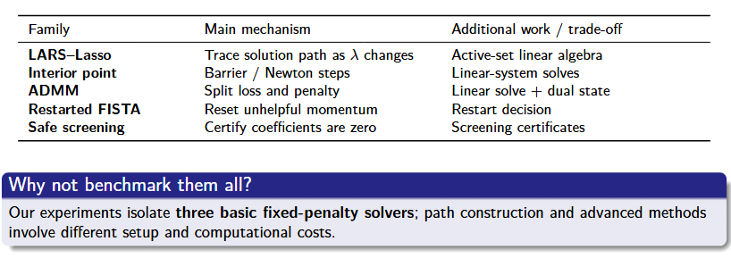
Beyond the Three Solvers
11
Notes:
SLIDE 11 | Beyond the Three Solvers
Suggested time: 55 seconds | 11:00–11:55 | Total planned: 23:00
English and Chinese are alternatives. Read one language only.
ENGLISH SCRIPT
The literature includes several other approaches. LARS-Lasso traces a solution path as lambda changes. Interior-point methods use barrier and Newton steps, requiring linear-system solves. ADMM separates the loss and penalty and maintains a dual state. Restarted FISTA can reset unhelpful momentum. Safe screening certifies that some coefficients can be removed because they are zero at a solution. These methods address different computational tasks or add mechanisms with their own costs. They provide context for our review, but we did not benchmark them. Our experiments isolate three basic solvers at a fixed penalty, which keeps the comparison focused and interpretable.
中文讲解稿
文献中还有其他求解思路。LARS-Lasso 随着 lambda 的变化追踪解路径；内点法使用障碍函数和牛顿更新，需要求解线性方程组；ADMM 把损失和惩罚拆开处理，并维护对偶变量；重启 FISTA 可以重置效果不好的动量；安全筛选则通过证书，确认某些系数在最优解处为零，从而排除相应变量。这些方法面向不同的计算任务，或者引入了额外机制和成本。它们构成文献综述的背景，但没有进入本次实测。我们的实验聚焦于固定惩罚参数下的三种基础求解器，让比较更集中，也更容易解释。
讲图提示（不朗读）
每种方法用一句话概括；明确本页为文献背景，未纳入三算法实验。

Slide 14
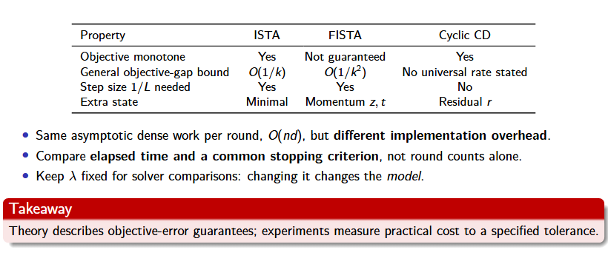
Strengths, Weaknesses, and Fair Comparison
12
Notes:
SLIDE 12 | Strengths, Weaknesses, and Fair Comparison
Suggested time: 60 seconds | 11:55–12:55 | Total planned: 23:00
English and Chinese are alternatives. Read one language only.
ENGLISH SCRIPT
This table summarizes what the comparison must account for. ISTA is simple and has little extra state. FISTA adds momentum and a stronger objective-gap guarantee, but loses the guarantee of monotone objective values. Coordinate descent maintains a residual and avoids a global gradient step size. For dense inputs, a vector round or a full coordinate sweep has the same order of work, n times d. Actual constants and implementation overhead still differ. We therefore compare elapsed time to a common stopping threshold, rather than judging the methods by round counts alone. We also hold lambda fixed. Changing lambda changes the statistical model, so that would answer a different question from comparing solvers for one objective.
中文讲解稿
这张表总结了公平比较时需要考虑的因素。ISTA 结构简单，额外状态较少；FISTA 加入动量，具有更强的目标误差保证，但不再保证目标值逐步下降；坐标下降维护残差，并且不需要全局梯度步长。对于稠密输入，一次向量更新或一轮完整坐标扫描，计算量都属于 n 乘 d 的量级，但常数和实现开销仍然不同。因此，我们比较的是达到同一个停止阈值所需的实际耗时，不能只看迭代轮数。同时还要固定 lambda，因为改变 lambda 就改变了统计模型，回答的已经不是同一个目标函数由哪种求解器更高效求解的问题。
讲图提示（不朗读）
表格不逐格朗读；突出共同精度、实际耗时、固定lambda三个比较原则。

Slide 15
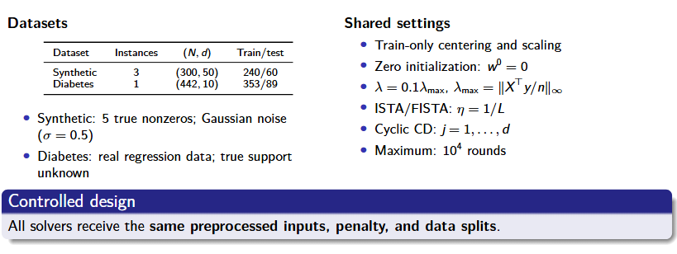
Datasets and Common Experimental Settings
13
Notes:
SLIDE 13 | Datasets and Common Experimental Settings
Suggested time: 85 seconds | 12:55–14:20 | Total planned: 23:00
English and Chinese are alternatives. Read one language only.
ENGLISH SCRIPT
We use two kinds of data in the main benchmark. The synthetic experiment has three instances, each with three hundred samples and fifty features. We use two hundred forty samples for training and sixty for testing. Each instance has five generating nonzero coefficients and Gaussian noise with standard deviation zero point five. The Diabetes dataset has four hundred forty-two samples and ten features, with a fixed training and test split of three hundred fifty-three and eighty-nine. Its true coefficient support is unknown. All solvers receive the same split and the same inputs, centered and scaled using training statistics only. They start at zero. The main penalty is zero point one times lambda max, defined by the largest absolute component of X transpose y divided by n. ISTA and FISTA use step size one over L. Coordinate descent visits features in a fixed cyclic order. Each method has a maximum of ten thousand rounds, with one complete sweep counted as a CD round.
中文讲解稿
主实验使用两类数据。合成实验有三个实例，每个实例包含三百个样本和五十个特征，其中二百四十个样本用于训练，六十个用于测试。生成模型有五个非零系数，并加入标准差为零点五的高斯噪声。Diabetes 数据集包含四百四十二个样本、十个特征，采用固定划分，训练集三百五十三个样本，测试集八十九个样本。这个真实数据集的真实系数支撑集未知。所有算法使用同一划分、同一预处理输入；中心化和标准化只使用训练集统计量。算法都从零向量开始。主实验的惩罚参数是零点一乘 lambda max，其中 lambda max 是 X 转置乘 y 再除以 n 后，各分量绝对值的最大值。ISTA 和 FISTA 的步长统一取 L 的倒数；坐标下降按固定顺序循环访问特征。每种方法最多运行一万轮，坐标下降的一轮指一次完整扫描。
讲图提示（不朗读）
先左侧数据规模，再右侧共同设置。后续相关性与维度扩展实验另有规模，不混用主实验的300×50。

Slide 16
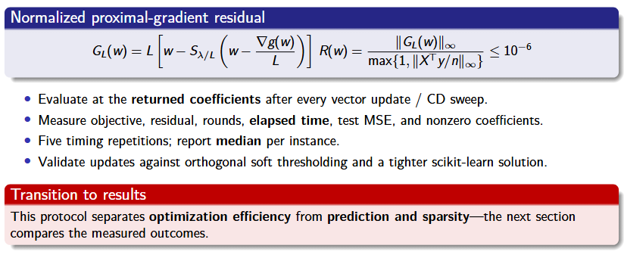
A Common Stopping Rule and Measurement Protocol
14
Notes:
SLIDE 14 | A Common Stopping Rule and Measurement Protocol
Suggested time: 100 seconds | 14:20–16:00 | Total planned: 23:00
English and Chinese are alternatives. Read one language only.
ENGLISH SCRIPT
Finally, we need a common definition of sufficiently accurate. We use the normalized proximal gradient residual shown here. Conceptually, we ask whether applying one proximal gradient step would change the returned coefficient vector. We multiply that change by L to obtain the gradient mapping, take its largest absolute component, and divide by the larger of one and the largest absolute component of X transpose y divided by n. All methods stop when this normalized residual is at most ten to the minus six. It is evaluated at the returned coefficients after every vector update or complete CD sweep. This makes the numerical target comparable across methods. It is a stationarity measure, not a direct upper bound on objective error. We record objective values, residuals, rounds, elapsed time, test mean squared error, and the number of nonzero coefficients. Each timing is repeated five times, and we report the median for each instance. Solver time includes solver preparation and monitoring, while shared preprocessing and spectral setup are excluded. We also validate the updates against an orthogonal soft-thresholding case and a tighter scikit-learn solution. With the protocol established, we can now compare the measured outcomes.
中文讲解稿
最后，需要给“求解得足够准确”一个共同定义。这里采用归一化的近端梯度残差。直观地说，我们检查：对算法返回的系数再做一次近端梯度更新，它还会改变多少。把这个变化乘以 L，得到梯度映射；取各分量绝对值的最大值，再除以一与 X 转置乘 y 除以 n 的无穷范数两者中的较大值。当归一化残差不超过十的负六次方时，所有算法都停止。每次向量更新或一次完整坐标扫描后，都在返回的系数上计算这一指标。这样，各方法达到的数值目标才具有可比性。它衡量的是最优性条件的满足程度，并不是目标函数误差的直接上界。我们同时记录目标值、残差、轮数、实际耗时、测试均方误差和非零系数数量。计时重复五次，对每个实例取中位数。求解器时间包括算法准备和监测开销，共享的预处理与谱范数准备不计入。此外，还用正交情形的软阈值解和更严格精度的 scikit-learn 解验证更新。明确了这些规则，下面就可以比较实际实验结果。
讲图提示（不朗读）
公式解释含义即可，不逐符号念。阈值为10⁻⁶；五次计时不是五个独立数据实例。衔接合并版第15页结果。

Slide 17
PART III
Results
ZHOU Xiyu
26025265R
COMP6704 Group 9
Notes:
SLIDE 1 | Classical Optimization Algorithms for Lasso Regression
Suggested time: 35 seconds | 00:00–00:35 | Total planned: 23:00
English and Chinese are alternatives. Read one language only.
ENGLISH SCRIPT
Hello everyone. Our presentation reviews and compares classical optimization algorithms for Lasso regression. We will first explain why Lasso produces sparse models and how its objective is structured. We will then introduce three solvers and a common experimental protocol. Finally, we will examine their fitted results and computational costs. Our central question is how the same optimization problem behaves under different solution methods.
中文讲解稿
大家好，我们今天汇报的主题是 Lasso 回归的经典优化算法及其实验比较。首先，我们会介绍 Lasso 为什么能够产生稀疏模型，以及它的目标函数结构。然后，我们会介绍三种求解方法和统一的实验方案。最后，通过实验比较它们的拟合结果与计算成本。整个汇报围绕一个问题展开：对于同一个优化问题，不同算法的求解表现有什么差别？
讲图提示（不朗读）
介绍完整汇报的三部分；无需逐字读副标题或姓名。

Slide 18
III Experimental Results and Conclusions
The same Lasso objective gives nearly identical fitted results.
Test MSE at the main penalty
R ≤ 10⁻⁶
Method | Synthetic | Diabetes
ISTA | 0.395983155 | 2966.935452
FISTA | 0.395981893 | 2966.936439
CD | 0.395982019 | 2966.936609
All main runs meet
the stopping threshold.
5
nonzero coefficients
for every method and instance
Synthetic: mean over 3 instances. Diabetes: one fixed split.
Comparable predictions let us focus on the cost of solving the same problem.
Source: Group 9 report, Sections 5.1 and 5.4. Main penalty: λ/λmax = 0.1.
ZHOU Xiyu
Experimental Results & Conclusions
15
Notes:
SLIDE 15 | III Experimental Results and Conclusions
Suggested time: 45 seconds | 16:00–16:45 | Total planned: 23:00
English and Chinese are alternatives. Read one language only.
ENGLISH SCRIPT
With the common protocol established, we can now compare the results. First, do the solvers reach comparable solutions? At the main penalty ratio of zero point one, every main run meets the residual threshold, and all three methods retain five nonzero coefficients. The test errors are almost identical within each dataset: about zero point three nine six on Synthetic, and two thousand nine hundred sixty-seven on Diabetes. These tiny differences do not establish a meaningful prediction ranking. This lets us focus on the computation needed to reach a comparable fitted result.
中文讲解稿
在明确共同实验流程之后，我们来看结果。首先，三个求解器是否得到了可比较的解？在主实验中，惩罚参数比值为零点一，所有主实验运行都满足残差阈值，三种方法都保留了五个非零系数。对于同一个数据集，测试误差几乎相同：合成数据约为零点三九六，Diabetes 约为二千九百六十七。这些微小差异不足以说明预测能力有实质排名。因此，接下来重点比较的是：达到相近拟合结果需要多少计算成本。
讲图提示（不朗读）
先指共同残差阈值，再指MSE表；每列只读约数。Synthetic为3个实例均值，Diabetes为一个固定划分。不要把5个非零系数自动解释为所有数据都正确恢复了真实变量。

Slide 19
Runtime depends on the dataset
The fastest solver changes between synthetic data and Diabetes.
Why FISTA can take longer
Its theory bounds objective error.
Our stopping rule uses a residual, which can fluctuate.
Synthetic: mean of 3 instance medians. Diabetes: median of 5 timings.
ISTA is fastest on Synthetic. CD is fastest on the fixed Diabetes split.
Source: original benchmark CSVs, 2026-10-06. Solver time includes monitoring and excludes shared spectral setup.
ZHOU Xiyu
Experimental Results & Conclusions
16
Notes:
SLIDE 16 | Runtime depends on the dataset
Suggested time: 70 seconds | 16:45–17:55 | Total planned: 23:00
English and Chinese are alternatives. Read one language only.
ENGLISH SCRIPT
The runtime chart gives different winners. On Synthetic, ISTA is fastest at about zero point three nine milliseconds. On the fixed Diabetes split, coordinate descent is fastest at about zero point five three milliseconds. ISTA and FISTA are close on Diabetes, with overlapping timing ranges. Here, Synthetic summarizes three instance medians, while Diabetes reports the median of five timings on one split. Repeated timings assess runtime variation; they are not independent datasets. Why does FISTA not always win? Its convergence theory bounds objective error, whereas our stopping rule uses an optimality residual. That residual can fluctuate, and each extrapolation also requires computation. A better objective error bound therefore does not guarantee a shorter measured runtime under this stopping rule. These are small, implementation-dependent timings.
中文讲解稿
耗时图给出了不同的最快方法。在合成数据上，ISTA 最快，约零点三九毫秒；在 Diabetes 的固定划分上，坐标下降最快，约零点五三毫秒。Diabetes 上 ISTA 与 FISTA 的耗时接近，而且计时范围重叠。这里，合成数据汇总的是三个实例各自计时中位数的平均值；Diabetes 则是同一划分重复五次计时的中位数。重复计时用于观察运行时间波动，并不代表多个独立数据集。为什么 FISTA 没有总是获胜？它的收敛理论约束的是目标函数误差，而这里的停止条件使用最优性残差。残差可能波动，外推也需要计算。因此，更好的目标误差界，并不保证在这个停止规则下实际运行更快。这些毫秒级结果也依赖具体实现。
讲图提示（不朗读）
先Synthetic，后Diabetes；约数分别0.39ms与0.53ms。求解器计时包含监测，排除共同预处理和谱范数计算。不要将Diabetes的ISTA/FISTA微小差别说成稳定排名。

Slide 20
Strong correlation changes the ranking
FISTA has the lowest mean time in the strongest correlation setting.
At ρ = 0.99
Method | Time (ms)
ISTA | 154.6 ± 10.5
FISTA | 19.9 ± 18.2
CD | 62.5 ± 8.7
FISTA has substantial
variation across instances.
Acceleration helps in this difficult setting. The ranking changes with the data.
Source: extended aggregated results, 2026-10-07. Error bars: SD across three instance medians, five timings each.
ZHOU Xiyu
Experimental Results & Conclusions
17
Notes:
SLIDE 17 | Strong correlation changes the ranking
Suggested time: 80 seconds | 17:55–19:15 | Total planned: 23:00
English and Chinese are alternatives. Read one language only.
ENGLISH SCRIPT
Next, we increase the correlation between features within a block. The horizontal axis shows this correlation, and the vertical axis uses a logarithmic time scale: equal vertical distances represent multiplicative changes. With independent features, ISTA has the lowest mean time. At correlation zero point nine nine, however, FISTA takes about twenty milliseconds, compared with sixty-three for coordinate descent and one hundred fifty-five for ISTA. This setting reverses the earlier ranking. Strong correlation can make progress slow in some directions, and acceleration helps here. But the uncertainty matters. FISTA's mean is about twenty milliseconds, with a standard deviation of about eighteen across only three instance medians. The error bars describe variation across those instances, not a confidence interval. We therefore report an average advantage in this experiment. Correlation also changes other problem properties, so this result is not an isolated test of conditioning alone.
中文讲解稿
接下来，我们提高同一特征块内的相关性。横轴表示相关系数，纵轴的耗时采用对数刻度，也就是相同的竖直距离代表相同倍数的变化。当特征独立时，ISTA 的平均耗时最低。但当相关系数达到零点九九时，FISTA 约需二十毫秒，坐标下降约六十三毫秒，ISTA 约一百五十五毫秒，排名与前面发生了变化。高度相关会使某些方向上的推进变慢，外推加速在这里发挥了作用。不过，也要看波动：FISTA 的均值约二十毫秒，三个实例计时中位数之间的标准差约十八毫秒。图中的误差条表示实例之间的标准差，并不是置信区间。所以，这里支持的是当前实验中的平均优势。相关性的变化还会改变问题的其他性质，不能把全部差别都归因于条件数。
讲图提示（不朗读）
指出纵轴是对数刻度；重点读ρ=0.99表格。FISTA精确值19.862±18.153ms，必须同时强调波动；三个实例、每实例五次计时。

Slide 21
A CD sweep gets costlier as features grow
A complete sweep updates every coefficient once.
4 complete sweeps
for CD at every tested size
Features | Coordinate updates
50 | 200
600 | 2,400
Fixed training size: 800 samples
A small sweep count can still involve substantial work.
Source: extended aggregated results, 2026-10-07. Independent features, 800 training samples. Error bars: sample SD.
ZHOU Xiyu
Experimental Results & Conclusions
18
Notes:
SLIDE 18 | A CD sweep gets costlier as features grow
Suggested time: 65 seconds | 19:15–20:20 | Total planned: 23:00
English and Chinese are alternatives. Read one language only.
ENGLISH SCRIPT
We now hold the training sample count at eight hundred and increase the number of features from fifty to six hundred. Coordinate descent needs four complete sweeps at every tested size, yet its runtime rises from about zero point six five to nearly seven milliseconds. One sweep visits every feature. Four sweeps therefore mean two hundred coordinate updates at fifty features, but two thousand four hundred at six hundred. A small round count can still involve substantial work. It also cannot be compared directly with the vector updates in ISTA or FISTA. ISTA remains fastest in this independent-feature study. The measured costs include the behavior of our implementations, such as vectorized operations and Python loops; their separate contributions were not measured.
中文讲解稿
现在固定训练样本数为八百，把特征数从五十增加到六百。在所有测试规模上，坐标下降都用了四次完整扫描，但耗时却从约零点六五毫秒增加到接近七毫秒。原因是每次扫描都要更新所有特征。四次扫描在五十维时包含二百次坐标更新，在六百维时则包含二千四百次。因此，轮数很少也可能对应相当多的计算，并且不能直接与 ISTA 或 FISTA 的整向量更新比较。在这组独立特征实验里，ISTA 仍然最快。测得的耗时也包括当前实现方式的影响，例如向量化操作和 Python 循环；实验并没有单独分离这些因素各自的贡献。
讲图提示（不朗读）
用右表解释4×50=200、4×600=2400；避免把一个sweep称为一次标量更新。最大维度600仍小于800个训练样本，不能延伸为d>n结论。

Slide 22
Sparser models can have larger test errors
A stronger penalty trades a smaller model against fitting error.
Selected variables
Test prediction error
At ratio 0.1, the model selects the 5 generating variables, but still shrinks their coefficients.
Fewer variables do not guarantee a smaller prediction error.
Source: regularization_results.csv, 2026-10-06. Means over three synthetic instances, solved using CD.
ZHOU Xiyu
Experimental Results & Conclusions
19
Notes:
SLIDE 19 | Sparser models can have larger test errors
Suggested time: 80 seconds | 20:20–21:40 | Total planned: 23:00
English and Chinese are alternatives. Read one language only.
ENGLISH SCRIPT
The final experiment changes the penalty rather than the solver. These synthetic results were obtained using coordinate descent and averaged over three instances. The left chart shows selected variables; the right shows test mean squared error. As the penalty ratio rises from zero point zero one to zero point one, the average number of selected variables falls from about twenty-two to five. Meanwhile, test error rises from about zero point two three six to zero point three nine six. At ratio zero point one, all three instances select the five generating variables, but their estimated coefficients are still shrunk. Recovering the correct variables therefore does not guarantee the smallest prediction error. At ratio one, every coefficient is zero, and prediction is the training response mean after restoring the intercept. These penalties were preset; the test scores were not used to select a penalty.
中文讲解稿
最后一个实验改变的是惩罚强度，而不是求解器。这里使用坐标下降求解，展示三个合成实例的平均结果。左图是选中的变量数，右图是测试均方误差。当惩罚参数比值从零点零一增加到零点一，平均入选变量数从约二十二个降到五个，同时测试误差从约零点二三六增加到零点三九六。在比值为零点一时，三个实例都选中了五个真实生成变量，但估计系数仍然向零收缩。因此，选对变量也不保证预测误差最小。当比值达到一时，所有系数都为零，恢复截距后，预测值是训练响应的均值。这里的惩罚参数都是预先设定的，没有使用测试分数来选择参数。
讲图提示（不朗读）
先左图变量数，再右图MSE；两图均为3实例均值。不要说所有实例的误差都严格单调；全零系数不意味着原尺度预测全为0。

Slide 23
Conclusions and limitations
The best solver depends on the data and the implementation.
Method | Observed advantage in our experiments
ISTA | Lowest time on the tested independent-feature problems
FISTA | Lowest mean time at the strongest correlation, ρ = 0.99
Cyclic CD | Lowest time on the fixed Diabetes split
All three methods produce nearly identical fitted results after convergence.
Stronger regularization produces a smaller model and can increase test error.
Scope of the evidence
Three synthetic instances per setting, one Diabetes split, and the current implementations.
Source: Group 9 report, Section 6. Findings apply to the recorded datasets, stopping rule and implementations.
ZHOU Xiyu
Experimental Results & Conclusions
20
Notes:
SLIDE 20 | Conclusions and limitations
Suggested time: 80 seconds | 21:40–23:00 | Total planned: 23:00
English and Chinese are alternatives. Read one language only.
ENGLISH SCRIPT
We can now answer the comparison question. For the problems and implementations tested here, ISTA has the lowest time on the independent-feature problems. Coordinate descent is fastest on the fixed Diabetes split. FISTA has the lowest mean time at the strongest correlation, although its variation is substantial. Once the methods satisfy the common stopping rule, their fitted results are almost identical. Solver choice mainly changes the cost of computing the solution to a fixed objective. Changing the regularization parameter changes that objective and the fitted model: stronger regularization can simplify the model while increasing prediction error. Our evidence covers three synthetic instances per setting, one Diabetes split, and the current implementations. Five timing repetitions do not expand that dataset coverage. A broader assessment would need more datasets, repeated splits, and additional implementations. Thank you for listening.
中文讲解稿
现在可以回答最初的比较问题了。在本次测试的问题和实现中，ISTA 在独立特征问题上的耗时最低；坐标下降在 Diabetes 的固定划分上最快；在相关性最强的设置下，FISTA 的平均耗时最低，但波动也较大。当三种方法都满足共同停止规则后，拟合结果几乎一致。对固定目标函数而言，选择求解器主要改变的是求解成本；而改变正则化参数，会改变目标函数以及拟合模型。更强的正则化可以简化模型，同时也可能增加预测误差。我们的证据范围是每个设置三个合成实例、一个 Diabetes 划分，以及当前实现。五次重复计时并没有扩大数据集的覆盖范围。更全面的评估还需要更多数据集、重复划分和更多实现。谢谢大家。
讲图提示（不朗读）
按表格三行收束，不重读所有数值。最后明确：solver影响固定问题的求解成本，λ改变模型。若接近25分钟，可直接读后三句结束。

