Slide 1

Classical Optimization
Algorithms for Lasso Regression
Four solvers · One objective · A common accuracy target
CAI Yangxiao
XUE Pengyu
ZHANG Kejia
ZHOU Xiyu
26023041R
26022951R
26049131R
26025265R
Opening: ZHANG Kejia | 30-minute presentation + 10-minute Q&A
github.com/Caiyangxiao/COMP6704-Group9-Project
Notes:
SLIDE 01 | Classical Optimization Algorithms for Lasso Regression
Speaker: ZHANG Kejia 26049131R
Suggested time: 35 seconds | 00:00–00:35 | Main presentation: 30:00
English and Chinese are alternative scripts; present in one language.
ENGLISH SCRIPT
Good afternoon. We are Group Nine. Our project compares four classical algorithms for Lasso regression: ISTA, FISTA, cyclic coordinate descent, and ADMM. All four solve the same optimization problem. Our focus is how their update mechanisms and computational costs interact with the data. Our comparisons concern these recorded implementations. We will explain the theory, describe a common experimental protocol, and then discuss the evidence and limitations.
中文讲解稿
大家好，我们是第九组。我们的项目比较 Lasso 回归的四种经典算法：ISTA、FISTA、循环坐标下降，以及 ADMM。四种算法求解同一个优化问题。我们关注的是，不同更新机制和计算成本如何与数据结构相互作用。比较结论针对本次记录的实现。接下来，我们会依次介绍理论、统一实验方案，以及实验结果和结论的适用范围。
VISUAL / DELIVERY CUES（不朗读）
Briefly introduce all four members; do not read every student ID.
SOURCES
Report title and abstract

Slide 2

Our Work and Presentation Plan
Four implementations answer one shared optimization question.
I Background
II Algorithms
III Results
CAI Yangxiao
Formulation, convexity
and sparse optimality
XUE Pengyu
ISTA, FISTA, cyclic CD, ADMM
and a common protocol
ZHOU Xiyu
Accuracy, runtime, sensitivity
and conditional conclusions
Introduction and work overview: ZHANG Kejia | Experimental design and evaluation: all four members
Group 9 four-solver report, Sections 1–6; member contributions confirmed by the group.
ZHANG Kejia 26049131R
Introduction
02 / 34
Notes:
SLIDE 02 | Our Work and Presentation Plan
Speaker: ZHANG Kejia 26049131R
Suggested time: 55 seconds | 00:35–01:30 | Main presentation: 30:00
English and Chinese are alternative scripts; present in one language.
ENGLISH SCRIPT
Our presentation follows three connected parts. In Part One, Cai introduces the Lasso motivation, objective, optimality conditions, and soft thresholding. In Part Two, Xue explains the four algorithms, their implementation costs, and our common experimental protocol. In Part Three, Zhou compares the fitted solutions and runtimes, then examines correlation, feature count, and penalty sensitivity. The same objective and stopping criterion connect all three parts. All four members contributed to report writing, revision, experimental design, and evaluation. I designed the slides and am introducing the work. Our aim is to explain what the recorded experiments support, together with their limits. We then welcome questions from the audience.
中文讲解稿
我们的展示分为三个相互衔接的部分。第一部分由 CAI Yangxiao 介绍 Lasso 的动机、目标函数、最优性条件和软阈值。第二部分由 XUE Pengyu 解释四种算法、实现成本以及统一实验方案。第三部分由 ZHOU Xiyu 比较拟合解和运行时间，并考察相关性、特征数和惩罚敏感性。相同目标和停止标准贯穿三个部分。四位成员共同参与报告撰写与修改、实验设计和实验评估。我负责 PPT 设计，并在这里介绍工作。我们的目标是说明记录的实验支持哪些结论，以及这些结论的限制。展示结束后欢迎现场提问。
VISUAL / DELIVERY CUES（不朗读）
Point to the three agenda sections in order: foundations, algorithms and protocol, then results and conclusions. Do not point to an implementation map on this slide.
SOURCES
Report §6, Author contributions; confirmed team responsibilities

Slide 3
PART I
Background and formulation
CAI Yangxiao
Student ID: 26023041R
Notes:
SLIDE 03 | PART I — Foundations
Speaker: CAI Yangxiao 26023041R
Suggested time: 10 seconds | 01:30–01:40 | Main presentation: 30:00
English and Chinese are alternative scripts; present in one language.
ENGLISH SCRIPT
I will introduce the modeling motivation, the convex objective, and the thresholding operation shared by our solvers.
中文讲解稿
下面我介绍建模动机、凸目标函数，以及四种求解器所涉及的软阈值操作。
VISUAL / DELIVERY CUES（不朗读）
SOURCES
Report §§1–2

Slide 4
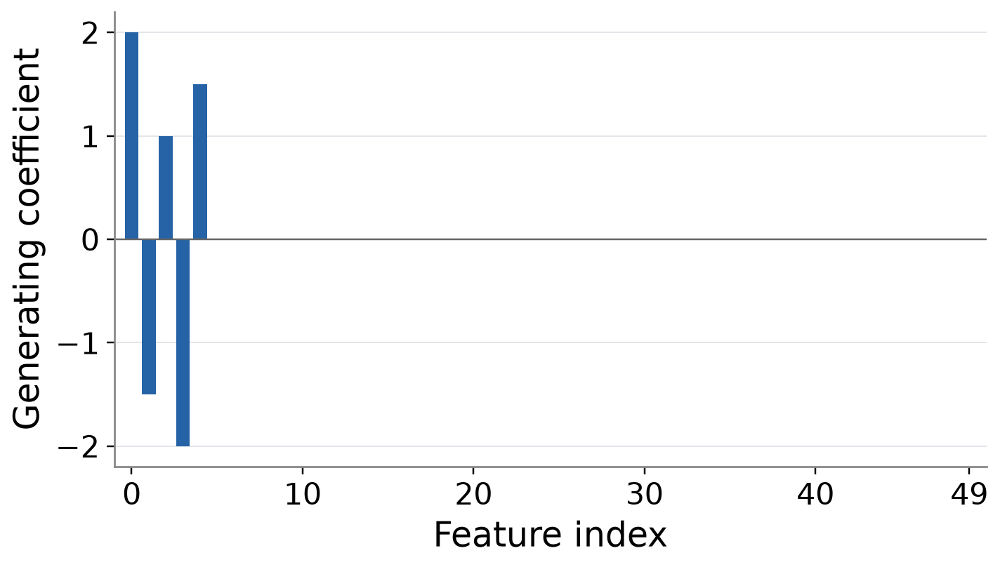
Why Study Lasso?
Sparse regression makes optimization and feature selection visible.
50 candidate features
5 generating variables
Convex + nonsmooth
A tractable model with
algorithmic choices
Known generating coefficients give a direct check of support recovery and shrinkage.
Report Sections 1 and 4.1; saved synthetic-generation specification. Bars show the generating coefficients.
CAI Yangxiao 26023041R
Part I
04 / 34
Notes:
SLIDE 04 | Why Study Lasso?
Speaker: CAI Yangxiao 26023041R
Suggested time: 50 seconds | 01:40–02:30 | Main presentation: 30:00
English and Chinese are alternative scripts; present in one language.
ENGLISH SCRIPT
Regression can fit a response using many candidate predictors, but a compact model is often easier to interpret. Our synthetic example makes this motivation concrete: there are fifty candidate features, while only five have nonzero generating coefficients. These known coefficients describe how the data were constructed; they are not an algorithm's recovered solution. Lasso encourages sparse fitted coefficients through an absolute-value penalty. This also creates a convex but nonsmooth optimization problem, making the model useful for comparing different solution strategies. However, obtaining a sparse fit does not automatically recover the true variables or remove coefficient shrinkage.
中文讲解稿
回归可以使用许多候选特征拟合响应，但较精简的模型通常更容易解释。我们的合成数据把这个动机具体化：一共有五十个候选特征，只有五个生成系数非零。这些已知系数说明数据是如何构造的，并不是算法已经恢复出的结果。Lasso 利用绝对值惩罚鼓励稀疏系数，同时形成一个凸但非光滑的优化问题，因此适合比较不同求解策略。不过，得到稀疏模型，并不自动意味着找回真实变量，也不意味着消除了系数收缩。
VISUAL / DELIVERY CUES（不朗读）
Use a sparse generating-coefficient illustration; label it “known generating coefficients”.
SOURCES
Report §§1, 4.1; data/manifest.json

Slide 5

The Same Lasso Objective for Every Solver
Every solver minimizes the same normalized Lasso objective.
Squared training loss
L1 penalty λ‖w‖₁
Fits centered responses
X: n × d, w: d coefficients
Encourages sparse coefficients
λ controls regularization
Center and scale using training statistics; restore an unpenalized intercept for prediction.
Report Section 2.1, Eq. (1); Tibshirani (1996).
CAI Yangxiao 26023041R
Part I
05 / 34
Notes:
SLIDE 05 | The Same Lasso Objective for Every Solver
Speaker: CAI Yangxiao 26023041R
Suggested time: 75 seconds | 02:30–03:45 | Main presentation: 30:00
English and Chinese are alternative scripts; present in one language.
ENGLISH SCRIPT
The objective has two terms. The squared loss measures training fit, and the L one penalty encourages sparse coefficients. We use the normalization one over two n everywhere. This matters because changing that normalization also changes the gradient and the effective penalty scale. X contains training features, y is the centered response, and w contains the coefficients. Every solver receives exactly the same transformed inputs. We center and standardize features using training means and population standard deviations, then apply those statistics to the test set. Responses are centered using the training mean, which is restored for prediction. This gives an unpenalized intercept without test leakage. We also remove constant training columns. This control is essential because scaling differences can otherwise masquerade as solver differences. Fixing these modeling choices lets us attribute computational differences to the algorithms rather than different training problems.
中文讲解稿
目标函数包含两项。平方损失衡量训练拟合，L1 惩罚鼓励稀疏系数。我们始终采用二 n 分之一的归一化；这是必要的，因为改变归一化也会改变梯度和有效的惩罚尺度。X 是训练特征，y 是中心化响应，w 是系数。每种求解器接收完全相同的变换后输入。特征使用训练均值和总体标准差进行中心化、标准化，再把同样统计量应用到测试集。响应使用训练均值中心化，预测时恢复这个均值，因此截距不受惩罚，也不会泄露测试信息。常数训练特征会被移除。这一步控制很关键，否则尺度差异可能被误认为求解器差异。固定这些建模选择，才能把计算差异归因于算法，而不是不同的训练问题。
VISUAL / DELIVERY CUES（不朗读）
Point to loss, then penalty; pause 3 s on the training-only preprocessing flow.
SOURCES
Report §2.1, Eq. (1)

Slide 6
Related Regression Penalties
Changing the penalty changes the estimator.
Model | Penalty | Main distinction
Ridge | α‖w‖₂² / 2 | Usually dense coefficients
Lasso | λ‖w‖₁ | Exact zeros through thresholding
Elastic net | λ‖w‖₁ + α‖w‖₂² / 2 | Sparsity and correlated-variable grouping
Adaptive Lasso | λ Σⱼ ωⱼ|wⱼ| | Fixed weighted thresholds
The benchmark fixes unweighted Lasso and compares how four algorithms solve it.
Report Section 1.2 and Table 1; Hoerl & Kennard (1970), Tibshirani (1996), Zou & Hastie (2005), Zou (2006).
CAI Yangxiao 26023041R
Part I
06 / 34
Notes:
SLIDE 06 | Related Regression Penalties
Speaker: CAI Yangxiao 26023041R
Suggested time: 45 seconds | 03:45–04:30 | Main presentation: 30:00
English and Chinese are alternative scripts; present in one language.
ENGLISH SCRIPT
Several regression models share the same squared loss but use different penalties. Ridge applies quadratic shrinkage and usually retains a dense coefficient vector. Lasso uses the L one norm and permits exact zeros. Elastic net combines both penalties and can encourage grouped selection of correlated predictors. Adaptive Lasso uses coordinate-specific weights estimated from an initial fit; with finite positive weights fixed, its objective remains convex. These choices change the statistical estimator. In our solver benchmark, we keep the unweighted Lasso objective fixed and compare four ways of computing its solution.
中文讲解稿
几种回归模型可以使用相同平方损失，但惩罚项不同。Ridge 施加二次收缩，通常保留稠密系数。Lasso 使用 L1 范数，允许精确为零。Elastic net 结合两种惩罚，可以鼓励相关变量成组选择。Adaptive Lasso 使用从初始拟合估计的特征权重；只要固定有限的正权重，目标仍然是凸的。这些选择会改变统计估计量。我们的求解器比较固定使用未加权 Lasso，只比较计算同一解的四种方式。
VISUAL / DELIVERY CUES（不朗读）
Read one distinction per row; leave formulas visible without expanding derivations.
SOURCES
Report §1.2, Table 1; Hoerl & Kennard (1970); Tibshirani (1996); Zou & Hastie (2005); Zou (2006)

Slide 7

Convexity and Sparse Optimality
Convexity supports global optimization; subgradients permit zeros.
Convex objective
Coordinate optimality
∇²g(w) = XᵀX / n ⪰ 0
λ‖w‖₁ is convex
Every local minimum is global.
w*ⱼ ≠ 0: ∇ⱼg = −λ sign(w*ⱼ)
w*ⱼ = 0: |∇ⱼg| ≤ λ
∂|0| = [−1, 1]
Coefficient uniqueness requires additional structure; optimality and true-support recovery are separate checks.
Report Section 2.2; Boyd & Vandenberghe (2004), Tibshirani (2013).
CAI Yangxiao 26023041R
Part I
07 / 34
Notes:
SLIDE 07 | Convexity and Sparse Optimality
Speaker: CAI Yangxiao 26023041R
Suggested time: 75 seconds | 04:30–05:45 | Main presentation: 30:00
English and Chinese are alternative scripts; present in one language.
ENGLISH SCRIPT
The least-squares Hessian is X transpose X divided by n, which is positive semidefinite. The L one norm is also convex, so the full objective is convex. With a positive lambda, the objective grows when the coefficient norm grows without bound, ensuring a minimizer exists. Full column rank is sufficient for a unique coefficient vector, although uniqueness can also hold in other cases. The optimality condition balances the loss gradient against a penalty subgradient. For a nonzero coefficient, the gradient must equal minus lambda times its sign. At zero, the absolute-value subgradient is the interval from minus one to one, so a gradient magnitude below lambda is compatible with optimality. These conditions apply jointly to the complete vector. The constrained formulation provides an equivalent geometric view at a corresponding norm budget. They explain exact zeros, but they do not establish correct support recovery.
中文讲解稿
最小二乘损失的 Hessian 是 X 转置乘 X 再除以 n，因此半正定。L1 范数也是凸函数，所以整个目标是凸的。当 lambda 为正时，系数范数无限增长会使目标无限增长，因此最优解存在。满列秩足以保证系数唯一，但并不是唯一性的必要条件。最优性条件要求损失梯度与惩罚次梯度相互平衡。对于非零系数，梯度必须等于负 lambda 乘其符号；在零点，绝对值次梯度包含负一到一的整个区间，因此梯度绝对值不超过 lambda 就可以满足最优性。条件必须对整个向量共同成立。约束形式还可以在对应范数预算下提供等价的几何视角。它解释精确零，但不能证明找回了真实支持集。
VISUAL / DELIVERY CUES（不朗读）
Point to the two coefficient cases; pause 3 s at the zero-coefficient interval.
SOURCES
Report §2.2, Eqs. (3)–(4); Tibshirani (2013)

Slide 8
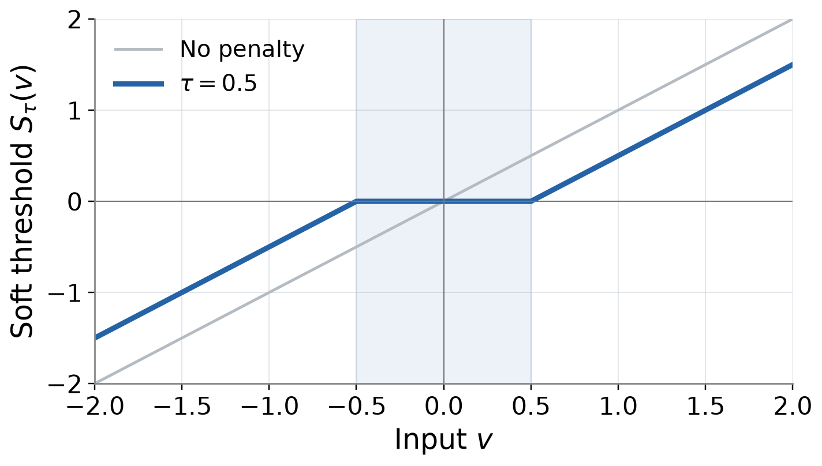
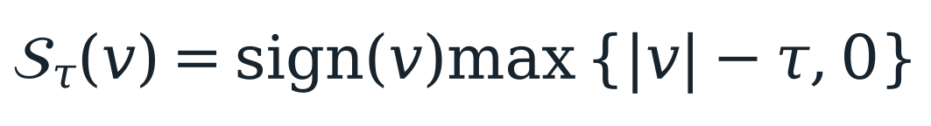
Soft Thresholding
Soft thresholding sets small inputs to zero and shrinks larger ones.
Input | τ = 0.5
1.2 | 0.7
−0.8 | −0.3
0.2 | 0
The same proximal operation appears in ISTA, FISTA, coordinate descent and ADMM.
Report Section 2.3, Eq. (5); Parikh & Boyd (2014).
CAI Yangxiao 26023041R
Part I
08 / 34
Notes:
SLIDE 08 | Soft Thresholding
Speaker: CAI Yangxiao 26023041R
Suggested time: 65 seconds | 05:45–06:50 | Main presentation: 30:00
English and Chinese are alternative scripts; present in one language.
ENGLISH SCRIPT
Soft thresholding turns the subgradient argument into a concrete operation. It subtracts the threshold from the input magnitude and clips negative results to zero, while retaining the sign of the remaining values. With threshold zero point five, one point two becomes zero point seven, minus zero point eight becomes minus zero point three, and zero point two becomes zero. The flat middle segment therefore creates exact sparsity. This operation solves a separable proximal problem: remain near the input while paying an absolute-value penalty. For appropriately normalized orthogonal features, it gives the full Lasso solution in one step. General predictors interact, so thresholding becomes a repeated building block. All four methods will use it, but at different points in their updates.
中文讲解稿
软阈值把次梯度条件变成具体操作：从输入的绝对值减去阈值，把负结果截断为零，并保留其余数值的符号。阈值为零点五时，一点二变成零点七，负零点八变成负零点三，零点二变成零。因此图中间的水平段产生精确稀疏性。它求解一个可分离的近端问题：尽量接近输入，同时支付绝对值惩罚。对于适当归一化的正交特征，一次软阈值就能给出完整 Lasso 解；一般特征会相互作用，所以阈值成为反复使用的基本步骤。四种算法都会用到它，但使用的位置不同。
VISUAL / DELIVERY CUES（不朗读）
Trace the flat interval, then the three numeric examples; pause 3 s before the orthogonal-design exception.
SOURCES
Report §2.3, Eq. (5); Parikh & Boyd (2014)

Slide 9
Research Questions and Solver Map
Fix the model, then compare update mechanisms and computation.
ISTA
FISTA
CD
ADMM
Gradient step
+ threshold
Implemented by
ZHOU Xiyu
Extrapolation
+ threshold
Implemented by
XUE Pengyu
Exact scalar
minimization
Implemented by
ZHANG Kejia
Linear solve
+ split updates
Implemented by
CAI Yangxiao
Same data, preprocessing, λ and final stationarity target across all four implementations.
Report Sections 3.1–3.4 and confirmed author contributions; classical methods, no new algorithm claimed.
CAI Yangxiao 26023041R
Part I
09 / 34
Notes:
SLIDE 09 | Research Questions and Solver Map
Speaker: CAI Yangxiao 26023041R
Suggested time: 40 seconds | 06:50–07:30 | Main presentation: 30:00
English and Chinese are alternative scripts; present in one language.
ENGLISH SCRIPT
We can now map the four solvers onto three mechanisms. ISTA and FISTA update the whole coefficient vector using a gradient and thresholding. Coordinate descent minimizes one scalar problem at a time. ADMM separates the loss and penalty, then couples their solutions through a constraint. Our comparison asks which mechanism reaches the same stationarity target efficiently, how data geometry changes the answer, and why the model penalty lambda must be distinguished from ADMM's algorithmic penalty beta. Xue will now explain the implementations and protocol.
中文讲解稿
现在可以把四种求解器归为三类机制。ISTA 和 FISTA 使用梯度与阈值更新整个系数向量；坐标下降每次精确求解一个标量问题；ADMM 把损失和惩罚分开，再用约束连接两者。我们比较哪种机制能更高效地达到同一平稳性目标，数据结构如何改变答案，以及为什么模型惩罚 lambda 必须与 ADMM 的算法惩罚 beta 区分。接下来由XUE Pengyu介绍实现和实验方案。
VISUAL / DELIVERY CUES（不朗读）
Make the three mechanism groups visually distinct; hand over to XUE.
SOURCES
Report §§1, 3

Slide 10
PART II
Algorithms and experimental design
XUE Pengyu
Student ID: 26022951R
Notes:
SLIDE 10 | PART II — Algorithms and Experimental Design
Speaker: XUE Pengyu 26022951R
Suggested time: 10 seconds | 07:30–07:40 | Main presentation: 30:00
English and Chinese are alternative scripts; present in one language.
ENGLISH SCRIPT
I will explain the four updates, their costs, and the common accuracy and timing rules used in our experiments.
中文讲解稿
下面我介绍四种更新、各自成本，以及实验统一使用的精度和计时规则。
VISUAL / DELIVERY CUES（不朗读）
SOURCES
Report §§3–4

Slide 11
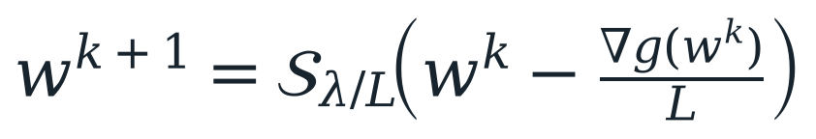
ISTA: Gradient Step, Then Threshold
ISTA takes a fitting step, then applies the L1 proximal map.
1 Current iterate
2 Gradient step
3 Threshold
wᵏ
η = 1/L
τ = ηλ
O(nd) dense work per monitored round; a nonincreasing objective with a valid step size.
Report Section 3.1; Daubechies et al. (2004), Beck & Teboulle (2009). Implementation: ZHOU Xiyu.
XUE Pengyu 26022951R
Part II
11 / 34
Notes:
SLIDE 11 | ISTA: Gradient Step, Then Threshold
Speaker: XUE Pengyu 26022951R
Suggested time: 70 seconds | 07:40–08:50 | Main presentation: 30:00
English and Chinese are alternative scripts; present in one language.
ENGLISH SCRIPT
ISTA begins at the current coefficient vector. A gradient step reduces the smooth squared loss, and soft thresholding then handles the nonsmooth penalty exactly. The gradient is Lipschitz continuous with constant L, the squared spectral norm of X divided by n. We use the reciprocal of L as the step size. This gives a quadratic upper bound on the loss, whose minimizer together with the penalty is the displayed update. With a valid step, the objective is nonincreasing. For dense data, the dominant operations are a prediction and a transposed matrix-vector product, so one round costs order n d. The code does not store a full Gram matrix. We use the same initialization for every method. ISTA's appeal is its simple structure and predictable progress, but weak-curvature directions can require many rounds.
中文讲解稿
ISTA 从当前系数向量开始。先用梯度步降低光滑平方损失，再通过软阈值精确处理非光滑惩罚。梯度的 Lipschitz 常数 L 等于 X 的谱范数平方除以 n，我们采用它的倒数作为步长。这样可以构造损失的二次上界；把上界与惩罚一起最小化，就得到展示的更新。有效步长下，目标值不会增加。对于稠密数据，主要操作是预测和转置矩阵向量乘法，因此每轮成本为 n d 的量级。代码不存储完整 Gram 矩阵。所有方法使用相同初始点。ISTA 的优点是结构简单、进展较平稳，但弱曲率方向可能需要很多轮。
VISUAL / DELIVERY CUES（不朗读）
Point to gradient then threshold; pause 3 s on the cost statement.
SOURCES
Report §3.1, Eq. (7); src/optimizers.py; Daubechies et al. (2004)

Slide 12
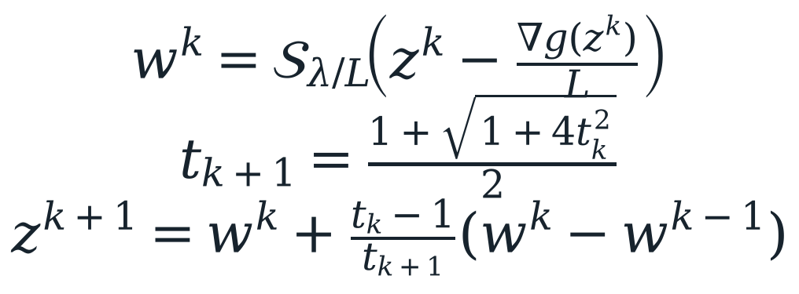
FISTA: Add Extrapolation
FISTA adds momentum through an extrapolated evaluation point.
Acceleration
O(k⁻²) objective-error bound
Standard FISTA can oscillate.
No restart is used here.
A stronger objective-error guarantee does not determine elapsed time to the common residual threshold.
Report Section 3.1; Beck & Teboulle (2009). Implementation: XUE Pengyu.
XUE Pengyu 26022951R
Part II
12 / 34
Notes:
SLIDE 12 | FISTA: Add Extrapolation
Speaker: XUE Pengyu 26022951R
Suggested time: 80 seconds | 08:50–10:10 | Main presentation: 30:00
English and Chinese are alternative scripts; present in one language.
ENGLISH SCRIPT
FISTA uses the same gradient and thresholding step, but evaluates it at an extrapolated vector. The extrapolation combines the current solution with the direction from the previous solution, weighted by the momentum sequence. We initialize the momentum at one and apply the standard recursion. The dominant matrix-vector products remain similar to ISTA, while extra vectors and arithmetic maintain the momentum. Under the stated convexity and smoothness assumptions, ISTA has an order one over k objective-error bound and FISTA has an order one over k squared bound. These are worst-case bounds on objective error. They do not directly bound our stationarity residual, coefficient error, or wall-clock time. Standard FISTA can also be nonmonotone. We deliberately use the standard algorithm without restart, so the method being compared is clear. A favorable theoretical bound is therefore a reason to test acceleration, rather than a measured timing result. The results will show why this distinction matters.
中文讲解稿
FISTA 使用相同的梯度和阈值步骤，但计算位置变成一个外推向量。外推把当前解与前后两次解的移动方向结合，权重由动量序列控制。我们把动量初始化为一，采用标准递推。主要矩阵向量乘法与 ISTA 类似，但需要额外向量和运算维护动量。在给定的凸性与光滑性条件下，ISTA 的目标误差界是 k 分之一量级，FISTA 则是 k 平方分之一。这些是目标误差的最坏情况界，并不直接约束我们的平稳性残差、系数误差或者实际时间。标准 FISTA 的进展还可能非单调。因此，有利理论界是检验加速效果的理由，还需要实际计时验证。我们不使用重启，保证比较对象明确；之后会看到这种区别为什么重要。
VISUAL / DELIVERY CUES（不朗读）
Show proximal and extrapolation steps separately; pause 4 s beside the two rates.
SOURCES
Report §3.1, Eqs. (8)–(11); Beck & Teboulle (2009)

Slide 13
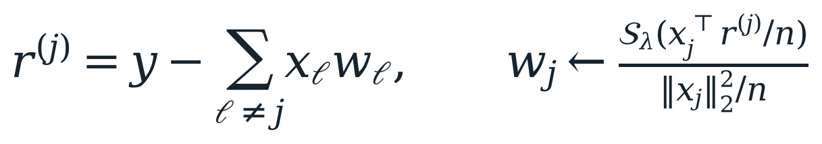
Cyclic Coordinate Descent
Cyclic CD solves one coefficient exactly using the latest residual.
Residual reuse
One complete sweep
r⁽ʲ⁾ = r + xⱼwⱼ
Update wⱼ, then r = r⁽ʲ⁾ − xⱼwⱼ
Visit j = 1, …, d
O(n) per coordinate; O(nd) per sweep
A small sweep count can still contain many sequential scalar updates.
Report Section 3.2; Friedman et al. (2010), Wu & Lange (2008). Implementation: ZHANG Kejia.
XUE Pengyu 26022951R
Part II
13 / 34
Notes:
SLIDE 13 | Cyclic Coordinate Descent
Speaker: XUE Pengyu 26022951R
Suggested time: 75 seconds | 10:10–11:25 | Main presentation: 30:00
English and Chinese are alternative scripts; present in one language.
ENGLISH SCRIPT
Coordinate descent fixes every coefficient except one and minimizes the resulting scalar Lasso problem exactly. The partial residual removes the contribution of the current coordinate from the fitted response. Thresholding the feature-residual inner product, then dividing by the feature's squared norm, gives the new coefficient. Standardization makes that denominator one, but our code retains the general formula. We maintain the residual throughout the sweep, adding back the old coordinate contribution and subtracting the new one after each update. This avoids recomputing a full prediction for every coefficient. One coordinate costs order n, and a complete sweep costs order n d. Exact scalar minimization makes the objective nonincreasing. However, a sweep contains d sequential updates, implemented here in a Python loop. Our comparison does not transfer randomized-coordinate rates to this cyclic implementation. A small sweep count must therefore be interpreted alongside elapsed time.
中文讲解稿
坐标下降固定除一个系数以外的所有系数，精确最小化对应的标量 Lasso 问题。部分残差先从拟合中移除当前坐标的贡献。对特征与残差的内积做阈值，再除以该特征的平方范数，就得到新系数。标准化使分母为一，但代码保留通用公式。整个扫描过程中持续维护残差：先加回旧坐标贡献，更新后再减去新贡献，避免每个系数都重新计算完整预测。单个坐标成本是 n 的量级，一整轮是 n d。精确最小化使目标非增。我们不会把随机坐标算法的速率直接用于这个循环实现。不过，一轮包含 d 次顺序更新，而且这里使用 Python 循环，因此较少轮数必须结合实际耗时理解。
VISUAL / DELIVERY CUES（不朗读）
Animate one coordinate and its residual update; emphasize “complete sweep”.
SOURCES
Report §3.2, Eq. (12); Friedman et al. (2010); Wu & Lange (2008)

Slide 14
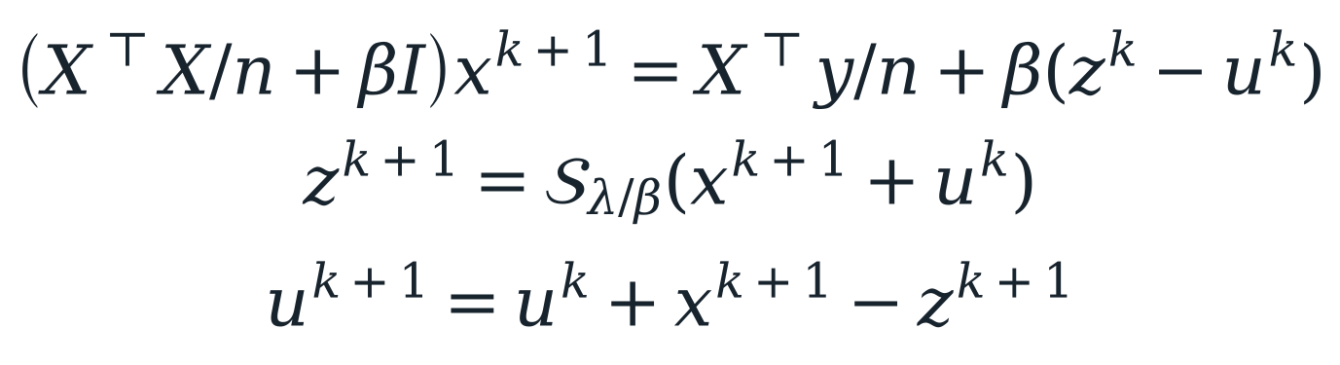
ADMM: Split the Loss and Penalty
ADMM separates squared loss and the L1 penalty through x = z.
β > 0 is the algorithmic penalty. λ controls the Lasso model.
Initialize x, z, u at zero. Return w = z. Main benchmark: β = 1.
The matrix, threshold and objective all use the same 1/(2n) loss normalization.
Report Section 3.3, Eqs. (14)–(16); Boyd et al. (2011). Implementation: CAI Yangxiao.
XUE Pengyu 26022951R
Part II
14 / 34
Notes:
SLIDE 14 | ADMM: Split the Loss and Penalty
Speaker: XUE Pengyu 26022951R
Suggested time: 90 seconds | 11:25–12:55 | Main presentation: 30:00
English and Chinese are alternative scripts; present in one language.
ENGLISH SCRIPT
ADMM introduces two coefficient copies. The squared loss uses x, the L one penalty uses z, and the equality constraint requires them to agree. The augmented Lagrangian adds a quadratic agreement penalty with positive parameter beta and a scaled dual vector u. Each iteration first solves a regularized least-squares system for x. It then applies soft thresholding to x plus u, with threshold lambda divided by beta, to obtain z. Finally, the dual update accumulates the disagreement between the two copies. All three vectors start at zero. We use beta for the algorithmic penalty because rho already denotes feature correlation in the experiments. Changing beta changes the iteration, while changing lambda changes the statistical model. When the split constraint holds, the formulation is exactly the original Lasso problem. The extra dual state records agreement progress between iterations, while leaving the training inputs unchanged. Convex ADMM theory supports convergence with fixed positive beta and exact subproblem solves, but does not promise that ADMM will beat every other method in finite time.
中文讲解稿
ADMM 引入两个系数副本：平方损失使用 x，L1 惩罚使用 z，并要求 x 与 z 相等。增广拉格朗日加入正参数 beta 控制的二次一致性惩罚，以及缩放对偶变量 u。每轮先通过一个正则化最小二乘线性系统更新 x，再对 x 加 u 做阈值为 lambda 除以 beta 的软阈值，得到 z；最后把两个副本的差异累加到对偶变量。三个向量都从零开始。我们用 beta 表示算法参数，因为 rho 已用于实验中的特征相关性。改变 beta 会改变迭代过程，改变 lambda 才会改变统计模型。约束满足时，这就是原来的 Lasso 问题。额外对偶状态记录副本一致性的迭代进展，训练输入仍然相同。固定正 beta、精确子问题求解下，凸 ADMM 理论支持收敛，但不保证有限时间内优于所有方法。
VISUAL / DELIVERY CUES（不朗读）
Trace x → z → u once; pause 4 s on λ versus β.
SOURCES
Report §3.3, Eqs. (13)–(16); Boyd et al. (2011); src/optimizers.py

Slide 15
ADMM Implementation and Correct Evaluation
ADMM reuses a factorization within each cold solve.
Prepare once
Repeat the split updates
Form XᵀX/n + βI
Cache a Cholesky factor
Include this cost in total time.
Dense preparation: O(nd² + d³)
Triangular solve, threshold, dual step
Monitor the same F(z) and R(z)
Per monitored round: O(nd + d²)
Extra matrix storage: O(d²)
No factorization is shared across timing repetitions, instances or penalty settings.
Report Sections 3.3–3.4; current dense Cholesky implementation and common monitoring protocol.
XUE Pengyu 26022951R
Part II
15 / 34
Notes:
SLIDE 15 | ADMM Implementation and Correct Evaluation
Speaker: XUE Pengyu 26022951R
Suggested time: 55 seconds | 12:55–13:50 | Main presentation: 30:00
English and Chinese are alternative scripts; present in one language.
ENGLISH SCRIPT
The implementation forms the normalized Gram matrix and factors the regularized system once per cold solve. It then reuses that Cholesky factor for the subsequent x updates, without explicitly computing an inverse. The factorization is inside the timed region and is repeated for every timing repetition. We return z because it is the thresholded coefficient vector. Both terms of the plotted objective are evaluated at z, and the common stationarity residual is also evaluated at z. Using the loss at x and the penalty at z before agreement would not be the original objective. We additionally save primal and dual residuals as diagnostics. The main comparison fixes beta at one.
中文讲解稿
实现会在每次冷启动求解内部构造归一化 Gram 矩阵，并对正则化系统做一次 Cholesky 分解。后续 x 更新复用这个因子，不显式求逆。分解成本包含在计时中，每次重复计时都会重新执行。我们返回经过阈值处理的 z，目标函数两项都在 z 上计算，共同平稳性残差也在 z 上计算。如果两个副本尚未一致，就把 x 的损失与 z 的惩罚拼在一起，那并不是原目标值。此外，我们保存原始与对偶残差用于诊断。主比较固定 beta 为一。
VISUAL / DELIVERY CUES（不朗读）
Highlight “inside timed solve” and “F(z), R(z)”; pause 3 s.
SOURCES
Report §3.3; src/optimizers.py; experiment_plan_admm.md

Slide 16
Algorithm Trade-offs and Fair Comparison
Rounds expose update counts; elapsed time includes their different costs.
Method | Core operation | Objective | Monitored work
ISTA | Vector thresholding | Monotone | O(nd)
FISTA | Extrapolation + threshold | May oscillate | O(nd)
Cyclic CD | d exact scalar updates | Monotone | O(nd) / sweep
ADMM | Cached solve + split updates | May oscillate | O(nd + d²)
All comparisons use the same returned-vector stationarity measure and cold total time.
Report Section 3.4 and Table 2; no universal cyclic-CD or ADMM rate is assigned.
XUE Pengyu 26022951R
Part II
16 / 34
Notes:
SLIDE 16 | Algorithm Trade-offs and Fair Comparison
Speaker: XUE Pengyu 26022951R
Suggested time: 50 seconds | 13:50–14:40 | Main presentation: 30:00
English and Chinese are alternative scripts; present in one language.
ENGLISH SCRIPT
All four methods perform different work within a round. ISTA and FISTA mainly use matrix-vector products. A CD sweep also has order n d work, but visits every coordinate sequentially. Dense ADMM first constructs and factors a d by d system, giving a larger preparation cost and extra quadratic storage. Its monitored rounds combine triangular solves with evaluation of the original objective and residual. Reusing a factor within one solve helps, but we do not reuse it across cold solves. These differences are why we report preparation, rounds, and total elapsed time together. A smaller number of rounds alone cannot establish a faster implementation.
中文讲解稿
四种方法每一轮所做的工作不同。ISTA 和 FISTA 主要使用矩阵向量乘法。CD 一整轮也是 n d 量级，但要顺序访问所有坐标。稠密 ADMM 首先构造并分解 d 乘 d 系统，因此准备成本更高，还需要额外平方量级存储。其监测轮次结合三角求解，以及原目标和残差计算。同一次求解内复用分解有帮助，但我们不跨冷启动求解复用。因此要同时报告准备、轮数和总时间，不能仅凭轮数较少判断实现更快。
VISUAL / DELIVERY CUES（不朗读）
Use a compact cost table; pause 3 s on ADMM preparation versus rounds.
SOURCES
Report §3.4, Table 2

Slide 17
Data and Controlled Studies
Saved inputs and paired designs isolate the effects we vary.
Study | Samples / features | Instances and control
Synthetic | 300 / 50; train 240 | Seeds 0–2; 5 active variables
Diabetes | 442 / 10; train 353 | One saved split; true support unknown
Correlation | 600 / 60; train 480 | ρ = 0, 0.5, 0.9, 0.99; paired seeds 10–12
Dimension | 1,000 / 50–600; train 800 | d = 50, 100, 300, 600; paired prefixes
Train-only preprocessing and fixed splits are shared by every solver on each problem.
Report Section 4.1; CSV hashes, controlled NPZ inputs and split indices are retained.
XUE Pengyu 26022951R
Part II
17 / 34
Notes:
SLIDE 17 | Data and Controlled Studies
Speaker: XUE Pengyu 26022951R
Suggested time: 60 seconds | 14:40–15:40 | Main presentation: 30:00
English and Chinese are alternative scripts; present in one language.
ENGLISH SCRIPT
The main comparison uses three saved synthetic datasets and one saved Diabetes split. Synthetic data have fifty independent features and five nonzero generating coefficients, with training and test sizes of two hundred forty and sixty. Diabetes has ten predictors, three hundred fifty-three training rows, and eighty-nine test rows. Its true support is unknown. Two paired studies then vary data geometry. The correlation study changes within-block correlation while sharing underlying random draws and splits within each seed. The dimension study uses prefixes of the same widest feature matrix, with a shared response within each seed. There are three instances per controlled setting. These pairings help isolate the changing design factor. The main model penalty is always one tenth of the training-derived maximum penalty.
中文讲解稿
主比较使用三个保存的合成数据集和一个保存的 Diabetes 划分。合成数据有五十个独立特征、五个非零生成系数，训练和测试样本数为二百四十与六十。Diabetes 有十个特征，训练三百五十三行，测试八十九行，真实支持集未知。随后两组配对研究改变数据几何：相关性研究在同一种子内共享基础随机抽样和划分，只改变块内相关性；维度研究使用同一最宽矩阵的前缀，并共享响应。每个受控设置有三个实例。这样的配对有助于隔离设计因素。主比较的模型惩罚始终为训练数据导出的最大惩罚的十分之一。
VISUAL / DELIVERY CUES（不朗读）
Point to the main data sizes, then the two paired sensitivity arrows.
SOURCES
Report §4.1; data/manifest.json; extended/configuration.json

Slide 18
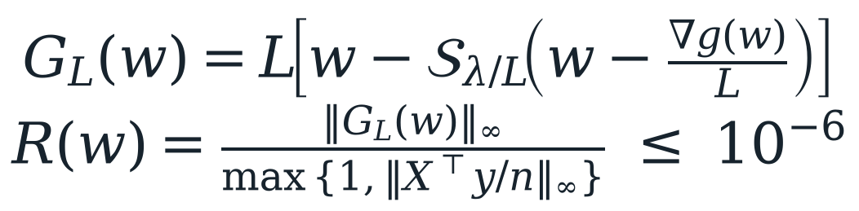
One Common Stopping Rule and Timing Protocol
Stop at the same stationarity accuracy on the returned coefficients.
•
R(w) ≤ 10⁻⁶; maximum 10,000 complete rounds.
•
Five interleaved timings; report each instance’s median.
•
Total includes preparation and monitoring; shared spectral setup is recorded separately.
R = 0 is KKT stationarity. A small R is not an objective-error upper bound.
Report Section 4.2, Eqs. (18)–(19). ADMM uses w = z; primal/dual split residuals are extra diagnostics.
XUE Pengyu 26022951R
Part II
18 / 34
Notes:
SLIDE 18 | One Common Stopping Rule and Timing Protocol
Speaker: XUE Pengyu 26022951R
Suggested time: 65 seconds | 15:40–16:45 | Main presentation: 30:00
English and Chinese are alternative scripts; present in one language.
ENGLISH SCRIPT
A fair accuracy comparison needs more than small changes between iterates. We use the same normalized proximal-gradient mapping for every solver, evaluated at its returned coefficients after a complete round. For ADMM, these coefficients are z. The threshold is ten to the minus six, with a cap of ten thousand rounds. The mapping is zero exactly at the Lasso optimality condition, but its numerical size is not an upper bound on objective error. Each instance-method pair has five timings, with the method order rotated between repetitions. We retain the median and summarize three-instance variation separately. Runtime includes solver preparation, ADMM factorization, objective and residual monitoring, and history recording. Loading, preprocessing, shared spectral calculation, and plotting are excluded. All four methods were rerun on the same host.
中文讲解稿
公平的精度比较不能只看相邻迭代变化很小。我们对每种求解器使用同一个归一化近端梯度映射，并在完整一轮后，于返回系数上计算；对 ADMM 来说就是 z。阈值为十的负六次方，上限一万轮。映射为零等价于 Lasso 最优性条件，但残差数值本身并不是目标误差上界。每个实例和算法进行五次计时，轮换执行顺序，保留中位数，再单独汇总三个实例之间的变化。时间包含准备、ADMM 分解、目标和残差监测、历史记录；排除读取、预处理、共同谱计算和绘图。四种方法均在同一主机重新运行。
VISUAL / DELIVERY CUES（不朗读）
Keep the common R formula central; pause 3 s at included/excluded cost columns.
SOURCES
Report §4.2, common proximal-gradient mapping and normalized residual; experiment_plan_admm.md

Slide 19
Validation and Reproducibility
Validate the normalization, then preserve the evidence needed to rerun it.
6 correctness tests passed
560 primary + 45 sensitivity runs
Orthogonal closed form
Normalized ADMM first update
Independent reference across β
Zero threshold and rank-deficient design
All reached R ≤ 10⁻⁶
Raw timings, coefficients and traces
Fixed inputs, configs and source hashes
11 figure groups from saved data
All four methods were rerun on one host; historical timings are preserved separately.
Report Section 4.3; tests/test_optimizers.py and results/2026-11-06-four-solvers/.
XUE Pengyu 26022951R
Part II
19 / 34
Notes:
SLIDE 19 | Validation and Reproducibility
Speaker: XUE Pengyu 26022951R
Suggested time: 45 seconds | 16:45–17:30 | Main presentation: 30:00
English and Chinese are alternative scripts; present in one language.
ENGLISH SCRIPT
Before timing, we validate the updates against an orthogonal closed form and a tight independent Lasso reference. Six tests also cover ADMM normalization, its returned vector, different beta values, the zero-solution threshold, a rank-deficient design, and invalid beta. All five hundred sixty primary timing runs and forty-five separate ADMM sensitivity timings converge. We retain input hashes, configurations, source snapshots, coefficient arrays, complete traces, and raw timings. The repository and README provide the reproduction commands. These correctness checks support the implementations; they do not establish a universal speed ranking. Zhou will now explain what the experiments show.
中文讲解稿
计时前，我们用正交闭式解和独立的高精度 Lasso 参考验证更新。六项测试还覆盖 ADMM 归一化、返回向量、不同 beta、零解阈值、秩亏设计和非法参数。五百六十次主计时以及另外四十五次 ADMM 敏感性计时全部收敛。我们保留输入哈希、配置、源码快照、系数数组、完整轨迹和原始时间。仓库与 README 提供复现命令。这些检查支持实现正确性，但不能证明普遍的速度排名。下面由ZHOU Xiyu介绍实验发现。
VISUAL / DELIVERY CUES（不朗读）
Point to the evidence chain; hand over to ZHOU.
SOURCES
Report §4.3; tests/test_optimizers.py; main/validation.json; https://github.com/Caiyangxiao/COMP6704-Group9-Project

Slide 20
PART III
Results and conclusions
ZHOU Xiyu
Student ID: 26025265R
Notes:
SLIDE 20 | PART III — Experimental Results and Conclusions
Speaker: ZHOU Xiyu 26025265R
Suggested time: 10 seconds | 17:30–17:40 | Main presentation: 30:00
English and Chinese are alternative scripts; present in one language.
ENGLISH SCRIPT
I will first compare the fitted solutions, then explain how data geometry and parameter choices change computational cost.
中文讲解稿
下面先比较拟合解，再说明数据结构和参数选择如何改变计算成本。
VISUAL / DELIVERY CUES（不朗读）
SOURCES
Report §§5–6

Slide 21
Nearly Identical Final Lasso Solutions
Converged solvers give nearly identical fitted results.
Solver | Synthetic test MSE | Diabetes test MSE | Nonzero coefficients
ISTA | 0.396 ± 0.139 | 2966.935 | 5 on every main input
FISTA | 0.396 ± 0.139 | 2966.936 | 5 on every main input
CD | 0.396 ± 0.139 | 2966.937 | 5 on every main input
ADMM | 0.396 ± 0.139 | 2966.937 | 5 on every main input
Maximum main within-problem relative objective spread: 3.17 × 10⁻¹²
Tiny test-error differences at fixed λ provide no evidence of optimizer predictive superiority.
Report Section 5.2, Table 4; synthetic values are means ± sample SD across three instances.
ZHOU Xiyu 26025265R
Part III
21 / 34
Notes:
SLIDE 21 | Nearly Identical Final Lasso Solutions
Speaker: ZHOU Xiyu 26025265R
Suggested time: 70 seconds | 17:40–18:50 | Main presentation: 30:00
English and Chinese are alternative scripts; present in one language.
ENGLISH SCRIPT
We begin with solution quality to check whether the runtime comparison is meaningful. At the main model penalty, all four methods retain five coefficients on every original instance. Their synthetic mean test errors all round to zero point three nine six, and the Diabetes errors all lie near two thousand nine hundred sixty-seven. The Diabetes spread is less than zero point zero zero two, so it does not establish a predictive advantage for any optimizer. Final objectives are also nearly identical; the largest controlled-study relative objective spread is about eight point six times ten to the minus eleven. These observations are consistent with accurate methods solving the same training objective. They do not mean the selected variables are causally important, or that this penalty is best for prediction. We can therefore focus on the computation required to reach these comparable fits.
中文讲解稿
首先比较解的质量，确认时间比较有共同精度基础。在主模型惩罚下，四种方法在每个原始实例都保留五个系数。合成数据的平均测试误差都四舍五入为零点三九六，Diabetes 误差都接近二千九百六十七，差异小于零点零零二，因此不能据此说某个优化器预测更好。最终目标值也几乎相同，受控研究最大相对目标差约为八点六乘十的负十一次方。这与准确方法求解同一训练目标一致，但不意味着选中变量有因果意义，也不说明该惩罚最适合预测。因此可以把重点放在达到这些相近拟合结果需要多少计算。
VISUAL / DELIVERY CUES（不朗读）
Show fit-quality table before discussing speed; pause 3 s at “no predictive ranking”.
SOURCES
Report §5.2; main/optimization_results.csv; extended/summary.json

Slide 22
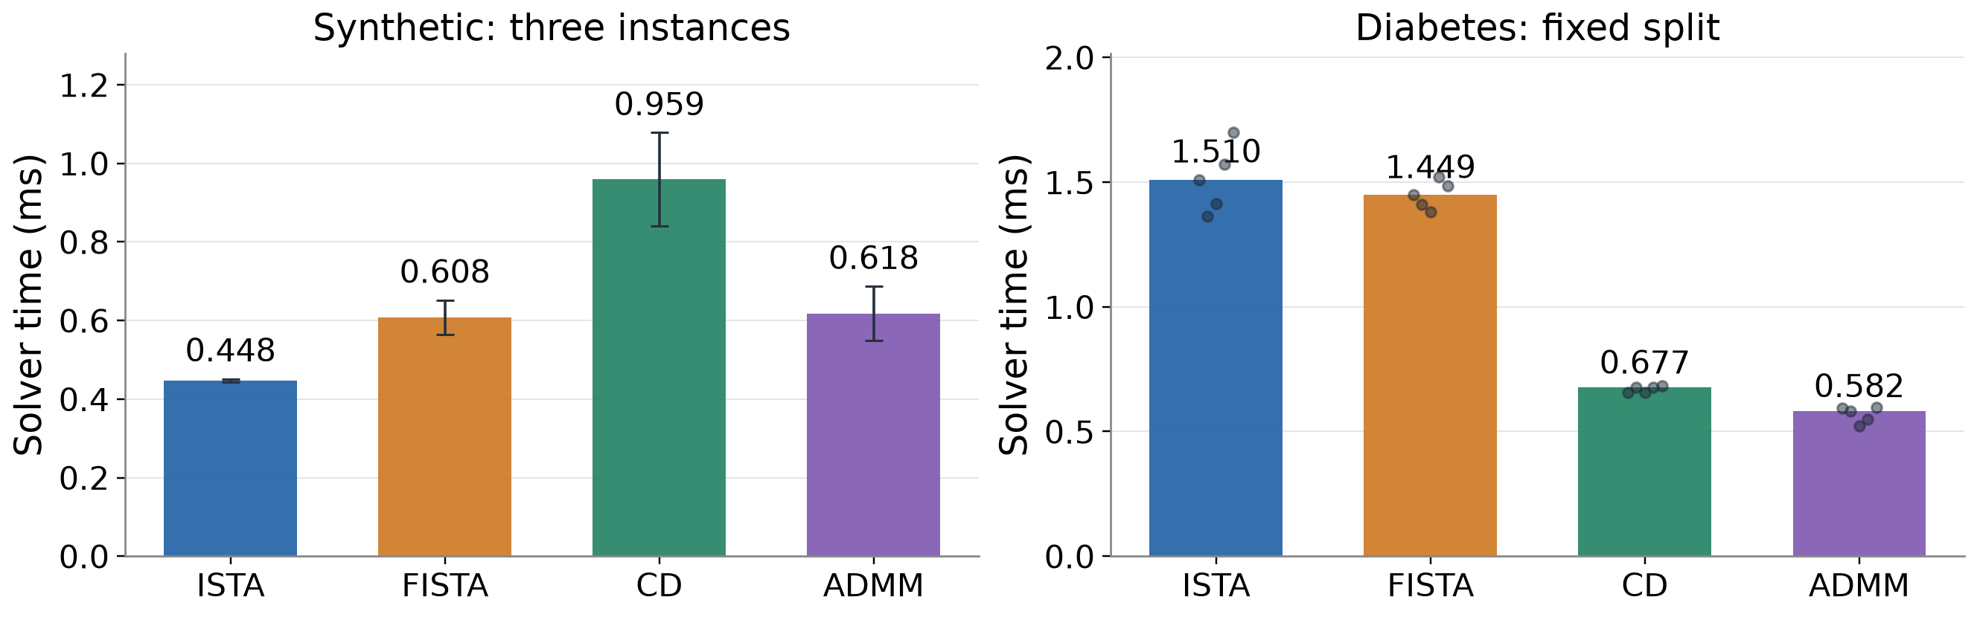
Main Runtime Depends on the Dataset
ISTA has the lowest synthetic mean; ADMM is fastest on Diabetes here.
Time includes ADMM preparation. The conclusion concerns these implementations and this host.
Report Section 5.1, Table 3; 5 timings per instance. Synthetic: means ± sample SD of three instance medians.
ZHOU Xiyu 26025265R
Part III
22 / 34
Notes:
SLIDE 22 | Main Runtime Depends on the Dataset
Speaker: ZHOU Xiyu 26025265R
Suggested time: 75 seconds | 18:50–20:05 | Main presentation: 30:00
English and Chinese are alternative scripts; present in one language.
ENGLISH SCRIPT
The main timing results show that the fastest implementation depends on the data. On the three independent-feature synthetic instances, ISTA has the lowest mean time, about zero point four five milliseconds. FISTA and ADMM have close means near zero point six milliseconds, while the Python coordinate loop takes about zero point nine six. On the saved Diabetes split, ADMM has the lowest median at zero point five eight milliseconds, followed by CD at zero point six eight. The vector methods take around one point five milliseconds. These are cold-solve times, including ADMM preparation and factorization. Synthetic error bars describe variation across three instance medians, not confidence intervals. The Diabetes panel represents one split. Because these operations are very short, implementation overhead and runtime variability matter. The observed ordering should not be generalized to production libraries or all Lasso problems.
中文讲解稿
主计时说明最快实现依赖数据。在三个独立特征合成实例上，ISTA 平均最快，约零点四五毫秒。FISTA 与 ADMM 的均值都接近零点六毫秒，而 Python 坐标循环约零点九六毫秒。在保存的 Diabetes 划分上，ADMM 中位数最低，约零点五八毫秒，CD 其次，约零点六八；两种向量方法约一点五毫秒。这些是冷启动时间，包含 ADMM 准备和分解。合成误差棒表示三个实例中位数之间的变化，不是置信区间；Diabetes 只有一个划分。操作时间很短，因此实现开销和运行波动都很重要。这个排名不能推广到所有 Lasso 问题或生产库。
VISUAL / DELIVERY CUES（不朗读）
Point to synthetic first, then Diabetes; pause 4 s before implementation limitation.
SOURCES
Report §5.1; main/optimization_results.csv; figure efficiency_summary

Slide 23
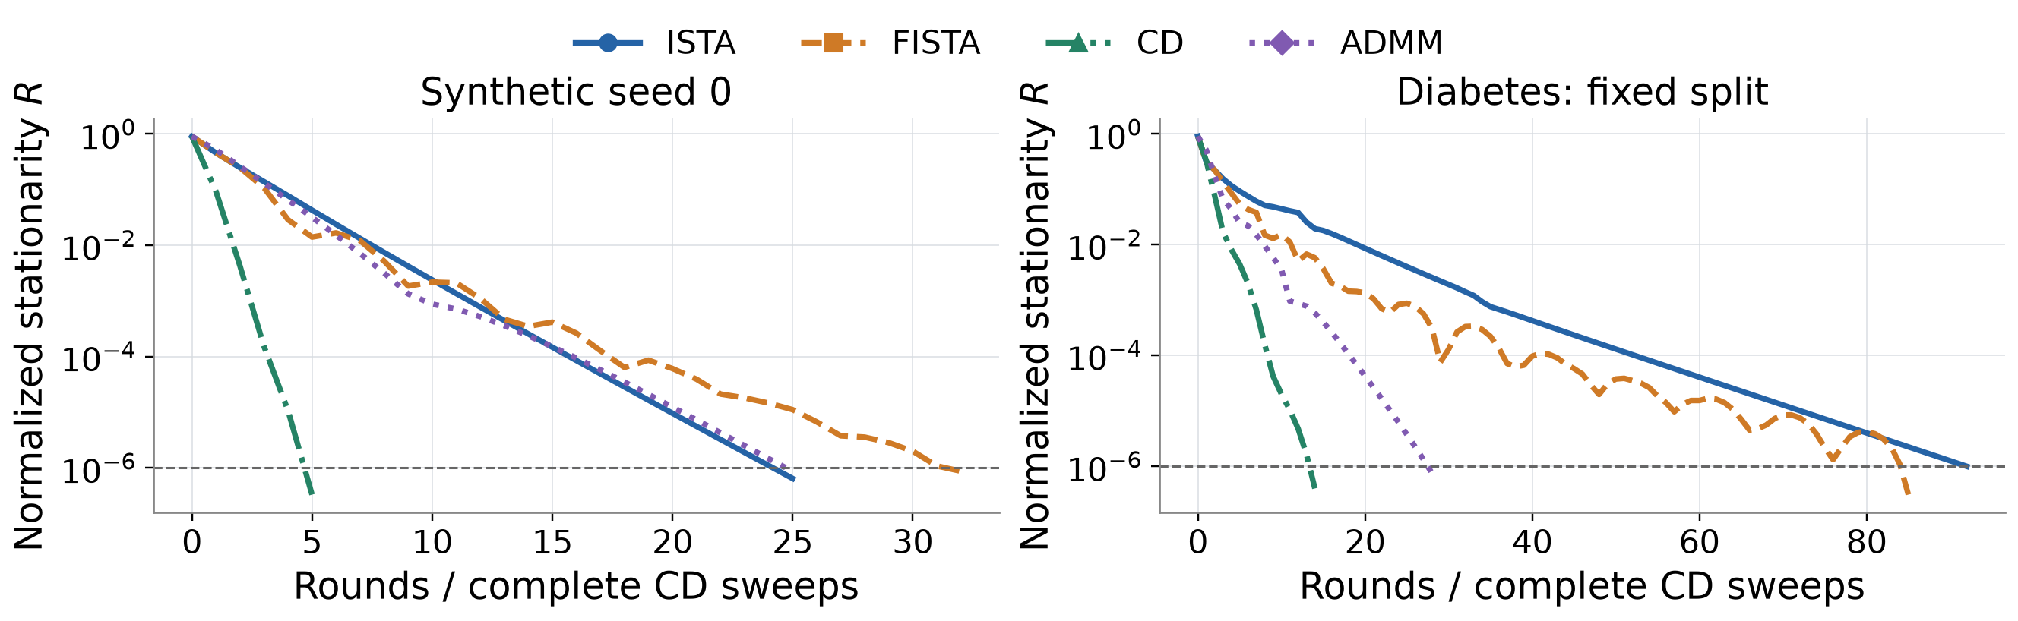
Convergence at a Common Residual Target
The common residual shows when each solver reaches the accuracy target.
FISTA’s accelerated objective bound does not guarantee earlier residual stopping on each problem.
Report Section 5.1; median-time histories. A CD round is a complete sweep; ADMM includes all split updates.
ZHOU Xiyu 26025265R
Part III
23 / 34
Notes:
SLIDE 23 | Convergence at a Common Residual Target
Speaker: ZHOU Xiyu 26025265R
Suggested time: 90 seconds | 20:05–21:35 | Main presentation: 30:00
English and Chinese are alternative scripts; present in one language.
ENGLISH SCRIPT
The two panels show the same normalized stationarity residual against complete rounds, on synthetic seed zero and the fixed Diabetes split. The dashed horizontal line is our stopping threshold of ten to the minus six. Every curve is consistently evaluated at the returned coefficient vector; for ADMM, that vector is z. One coordinate descent round contains a complete sweep, whereas ISTA, FISTA, and ADMM use vector or split updates. FISTA's residual can oscillate, so quick early progress does not necessarily give the smallest round count to this threshold. Its theoretical guarantee concerns objective error, which is a different quantity from the residual shown here. On the synthetic panel, ISTA reaches the threshold after about twenty-five updates, ADMM after twenty-five, and CD after five sweeps. These round counts do not compare equal computational work. ADMM also pays preparation and factorization costs before iterating. The curves therefore explain stopping behavior, while the preceding timing results establish the measured runtime comparison. These are instance-specific traces, not an objective-error certificate or an asymptotic rate estimate.
中文讲解稿
这两个面板分别在合成种子零和固定 Diabetes 划分上，展示同一个归一化平稳性残差随完整轮数的变化。水平虚线是十的负六次方停止阈值。所有曲线都在返回系数上计算；对于 ADMM，这个向量是 z。坐标下降一轮包含完整扫描，而 ISTA、FISTA 和 ADMM 执行向量或分裂更新。FISTA 残差可能振荡，因此早期下降快不一定意味着达到阈值所需轮数最少。它的理论保证针对目标误差，与这里画出的残差是不同的量。合成面板中，ISTA 约二十五轮达到阈值，ADMM 也是二十五轮，CD 则是五次扫描。但这些轮数对应的计算工作并不相等；ADMM 在迭代前还支付准备和分解成本。因此这些曲线解释停止行为，前一页计时结果则提供实际耗时比较。它们是具体实例的轨迹，不是目标误差证书或渐近速率估计。
VISUAL / DELIVERY CUES（不朗读）
Point to the synthetic and Diabetes residual panels, then the dashed R = 1e-6 line. Pause 5 s while comparing FISTA oscillations and complete CD sweeps; discuss runtime using the preceding timing slide.
SOURCES
Report §§5.1–5.2; main/trace_*.csv; figures convergence and stationarity

Slide 24
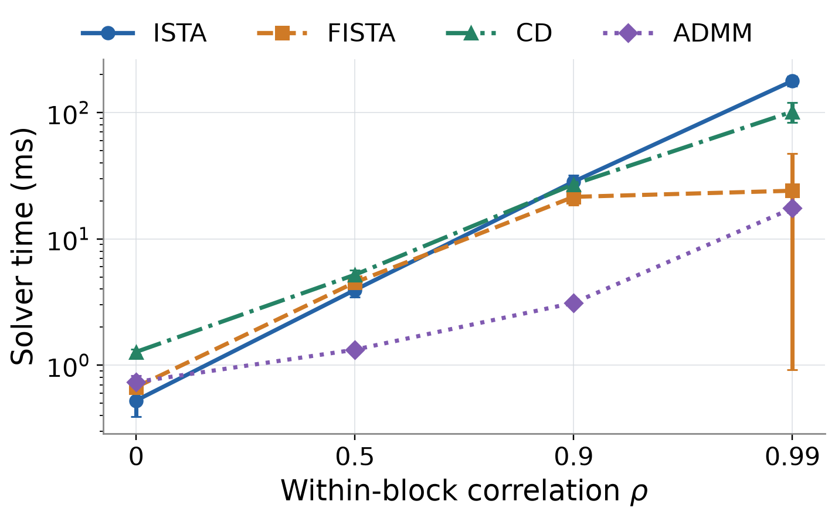
Strong Correlation Changes the Ranking
Strong correlation changes the ranking and exposes instance variation.
At ρ = 0.99: time (ms)
Seed | FISTA | ADMM
10 | 8.30 | 19.06
11 | 50.59 | 16.83
12 | 13.24 | 16.47
ADMM has the lower mean;
FISTA wins on 2 of 3 seeds.
At ρ = 0.99: ADMM 17.457 ± 1.401 ms; FISTA 24.041 ± 23.123 ms.
Report Section 5.4, Table 6; paired seeds 10–12. Error bars show sample SD across three instance medians.
ZHOU Xiyu 26025265R
Part III
24 / 34
Notes:
SLIDE 24 | Strong Correlation Changes the Ranking
Speaker: ZHOU Xiyu 26025265R
Suggested time: 105 seconds | 21:35–23:20 | Main presentation: 30:00
English and Chinese are alternative scripts; present in one language.
ENGLISH SCRIPT
We next increase within-block correlation while keeping the paired study structure. The mean full-Gram condition number rises from about four to almost two thousand five hundred, exposing weak-curvature directions. ISTA's fixed step becomes much slower, and the independent-feature ranking does not persist. ADMM has the smallest mean time at the three positive correlation levels. At correlation zero point nine nine, its mean is seventeen point five milliseconds, compared with about twenty-four for FISTA, one hundred two for CD, and one hundred seventy-eight for ISTA. The important qualification is FISTA's large instance variation. FISTA is actually faster than ADMM on two of the three most-correlated instances; one slower instance raises its mean. Therefore the displayed average does not establish uniform ADMM dominance. Acceleration still improves sharply over ISTA in this setting. The condition number helps describe the geometry, but cannot predict the complete runtime: the selected support, effective penalty, monitoring cost, and update mechanism also contribute. Error bars here are sample standard deviations across three instance medians, each obtained from five timings; they do not summarize independent timing uncertainty. We should interpret the full table and individual traces together rather than declaring one solver universally best.
中文讲解稿
接下来增加块内相关性，并保持配对研究结构。完整 Gram 矩阵的平均条件数从约四上升到接近二千五百，暴露弱曲率方向。ISTA 固定步长显著变慢，独立特征上的排名不再保持。ADMM 在三个正相关水平的平均时间最低。相关性零点九九时，ADMM 平均约十七点五毫秒，FISTA 约二十四，CD 约一百零二，ISTA 约一百七十八。关键限定是 FISTA 的实例间波动很大：它实际上在三个最高相关实例中的两个比 ADMM 快，一个较慢实例抬高了均值。因此平均排名不代表 ADMM 每个实例都占优。与此同时，加速在这里仍然明显优于 ISTA。条件数有助于描述几何，但无法完整预测时间；支持集、惩罚尺度、监测成本和更新机制同样影响结果。这里误差棒是三个实例中位数的样本标准差，每个中位数来自五次计时；它不表示独立计时不确定性。应结合表格和各实例轨迹理解，而不是宣布一个普遍最优求解器。
VISUAL / DELIVERY CUES（不朗读）
Show the time curve, then the ρ=.99 uncertainty callout; pause 5 s on “FISTA wins 2/3 instances”.
SOURCES
Report §5.4; extended/aggregated_results.csv; extended/optimization_results.csv

Slide 25
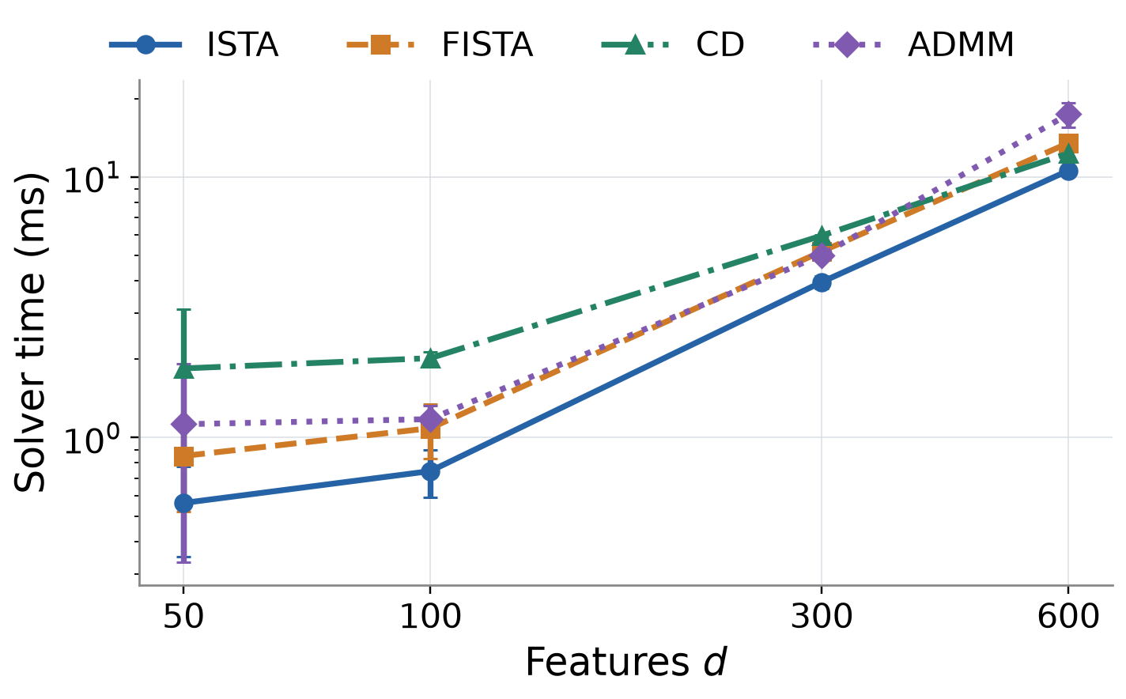
More Features Increase Work and Setup Cost
ADMM’s cold preparation becomes material as the feature count grows.
At d = 600
ADMM total: 17.413 ms
Preparation: 8.251 ms
47% of the total
ISTA total: 10.582 ms
CD still uses 4 sweeps, but each sweep visits more coordinates; round count alone misses the cost.
Report Section 5.5 and Table 7; means over three representative median-time runs, 800 training samples.
ZHOU Xiyu 26025265R
Part III
25 / 34
Notes:
SLIDE 25 | More Features Increase Work and Setup Cost
Speaker: ZHOU Xiyu 26025265R
Suggested time: 80 seconds | 23:20–24:40 | Main presentation: 30:00
English and Chinese are alternative scripts; present in one language.
ENGLISH SCRIPT
The dimension study holds the sample count fixed and increases the number of independent features. ISTA has the smallest mean time at every tested width. CD uses four complete sweeps throughout, but each sweep visits more coordinates, so its elapsed time rises. ADMM also illustrates why rounds alone can mislead. At six hundred features, it uses fewer rounds than ISTA, yet its mean total time is seventeen point four milliseconds compared with ISTA's ten point six. ADMM preparation takes about eight point three milliseconds, or forty-seven percent of its total, including Gram construction, Cholesky factorization, and the first common check. The factor is reused within each solve, but every cold repetition pays this cost again. Other workloads could amortize preparation differently. The observed setup share is the ratio of displayed means, rather than a separate causal profiling experiment. A warm-started path or a structure-aware ADMM implementation would require a separate benchmark.
中文讲解稿
维度研究固定样本数，增加独立特征数量。ISTA 在每个测试宽度的平均时间都最低。CD 始终只需四次完整扫描，但每轮访问的坐标增加，因此时间仍上升。ADMM 进一步说明轮数可能误导：六百个特征时，它的轮数少于 ISTA，但平均总时间约十七点四毫秒，ISTA 约十点六。ADMM 准备约八点三毫秒，占总时间百分之四十七，包含 Gram 构造、Cholesky 分解和第一次共同检查。同一次求解复用因子，但每次冷启动重复都重新支付成本。这里准备占比是所示均值的比值，不是另一个因果剖析实验。其他工作负载可能摊薄准备成本；热启动路径或利用结构的 ADMM 需要另行比较。
VISUAL / DELIVERY CUES（不朗读）
Connect the width curve to the preparation/iteration breakdown; pause 4 s on 47.4%.
SOURCES
Report §5.5; extended/aggregated_results.csv; figure setup_cost

Slide 26
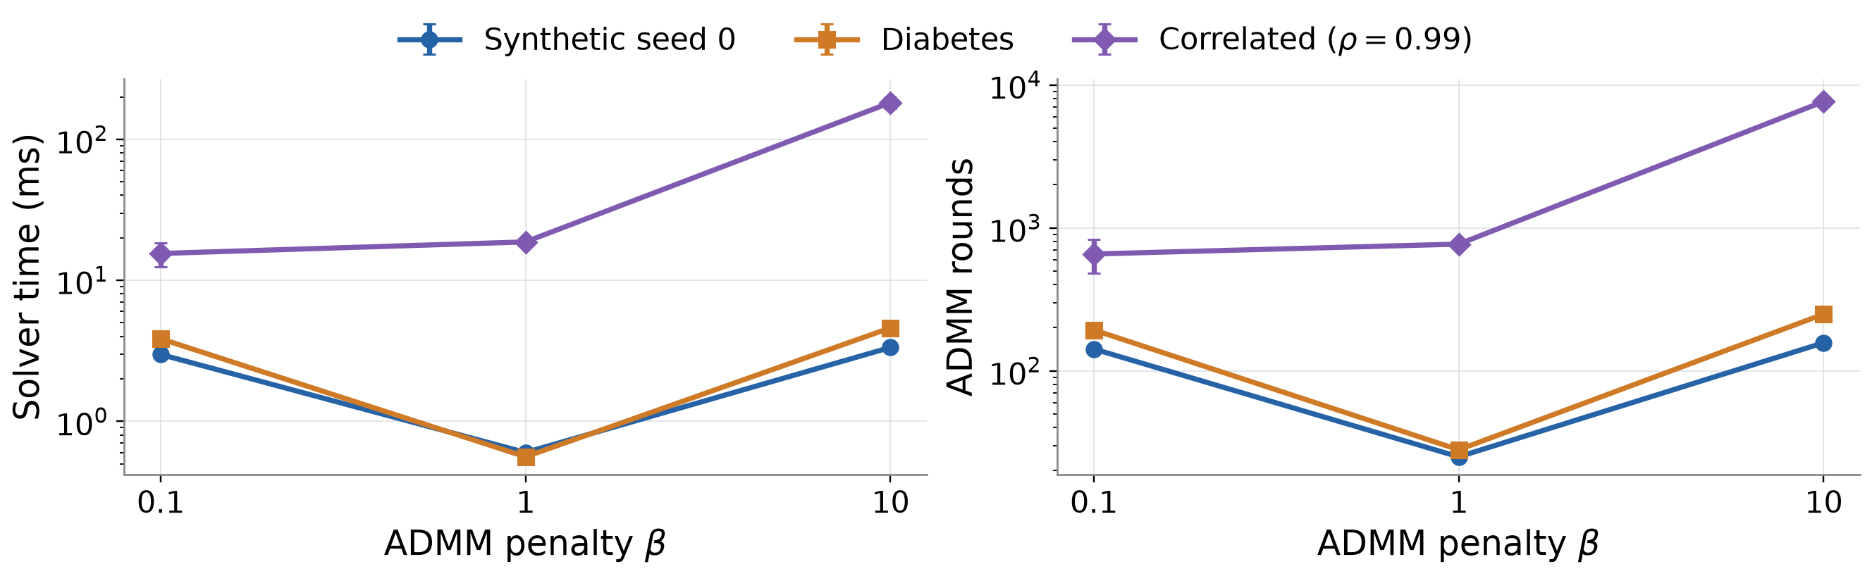
ADMM’s β Changes the Algorithm, Not the Model
ADMM’s best algorithmic penalty depends on the input.
Model λ is fixed. The main comparison keeps predeclared β = 1 regardless of sensitivity outcomes.
Report Section 5.6, Table 8; β = 0.1, 1, 10. Three timings per setting; 45 runs in this separate study.
ZHOU Xiyu 26025265R
Part III
26 / 34
Notes:
SLIDE 26 | ADMM’s β Changes the Algorithm, Not the Model
Speaker: ZHOU Xiyu 26025265R
Suggested time: 80 seconds | 24:40–26:00 | Main presentation: 30:00
English and Chinese are alternative scripts; present in one language.
ENGLISH SCRIPT
ADMM's algorithmic penalty controls how the split copies reach agreement. We examine beta values of zero point one, one, and ten while keeping the Lasso model penalty and stopping tolerance fixed. This is a separate study with three timings per setting. Beta one is fastest among these choices on synthetic seed zero and Diabetes. In the highly correlated three-instance summary, beta zero point one has a lower mean time than beta one, although this is not true for every seed. Beta ten is much slower there, requiring roughly seven to eight thousand rounds. All settings still reach the common residual threshold. These outcomes show that one fixed default is not uniformly optimal. They do not retroactively tune the main comparison, which remains at beta one. The three-repeat sensitivity timings remain separate from the main five-repeat records. Changing beta modifies convergence behavior; it does not define a different Lasso estimator or establish a prediction advantage.
中文讲解稿
ADMM 的算法惩罚控制两个副本如何达到一致。我们在固定 Lasso 模型惩罚和停止容差下，比较 beta 为零点一、一、十。这是单独的研究，每个设置三次计时。在合成种子零和 Diabetes 上，beta 一在三个选择中最快。最高相关性的三个实例汇总中，beta 零点一平均时间低于一，但并非每个种子都如此。Beta 十在该设置明显较慢，需要约七千至八千轮，不过所有设置都达到共同残差阈值。这说明固定默认值不普遍最优。我们不会据此回头调整主比较；主比较仍用预先指定的 beta 一。三次重复的敏感性记录与五次重复的主计时保持分开。改变 beta 改变收敛过程，不会定义另一种 Lasso 估计量，也不能证明预测优势。
VISUAL / DELIVERY CUES（不朗读）
Keep λ fixed visually while moving β; pause 4 s before the main-comparison caveat.
SOURCES
Report §5.6; sensitivity/sensitivity_results.csv; sensitivity/configuration.json

Slide 27
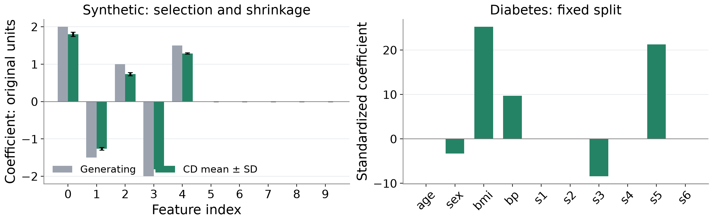
Correct Support Can Still Have Shrinkage Error
Exact support recovery still leaves shrinkage error in the retained coefficients.
Synthetic support is known; Diabetes coefficients describe associations on one saved split.
Report Section 5.3; CD represents a converged solution. Synthetic coefficients are restored to original units.
ZHOU Xiyu 26025265R
Part III
27 / 34
Notes:
SLIDE 27 | Correct Support Can Still Have Shrinkage Error
Speaker: ZHOU Xiyu 26025265R
Suggested time: 65 seconds | 26:00–27:05 | Main presentation: 30:00
English and Chinese are alternative scripts; present in one language.
ENGLISH SCRIPT
The coefficient plot separates variable selection from magnitude estimation. In the synthetic experiments, the fitted support matches the five generating variables, and all forty-five inactive variables are zero. However, the retained coefficients move toward zero. Their mean absolute active-coefficient error is about zero point two two one across the three instances. Thus exact support recovery does not remove Lasso shrinkage error. The plot uses a representative converged CD fit because the solver solutions are nearly identical. Synthetic coefficients are converted back to original feature units before comparison with the known values. The Diabetes panel instead uses standardized coefficients. Its selected features are sex, body mass index, blood pressure, s three, and s five, but there is no known true support for judging recovery accuracy.
中文讲解稿
系数图把变量选择和幅值估计分开。在合成实验中，拟合支持集匹配五个生成变量，四十五个非活动变量都为零。但保留的系数向零收缩，三个实例的活动系数平均绝对误差约零点二二一。因此精确恢复支持集并不能消除 Lasso 收缩误差。由于求解器解几乎相同，图中采用收敛 CD 解作为代表。合成系数先换回原特征单位，再与已知值比较；Diabetes 使用标准化系数。它选中 sex、bmi、bp、s3 和 s5，但没有已知真实支持集，不能据此判断恢复准确率。
VISUAL / DELIVERY CUES（不朗读）
Compare generating and estimated synthetic bars, then switch to the distinct Diabetes interpretation.
SOURCES
Report §5.3; main/coefficients_*.npz; figure coefficient_analysis

Slide 28
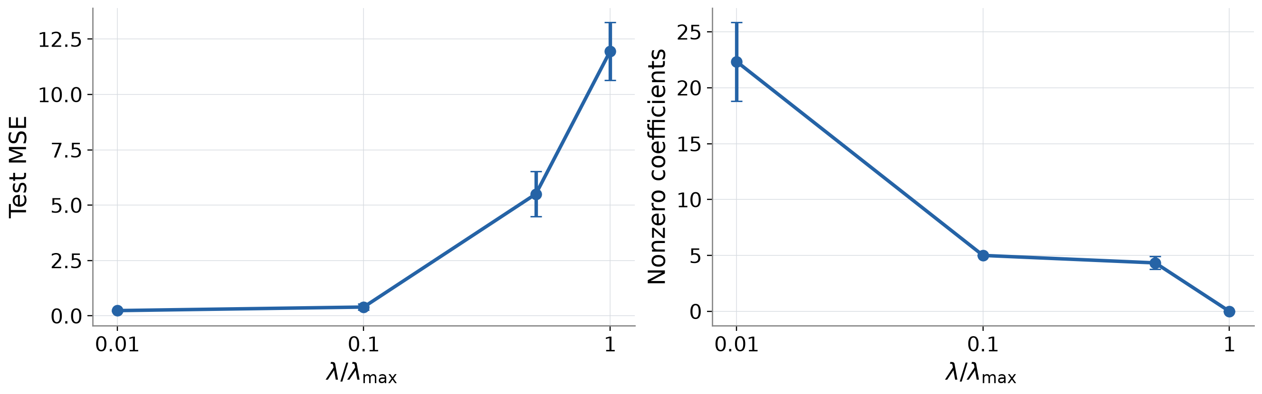
The Model Penalty Trades Fit Against Sparsity
A smaller selected model need not have the smallest prediction error.
At λ/λmax = 0.1, the synthetic fits recover 5 variables but have higher average test MSE than at 0.01.
Report Section 5.3 and Table 5; CD, means across three synthetic instances. Test scores are not used for tuning.
ZHOU Xiyu 26025265R
Part III
28 / 34
Notes:
SLIDE 28 | The Model Penalty Trades Fit Against Sparsity
Speaker: ZHOU Xiyu 26025265R
Suggested time: 70 seconds | 27:05–28:15 | Main presentation: 30:00
English and Chinese are alternative scripts; present in one language.
ENGLISH SCRIPT
Now we change the model penalty lambda rather than ADMM's algorithmic penalty. CD solves four prespecified ratios of lambda to lambda maximum. On synthetic data, the mean selected count falls from about twenty-two variables to five, then four, and finally zero as the penalty grows. Meanwhile, mean test error rises from zero point two three six to zero point three nine six and then much more sharply. The five-variable fit recovers the generating support, but does not have the lowest prediction error among these settings. At lambda maximum, the zero vector is optimal, so predictions equal the training response mean. The saved coefficient paths give a finer view of the same change. These test scores describe fixed settings; we do not use them to choose a penalty and then claim unbiased prediction accuracy.
中文讲解稿
这里改变的是模型惩罚 lambda，而不是 ADMM 算法惩罚。CD 求解四个预先指定的 lambda 与 lambda 最大值之比。在合成数据上，惩罚增强时，平均选中数量从约二十二个降为五个、约四个，最终为零；同时平均测试误差从零点二三六升为零点三九六，之后明显增加。五变量拟合恢复生成支持集，却不是这些设置中预测误差最低的。达到 lambda 最大值时，零向量最优，预测等于训练响应均值。保存的系数路径更细致地显示了同一变化。这些测试分数只是固定设置的描述，没有用它们选惩罚后再宣称无偏预测精度。
VISUAL / DELIVERY CUES（不朗读）
Move from the nonzero-count panels to MSE panels; pause 4 s at λmax and the zero solution.
SOURCES
Report §5.3; main/regularization_results.csv; extended/path_results.csv

Slide 29
Conclusions and Limits
The useful solver choice depends on design, implementation and accuracy.
Independent features
Positive correlation
Diabetes, one split
ISTA has the lowest
mean time in our tests.
ADMM has the lowest mean;
FISTA varies by instance.
ADMM has the lowest
recorded cold median.
Scope: small dense designs · 3 synthetic instances · 1 real-data split
Python/native-kernel and monitoring costs remain part of the comparison.
Model λ changes sparsity and shrinkage; algorithmic β changes ADMM’s computation.
Report Section 6; conclusions are conditional on the recorded datasets, preprocessing, implementations and stopping rule.
ZHOU Xiyu 26025265R
Part III
29 / 34
Notes:
SLIDE 29 | Conclusions and Limits
Speaker: ZHOU Xiyu 26025265R
Suggested time: 75 seconds | 28:15–29:30 | Main presentation: 30:00
English and Chinese are alternative scripts; present in one language.
ENGLISH SCRIPT
The main conclusion is conditional rather than a universal ranking. All four implementations reach nearly identical Lasso solutions. ISTA has the lowest mean time on our tested independent-feature designs. ADMM is fastest on the saved Diabetes split and has the lowest mean time at positive block correlations, but FISTA wins on two of the three most-correlated instances. ADMM's preparation becomes substantial as feature count grows, and its beta parameter changes computational progress. Lambda instead changes the estimator's sparsity and shrinkage. Our limits include small dense matrices, one real-data split, three synthetic instances, Python coordinate loops, and a specific monitoring and timing convention. A small stationarity residual is not an objective-error certificate. These extensions would test how robust the present conclusions are under changed implementations and workloads. Future work should compare compiled coordinate descent, restarted FISTA, structure-aware or adaptive ADMM, dual-gap stopping, and validation-selected penalties over repeated real-data splits.
中文讲解稿
主要结论是有条件的排名，而不是普遍优胜者。四种实现达到几乎相同的 Lasso 解。ISTA 在测试的独立特征设计中平均时间最低；ADMM 在保存的 Diabetes 划分上最快，并在正块相关设置中平均时间最低，但 FISTA 在三个最高相关实例中的两个获胜。特征增加时，ADMM 准备成本明显，其 beta 参数改变计算进展；lambda 则改变估计量的稀疏与收缩。局限包括小型稠密矩阵、单一真实数据划分、三个合成实例、Python 坐标循环，以及特定监测和计时口径。小平稳性残差不是目标误差证书。这些扩展可以检验实现和工作负载改变后，目前结论是否仍然稳健。后续可比较编译 CD、重启 FISTA、结构化或自适应 ADMM、对偶间隙停止，并在重复真实划分上用验证集选惩罚。
VISUAL / DELIVERY CUES（不朗读）
Summarize one advantage per method; pause 4 s on the limitations box.
SOURCES
Report §6; Tables and figures in §5

Slide 30
Contributions and Discussion
Four implementations, shared writing and shared experimental evaluation.
Member | Student ID | Implementation | Presentation role
CAI Yangxiao | 26023041R | ADMM | Part I
XUE Pengyu | 26022951R | FISTA | Part II
ZHANG Kejia | 26049131R | Cyclic CD | Opening + PPT design
ZHOU Xiyu | 26025265R | ISTA | Part III
Report writing and revision: all four members
Experimental design and evaluation: all four members
Presentation design and opening overview: ZHANG Kejia. All four members join the Q&A.
Member responsibilities supplied and confirmed by Group 9; report Author contributions section.
ZHOU Xiyu 26025265R
Part III
30 / 34
Notes:
SLIDE 30 | Contributions and Discussion
Speaker: ZHOU Xiyu 26025265R
Suggested time: 30 seconds | 29:30–30:00 | Main presentation: 30:00
English and Chinese are alternative scripts; present in one language.
ENGLISH SCRIPT
To close, the four implementation responsibilities are shown here. All four members contributed to report writing, revision, experimental design, and evaluation. Zhang also designed the slides and introduced the work. Our repository contains the code, figures, and saved evidence behind the comparison. Thank you for listening. We now welcome questions, and all four members will participate in the discussion.
中文讲解稿
最后，这里列出四种算法的实现分工。四位成员共同参与报告撰写与修改、实验设计和实验评估；ZHANG Kejia另外负责 PPT 设计和工作介绍。仓库保存了比较所依据的代码、图片和实验记录。感谢大家聆听。接下来欢迎提问，四位成员都会参与讨论。
VISUAL / DELIVERY CUES（不朗读）
Finish the main presentation at 30:00; transition to the separate 10-minute Q&A.
SOURCES
Report §6, Author contributions; https://github.com/Caiyangxiao/COMP6704-Group9-Project

Slide 31
Discussion
10-minute Q&A · All four members
CAI — formulation and ADMM
XUE — acceleration and comparison protocol
ZHANG — cyclic CD and reproducibility
ZHOU — ISTA and empirical findings
Code, data and reproducibility: github.com/Caiyangxiao/COMP6704-Group9-Project
Notes:
SLIDE 31 | Questions and Answers
Speaker: All four members
Q&A / backup: outside the 30-minute main presentation.
English and Chinese are alternative scripts; present in one language.
ENGLISH SCRIPT
This slide begins the separate ten-minute question period and is not part of the thirty-minute presentation. Invite questions first rather than reading the prompts aloud. All four members should participate. Suggested first responders are Zhou for ISTA, Xue for FISTA, Zhang for coordinate descent, and Cai for ADMM; experimental design and interpretation are shared responsibilities. For rate questions, distinguish objective bounds from the measured residual. For ADMM accuracy, explain evaluation at z and the common threshold. For factorization, explain cold setup and possible amortization in a different workload. For prediction, distinguish numerical convergence, support recovery, shrinkage, and validation-based model selection. Use the backup slides only when a question calls for them.
中文讲解稿
这一页开始单独的十分钟问答，不计入三十分钟展示。先邀请现场提问，不要逐条朗读提示。四位成员都应参与。建议算法问题分别由ZHOU Xiyu回应 ISTA、XUE Pengyu回应 FISTA、ZHANG Kejia回应 CD、CAI Yangxiao回应 ADMM；实验设计和解释由全体共同负责。收敛率问题要区分目标界与测量残差；ADMM 精度问题说明在 z 上计算共同阈值；分解问题说明冷启动成本，以及其他负载可能摊薄该成本；预测问题区分数值收敛、支持恢复、收缩和验证选模型。仅在问题需要时使用备份页。
VISUAL / DELIVERY CUES（不朗读）
Q&A clock: 30:00–40:00; do not rehearse this page as an extra talk segment.
SOURCES
Report §§3–6

Slide 32
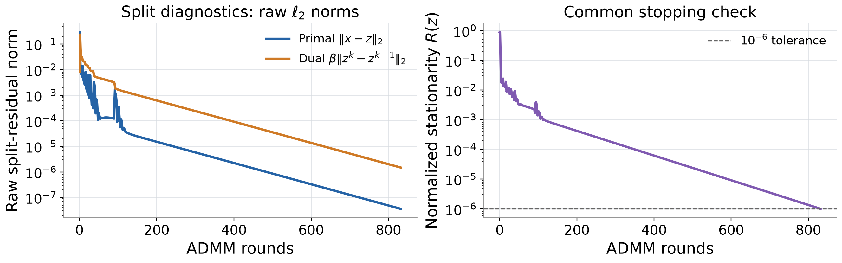
Backup — ADMM Residual Diagnostics
ADMM’s split diagnostics explain progress; common R(z) controls stopping.
Primal: ‖x − z‖₂. Dual: β‖zᵏ⁺¹ − zᵏ‖₂. These raw norms have a different scale from R(z).
Backup; saved ADMM diagnostics and common residual on correlation 0.99, seed 10. No extra stopping criterion is imposed.
CAI Yangxiao 26023041R
Backup
32 / 34
Notes:
SLIDE 32 | Backup — ADMM Residual Diagnostics
Speaker: CAI Yangxiao 26023041R
Q&A / backup: outside the 30-minute main presentation.
English and Chinese are alternative scripts; present in one language.
ENGLISH SCRIPT
Use this backup only if asked about ADMM feasibility or stopping. The primal residual measures disagreement between x and z; the dual residual measures the beta-scaled change in z. They need not decrease at the same rate. We save both traces to diagnose the split iteration, but the same original-objective stationarity criterion at z controls stopping for every method. We do not add stricter ADMM-only tests to the primary timing comparison. A split objective evaluated at two unequal vectors can be misleading, which is why every reported Lasso objective uses z for both terms. The saved diagnostics allow readers to inspect this distinction directly.
中文讲解稿
仅在询问 ADMM 可行性或停止规则时使用本页。原始残差衡量 x 与 z 的差异，对偶残差衡量 beta 缩放后的 z 变化，两者不一定以同样速率下降。我们保存两条轨迹诊断分裂迭代，但所有方法仍由 z 上同一个原目标平稳性指标决定停止，没有给 ADMM 额外加更严格条件。两个不相等向量上的分裂目标可能误导，因此报告的 Lasso 目标两项都使用 z。保存的诊断可以让读者直接检查这种区别。
VISUAL / DELIVERY CUES（不朗读）
Optional backup; no allocated main-talk time.
SOURCES
Report §§3.3, 4.2, 5.6; main/admm_diagnostics_*.csv; extended/admm_diagnostics_*.csv

Slide 33
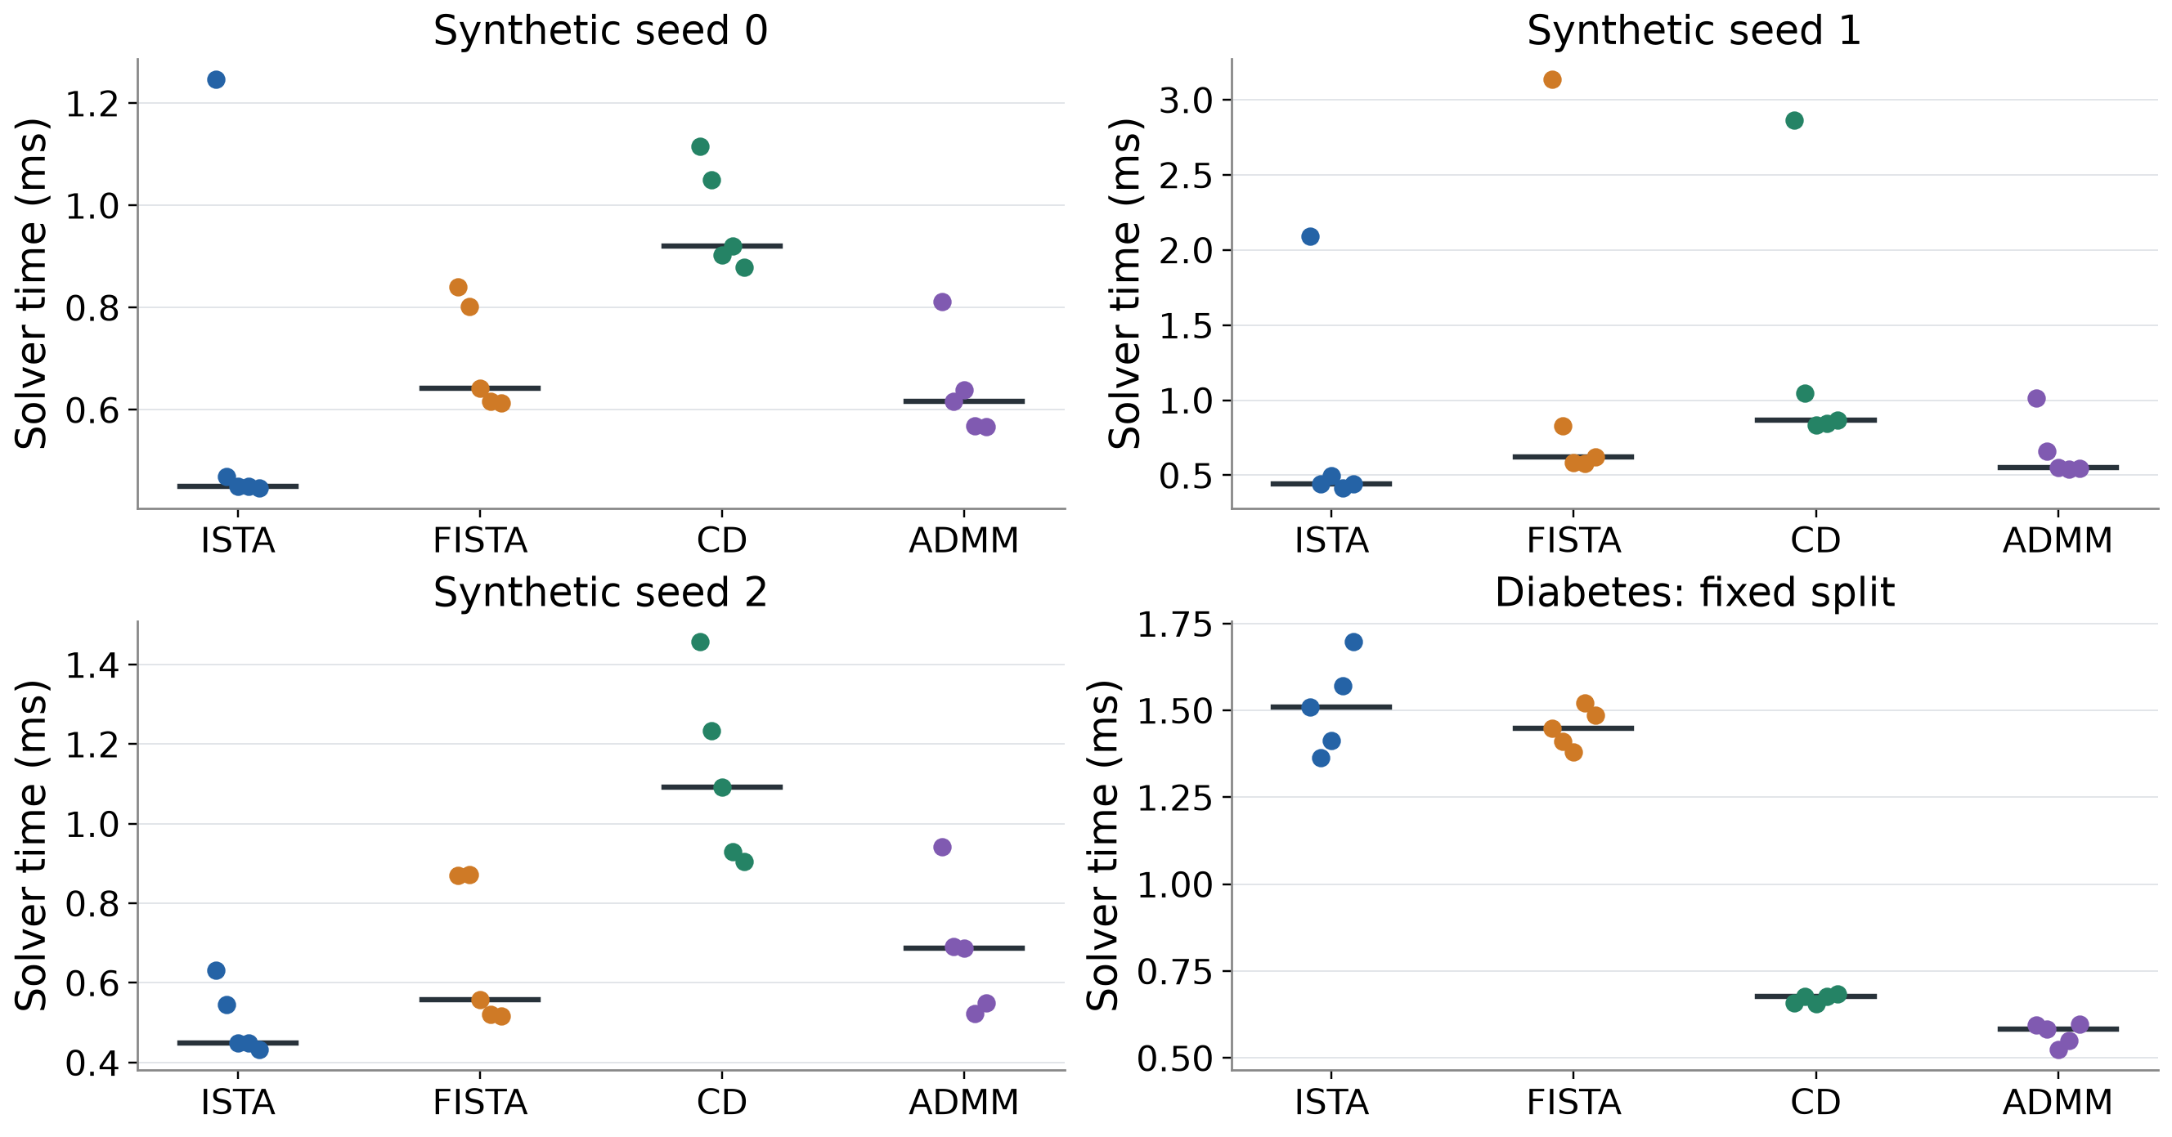
Backup — Raw Timing Repetitions
The full repetitions retain outliers and overlapping timing ranges.
Five fixed-data repetitions support descriptive timing comparisons; no significance test is claimed.
Backup; main/timing_repeats.csv. Sample variation across data instances is a separate source of uncertainty.
ZHOU Xiyu 26025265R
Backup
33 / 34
Notes:
SLIDE 33 | Backup — Raw Timing Repetitions
Speaker: ZHOU Xiyu 26025265R
Q&A / backup: outside the 30-minute main presentation.
English and Chinese are alternative scripts; present in one language.
ENGLISH SCRIPT
Use this backup if asked whether small timing differences are reliable. Every point is a saved cold-solve timing, with medians used for the main table. Some short repetitions show substantial runtime variability, so the synthetic mean difference between FISTA and ADMM should not be treated as a robust ranking. On the saved Diabetes split, the five ADMM times range from about zero point five two four to zero point five nine eight milliseconds; the CD range is about zero point six five seven to zero point six eight three. These recorded ranges are disjoint, but five timings on one split still do not establish universal algorithm superiority. We make no confidence-interval or significance claim.
中文讲解稿
若被问到很小的时间差是否可靠，可使用本页。每个点都是保存的冷启动时间，主表采用中位数。有些短运行波动明显，因此不能把合成数据上 FISTA 与 ADMM 的小均值差当成稳健排名。保存的 Diabetes 划分上，五次 ADMM 时间约零点五二四至零点五九八毫秒，CD 约零点六五七至零点六八三；范围不重叠，但一个划分上的五次时间仍不能证明普遍算法优势。我们没有声称置信区间或显著性。
VISUAL / DELIVERY CUES（不朗读）
Optional backup; point to ranges and median markers.
SOURCES
Report §5.2; main/timing_repeats.csv

Slide 34
Selected References and Reproduction
Selected primary references and the reproducible project repository.
Tibshirani (1996)
Boyd et al. (2011)
Regression shrinkage and selection via the lasso.
ADMM for distributed optimization and learning.
Daubechies et al. (2004)
Parikh & Boyd (2014)
Iterative thresholding for linear inverse problems.
Proximal algorithms.
Beck & Teboulle (2009)
Efron et al. (2004)
FISTA for linear inverse problems.
Least angle regression; Diabetes context.
Friedman et al. (2010)
Tseng (2001)
Coordinate descent regularization paths.
Block coordinate descent convergence.
Wu & Lange (2008)
Tibshirani (2013)
Coordinate descent for lasso-penalized regression.
The lasso problem and uniqueness.
github.com/Caiyangxiao/COMP6704-Group9-Project
Backup; full bibliographic details and links appear in the report’s References. All empirical figures use Group 9 saved results.
All four members
References
34 / 34
Notes:
SLIDE 34 | Selected References and Reproduction
Speaker: All four members
Q&A / backup: outside the 30-minute main presentation.
English and Chinese are alternative scripts; present in one language.
ENGLISH SCRIPT
This reference page is available for questions and is not an additional timed presentation segment. The report provides the complete bibliography and primary-source links. The repository contains code, the frozen dependencies, data and saved splits, raw results, figure-generation code, report sources, and documented reproduction commands. Citations support the mathematical mechanisms; the speed conclusions come from our own saved experiments and remain limited to that experimental setting.
中文讲解稿
这一页用于答问和查阅，不是额外计时展示。完整参考文献和原始来源链接在报告中。仓库包含代码、固定依赖、数据与保存划分、原始结果、绘图程序、报告源文件，以及复现命令。文献支持算法数学机制；速度结论来自我们保存的实验，并限定在该实验设置中。
VISUAL / DELIVERY CUES（不朗读）
Optional reference page; no allocated main-talk time.
SOURCES
Report References and §4.3; https://doi.org/10.1111/j.2517-6161.1996.tb02080.x; https://doi.org/10.1137/080716542; https://doi.org/10.18637/jss.v033.i01; https://doi.org/10.1561/2200000016; https://doi.org/10.1561/2400000003; https://github.com/Caiyangxiao/COMP6704-Group9-Project

