Slide 1

Autonomous Drone Fleet
Management System
A Comprehensive Simulation in Rust
小组成员：蔡志洁 钟诗润 李思婷 叶力豪 张浩 黄毅凯
Final Project Presentation | CS-499 Advanced Systems | Northwood University
Notes:
Good morning everyone.
I’m excited to present our final project — an autonomous （饿套你门死）drone （撞）fleet （福李特）management simulation （c米雷神）built entirely （因太饿哩）in Rust.
Let’s dive （带）into what this system does, how it’s designed（地赛特）, and what we’ve achieved.

Slide 2


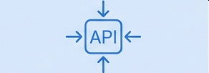

Project Overview: A Centralized Command & Control Simulation
Key Functionality
Multiple drone simulators connect to a central server.
A web-based GUI displays real-time drone status
on an interactive map.
Operators can issue commands (Takeoff, Land, FIyTo) to individual drones.
Core Objective
To build a system for the real-time monitoring and control of a fleet of autonomous drones, covering robotics control, network communication, and graphical user interfaces.
Technology Stack
Frontend: Leaflet.js, OpenStreetMap, Vanilla JavaScript
Language: Rust
Async Runtime: Tokio
Web Framework: Axum
Notes:
First, let’s look at the project overview. This is a centralized （三臭来死特）command and control simulation with three key features（非扯死）: multiple（模特步） drone simulators connect to a central server, a web-based GUI shows real-time drone status （斯坦李死）on an interactive map, and operators can send commands like Takeoff, Land, and FlyTo to individual （印地威特博）drones.
Our core goal was to build a complete system covering robotics control, network communication, and graphical user interfaces — all working together seamlessly.
Now, let’s talk about the technology stack. We used Rust as the main language for its safety and performance.
For the frontend, we chose Leaflet.js with OpenStreetMap for the interactive map, plus vanilla （维里那）JavaScript for simplicity.（森per死题】
On the backend, we used Tokio as the async （饿c）runtime and Axum as the web framework — both perfect for building efficient（饿非神特）, concurrent systems.

Slide 3


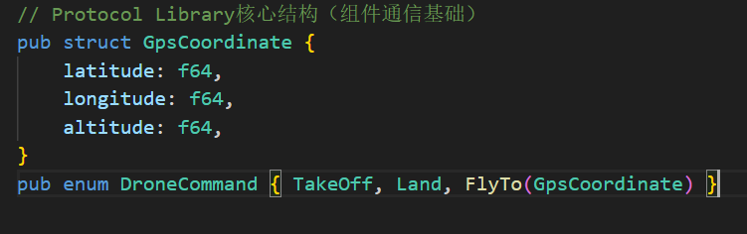
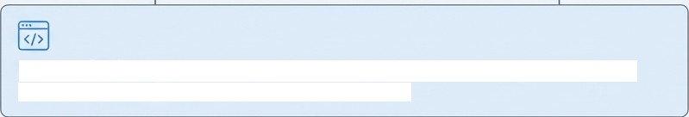
System Architecture: A Four-Component Design
Command GUI
Command Server
The central hub that manages state, handles drone connections, and exposes a control API.
A web-based interface for operators to monitor the fleet and issue commands.
Drone
Simulator(s)
Simulates flight dynamics and communicates its state via a long lived TCP connection.
HTTP REST
API
JSON over TCP
Static Files (HTMUJS/CSS)
HTTP API
Sever
(Port 3000)
TCP Server
(Port 8080)
Protocol Library A shared Rust crate defining all data structures ("DroneStatus“,
“DroneCommand") for system-wide communication.
Notes:
The system architecture follows a four-component design. First, the Command GUI: a web interface for operators to monitor and send commands. Second, the Command Server — the central hub that manages state, handles drone connections, and exposes a control API. It uses two ports: 3000 for HTTP API and 8080 for TCP drone connections. Third, the Drone Simulators: they mimic flight dynamics and communicate with the server via long-lived TCP connections. Fourth, the Protocol Library — a shared Rust crate that defines data structures like DroneStatus and DroneCommand for system-wide communication.

Slide 4
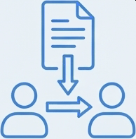
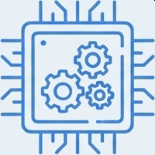

Three Core Engineering Pillars
The success of this system rests on three foundational design choices.
We will now explore the rationale and implementation of each.
1. The Communication
Protocol
Designing the language for
system-wide data exchange.
2. The Asynchronous Server Core
Building a non-blocking hub for concurrent connections.
3. The Real-Time GUI Architecture
Engineering a responsive, data-driven user interface.
Notes:
The success of this system rests on three core engineering pillars. Let’s start with Pillar 1: The Communication Protocol. We needed a reliable way for distributed components to talk. Instead of using MAVLink (a standard drone protocol), we built a custom JSON-over-TCP protocol. Why? Because JSON is human-readable — great for debugging without special tools. Rust’s serde library makes serialization and deserialization easy, speeding up development. And for a local simulation, bandwidth isn’t an issue, so JSON’s verbosity is acceptable. Each message is a single line of JSON ending with a newline, which simplifies parsing

Slide 5
Pillar I: The Communication Protocol
The Challenge: How should distributed components communicate reliably? The project requirements allowed for the use of MAVLink, a standard drone protocol, or the development ofa custom protocol.
The Rationale: Why a Custom JSON-over-TCP Protocol?
Simplicity & Debuggability: JSON is human-readable, making it easy to inspect messages during development without specialized tools.
Rapid Development: Rust's serde“ library provides robust, one-line serialization and deserialization, accelerating development.
Sufficient for Simulation: Bandwidth and message size, primary concerns for real-world radio links, are not constraints in this local simulation.
Implementation
Each message is a single line of JSON terminated by a newline character (‘\n’), simplifying the parsing logic on the stream.
( "key" : "va1ue" } \n
Notes:
The core data structures are straightforward. DroneCommand is an enum with Takeoff, Land, and FlyTo (which includes a GPS coordinate).

Slide 6

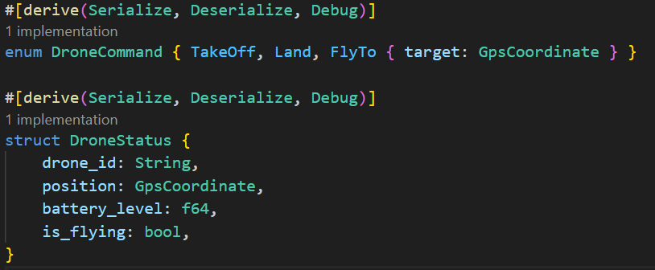
Protocol in Detail: Data Structures and Message Flow
Core Data Structures
DroneCommand (Enum)
enum DroneCommand { Take0ff,
Land,
F1yTo ( target: GpsCoordinate ),
Example Message Exchange
Server -+ Drone (Command)
A user clicks 'Take Off!' for Drone 001.
{”drone_id":"XiG001”,”command”:”Take0ff“}
Drone -+ Server (Status Update)
The drone reports its new state every 5 seconds
(”statusUpdate”:(“drone id”:”Tii001”,”positi on”:(latitude":39.9,longitude”:116.4,”altitud e”:50.0},"battery level”:99.5,"is flying”:true}}
DroneStatus (Struct)
struct DroneStatus { drone id: String,
position: GpsCoordinate,
battery level: f64,
is flying: bool,
Notes:
DroneStatus is a struct with drone ID, position (GPS coordinate), battery level, and a flying status flag. Here’s an example of how messages flow: when a user clicks “Take Off” for Drone 001, the server sends a JSON command like {"drone_id":"XiG001","command":"TakeOff"}. The drone then reports its status every 5 seconds with a message that includes its position, battery level, and flying state.

Slide 7


Pillar II: The Asynchronous Server Core
The Challenge: High Concurrency, Low Overhead
The server must simultaneously manage:
Multiple, long-lived TCP connections from the entire drone fleet.
Numerous, short-lived HTTP API requests from the GUI.
A traditional thread-per-connection model would be inefficient and resource-intensive as the fleet size grows.
The Solution: Non-Blocking I/O with Tokio
We built the server on the Tokio asynchronous runtime.
Asynchronous tasks yield the CPU while waiting for I/O, allowing a small number of threads to handle thousands of concurrent operations efficiently.
Notes:
Moving to Pillar 2: The Asynchronous Server Core. The big challenge here was handling high concurrency with low overhead. The server needs to manage multiple long-lived TCP drone connections and many short HTTP requests from the GUI. A traditional thread-per-connection model would be inefficient, so we used Tokio’s async runtime. Async tasks give up the CPU while waiting for I/O, letting a small number of threads handle thousands of concurrent operations.

Slide 8
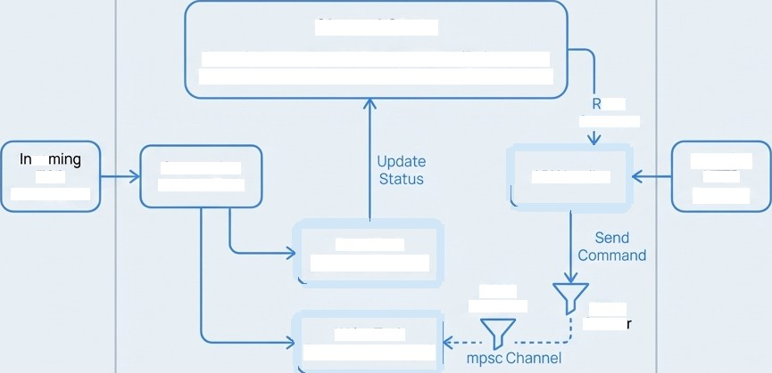
Server Architecture: Decoupled Tasks and Safe State
Key Concepts
Arc<Mutex‹T>>: Enables safe. shared access to state (like the list of drones) across many asynchronous tasks without data races.
mpsc Channel: A multi-producer,
single-consumer channel is created for each* drone connection. This decouples the API handlers from the TCP write logic, creating anin-memory, non-blocking command queue (capacity. 100) for each drone.
Command Server Internals
Shared State
DroneStatuses: Arc‹Mutex‹HashMap‹ID, Status» DroneChannels Arc‹Mutex‹HashMap«ID, Sender»
Statuses
cO
TCP
Connection
Connection
Handler Task
API Hand ler
Incoming
HTTP
Request
Read Task (Receives Status)
mpsc Receiver
mpsc
Sendg
Write Task (Sends Commands)
Notes:
The server uses shared state with Arc<Mutex> for safe access across async tasks — one for drone statuses andon for communication channels. For each drone connection, we create an mpsc channel (a message queue) with a capacity of 100. This decouples API handlers from TCP write logic, ensuring commands are sent in order without blocking. The server also runs two main async tasks: a TCP listener for drones and an HTTP API server for the GUI. Both work concurrently without interfering

Slide 9
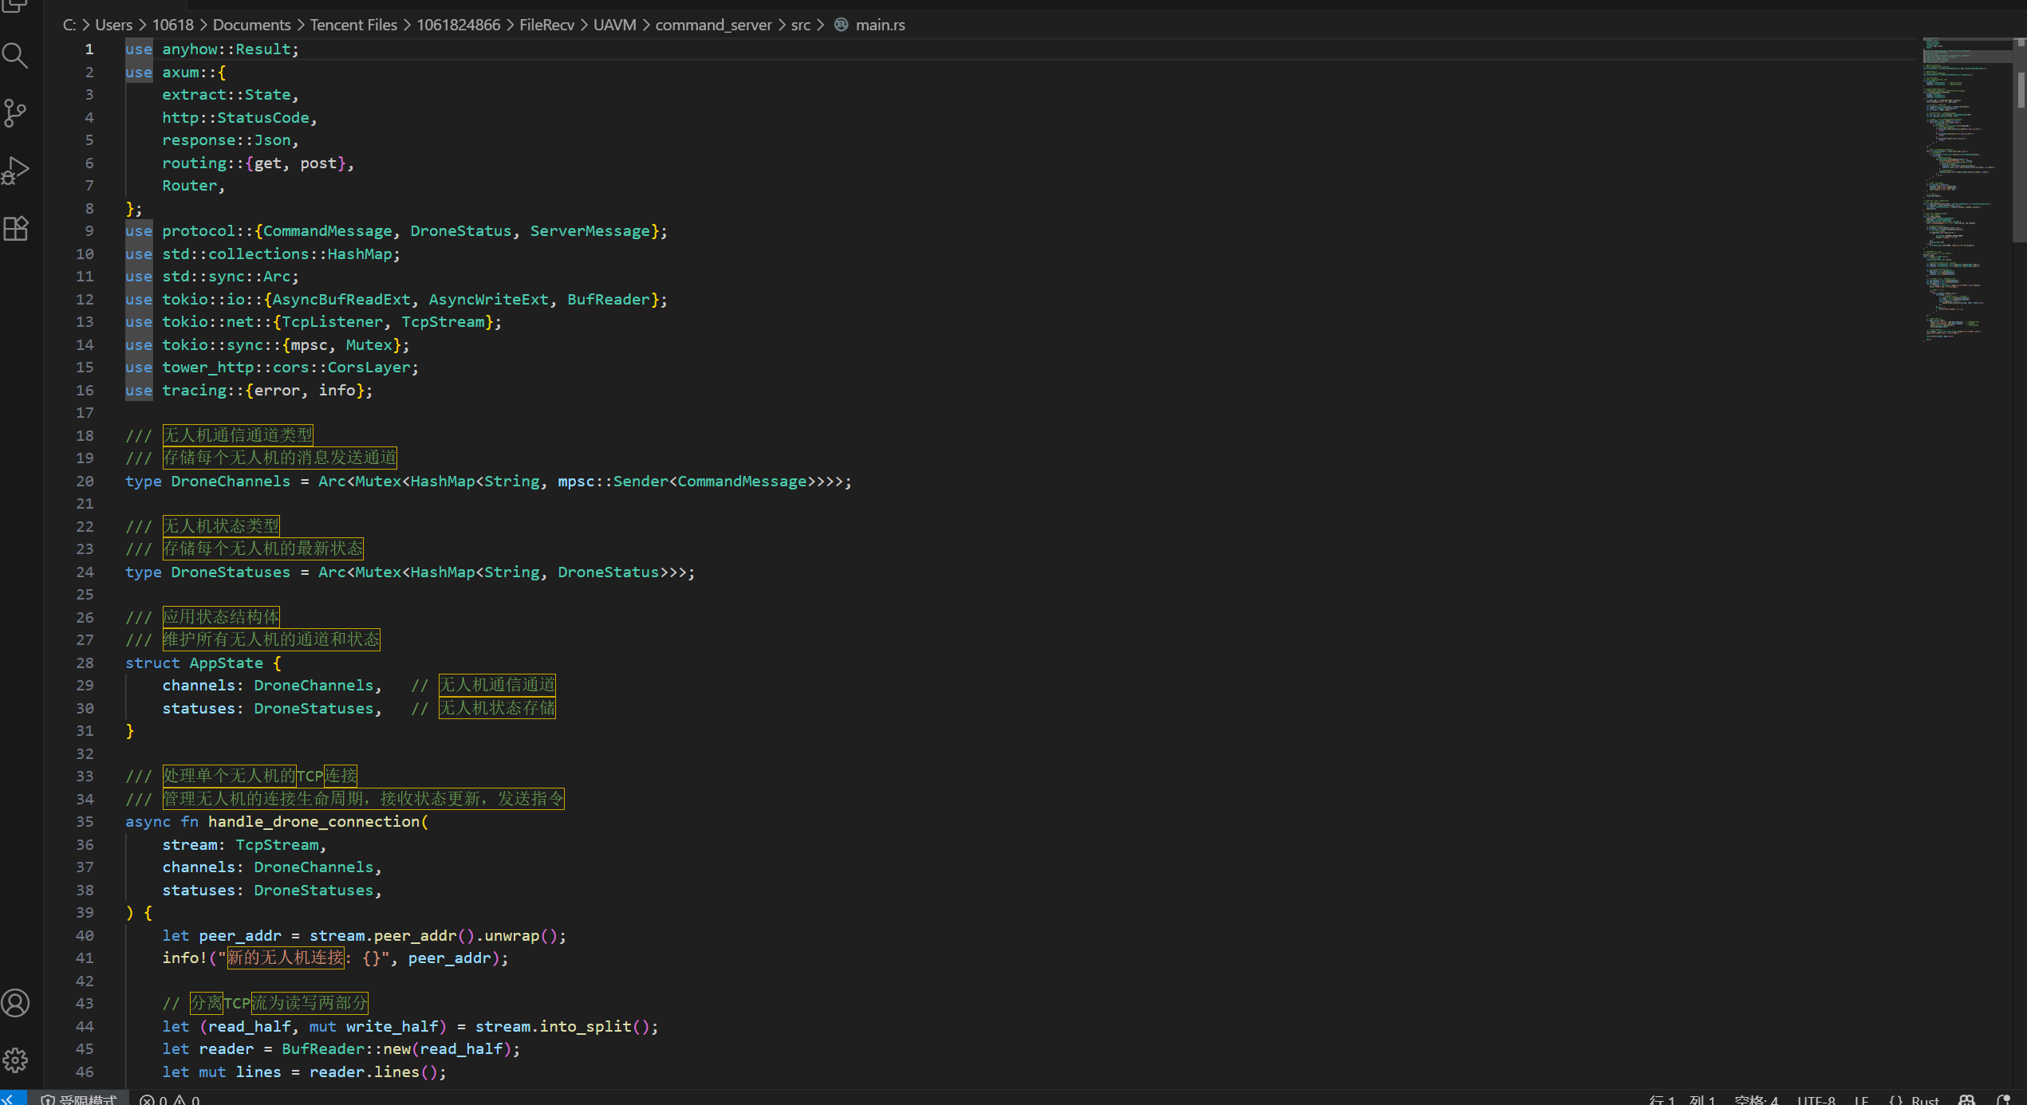
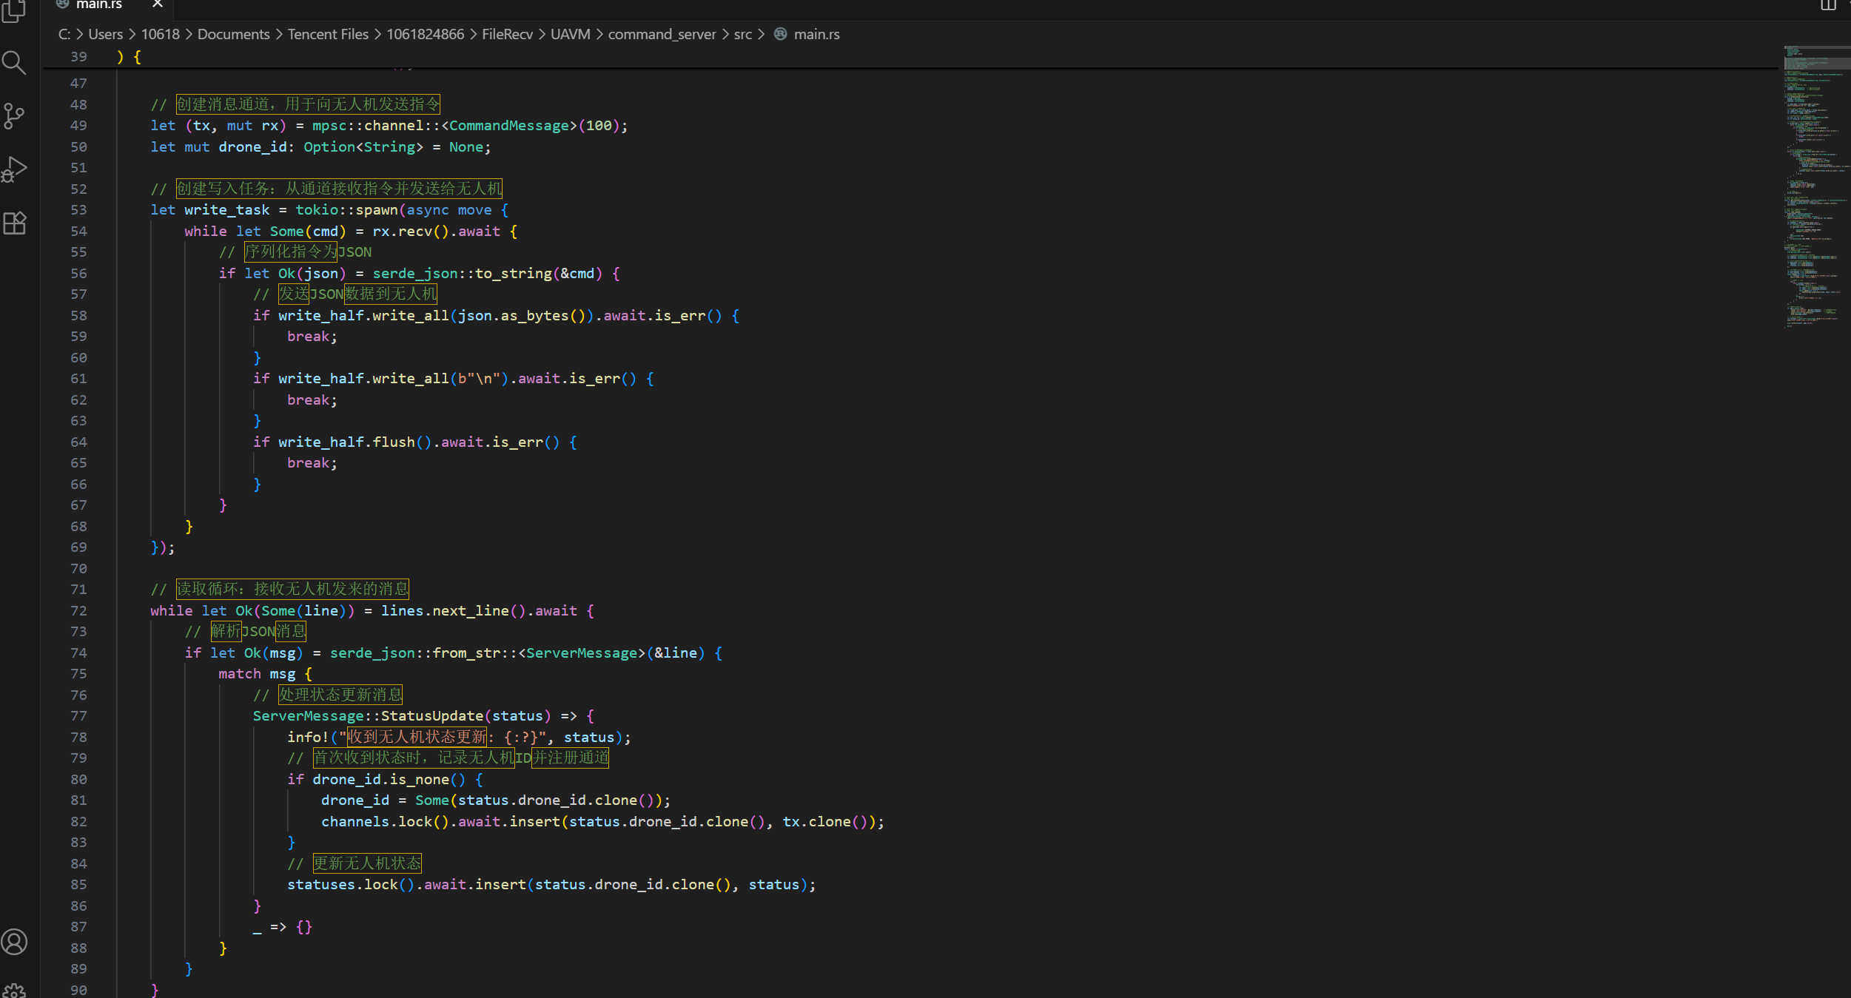
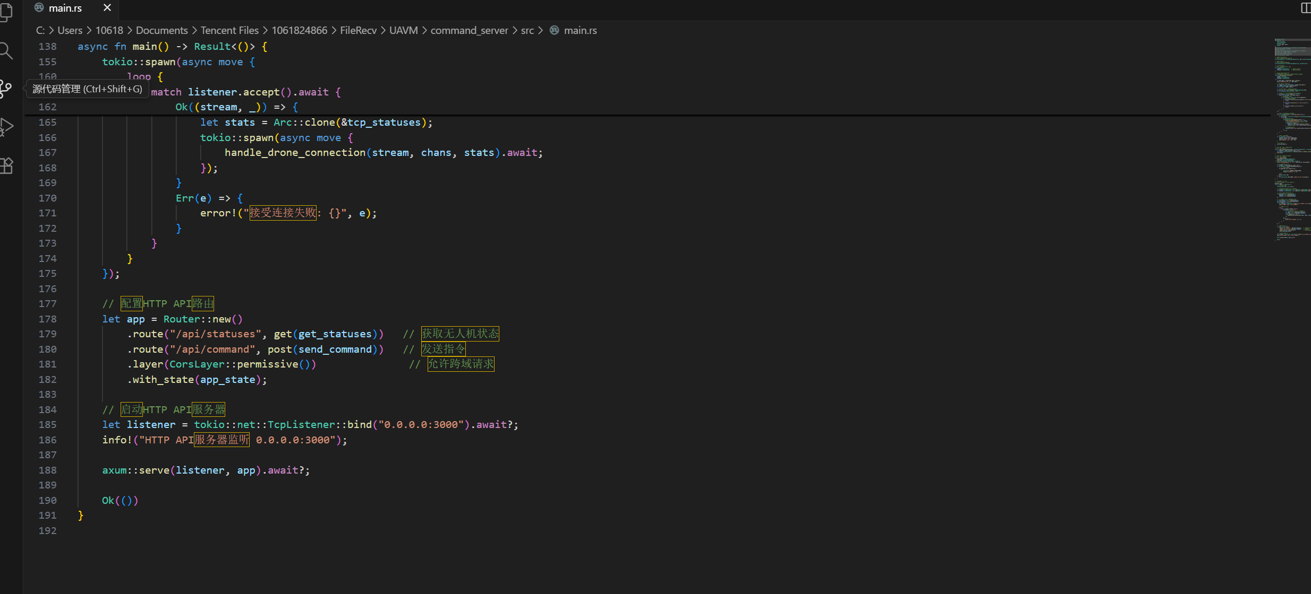
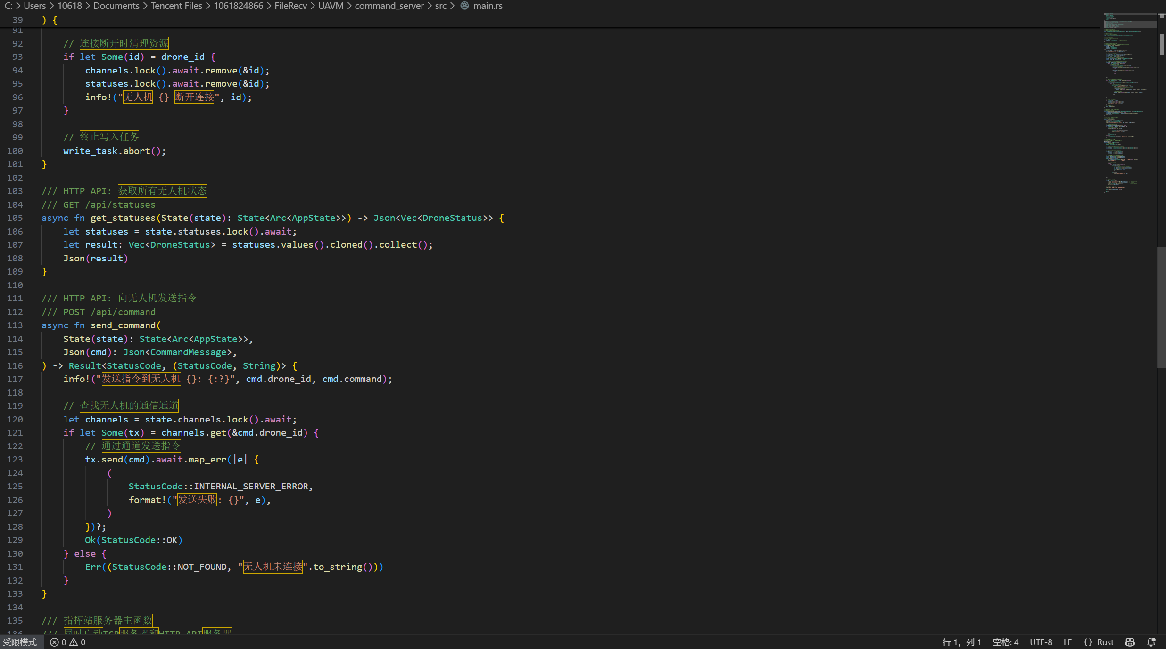
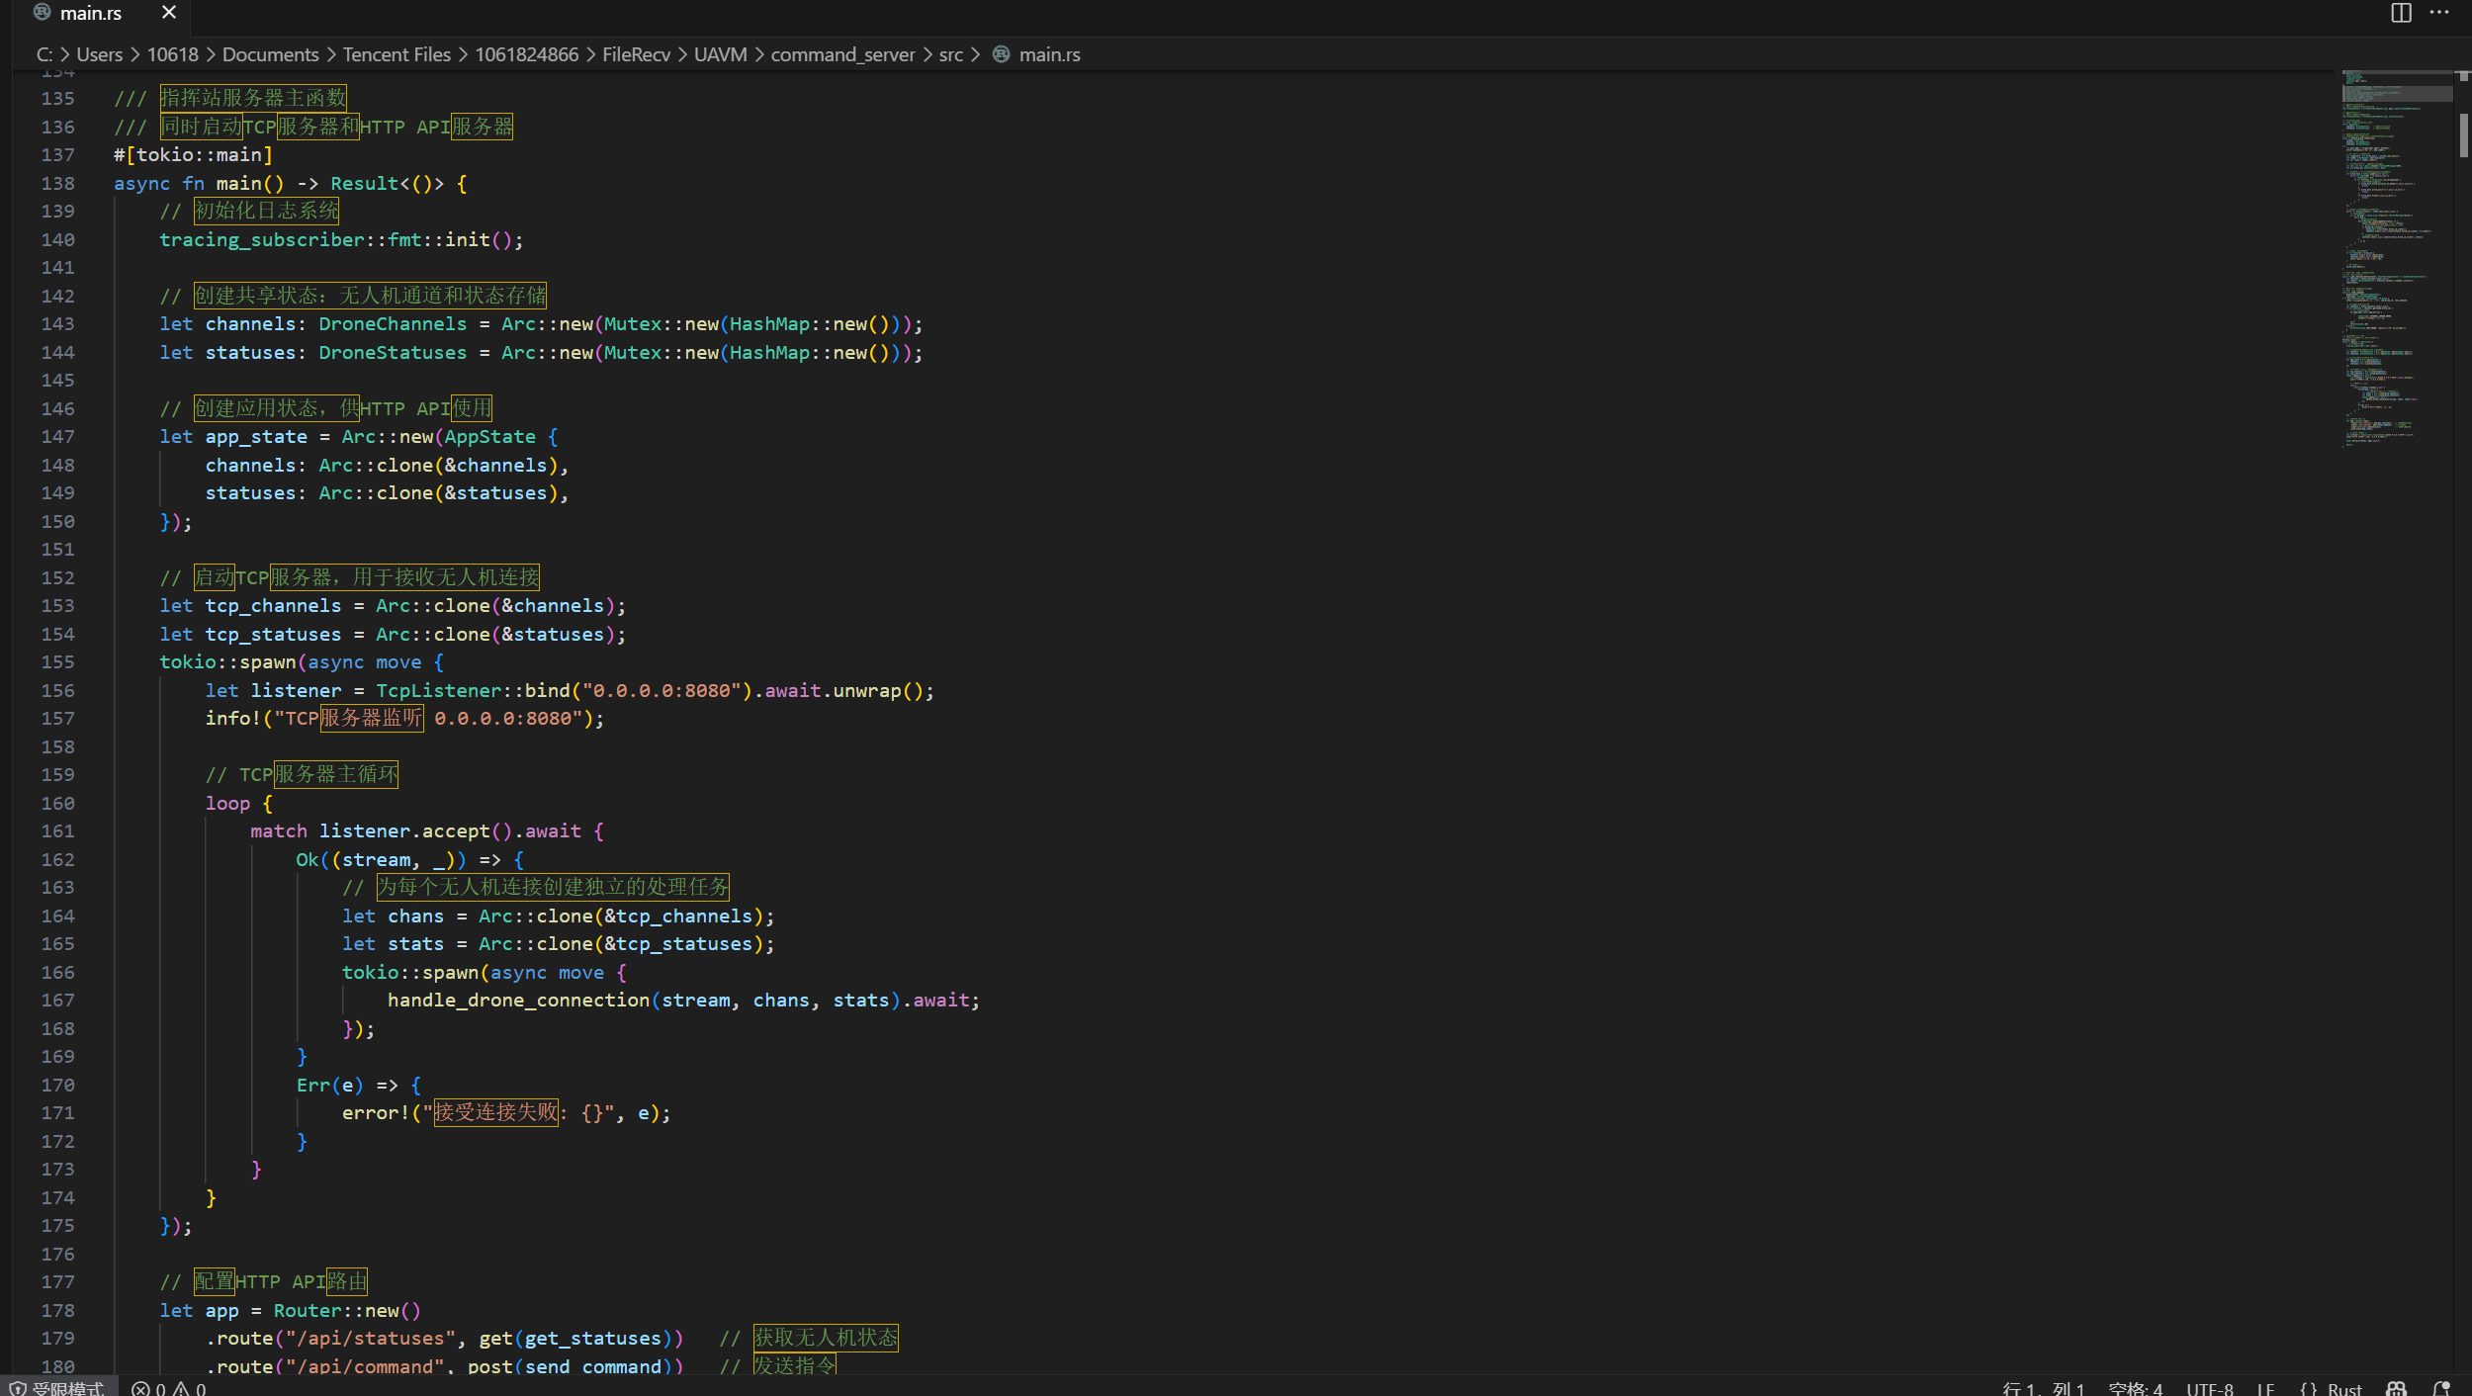

Slide 10


Pillar III: The Real-Time GUI Architecture
The Goal
Create a responsive and interactive interface for monitoring and control that feels like a native application.
The Architecture: Decoupled Front-End
Key Advantages
Separation of Concerns: Frontend and backend development are fully independent.
Leverages Browser Power: Utilizes the browser's highly optimized
rendering engine for smooth map animations and UI updates.
Backend (Axum on Port 8080)
A minimal Rust server responsible only for serving the static index.html,
JavaScript and CSS files.
Frontend (Browser)
A single-page application built with vanilla JavaScript and the Leaflet.js library.
All logic for rendering, state management. and user interaction runs client- side.
Notes:
Now, Pillar 3: The Real-Time GUI Architecture. We wanted a responsive interface that feels native. So we used a decoupled frontend-backend design. The backend is a lightweight Rust server that only serves static files (HTML, CSS, JS). The frontend is a single-page app with Leaflet.js for maps. This separation lets frontend and backend be developed independently, and leverages the browser’s fast rendering engine for smooth animations.

Slide 11
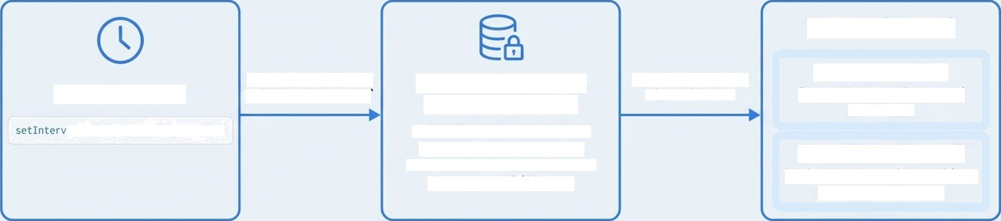
Achieving ‘Real-Time’ with Data-Driven Updates
The Data Flow
4. Client (Update)
updateDroneList()
Re-renders the side-panel
status list.
Async 'fetch' request to 'GET /api/statuses
3. Server (Command
Server: Port 3000)
API handler locks the shared "DroneStatuses" map and returns the current state of all drones as a JSON array.
JS promise resolves with JSON data
1. Client (Timer)
z I(Ie tchDrone Statuses , 1000)
updateDroneMarkers()
Updates map marker positions and trajectory lines.
Enhancing Smoothness
Backend Simulation: The drone simulator uses linear interpolation to move drones in 50 small steps over 6 seconds.
Frontend Perception: Even though the GUI refreshes only once per second, it receives a new position from this smooth path, and Leaflet's built-in animations make the marker transition appear fluid.
Notes:
To achieve real-time updates, the frontend uses a simple timer: it sends a GET request to /api/statuses every second. The server responds with a JSON array of all drone statuses. The frontend then updates the map markers and sidebar status list. We optimized smoothness by having the drone simulator use linear interpolation — moving in 30 small steps over 6 seconds. Even with 1-second GUI refreshes, the markers move fluidly thanks to Leaflet’s animations.

Slide 12
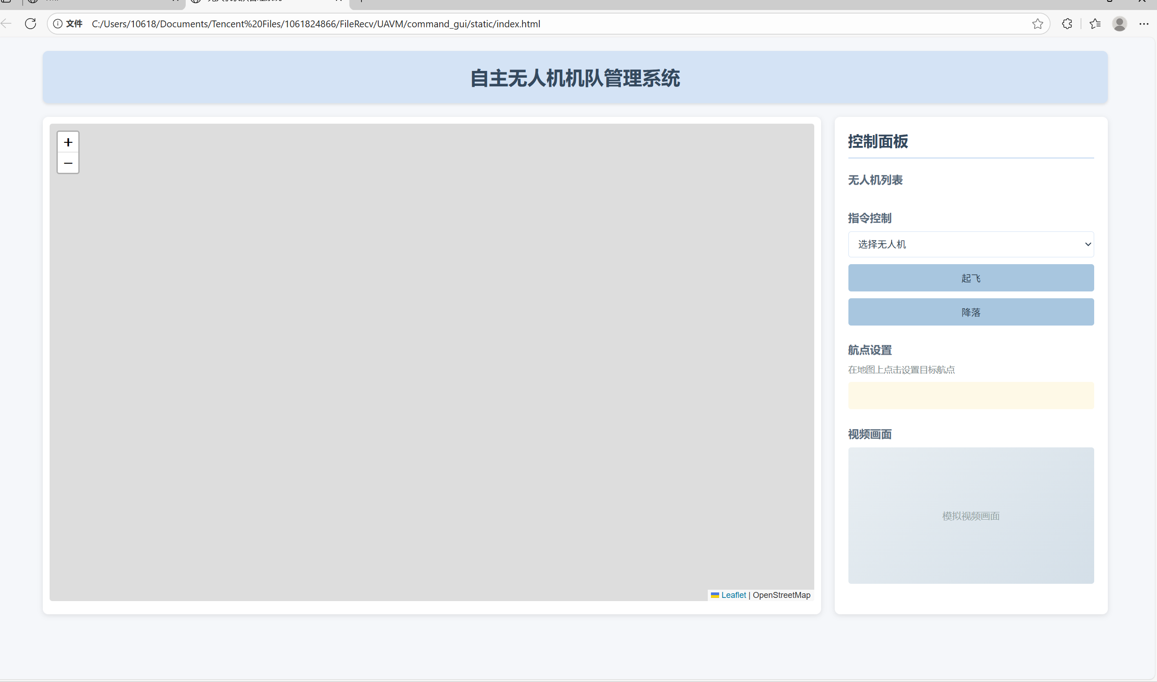
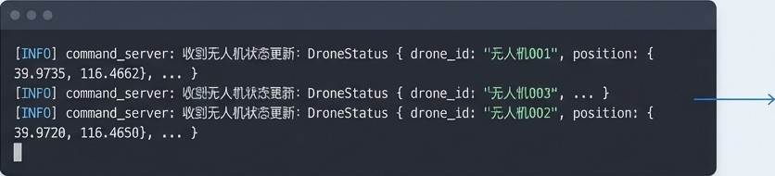
The System in Action
Operation page
Backend server processing concurrent status updates.
Notes:
Let’s see the system in action. The GUI shows an interactive map with drone positions and flight trajectories (last 50 points). The sidebar lists all drones with their status — you can click a drone to select it, then send Takeoff, Land, or FlyTo commands. To set a waypoint, just click the map, and the drone will fly there.

Slide 13
Implemented Features Checklist
Drone Simulation | Command Server | Graphical User Interface
GPS positioning, battery | Concurrent management | Real-time drone position
consumption, and flight | of multiple drones via long- | display on a Leaflet.js map
state simulation. | lived TCP connections. | (1s refresh).
Smooth flight animation | Asynchronous command | Flight trajectory drawing
using linear interpolation | queueing and dispatching. | (last 50 points).
(30 steps). | HTTP REST API for | Interactive controls: click-
Execution of Takeoff, Land, | frontend status queries | to-set-waypoint, status list
and FIyTo commands. | and command injection. | selection, command buttons.
 |  | Thoughtful UX with a light
 |  | color scheme and clear
 |  | visual state indicators.
Notes:
Let’s check the implemented features. For Drone Simulation: GPS positioning, battery consumption, smooth flight animation, and command execution. For Command Server: concurrent drone management, async command queuing, and HTTP API for status queries and commands. For the GUI: real-time map display, trajectory drawing, interactive controls, and a user-friendly design.

Slide 14



Technical Learnings and Reflections
Rust Core Concepts
Mastered the ownership model to write safe concurrent code.
Applied ’Arc” and Mutex’ for thread-safe shared state, and mpsc channels for safe message passing between asynchronous tasks.
Gained practical experience with async/await‘ and the Tokio runtime for building high-performance I/O-bound applications.
Network Programming
Implemented both TCP stream processing for stateful connections and a stateless H PRESTAPIt
Understood the trade-offs in protocol design (e.g., JSON's verbosity vs. ease of use).
SoRware Engineering
Designed a modular, multi- component system using Cargo workspaces.
Applied the principle of front-end/back-end separation for a clean and maintainable architecture.
Notes:
Working on this project taught us a lot. We mastered Rust’s ownership model, async/await with Tokio, and concurrent state management with Arc and Mutex. We gained practical experience with TCP and HTTP programming, and learned how to design modular systems with Cargo workspaces. We also understood the trade-offs in protocol design and the benefits of frontend-backend separation.

Slide 15


A System of Systems: Where Architecture Defines Function
This project is more than a drone simulator; it is a demonstration of how distinct architectural decisions—a simple protocol, a non-blocking server core, and a decoupled UI—integrate to form a robust, functional, and scalable system.
The Real-Time GUI
Architecture
The Asynchronous Server Core
GUI
(Client)
API
Command
Server
Drone Simulator
The Communication Protocol
The final implementation is a direct reflection of these foundational choices, showcasing a complete cycle from system design theory to practical application.
Notes:
This project is more than a simulator — it’s a demonstration of how good architectural choices come together to make a robust system. The simple protocol, non-blocking server, and decoupled UI each play a key role in making the system work smoothly.
For future work, we have several improvements in mind. First, replace HTTP polling with WebSockets for lower latency real-time updates. Second, add a database for data persistence — storing flight logs and trajectories for later analysis. Third, implement a heartbeat mechanism for drones to handle reconnections automatically. Fourth, add authentication and authorization to secure the command API.

Slide 16
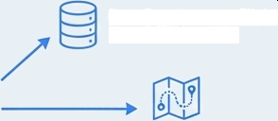








Potential Extensions and Future Work
Network 6 Performance Optimization
HTTP Polling
Feature Enhancements
Data Persistence - Flight Logs 6 Trajectories
Before:
(High Latency)
Frontend
Command Server
WebSockets (Low-time)
Advanced Flight Planning - Multi-waypotnt, Pathfinding, No-fly Zones
Security -
Authentication & Authorization, Command API
After:
(Real-time, Low Latency)
Client Command Server
From Polling to Push: Replace the frontend's HTTP polling with WebSockets for true real-time, low- latency updates pushed from the server.
Efficient Protocol：Migrate from JSON to a binary format like Protocol Buffers (Protobuf) to reduce network overhead, critical for real-world applications.
Resilience: Implement a heartbeat mechanism and automatic reconnection logic for drones.
Data Persistence: Integrate a database to store flight logs and historical trajectories for post-mission analysis and playback.
Advanced Flight Planning: Implement multi-waypoint missions, automated pathfinding, and no-fly zone detection.
Security: Add authentication and authorization to secure the command API.
Notes:
In conclusion, this project successfully delivers a complete autonomous drone fleet management simulation. It combines Rust’s strengths in safety and concurrency with practical web and network programming to create a functional, user-friendly system. The three core pillars — communication protocol, async server, and real-time GUI — work in harmony to meet the project’s goals.
Thank you for your attention. We’re happy to answer any questions!

