Slide 1
IDEA/APPROACH DETAILS
TECHNOLOGY BUCKET: Agriculture and Rural Development CATEGORY: Software
COMPANY NAME/MINISTRY NAME: KISAN FORUM PVT LTD PROBLEM CODE: NS5
TEAM LEADER: Clayton Sohan Pereira COLLEGE CODE: 1-3508330114

Slide 2
To create a app which would be profitable for the both i.e. the farmers as well as the consumers.
The goal is to eliminate the middle man i.e. the traders, the manufacturers and retailers which increase the overall cost of the farmer’s product and the consumer has to pay a huge amount thereafter.
On the other hand, the farmer also doesn’t get the right value of his produce because such a system.
This goal can be achieved by implementing an auction system where the auction would be hosted by the farmers or a ‘group of farmers’ on our application which would be visible to both the farmers as well as bidders i.e. the consumers.
The main aim of our application is to benefit the farmer’s overall revenue, by eliminating the middle man cost.
In this way, a single farmer or a group of farmers can join a group and would add a quantity of a particular commodity in bulk and would offer them for the bid in an ‘Auction’.
The consumers(Buyer) subscribed to our app will be able to view the active auction and participate in it.
The consumer having the highest bid will finally have the hold of the bided product.
The consumer has to then pay the amount once the commodity has been delivered and only if he is satisfied
with the commodity, otherwise , a refund or a exchange is done based on T&C.
Farmers can also come together as group(Or only buy for himself) to buy base commodities like crops/fertilizers from a farm product seller
TECHNOLOGY STACK:
CLIENT-SIDE:
SERVER-SIDE:
DESCRIPTION OF THE IDEA /SOLUTION/ PROTOTYPE
1] React Native Framework (Open source library) | 2] Native Base UI Library (Open source framework)
1] Express Framework (For Backend Business logic) (Open Source Framework) | 2] Mongo Database(For Storing user details) (Open Source Database)

Slide 3
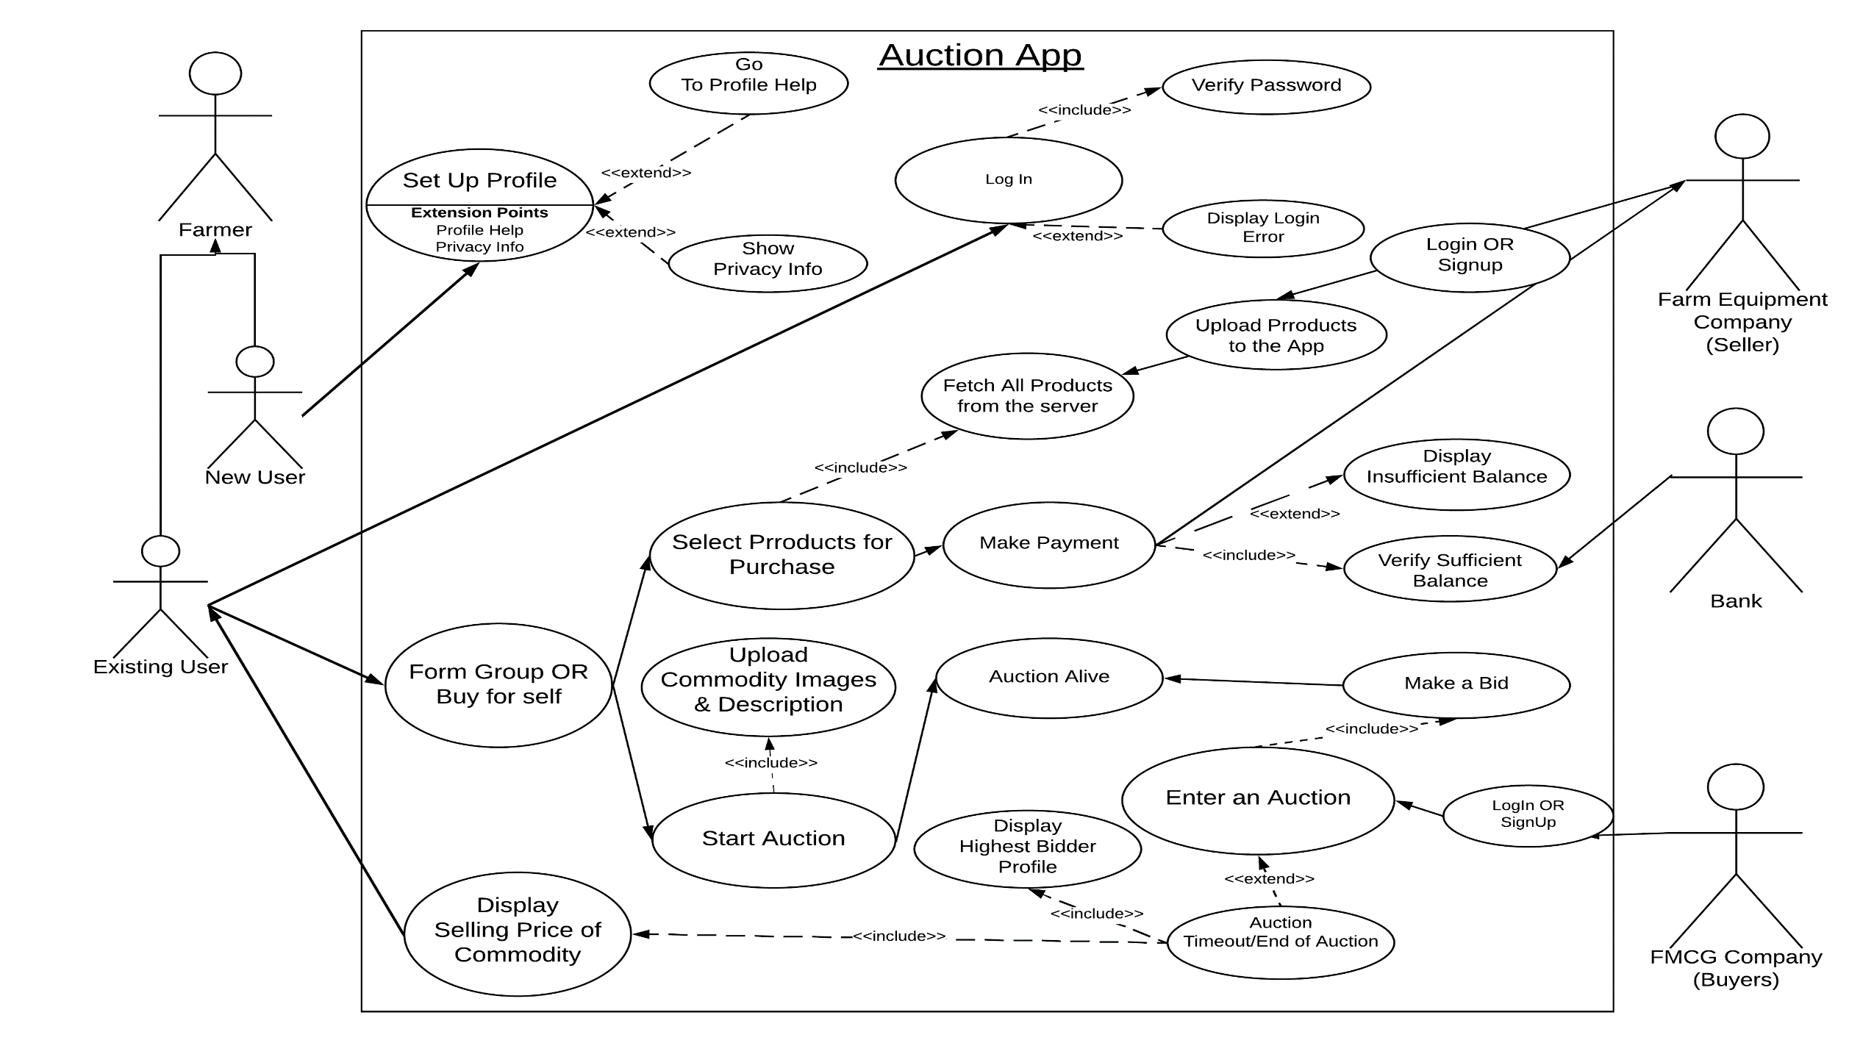
DESCRIPTION OF USE CASES: UML USE CASE DIAGRAM

Slide 4
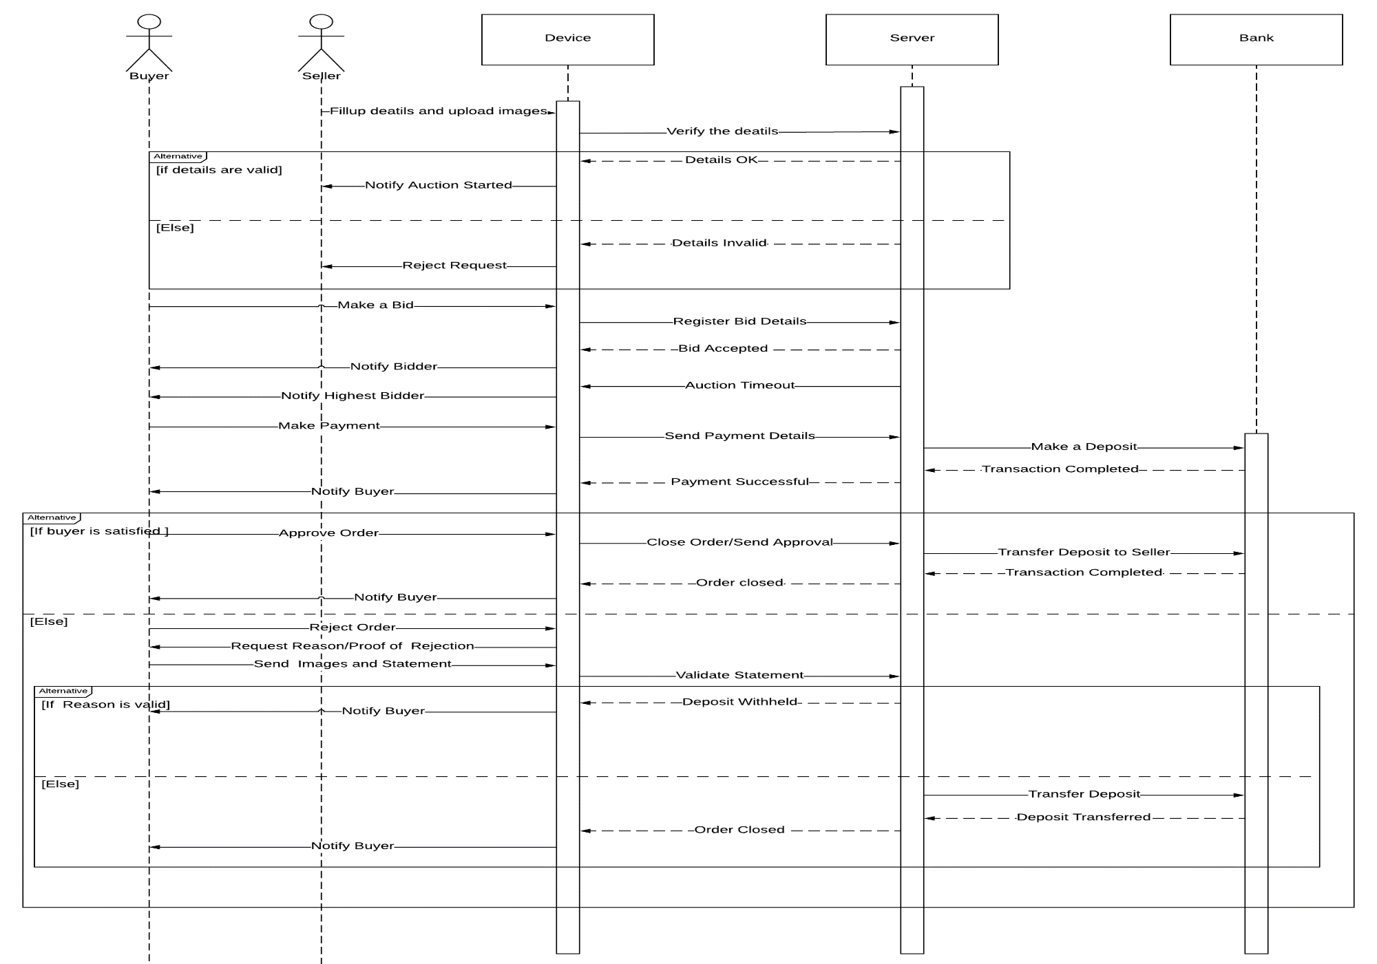
SEQUENCE DIAGRAM

Slide 5
SELLERS
Farmers:
The farmer’s would be able to offer their product for bidding. Also after the max bid has been done , he will attain the equivalent amount directly to his bank account through a secure payment gateway
if and only if the consumer(Buyer/FMCGs) is satisfied with the commodity.
Farm equipment sellers:
The bidders are the consumer’s(Buyer/FMCGs) who will participate in the active auction hosted by the farmer and would continue bidding until a timeout of the auction. The bidder has to send the equivalent amount through the payment gateway which would be transferred to the farmer.
BUYERS
Farmers:
The farmer/Group of farmers can buy the base products needed for his agricultural activities from the ‘Farm Equipment seller’s through the Application.
FMCGS:
The management committee will sell their products like fertilizers, crops, and other equipment's to the farmers.
ADMIN
Admin can manage all the activities on the app, i.e. approve/disapprove auctions being hosted. Additionally admin has the right to activate/deactivate any user’s account in case of unethical activities.
DEPENDENCIES/SHOW STOPPER:
Additional transportation cost incurred due to refund and exchange, rejection of orders by the buyer.
Damage occurred during the transportation would lead to refund/exchange/rejection of orders which would affect the farmer’s revenue

