Slide 1

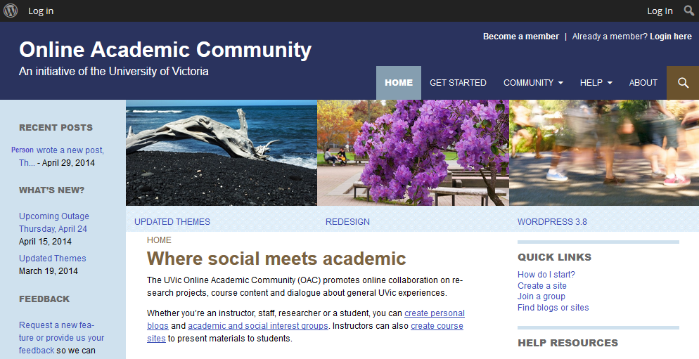

Online Academic Community Workshop
Instructor: David Shaykewich | dshaykew@uvic.ca

Slide 2
Introduction
AGENDA
Agenda
Part 1: Introduction to OAC (Background)
Features of the OAC
Basics of using WordPress
Part 2: Creating an OAC blog
Hands-on opportunity to try the OAC
< Click here to return to Table of Contents >

Slide 3
Introduction
AGENDA
Introduction to OAC
The UVic Online Academic Community (OAC)
Pilot introduced in May 2013
WordPress-powered community
Hosted on UVic Servers
< Click here to return to Table of Contents >

Slide 4
Introduction
AGENDA
WordPress Background
CMS = Content Management System
Popular format
Used by 20.3% of all websites (Source: W3Techs)
Powers blogs + web pages for many professional/corporate websites
Easy to use
< Click here to return to Table of Contents >

Slide 5
Introduction
AGENDA
Who may participate in the OAC?
Open to faculty, staff, researchers and students
< Click here to return to Table of Contents >

Slide 6
Introduction
AGENDA
Uses of the OAC
Promote collaboration in research and general UVic initiatives
Course sites
Host course blogs + web pages for students
Provide an environment for online discussion
Personal blogs / sites
Discover individuals/groups with complementary interests
< Click here to return to Table of Contents >

Slide 7
Introduction
AGENDA
Reasons to use the OAC
Centralized
Secure
Hosted locally (here at UVic)
FIPPA – Student content cannot be hosted outside Canada*
* Some widgets when enabled send information to the United States
UVic Systems manages all updates to ensure latest version of WordPress is running
Fast learning curve of WordPress interface
Supports active learning → Student contributions
Space to continue discussions outside the classroom
< Click here to return to Table of Contents >

Slide 8
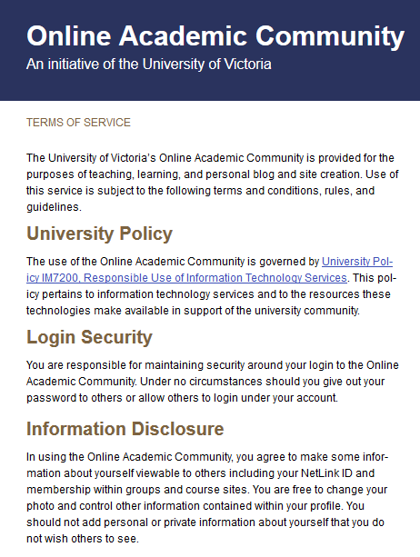
Introduction
AGENDA
OAC privacy and security
OAC Terms of service
Presented upon first-time login to oac.uvic.ca
Is also accessible at the footer of OAC main page.
URL:https://onlineacademiccommunity.uvic.ca/about/terms-of-service/
< Click here to return to Table of Contents >

Slide 9
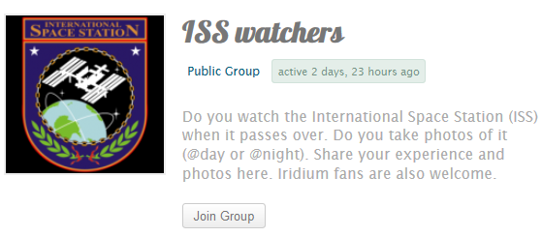
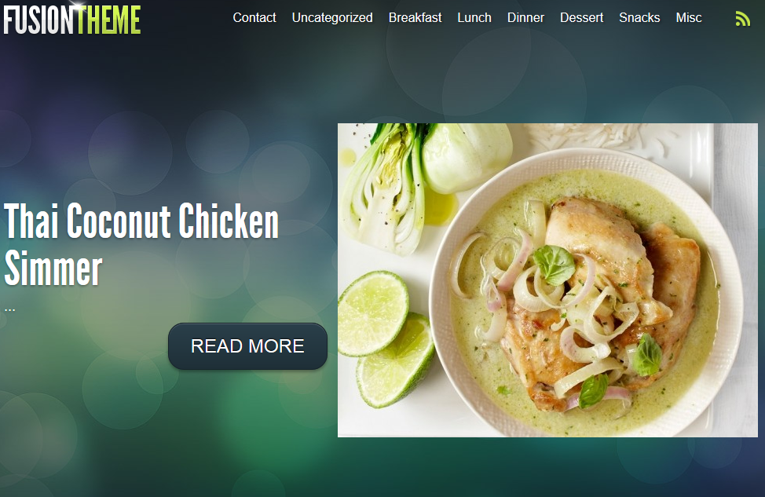
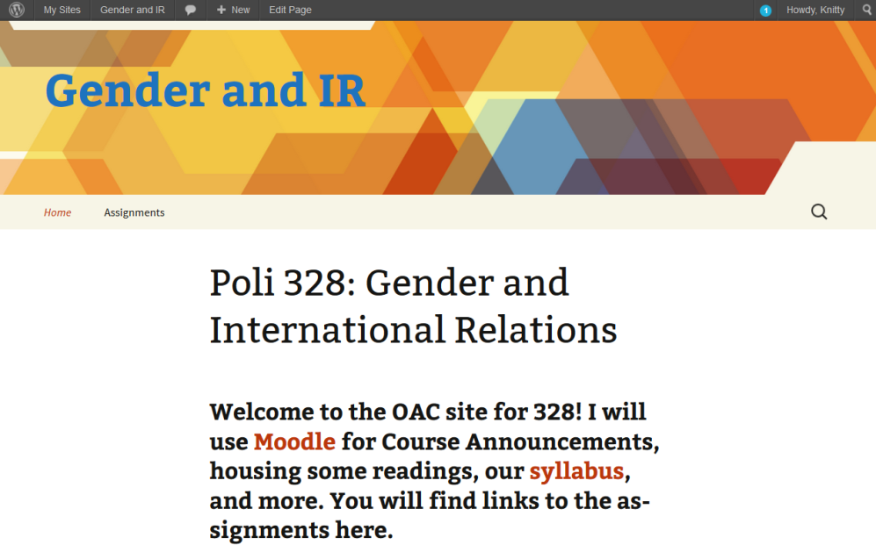
Introduction
AGENDA
Uses of the OAC
Personal blogs, academic sites and social interests groups
< Click here to return to Table of Contents >

Slide 10
Introduction
AGENDA
Getting Started
Login to UVic Online Academic Community (OAC) using your NetLink ID
oac.uvic.ca
First-time login: READ and Agree to terms of service.
< Click here to return to Table of Contents >

Slide 11
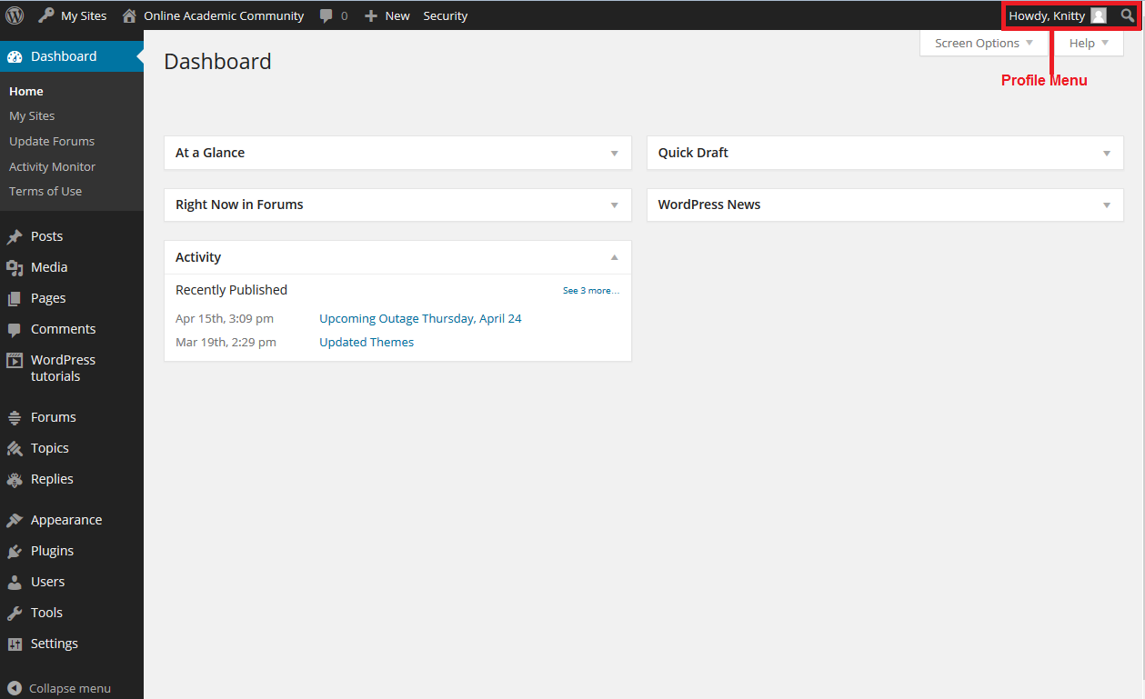
Getting Started
AGENDA
Dashboard
Behind the scenes of WordPress
Area where you add/modify content and customize your blog
< Click here to return to Table of Contents >

Slide 12
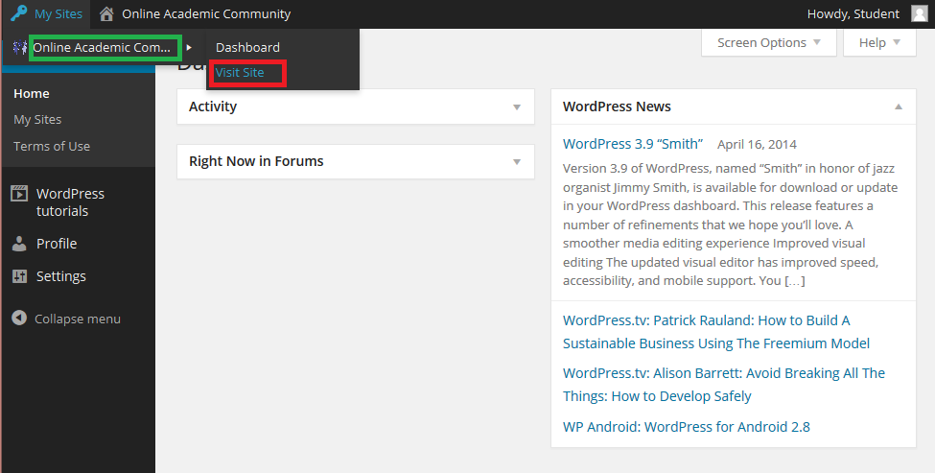
Getting Started
AGENDA
Customizing Your Profile
Click on your My Sites tab in the top left corner
From the drop-down, select “Online Academic Site” and then click “Visit Site”
< Click here to return to Table of Contents >

Slide 13
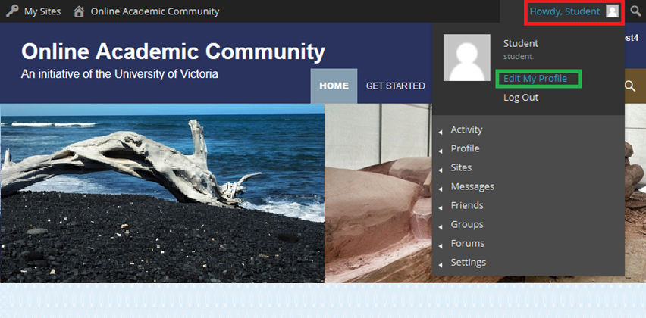
Getting Started
AGENDA
Customizing Your Profile…
On the OAC homepage, click on your avatar in the top right corner
From drop-down, select “Edit My Profile”
< Click here to return to Table of Contents >

Slide 14
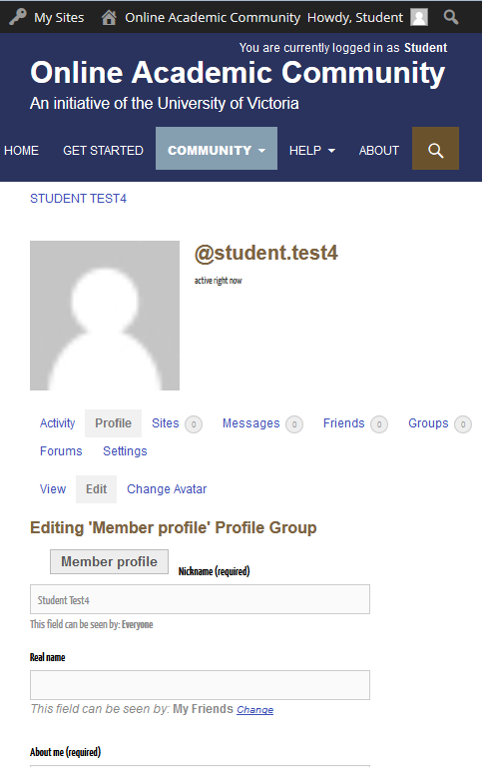
Getting Started
AGENDA
Customizing Your Profile…
Tips For Filling Out Your Profile
Fill out your profile for other OAC members to find you based on:
Research
Personal interests
Once complete, scroll to the bottom page and select “save changes”
< Click here to return to Table of Contents >

Slide 15
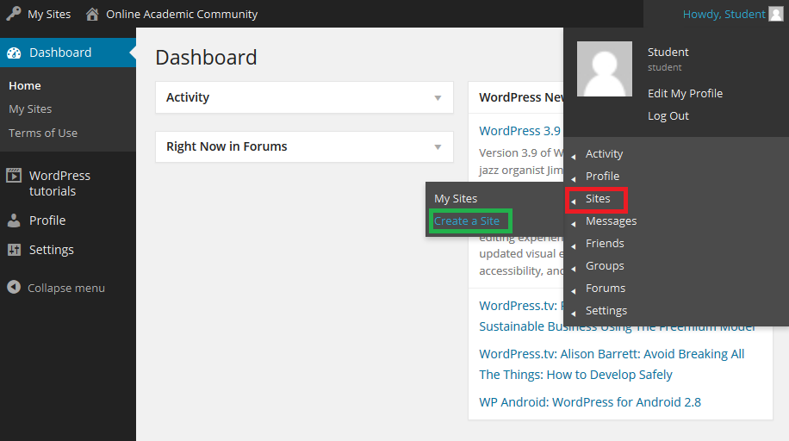
Getting Started
AGENDA
Creating a Blog
Click on your avatar (top right corner)
From drop-down, select “Sites” and then click on “Create a Site”
< Click here to return to Table of Contents >

Slide 16
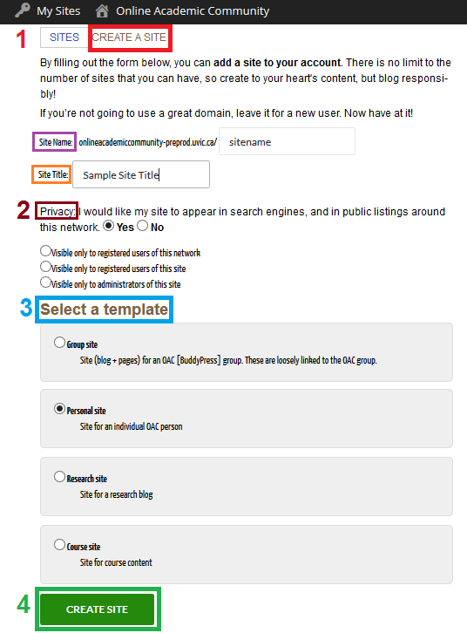
Getting Started
AGENDA
Creating a Blog…
1) Fill out the “Create a Site” form fields
“Site Name”: The URL identity for your blog
Please use lower-case without spaces and special characters
“Site Title”: The actual name you wish for your blog
You may use spaces
2) Select your desired site visibility under “Privacy”.
3) Choose one of the options under “Select a template”
4) Once Finished, click the “Create a Site” button at the bottom of the page

Slide 17
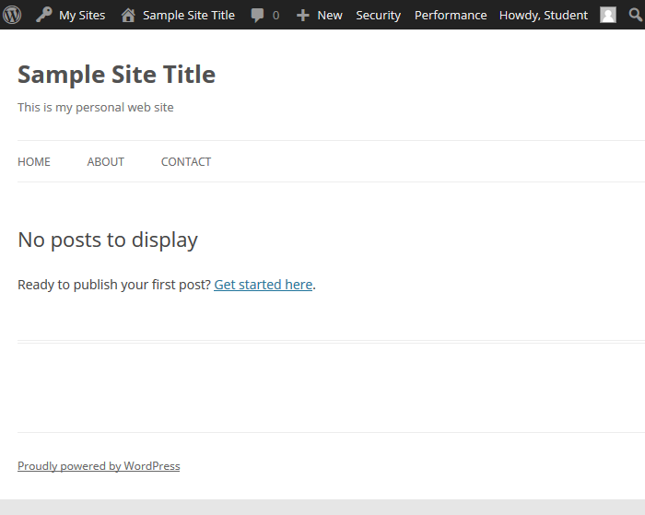
Getting Started
AGENDA
Choosing Your Theme
A blog’s look and feel (layout, colors, fonts, etc.) is controlled by the theme.
If you desire, you may change the theme in the dashboard.
< Click here to return to Table of Contents >

Slide 18
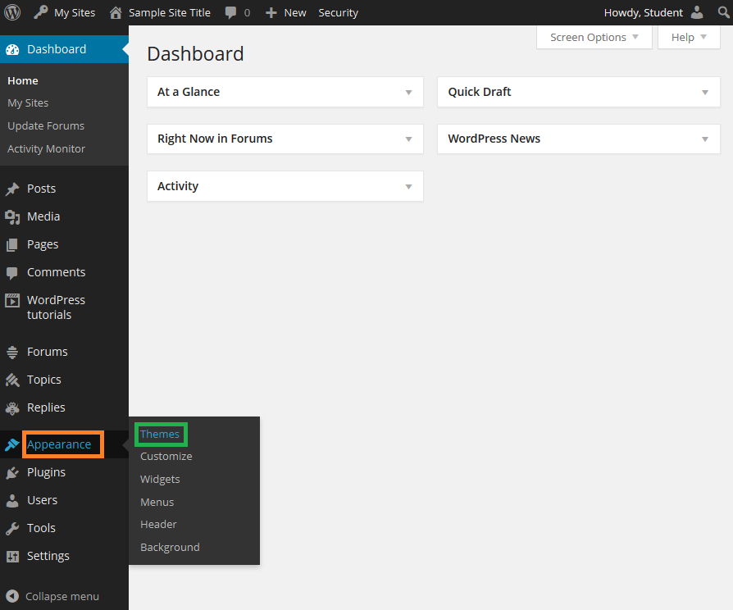
Getting Started
AGENDA
Choosing Your Theme…
From the Dashboard left side-bar click “Appearance” and then select “Themes”
< Click here to return to Table of Contents >

Slide 19
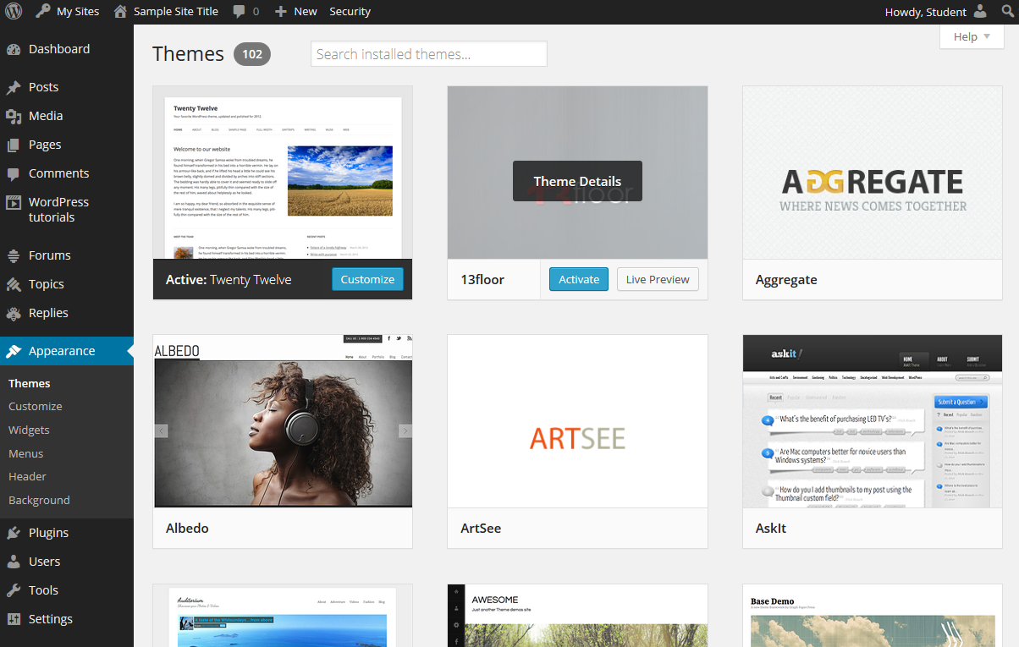
Getting Started
AGENDA
Choosing Your Theme…
The OAC has over 100 themes available
< Click here to return to Table of Contents >

Slide 20
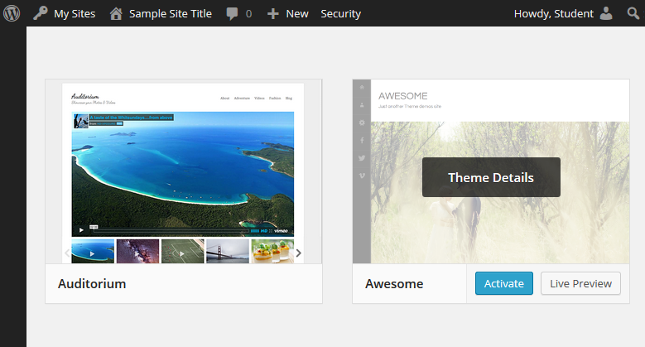
Getting Started
AGENDA
Choosing Your Theme…
Locate desired theme and select “Activate”
< Click here to return to Table of Contents >

Slide 21
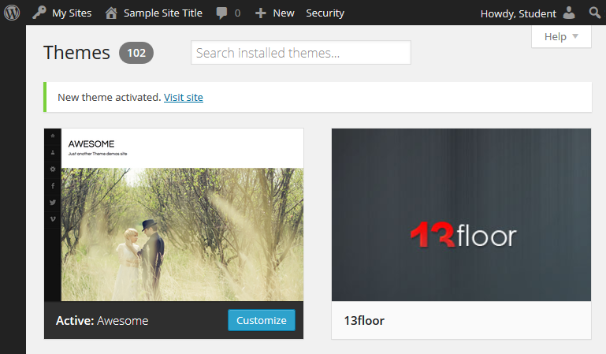
Getting Started
AGENDA
Choosing Your Theme…
< Click here to return to Table of Contents >

Slide 22
Getting Started
AGENDA
Customizing Your Theme…Widgets and Plugins
Widgets/plugins enable special features within WordPress like social media, video embedding, RSS feeds, etc.
Widgets are placed within the sidebars, headers and footers of the blog
Developed by 3rd parties
Note: Enabling widgets/plugins may expose personal information (you or your visitors) to other companies
< Click here to return to Table of Contents >

Slide 23
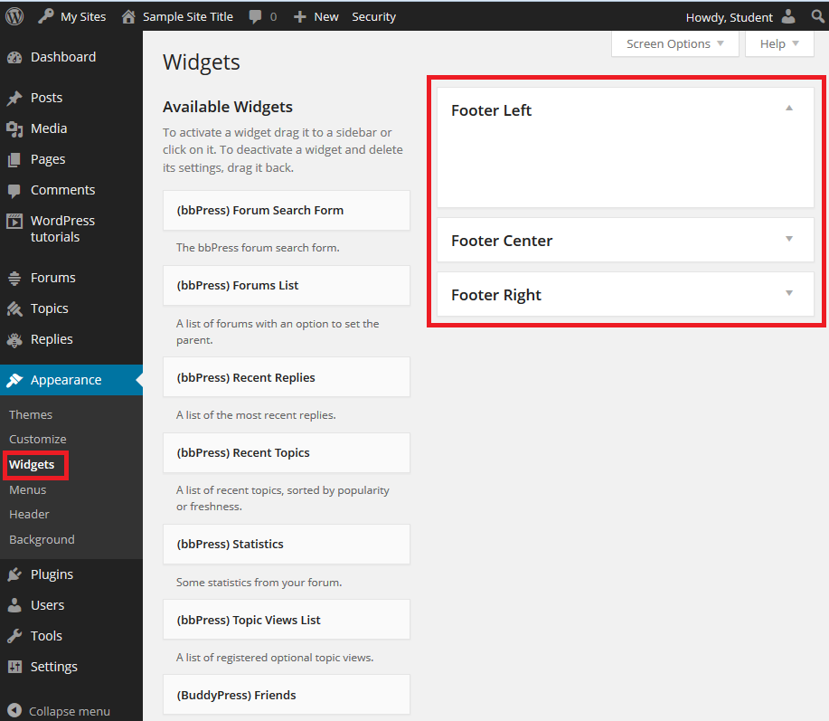
Getting Started
AGENDA
Customizing Your Theme…Widgets
Widget compatibility depends heavily on the theme’s layout
< Click here to return to Table of Contents >

Slide 24
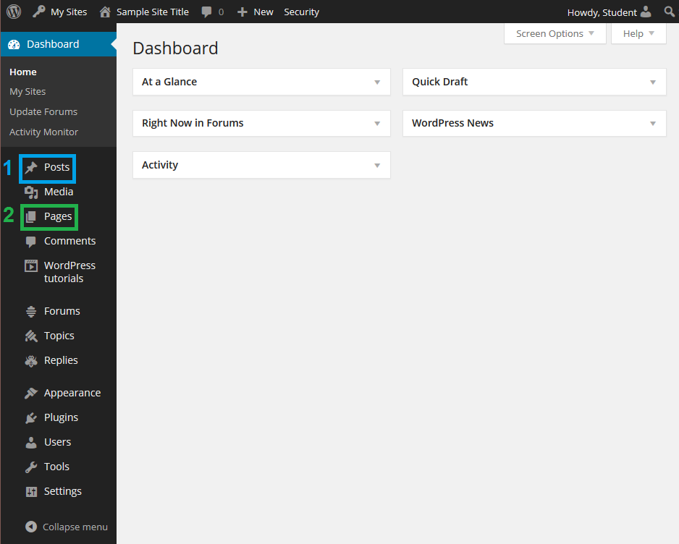
Getting Started
AGENDA
Posts vs. Pages – What’s the difference?
Posts
The information you update regularly
Organized by category and date
Example: articles, products, news bulletins
2) Pages
Information that remains relatively constant
Stand alone
Example: “contact information”, “about me” or “links”
< Click here to return to Table of Contents >

Slide 25
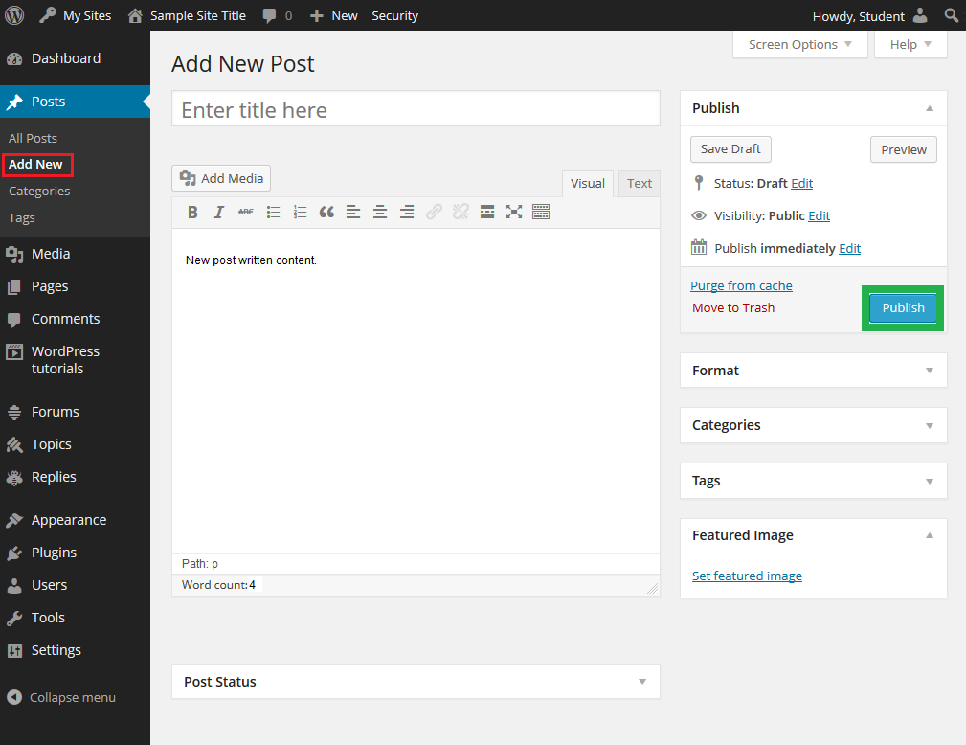
Getting Started
AGENDA
Creating a Post
From left side bar in Dashboard, select “Posts”.
Click on “Add New”
Once you’re finished writing, click “Publish”.
< Click here to return to Table of Contents >

Slide 26
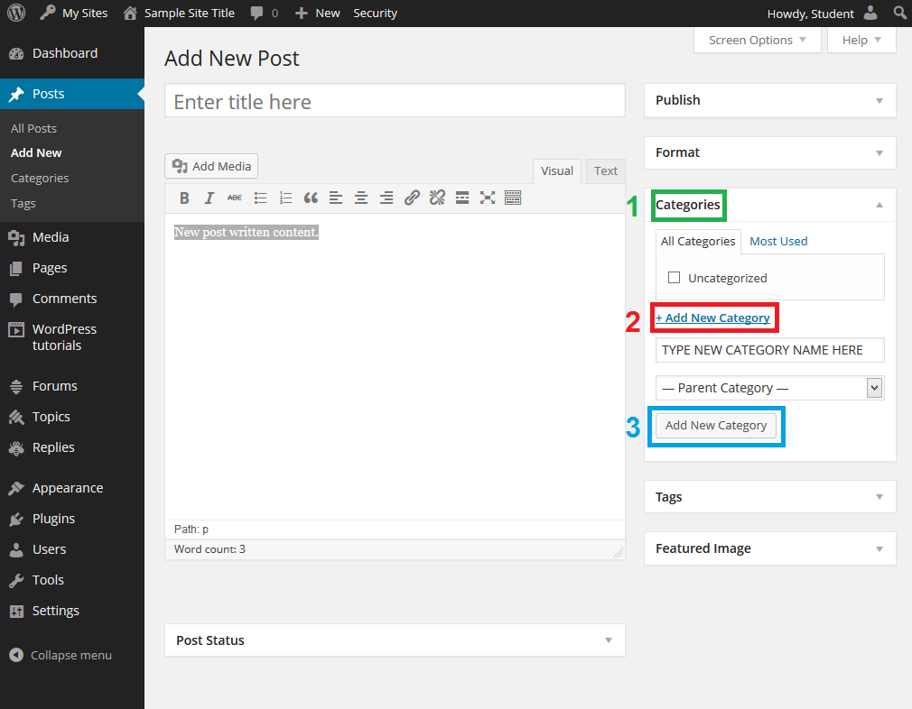
Getting Started
AGENDA
Creating a Post – Adding Categories
To Add Categories
Click “Categories” tab on the right side
Click on “+ Add New Category”
Type in name of category into field
Once finished, click “Add New Category”
Use categories to index and organize your blog posts
E.g. Food Blog Categories:
Breakfast
Lunch
Dinner
< Click here to return to Table of Contents >

Slide 27
Getting Started
AGENDA
Adding Media
You can upload images and audio files to your blog’s library located in the Dashboard.
< Click here to return to Table of Contents >

Slide 28
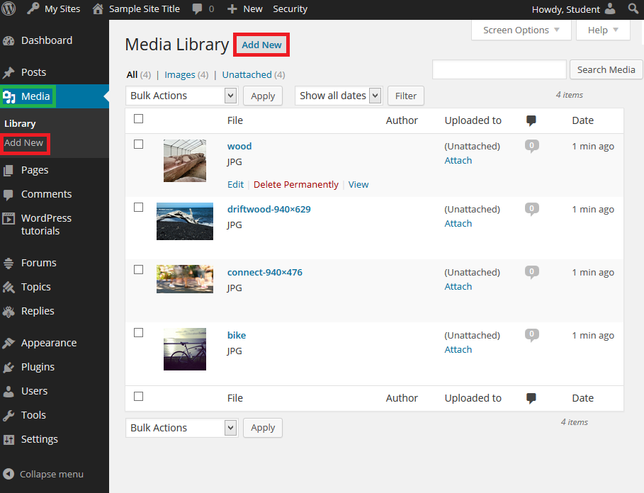
Getting Started
AGENDA
Adding Media
Click “Media” tab on the left side-bar in the Dashboard
Click on “Add New”
< Click here to return to Table of Contents >

Slide 29
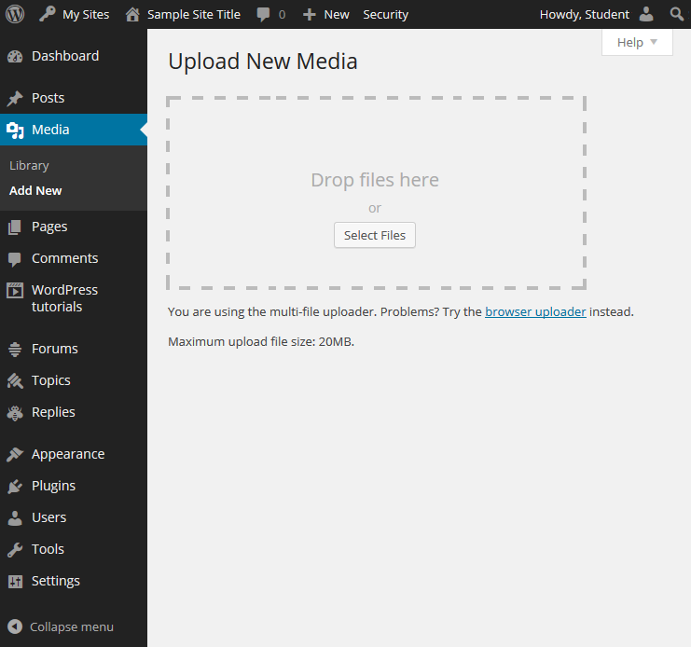
Getting Started
AGENDA
Adding Media
Simply drag and drop images and audio files into the “Upload New Media” dialogue box.
< Click here to return to Table of Contents >

Slide 30
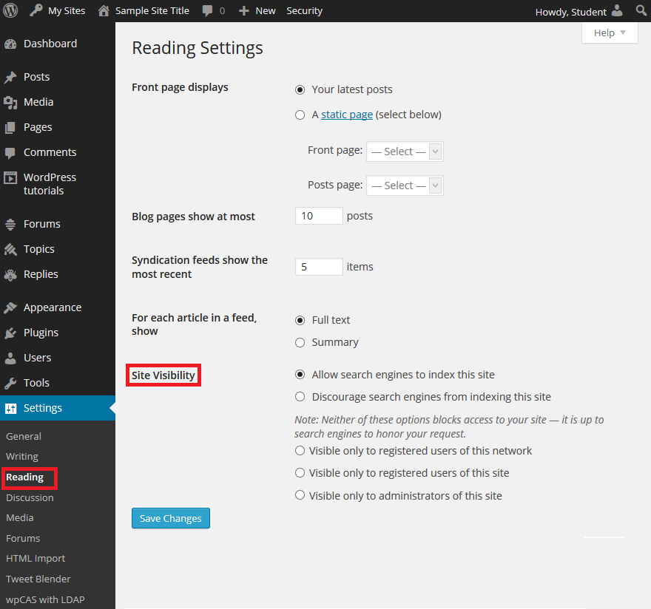
Getting Started
AGENDA
OAC privacy and security
Blog privacy settings
From “Reading Settings”, OAC users have the ability to restrict access to their blog
< Click here to return to Table of Contents >

Slide 31
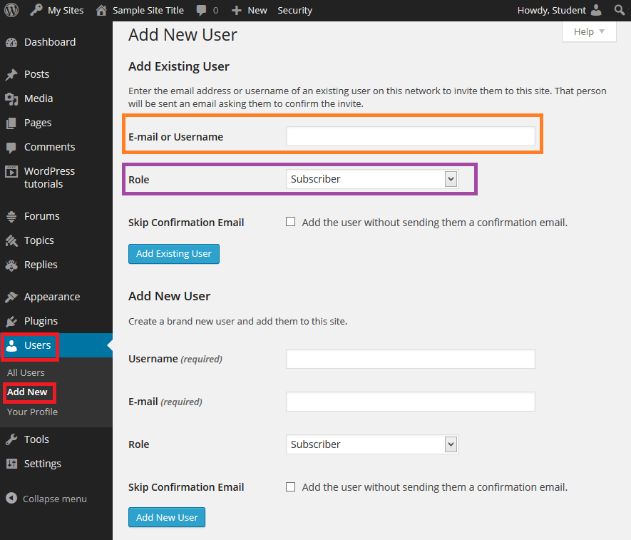
Getting Started
AGENDA
Add users to your site
Add users to your site
On the Dashboard menu left side bar select “Users” and then click “Add New”
Under “Add Existing User”, input the following:
Email or Username: Enter the NetLink-ID of user you wish to add
Role: Administrator
Click “Add Existing User” button
< Click here to return to Table of Contents >

Slide 32
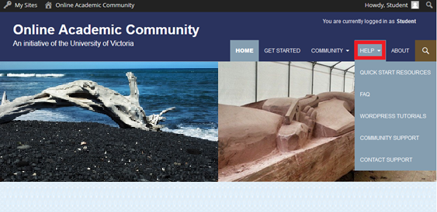
Getting Started
AGENDA
Further Assistance…
On OAC main page, click “Help” tab on the yellow ribbon
Quick start resources: OAC set-up video
WordPress tutorials: Training Videos created by WPMUDev
Community support: Ask/answer questions by OAC members
Contact support: Link to Computer Help Desk
< Click here to return to Table of Contents >

Slide 33
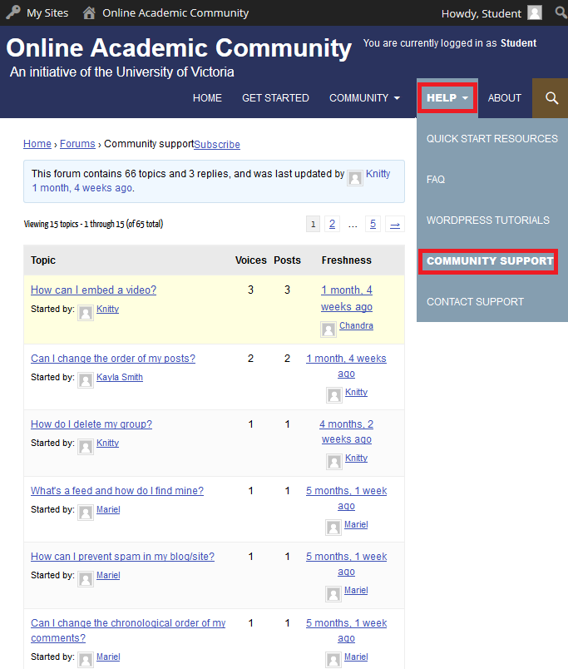
Getting Started
AGENDA
Further Assistance…
Community Support
On OAC main page, click “Help” and from the drop-down menu, select “Community Support”
Forum to ask and answer questions from other OAC members
< Click here to return to Table of Contents >

Slide 34

Getting Started
AGENDA
Further Assistance…
Computer Help Desk
To report any issues, provide feedback, or ask general questions about the Online Academic Community, please contact the Computer Help Desk.
< Click here to return to Table of Contents >

Slide 35
Getting Started
AGENDA
Thank You
< Click here to return to Table of Contents >

