Slide 1
ENGR 6010 / AI IN ROBOTICS
Sim-to-Real
Joint Tracking
with PPO
q
Can varied training physics improve
performance in an unfamiliar simulation?
1 joint • 2 policies
120 evaluation episodes
Mechatronics engineering student demonstration
SAY “My question is whether varied training physics helps a controller handle an unfamiliar simulated joint.”
One-joint educational simulation • No physical robot trial
01 / 18
Notes:
SLIDE 1: Can varied training physics improve transfer?
Suggested time: 40 seconds
READ-ALOUD SCRIPT
For my Reading 5 project, I investigated a practical question: can a learned controller become more robust when its training simulation changes from episode to episode? I built a one-degree-of-freedom joint inspired by the control problems inside quadrupedal robots such as Go2 and ANYmal. Two PPO policies choose target angles for the same PD controller. One trains with fixed physics, and the other trains with randomized physics. I then compare them under nominal and unfamiliar simulated conditions. This is an educational simulation study, not a physical robot experiment.
POINT TO / DO
Point to the project question, then the fixed-versus-randomized comparison.
TRANSITION
First, I will connect that question to the mechanical, electrical, and control systems in a robot.

Slide 2
ENGR 6010 / AI IN ROBOTICS
Why this is a mechatronics problem
A robot controller meets more than an ideal equation.
MECHANICS
ACTUATION
SENSING
Inertia changes acceleration.
Friction changes damping.
Delayed commands arrive late.
Torque has physical limits.
Measurements contain noise.
Feedback quality affects control.
Inspired by Go2 / ANYmal applications; this model isolates one joint.
SAY “A useful controller must work with the motor, the sensors, and the mechanical system together.”
One-joint educational simulation • No physical robot trial
02 / 18
Notes:
SLIDE 2: Why this is a mechatronics problem
Suggested time: 45 seconds
READ-ALOUD SCRIPT
As a mechatronics student, I see the reality gap as an interaction between the mechanical plant, actuator behavior, sensing, and software. A heavier effective joint responds differently to torque. Friction changes damping, actuator latency delays corrections, and measurement noise distorts feedback. A policy trained against only one ideal combination can depend too strongly on that combination. My simplified model makes these effects visible without needing a complete walking robot. The engineering motivation is to develop a controller that tolerates uncertainty, while being honest about which physical effects the demonstration leaves out.
POINT TO / DO
Trace the mechanical, actuator, sensor, and software blocks.
TRANSITION
The control architecture separates the policy's target decision from the actuator torque calculation.

Slide 3
ENGR 6010 / AI IN ROBOTICS
PPO chooses a target; PD supplies torque
OBSERVATION
PPO
DELAY + PD
JOINT MODEL
q, ω (noisy)
r, r (preview)
Last target
Target angle
−1 to +1 rad
Queued target
Torque ±12 N·m
Inertia + friction
Angle + velocity
Noisy state returns to both the policy and PD feedback.
τ = clip[12(qtarget, delayed − qmeasured) − 2ωmeasured, −12, 12]
Both policy and PD updates run at 20 Hz in this simplified implementation.
SAY “The policy decides where to move; the PD controller computes the torque needed to move there.”
One-joint educational simulation • No physical robot trial
03 / 18
Notes:
SLIDE 3: PPO chooses a target; PD supplies torque
Suggested time: 55 seconds
READ-ALOUD SCRIPT
The policy action is a target joint angle bounded between minus one and plus one radian. That target passes through a delay queue before reaching the PD controller. The controller uses proportional position error and derivative velocity feedback, then clips commanded torque to plus or minus twelve newton metres. The dynamics update the true joint state, and noisy measurements return to both the policy and PD feedback. This structure connects reinforcement learning to a familiar control loop. In this educational code, both the policy and PD calculation update every fifty milliseconds; I am not modeling a separate high-frequency motor controller.
POINT TO / DO
Follow the target-angle arrow, delay queue, PD equation, and feedback loop.
TRANSITION
Next, I will show exactly what the environment observes and how its dynamics advance.

Slide 4
ENGR 6010 / AI IN ROBOTICS
A transparent Gymnasium joint environment
TRANSPARENT DYNAMICS
GYMNASIUM CONTRACT
I · angular acceleration = τ − b · ω
Semi-implicit Euler, Δt = 0.05 s:
ωnext = ω + Δt(τ − bω) / I
qnext = q + Δt · ωnext
5 continuous observations
1 bounded angle-target action
100 steps = 5 simulated seconds
Safety: |q| > 2 rad or |ω| > 12 rad/s
reset(seed) → observation, info step(action) → observation, reward, terminated, truncated, info
SAY “The model is small enough that we can inspect every observation, force balance, and integration step.”
One-joint educational simulation • No physical robot trial
04 / 18
Notes:
SLIDE 4: A transparent Gymnasium joint environment
Suggested time: 50 seconds
READ-ALOUD SCRIPT
The environment observation contains measured angle, measured angular velocity, the current reference, the reference one hundred fifty milliseconds ahead, and the latest policy target. The preview is allowed because this is a prescribed trajectory, not an unknown future sensor measurement. Dynamics follow inertia times acceleration equals actuator torque minus viscous friction. Semi-implicit Euler updates velocity first, then angle using the new velocity. An episode lasts one hundred steps, or five simulated seconds, unless position or velocity exceeds the stated safety limits. Gymnasium reset and step methods are checked with Stable-Baselines3 before training.
POINT TO / DO
Point to the observation vector, Euler update, and terminated-versus-truncated conditions.
TRANSITION
Those states and torques also define the tracking reward and the separate success criterion.

Slide 5
ENGR 6010 / AI IN ROBOTICS
Reward encourages tracking; success is predefined
reward = 1 − 5e² − 0.005ω² − 0.001τ²
TRACKING ERROR
ANGULAR VELOCITY
TORQUE
Follow the desired angle.
Discourage fast oscillations.
Limit excessive effort.
Success: full 5 s episode, no safety termination, RMSE < 0.32 rad
Threshold retained before training; 0.32 rad ≈ 18.3° is an educational tolerance.
SAY “The reward guides learning; the fixed RMSE threshold judges the final behavior.”
One-joint educational simulation • No physical robot trial
05 / 18
Notes:
SLIDE 5: Reward encourages tracking; success is predefined
Suggested time: 55 seconds
READ-ALOUD SCRIPT
The step reward starts at one and subtracts three costs. Five times squared tracking error emphasizes accuracy. The squared-velocity penalty discourages unnecessarily fast or oscillatory motion, and the squared-torque penalty discourages control effort. I score these terms using the true simulated state, while the policy sees noisy measurements. Success is defined separately: complete the full five-second episode without safety termination and achieve RMSE strictly below zero point three two radians. That threshold came from the original program and was retained before training. It is an educational tolerance, approximately eighteen degrees, rather than a real robot accuracy specification.
POINT TO / DO
Identify each reward term, then underline the strict RMSE < 0.32 rad condition.
TRANSITION
To make the comparison meaningful, both policies must share the learning setup and scoring rules.

Slide 6
ENGR 6010 / AI IN ROBOTICS
Matched PPO training conditions
MATCHED PPO RECIPE
POLICY-GRADIENT CONNECTION
SB3 PPO • MLP [32, 32] • CPU
12,288 timesteps per policy
Rollout 256 • batch 64 • 5 epochs
Learning rate 0.0008 • γ = 0.98
Same reward, references, seed 42
Sutton & Barto: general foundations
PPO: a specific actor–critic method
with a clipped surrogate objective
Training-ratio clipping ≠ torque saturation
Experimental change: the distribution of training physics.
SAY “I changed the training physics distribution while keeping the other experimental choices consistent.”
One-joint educational simulation • No physical robot trial
06 / 18
Notes:
SLIDE 6: Matched PPO training conditions
Suggested time: 55 seconds
READ-ALOUD SCRIPT
Both controllers use Stable-Baselines3 PPO with the same network architecture, seed, reward, reference-trajectory sequence, and training budget. Each policy receives twelve thousand two hundred eighty-eight environment steps, exactly forty-eight PPO rollouts of two hundred fifty-six steps. The hidden-layer architecture is thirty-two by thirty-two, with identical learning rate, batch size, update epochs, and discount factor. PPO is a particular actor-critic policy-gradient method using a clipped surrogate learning objective. It is not synonymous with every policy-gradient method, and its learning-objective clipping is different from the torque saturation inside the joint environment.
POINT TO / DO
Point across the matched settings, then distinguish PPO clipping from actuator saturation.
TRANSITION
The intended difference is the physical parameter distribution seen during training.

Slide 7
ENGR 6010 / AI IN ROBOTICS
Nominal, randomized, and held-out physics
Condition
Inertia scale
Friction b
Target delay
Fixed / nominal
1.00
0.20
0 ms
Randomized training
U(0.70, 1.80)
U(0.10, 0.65)
0, 50, 100, 150 ms
Held-out simulation
1.95
0.75
200 ms
Randomize at every reset; keep each episode’s physics constant.
Sensor SD: training / nominal = 0.005 rad, 0.02 rad/s
Held-out = 0.045 rad, 0.09 rad/s; noise affects policy and PD.
SAY “Randomization covers varied training joints; the held-out joint deliberately exceeds those ranges.”
One-joint educational simulation • No physical robot trial
07 / 18
Notes:
SLIDE 7: Nominal, randomized, and held-out physics
Suggested time: 55 seconds
READ-ALOUD SCRIPT
Fixed training uses inertia scale one, viscous friction zero point two, and no target-command delay. Randomized training samples inertia between zero point seven and one point eight, friction between zero point one and zero point six five, and delay from zero through three control steps at every reset. These values stay constant within that episode. The held-out condition uses inertia one point nine five, friction zero point seven five, and four delay steps, or two hundred milliseconds. It also increases position and velocity measurement noise. Both training modes use the same smaller sensor-noise levels.
POINT TO / DO
Compare each held-out value with the corresponding upper training boundary.
TRANSITION
Those experimental choices map directly onto a small set of functions and saved deliverables.

Slide 8
ENGR 6010 / AI IN ROBOTICS
From readable code to auditable deliverables
Code or artifact
Purpose
Joint / check_env()
Physical model, API, and environment validation
train() + policy_*.zip
Two matched PPO training runs and saved controllers
roll() / summarize()
Paired evaluations and reproducible statistics
figures() + three PNGs
Recorded learning, tracking, and success
CSVs + tests + README
Audit trail, installation, and limitations
The classroom helper reuses saved models and writes into classroom/demo_runs/.
SAY “The files connect environment design, actual learning, evaluation, and evidence that another student can check.”
One-joint educational simulation • No physical robot trial
08 / 18
Notes:
SLIDE 8: From readable code to auditable deliverables
Suggested time: 40 seconds
READ-ALOUD SCRIPT
The source is organized around a few functions. Joint defines the environment, train creates each PPO policy, roll records an evaluation episode, summarize computes statistics, and figures creates the three requested plots. The trained policy files allow evaluation without repeating learning. Training rewards, episode records, and step records preserve the underlying numerical evidence. Requirements and the README explain installation and limitations. The executable is two hundred eighteen lines because it also includes complete plotting and audit exports. I chose inspectable output over compressing those functions into a difficult-to-read one hundred fifty lines.
POINT TO / DO
Point from each function name to its corresponding model, CSV, or figure output.
TRANSITION
The first output to inspect is the actual reward history recorded during training.

Slide 9
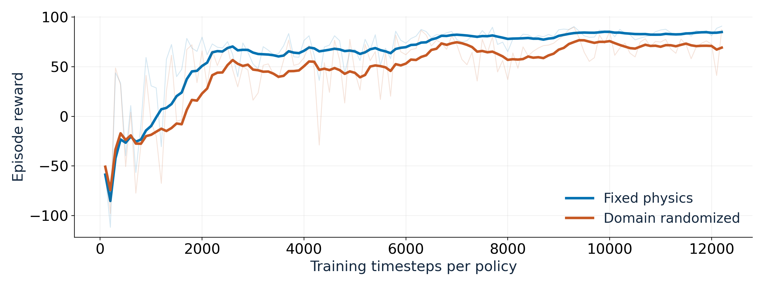
ENGR 6010 / AI IN ROBOTICS
What the recorded training rewards show
Faint: actual episode returns • Bold: trailing 10-episode mean • Different training physics
SAY “These are actual training returns; the randomized policy is learning across a harder range of conditions.”
One-joint educational simulation • No physical robot trial
09 / 18
Notes:
SLIDE 9: What the recorded training rewards show
Suggested time: 45 seconds
READ-ALOUD SCRIPT
This figure uses recorded completed-episode rewards, not constructed curves. Faint lines show individual episodes, and bold lines show a trailing ten-episode average. Both policies improve substantially during the short training budget. The randomized policy generally has lower training returns because its episodes span harder and more varied physical conditions. That does not automatically mean worse transfer, because the two training distributions differ. The meaningful comparison comes when both trained policies face the same evaluation conditions. A rising curve also does not establish full convergence; this is deliberately short CPU training for a classroom-scale experiment.
POINT TO / DO
Identify the faint raw episodes and bold moving averages; compare the training distributions.
TRANSITION
To compare transfer fairly, I evaluate the saved policies with matched conditions and seeds.

Slide 10
ENGR 6010 / AI IN ROBOTICS
Evaluation: 30 matched trials per condition
30 MATCHED SEEDS
120 EPISODES
AUDITABLE METRICS
1000–1029
Same reference + initial state
Same underlying noise draws
2 policies × 2 environments
× 30 episodes
Deterministic evaluation
Reward and RMSE: mean ± SD
Success: percentage
95% Wilson intervals
The 30 evaluation seeds vary trials; there is only one training seed per policy.
SAY “The policies face matching trajectories and initial conditions, and every trial is saved.”
One-joint educational simulation • No physical robot trial
10 / 18
Notes:
SLIDE 10: Evaluation: 30 matched trials per condition
Suggested time: 50 seconds
READ-ALOUD SCRIPT
Evaluation uses deterministic actions from each trained policy. I run thirty distinct matched seeds in nominal simulation and thirty in the held-out simulation for each policy, giving one hundred twenty episodes total. Separate random streams keep the reference and initial-state sequences matched despite physics randomization. The seeds also align underlying sensor-noise draws, although held-out noise is larger. I report mean episode reward, mean per-episode RMSE, sample standard deviations, and success percentages with Wilson intervals. These thirty evaluation trials vary conditions for already-trained policies; they are not thirty independent policy-training runs.
POINT TO / DO
Trace the two policies by two environments by thirty seeds design.
TRANSITION
One preselected held-out trial lets us see the tracking behavior behind those aggregate numbers.

Slide 11
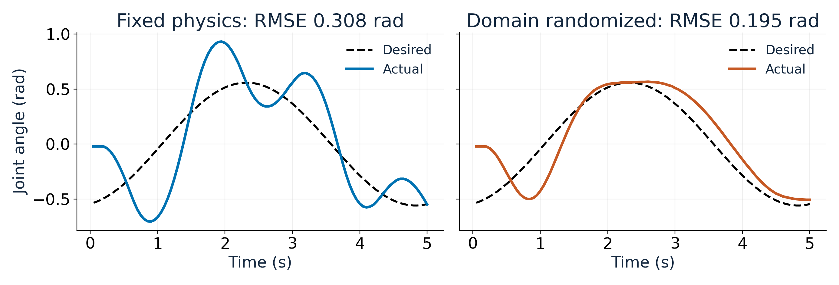
ENGR 6010 / AI IN ROBOTICS
Held-out tracking: one matched example
Held-out seed 1000: both policies pass 0.32 rad. This one trial illustrates tracking, not the overall success rate.
SAY “This preselected trial shows tracking behavior; the full thirty-trial evaluation supports the overall comparison.”
One-joint educational simulation • No physical robot trial
11 / 18
Notes:
SLIDE 11: Held-out tracking: one matched example
Suggested time: 50 seconds
READ-ALOUD SCRIPT
Both panels show the same held-out physics and reference trajectory for seed one thousand, chosen before viewing the results. The fixed-physics policy has larger oscillation and overshoot, while the randomized policy follows this reference more closely. Higher inertia reduces acceleration for a given torque, friction changes damping, and delayed targets arrive after the state has changed. Their combined effect can produce lag and overshoot. Importantly, both policies pass the RMSE threshold in this particular trial: approximately zero point three zero eight and zero point one nine five radians. The full evaluation, not this one plot, determines the reported success rates.
POINT TO / DO
Compare identical dashed references, then point to the two displayed RMSE values.
TRANSITION
The grouped success chart summarizes all thirty paired trials rather than only this example.

Slide 12
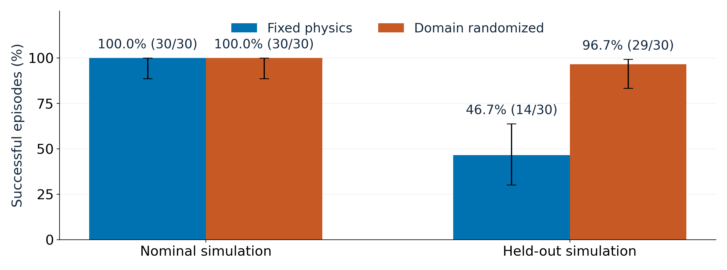
ENGR 6010 / AI IN ROBOTICS
Observed result: stronger held-out performance
Held-out mean episode RMSE: 0.3299 → 0.2250 rad • Intervals describe evaluation uncertainty
SAY “Domain randomization helped this trained policy pair in the held-out simulation; it is not a universal guarantee.”
One-joint educational simulation • No physical robot trial
12 / 18
Notes:
SLIDE 12: Observed result: stronger held-out performance
Suggested time: 55 seconds
READ-ALOUD SCRIPT
Both policies succeed in all thirty nominal trials. In the held-out simulation, the fixed policy succeeds in fourteen of thirty trials, or forty-six point seven percent. The randomized policy succeeds in twenty-nine of thirty, or ninety-six point seven percent. Mean episode RMSE falls from zero point three two nine nine to zero point two two five zero radians. The error bars are ninety-five percent Wilson success intervals. Nominal RMSE is slightly higher for the randomized policy, so the result is not better accuracy everywhere. The supported conclusion is improved held-out robustness for this one trained policy pair.
POINT TO / DO
Point to nominal equality, held-out 14/30 versus 29/30, and the uncertainty bars.
TRANSITION
I will now replay the saved policies so the code-to-result connection is visible.

Slide 13
ENGR 6010 / AI IN ROBOTICS
Live demonstration: replay, compare, repeat
Replay the trained models; repeat the same matched seeds.
.\.venv\Scripts\python.exe classroom\demo.py --trials 3 --rounds 2
1 RUN
2 COMPARE
3 REPEAT
Load saved policies.
Watch both rounds finish.
Open the new tracking PNG.
Check identical rounds.
Run again: a fresh folder.
Or double-click run_demo.cmd.
Quick demo = 3 seeds; original results = 30. Repeated rounds add no independent evidence.
SAY “I am reloading trained policies, evaluating matching trials, and checking repeatable execution—not training again.”
One-joint educational simulation • No physical robot trial
13 / 18
Notes:
SLIDE 13: Live demonstration: replay, compare, repeat
Suggested time: 100 seconds
READ-ALOUD SCRIPT
For the live demonstration, I load the two saved model files and run the classroom helper with three trials and two rounds. The helper evaluates both policies in both conditions, then repeats exactly the same seeds to check reproducibility. Three-trial success rates can differ from the thirty-trial figures on the previous slide, so I will not substitute these quick-demo values for the scientific results. The second round is repeated execution, not independent evidence. Each invocation saves new timestamped output without changing the original models or report data. I can use thirty trials and one round to replay the complete evaluation.
POINT TO / DO
Switch to the prepared terminal, run --trials 3 --rounds 2, and show the repeatability check plus PNG.
TRANSITION
After the replay, I will summarize what was tested and how long the full experiment took.

Slide 14
ENGR 6010 / AI IN ROBOTICS
Validation, provenance, and measured runtime
ENVIRONMENT
EXPERIMENT
CLASSROOM
check_env(): all 3 modes
8 regression tests passed
Bounds, delay, dynamics
7 artifact audits passed
12,000 evaluation steps
Saved-model replay
Two rounds match exactly
Full replay matches CSVs
Root results preserved
Measured cloud runtimes
Full experiment: 27.72 s • Training: 20.45 s
Quick replay: 5.82–7.06 s • Full replay: 9.32 s
Measured on the cloud CPU; laptop timing varies.
SAY “The plots are backed by raw records, executable checks, saved models, and measured wall-clock time.”
One-joint educational simulation • No physical robot trial
14 / 18
Notes:
SLIDE 14: Validation, provenance, and measured runtime
Suggested time: 45 seconds
READ-ALOUD SCRIPT
The environment passes Stable-Baselines3's Gymnasium checker in all three physics modes. Eight regression tests cover seeding, dynamics, reward arithmetic, delay, episode handling, and safety limits. Seven artifact audits independently recompute statistics, check bounded controls and image quality, and reload the saved models to reproduce recorded trajectories. The verified full cloud run took twenty-seven point seven two seconds, including imports, both training runs, evaluation, and plotting; training took twenty point four five seconds. A repeat produced identical training and evaluation CSVs. Laptop timing and exact floating-point equality across platforms are not guaranteed.
POINT TO / DO
Point to the checker, 8 + 7 tests, raw-data trail, and full-run runtime label.
TRANSITION
Successful execution still leaves scientific and engineering limitations that matter for interpretation.

Slide 15
ENGR 6010 / AI IN ROBOTICS
Limitations and the next engineering experiment
WHAT THIS RUN SUPPORTS
NEXT ENGINEERING TESTS
A controlled comparison of training physics
Observed robustness in one held-out condition
An inspectable mechatronics control loop
Multiple independent training seeds
Plain PD baseline and parameter ablations
Timestep sensitivity and richer dynamics
Calibrated hardware with safety systems
No full quadruped, contacts, balance, calibrated hardware, or proof of stability is claimed.
SAY “The next step is stronger evidence: more training seeds, classical baselines, and more realistic physics.”
One-joint educational simulation • No physical robot trial
15 / 18
Notes:
SLIDE 15: Limitations and the next engineering experiment
Suggested time: 55 seconds
READ-ALOUD SCRIPT
This model omits gravity, contacts, body coupling, balance, transmissions, and motor electrical or thermal behavior. Its inertia and noise are not calibrated to a real robot. Only one training seed was used, and evaluation uncertainty does not capture variability from retraining. The observation also hides the full delayed-action queue and physical parameters. Useful next experiments would add independent training seeds, a direct reference-following PD baseline, and one-parameter-at-a-time ablations. A richer simulator such as MuJoCo could add multibody and contact dynamics. Hardware testing would then require calibration, safety supervision, and evidence beyond this demonstration.
POINT TO / DO
Point first to missing physics, then the proposed baseline, seed, and ablation comparisons.
TRANSITION
My conclusion therefore needs to stay narrower than a claim of general real-world transfer.

Slide 16
ENGR 6010 / AI IN ROBOTICS
Takeaway: robustness is an evidence-based claim
For this policy pair, varied physics
improved held-out robustness.
14 → 29
0.3299 → 0.2250
100%
Successful held-out trials / 30
Held-out mean RMSE (rad)
Nominal success, both
Engineering takeaway: test the reality gap, retain the evidence, and qualify the claim.
SAY “Randomization improved this simulated transfer test; the data define how far that conclusion can go.”
One-joint educational simulation • No physical robot trial
16 / 18
Notes:
SLIDE 16: Takeaway: robustness is an evidence-based claim
Suggested time: 35 seconds
READ-ALOUD SCRIPT
My main takeaway is that the training distribution can matter as much as nominal training reward. In this experiment, varying inertia, friction, and target delay produced a policy with better held-out tracking and a higher success rate, while both policies retained full nominal success. I can demonstrate the comparison repeatedly by reloading the saved models, without confusing replay with new learning. The same workflow also preserves a disappointing result if randomization fails in a future experiment. For a mechatronics application, the value is a transparent path from assumptions to control behavior, numerical evidence, and clearly stated limitations.
POINT TO / DO
Return to the original question and point to the limited, evidence-supported answer.
TRANSITION
I have the reading connections and full numerical table available for questions.

Slide 17
ENGR 6010 / AI IN ROBOTICS
How the four Reading 5 sources connect
TAN ET AL. (2018)
Sim-to-Real: Learning Agile Locomotion for Quadruped Robots
https://arxiv.org/abs/1804.10332 | Actuation and randomized-simulation motivation
ZHAO ET AL.
Sim-to-Real Transfer in Deep Reinforcement Learning for Robotics: A Survey
https://arxiv.org/abs/2009.13303 | Reality-gap context and transfer strategies
SUTTON & BARTO · CHAPTER 13
Reinforcement Learning: An Introduction
http://incompleteideas.net/book/the-book-2nd.html | Policy-gradient / actor–critic foundations
MUJOCO
Full multibody physics, contacts, constraints, and actuators
https://mujoco.org/ | A richer simulator; not used in this one-joint code
Specific PPO method: Schulman et al. (2017), https://arxiv.org/abs/1707.06347
SAY “The readings motivate the engineering choices; this small experiment does not reproduce their complete systems.”
One-joint educational simulation • No physical robot trial
17 / 18
Notes:
SLIDE 17: How the four Reading 5 sources connect
Suggested time: 30 seconds
READ-ALOUD SCRIPT
Tan and colleagues motivate attention to actuator behavior and randomized training physics in locomotion transfer. Zhao and colleagues place domain randomization within the broader reality-gap literature. Sutton and Barto's Chapter Thirteen explains policy-gradient and actor-critic foundations, while PPO is the later specific algorithm implemented here by Stable-Baselines3. MuJoCo illustrates the richer multibody, contact, constraint, and actuator physics omitted from my small Euler-integrated joint. Together, these sources explain why the experiment is relevant and why its limits matter. I am borrowing a research pattern, not claiming to reproduce a complete quadruped or its hardware performance.
POINT TO / DO
Point to each source's contribution and the full reference links.
TRANSITION
The final backup slide contains the complete statistics if a numerical detail is useful.

Slide 18
ENGR 6010 / AI IN ROBOTICS
Backup: complete verified numerical comparison
Policy
Condition
Reward ± SD
RMSE ± SD (rad)
Success
95% interval
Fixed
Nominal
93.42 ± 2.64
0.1022 ± 0.0225
100.0%
88.6–100.0%
Randomized
Nominal
93.67 ± 2.62
0.1037 ± 0.0235
100.0%
88.6–100.0%
Fixed
Held-out
34.08 ± 26.05
0.3299 ± 0.0734
46.7%
30.2–63.9%
Randomized
Held-out
70.97 ± 12.65
0.2250 ± 0.0505
96.7%
83.3–99.4%
Replay all 30 seeds without retraining:
.\.venv\Scripts\python.exe classroom\demo.py --trials 30 --rounds 1
SAY “These are the full thirty-trial statistics; quick replay values are labeled separately.”
One-joint educational simulation • No physical robot trial
18 / 18
Notes:
SLIDE 18: Backup: complete verified numerical comparison
Suggested time: 30 seconds
READ-ALOUD SCRIPT
This table is the numerical reference for the presentation. Each row represents thirty episodes for one policy and one evaluation condition. Reward and RMSE are reported with sample standard deviations, while success includes a count, percentage, and Wilson interval. The randomized policy has slightly higher nominal mean RMSE despite similar reward and identical nominal success, because reward also includes speed and torque costs. Held-out performance improves across the reported tracking and success measures. These numbers come from the original verified evaluation CSVs; a three-trial classroom replay is a separate illustration with a smaller sample.
POINT TO / DO
Use the relevant row and column to answer a specific numerical question.
TRANSITION
I will return to the relevant slide for any questions about the model, learning method, or evidence.

