Slide 1
Halide
张航凯 阮超逸 汪超

Slide 2
01
INTRODUCTION

Slide 3

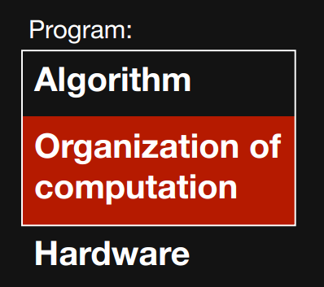

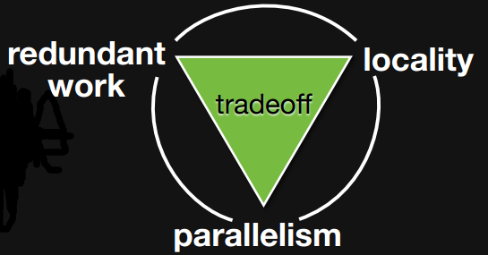
01
Background
challenge for image processing
Image processing pipelines combine the challenges of stencil computations and stream programs. They are composed of large graphs of different stencil stages, as well as complex reductions, and stages with global or data-dependent access patterns. Efficient implementations require optimization of both parallelism and locality, but due to the nature of stencils, there is a fundamental tension between parallelism, locality, and introducing redundant recomputation of shared values.
Notes:
图像处理流水线综合了模板计算和流程序两方面的挑战。 主要包括大型图形下 较复杂的缩减，以及全局性或数据相关的访问模式。 有效的实现需要优化并行性和局部性，
但是由于模板的本质，在并行性，局部性和引入共享值的冗余重新计算之间存在一个基本的紧张关系。

Slide 4
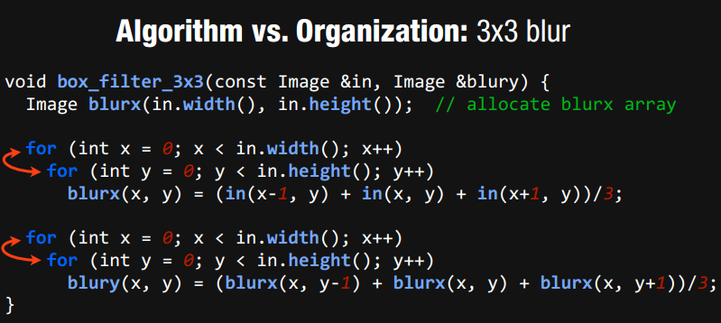
01
Example
Same algorithm, different organization. One of them is 15x faster
Why swapping loops make things faster/slower Reorganize computation to maximize parallelism & locality

Slide 5
01
Halide
a language and compiler for image processing
Halide is a new programming language designed to make it easier to write high-performance image processing code on modern machines. Its current front end is embedded in C++.
A systematic model of the tradeoff space fundamental to stencil pipelines, a schedule representation which describes concrete points in this space for each stage in an image processing pipeline, and an optimizing compiler for the Halide image processing language that synthesizes high performance implementations from a Halide algorithm and a schedule.
Notes:
一个用于权衡流水线的基本空间的系统化模板，
一个，描述当前空间内每个阶段中图像处理流水线的具体点，的调度表示
一个针对Halide图像处理语言的优化编译器

Slide 6
01
Organizing computation is hard
Optimizing parallelism, locality requires
transforming program & data structure.
What transformations are legal?
What transformations are beneficial?
Halide’s answer: decouple algorithm from schedule
Notes:
从计划中分离算法

Slide 7
01
decouple algorithm from schedule
Algorithm: what is computed
Schedule: where and when it’s computed Easy for programmers to build pipelines
Easy to specify & explore optimizations
Easy for the compiler to generate fast code

Slide 8
01
Feature
Combining this compiler with stochastic search over the space of schedules enables terse, composable programs to achieve state-of-the-art performance on a wide range of real image processing pipelines, and across different hardware architectures, including multicores with SIMD, and heterogeneous CPU+GPU execution. From simple Halide programs written in a few hours, we demonstrate performance up to 5× faster than hand-tuned C, intrinsics, and CUDA implementations optimized by experts over weeks or months, for image processing applications beyond the reach of past automatic compilers.
Notes:
图像处理涉及到大量的循环操作，但如何组织这些循环使得有效的计算这些循环（Cache利用率，并行性）即使是很有经验的工程师也很难很好完成
这是Halide要解决的问题。。
Halide的主要特点就是较为高效，一般情况下，几个小时内写出的代码性能比专家优化几个星期还要优。
Halide在各种图像处理流水线上以及不同的硬件体系结构

Slide 9
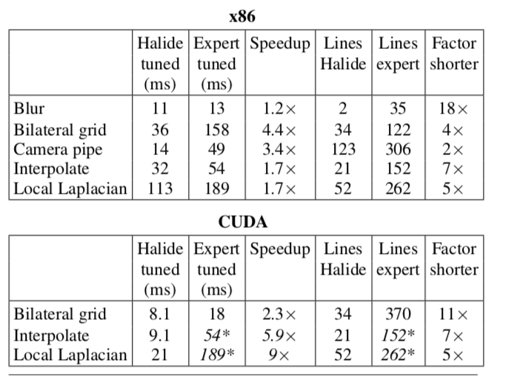
01
Notes:
一个用于权衡流水线的基本空间的系统化模板，
一个，描述当前空间内每个阶段中图像处理流水线的具体点，的调度表示
一个针对Halide图像处理语言的优化编译器

Slide 10
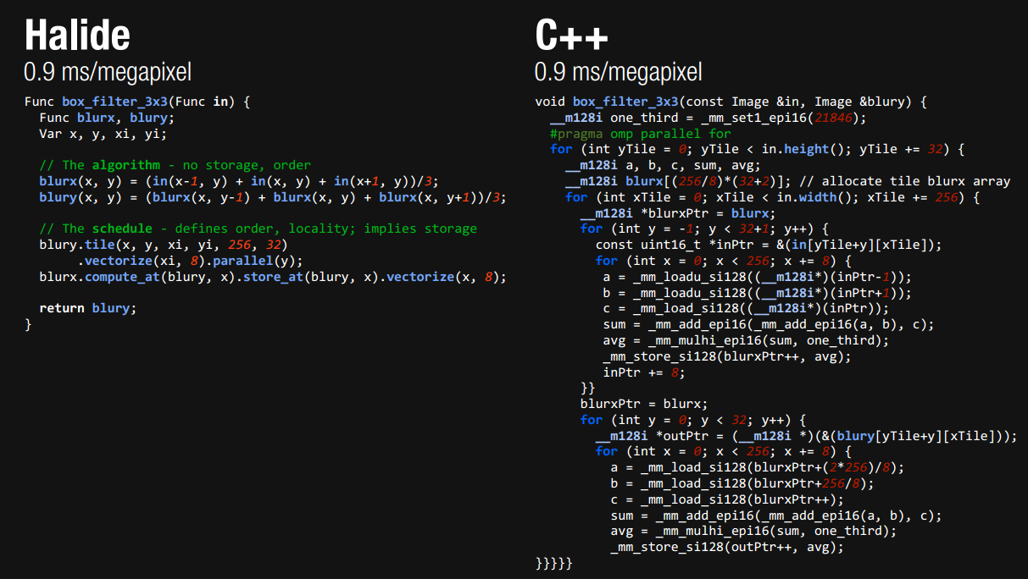

Slide 11
02
DSL

Slide 12
02
DSL
In Halide, values that would be mutable arrays in an imperative language are instead functions from coordinates to values. It represents images as pure functions defined over an infinite integer domain, where the value of a function at a point represents the color of the corresponding pixel. Pipelines are specified as chains of functions. Functions may either be simple expressions in their arguments, or reductions over a bounded domain. The expressions that define functions are side-effect free, and are much like those in any simple functional language, including:
​ • Arithmetic and logical operations;
​ • Loads from external images;
​ • If-then-else expressions;
•References to named values(which maybe function arguments, or expressions defined by a functional let construct);
​ • Calls to other functions, including external C ABI functions.
​ ​
For example, a separable 3 × 3 unnormalized box filter is expressed as a chain of two functions in x, y:
​
UniformImage in(UInt(8), 2)
Var x, y
Func blurx(x,y) = in(x-1,y) + in(x,y) + in(x+1,y)
Func out(x,y) = blurx(x,y-1) + blurx(x,y) + blurx(x,y+1)
​This representation is simpler than most functional languages. It does not include higher-order functions, dynamic recursion, or additional data structures like lists. Functions simply map from integer coordinates to a scalar result.
Notes:
在Halide中，值由坐标函数确定的。 它将图像表示为在无限整数域上定义的纯函数，其中点上函数的值表示相应像素的颜色。 函数可以是参数中的简单表达式，也可以是有界域上的简化表达式。 定义函数的表达式是无副作用的，与任何简单的函数式语言类似，包括：
•算术和逻辑运算;
•从外部图像加载;
•If-then-else表达式;
•对指定值的引用（可能是函数参数，或由函数let构造定义的表达式）;
•调用其他功能，包括外部C ABI功能。（二进制接口）
这种表示比大多数功能语言更简单。 它不包括高阶函数，动态递归或像列表这样的其他数据结构。 函数只是从整数坐标映射到标量结果

Slide 13
02
Scheduling Image Processing Pipelines
Halide’s representation of image processing algorithms avoids imposing constraints on the order of execution and placement of data. Values need to be computed before they can be used, to respect the fundamental dependencies in the algorithm, but many choices remain unspecified:
​ • When and where should the value at each coordinate in each function be computed?
​ • Where should they be stored? ​
• How long are values cached and communicated across multiple consumers, and when are they independently recomputed by each?
Notes:
Halide对图像处理算法的表示避免了对 数据存放和执行顺序 施加限制。 在使用这些值之前，需要计算这些值以尊重算法中的基本依赖关系，但许多选择仍然未指定：
•何时何地计算每个函数中每个坐标的值？
•他们应该在哪里储存？
•在多个消费者之间缓存和交流价值多久？每个消费者何时独立重新计算价值？

Slide 14
02
Scheduling a Two-Stage Pipeline
The simple two-stage blur algorithm, which computes a 3 × 3 box filter as two 3 × 1 passes. The first stage, blurx, computes a horizontal blur of the input by averaging over a 3 × 1 window:
blurx(x,y) = in(x-1,y) + in(x,y) + in(x+1,y)
The second stage, out, computes the final isotropic blur by averaging a 1 × 3 window of the output from the first stage:
out(x,y) = blurx(x,y-1) + blurx(x,y) + blurx(x,y+1)
Notes:
简单的两阶段模糊算法，计算3×3盒过滤器为两次3×1遍。 第一阶段，blurx，通过平均3×1窗口计算输入的水平模糊：
第二阶段，通过平均第一阶段的输出的1×3窗口来计算最终的各向同性模糊：

Slide 15
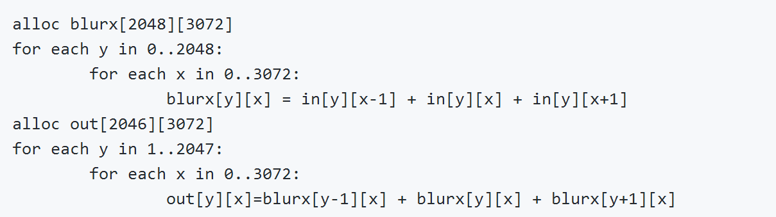
02
Scheduling a Two-Stage Pipeline
First, it could compute and store every required point in blurx before evaluating any points in out. Applied to a 6 megapixel(3k × 2k) image, this is equivalent to the loop nest:
Notes:
首先，它可以计算和存储每个需要的点在模糊之前评估任何点进来。 应用于600万像素（3k×2k）的图像，这相当于循环嵌套：

Slide 16
02
Scheduling a Two-Stage Pipeline
This is the most common strategy in hand-written pipelines, and what results from composing library routines together: each stage executes breadth-first across its input before passing its entire output to the next stage. There is abundant parallelism, since all the required points in each stage can be computed and stored independently, but there is little producer-consumer locality, since all the values of blurx must be computed and stored before the first one is used by out.
Notes:
这是手写流水线中最常见的策略，也是将库例程组合在一起的结果：每个阶段在将其整个输出传递到下一个阶段之前，在其输入中执行广度优先。 因为在每一个阶段中所有需要的点都可以被独立地计算和存储，但是由于所有的blurx值先计算和存储，然后被out使用，因此局部上的生产者 - 消费者关系几乎没有。

Slide 17
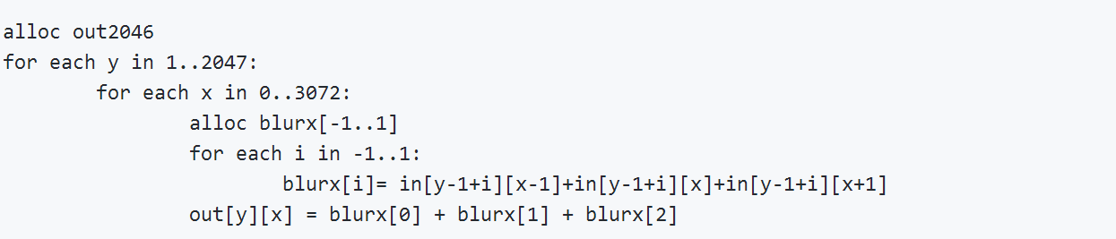
02
Scheduling a Two-Stage Pipeline
Interleaving the two stages, without storing the intermediate results across uses, is equivalent to the loop nest:
Each pixel can be computed independently, providing the same abundant data parallelism from the breadth-first strategy. The distance from producer to consumer is small, maximizing locality. But because shared values in blurx are not reused across iterations, this strategy performs redundant work. This can be seen as the result of applying classical loop fusion through a stencil dependence pattern: the body of the first loop is moved into the second loop, but its work is amplified by the size of the stencil
Notes:
交错两个阶段，不用在中间结果中存储用途，相当于循环嵌套：
每个像素可以独立计算，提供与广度优先策略相同的丰富的数据并行性。 从生产者到消费者的距离是很小的。 但是因为在迭代过程中blurx没有被重复使用，所以这个策略执行冗余工作。 这可以看作是通过模板依赖模式的循环融合的结果：第一个循环的主体被移动到第二个循环，但是它的工作被模板的大小放大

Slide 18
03
Algorithm

Slide 19
03
NEED
In addition to an unmodified Halide program, the auto-scheduler requires as input an estimate of concrete bounds for the domain of the program’s output function (e.g., the size of the outputs) as well as concrete bounds for any inputs that cannot be directly inferred from the output bounds.
Step
1. Function Preprocessing
2. Function Groups and Tiling
3. Function Inlining
4. Final Schedule Generation

Slide 20
03
Function Preprocessing
1. Estimate arithmetic cost
2. Compute concrete bounds
3. Compute per-direction input reuse
Function Groups and Tiling
1. Enumerate all remaining group merging opportunities.
2. For each merging opportunity, estimate the performance benefit of merging the two groups. The act of evaluating the benefit of a merge requires determining a tiled loop-nest structure for the potential merged group.
3. Select the merge that yields the greatest performance benefit (provided at least one merge that provides benefit does exist) and merge the two groups.

Slide 21
03
Function Inlining
1. Inlining can be applied to functions with multiple consumers.
2. The auto-scheduler must consider the cost of inlining a function into all consumers.
3. The auto-scheduler substitutes the producer function expression into the consumer function and reevaluates the arithmetic cost of the new expression.
Final Schedule Generation
1. Reorder each group output function’s loops in order of maximal input locality.
2. Unrolls the innermost loop if it contains only a small number of iterations.
3. Parallelizes as many outermost dimensions of the loop nest as necessary to obtain sufficient multi-core parallelism for the target machine.

Slide 22
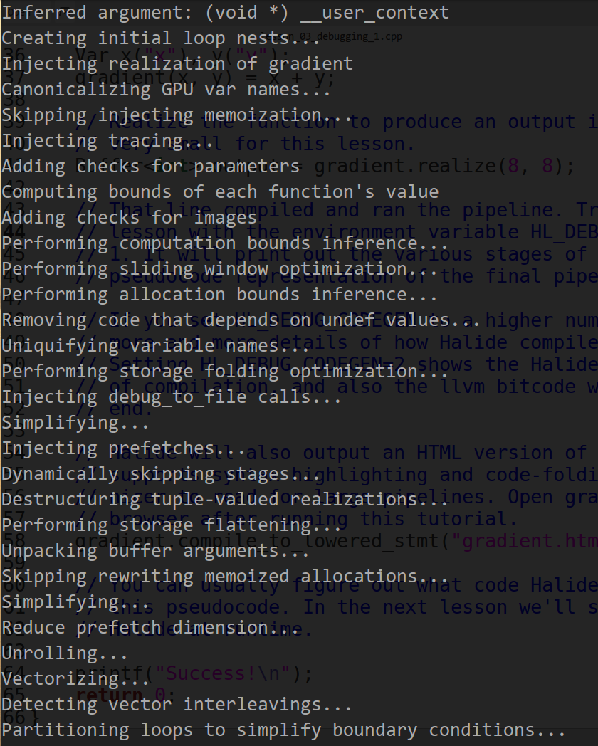
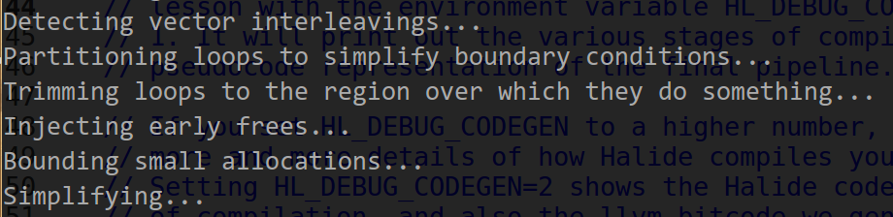
03

Slide 23
03
Col major
Row major

Slide 24
03
Tiled
Parallel tiles

Slide 25
03
Split 7 by 3
vectors

Slide 26
04
Back-end code generation

Slide 27
05
low-level optimizations and emit machine code for pipeline
Preparation:
First run a standard constant-folding and dead-code elimination pass on our IR, which also performs symbolic simplification of common patterns produced by bounds inference. At this point, the representation is ready to be lowered to LLVM IR.
One-to-one mapping:
Two specific patterns warrant mention.
Notes:
。我们的主要后台使用LLVM用于低级别代码生成。我们首先在IR上运行一个标准的常量折叠和死代码消除传递，它还对边界推断产生的常见模式进行符号化简化。在这一点上，表示已经准备好被降低到LLVM IR。在我们的表示和LLVM之间主要有一对一的映射，但是有两种特定的模式。

Slide 28
05
One-to-one mapping
Firstly:
1. builds a closure containing state referred to in the body of a for loop
2. The loop body is lowered to a separate function that accepts the closure as an argument and performs one iteration of the loop
3. enqueues the iterations of the loop onto a task queue
Secondly:
1. difficult to express or generate poor code if passed directly to LLVM
2. peephole optimization
3. interleaving stores, strided loads, vector averages, clamped arithmetic …
Notes:
首先，将循环的并行度降低到LLVM代码，该代码首先构建一个包含在for循环体中引用的状态的闭包。循环体被降低到一个单独的函数，该函数接受闭包作为参数，并执行循环的一次迭代。最后，我们生成代码，将循环迭代到任务队列中，线程池在运行时使用它。
第二，如果直接传递给LLVM，许多矢量模式难以表达或生成糟糕的代码。我们使用peephole优化将其重新路由到特定于体系结构的内部。例如，我们执行自己的分析过程来确定向量加载和存储的对齐方式，并且捕获交错存储，跨步加载，向量平均，夹紧算术，定点算法，加宽或缩小算法等常见模式。 将特定表达式IR模式映射到每个体系结构上特定的SIMD操作码，为程序员提供了一种在ARM（使用NEON）和x86（使用SSE和AVX）上使用所有相关SIMD操作的手段。

Slide 29
05
GPU code generation
The data parallel grids
Compiler uses the same scheduling primitives, along with a few simple conventions
GPU kernel launches < -->Dimensions (loops)
Synthesizing
No stage before the backend is aware of GPU execution
At the start of each GPU block loop, generates the same optimized code as CPU
Build a closure over all state which flows into the GPU loops
Generate the host API calls
Also generate dynamic code to trace buffers need to be copied to or from the device
Notes:
定义数据并行grids
编译器使用相同的调度原语和一些简单的约定来模拟GPU的执行选择
GPU内核的启动被建模为计划并行的维度(循环)
GPU后端扩展了x86后端，包括其完整的特性集。在对块和线程维度的循环之外，编译器会生成与纯CPU目标相同的优化SSE代码。在每个GPU块环的开始处，我们将子嵌套划分为一个类似于CPU后端的循环，只在GPU上生成。
我们首先对流入GPU循环的所有状态建立一个闭包。然后我们从这些循环的主体生成一个GPU内核。
最后，我们生成宿主API调用，在宿主代码的对应点启动该内核，将闭包作为参数传递。
我们还在启动之前和之后生成动态代码，以跟踪哪些缓冲区需要被复制到或从设备中复制。在GPU上使用的每个分配的缓冲区都有相应的设备内存分配，它们的内容只有在需要时才被延迟复制。

Slide 30
THANKS FOR WACTHING

