Slide 1


Artificial Intelligence, Workforce Transformation, & the Future of Work in Lake County
Presented By:
Eric Nordstrom & Demar Harris
Notes:
Welcome - Rason

Slide 2
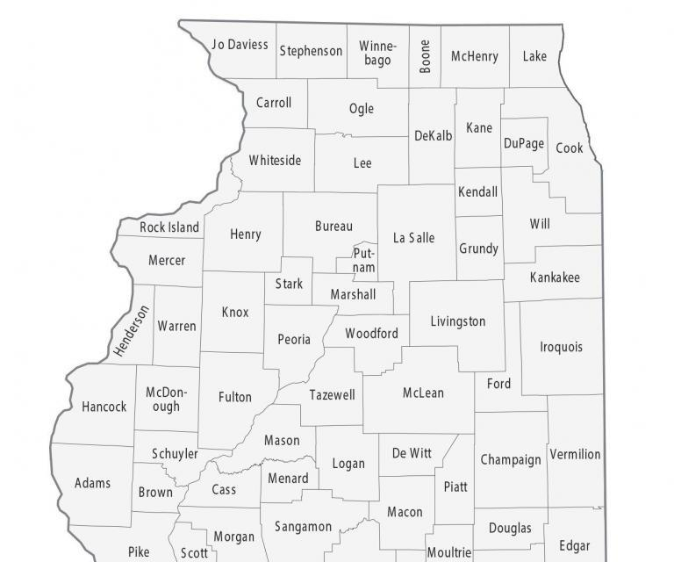
Lake County, IL (not CA)
At-a-Glance
Population: ~720,000
  3rd highest in Illinois
Local Workforce Innovation Area 1
Major Industries:
  Manufacturing
  Healthcare
  Retail & Hospitality
  Government & Public Sector

Slide 3

Agenda
Lake County Workforce Development AI Initiative
Local AI Research & Impact Report
Data-Driven Training Plan for the Workforce Ecosystem
Building Digital Literacy in Partnership
Sustainability Plan
Questions
Notes:
Rason- Welcome & Introduction of speakers
Lake County Workforce Development AI Initiative – Jen S
AI Research and Impact – Clark
Q & A – Rason
Closing Remarks - Eric

Slide 4
Lake County Workforce Development AI Initiative
Notes:
Welcome - Rason

Slide 5
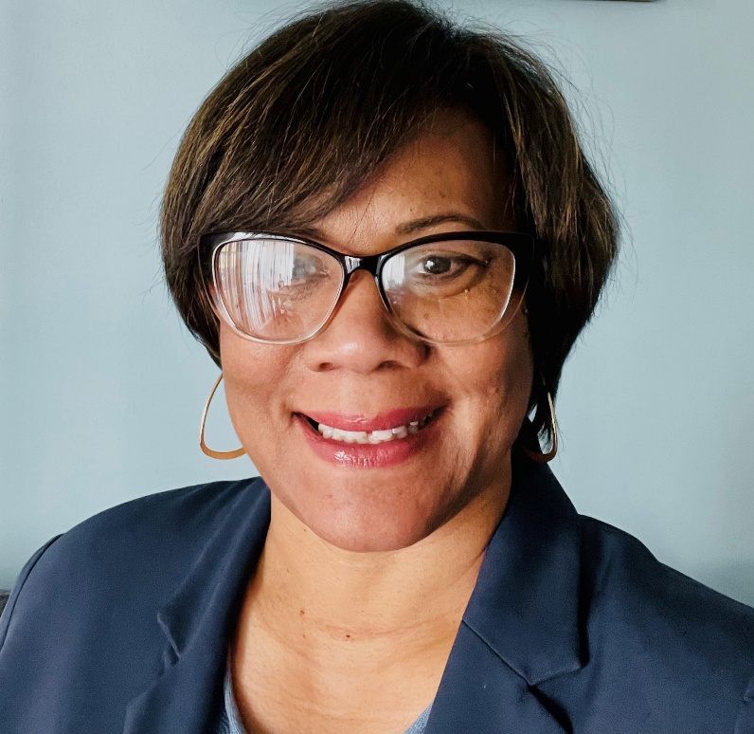
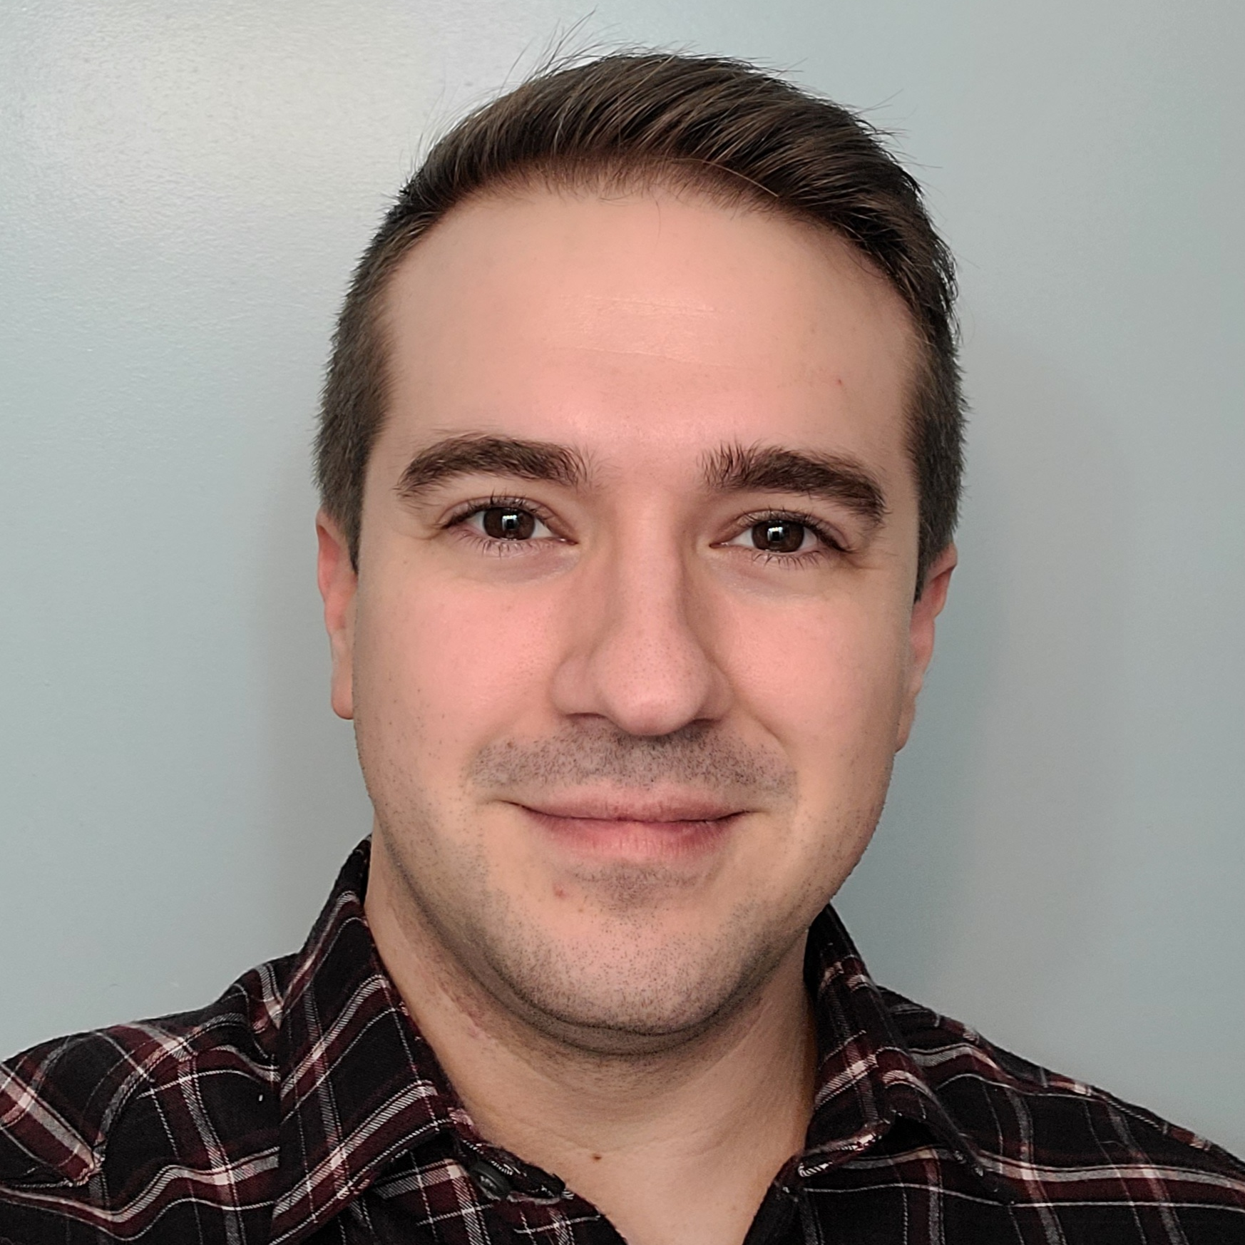
Project Managers
Rason Grant
Job Center on the Move Coordinator
Lake County Workforce Department
Eric Nordstrom
Project Analyst
Lake County Workforce Department
Notes:
Eric/Rason

Slide 6

Background
The demand for Artificial Intelligence (AI) education and workforce solutions is accelerating. AI-related roles now represent ~10% of the IT workforce, with projected growth of 40% over the next five years.
Why a Sector Strategy for AI Implementation & Integration?
This RFP supports a strategic, equity-driven approach to:
Expand AI literacy and career pathways for job seekers and businesses
Equip the workforce with ethical, hands-on training in AI technologies
Support local employers with AI adoption, consultation, and workflow integration
Build sustainable systems for AI education across sectors
AI Sector Impact
AI is reshaping industries including:
Healthcare, Transportation, Finance, Manufacturing, and Professional Services
Significant potential benefits (amplified drug discovery) need to be balanced with potential job displacement and possibly forgoing ethical use for the sake of progress
Workforce strategies must adapt to ensure economic resilience and equitable access

Slide 7
Intent
Lake County Workforce Development entered into a professional service agreement (PSA) with Deloitte Consulting LLP to deliver comprehensive AI solutions that enhance workforce capabilities, streamline operations, and responsibly integrate AI into workforce systems.
Proposed Services Should Include
AI tools for workforce and employer services
Onsite/hybrid training modules and hands-on workshops
100 hours of consultation for local businesses
Industry case studies and career pathway development
Micro-credentials and train-the-trainer models
Recorded content to expand access and reinforce learning
Strategic Goals
Advance scalable, ethical AI applications
Integrate AI into workforce and business systems
Expand equitable access to training and tools
Educate stakeholders on automation, ethics, and personalization
Improve productivity and reduce administrative burdens

Slide 8
Scope of Work: Research and Impact Report
Intent: Advance equitable, scalable AI integration across Lake County’s workforce systems
Research Analysis & Assessment Report
Conduct an up to 6-month impact study on AI’s effects across major industries
Deliver quantitative + qualitative findings on job seekers and economic trends
Research is focused on the impact of artificial intelligence on high-demand industries such as Professional Services and Business, Manufacturing, Healthcare, Information Technology, Transportation and Logistics, and Education
Provide strategic recommendations to guide program design
Notes:
Rason

Slide 9
Scope of Work – Program Overview
AI Literacy & Awareness: Audience: Municipalities, employers, businesses & Industry associations, job seekers, governmental units, workforce clients, contractors, partner agencies, and academia
  Real-world case studies
  AI trends in high demand sectors
  Career pathways
Applied AI for Workforce & Community: Audience: Municipalities, employers, businesses & Industry associations, job seekers, governmental units, workforce clients, contractors, partner agencies, and academia
  Bias awareness modules
  Ethical & Inclusive AI Use
  Responsible data practices & governance
Dual-Track Approach:
Audience: Workforce Development Internal Staff, Partners, and Jobseekers
  Training for managers on leading AI integration
  Training for front-line staff empowerment
  Hands-On-Training and micro-credentialing
  Use of AI tools in daily workflows and AI use cases
Notes:
Use either 7/8

Slide 10

Funding & Duration
$100,000 in total WIOA funds awarded to entity. Services will provide AI integrated services to the following stakeholders:
  Employers/Businesses, Incumbent Workers, Non-Profits, & Industry Associations
  Job Seekers, Tech Campus, and WIOA Clients
  Municipalities, Lake County Partners, & Governmental Units
  Workforce Clients, WD Staff, Youth Contractors, and Job Center Partner Agencies
  ROE Schools, University Center, & Summer Program Workshop
The program began January 2026. The Lake County Workforce Board awarded an 18-month agreement, ending on June 30th, 2027. The County reserved the right to renew the contract for 1 additional year contingent upon acceptable performance and progress by the proposer and the appropriation of sufficient funds.
Notes:
Rason

Slide 11

Key Metrics
AI-Driven Tools Implementation
    # of AI tools introduced
Foundational Training Modules (Onsite/Hybrid)
    # of participants enrolled and
    # completed training
Hands-On Workshops
    # of workshops held and
    # attendees per session
Consultant Hours (100 hours for business consultation)
    # of businesses engaged and
    # of consulting hours utilized
Industry-Relevant Case Studies
    of case studies developed and distributed
AI Career Pathway Development
    # Career maps or pathways created/illustrated
Micro-Credentialing
    # of credentials issued
    % credential completion
Train-the-Trainer model (Sustainability Plan)
    # of staff trained as trainers
Recorded Instructional Content (Sustainability Plan)
    # of recorded sessions produced
    # of views/access points
Notes:
Eric

Slide 12
Local AI Research &
Impact Report
Notes:
Welcome - Rason

Slide 13
AI Trends
Nationally, AI adoption is wide but shallow. Lake County can build AI skills ahead of employer demand while the window is still open.
88%
Workers with AI skills earn
February 2026
56% more
of organizations report using AI in at least one business function, but only about one-third have scaled AI programs beyond piloting
DOL releases AI Literacy Framework explicitly encouraging investment in AI skill building
than peers in the same role, an advantage expected to narrow as AI skills become standard
No AI-specific skill requirements
in Lake County's top job postings (Lightcast, Q1 2026)
Notes:
Clark

Slide 14
DOL AI Literacy Framework
Five Core Competencies
Understanding AI principles
Applying AI in real-world contexts
Directing AI tools effectively through promotion and iteration
Critically evaluating AI outputs
Using AI responsibly and ethically
Notes:
All this aligns with DOL’s AI Literacy Framework

Slide 15
Industry Trends
In hands-on industries, AI is changing the work around the job. In knowledge industries, AI is changing the job.
Manufacturing
AI is not replacing physical trades — but competitors using AI to run leaner operations will outpace those who do not
Healthcare
AI is reducing paperwork so clinicians can spend more time with patients, but healthcare workers need specialized training as tools and risks differ
Information Technology
Entry-level coding and help desk roles are shrinking while demand grows for workers who can design, evaluate, and architect around AI
Professional Services
AI is compressing entry-level pathways — the drafting, research, and scheduling roles that gave workers a foothold are the ones declining fastest
Transportation & Logistics
The CDL still gets you hired, but the dispatcher who can read an AI-generated route plan and identify errors is the one positioned for promotion
Notes:
Clark

Slide 16



What AI Actually Looks Like at Work
AI is already embedded in daily tasks across job centers, employers, and workforce organizations — the question is whether people know how to use it well.
Job Center Staff
Employer
Workforce Development
Digital Navigators introduce AI alongside basic digital skills, showing job seekers how to tailor a resume to a specific posting, generate practice interview questions – in minutes, not hours.
An engineering firm uses AI to search a century-old technical archive — identifying relevant documents, failure patterns, and compliance history that previously required days of manual review.
A nonprofit leader uses AI translation tools to bridge language barriers for workers in the trades, then uses those same tools to draft communications, summarize program data, and expand the capacity of a small team.
Notes:
Clark

Slide 17
A Data-Driven Training Plan for the Workforce Ecosystem
Notes:
Welcome - Rason

Slide 18
Building AI fluency in the Workforce Ecosystem
AI Academy Learning Management is a web-based platform that provides courses about artificial intelligence (AI), generative AI (GenAI), agentic AI, and other emerging technologies.
Notes:
Timeline

Slide 19
AI Academy: Modules
Start Here
Welcome & Orientation
5 minutes
AI Fundamentals
11 lessons
AI - Powered Productivity
9 lessons
Prompt Engineering Basics
7 lessons
AI Academy
  Registration is required
  Learning management system (modular format) with videos to reinforce concepts
  3.5 hours to complete all modules
  Recommended to take the course in sequence
  Retake option is available
    No pass/fail
  Dashboard tracker for admins
  Participant receives digital badges and certificate of completion
Technology, Trust, and Ethics
6 lessons
Problem Solving with AI
7 lessons
Agentic AI Essentials
9 lessons
Applied Agentic AI
7 lessons
30 Minute Friday - Lunch and Learn Sessions
Session I – AI Fundamentals and Powered Productivity
Session II - Problem solving with AI and Agentic AI
Session III – Prompt Engineering Basics and Technology, Trust, and Ethics

Slide 20
Self-paced learning modules
Week 1: Welcome and Self Assessment Survey and AI Fundamentals
Week 2: AI Powered Productivity
Week 3: Prompt Engineering Basics
Week 4: Technology, Trust, and Ethics
Week 5: Problem Solving with AI
Week 6: Agentic AI Essentials
Week 7: Applied Agentic AI
30 Minute Friday - Lunch and Learn Sessions
Session I – AI Fundamentals and Powered Productivity
Session II - Problem Solving with AI and Agentic AI
Session III – Prompt Engineering Basics and Technology, Trust, and Ethics

Slide 21

Cohort I: Workforce Development Staff & Digital Navigators
AI Academy Platform Training
Instructor Led
Capstone
Information Session
30 Minutes
8 Weeks
1 Hour
Prompt-a-thon

Slide 22


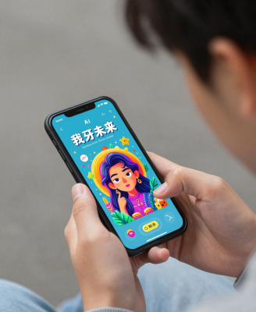
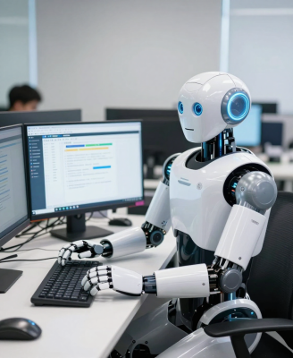
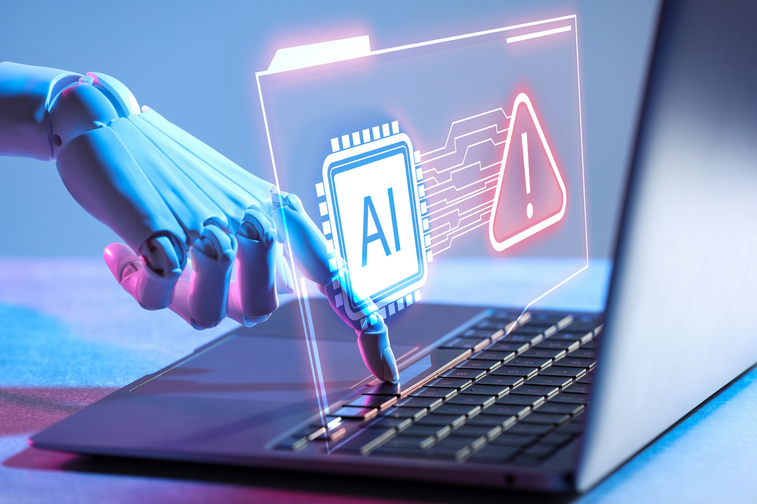

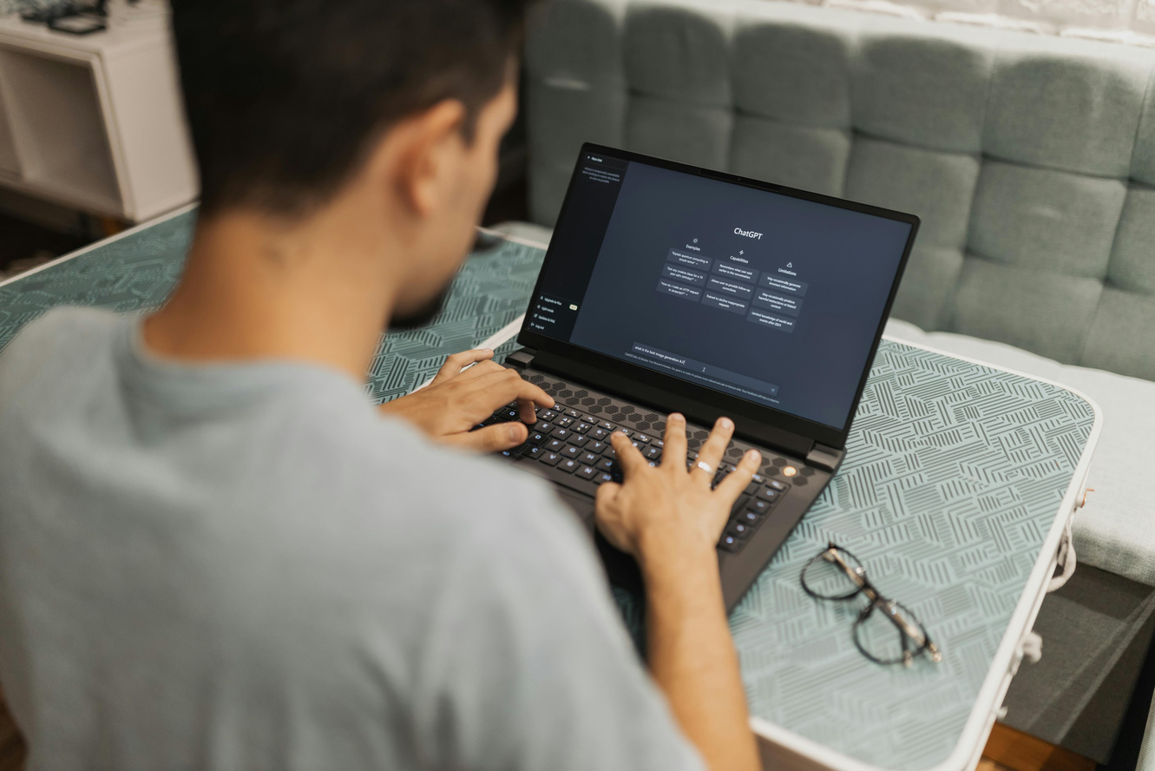

Cohort II: Summer Youth
Total Cohort Size: 58
3 Individual Cohorts
58 Total Participants
Lessons were differentiated for youth
AI fundamentals and terminology
Ethics and responsible use
Ages 14 – 18 (up to 21 years if on an IEP)
Machine Learning
Deep Learning
Generative AI
Agentic AI
Benefits
Challenges
Ethics
and Safety
Use Cases
Notes:
58 participated

Slide 23
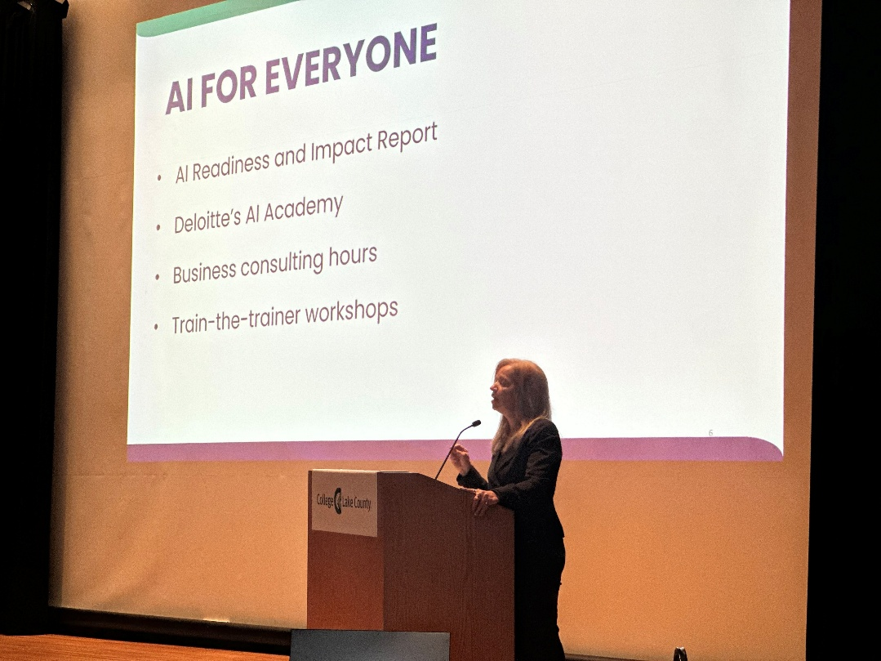
What’s Next?
Cohort III: Municipalities, employers, businesses & industry associations, governmental units, contractors, partner agencies, and academia
Cohort IV and beyond: WIOA-enrolled customers and Job seekers (recurring cohorts)
Business Consultation Sessions: 5
Learn about trends and use cases specific to their industry
Understand the skill needs of employers in an AI Era
Discuss strategies to help local business navigate AI adoption
Notes:
need more pictures from Eric

Slide 24
Building Digital Literacy in Partnership
Notes:
Welcome - Rason

Slide 25
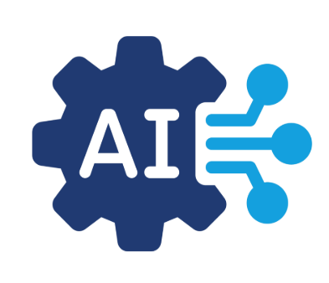
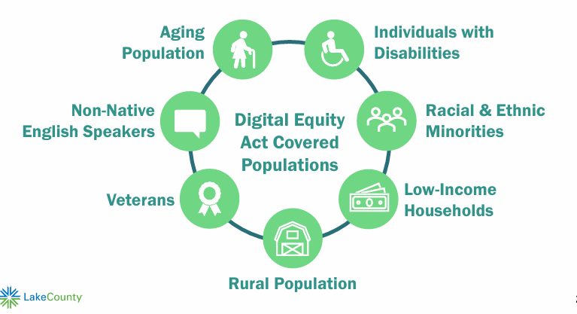
Strategic and equity-driven approach through partnerships
Lake County Workforce Development
  Expand AI literacy and career pathways for job seekers and employers
  Equip the workforce with ethical, hands-on training in high-impact technologies
  Support local employers with AI adoption, consultation, and workflow integration
  Build sustainable strategy for AI education across sectors
Lake County Digital Growth Initiative
American Rescue Plan Act (ARPA) State and Local Fiscal Recovery Funded
Deliver digital literacy in Lake County
No cost laptop opportunity
Notes:
Northstar Digital Learning is a software aimed at teaching basic digital skills to learners.
Curriculum or self-paced online modules with exams
No-cost Laptop Opportunity for participants who complete Northstar learning and proctored exams at partner locations:

Slide 26
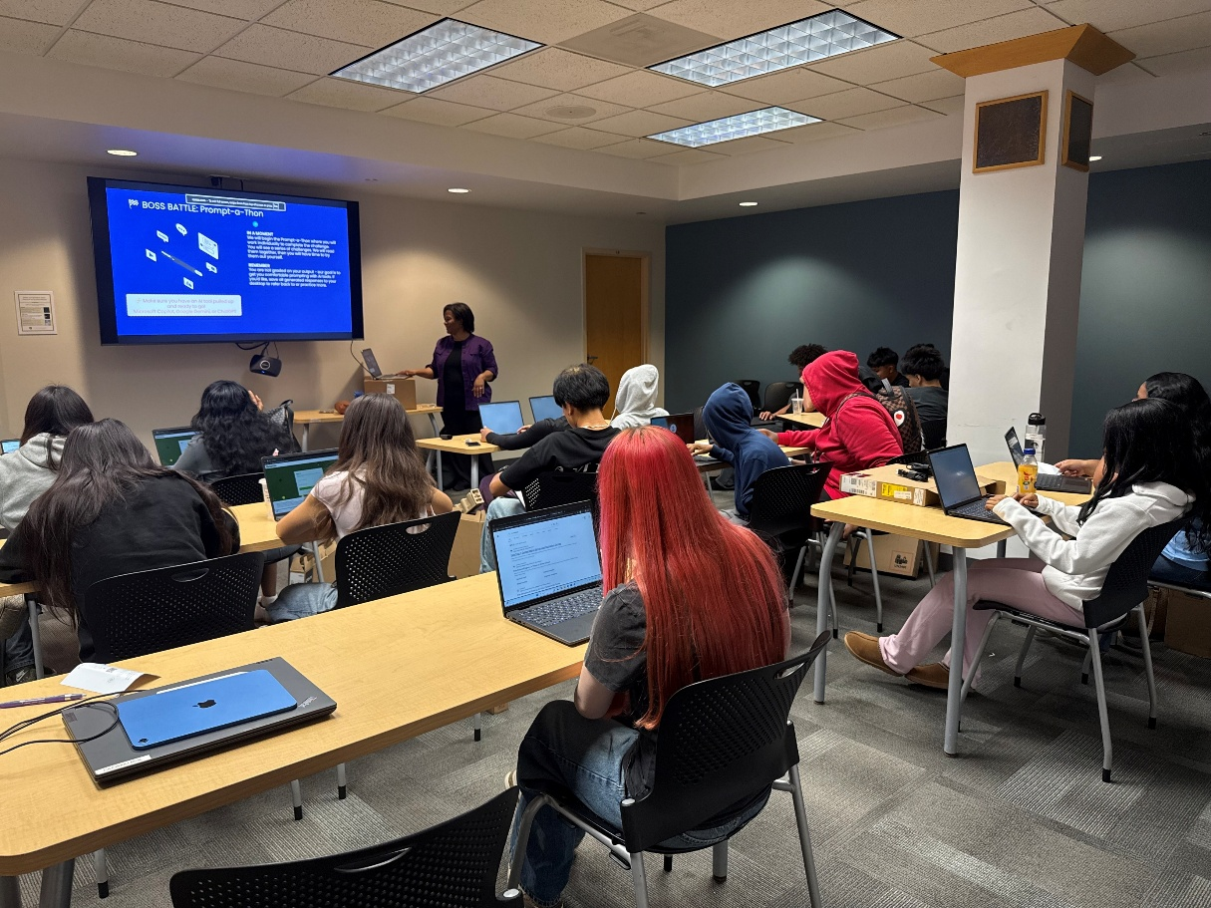



Partnership and Integrated Services
Digital Growth Initiative: CY25-26
Device Distribution: 103
Total Cohorts Held in Partnership: 12
SYEP Workshops Held: 26
Lake County Workforce Development (Cohort 1-2):
AI Academy Hands-On Workshops: 4
Attendees: 111
AI Academy enrolled participants: 111
Notes:
Speaker: Kim Lunt
Overview of Northstar Digital Literacy
Device Distribution Model and Events
Community Partners

Slide 27
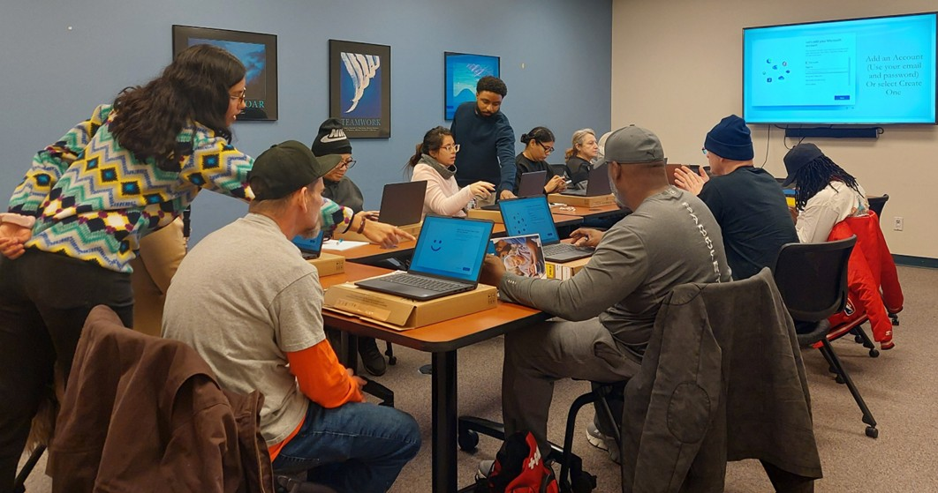
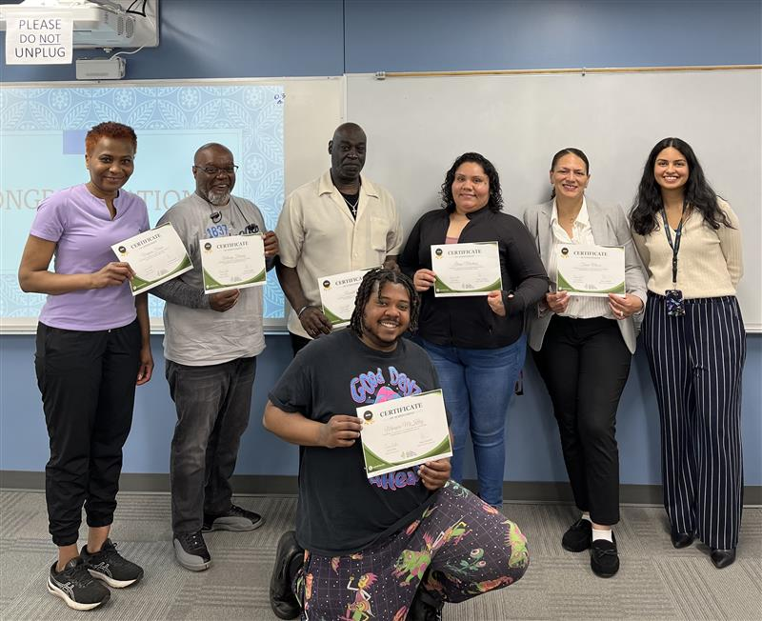
Expanding and Strengthening Digital Literacy
Anna, a former Digital Navigator, shared, “A participant seemed to distance himself from using technology because he was having a hard time learning all the little tricks to use applications. He kept expressing how he didn't know much and that he didn't know what he was doing. As the classes went by, she noticed he became more comfortable with using his laptop and browsing the internet. She believed that the activities helped him practice the skills he learned, which made a big difference. He was also very attentive during class and asked questions, which she thinks helped him learn a lot. He passed the class with a great score and was very happy at the end of the cohort.”
Notes:
.
I had a participant who seemed to distance himself from using technology because he was having a hard time learning all the little tricks to use applications. He kept expressing who he didn't know much and that he didn't know what he was doing. As the classes went by, I noticed he became more comfortable with using his laptop and browsing the internet. I think the activities helped him practice the skills we learned, which made a big difference. He was also very attentive during class and asked questions, which I think also helped him learn a lot. He passed the class with a great score and was very happy at the end of the classes

Slide 28
Sustainability Plan
Notes:
Welcome - Rason

Slide 29
Sustainability Plan
Build upon the existing foundation of Lake County’s Digital Growth Initiative
Bootcamp Focus Areas
NorthStar Digital Literacy Curriculum
Digital Certificates & Micro-Credentials
Embed AI fluency in Job Center career readiness workshops
Resume Writing
Effective Job Search
Interviewing skills
Purpose & Impact
Strengthen Workforce Readiness
Support Layoff-Impacted Workers
Enhance Countywide Digital Capacity
Notes:
Lake County Workforce Development will build upon the successful foundation established by Lake County’s Digital Growth Initiative by offering localized Digital Skill Bootcamps
Goal of the digital bootcamps
Bootcamp Focus Areas
NorthStar Digital Literacy Curriculum
Digital Certificates & Certifications
Technology-Enabled Job Search Skills
Purpose & Impact
Strengthen Workforce Readiness
Support Layoff-Impacted Workers
Enhance Countywide Digital Capacity
Metrics
Participant Outcomes
25 WIOA-eligible dislocated workers served
15 dislocated workers receiving occupational skills training
10 dislocated workers receiving paid work experience / OJT
15 dislocated workers receiving a laptop
76% securing full-time employment (19 of 25)
125 residents receiving no-cost digital skills training
Employer Outcomes
20 employers supported Gain access to a job-ready digital workforce, reduced onboarding time, improved retention, and strengthened layoff-aversion outcomes.

Slide 30
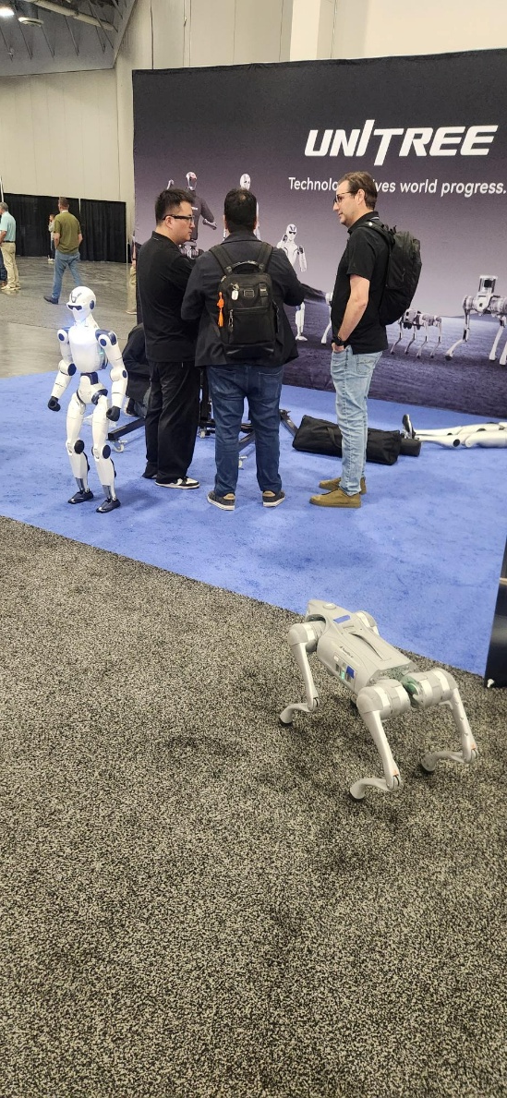
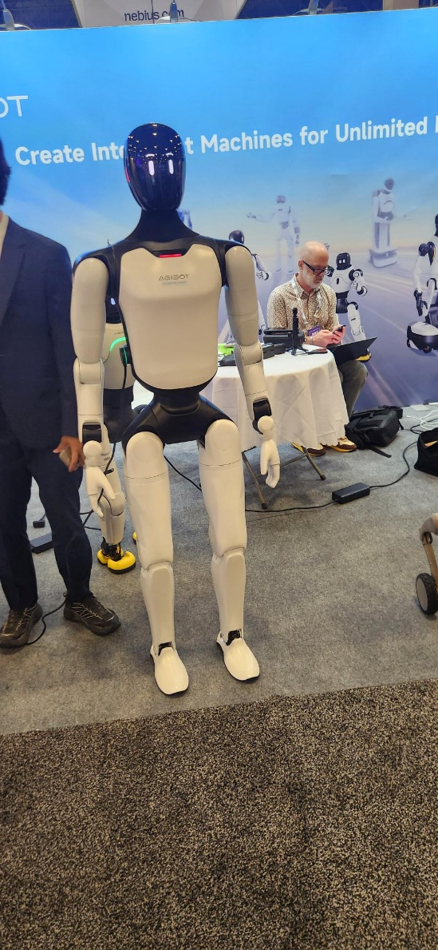
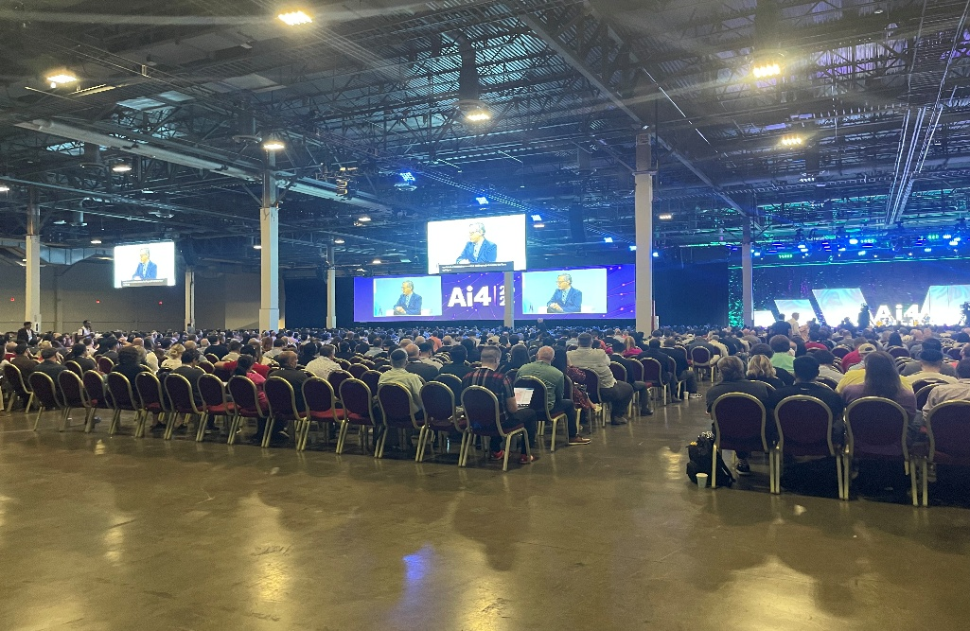
Continuous Learning: Ai4 2026 conference
Trending Topics
  Job and Industry Transformation
  “Tokenomics”
  Agentic AI – deployment and workflows
  Governance, regulation, and guardrails
  Ethics and responsible Use
Notes:
AI in the background, curing cancer/eradicating illiteracy
Keynote speakers
Existential risks concerning AI
Is AI beyond human control (escaping from sandboxes)
AI’s impact on jobs (upskilling is key)
Increased productivity but not shared prosperity

Slide 31

Thank You!
We’d be happy to take any questions you may have.

