Slide 1






WORKFORCE DEVELOPMENT IN PRIORITY SECTORS
Building Cross-Sectoral Skills across Emerging and Evolving Industries
SEPTEMBER 10, 2026
9:45-10:45 AM

Slide 2
WHO’S IN THE ROOM?
Q1. Which region do you represent?
Northern California
Central California
Southern California
Statewide/Multi-Region
Other
Q2. What type of organization do you represent?
Education and Training
Economic Development
Workforce Development
Government
Nonprofit
Other
Building Cross-Sectoral Skills across Emerging and Evolving Industries

Slide 3

SESSION AGENDA
01
INTRODUCTION
02
DATA & KEY FINDINGS
03
RESEARCH IMPLICATIONS & NEXT STEPS
04
LIVE POLLING AND Q&A SESSION
Building Cross-Sectoral Skills across Emerging and Evolving Industries

Slide 4
PART 1. INTRODUCTION
Building Cross-Sectoral Skills across Emerging and Evolving Industries

Slide 5


SPEAKERS
JACOB POORE
DIRECTOR, SOUTH CENTRAL COAST CENTER OF EXCELLENCE FOR LABOR MARKET RESEARCH (COE)
Leads the COE’s research team, producing labor market analyses that inform community college program development, expansion, and alignment with regional workforce needs.
JOSH WILLIAMS
FOUNDER AND CHIEF RESEARCH OFFICER, BW RESEARCH PARTNERSHIP INC. (BW)
Leads BW’s West Coast practice, integrating economic modeling, survey research, and empirical data to analyze how technological change, industry transitions, and innovation shape regional economies and opportunity.
Building Cross-Sectoral Skills across Emerging and Evolving Industries

Slide 6
We aspire to be the leading source of workforce information and insight for California’s community colleges.
The COE provide quality labor market data and information to help colleges with:
Assessing labor
market needs
Reviewing career education programs
Investing in new career education programs
Grant program planning and investment

Slide 7
BW delivers
research that empowers regions and workforce systems to make informed decisions and advance meaningful outcomes.
BW Research supports workforce and economic development across the Central Coast.
Regional Workforce Ecosystem Mapping
Regional Workforce & Economic Profiles
Career Pathways Analysis
Strategic Workforce & Sector Planning

Slide 8

WHY THE COE ENGAGED BW
  Innovation outpaces existing classification systems, creating ambiguity in sector definitions.
  Emerging industries and emerging R&D in traditional industries span multiple outdated NAICS codes, making traditional sector definitions unreliable.
  BW’s comprehensive approach enables more accurate sector definitions across NAICS industries and prevents double-counting between sectors.
  BW’s occupational analyses support career pathways and examine job quality, advancement, and automation impacts, both now and in the future.
Building Cross-Sectoral Skills across Emerging and Evolving Industries

Slide 9
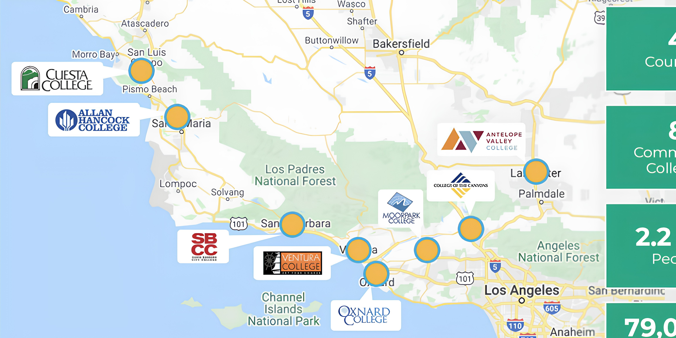
SOUTH CENTRAL COAST REGION
4
Counties
8
Community
Colleges
2.2M+
People
79,000+
CTE Students
(2023-2024)
Building Cross-Sectoral Skills across Emerging and Evolving Industries

Slide 10
STRUCTURAL CHALLENGES: SOUTH CENTRAL COAST
CCCCO Region
South Central Coast
Regional Planning Unit
Los Angeles Basin
South Central Coast
Ventura
LA County
Central Coast
Jobs First Region
Northern Los Angeles
San Luis Obispo
Santa Barbara
Ventura
County
Building Cross-Sectoral Skills across Emerging and Evolving Industries

Slide 11
PART 2. DATA AND KEY FINDINGS
Building Cross-Sectoral Skills across Emerging and Evolving Industries

Slide 12
SOUTH CENTRAL COAST PRIORITY SECTORS
Session Focus: Clean Economy and Aerospace & Defense
AEROSPACE & DEFENSE
CLEAN ECONOMY
HIGH-TECH
LIFE SCIENCES
WORKING LANDS & WATER
aircraft, space, & defense systems manufacturing and services
renewable energy generation, energy efficiency, grid modernization
software, hardware, IT services, AI/ML, quantum, robotics, advanced comput
R&D in biotech, diagnostics, medtech, therapeutics, genomics
agriculture, AgTech, BlueTech, land management, natural resources
Under California Jobs First, these five sectors represent strategic priorities for the South Central Coast due to their projected growth and importance to the regional innovation ecosystem. Collectively, the five Jobs First sectors represent:
18%
26%
share of jobs in the South Central Coast
share of regional economic output
Building Cross-Sectoral Skills across Emerging and Evolving Industries

Slide 13
SHARED WORKFORCE CHALLENGES
Cross-Sector Challenges Shaping Workforce Pipelines Across the South Central Coast
HIGH COST OF LIVING
HIRING & RETENTION CHALLENGES
BELOW-AVERAGE WAGES
+37%
38%
-24%
Gap between the Living Wage and the Average Wage in the South Central Coast
Share of South Central Coast employers citing hiring and retention as a top challenge
Gap between the South Central Coast average wage and the statewide average wage
Building Cross-Sectoral Skills across Emerging and Evolving Industries

Slide 14
WHY FOCUS ON THESE SECTORS?
Session Focus: Clean Economy and Aerospace & Defense
Both sectors...
01
Are anchored by major regional assets driving workforce demand.
Predict near-term growth but face considerable hiring challenges.
02
03
Have strong overlaps in occupational and skills needs.
04
Offer strong opportunities to expand employer-educator partnerships.
Building Cross-Sectoral Skills across Emerging and Evolving Industries

Slide 15
JOB LENSES
A Framework for Analyzing Priority Occupations
01
03
02
JOB QUALITY
JOB AUTOMATION
Assesses the extent to which jobs in a region offer livable, sustainable wages
JOB ADVANCEMENT
Measures the proportion of skills and tasks that can be automated within a particular occupation
Measures workers’ potential to advance to higher-paying job opportunities
Building Cross-Sectoral Skills across Emerging and Evolving Industries

Slide 16
OCCUPATIONAL PRIORITIZATION PROCESS
A Framework-Informed Process of Prioritizing Regional Investments by Occupation
Identified ~20 priority occupations per sector based on secondary data and proprietary staffing patterns.
01
Assessed overall employment, job quality, advancement potential, and skills requirements to identify the highest-priority occupations.
02
Reviewed automation exposure to better understand the potential change in needed skills and training curricula
03
Integrated employer survey and stakeholder interview insights to identify emerging occupational and evolving skills needs.
04
Building Cross-Sectoral Skills across Emerging and Evolving Industries

Slide 17
SECTOR-SPECIFIC HIRING CHALLENGES
Insights from Employer Surveys, Stakeholder Interviews, and Secondary Data Analysis
CLEAN ECONOMY
AEROSPACE & DEFENSE
01
RAPID TECHNOLOGICAL CHANGE
01
DEMOGRAPHIC SHIFTS
Emerging technologies drive evolving skills needs.
Aging workforce drives growing talent shortages.
02
INFRASTRUCTURE CONSTRAINTS
02
SPECIALIZED SKILLS AND REQUIREMENTS
Grid infrastructure and storage needs affect deployment.
Stringent requirements constrain workforce pipelines.
03
EMERGING ROLES
03
FEDERAL CONTRACTING CYCLES
Offshore wind and nuclear face uncertain timelines.
Shifting budgets and timelines create uncertainty.
04
PERMITTING AND REGULATORY CHALLENGES
04
REGIONAL EMPLOYMENT CLUSTERS
Regulatory hurdles affect project development and hiring.
Talent clusters follow statewide investment activity patterns.
Building Cross-Sectoral Skills across Emerging and Evolving Industries

Slide 18
SHARED OCCUPATIONAL NEEDS
These occupations emerged as shared regional priorities based on regional employment footprint, skills requirements, and advancement potential.
CURRENT PRIORITIES
Welders
Industrial Machinery Mechanics
Electrical and Electronic Assemblers
EMERGING PRIORITIES
Electrical Technicians
Data Scientists and
Data Analysts*
* These occupations generally require a four-year degree at entry.

Slide 19

SHARED SKILLS NEEDS
Shared Skills Underpinning Priority Occupations in the Clean Economy and Aerospace & Defense Sectors
01
Troubleshooting & Diagnostics
Data Analysis & Problem-Solving
02
03
Hands-On Electrical & Electronics Skills
Hands-On Mechanical Skills
04
05
Communications Skills
Safety & Compliance Protocols
06
07
AI Literacy & Digital Skills
Precision Assembly
08
Building Cross-Sectoral Skills across Emerging and Evolving Industries

Slide 20



CLEAN ECONOMY SECTOR-SPECIFIC NEEDS
HIGH-PRIORITY OCCUPATIONS
EMERGING OCCUPATIONS
EMERGING SKILLS NEEDS
  Carpenters
  Electricians
  HVAC Technicians
  Plumbers, Pipefitters, and Steamfitters
  Electrical Technicians
  Energy Auditors
  Environmental Remediation Technicians
  Solar Panel Recycling and Maintenance Technicians
  Building electrification installation
  Fleet electrification (data analytics)
  Hands-on electrical troubleshooting
  Solar panel recycling & maintenance
  Climate-smart agriculture planning
  Home energy advising
Building Cross-Sectoral Skills across Emerging and Evolving Industries

Slide 21
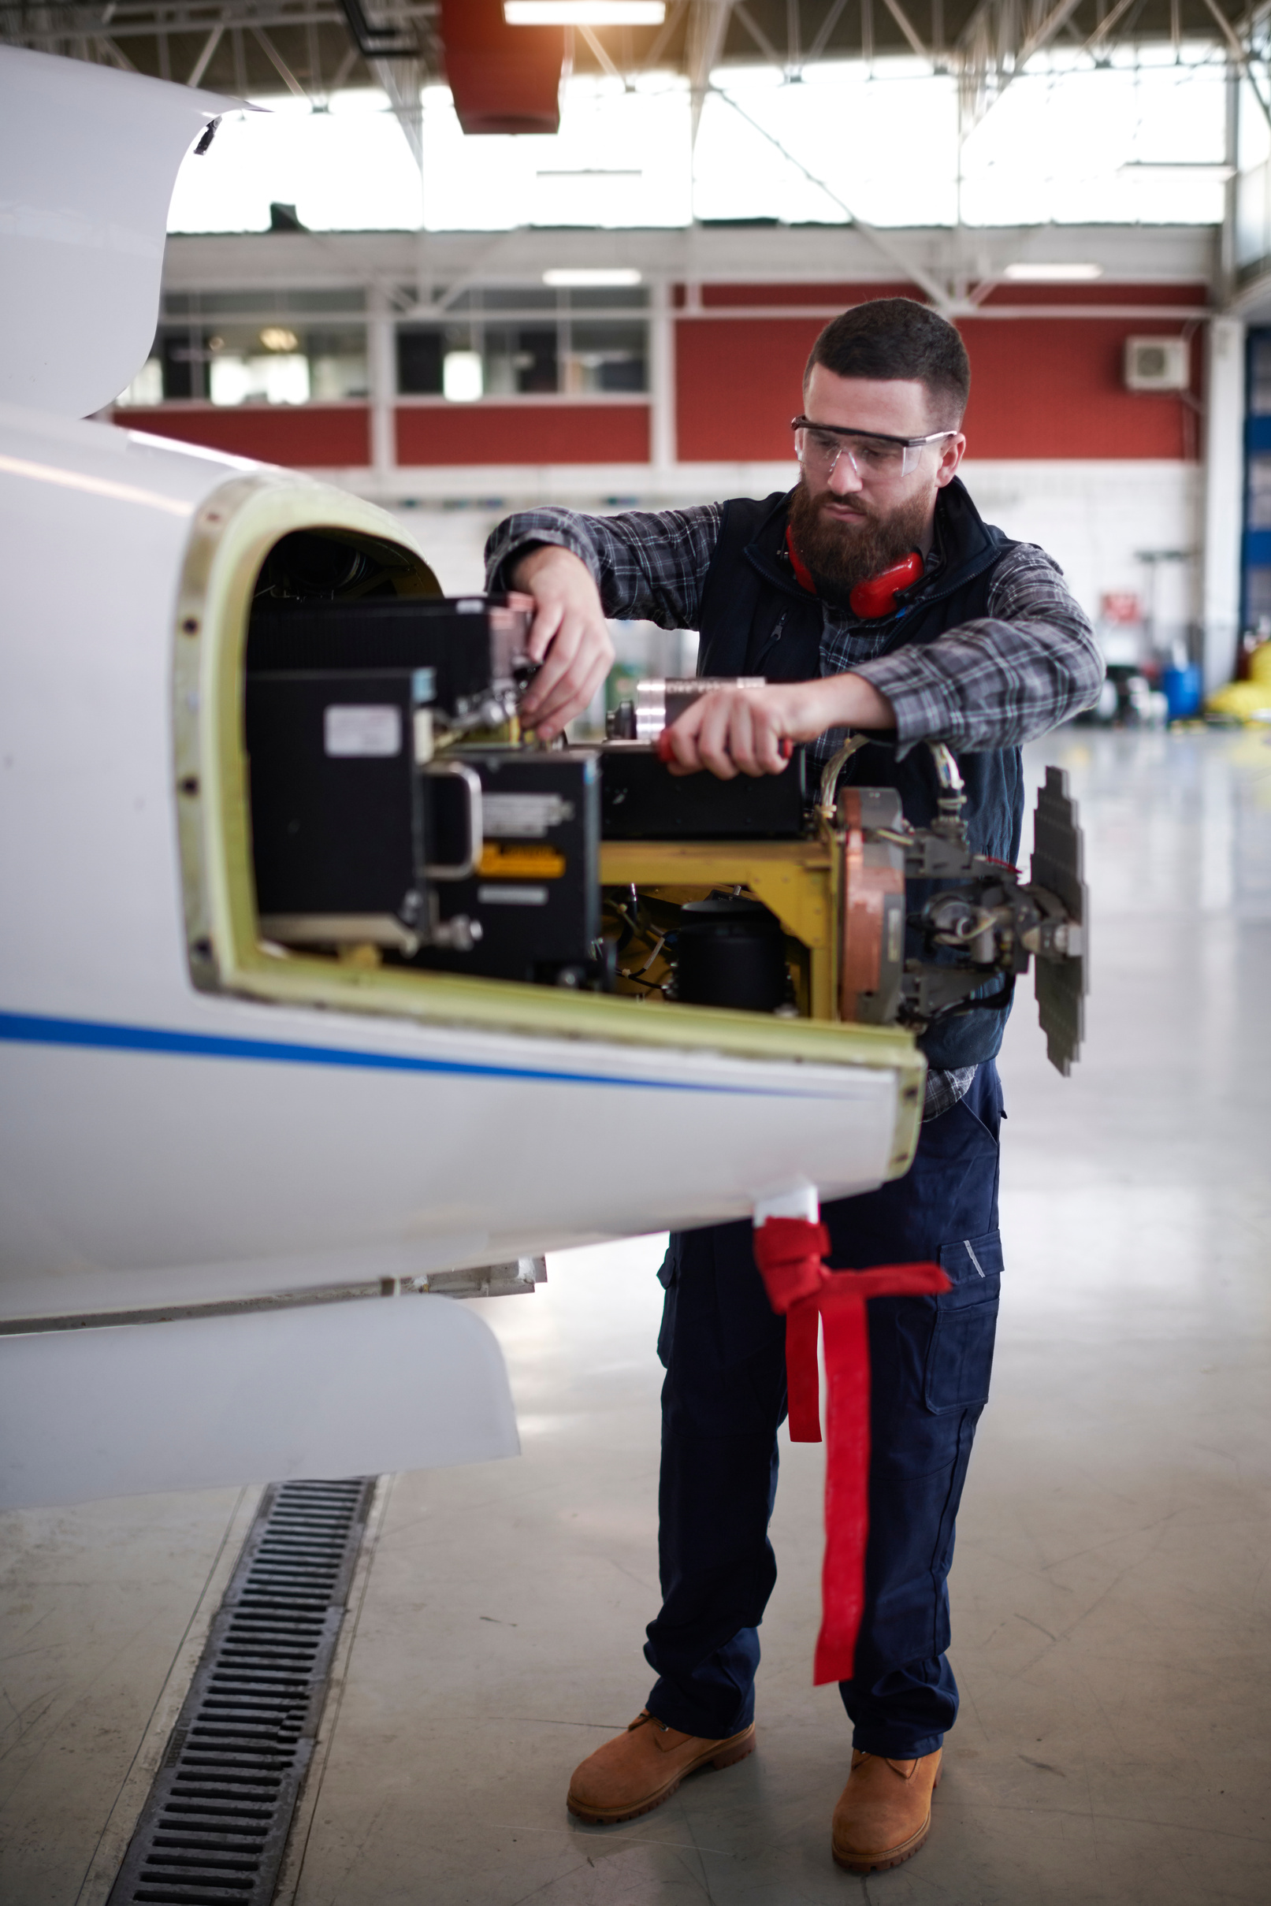
AEROSPACE & DEFENSE
SECTOR-SPECIFIC NEEDS
HIGH-PRIORITY OCCUPATIONS
EMERGING OCCUPATIONS
  Aircraft Mechanics and Service Technicians
  CNC Tool Programmers and Operators
  Airframe and Powerplant Technicians
  Aviation Maintenance Technicians
  Avionics Technicians
EMERGING SKILLS NEEDS
  Data analysis
  AI literacy and digital skills
  Blueprint reading
  Precision assembly
  Precision measurement
  Troubleshooting and diagnostics

Slide 22

PARTNERSHIP OPPORTUNITIES
Employer Demand Signals, Workforce Constraints, and Partnership Interest
RISING DEMAND
  Nearly 60% of employers across Aerospace & Defense and Clean Economy predict 12-month headcount growth.
TALENT SHORTAGES
  Talent shortages are top-of-mind for 26% of Aerospace & Defense employers and 19% of Clean Economy employers.
PARTNERSHIP OPPORTUNITIES
  While 93% of employers in both sectors express strong interest in expanding job readiness and work-based learning, less than half partner with community colleges or workforce development boards to recruit, hire, or train workers.
Building Cross-Sectoral Skills across Emerging and Evolving Industries

Slide 23
LIVE POLLING AND Q&A
Q3. Which of the priorities highlighted in today’s session is most pressing for your region now?
A. Strengthen career pathways and job quality in key sectors
B. Expand access to training and employment opportunities that leads to higher- paying jobs
C. Align programs to current and expected employer needs
Building Cross-Sectoral Skills across Emerging and Evolving Industries

Slide 24
PART 3.
RESEARCH IMPLICATIONS & NEXT STEPS
Building Cross-Sectoral Skills across Emerging and Evolving Industries

Slide 25

IMPLICATIONS FOR COLLEGES & WORKFORCE PARTNERS
Regional Alignment and Talent Pipeline Shifts
  Stronger regional coordination is needed to reduce overlaps in program design, build shared talent pipelines, and ensure curriculum relevance amidst rapid technological change.
  Shrinking K–12 enrollments increase the need to serve adult learners, incumbent workers, and re‑entry populations, who constitute a growing share of the regional talent pipeline.
  Cross-regional pathways with Silicon Valley, Monterey Bay, and Los Angeles R&D hubs are essential to support shared work-based learning programs and training facilities.
Building Cross-Sectoral Skills across Emerging and Evolving Industries

Slide 26

IMPLICATIONS FOR COLLEGES & WORKFORCE PARTNERS
Program Design Considerations
  Training programs should incorporate cross-cutting skills and emerging technologies to maximize investment impact and build regional capacity across priority sectors.
  Programs should incorporate targeted supports for underserved populations to ensure equitable access to higher-wage career pathways.
  Continuous, up-to-date regional workforce intelligence is needed to maintain alignment of education programs with evolving employer skills needs.
Building Cross-Sectoral Skills across Emerging and Evolving Industries

Slide 27

RECOMMENDATIONS FOR COLLEGES & WORKFORCE BOARDS
STRENGTHEN CAREER PATHWAYS AND JOB QUALITY
  Strengthen programs supporting pathways with clear career progression.
  Scale high-value trades and technical programs.
  Support job quality through intentional program design.
EXPAND ACCESS TO OPPORTUNITY
  Incorporate wraparound supports and flexible training delivery models.
FUTURE-PROOF AND ALIGN PROGRAMS TO EMPLOYER NEEDS
  Incorporate AI literacy and cross-cutting foundational skills modules.
  Offer job readiness courses as a prerequisite for work-based learning.
  Streamline and unify employer outreach and engagement.
Building Cross-Sectoral Skills across Emerging and Evolving Industries

Slide 28




NEXT STEPS I
  Assess advisory board structures to reduce duplication across programs and subregions while adhering to statutory requirements (e.g., California Education Code, Perkins V)
  Re-evaluate employer engagement metrics and outcomes to ensure alignment with regional and statewide goals to increase the number of: WBL participants, students in apprenticeship programs, number of WDBs or EDOs in an active partnership, and number of employers engaged through employer engagement liaisons
  Convene regional community college leaders to create a more unified strategic plan to address current and emerging workforce needs across sectors, but particularly within Aerospace & Defense and Clean Economy, as they have the largest workforce opportunity and impact all counties in the region
  Align efforts across other regional community college initiatives related to apprenticeship development in Advanced Manufacturing/Aerospace Manufacturing, as well creating K-12 pipelines and stronger awareness of priority sectors
Building Cross-Sectoral Skills across Emerging and Evolving Industries

Slide 29

NEXT STEPS II
  Provide additional analysis of skills requirements for colleges to use in curriculum planning, when engaging employers, during advisory committees, and long-term planning
  Expand audience for COE data to more intentionally include WDBs, chambers of commerce, EDCs, and other industry organizations to create common language around labor market insights and aligning program development with data
  Incorporate data and findings into other reports and products to ensure continuous alignment across sectors with different definitions and sources
Building Cross-Sectoral Skills across Emerging and Evolving Industries

Slide 30
PART 4. LIVE POLLING AND Q&A
Building Cross-Sectoral Skills across Emerging and Evolving Industries

Slide 31
LIVE POLLING AND Q&A
Q4. Which strategy do you think could have biggest potential impact in your region?
Strengthen programs supporting pathways with clear career progression
Expand access to flexible, accessible training and workforce supports
Embed AI literacy and foundational job readiness skills into training programs
Strengthen employer advisory structures
Q5. What is the most significant challenge to implementing these strategies in your region?
Student and jobseeker access and awareness
Foundational job readiness
Employer engagement
Curriculum alignment
Rapid skills change
Other
Building Cross-Sectoral Skills across Emerging and Evolving Industries

Slide 32
THANK YOU.
Contact Jacob Poore:
jacob.poore@canyons.edu
www.coeccc.net/region/south-central-coast/
Contact Josh Williams:
jwilliams@bwresearch.com
www.bwresearch.com

Slide 33
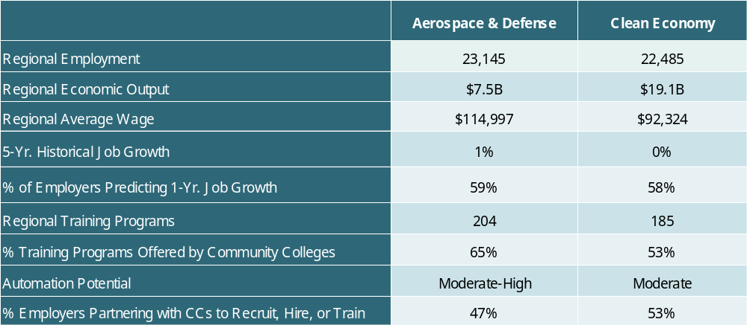
APPENDIX: PRIORITY SECTOR SNAPSHOT
Building Cross-Sectoral Skills across Emerging and Evolving Industries

