Slide 1


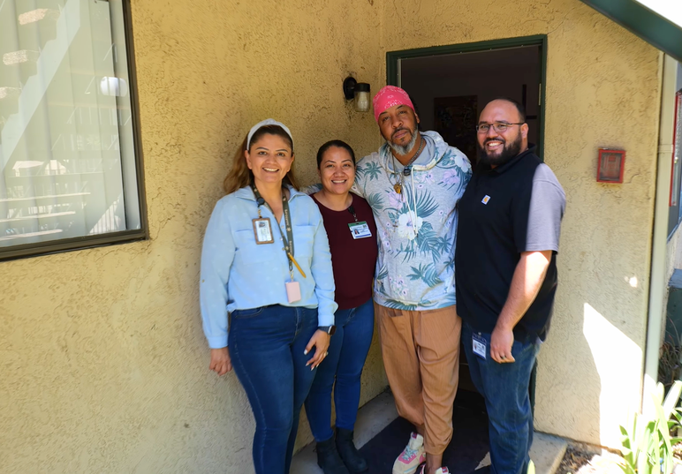
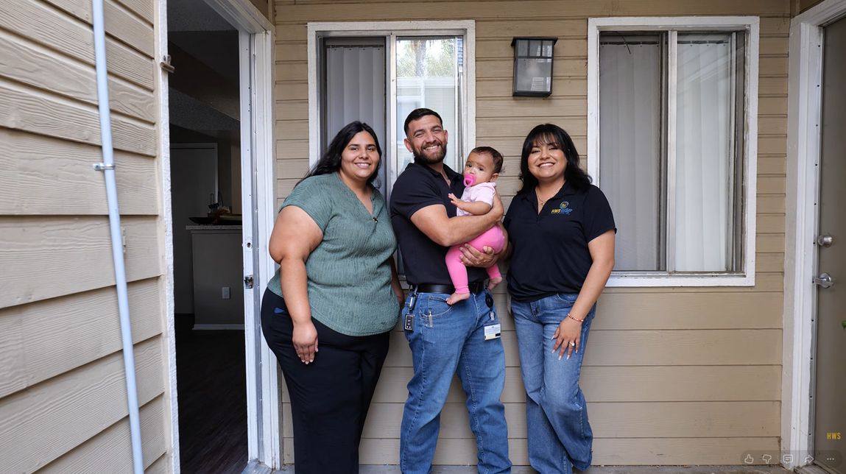

Connecting
WORKFORCE
& HOUSING
Presented By : Riverside County Housing and Workforce Solutions

Slide 2





WHO WE ARE
COUNTY OF RIVERSIDE OFFICE OF
HOMELESS SERVICES

Slide 3






Connecting
WORKFORCE
& HOUSING
RIVERSIDE COUNTY MODELS THAT CONNECT EMPLOYMENT,
SUPPORTIVE SERVICES AND HOUSING STABILITY
EMPLOYER CONNECT
Employer incentive + job matching + homelessness resource awareness.
CSBG
Career coaching, supportive services and training for people experiencing homelessness or temporary housing.
HOMELESS TO WORK
Transitional employment + community beautification + wrap-around support toward housing and permanent work.
THE COMMON THREAD
Meet people where they are — then connect employment, services and partners around a pathway forward.

Slide 4
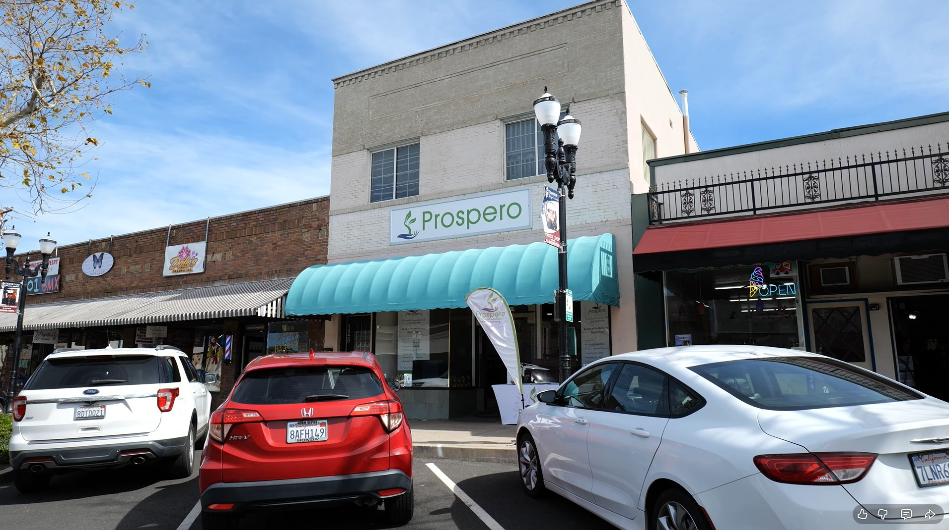
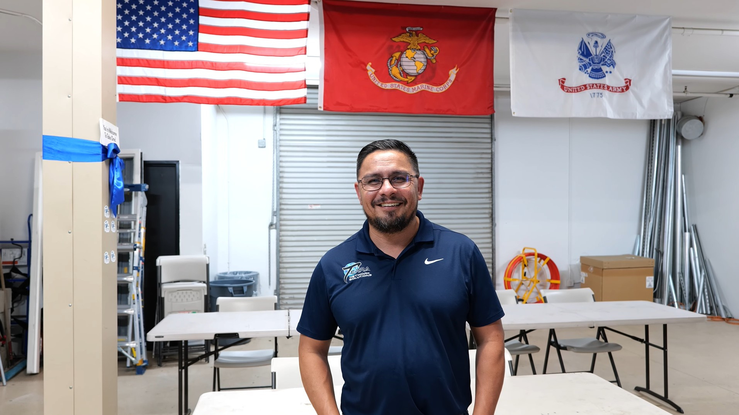
EMPLOYER CONNECT PROGRAM
BUSINESS-FACING WORKFORCE STRATEGY BUILDING COMMUNITY AWARENESS
UP TO $9,600 NEW-HIRE WAGE REIMBURSEMENT FOR ELIGIBLE EMPLOYERS
HOW IT WORKS
1. EMPLOYER INCENTIVE
Wage reimbursement helps offset the cost of a new hire.
2. RESOURCE TRAINING
New hires complete training from the Office of Homeless Services.
3. CHAMBER REFERRALS
Chambers help connect employers to the program.
4. AJCC JOB MATCHING
AJCCs support recruitment and match employers with job seekers.

Slide 5




COMMUNITY SERVICES BLOCK GRANT (CSBG)
FLEXIBLE FUNDING THAT HELPS COMMUNITIES ADDRESS BARRIERS THAT MAKE IT HARDER FOR PEOPLE AND FAMILIES TO BECOME ECONOMICALLY STABLE
GIVES LOCAL COMMUNITIES FLEXIBILITY TO RESPOND TO THE NEEDS THEY SEE EVERY DAY INSTEAD OF LIMITING FUNDING TO ONE SPECIFIC TYPE OF SERVICE
One-on-one guidance, career planning and navigation toward employment.
Supportive services that help reduce practical barriers to participating in training and employment.
Training and skill development designed to strengthen readiness for employment opportunities.
WHY IT MATTERS FOR WORKFORCE
CSBG GIVES US ANOTHER TOOL TO ADDRESS BARRIERS THAT WORKFORCE FUNDING ALONE MAY NOT COVER.

Slide 6
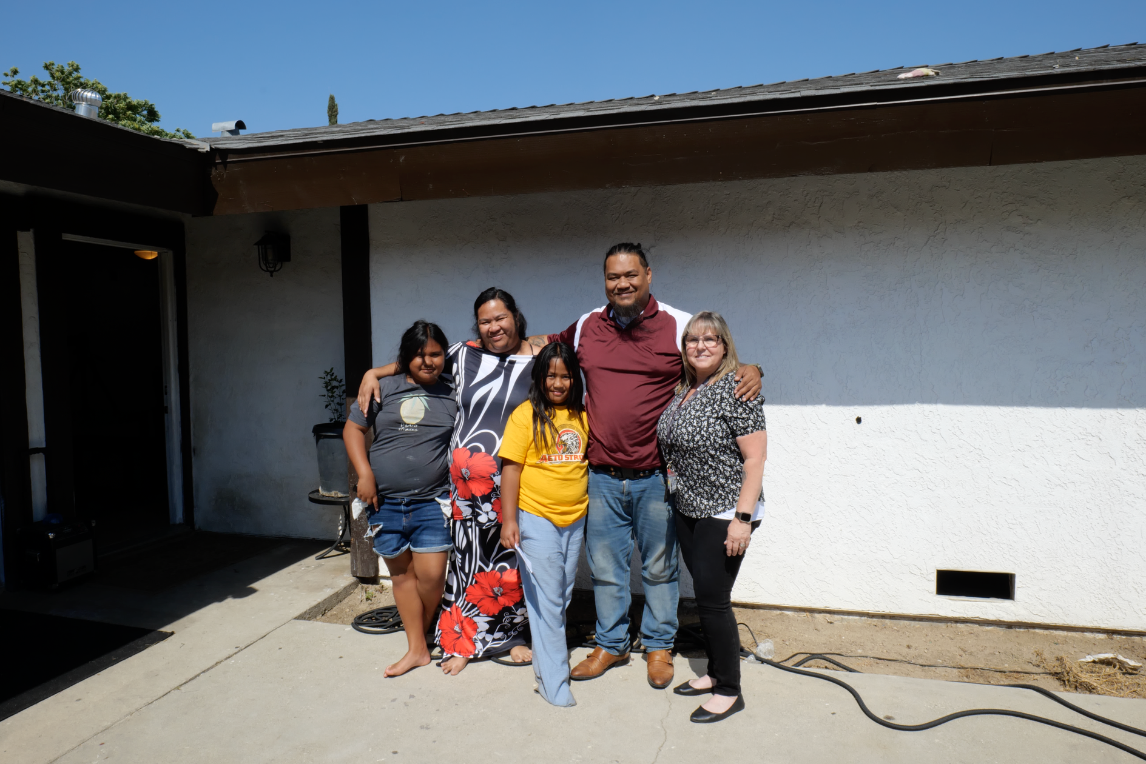
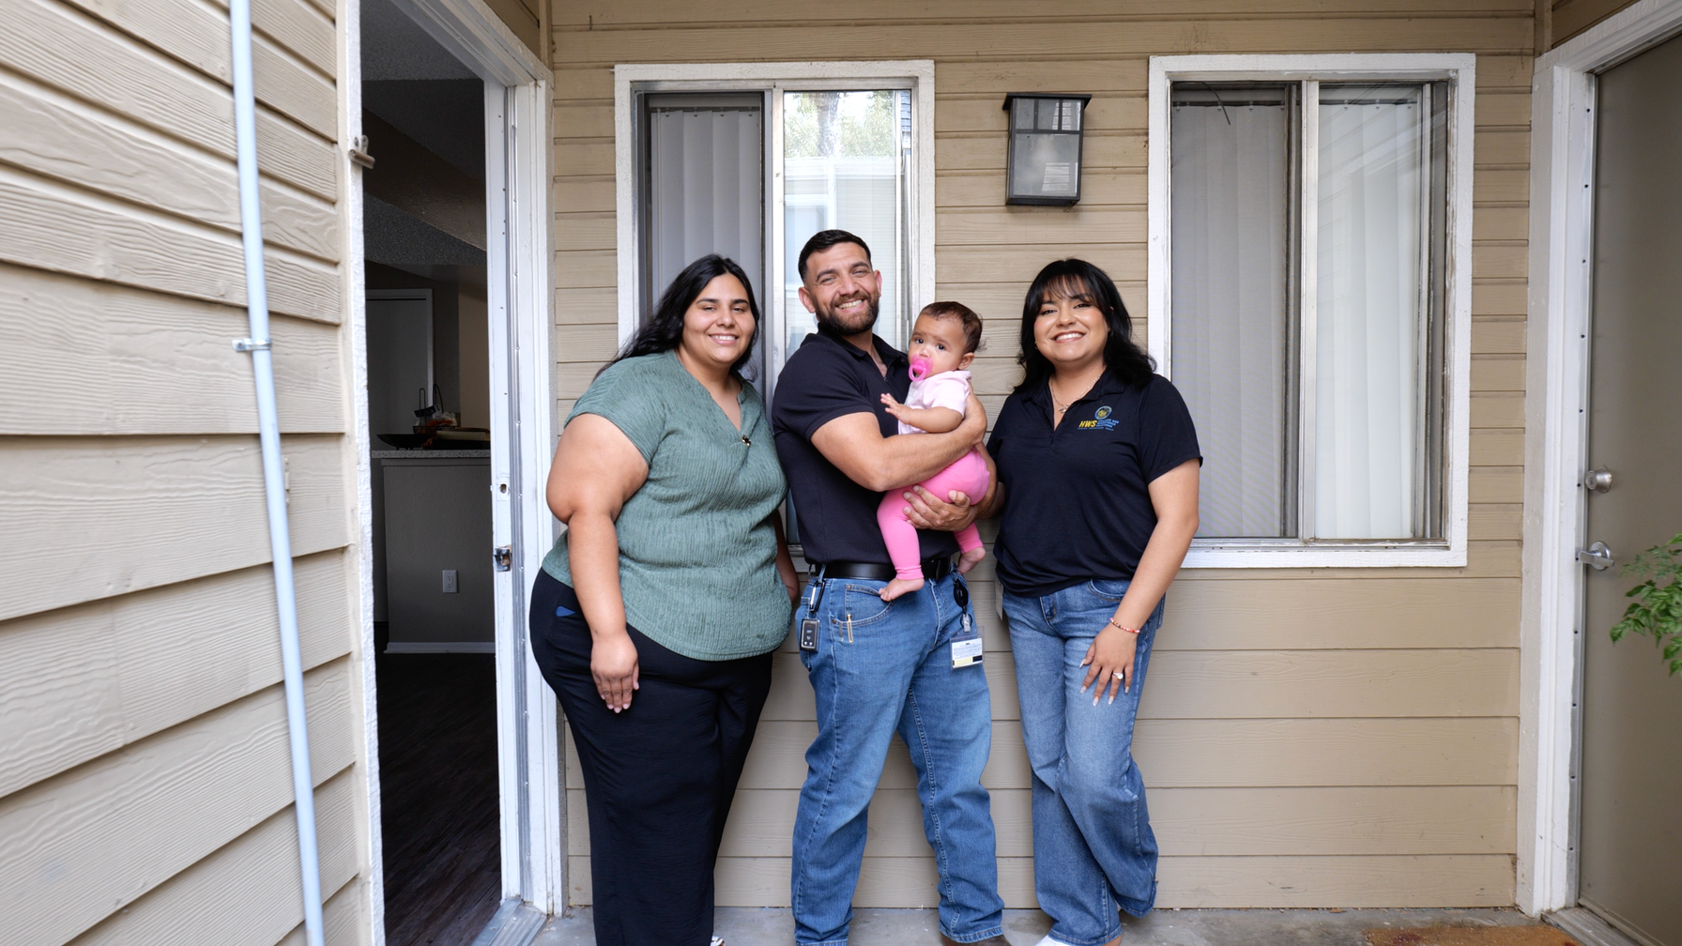
HOMELESS TO WORK
TRANSITIONAL EMPLOYMENT AS A BRIDGE TO STABILITY, HOUSING AND PERMANENT EMPLOYMENT
PAID WORK EXPERIENCE
Participants experiencing homelessness — often living in encampments — gain transitional employment through County beautification projects.
WRAP-AROUND SERVICES
Support is provided alongside work experience to help participants move toward housing and permanent employment.
A PATHWAY FORWARD
The model combines immediate work experience with longer-term housing and employment goals.
EXPANDING THE MODEL
Homeless Veterans + VASH — New DOL grant serving homeless veterans in partnership with the Housing Authority’s VASH program.
Affordable Housing Outreach — Workforce office hours at affordable housing development sites.

Slide 7






OUTCOMES & COMMUNITY IMPACT
400
Employer Connect employers
400
Employer Connect participants
$3.6 Million
Reimbursed to participating businesses
$9,600
Eligible new-hire wage reimbursement
COMMUNITY OUTCOMES
HWS-WIDE METRICS
Connected residents to employment, training, supportive services, and economic opportunity.
Expanded employer engagement and strengthened connections between businesses and local talent.
Used multiple programs and funding streams to address barriers to employment and stability.
325 individuals experiencing homelessness connected to employment
1,057 total participants served and placed into training or employment
856 employers and community partners engaged and are administering grant-funded programs
Key message: measure success by participant stability, employment connections, employer engagement, and stronger community delivery capacity.

Slide 8
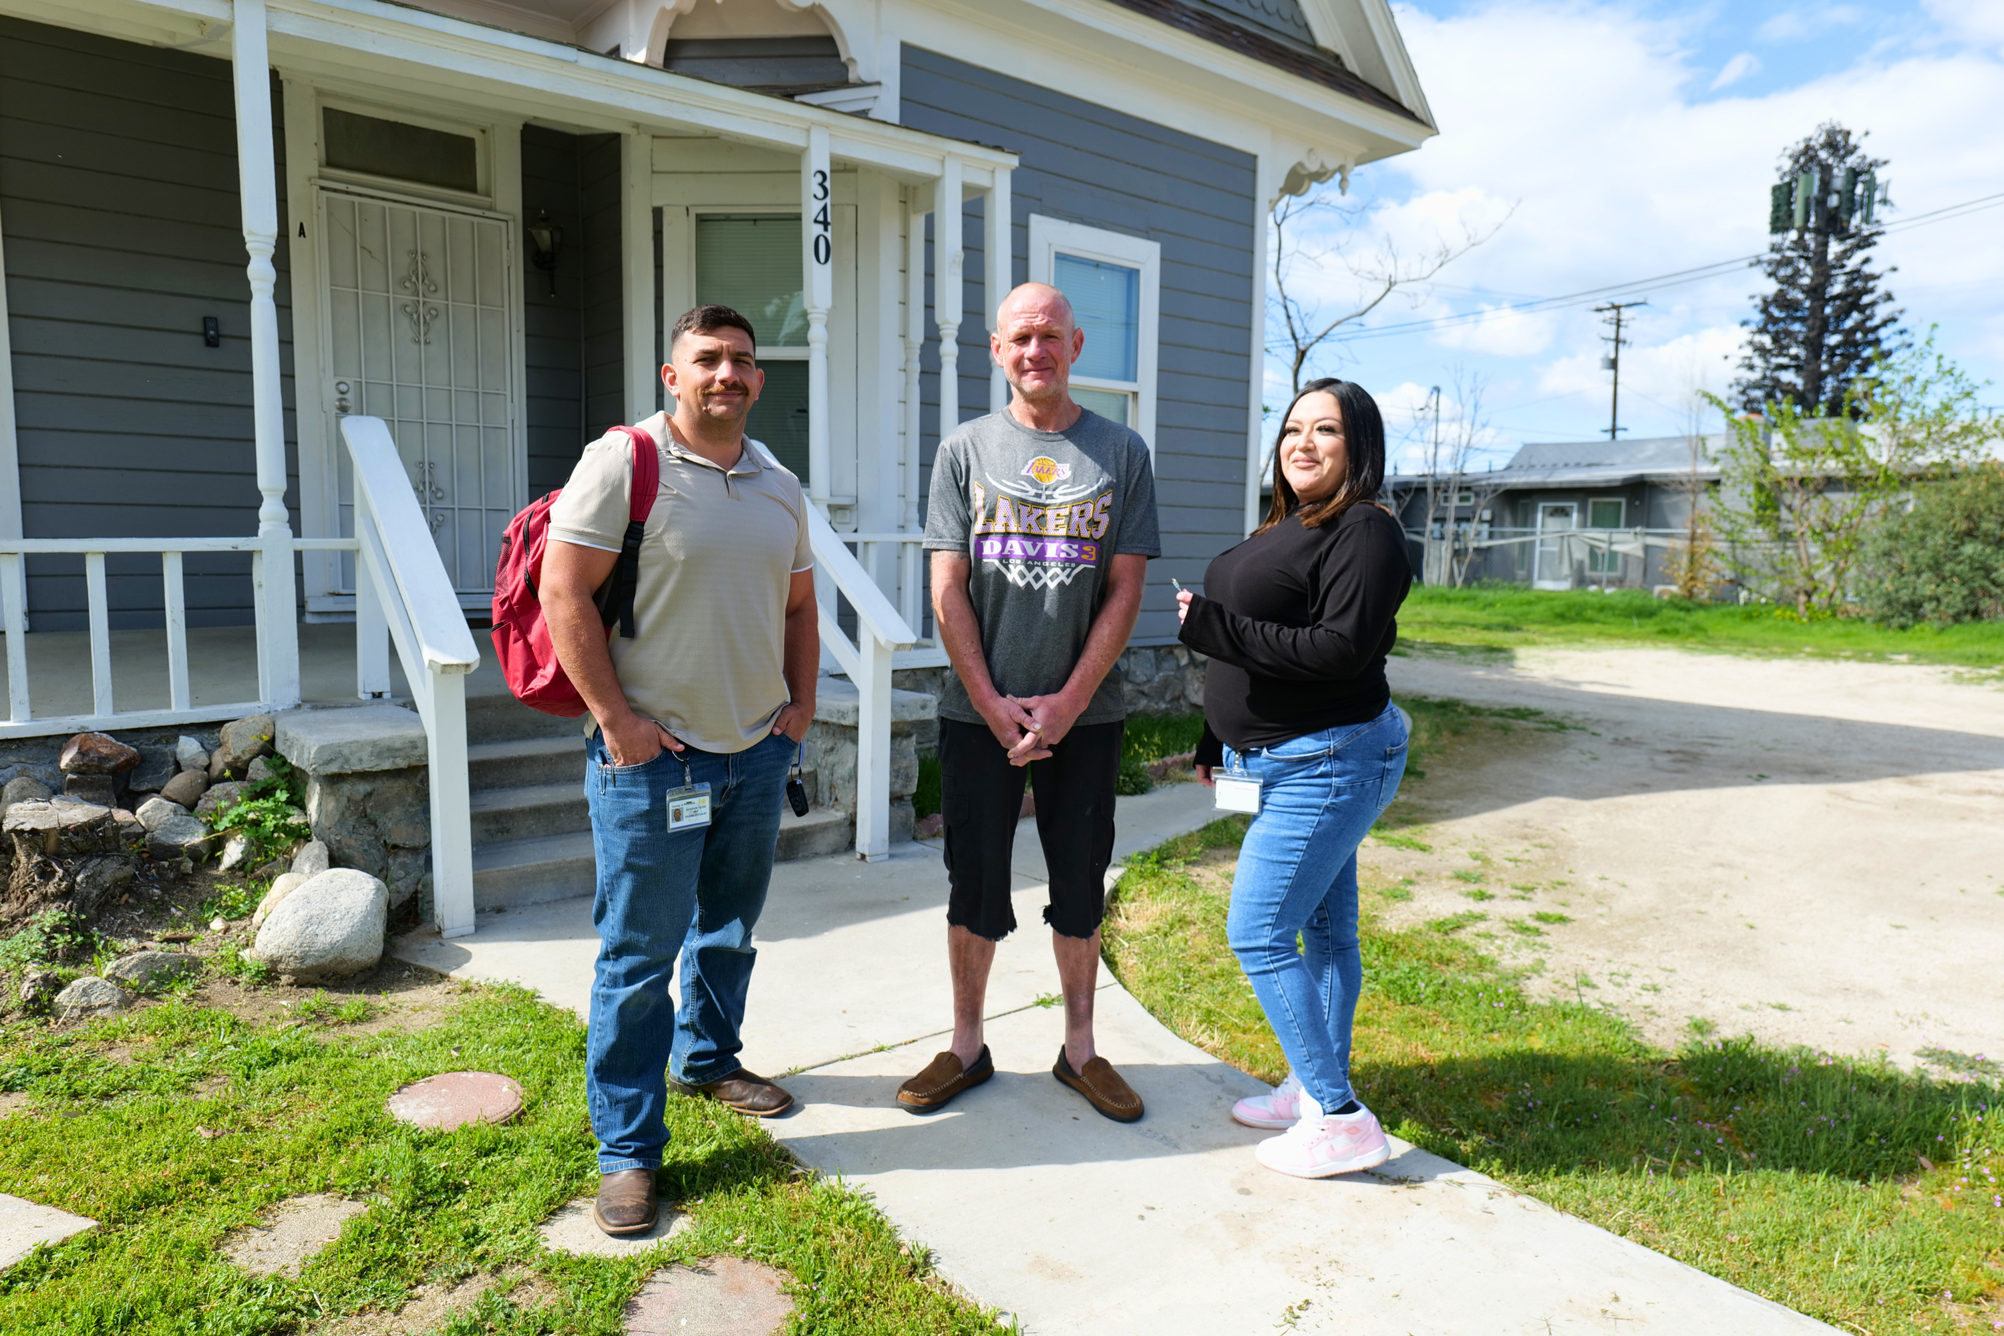





LESSONS LEARNED:
BUILDING VENDOR CAPACITY
SOME PARTNERS WERE ADMINISTERING FEDERAL OR GRANT-FUNDED PROGRAMS FOR THE FIRST TIME
NEW VENDORS
Limited experience with
federal funding
HWS TECHNICAL ASSISTANCE
Hands-on guidance and
ongoing support
STRONGER PRACTICES
Improved reporting, documentation and compliance
COMMUNITY CAPACITY
Partners better prepared
for future funding
WHAT IS REQUIRED FROM HWS TEAMS
POSITIVE OUTCOME
Technical assistance on contract requirements, allowable costs, invoicing and documentation.
Support with participant eligibility, performance reporting, grant compliance and monitoring.
Frequent follow-up and coordination across Programs, Fiscal, Contracts, Data, Compliance and Administration
Vendors gained hands-on experience administering grant-funded programs.
Partners strengthened fiscal, reporting and compliance practices.
Riverside County now has more community organizations prepared to administer future public funding.

Slide 9
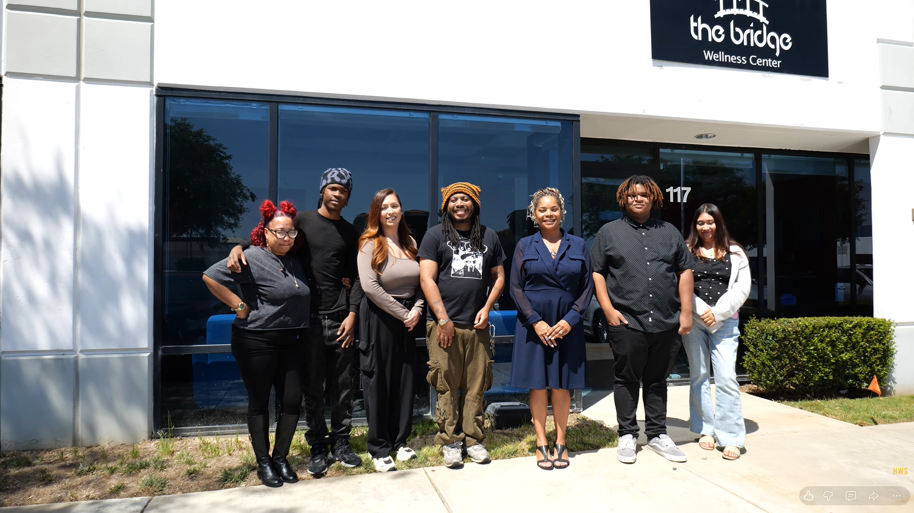

LESSONS LEARNED:
STRENGTHENING OUR INTERNAL SYSTEMS
PROGRAM SUCCESS DEPENDED ON COORDINATED ADMINISTRATION
NOT PROGRAM OPERATIONS ALONE
WHAT WE LEARNED
HOW OUR TEAMS GREW
Earlier cross-functional coordination improves implementation.
Clear expectations and standardized reporting reduce downstream issues.
Newer providers often require more structured onboarding and follow-up.
Technical assistance should be planned as part of program delivery—not added only after issues arise.
Stronger collaboration across Programs, Fiscal, Contracts, Data, Compliance and Administration.
Greater experience managing diverse funding requirements and provider needs.
Improved ability to identify compliance and performance risks earlier.
More consistent focus on documentation, accountability and measurable outcomes.
GOING FORWARD
Build pre-award readiness into implementation planning.
Use standardized vendor onboarding and TA resources.
Establish clear milestones and reporting expectations at launch.
Use performance data and partner feedback to continuously improve services

Slide 10






A STRONGER PROGRAM IMPLEMENTATION MODEL
APPLYING LESSONS LEARNED TO FUTURE HOUSING & WORKFORCE INITIATIVES
PRE-AWARD ASSESSMENT
Understand readiness
VENDOR ONBOARDING
Set expectations
TRAINING & TECHNICAL
ASSISTANCE
Build capacity
PERFORMANCE MONITORING
Partners better prepared
for Track results
CORRECTIVE SUPPORT
Address gaps
SUCCESSFUL DELIVERY
Sustain outcomes
TECHNICAL ASSISTANCE IS NOT SEPARATE FROM PROGRAM SUCCESS.
IT IS ONE OF THE TOOLS THAT MAKES SUCCESSFUL DELIVERY POSSIBLE.

Slide 11
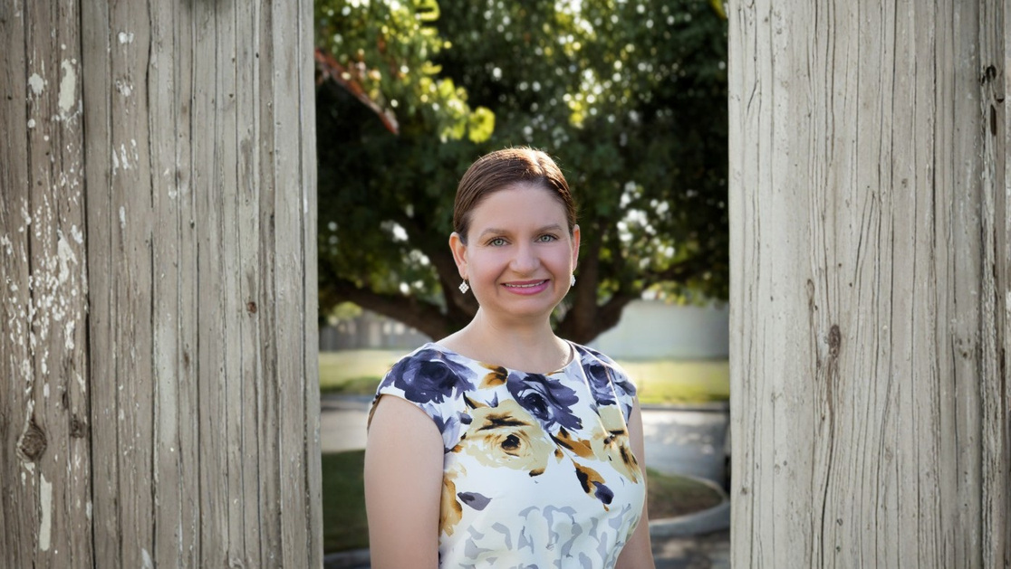
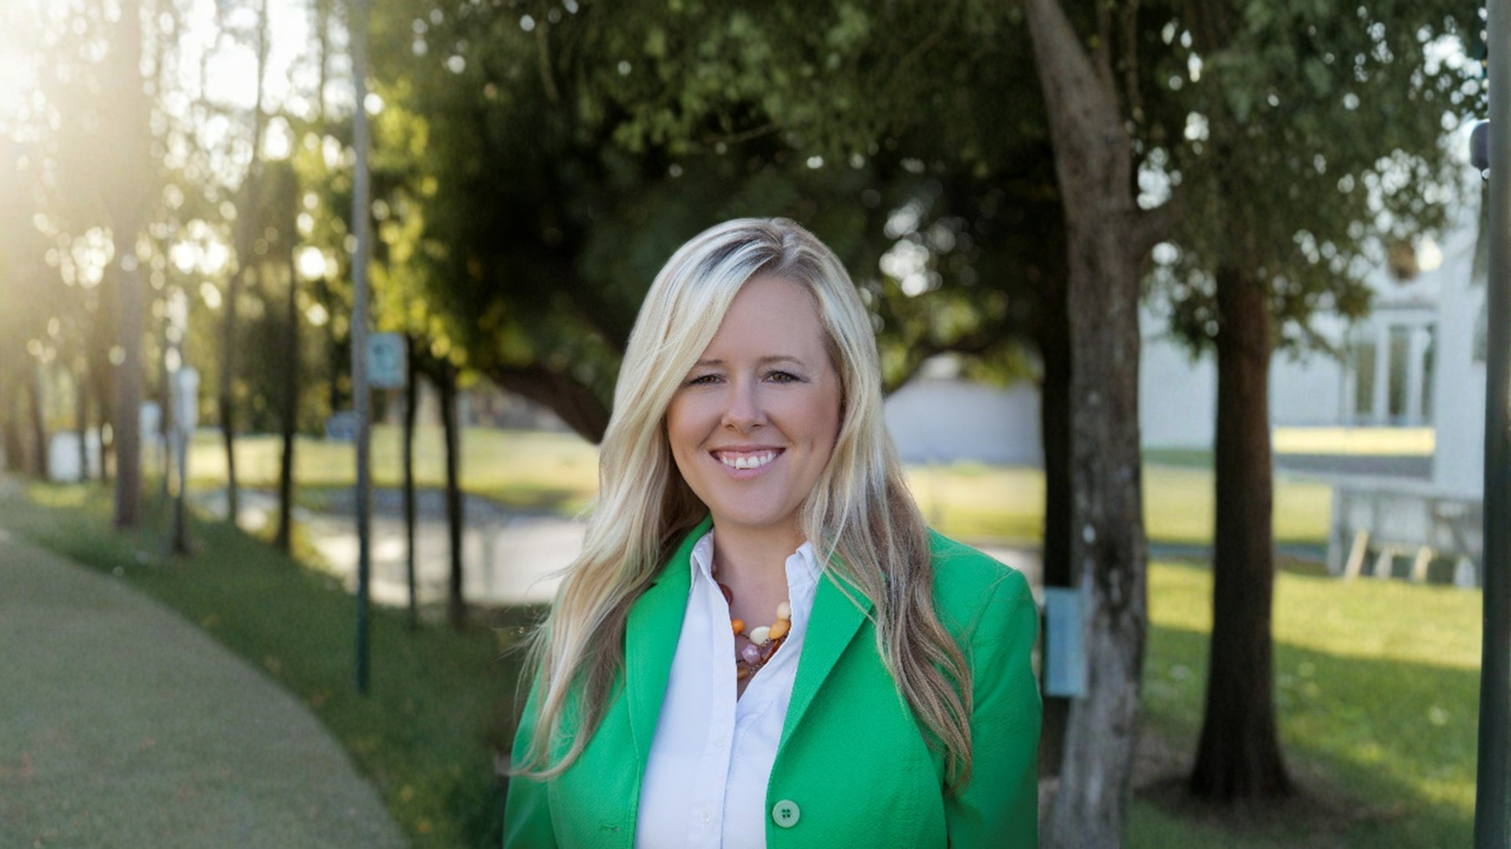

COUNTY OF RIVERSIDE OFFICE OF
HOMELESS SERVICES
HEIDI MARSHALL
STEPHANIE ADAMS
ADRIANA ESCOBEDO
Director
Deputy Director
Principal Development Specialist
HMARSHALL@RIVCO.ORG
SJADAMS@RIVCO.ORG
AESCOBEDO@RIVCO.ORG

