Slide 1




Slide 2



The MI Story

Slide 3



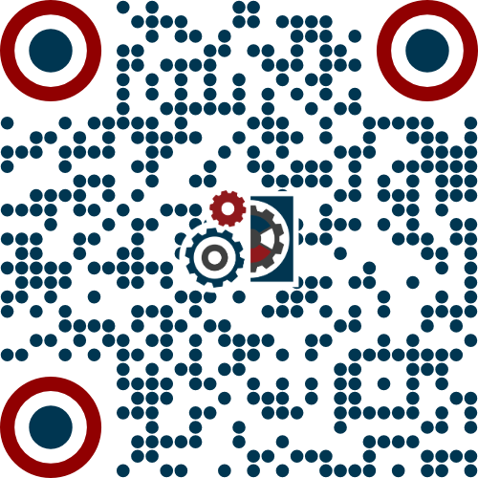
MI Educates, Supports, Mentors, and Empowers.
OUR MISSION
To empower workers to build a better future through world class education, training and union rights on the job.
OUR CORE VALUES
Built on the belief that education and training improves society and creates better futures for all, we commit to core values of:
OUR VISION
Excellence
Ethics
Dignity
Diversity and Equity
Solidarity
Accountability
Collective Bargaining Rights
We envision prosperity for workers across multiple industries through accessible and affordable world class education and training. By providing pathways to needed skill development for IAM members and community members in need of opportunities and rights in the workplace.
Scan for our video introduction

Slide 4


MI Takes a Holistic Approach To Delivering Accessible Education.
PARTNER
BUILD
EXPAND
IAM
Employers
K12
Higher Education
Community Partners
Legislators
Workforce System
Learning Management System
Instructional Designers
Train the Trainer
Apprenticeship Development
Standardized Curriculum
Technical Assistance
Student Supports
Use Proven Model to replicate:
Rural Delivery
Hybrid Delivery
Through Partnerships
Underserved Communities
Tribal Partners
National Expansion

Slide 5
Who Is CAEL?
A National Leader in Economic Mobility
50+ Years of Impact
For more than 50 years, CAEL has worked at the intersection of workforce development, higher education, employer engagement, and economic mobility — helping regions build ecosystems that connect adult learners to family-sustaining careers.
explore
OUR NORTH STAR
Economic mobility through lifelong learning and easily navigable career pathways
Notes:
We like to describe CAEL by saying we bring education and training perspectives to workforce challenges and workforce perspectives to education and training challenges.
Because we occupy all the spaces where those areas intersect.

Slide 6

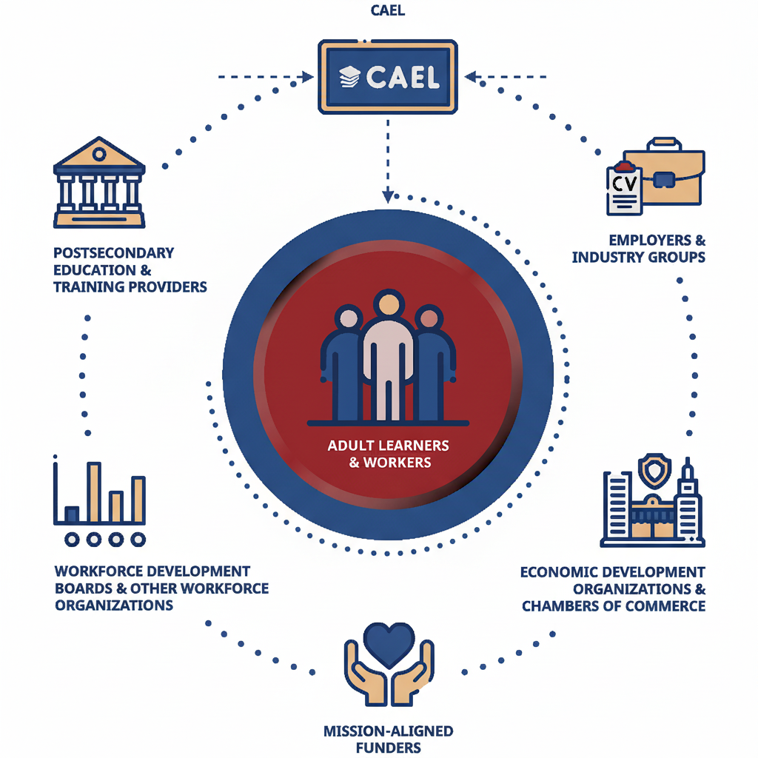
An Ecosystem Approach
CAEL meets regional stakeholders where they are and helps by providing expertise, resources, and innovative solutions that effectively support adult learners as they navigate on-and off- ramps between education and employment.
CAEL: Operates as the coordinating intermediary to align employers, workforce systems, education, and labor
Notes:
Economic mobility isn’t possible if the different sectors of the talent development ecosystem become siloed niches. Seamless alignment requires a trusted intermediary that can accelerate links among education, training, and employment.
That’s the role CAEL embraces.

Slide 7

CAEL’s Ecosystem Model
Integrated Talent Development Requires a Trusted Intermediary
Higher education and workforce development are two sides of the same coin, requiring neutral coordination to link learning and earning.
workWorkforce Development
Employer & labor coalition engagement
Occupational crosswalks & competency mapping
Credit for Prior Learning (CPL) design
Learning & Employment Record (LER) mobility
account_balancePostsecondary Education
Institutional capacity for adult learners
Degree pathway alignment & credit mobility
Prior Learning Assessment (PLA) models
RSI to degree-credit translation
gavelPolicy & System Alignment
Centering adult learner access & equity
Translating state policy into local practice
Strategic regional partnerships
Braiding & aligning funding streams
linkCAEL accelerates links among education, training, and employment
Notes:
CAEL operates as the trusted bridge between postsecondary education and workforce development. We view higher ed and workforce development as both sides of the same coin rather than competing currencies in the talent development marketplace.
We support the entire talent development ecosystem, because the worlds of learning and work are stronger together. That strength is only possible when adults can thrive in both. Broader community prosperity rests on individual economic mobility.

Slide 8
Applying the Ecosystem Model: California’s Apprenticeship Landscape
Statewide Goals and Momentum
Statewide Ambition & Scale
93,000+ Active Apprentices: California holds the largest active apprenticeship footprint in the nation, with aggressive growth goals.
500,000
Registered Apprentices by 2029
Governor Newsom's primary target for expanding formal registered apprenticeship pathways.
Policy & Funding Drivers
California Apprenticeship Initiative (CAI): Funding regional community college pathways and expansion into nontraditional sectors.
Apprenticeship Pathways Demonstration Project (APDP): Aligning degree completion directly with registered programs.
600,000+
Earn-and-Learn Opportunities
Cumulative state total including registered programs, pre-apprenticeships, and workforce grant pathways.
The Strategic Need
Scaling Intermediaries: With hundreds of thousands of workers entering pre-apprenticeships and work-based training, regional intermediaries are needed to bridge these entry points directly into registered degrees.
Notes:
Regional approaches that are inclusive of the full talent development ecosystem are key to sustaining the kind of growth you see on this slide, especially amid a rapidly evolving labor market that depends on a skilled, and diverse workforce.
When looking at California's landscape, you'll see headlines celebrating more than 600,000 earn-and-learn opportunities created since 2019. That broad total encompasses everything from pre-apprenticeships to specialized workforce grant programs. Within formal Registered Apprenticeships specifically, the state maintains a nation-leading active footprint of more than 93,000 workers at any given time. For CAEL and the Machinists Institute, our focus is ensuring these earn-and-learn activities include pathways to college credentials.
Programs like the California Apprenticeship Initiative and the Apprenticeship Pathway Demonstration Project were created specifically to integrate traditionally disparate trade and academic education and training pathways.
California views registered apprenticeships not merely as on-the-job training, but as a primary strategy for achieving statewide postsecondary degree attainment, ensuring workers earn family-sustaining credentials without taking on college debt.
Sources: https://www.dir.ca.gov/DIRNews/2026/2026-18.html “California continues to lead the nation in career education by surpassing its original goal of reaching 500,000 apprenticeships by 2029. In his most recent State of the State address, Governor Gavin Newsom announced that California has added 600,000 earn-and-learn opportunities, furthering the administration’s commitment to building a strong and skilled workforce.”
https://www.gov.ca.gov/2026/04/28/governor-newsom-celebrates-national-apprenticeship-week-highlighting-pathways-connecting-workers-to-good-jobs/ “More than 674,735 opportunities, including over 245,000 registered apprenticeships have been created across the state since 2019. “

Slide 9

A Lack of Credit for a Wealth of Experience
High Demand From Apprentices for Postsecondary Credentials
schoolStrong Apprentice Demand
bar_chartEnrollment vs. Credential Yield
Enrolled in Community College Training
73%
Desire Postsecondary Credentials
78%
Earn a Postsecondary Certificate
3%
Attain an Associate Degree
~1%
Nearly three-quarters of registered apprentices express a clear interest in earning an associate degree alongside their trade credentials.
warningStructural Disconnect
Colleges primarily deliver trade instruction as clock-hour licensing requirements rather than credit-bearing courses mapped toward academic degree requirements.
Source: WSAC / Education Northwest Study (Appendix D)
Source: Washington Student Achievement Council (WSAC) 2023 Report
Notes:
The vast majority of apprenticeships are classified in "non-credit" or "terminal technical certificate" pathways. Expanding avenues to apprenticeships shouldn’t mean closing the door on a college degree.
Either/or siloes: According to a Washington Student Achievement Council study, while 78% of registered apprentices take coursework at community colleges, only about 1% earn an associate degree and only 3% complete a postsecondary certificate due to a structural disconnect between trade instruction and academic degree requirements.

Slide 10



The Learner/Earner Framework
Learning Counts No Matter Where It Happens
Recognizing competencies gained through labor and life experience accelerates economic mobility for adult learners.
The "Learner/Earner"
Beyond the Classroom
Unbundling Education
Dual Identity: Most adult learners are active workers, and most workers must engage in continuous lifelong learning.
Recognizing real-world learning: Learning doesn't begin or end at school doors; adults carry skills built through labor and life.
Stackable Milestones: Deconstruct rigid "all-or-nothing" degree tracks into modular, bite-sized learning achievements.
Notes:
The adult learner/earner: Most adult learners are also workers, and vice versa. Just as working for a single lifelong employer has become increasingly rare, the need for lifelong learning has become increasingly critical.
Learning doesn’t begin–or end–at the classroom door: When adult learners walk through those doors, they are carrying a lot more than their books (or laptops). They are carrying competencies worthy of recognition. Competencies they have gained through their labor and through living their lives.
“Unbundling” education and training pathways: Breaking down “all or nothing” degree pathways into “bite-sized” learning experiences has great potential to address the "no experience, no job" catch-22. Stackable learning experiences deliver real-time upskilling that offers immediate workforce impact to employers while maintaining a path toward long-term educational attainment

Slide 11
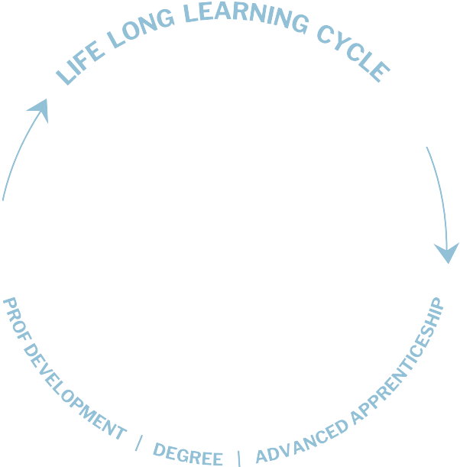
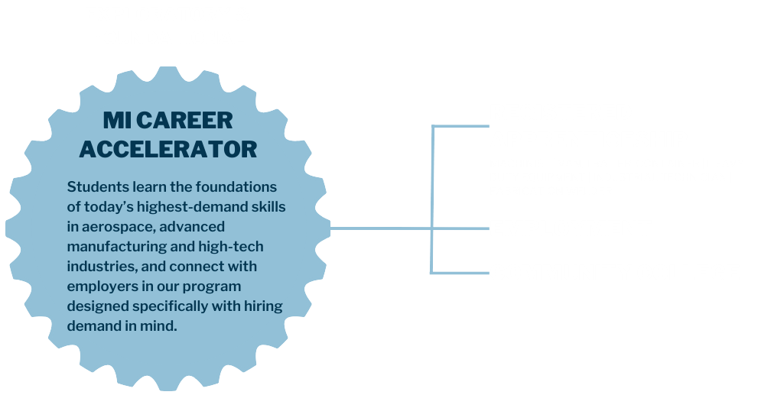
EDUCATIONAL MODEL
Putting Policy Into Practice

Slide 12
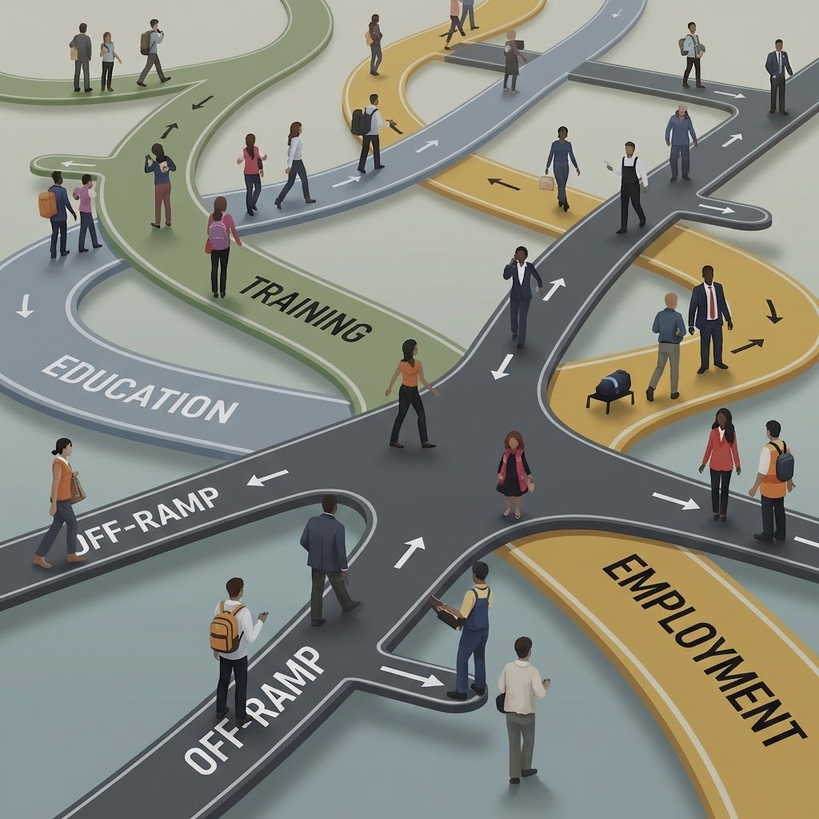

Designing Flexible and Accessible Pathways
The Core Belief
No one should be locked into an unrewarding or unfulfilling career. Everyone deserves access to extended career pathways.
The Broad Impact
When those pathways are present, they don’t just lead to individual success for adult learners. They meet critical talent needs, drive economic mobility, and fuel community prosperity.
Notes:
Putting policy into practice: California’s state-level goals for expanding degree pathways and equitable economic mobility set an ambitious agenda, but local workforce boards carry the heavy lift of operationalizing that vision every day. Because CAEL works regularly alongside California’s postsecondary and workforce leadership, we serve as a bi-directional translator, helping translate state-level higher ed priorities into practical, degree-bearing pathways while elevating real-world workforce mechanics to the state policy table.

Slide 13
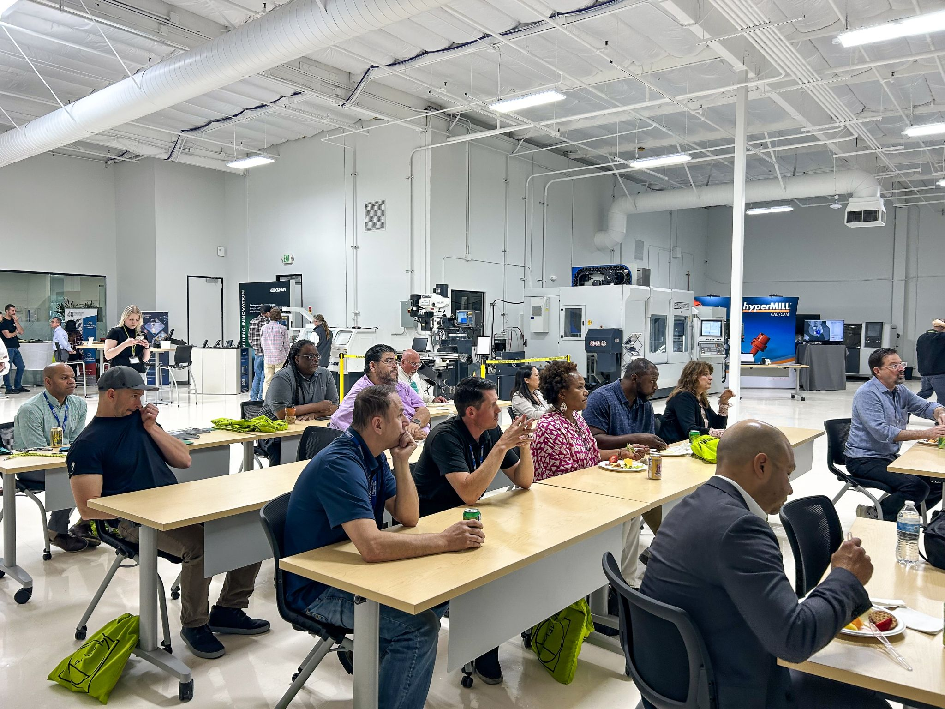



College or Trade School? Saying ‘Yes’ to Both
A Seamless, Dual-Outcome Educational Model
school
100% Completion Rate
monetization_on
Zero Extra Cost or Seat Time
volunteer_activism
Holistic Wraparound Support
workspace_premium
Apprenticeships as Education Benefits
Notes:
100% completion rate: Under the CAEL–Machinists Institute-Renton Technical College model, 100% of apprentices who complete their four-year registered apprenticeship also earn an Associate of Applied Science in Multi-Occupational Trades.
Zero extra cost or seat time: Competency-based crosswalks align workplace instruction directly with college General Education outcomes, eliminating tuition and additional seat time.
Holistic wraparound support: Registering apprentices as postsecondary students grants them full access to campus supportive resources, including libraries, computer labs, and food pantries.
Framing apprenticeships as education benefits: Elevating trade training to degree-granting pathways turns registered apprenticeships into powerful recruitment and retention tools for employers.

Slide 14
A Brighter Future Built on Learner/Earner Choice
Reimagined Degree Pathways
Apprenticeship Program
General Education Outcomes for Degree
Minimum 6000 Hours OJT
Minimum 450 Related Instruction
Graduation
Embed all outcomes of GEN ED courses in Related Instruction
Journey Certificate
AND
Associate of Applied Science
At the same time
Notes:
Degree as "career insurance": As CAEL and the Machinists Union readily acknowledge, not every apprentice may want or need a college degree, especially at the onset of their career. But an associate degree serves as vital career insurance. As trade workers age or face physical wear-and-tear, holding an accredited degree unlocks future career forks in management, safety, supervision, or instruction.

Slide 15
Validating the Impact of Seamless Education-Employment Pathways
Apprenticeships for America
Highlights the apprenticeship-embedded model as the “most innovative” national approach for credentialing work-based learning seamlessly across postsecondary systems.
Unlocking Systemic Barriers
Unions & Labor
Faculty & Deans
Registrars
Employers
Accreditors
Workforce Boards
NEUTRAL FACILITATOR
CAEL Solutions Architect
Urban Institute Report
Cites this model as an “emerging innovation” directly addressing the critical national gap where <10% of postsecondary institutions offer active apprenticeship degrees.
CORE ALIGNMENT SYNTHESIS
Research Finding: Scaling apprenticeship degrees requires aligning chronically siloed stakeholders.
CAEL Role: Acts as the neutral solutions architect orchestrating cross-system compliance, credit transferability, and pathway design.
Notes:
National Research Validates the CAEL-Machinists Institute “Both/And” Solution
We wanted to end with some national recognition of our approach and what’s needed going forward.
In its national report, Apprenticeships for America ((Learning from the Field: Making Apprenticeship Degrees Work at Scale), AFA highlights the CAEL–Machinists Institute–Renton Technical College partnership as a key example of linking apprenticeships and degrees.
Most innovative model: The AFA categorizes our approach within the Apprenticeship-Embedded Degree model, the most innovative model of aligning apprenticeships with degree programs, which “unlocks the full potential of work-based learning by formally recognizing and credentialing competencies developed through real-world experience.” The embedded model is considered the most innovative because it utilizes a competency-based approach to weave academic requirements directly into apprenticeship training, such as embedding general education requirements right into technical instruction, rather than requiring workers to sit through traditional, separate classes.
Urban Institute: The Urban Institute report (Setting the Stage for Scaling Apprenticeship Degrees), which CAEL experts contributed to, also argues for expanding and scaling high-quality apprenticeship-degree pathways as a high-potential solution to align higher education with workforce development. It highlights that fewer than 10% of U.S. higher education institutions offer apprenticeship degrees, citing our work as a national "emerging innovation."
Solving the multi-stakeholder bottleneck: Both reports conclude that scaling apprenticeship-degree programs is not possible without aligning chronically siloed stakeholders: unions, academic faculty, registrars, workforce developers, employers, and accrediting bodies. CAEL acts as the neutral "solutions architect," bringing deep technical expertise in credit for prior learning, competency-based career pathways mapping, and higher education operations to orchestrate seamless cross-system coordination.

Slide 16










Connect With Us
Machinists Institute
CAEL
Casey Gallagher
Earl Buford
CA Regional Director
President and CEO, CAEL
Casey.Gallagher@MachinistsInstitute.org
ebuford@cael.org
The Machinists Institute
CAEL
www.machinistsinstitute.org
www.cael.org
SCAN TO CONNECT
SCAN TO CONNECT
LINKING LEARNING AND WORK TO DRIVE ECONOMIC MOBILITY
Notes:
You are a key piece of the cross-sector collaboration puzzle, so thank you, and I hope you’ll connect with us.

Slide 17


Thank You!
Linking learning and work to drive economic mobility.

