Slide 1
Razor Pages
Defining base classes

Slide 2
Create
Read
Update
Delete
All
Data service
Product
Customer
Order
User
…

Slide 3
Inheritance
Create
Read
Update
Delete
Type-parameterization
All
Data service
Product
Customer
Order
User
…

Slide 4
Page Model Base Classes | CreatePM | ReadPM | UpdatePM | DeletePM | AllPM
OnPostRedirPage | X | - | X | X | -
OnErrorRedirPage | (X) | X | X | X | -
Data service ref | X | X | X | X | X
Data property | X | X | X | X | -
List property | - | - | - | - | X
OnGet | - | - | - | - | X
OnGet(int id) | - | X | X | X | -
OnPost | X | - | X | X | -

Slide 5
 | CreatePM | ReadPM | UpdatePM | DeletePM | AllPM
OnPostRedirPage | X | - | X | X | -
OnErrorRedirPage | (X) | X | X | X | -
Data service ref | X | X | X | X | X
Data property | X | X | X | X | -
List property | - | - | - | - | X
OnGet() | - | - | - | - | X
OnGet(int id) | - | X | X | X | -
OnPost() | X | - | X | X | -

Slide 6
PageModel base classes
PageModel: Given by framework
PageModelAppBase: Base class for all page model classes in this app
Data service reference, init by dependency injection
Data property
Redirect page for Error
Redirect page for OnPost (even if Read doesn’t need it)
AllPM: Inherits from PageModel, little in common with others

Slide 7
PageModel
PageModel
AppBase
AllPM

Slide 8
 | CreatePM | ReadPM | UpdatePM | DeletePM
OnGet(int id) | - | X | X | X
OnPost() | X | - | X | X

Slide 9
PageModel base classes
PageModelExistingData: Base class for all page model classes that operate on existing data
OnGet with id parameter
ReadPM, UpdatePM and DeletePM inherit from PageModelExistingData
UpdatePM and DeletePM implement OnPost()

Slide 10
PageModel
PageModel
AppBase
PageModel
ExistingData
DeletePM
UpdatePM
ReadPM
AllPM

Slide 11
 | CreatePM
OnPost() | X

Slide 12
PageModel base classes
CreatePM: Base class for all page model classes that create new data. Inherits from PageModelAppBase
Implements OnPost

Slide 13
PageModel
PageModel
AppBase
PageModel
ExistingData
DeletePM
UpdatePM
ReadPM
CreatePM
AllPM

Slide 14
PageModel
PageModel
AppBase
PageModel
ExistingData
DeletePM
UpdatePM
ReadPM
CreatePM
AllPM
Product
DeletePM
Customer
DeletePM
Order
DeletePM

Slide 15
Data Service Base Class | Create(…) | Read(…) | Update(…) | Delete(…) | All(…)
DBContext needed | (X) – specific DBC | (X) – specific DBC | (X) – specific DBC | (X) – specific DBC | (X) – specific DBC
Base class impl. | X | (X) - includes | (X) – update logic | X | (X) - includes

Slide 16
Data Service base class
Implements IDataService<T>, by use of EFCore
Can specify general, EFCore-based logic for all CRUDA-methods
Cannot
Create specific DBContext-object
Implement specific update logic
Setup specific object references with Include-statements
Is an example of Template Method pattern

Slide 17
Data Service base class
Is an example of Template Method pattern
Implement as virtual/abstract in base class, provide actual implementation in subclasses
Defer actual update logic to domain classes, by requiring they implement a specific interface

Slide 18
Data Service base class
EFCDataServiceBase: Base class containing all CRUDA logic, abstract method for DBContext creation, virtual method for object reference includes
EFCDataServiceAppBase: Implements abstract method for DBContext creation, since this is the same for all subclasses
EFCOrderDataService: Overrides virtual virtual method for object reference includes, as it is specific for Order
Order: Implements UpdateFromOther interface

Slide 19
IData
Service
EFCDS
Base
EFCDS
AppBase
EFCDS
Product
EFCDS
Customer
EFCDS
Order

Slide 20
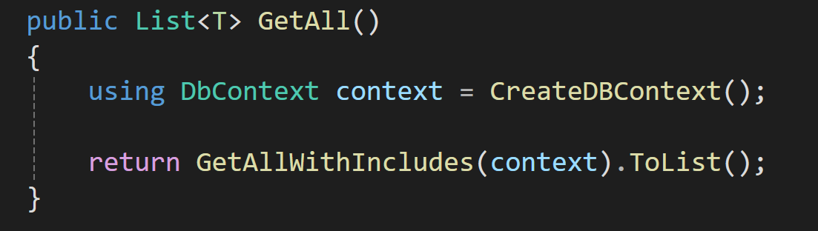
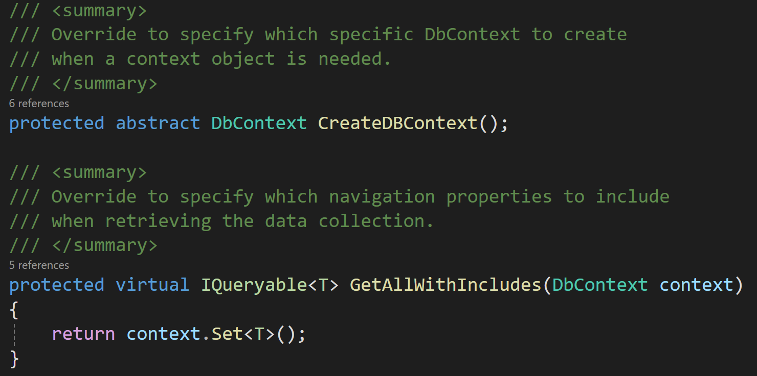

Slide 21
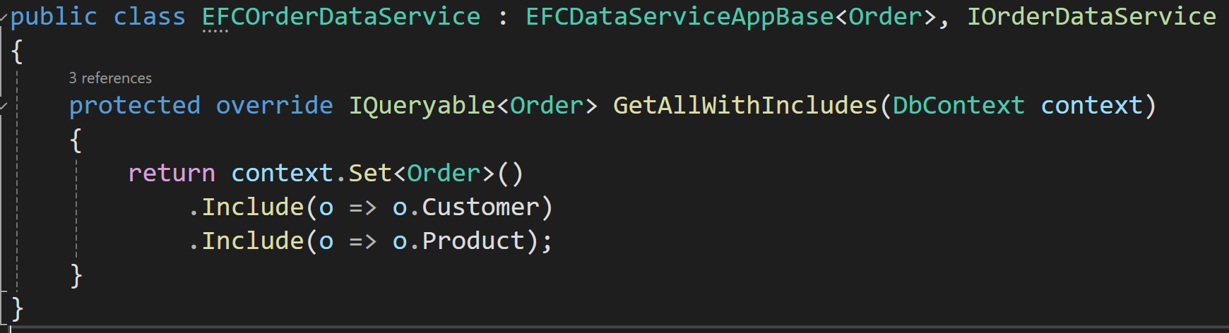

Slide 22
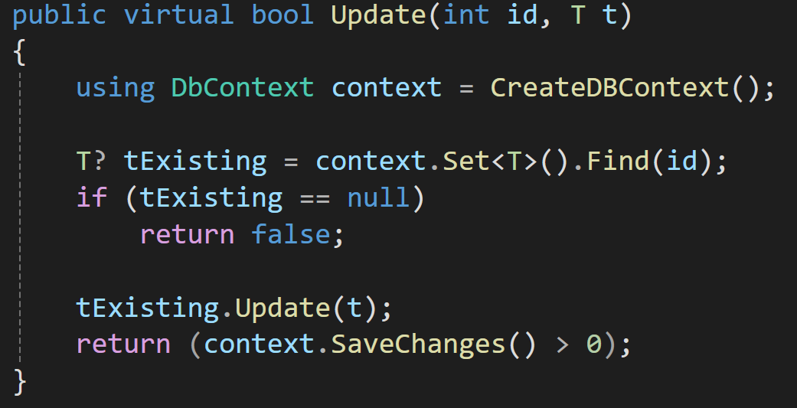
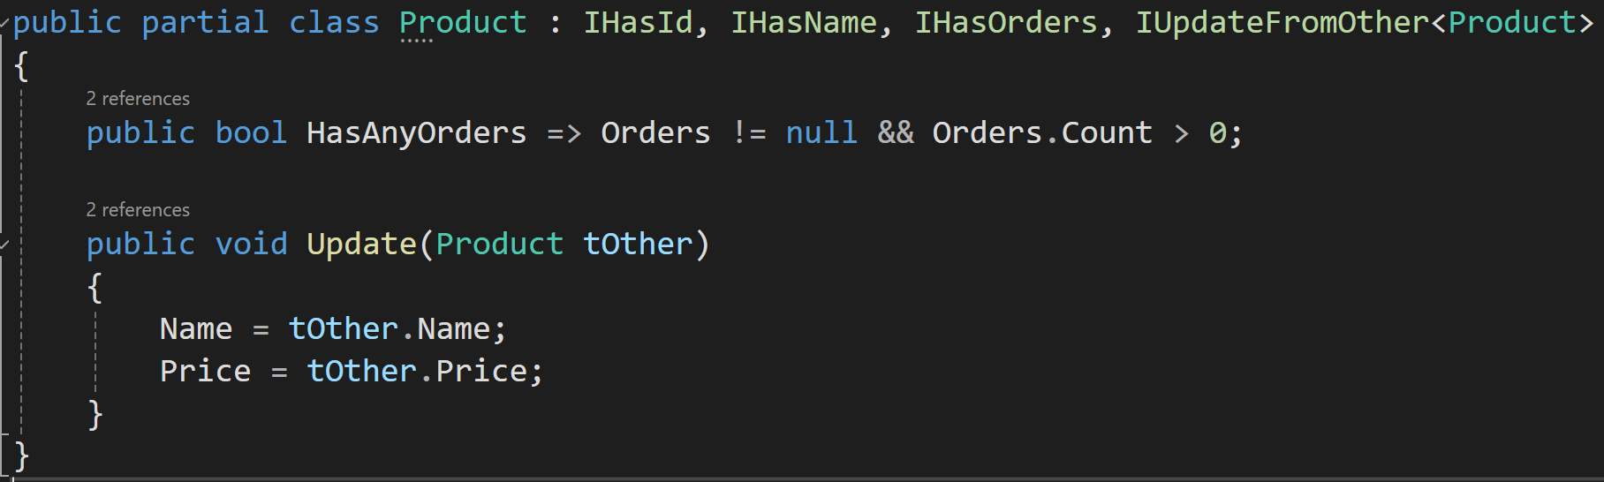

Slide 23
Data Service base class - reflections
Overkill not to let Data Service base class know application-specific DBContext subclass…?
Could use directly or perhaps as additional type parameter
Ok to ”pollute” domain classes like Order with interface implementations required for data service…?
Could make update step in Update method abstract instead

