Slide 1
Razor Pages
user/admin concept

Slide 2
Goals
Access to certain parts (i.e. Pages) is restricted based on the privileges of the current user
Current user identifies by logging in to the App, with a
User name
Password
Users can be created by a user with such privileges
Privileges can be role-based, i.e. user is also assigned a role.

Slide 3
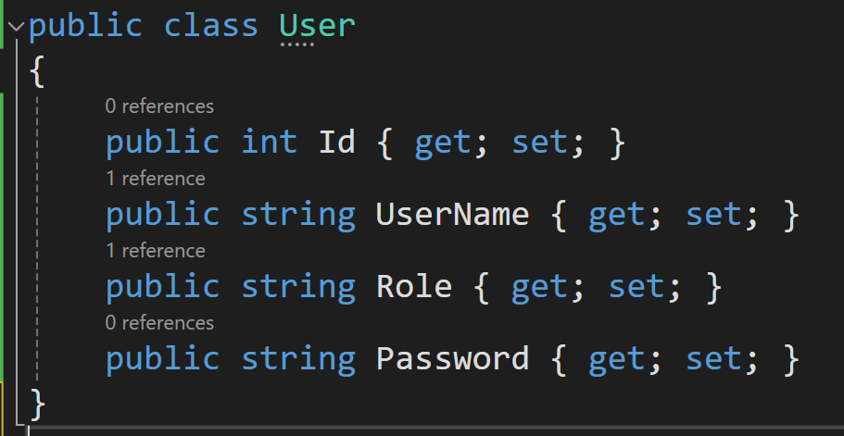
User class

Slide 4
User class
A User is ”just another class”, so we can use typical structures for CRUD (CRUD pages, User data service)
Access to CRUD-functionality for User should be restricted, e.g. only allowed for Users with the role admin.

Slide 5
User Log-in
The Log-in process should
Allow entering of a user name and password
Verify that the entered user name and password match an existing user
Perform the ”programmatic” log-in logic

Slide 6
User Log-in
Programmatic log-in uses the Microsoft.AspNetCore.Authentication class library
We call SignInAsync on the HTTPContext property (defined in the PageModel base class)
Parameters
Authentication scheme (string)
Claims principal (ClaimsPrincipal)

Slide 7
User Log-in
A ”claims principal” is a list of Claim objects
Each Claim object is essentially a statement about a User, e.g.
The name of the User
The role of the User
NB: A Claim is in practice just a (string, string) pair, so any sort of claim can be made. However, a number of predefined ”claim types” exist, such as Name, Role, Country, etc..
We only use Name and Role here

Slide 8
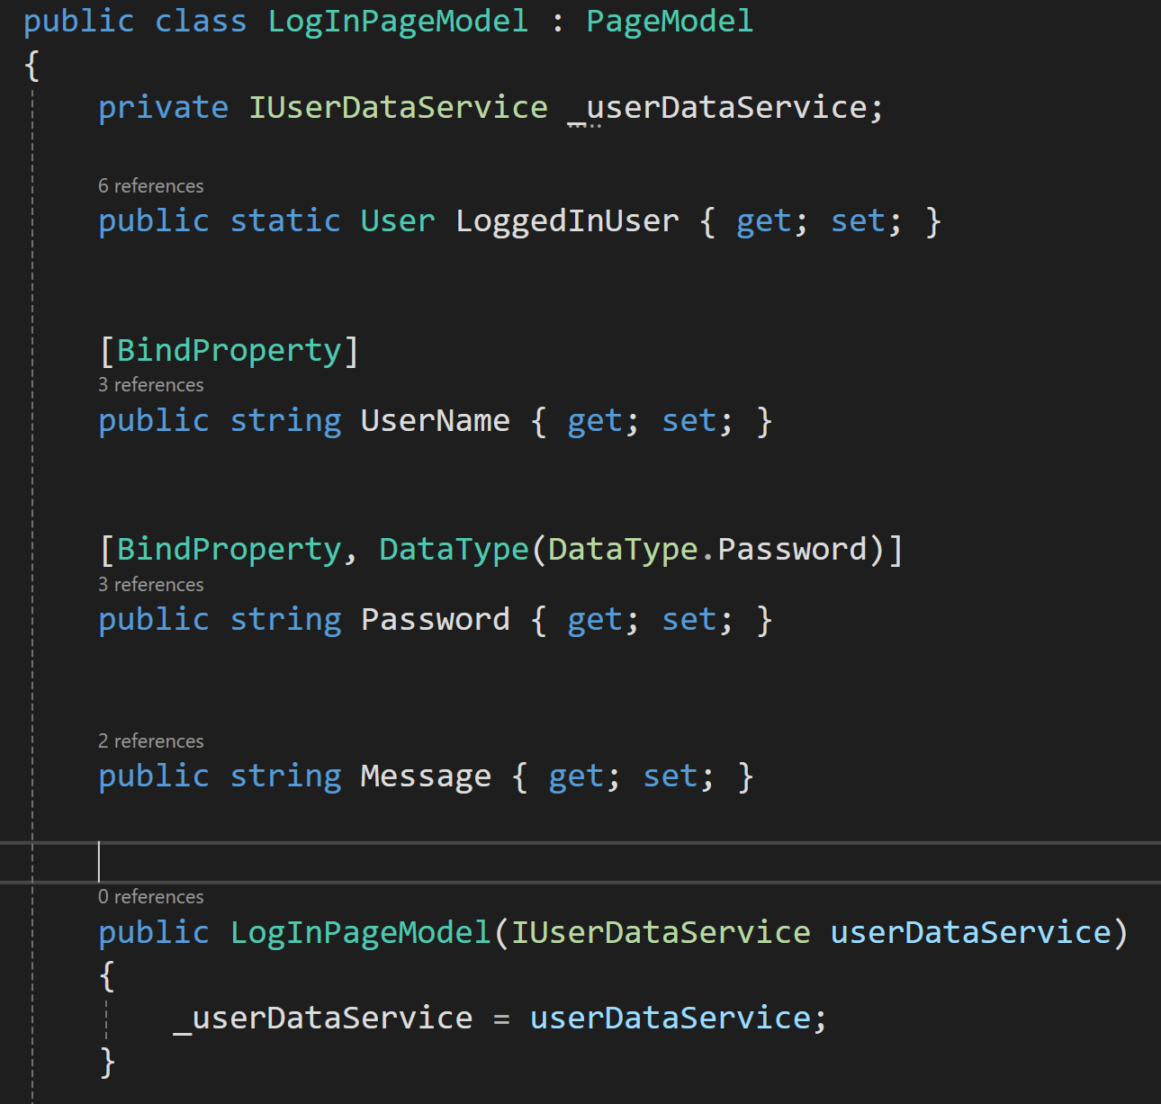
User Log-in

Slide 9
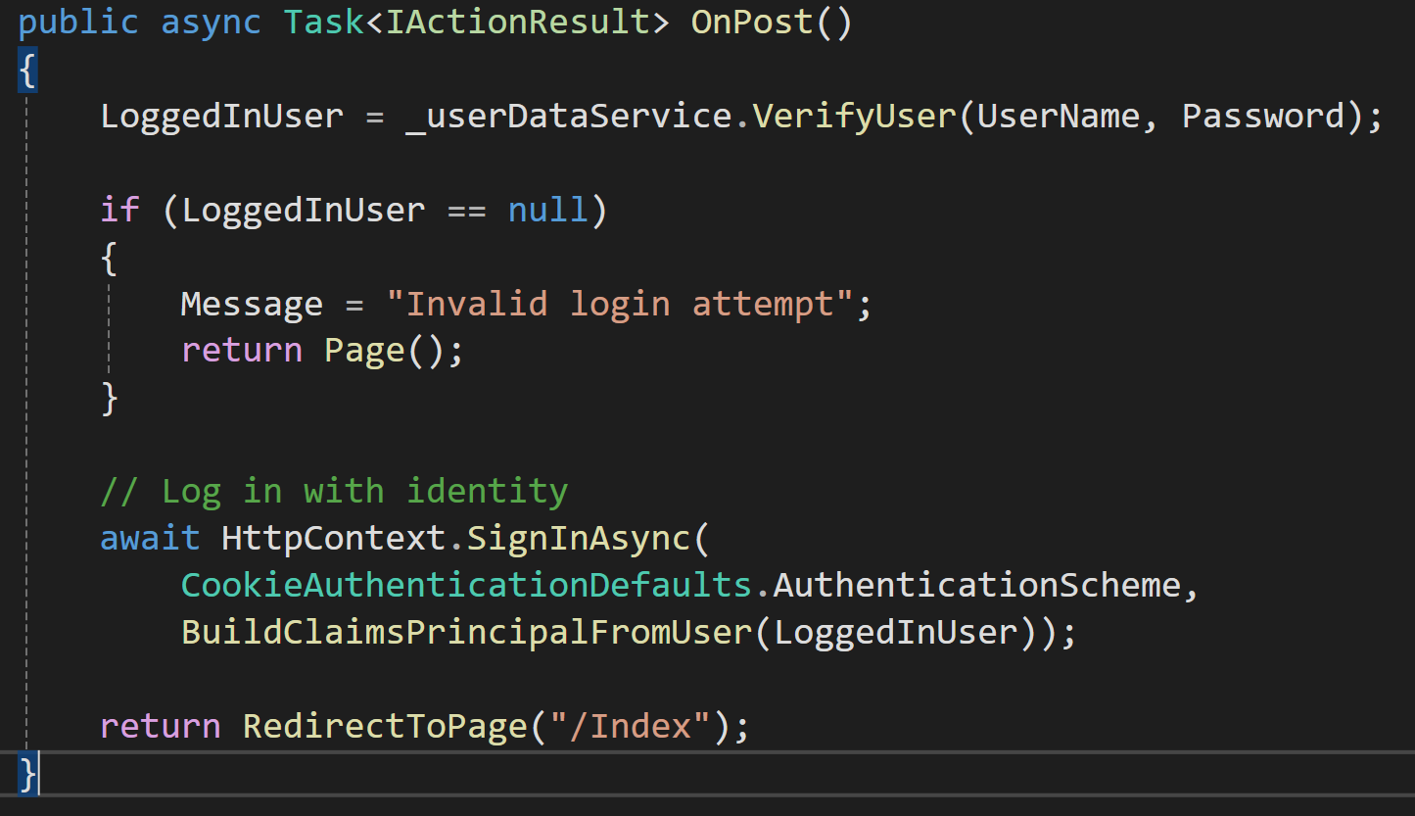
User Log-in

Slide 10
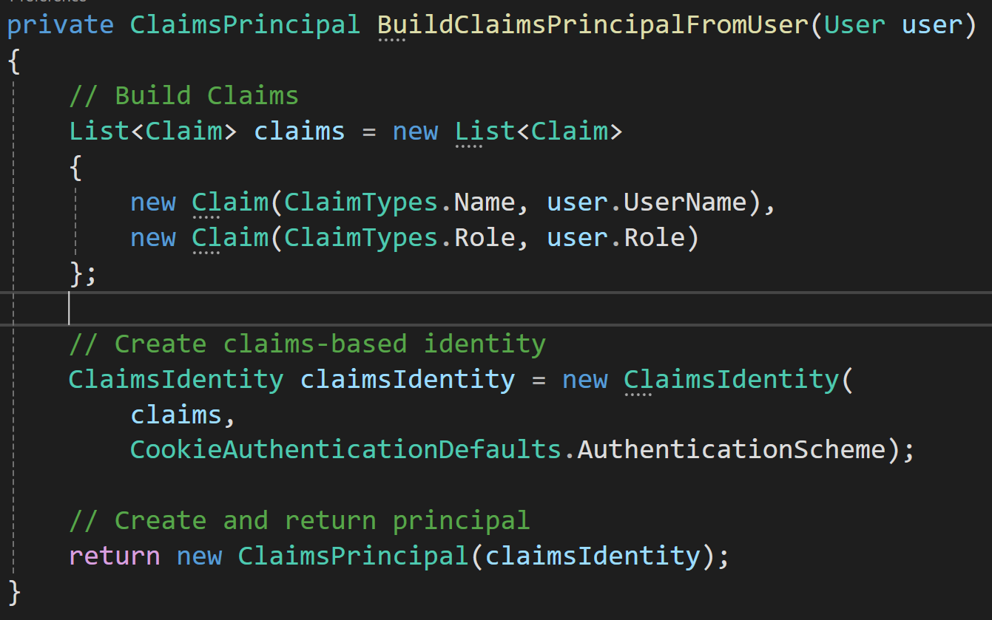
User Log-in

Slide 11
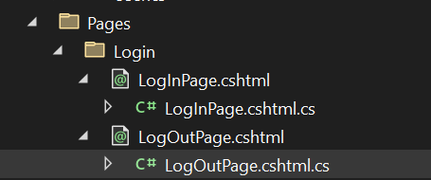
User Log-in
The log-in page and log-out page can e.g. be placed in a separate folder uner Pages.
NB: The path to the log-in page is important, since we need it later for configuration purposes (see next slide).

Slide 12
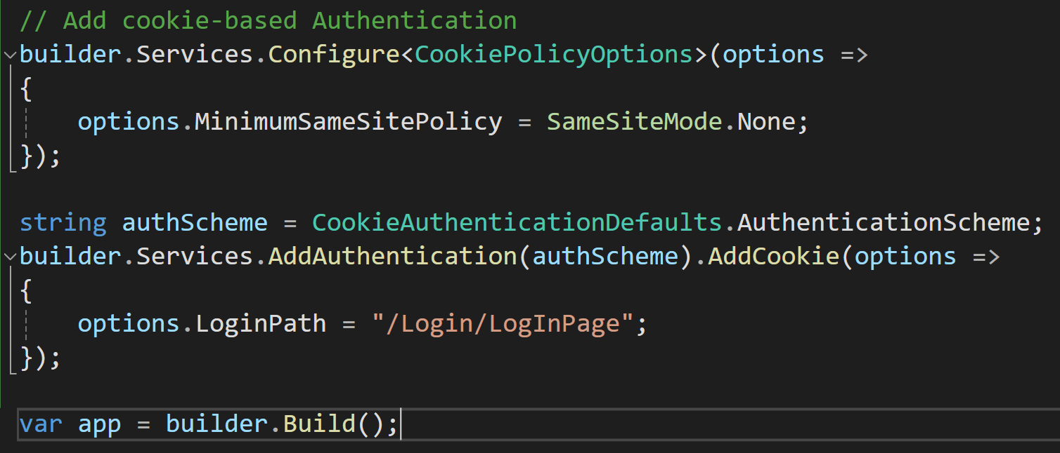
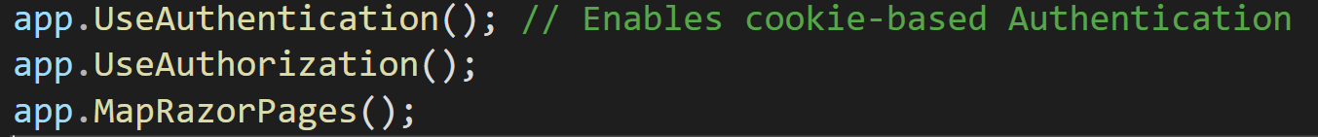
User Log-in
A couple of additions to Program.cs are needed
Cookie-based authentication definitions, just before builder.Build()
Cookie-based authentication enabled, just before app.UseAuthorization()

Slide 13
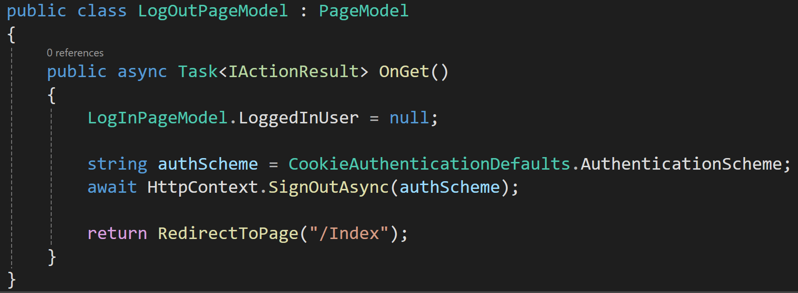
User Log-out
No UI needed (perhaps an ”are you sure” warning)
Still need a Page for log-out, but only for executing the programmatic log-out logic
No code added to .cshtml

Slide 14


Slide 15
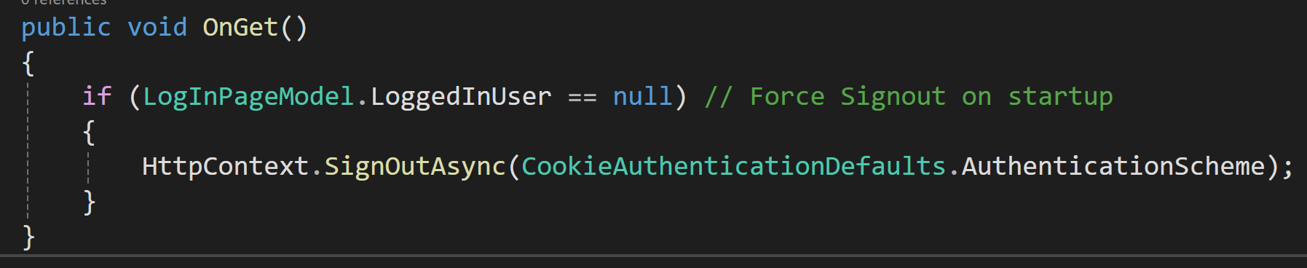
User Log-out
If we ”shut down” the app by closing the browser, the ”session cookie” may remain…
We can force a Log-out at startup, by adding code to OnGet in Index.cshtml.cs

Slide 16
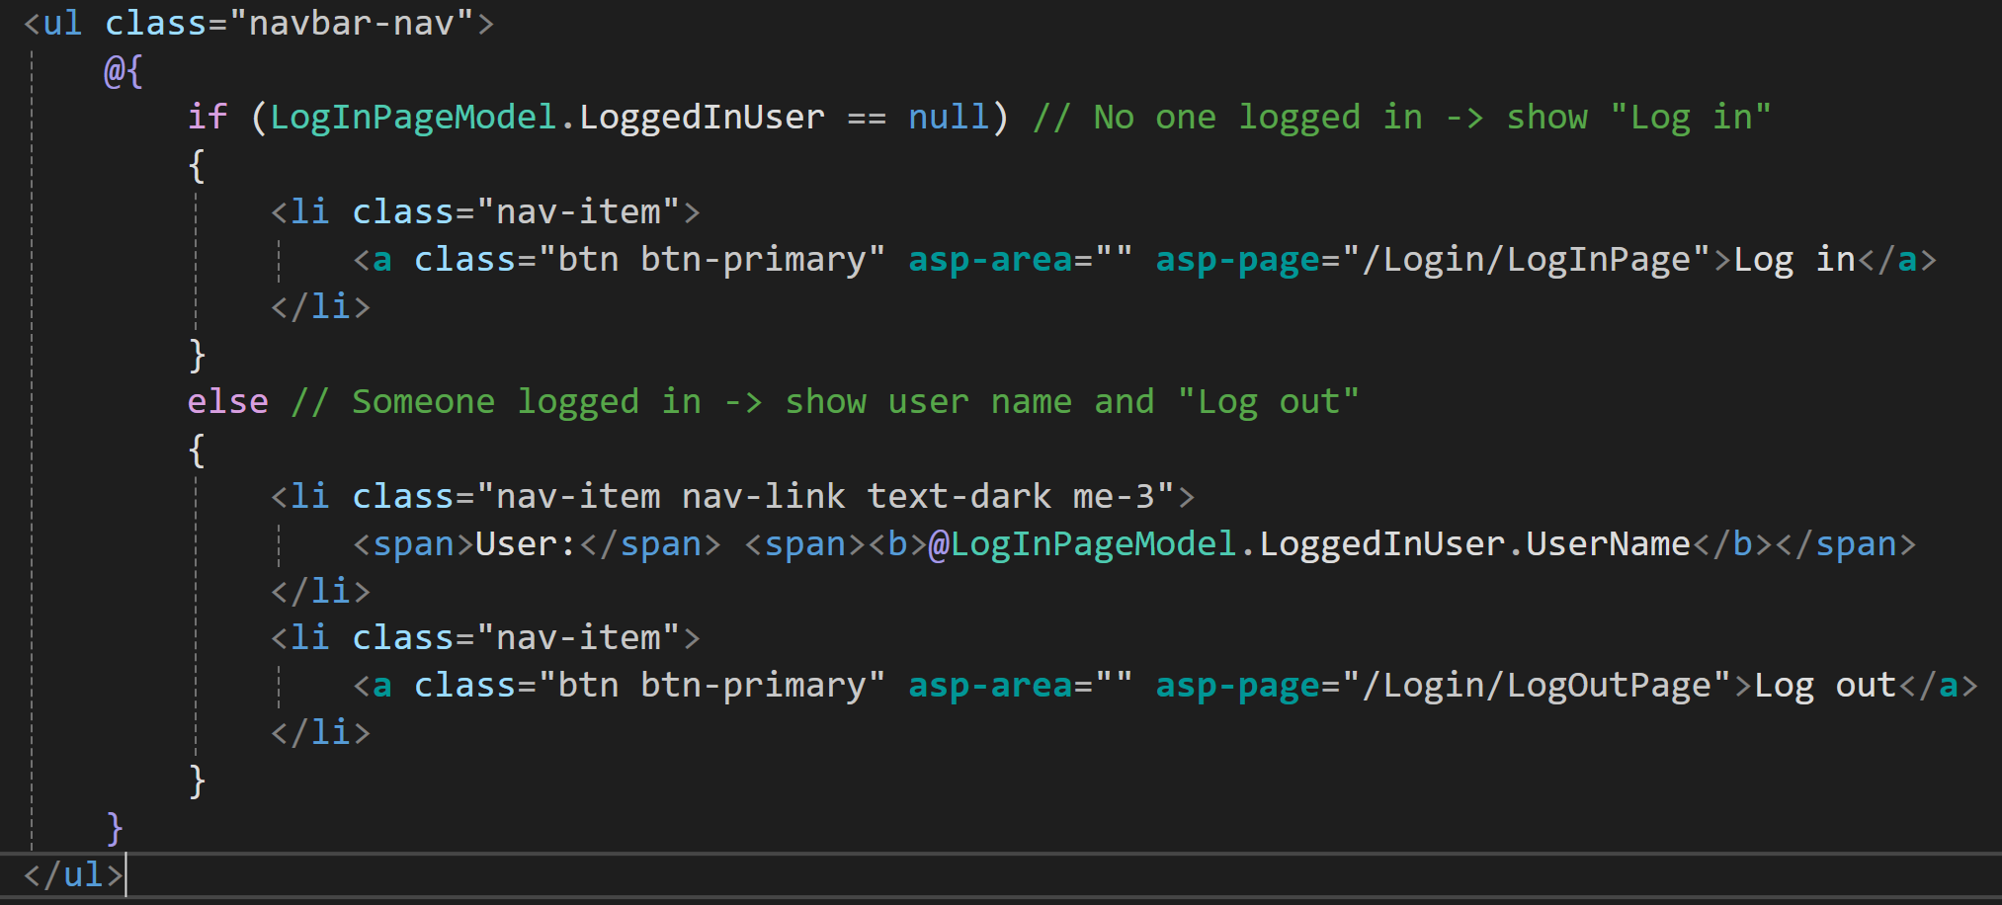
Navigating to Login/Logout
Typical approach is to add Login/Logout buttons to navigation bar (in Pages/Shared/_Layout.cshtml)

Slide 17
Navigating to Login/Logout

Slide 18
Restricting Page Access
Levels of page access restriction
None, can be accessed without even logging in (default)
Require that a user is logged in
Require that a user with a certain role is logged in
Level 1: default, no action required
Level 2: typically managed by options configuration (in Program.cs)
Level 3: typically managed with per-page Authorize annotation on specific PageModel classes

Slide 19
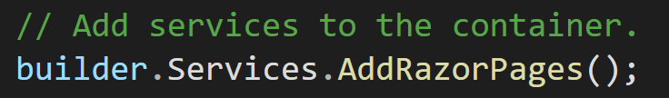
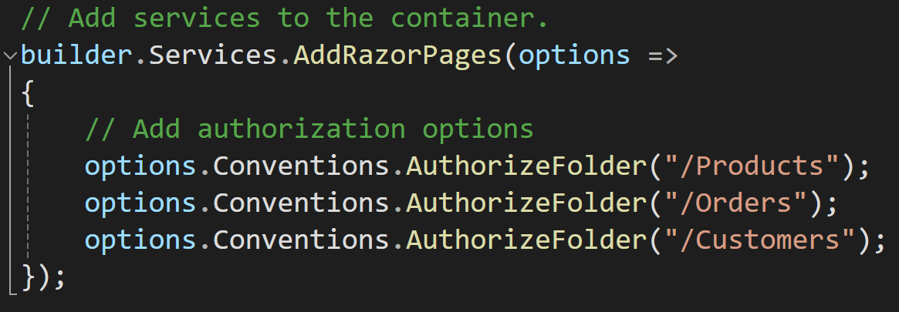
Restricting Page Access – level 2

Slide 20
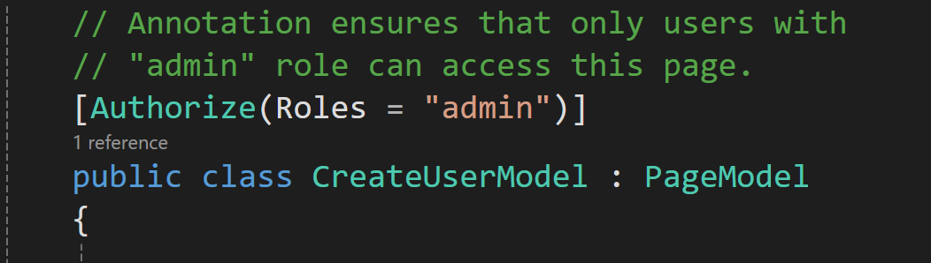
Restricting Page Access – level 3

Slide 21
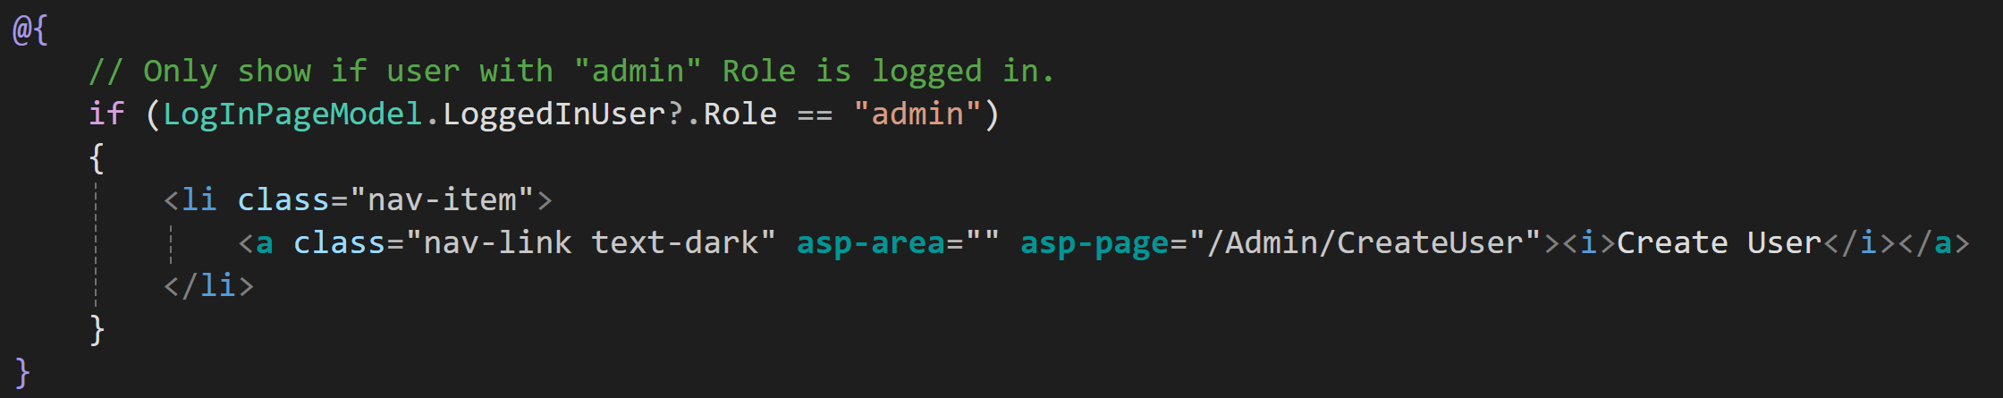
Restricting Page Access
Can also use User information to show/hide UI navigation elements based on roles
NB: possible to circumvent if full Page URL is known

Slide 23
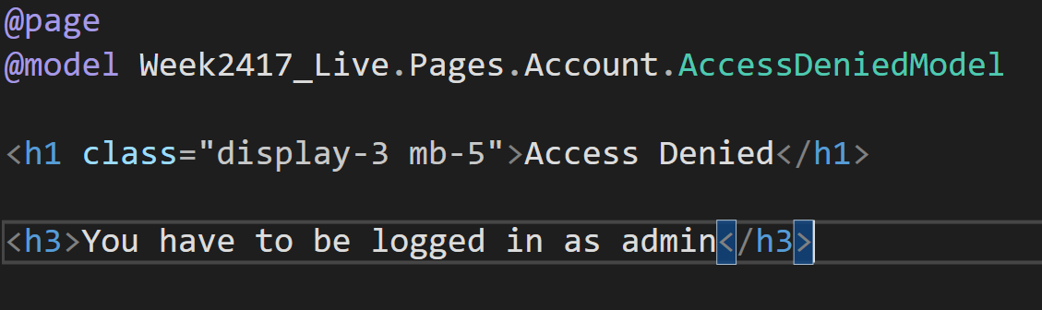
Restricting Page Access
Need to add a Page for handling ”access denied”
NB: Page name (AccessDenied) and placement (Pages/Account) is important (is assumed by framework)

Slide 24
Password encryption
Storing password as plain text in a DB/file is a potential security risk
Passwords can be encrypted using the class PasswordHasher (found in Microsoft.AspNetCore.Identity)
When creating a new User, use HashPassword to encrypt password
When verifying an entered password, use VerifyHashedPassword to see if entered password encrypts to stored encrypted password
Can e.g. be implemented by updating UserDataService

Slide 25
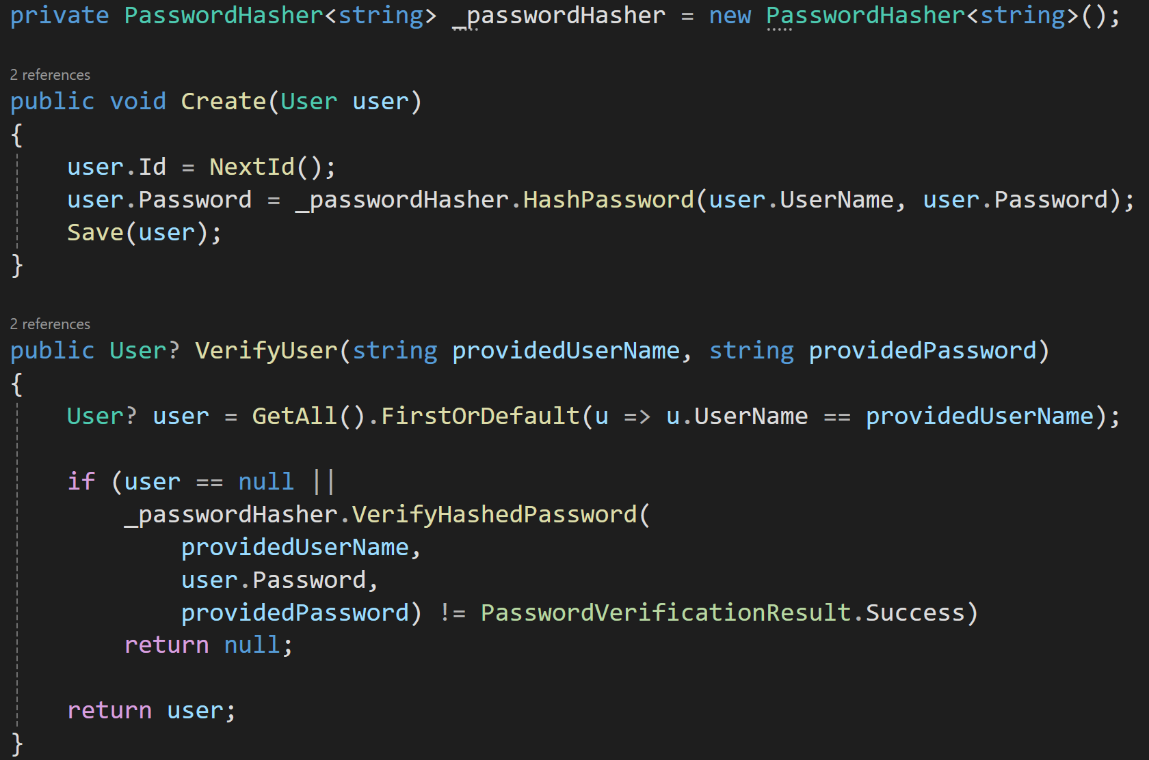
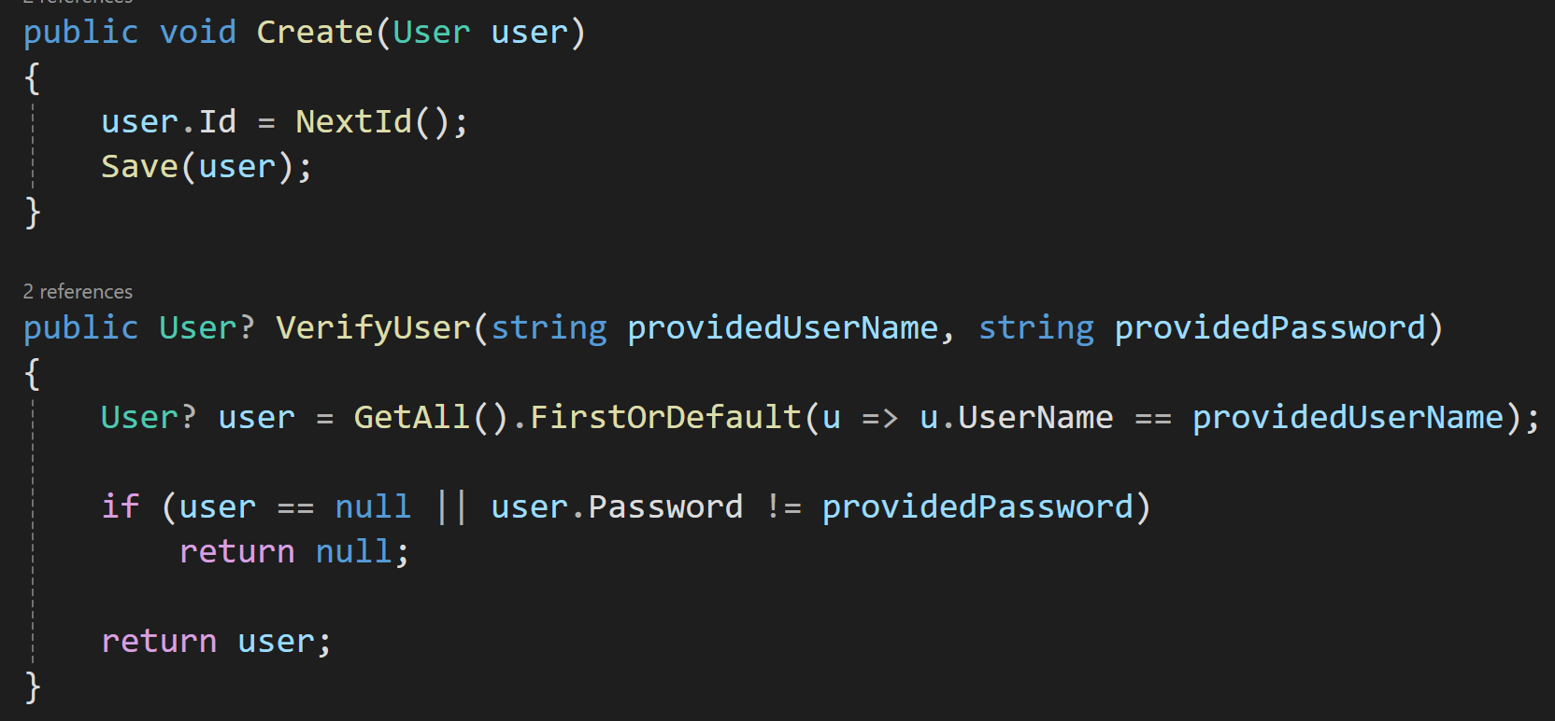
Password encryption

