Slide 1
Databases Normalisation

Slide 2
Normalisation – Why?
Overall goal: keep data consistent
Try to minimise data redundancy (the DRY principle yet again…)
Classic problem: data is represented more than once; what happens in case data is only partially updated?
Such problems are generally named update anomalies

Slide 3
Employee
Id | Name | BranchId | BranchAddress
1 | John Hansen | 1 | Solvej 23, 4000 Roskilde
2 | Mira Holm | 2 | Allegade 43, 2000 Frederiskberg
3 | Alex Svensson | 1 | Solvej 23, 4000 Roskilde
4 | Steven Risch | 2 | Allegade 43, 2000 Frederiskberg
5 | Joanne Høegh | 3 | Bygaden 11, 2750 Ballerup
6 | Hannah Lind | 3 | Bygaden 11, 2750 Ballerup
7 | Susanne Larsen | 1 | Solvej 23, 4000 Roskilde

Slide 4
Employee
Id | Name | BranchId | BranchAddress
1 | John Hansen | 1 | Solvej 23, 4000 Roskilde
2 | Mira Holm | 2 | Allegade 43, 2000 Frederiskberg
3 | Alex Svensson | 1 | Solvej 23, 4000 Roskilde
4 | Steven Risch | 2 | Allegade 43, 2000 Frederiskberg
5 | Joanne Høegh | 3 | Bygaden 11, 2750 Ballerup
6 | Hannah Lind | 3 | Bygaden 11, 2750 Ballerup
7 | Susanne Larsen | 1 | Solvej 23, 4000 Roskilde

Slide 5
Normalisation – minimise data redundancy
Minimising data redundancy results in
Less risk of update anomalies
Smaller physical database
The so-called normal forms are rules for table design which minimise data redundancy
To normalise a database is thus the process of ensuring that all tables obey the rules from the normal forms

Slide 6
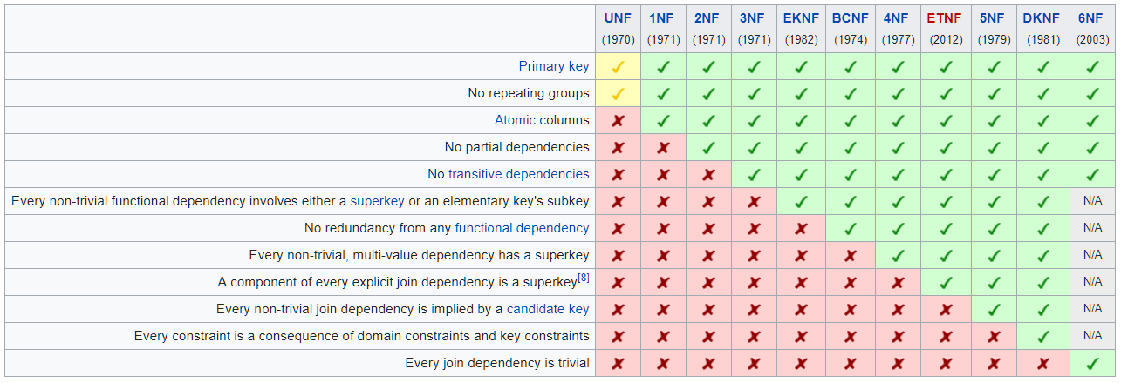
https://en.wikipedia.org/wiki/Database_normalization

Slide 7
Normalisation – 1NF
First normal form (1NF): All values in a row are single values
Employee
Id | Name | Phones
1 | John Hansen | 55431209, 21345501, 33201332
2 | Mira Holm | 56712341, 22009836, 21213450
3 | Alex Svensson | 44651212, 56442021

Slide 8
Normalisation – 1NF
We usually achieve 1NF by creating a new table, containing a single-value column corresponding to the found multi-value column
In the new table, the primary key becomes the primary key from the original table plus the new single-value column
The multi-value column is then removed from the original table

Slide 9

Normalisation – 1NF
First normal form (1NF): All values in a row are single values
EmployeePhone
EmployeeId | Phone
1 | 55431209
1 | 21345501
1 | 33201332
2 | 56712341
2 | 22009836
2 | 21213450
3 | 44651212
3 | 56442021
Employee
Id | Name
1 | John Hansen
2 | Mira Holm
3 | Alex Svensson

Slide 10
Normalisation – 2NF
Second normal form (2NF):
Table is already in 1NF
A value in a non-primary-key column must depend on all columns in the primary key
Casting
MovieId | ActorId | MovieLength
1 | 1 | 112
1 | 4 | 112
2 | 7 | 106
3 | 1 | 98
3 | 3 | 98

Slide 11
Normalisation – 2NF
We usually achieve 2NF by moving problematic columns to other tables, or simply deleting them
If you use a single-column primary key (like e.g. Id), 2NF is never an issue

Slide 12
Normalisation – 2NF
Casting
MovieId | ActorId
1 | 1
1 | 4
2 | 7
3 | 1
3 | 3
Second normal form (2NF):
Table is already in 1NF
A value in a non-primary-key column must depend on all columns in the primary key
Movie
Id | MovieLength
1 | 112
2 | 106
3 | 98

Slide 13
Normalisation – 3NF
Third normal form (3NF):
Table is already in 1NF and 2NF
A value in a non-primary-key column must not depend on any value in another non-primary-key column
Restaurant
Id | Address | ZipCode | City
1 | Hovedvejen 224 | 4000 | Roskilde
2 | Algade 67 | 4000 | Roskilde
3 | Tempovej 18 | 2750 | Ballerup

Slide 14
Normalisation – 3NF
Suppose we have discovered that in the table T, the non-primary-key value V depends on another non-primary-key value K (in the example: T = Restaurant, V = City, K = ZipCode)
We then achieve 3NF by creating a new table, where K is the primary key, and V is an ordinary column
We also remove the column V (but not the column K) from the table T

Slide 15
Normalisation – 3NF
Third normal form (3NF):
Table is already in 1NF and 2NF
A value in a non-primary-key column must not depend on any value in another non-primary-key column
Restaurant
Id | Address | ZipCode
1 | Hovedvejen 224 | 4000
2 | Algade 67 | 4000
3 | Tempovej 18 | 2750
ZipCity
ZipCode | City
4000 | Roskilde
2750 | Ballerup

Slide 16
Normalisation – Summary
1NF: All values must be single-value
2NF + 3NF: A value in a non-primary-key column must depend on all values in the primary-key columns, and only those values
Pro tip: Use single-column primary keys!

