Slide 1
Databases Introduction

Slide 2
What is a Database?

Slide 3
What is a Database?
A collection of data
Data is related, i.e. some data elements are directly related to other data elements

Slide 4
What is a Database?
3 | 43092174
Jonas | Solvej 5 | 3400 | 23411244 | 17-09-1993
A collection of data
Data is related, i.e. some data elements are directly related to other data elements
2 | 42775426
3 | Søborg | Svinget 33 | 2860
2 | Valby | Stien 45 | 2500
Helle | Algade 22 | 3000 | 43092174 | 02-03-1995
Allan | Egevej 81 | 3000 | 42775426 | 30-12-1990
2 | 23411244

Slide 5
What is a Database?
3 | 43092174
Jonas | Solvej 5 | 3400 | 23411244 | 17-09-1993
Desirable properties
Can be used by many users at the same time
Minimal data duplication
Self-describing
Well-defined relations
Reflects real-world data and relations
2 | 42775426
3 | Søborg | Svinget 33 | 2860
2 | Valby | Stien 45 | 2500
Helle | Algade 22 | 3000 | 43092174 | 02-03-1995
Allan | Egevej 81 | 3000 | 42775426 | 30-12-1990
2 | 23411244

Slide 6
Database = DB

Slide 7
Database

Slide 8
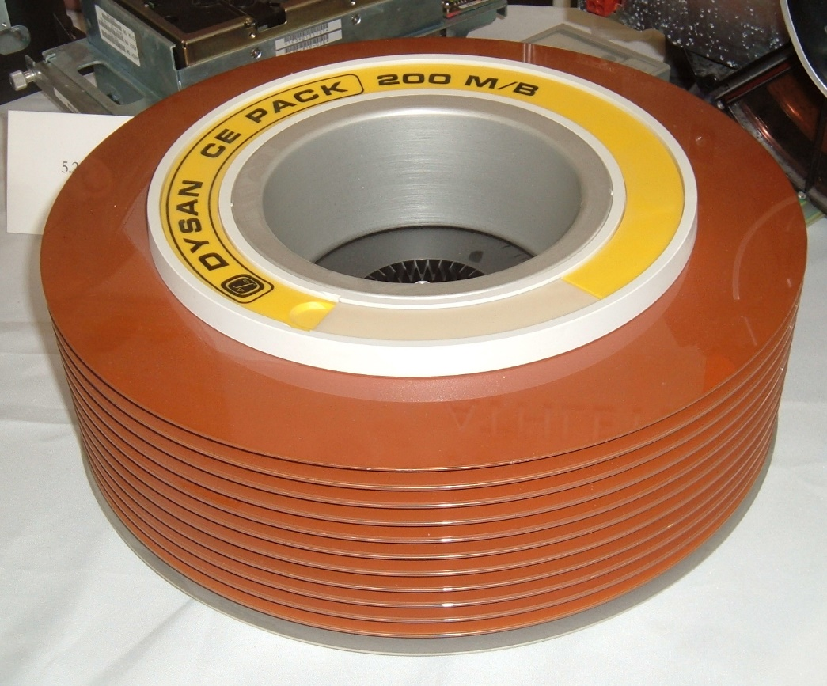
Database
By Arnold Reinhold - I took this picture with permission at the EMC Corp. booth at the Massachusetts State Science Fair held at MIT on May 5, 2006.--agr 00:02, 11 May 2006 (UTC), CC BY-SA 2.5, https://commons.wikimedia.org/w/index.php?curid=774136

Slide 9
What is a Database Management System?

Slide 10
What is a Database Management System?
Software that enables users to define, create and maintain data
Create, Read ,Update and Delete = CRUD
Also able to control access to data
Other useful services:
Handle concurrent access
Backup/Recovery
Authorization
Data integrity
DBMS
Database

Slide 11
Database Management System = DBMS

Slide 12
Relational Database Management System = RDBMS

Slide 13
What is a Database Application Program?

Slide 14
What is a Database Application Program?
Any software interacting with a database (usually through a DBMS)
How do you interact with a database?
Using a query language
De facto standard for query languages is SQL (Structured Query Language)
A program interacting with a database is often called a client program
Client
DBMS
Database

Slide 15
Architecture (two-tier)
UI + Biz Logic
Client A
DBMS
Database
Client B
Client C

Slide 16
Architecture (three-tier)
UI
Biz Logic
Client A
Web
DBMS
Server
Database
Client B
Client C

Slide 17
How does this fit with Razor Pages?
A Database is a data provider, in principle just as a text file with JSON data
A data provider can provide data for e.g. a repository-like service
Interaction between the data provider and a repository-like service can be confined to the service layer (a.k.a. the ”model” layer) in Razor Pages apps.
This can also be ”simulated” in console apps.

Slide 18
Architecture (three-tier Razor Pages App)
Browser
Web
RP App
Page
PageModel
Repository

Slide 19
Architecture (three-tier Razor Pages App)
Browser
Web
RP App
Page
DBMS
PageModel
Database
Repository

