Slide 1
Databases and Visual Studio Creating a Database

Slide 2
Creating a database in Visual Studio
We can use Visual Studio as a lightweight RDBMS
First steps:
Create a local database (is physically located on your PC)
Create tables, rows, etc, either by
Entering information manually, or
Using a given database script

Slide 3
Creating a database in Visual Studio
Under the View menu, choose SQL Server Object Explorer
Expand the SQL Server section
Expand the (localdb)\… section
Expand the Databases section
Right-click on the Databases section, and choose Add New Database
Enter a name for the database, and click OK
The new database should now show up in the list of databases

Slide 4
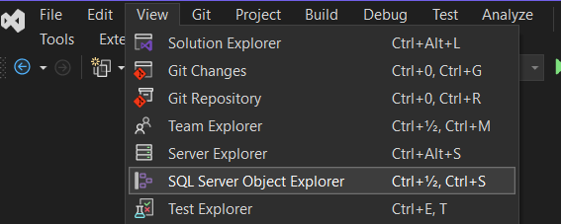
Choose this option

Slide 5
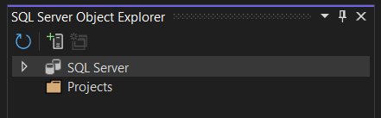
A database runs on a database server (found under SQL Server)

Slide 6
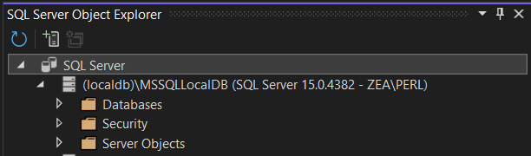
This is a built-in database server, named (localdb)\MSSQLLocalDB

Slide 7
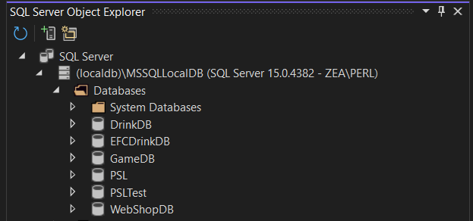
You probably don’t have all these databases… ☺

Slide 8
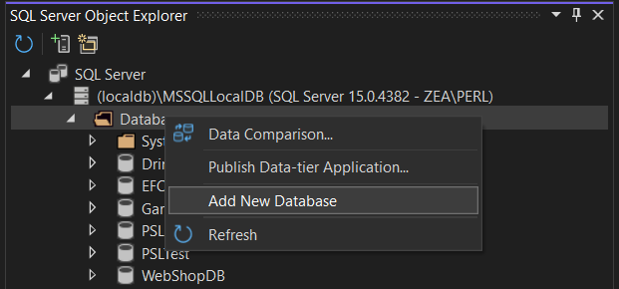
Right-click on Databases, and choose Add New Database

Slide 9
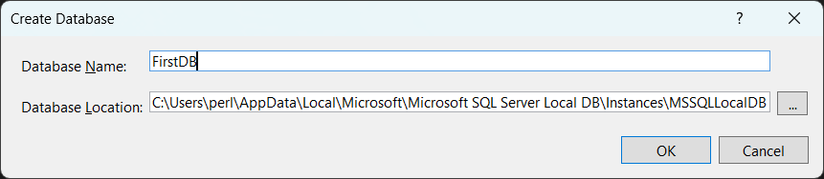

Slide 10
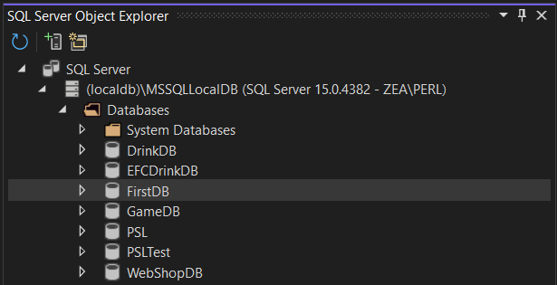

Slide 11
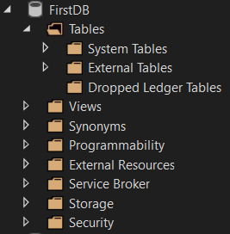

Slide 12
Creating a database in Visual Studio
We have created a (local) database called FirstDB
The database does not contain any (user-defined) tables yet
Table definitions can be created manually or by running a database script
A script generally just contains SQL code, which may e.g.
Create a number of tables
Enter a number of rows into the tables

