Slide 1
Databases and Visual Studio Defining a Table

Slide 2
Defining a table manually
Two approaches:
Write SQL code for table definition directly in query window
Use the Designer to help with table definition. SQL code is then generated automatically

Slide 3
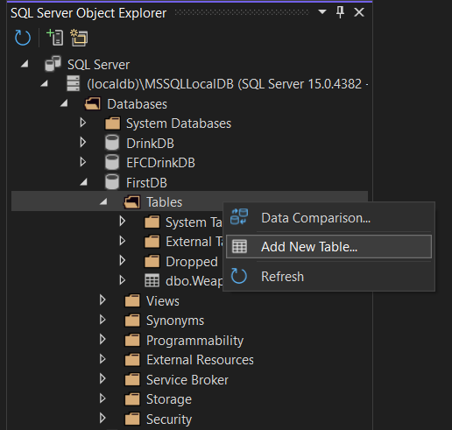
Right-click on Tables folder, choose Add New Table

Slide 4
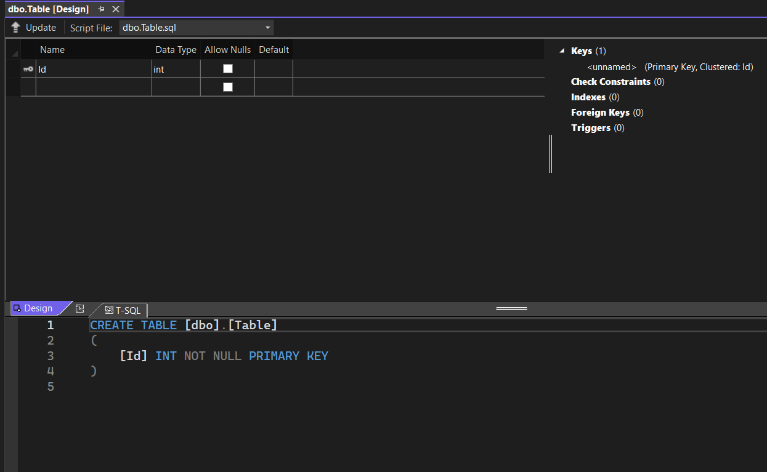
New table is initially named Table

Slide 5
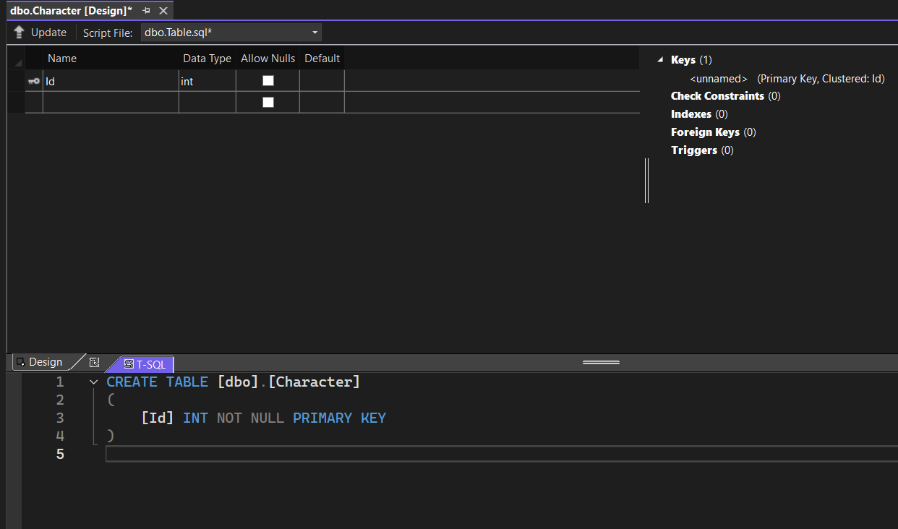
Change name manually here

Slide 6
Table initially has one column named Id

Slide 7
The column Id is:
A primary key
Of type int
Cannot be null

Slide 8
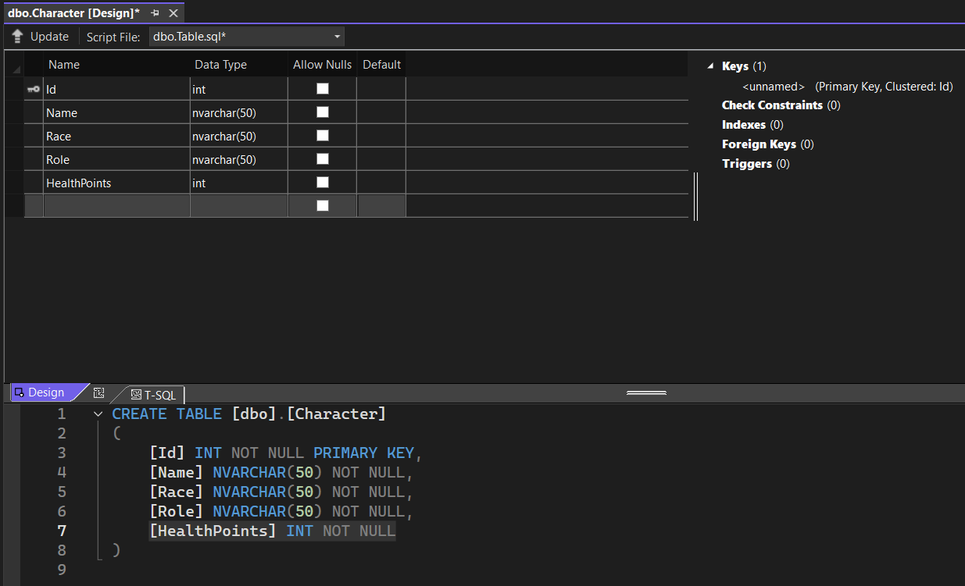
Add further column definitions in the Design view
SQL code for column definitions is automatically updated

Slide 9
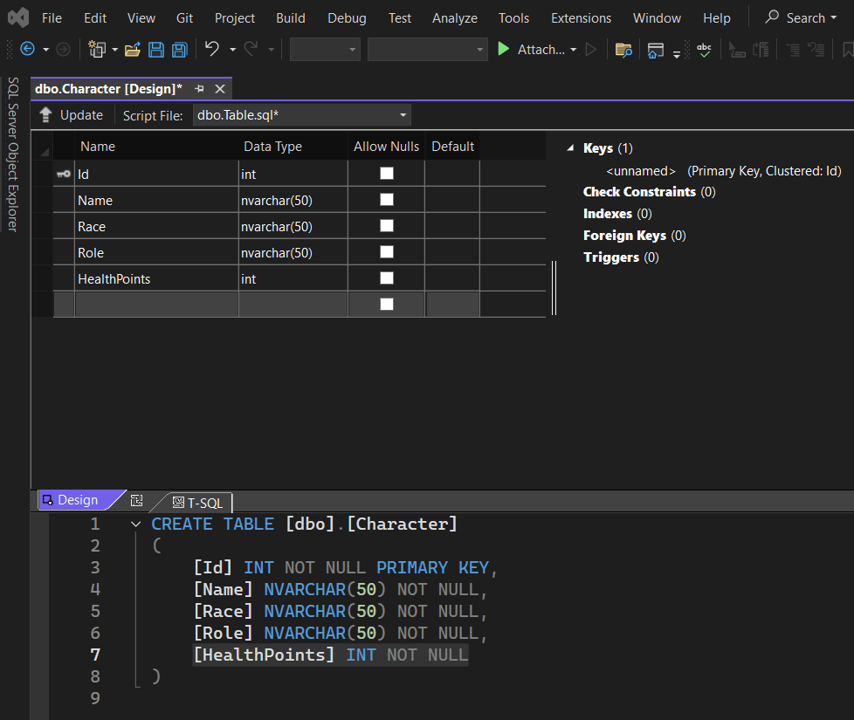
Don’t click here
NB: A new table is not saved (i.e. added to the database) by clicking on Save!

Slide 10
Click on the Update button

Slide 11
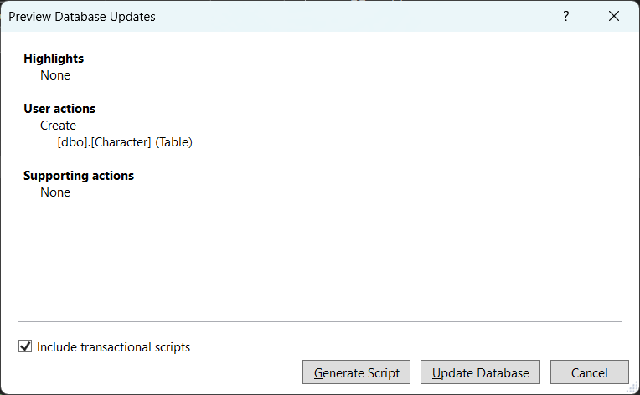
If all looks good, click on the Update Database button

Slide 12
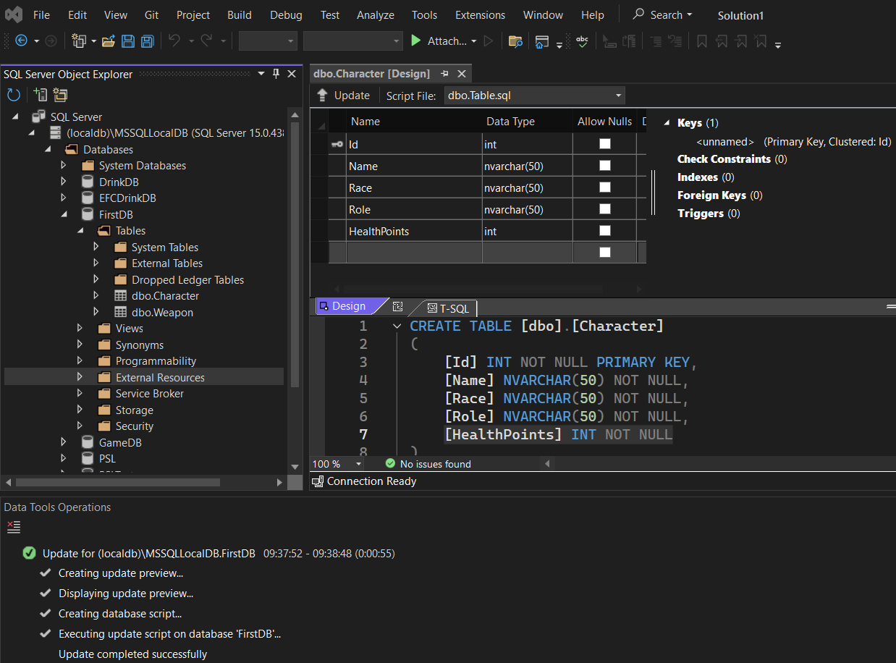
SUCCESS!!

Slide 13
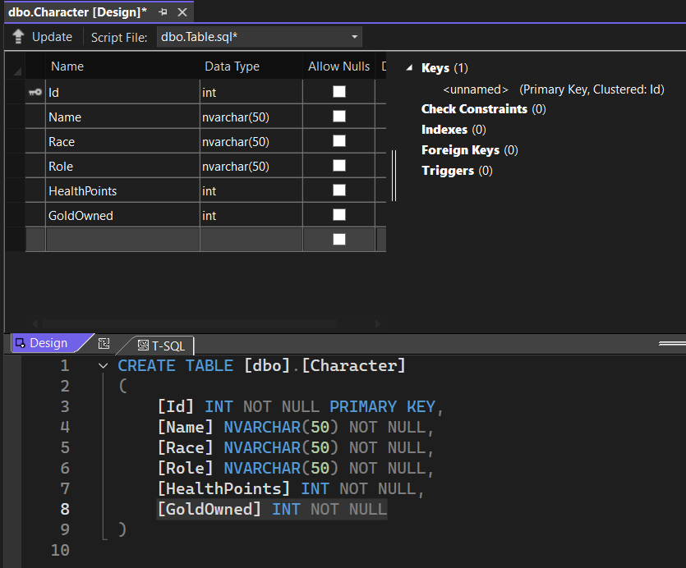
…and click on the Update button
If you want to update the table definition, then update it…

Slide 14
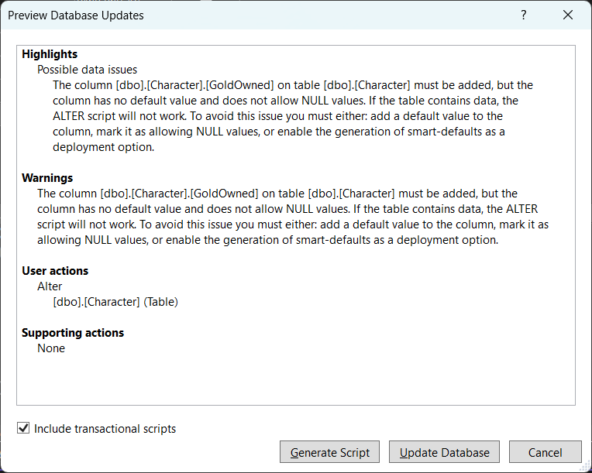
NB: Some changes may result in warnings in the Preview Window!
If all looks good (also the warning) click on the Update Database button

Slide 15
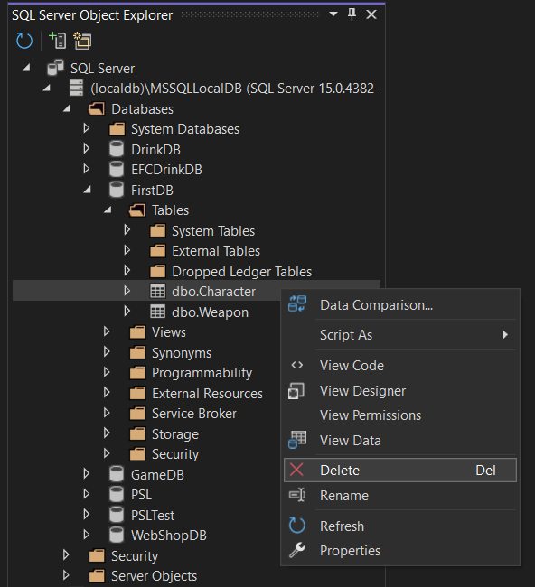
A table can also be deleted: Right-click on the table, and choose Delete

Slide 16
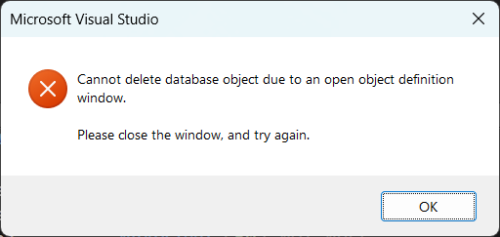
NB: Remember to close any windows relating to the table ☺

Slide 17
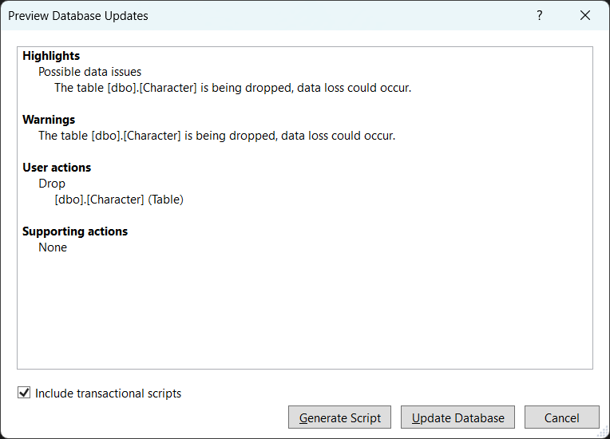
If all looks good (also the warning) click on the Update Database button

Slide 18
