Slide 1
Databases and Visual Studio Running a Script

Slide 2
Run a script on a database in Visual Studio
We have created a (local) database called FirstDB
The database does not contain any (user-defined) tables yet
Table definitions can be created manually (later), or by running a database script
A script generally just contains SQL code, which may e.g.
Create a number of tables
Enter a number of rows into the tables

Slide 3
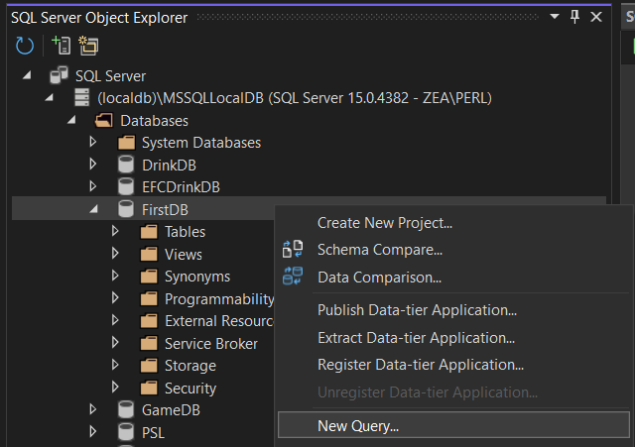
Right-click on FirstDB, and choose New Ouery…

Slide 4
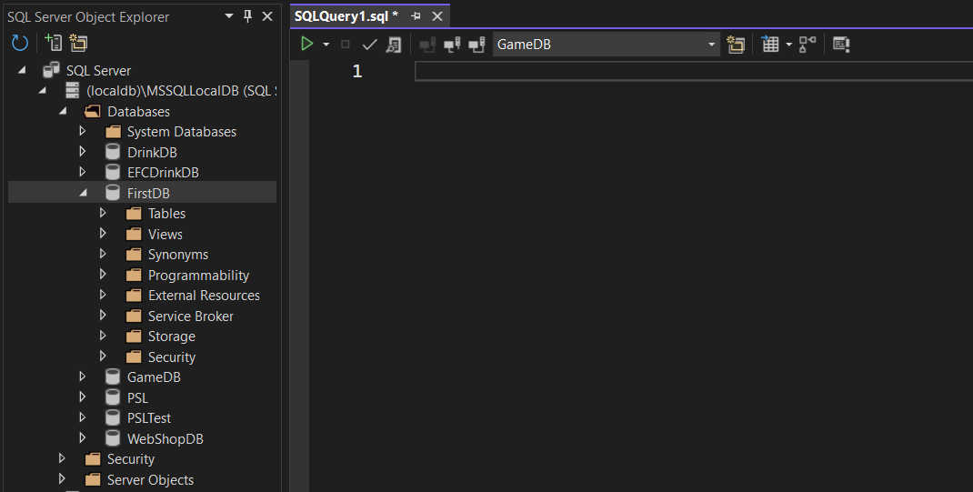
This opens a Query window

Slide 5
Here you can write SQL directly, or copy SQL from a given script

Slide 6
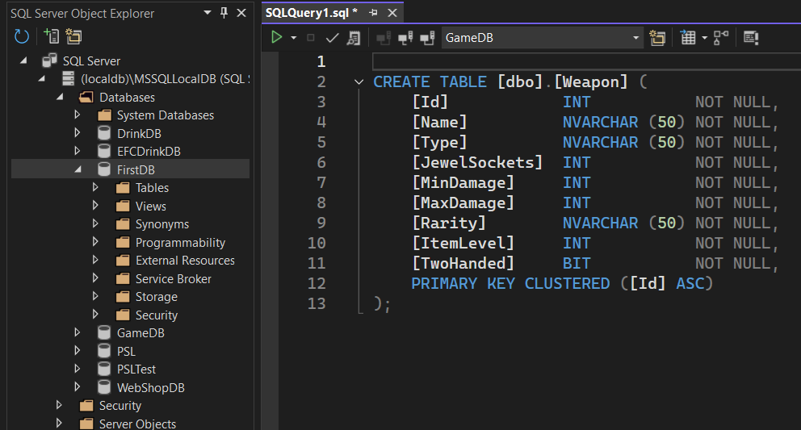
Copy content from text file into Query window

Slide 7
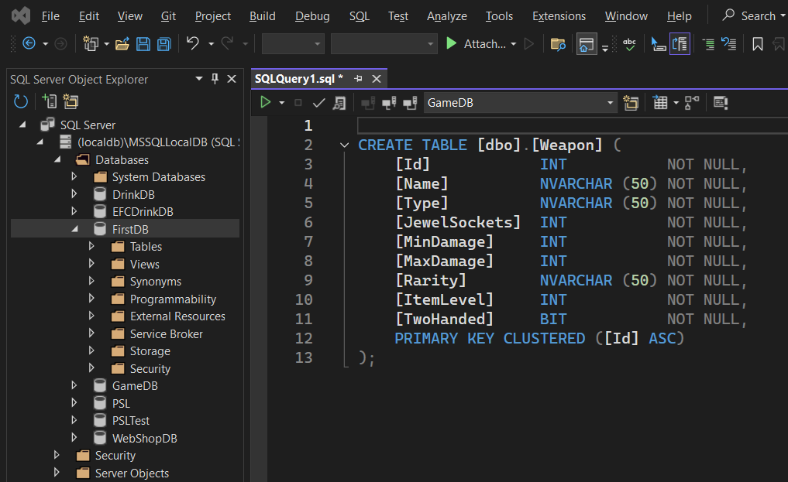
NOT THIS ONE!
I REPEAT!!
NOT THIS ONE! ☺
Run script by clicking the small green triangle

Slide 8
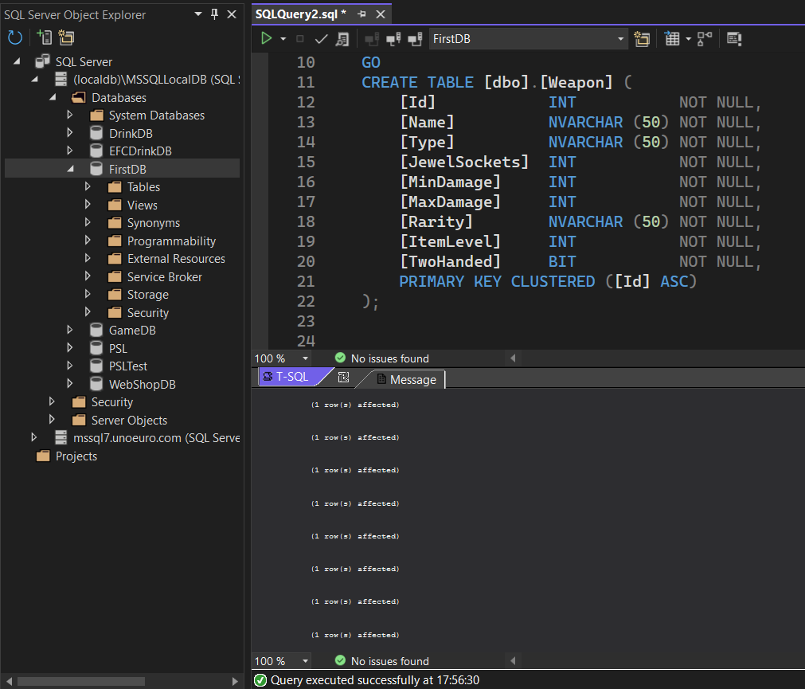
Result of executing query is shown here

Slide 9
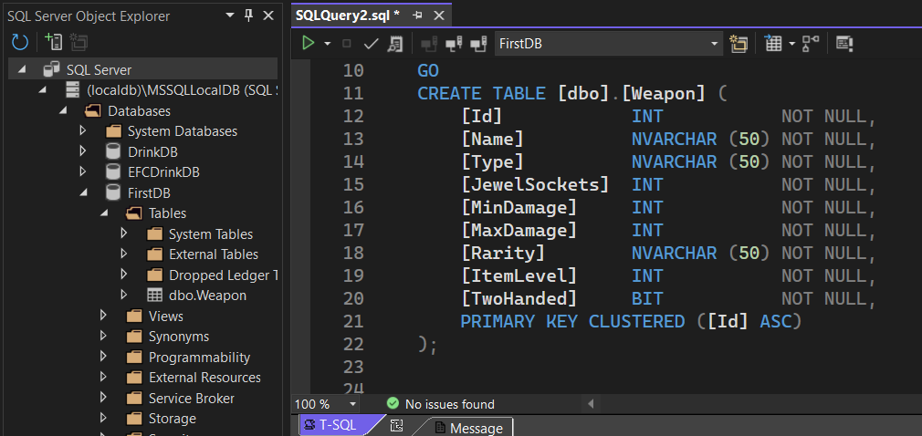
Now click the Refresh button…
…a new table Weapon has been added to FirstDB ☺

Slide 10
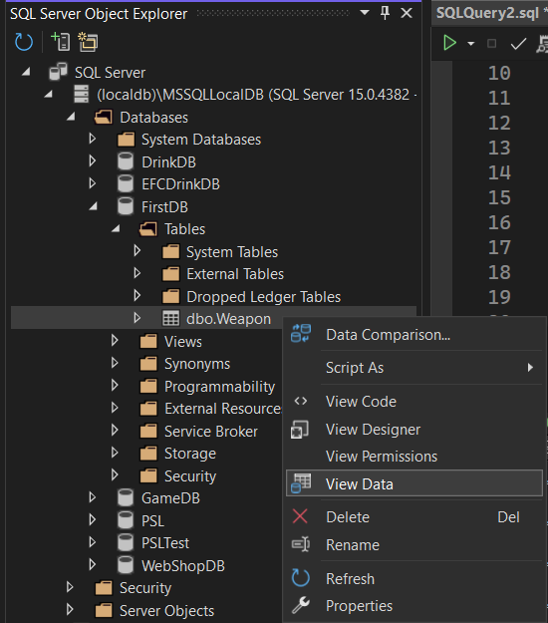
Right-click on Weapon table, and choose View Data

Slide 11
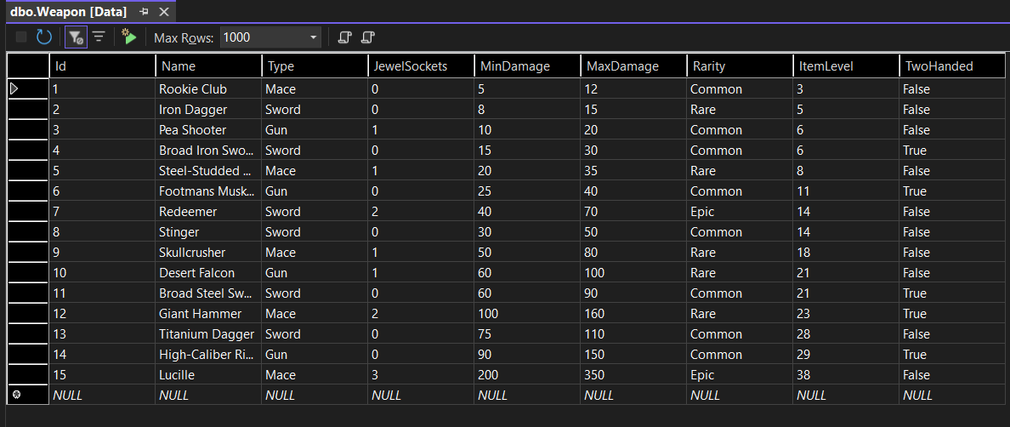
The Weapon table contains 15 rows

Slide 12
You can type in additional rows simply by entering values into the bottom row

Slide 13
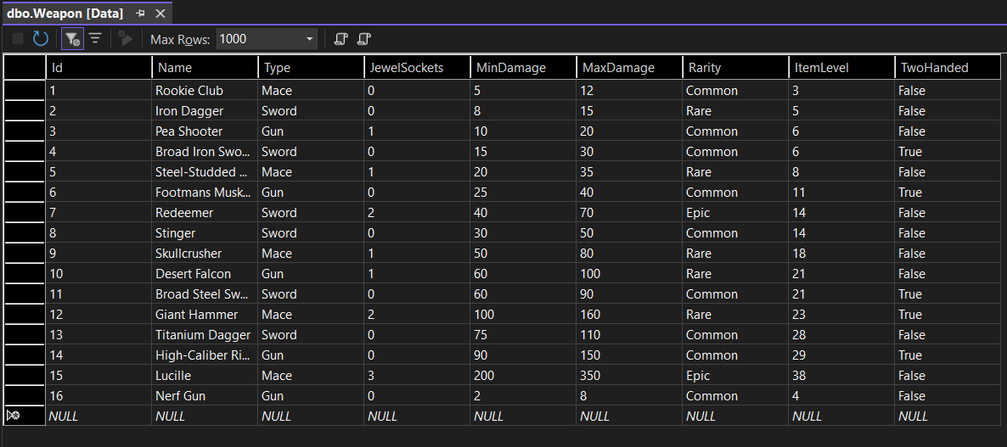

Slide 14
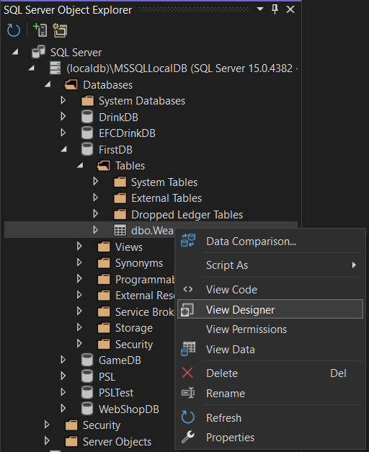
Right-click on Weapon table, and choose View Designer

Slide 15
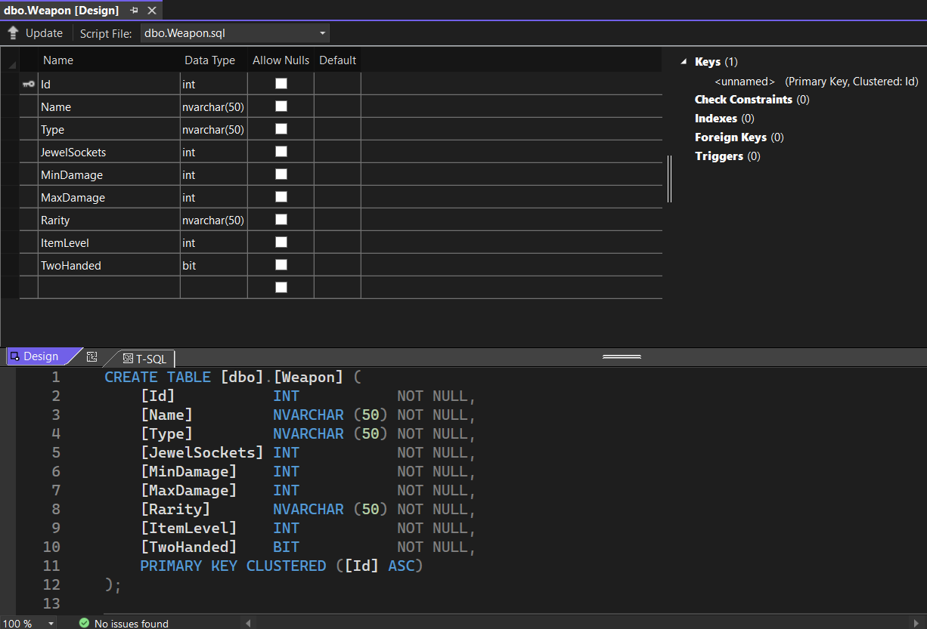
Column definitions for Weapon table (designer view)

Slide 16
Column definitions for Weapon table (SQL code view)

