Slide 1
Code Organisation

Slide 2
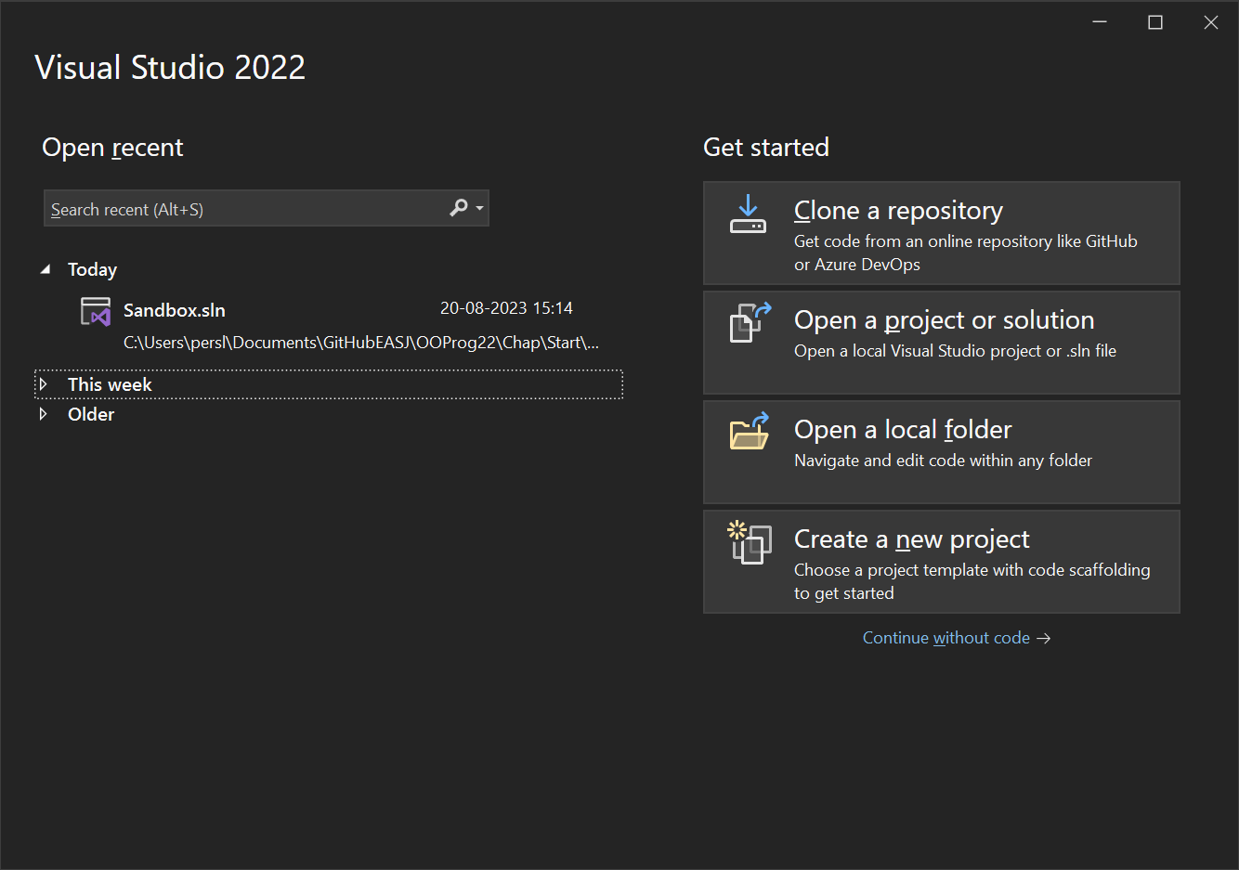
Load Solution into Visual Studio
Start Visual Studio
Choose Open a project or solution
Navigate to the folder named Sandbox, and into that folder
Double-click on the file named Sandbox.sln
The code should now load – you will see some files in the window with the title Solution Explorer

Slide 3
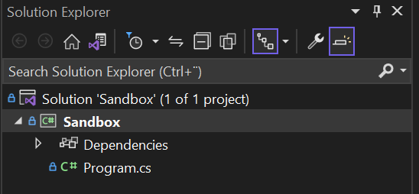
Solution
Top-level unit of organisation
Holds together all elements of a complete solution
Clients
Servers
Mobile Apps
…
Each element represented by a project
Solution defined by .sln file

Slide 4
Project
Usually a single application
Projects can be built, tested and executed independently
Each project consists of a number of classes
Project defined by .csproj file

Slide 5
Class
The central concept in Object-Oriented programming!
Contains code relating to a single ”concept” (Student, Classroom,…)
Class defined in .cs file
NB: Program.cs is a special file, and does not (explicitly) contain a class definition…

Slide 6
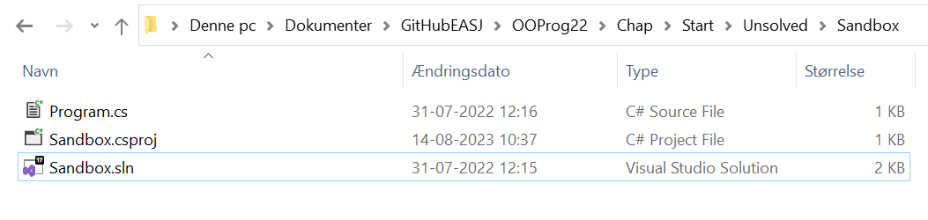
File structure

Slide 7
(Namespace)
Organisational unit between Project and Class
Classes with a natural relationship can be placed in a single namespace
Also a mechanism to avoid name conflicts
Is not represented by specific file type
We will not really worry about namespaces initially…

Slide 8
Project
Class
Class
Class
Class

Slide 9
Class
Method
Method
Method
Method

Slide 10
Method
Statement
Statement
Statement
Statement

Slide 11
Top to bottom…
A solution contains a number of
projects, that contain a number of
namespaces, that contain a number of
classes, that contain a number of
methods, that contain a number of
statements

Slide 12
Typical structure for classroom code
A solution that contains one
project, that contains one
namespace, that contain a few
classes, that contain a few
methods, that contain a few
statements

