Slide 1
Introduction to HW
HW - Hardware

Slide 2
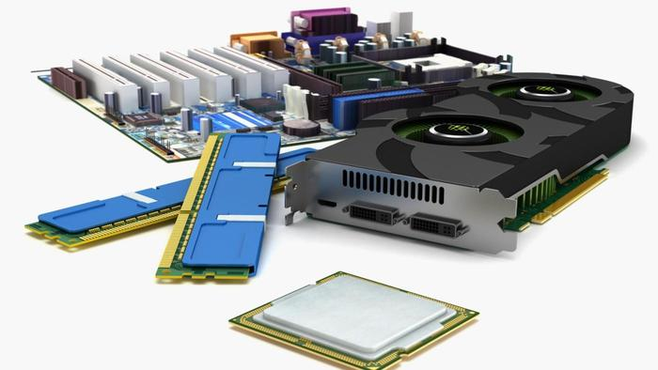
Definition
Physical components in an electronic computer
Processor (CPU)
Memory (RAM)
Permanent storage (HDD, SSD, …)
Input/Output devices (Monitor, Keyboard, Mouse, Camera…)
…more exotic devices (3D printers, VR/AR, …)

Slide 3
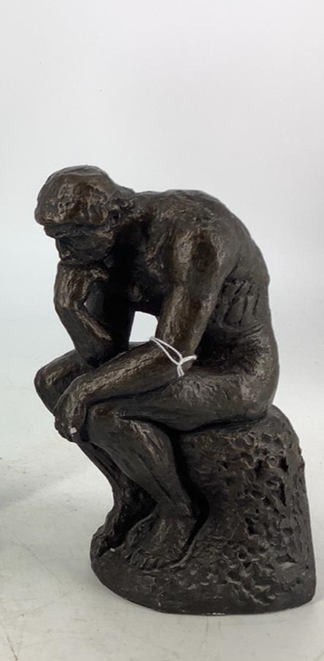
Thinking metal…
A computer is just a lump of thinking metal…
…or more precisely; computing metal
Metal + electrical current
Simplest use of current: on/off
A transistor can use this for calculation

Slide 4
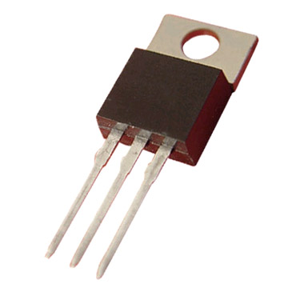
Transistor
Very simple – but extremely useful – electronic component
Two wires in, one wire out
”Calculates” a very simple function

Slide 5
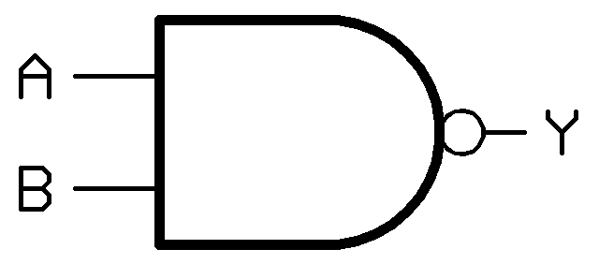
A | B | Y
Off | Off | On
Off | On | On
On | Off | On
On | On | Off

Slide 6
Logical function
This ”calculation” is an example of a logical function
AKA Boolean function (after George Boole)
A logical function
Takes one or more boolean (on/off) values as input
Returns one boolean value as output
On = true, Off = false

Slide 7
A | B | Y
Off | Off | On
Off | On | On
On | Off | On
On | On | Off

Slide 8
A | B | Y
false | false | true
false | true | true
true | false | true
true | true | false

Slide 9
A | B | Y
0 | 0 | 1
0 | 1 | 1
1 | 0 | 1
1 | 1 | 0

Slide 10


Slide 11
Binary numbers
A computer performs calculations using the binary number system (aka base-2)
Humans (usually) use the decimal number system (aka base-10)
In base-10, 110 means:
(1 x 10²) + (1 x 10¹) + (0 x 10⁰) = 110 (base-10)
(1 x 100) + (1 x 10) + (0 x 1) = 110 (base-10)
In base-2, 110 means:
(1 x 2²) + (1 x 2¹) + (0 x 2⁰) = 6 (base-10)
(1 x 4) + (1 x 2) + (0 x 1) = 6 (base-10)

Slide 12
Binary numbers
Slightly cryptic… but all rules of arithmetic are the same as for base-10
Base-10: 5 + 7 = 12
Base-2: 101 + 111 = 1100
Use of ”carry” is also as usual:
0 + 0 = 0
1 + 0 = 1
0 + 1 = 1
1 + 1 = 0, and 1 to carry

Slide 13
A | B | Carry In | Y | Carry out
0 | 0 | 0 | 0 | 0
0 | 1 | 0 | 1 | 0
1 | 0 | 0 | 1 | 0
1 | 1 | 0 | 0 | 1
0 | 0 | 1 | 1 | 0
0 | 1 | 1 | 0 | 1
1 | 0 | 1 | 0 | 1
1 | 1 | 1 | 1 | 1

Slide 14
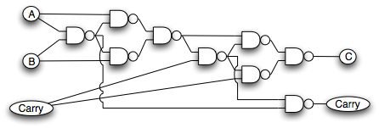
Making ends meet…
The transistor calculates a logical function…
…but we would like to calculate an arithmetic function
With a bit of ingenuity, we can map one to the other

Slide 15
Making ends meet…
The transistor calculates a logical function…
…but we would like to calculate an arithmetic function
With a bit of ingenuity, we can map one to the other

Slide 16
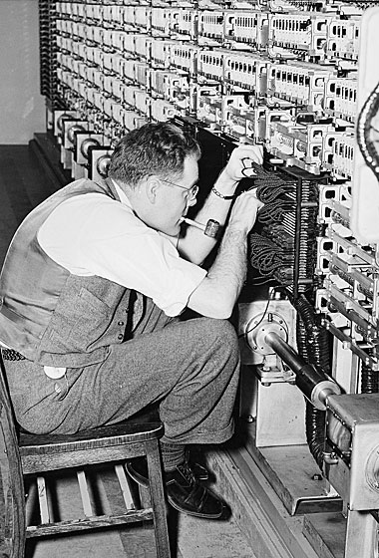
Building blocks in place
Now we can do human-friendly calculations with our metal and current
Other types of calculation (division, multiplication, …) can also be constructed from relatively few transistors
We are up-and-running!

Slide 17
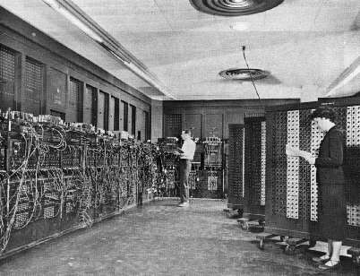
ENIAC
USA, 1945 (WW2)
30 tons
About 18.000 transistors (radio tubes)
Originally for calculation of projectile trajectories, first actual use was calcu-lations for nuclear weapons 😐.
Similar computers being built in other countries

Slide 18
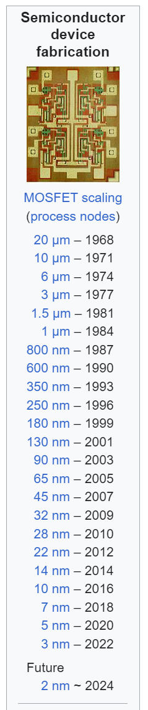
Present day
Integrated circuits (aka microchips)
An enormous amount of transitors on each chip!
State-of-the-art (2024)
CPU/GPU: Roughly 10¹¹ (100 billion)
Storage: Roughly 10¹² (1 trillion)
Wiring at atomic scale…

Slide 19
Data sizes
The size of data is usually measured in bytes
8 bits (0/1) to make a byte
From the computer’s perspective, all data is just a stream of bits
A stream of bits can be interpreted as something else, e.g. by using software
Text
Image
Sound
Video
…

Slide 20
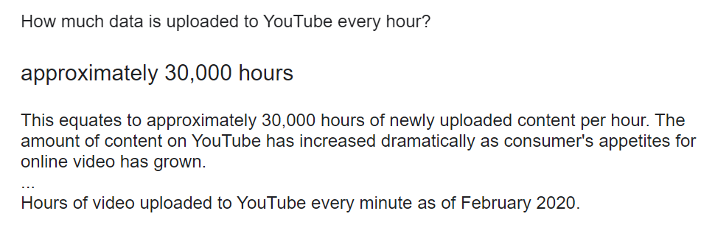
Data sizes
 | Text | Music | Video
Kilo-byte (10³) | Page | < Second | << Second
Mega-byte (10⁶) | Novel | Minute | Second
Giga-byte (10⁹) | Large bookshelf | Day | 15 Minutes
Tera-byte (10¹²) | Large library | Year | Week
Peta-byte (10¹⁵) | …? | Millenium | Decade

Slide 21
Speed
Transistors must work ”in step” in order to do calculations
How many steps can be done each second?
ENIAC: about 10.000 (10 kHz)
Modern PC: about 3-5 GHz
Electrical current moves at lightspeed (3 GHz = 10 cm)
Power consumption and heat generation grows with speed
Processor cooling a major challenge…

Slide 22
Computer Architecture
CPU
RAM
Storage

Slide 23
CPU
Central Processing Unit
Unit performing actual calculations
Typically a single physical chip (perhaps with multiple cores)
CPU performs bitwise calculation
Relevant streams of bits are fetched from RAM
Also GPU (Graphical Processing Unit), specialised for calculations related to image rendering
GPU architecture also turned out to be excellent for AI computation!

Slide 24
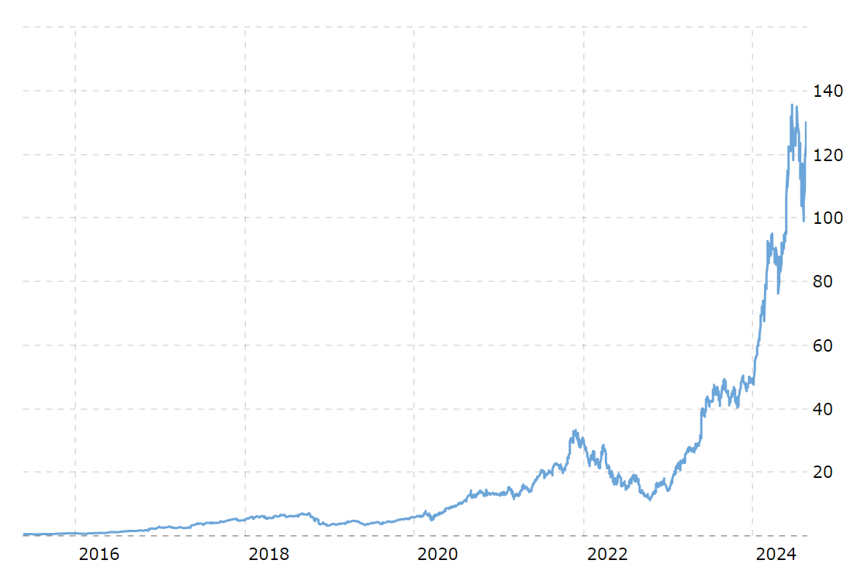

Slide 25
RAM
Random Access Memory
Calculations involve
Fetch data from RAM
Calculate
Write data back to RAM
RAM is passive, no calculations done here
RAM is transient; when power is cut, all data is lost
Typical amount of RAM in a PC: 8 – 64 GB

Slide 26
Storage
Comes in several forms, but are all
Passive
Persistent (data remains after power is cut)
When starting an program, data is read from storage to RAM
Magnetic (”classic” hard drive (HDD), tapes, floppy disc (r.i.p.))
Optical (DVD, Blu-Ray, 4K-disc, …)
Solid-state (Solid-state drive (SSD), SD cards, USB sticks, …)

Slide 27
RAM vs Storage
Couldn’t the CPU just read/write data from/to storage, without involving the RAM?
In principle possible, but too slow (yet…)
The faster the storage unit is, the more expensive it is
CPU cache (L0, L1,…)
RAM
SSD
HDD
Cloud

Slide 28
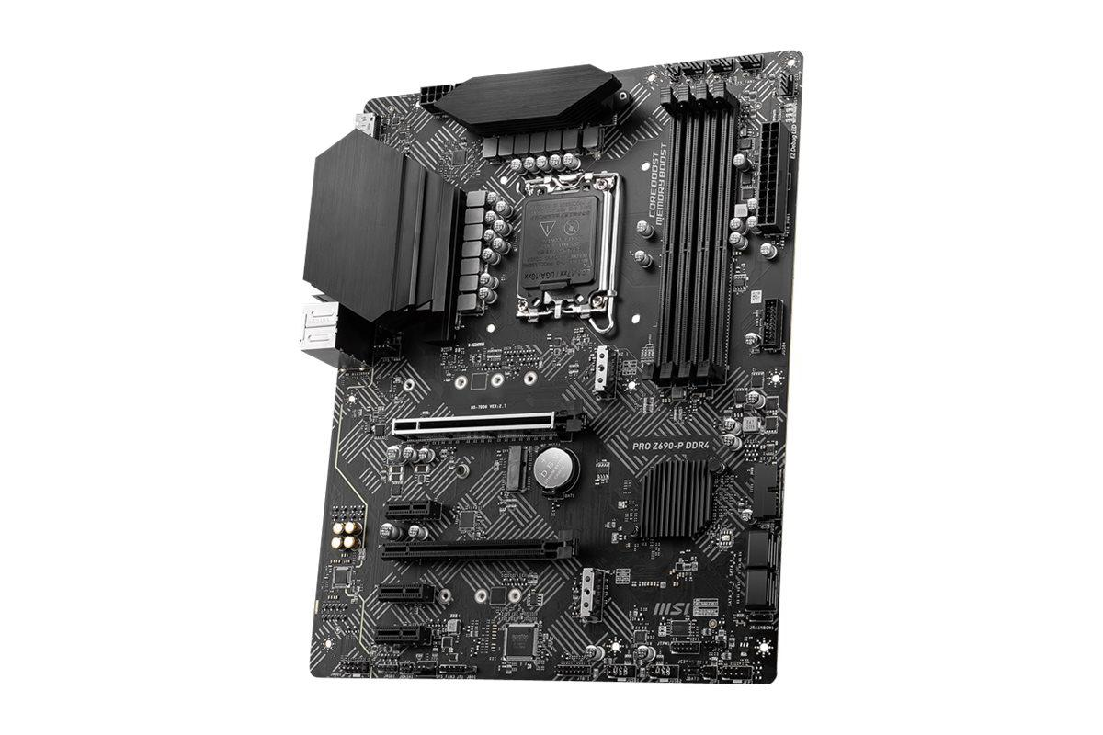
Motherboard/bus
Ties various components together, enables communication
Components are physically mounted on a motherboard, communicates through ports
Communication follows a bus standard, e.g. USB or PCI

Slide 29
…so now you know
We will not really deal with HW directly (at least not during first year)
Usually, hardware is abstracted away through layers of software
Bottom layer is the operating system (and device drivers)
Other programs talk to the operating system, instead of talking directly to the hardware

