Slide 1
Software Tools

Slide 2
Overall purpose
Write C# code as easily as possible
Write C# code of high quality
Write C# code in collaboration with other developers
Help us to obtain – and maintain – an overview of the entire body of code, including all the various units of code organisation
Translate our C# code into code that the computer can run directly (often referred to as compiling the code)
Help us find and fix errors in our code, both when the code is written (syntax errors) and executed (logic errors)

Slide 3


Slide 4

Tools
Extensions
Packages

Slide 5
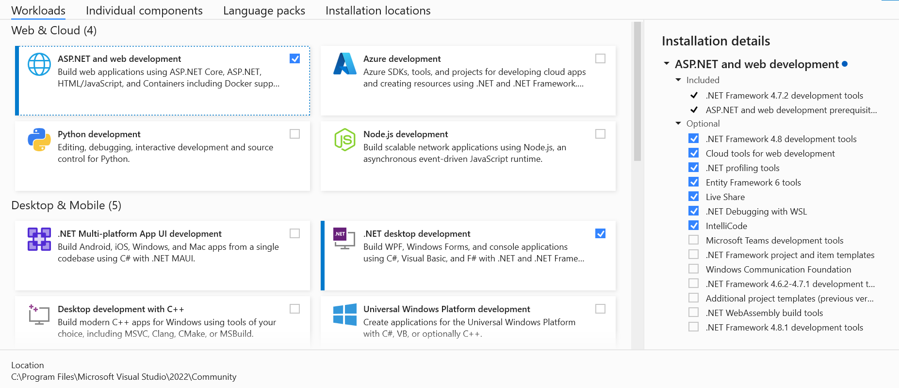
Tools | Get Tools and Features…

Slide 6
Tools (Workloads)
.NET Desktop development (NB: needed from Day 1)
ASP.NET and web development (later)

Slide 7
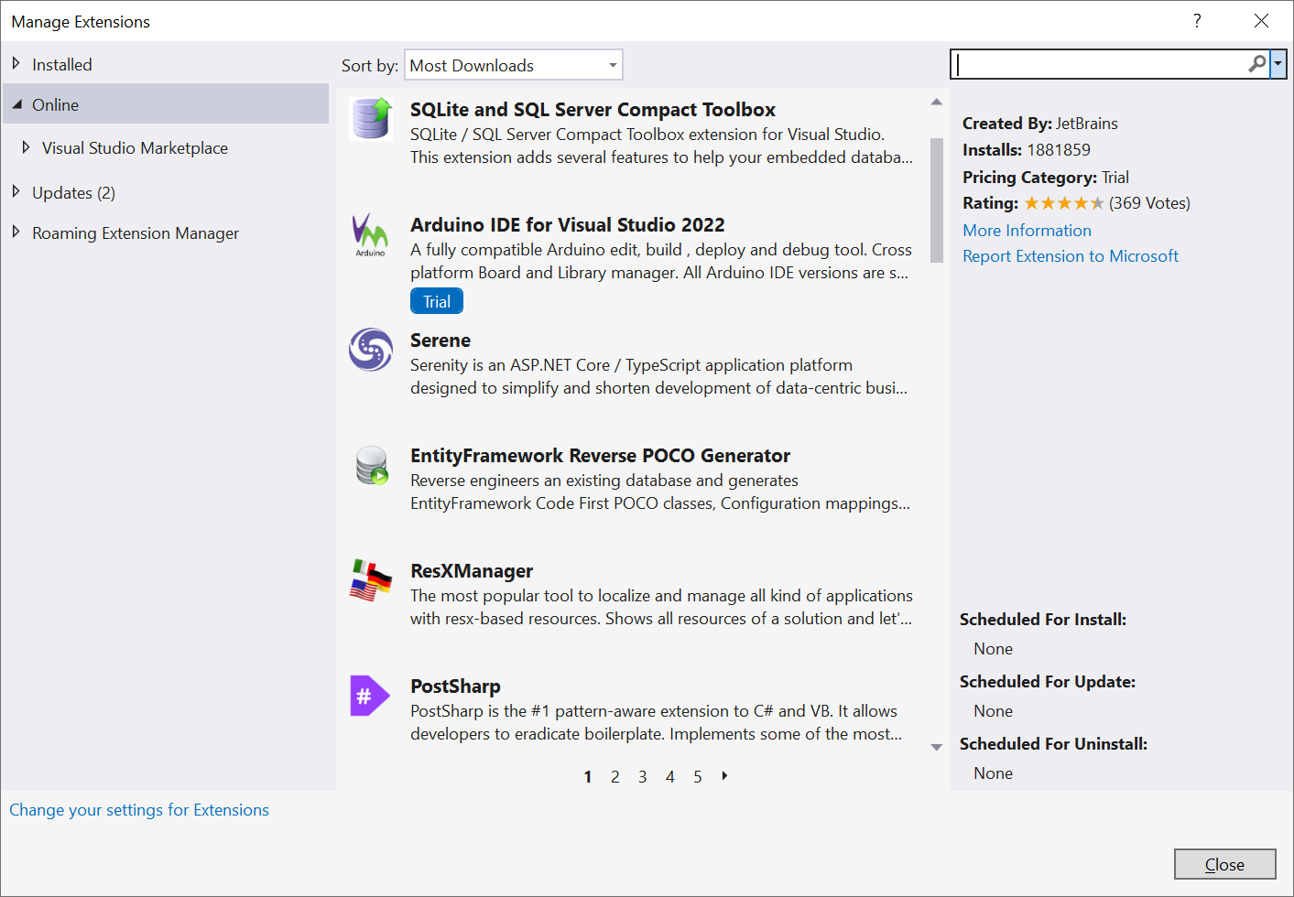
Extensions | Manage Extensions
None needed…

Slide 8
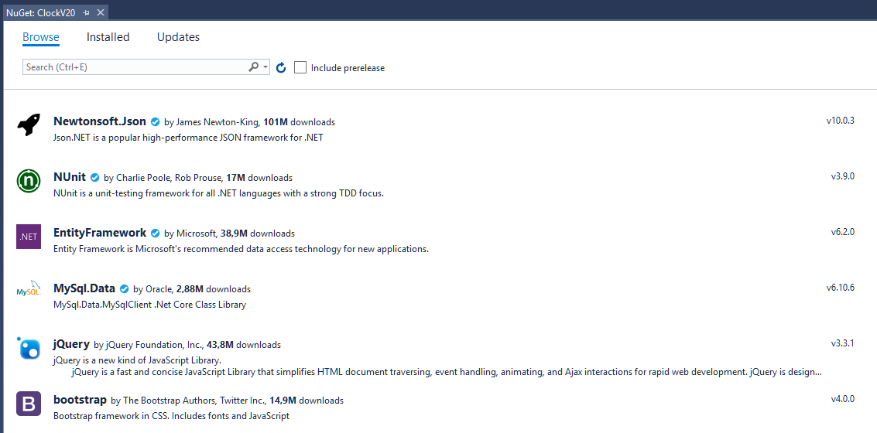
(Project) | Manage NuGet Packages…

Slide 9
NuGet Packages
Project-specific…
We need not worry about NuGet packages initially

