Slide 1
Razor Pages
overview

Slide 2
Your PC
HTTP Request
Web Server
Brow
ser
Web
Web App
HTTP Response

Slide 3
Your PC
HTTP Request
Web Server
Brow
ser
Web App
HTTP Response

Slide 4
HTTP Request
GET: Essentially a URL
POST: A URL and some data

Slide 5
HTTP Response
Status code (200, 404,…)
HTML (which the browser then renders)

Slide 6
Web App
App receives HTTP Requests (GET/POST plus URL)
App invokes controller matching the URL
Controller ”calculates” the HTML which should be shown in the browser (the page matching the URL)
App sends the HTML – and possibly also CSS – back to the browser, in the form of HTTP Responses

Slide 7
Razor Pages Web App
Handles HTTP Requests/Responses
Is page-centric: matches a URL with a page (i.e. a Razor Page)
We write
Page layout code
Page controller code
Assisting services code

Slide 8
Razor Pages Web App
Example: A page named ViewMessage
Layout code
Written in ViewMessage.cshtml
A mix of HTML, C# and ASP ”helper tags”
Often referred to as page layout code
Controller code
Written in ViewMessage.cshtml.cs
Pure C# (!)
Often referred to as page model code

Slide 9


Slide 10
Razor Pages Web App
NB: ALWAYS add pages under the Pages folder!
We will often define and use subfolders under Pages

Slide 11
Razor Pages Web App
What is a ”service”…?
Pure C# classes containing needed logic (business, persistence, …)
Not written as part of the page itself
Written as stand-alone classes that can be injected into page controller code
Usually style is a interface plus (at least) one class implementing the interface
Must be registered in Program.cs, as a ”singleton” service or a ”transient” service.

Slide 12
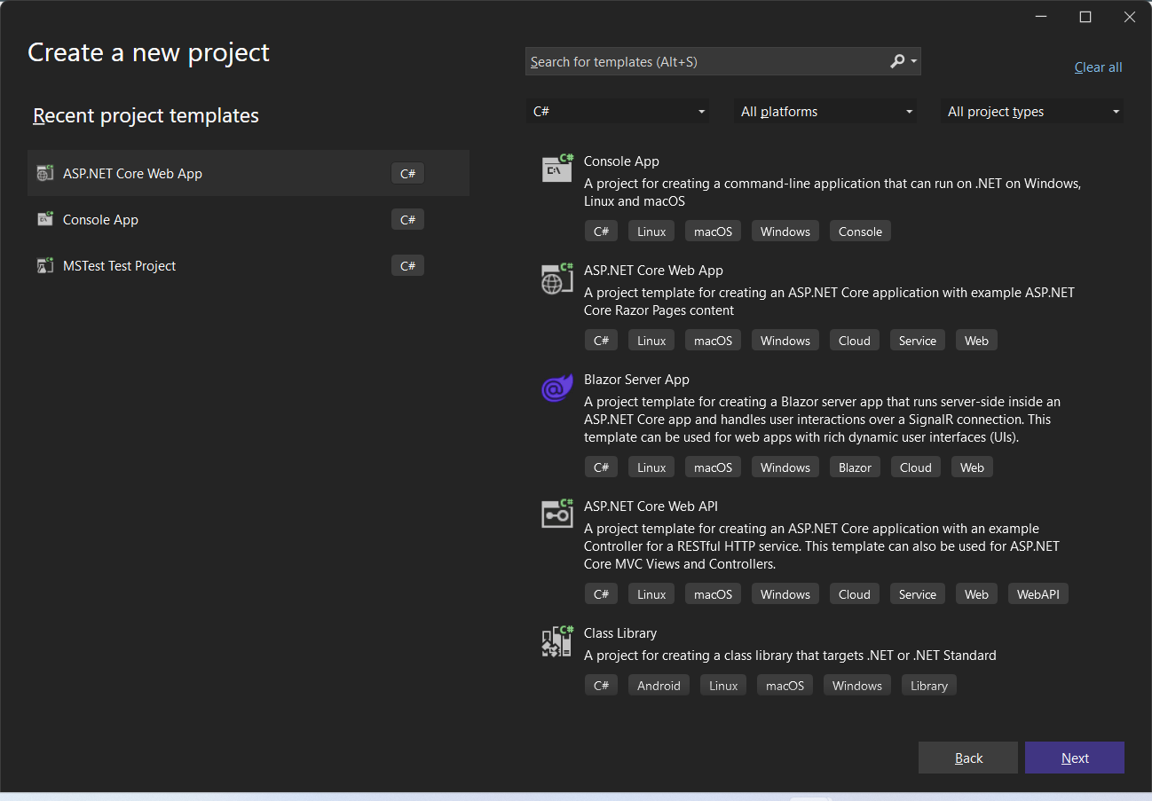

Slide 13
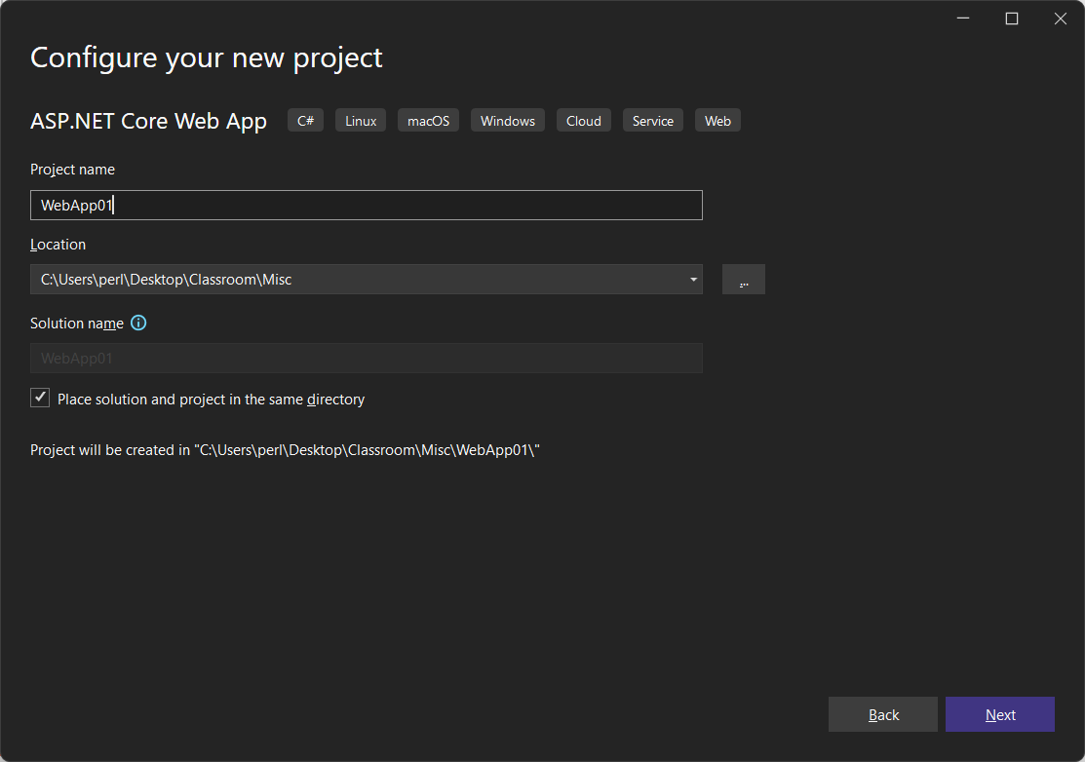

Slide 14
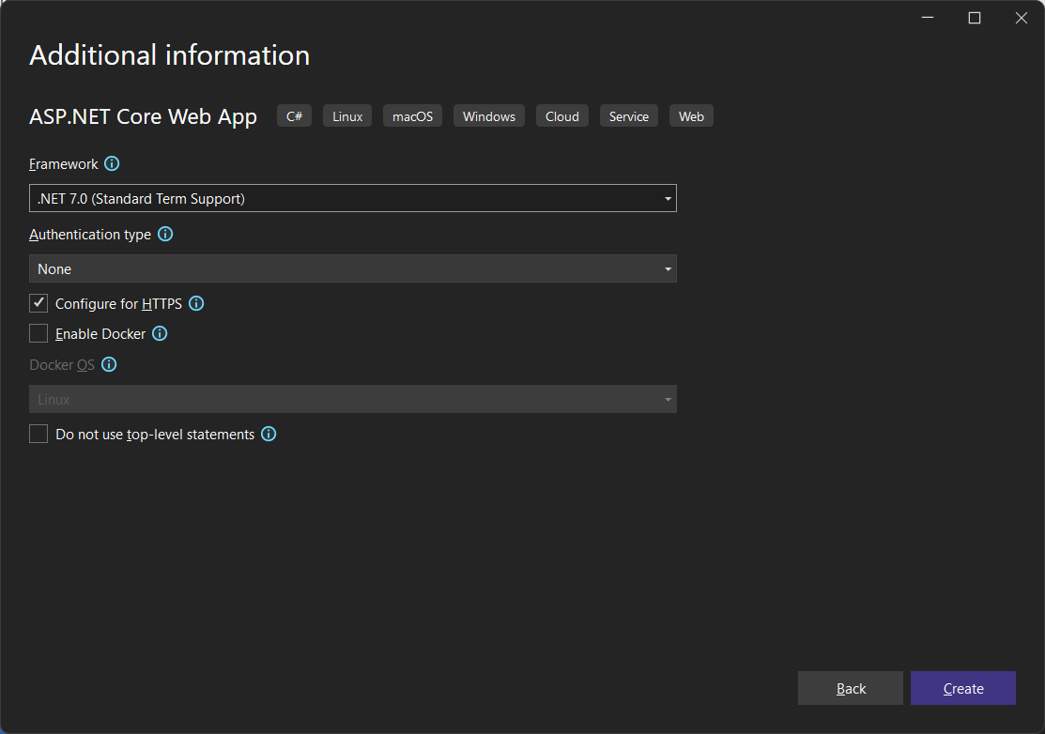

Slide 15
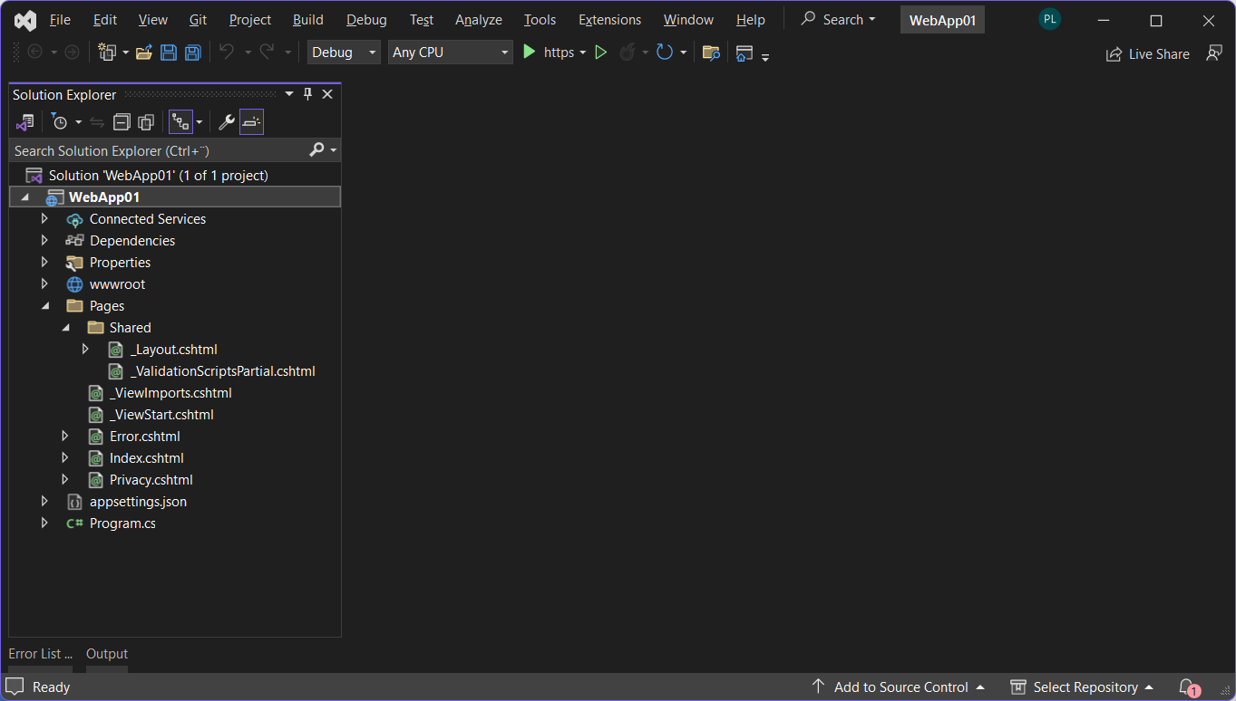

Slide 16
Page
Layout
(ViewMsg)

Slide 17
Page
Layout
(ViewMsg)
@page
@model ViewMsgModel
@{
}

Slide 18
Page
Layout
(ViewMsg)
@page
@model ViewMsgModel
@{
}
<h1>Hi World</h1>

Slide 19
_Layout.cs
…
<li class="nav-item">
<a … asp-page="/ViewMsg">View Message</a>
</li>
…

Slide 20
Page
Layout
(ViewMsg)
@page
@model ViewMsgModel
@{
}
<h1>Hi World, it is @DateTime.Now</h1>

Slide 21
Page
Model

Slide 22
Page
Model
public class ViewMsgModel : PageModel
{
}

Slide 23
Page
Model
public class ViewMsgModel : PageModel
{
public string Message { get; }
}

Slide 24
Page
@page
@model ViewMsgModel
@{
}
<h1>@Model.Message</h1>

Slide 25
@page
@model ViewMsgModel
@{
}
<h1>@Model.Message</h1>
public class ViewMsgModel : PageModel
{
public string Message { get; }
}

Slide 26
Service
public interface IMsgService
{
}

Slide 27
Service
public interface IMsgService
{
string GetMessage();
}

Slide 28
Service
public class MsgService : IMsgService
{
public string GetMessage()
{
…
}
}

Slide 29
Page
Model
public class ViewMsgModel : PageModel
{
private IMsgService _msgService;
}

Slide 30
@page
@model ViewMsgModel
@{
}
public class ViewMsgModel : PageModel
{
private IMsgService _msgService;
}
public class MsgService : IMsgService
{
}

Slide 31
Page
@page
@model ViewMsgModel
@{
}
<h1>@Model.Message</h1>

Slide 32
Page
Model
public class ViewMsgModel : PageModel
{
private IMsgService _msgService;
public string Message { get; }
}

Slide 33
@page
@model ViewMsgModel
@{
}
<h1>@Model.Message</h1>
public class ViewMsgModel : PageModel
{
private IMsgService _msgService;
public string Message { get; }
}

Slide 34
Page
Model
public class ViewMsgModel : PageModel
{
private IMsgService _msgService;
public ViewMsgModel(IMsgService msgSrv)
{
_msgService = msgSrv;
}
public string Message { get; }
}

Slide 35
Page
Model
public class ViewMsgModel : PageModel
{
private IMsgService _msgService;
public ViewMsgModel(IMsgService msgSrv)
{
_msgService = msgSrv;
}
public string Message { get; private set;}
public void OnGet()
{
Message = _msgService.GetMessage();
}
}

Slide 36
Service
public class MsgService : IMsgService
{
public string GetMessage()
{
…
}
}

Slide 37
public class ViewMsgModel : PageModel
{
private IMsgService _msgService;
public ViewMsgModel(IMsgService msgSrv)
{
_msgService = msgSrv;
}
public string Message { get; }
public void OnGet()
{
Message = _msgService.GetMessage();
}
}
public class MsgService : IMsgService
{
public string GetMessage() { … }
}

Slide 39
Program.cs
…
builder.Services.AddRazorPages(); // already there
builder.Services.AddSingleton<IMsgService,MsgService>();
…

Slide 40
Page (SetMsg)
@page
@model SetMsgModel
@{
}
<form method="post">
<div class="form-group">
<label asp-for="@Model.Message" class="control-label"></label>
<input asp-for="@Model.Message" class="form-control" />
</div>
<input type="submit" value="Save" class="btn btn-primary mt-3" />
</form>

Slide 41
Page
Model
public class SetMsgModel : PageModel
{
private IMsgService _msgService;
public string Message { get; private set; }
public SetMsgModel(IMsgService msgSrv)
{
_msgService = msgSrv;
}
public void OnGet()
{
Message = _msgService.GetMessage();
}
public void OnPost()
{
_msgService.SetMessage(Message);
}
}

Slide 42
Service
public interface IMsgService
{
string GetMessage();
void SetMessage(string message);
}

Slide 43
Service
public class MsgService : IMsgService
{
private string _theMessage;
public MsgService()
{
_theMessage = "Hi World";
}
public string GetMessage()
{
return _theMessage;
}
public void SetMessage(string message)
{
_theMessage = message;
}
}

Slide 44
_Layout.cs
…
<li class="nav-item">
<a … asp-page="/ViewMsg">View Message</a>
</li>
<li class="nav-item">
<a … asp-page="/SetMsg">Set Message</a>
</li>
…

Slide 46
Page
Model
public class SetMsgModel : PageModel
{
private IMsgService _msgService;
[BindProperty] // NB!!!
public string Message { get; set; } // NB!!!
public SetMsgModel(IMsgService msgSrv)
{
_msgService = msgSrv;
}
public void OnGet()
{
Message = _msgService.GetMessage();
}
public void OnPost()
{
_msgService.SetMessage(Message);
}
}

Slide 47
Web App with Domain Class
We want to be able to ”manage” several instances of a domain class
Domain class like e.g. Item, Movie, Customer, etc..
Typically need functionality for
CRUD operations
View all instances
Domain-specific operations

Slide 48
Web App with Domain Class
Recommendations
Add top-level folder Models to project
Add domain class definitions to this folder
NB: All domain classes must have a default constructor (i.e. no parameters)
Under the Pages folder, add one subfolder for each domain class
Give each subfolder the same name as the domain class
Add all Pages relating to this domain class to this subfolder
Add top-level folder Services to project
Add all service interfaces/classes to this folder (add subfolders if needed)
NB: Be aware of namespaces!

Slide 49
Domain
public class Movie
{
public int Id { get; set; }
public string Title { get; set; }
public int Length { get; set; }
public DateTime ReleaseDate { get; set; }
public Movie() { }
public Movie(string title, int length, DateTime releaseDate)
{
Id = 0;
Title = title;
Length = length;
ReleaseDate = releaseDate;
}
}

Slide 50
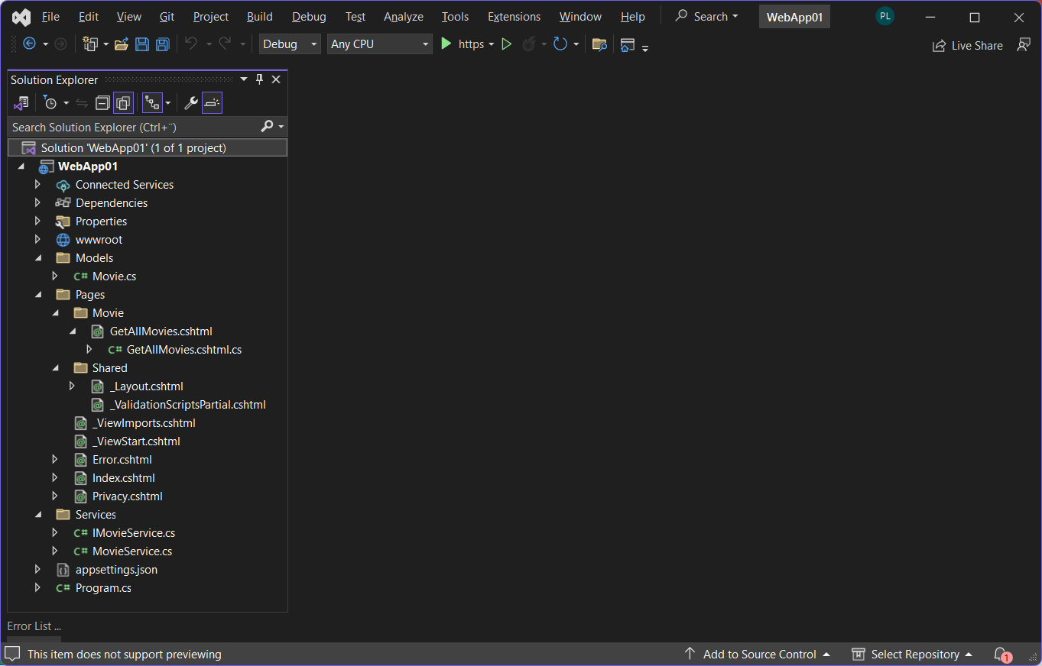

Slide 51
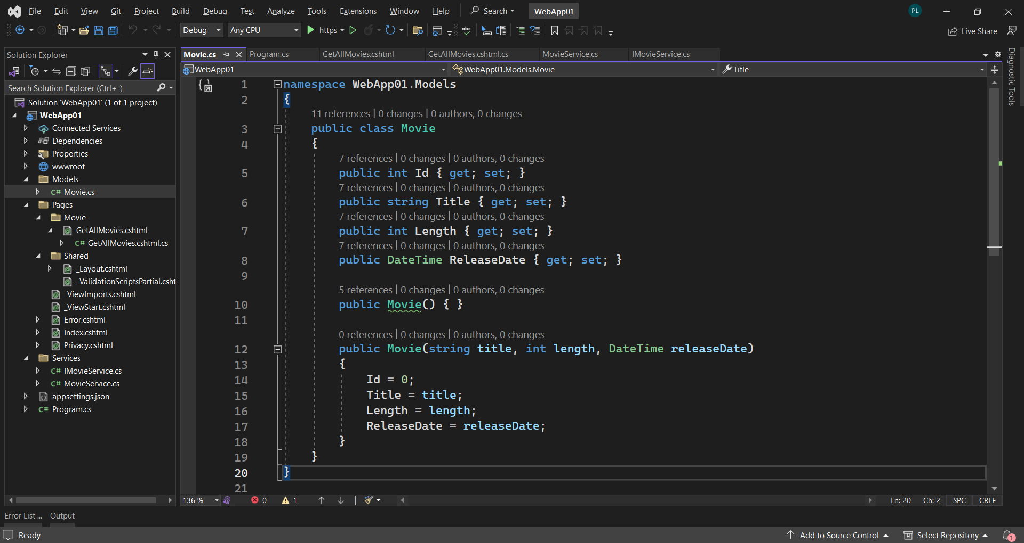

Slide 52
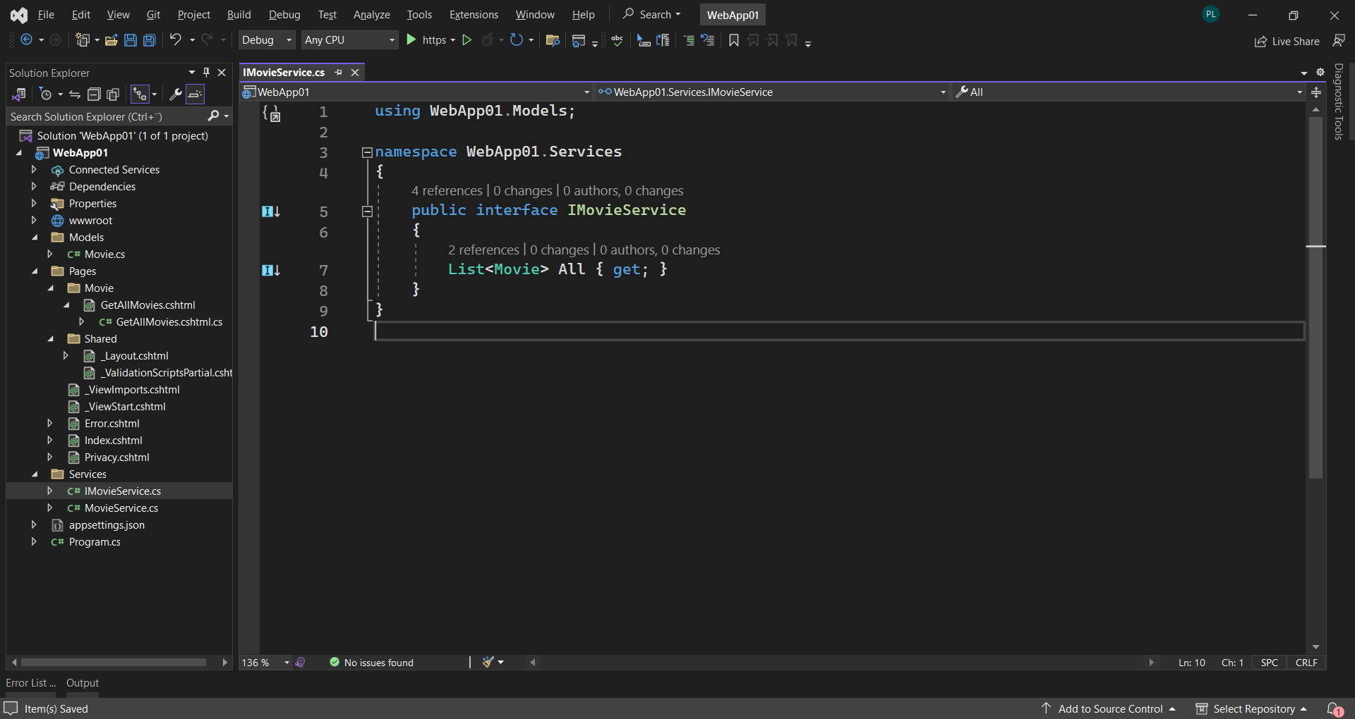

Slide 53
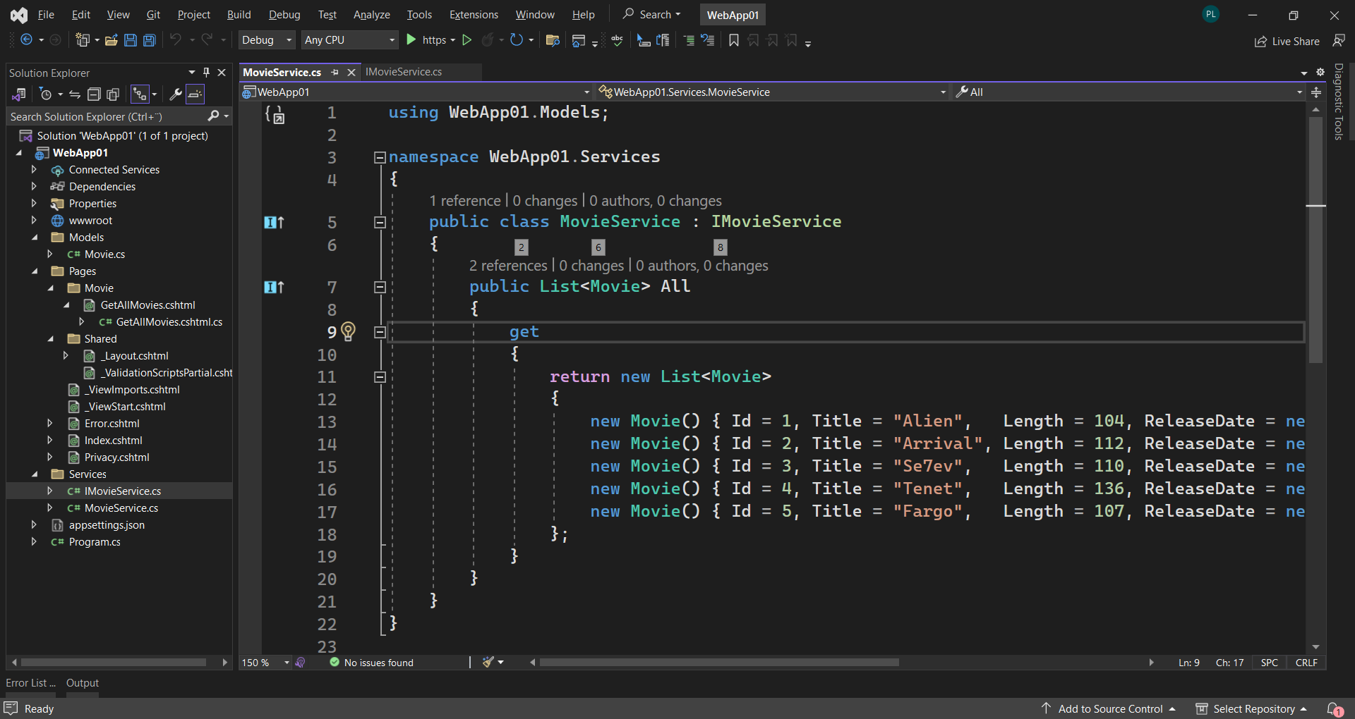

Slide 54
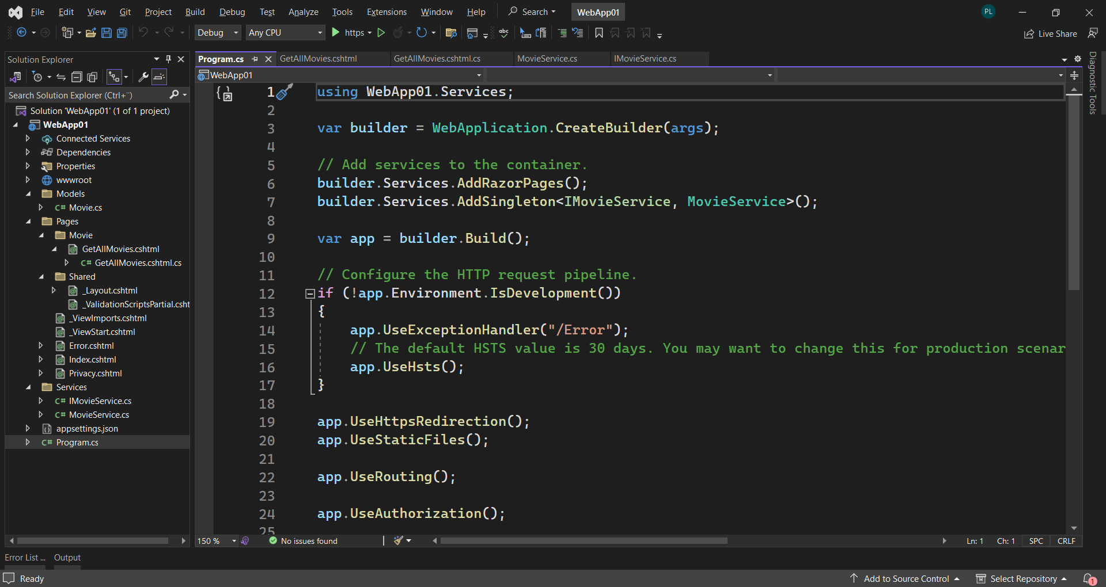

Slide 55
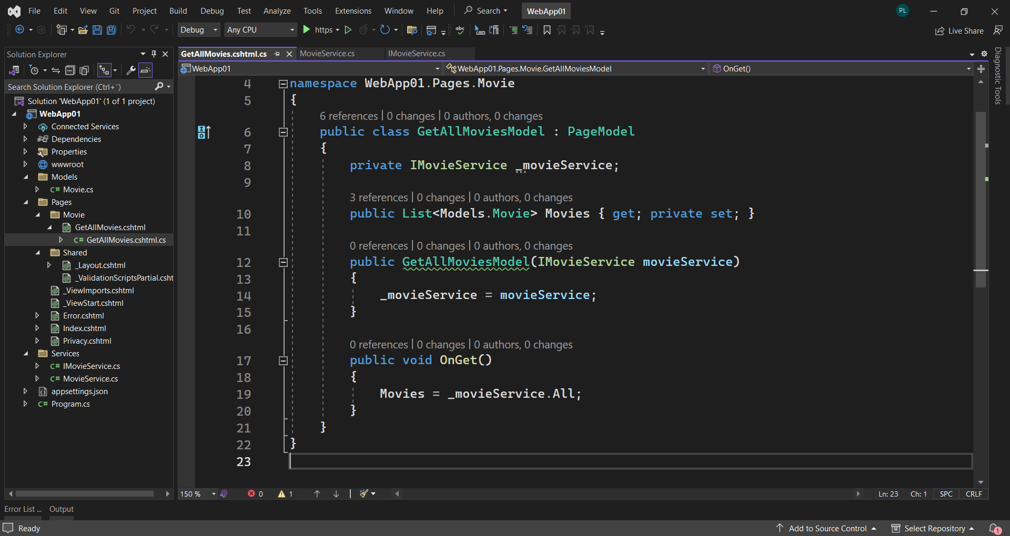

Slide 56
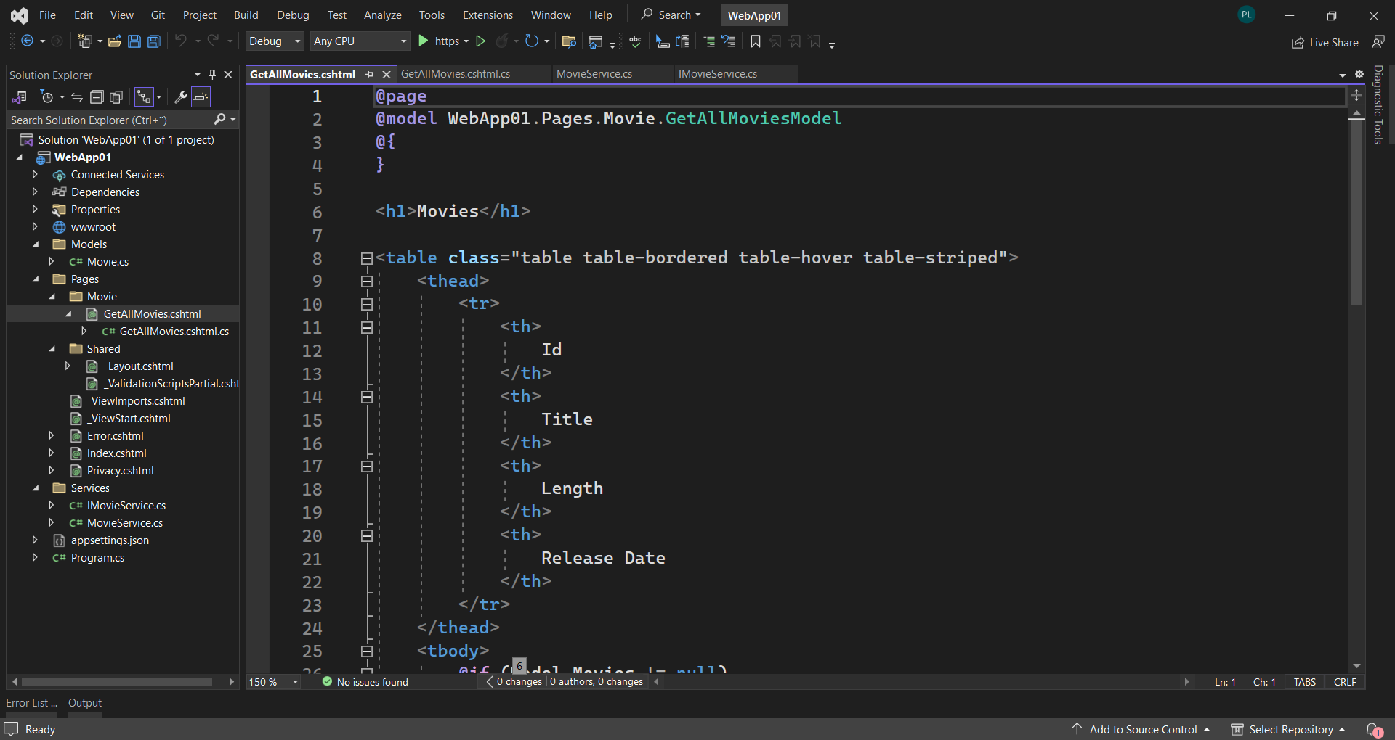

Slide 57
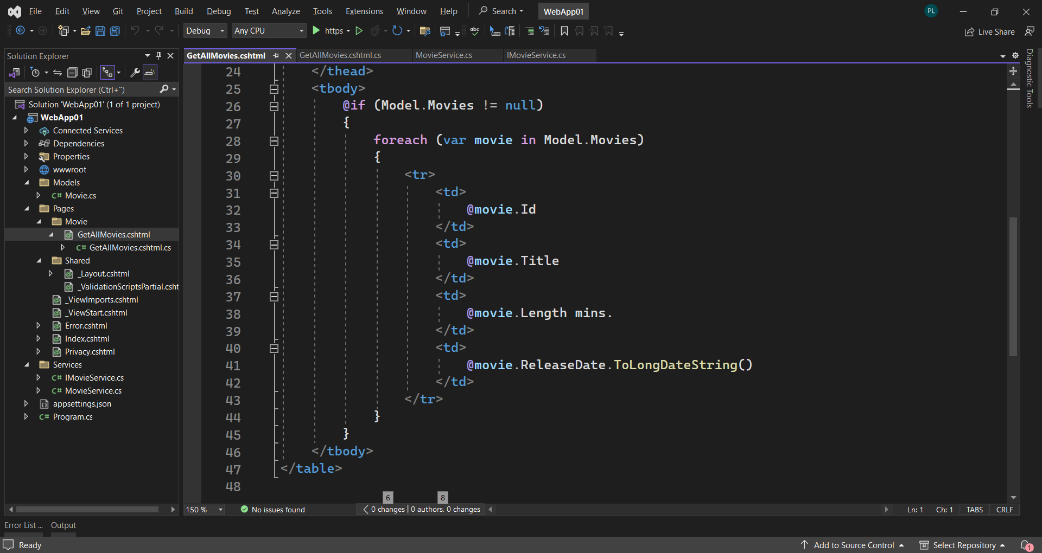

Slide 58
