Slide 1
Debugging

Slide 2
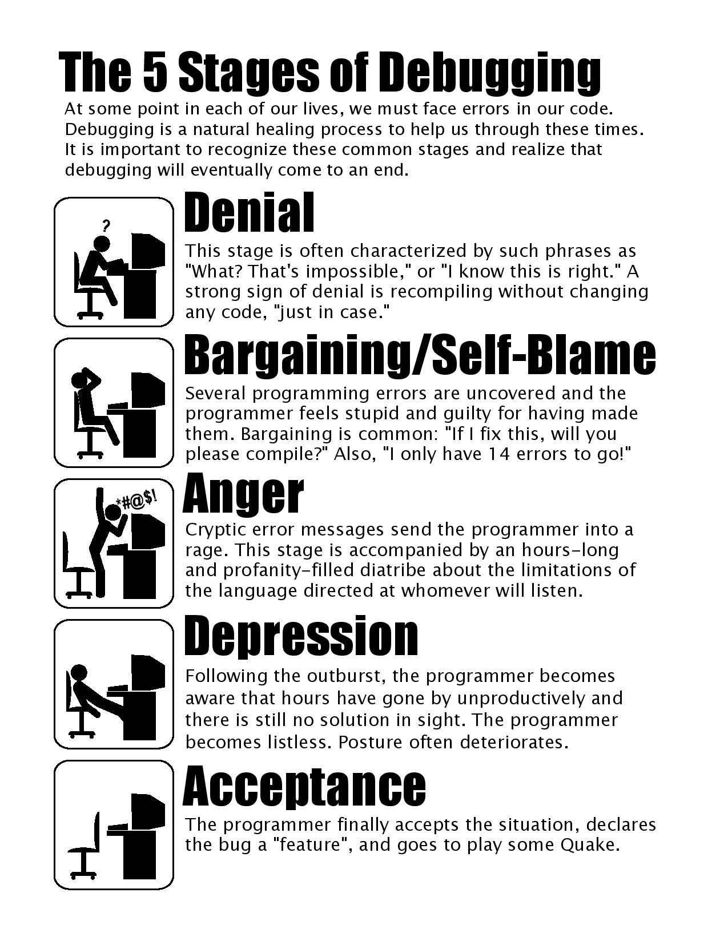

Slide 3
Levels of code correctness
Code can compile (no syntax errors)
Code behaves as specified (no logical errors)
Code is of high quality (?)

Slide 4
Levels of code correctness
Code can compile (no syntax errors)
Code behaves as specified (no logical errors)
Code is of high quality (?)

Slide 5
Levels of code correctness
Developement environvent (+ compiler) helps with syntax errors
Remedies for logical errors
Human-centric debugging
Tool-centric debugging

Slide 6
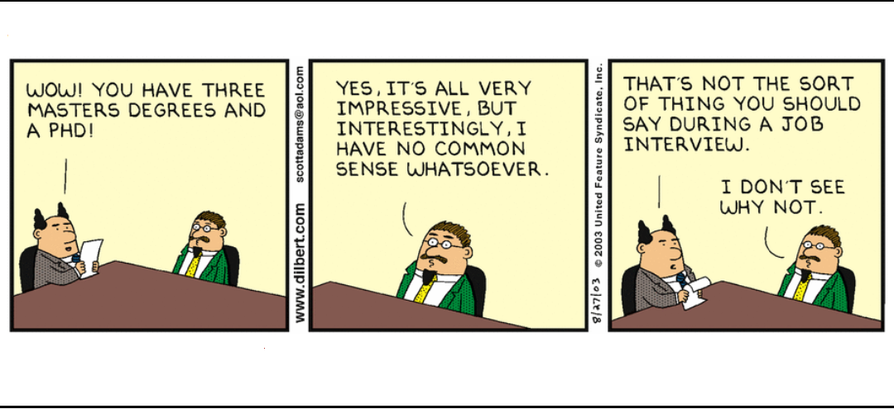
Human-centric debugging
Common sense!
Read the code (again…)
Explain the code (to somebody else…)
Are requirements clear?

Slide 7
Tool-centric debugging
for (int divideBy = 10; divideBy >= 0; divideBy--)
{
Console.WriteLine(100 / divideBy);
}

Slide 8

Tool-centric debugging
for (int divideBy = 10; divideBy >= 0; divideBy--)
{
Console.WriteLine($"Trying to divide by {divideBy}");
Console.WriteLine(100 / divideBy);
}

Slide 9

Tool-centric debugging
for (int divideBy = 10; divideBy >= 0; divideBy--)
{
Debug.WriteLine($"Trying to divide by {divideBy}");
Console.WriteLine(100 / divideBy);
}

Slide 10

Using the Integrated Debugger
Use it!
Getting started:
Setting a breakpoint
Inspecting variable values
Stepping through code

Slide 11
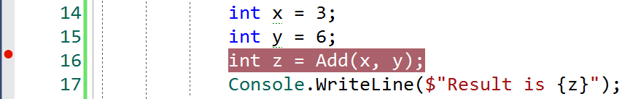
Setting a Breakpoint

Slide 12

Setting a Breakpoint
Click filled green triangle (or hit F5)
Code will run until – but not including – the line where the breakpoint is set
Execution is paused, NOT stopped

Slide 13
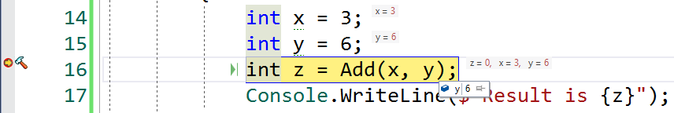
Inspecting variable values
Execution paused
Hover mouse cursor over variable

Slide 14

Inspecting variable values

Slide 15

Inspecting variable values
If we are done: click Continue
Runs until next breakpoint, or until execution ends

Slide 16

Stepping through code
If we are not done…
Various options for ”stepping” through code; moving execution a single line forward
Step Into
Step Over
Step Out

Slide 17
Step Into
Step Over
Step Out

Slide 18
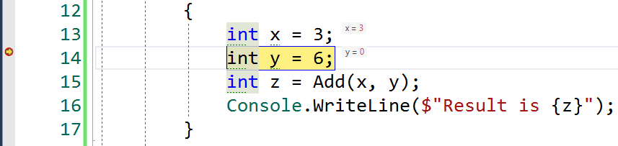
Step Over (simple statement)

Slide 19
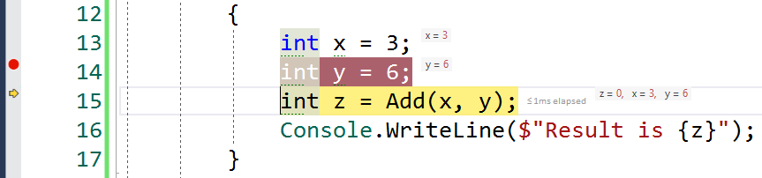
Step Over (simple statement)

Slide 20
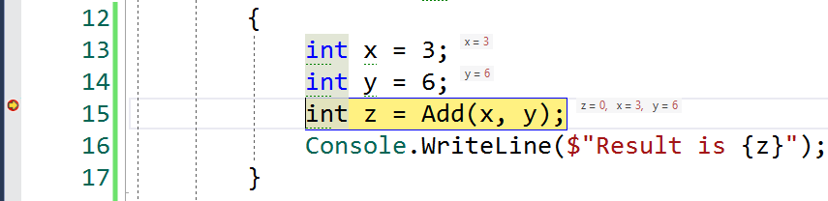
Step Over (method call)

Slide 21
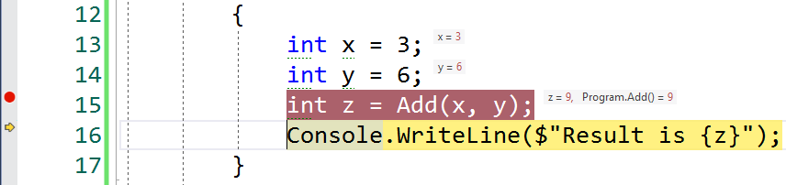
Step Over (method call)

Slide 22
Step Into (simple statement)

Slide 23
Step Into (simple statement)

Slide 24
Step Into (method call)

Slide 25
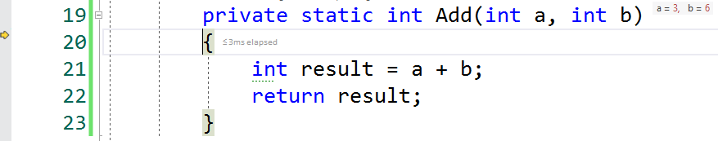
Step Into (method call)

Slide 26
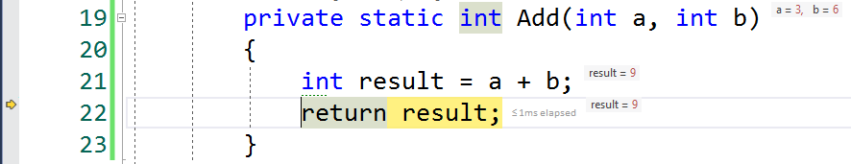
Step Into (method call)

Slide 27
Step Out

Slide 28
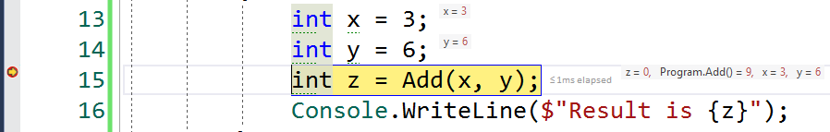
Step Out

Slide 29
Plan(…)
{
…
…
…
Calculate(…);
…
…
…
…
…
…
…
}
Calculate(…)
{
…
…
Add(…);
…
…
…
}
Add(int a, int b)
{
int r = a + b;
return r;
}

Slide 30
Plan(…)
{
…
…
…
Calculate(…);
…
…
…
…
…
…
…
}
Step Into
Calculate(…)
{
…
…
Add(…);
…
…
…
}
Step Out
Step Into
Add(int a, int b)
{
int r = a + b;
return r;
}

Slide 31
