Slide 1
Entity Framework Core Essentials

Slide 2
Preface
Entity Framework Core aka EFCore
We use EFCore version 7 (NB: Version 8 does exist, but currently not compatible with EFCore Power Tools )
NOT an exhaustive presentation of EFCore!
Focus on
The DbContext base class
The DbSet properties and Set<T>() method
The EFCore Power Tools (aka EFC PT) extension (NB: not part of EFCore)

Slide 3
Purpose
An Object-Relational Mapping (ORM) framework that enables us to work with relational databases using .NET objects
Key strength: (almost) automatic resolution of object references.
Is as such born as a code-first tool – we will primarily use the database-first approach (EFC PT helps with this)
Once the setup/generate phase is done, the database is abstracted away…

Slide 4
EFCore is nice, but…
When using database-first approach, domain classes are generated (by EFC PT).
We cannot choose property names freely…
Classes are generated as partial classes.
We can add ”custom” elements to domain classes, typically in separate files.
Content in auto-generated files is overwritten upon re-generation!

Slide 5
DbContext
Main class in EFCore, used to interact with a database.
Represents a “session” with the database
Provides access to data in database through properties/methods
Typically subclassed to create a custom context for a specific application (EFC PT can generate this class).
OnModelCreating: override to configure the entity classes and their relationships (EFC PT also generates this code).
SaveChanges: persists changes to the database.

Slide 6
DbContext (all code generated by EFC PT)
public partial class EFCDrinkDBContext : DbContext
{
…
public virtual DbSet<Drink> Drinks { get; set; }
public virtual DbSet<Ingredient> Ingredients { get; set; }

Slide 7
DbContext (all code generated by EFC PT)
public partial class EFCDrinkDBContext : DbContext
{
…
protected override void OnConfiguring(DbContextOptionsBuilder optionsBuilder)
{
if (!optionsBuilder.IsConfigured)
{
optionsBuilder.UseSqlServer("Data Source=(localdb)\\MSSQLLocalDB;
Initial Catalog=EFCDrinkDB");
}
}

Slide 8
DbContext (all code generated by EFC PT)
public partial class EFCDrinkDBContext : DbContext
{
…
protected override void OnModelCreating(ModelBuilder modelBuilder)
{
modelBuilder.Entity<Drink>(entity =>
{
entity.HasOne(d => d.AlcoholicPart)
.WithMany(p => p.DrinkAlcoholicParts)
.HasForeignKey(d => d.AlcoholicPartId)
.HasConstraintName("FK_Drink_Ingredient_Alc");
entity.HasOne(d => d.NonAlcoholicPart)
.WithMany(p => p.DrinkNonAlcoholicParts)
.HasForeignKey(d => d.NonAlcoholicPartId)
.HasConstraintName("FK_Drink_Ingredient_NonAlc");
});
OnModelCreatingPartial(modelBuilder);
}
partial void OnModelCreatingPartial(ModelBuilder modelBuilder);

Slide 9
DbContext
We will usually not do much with the auto-generated context class. We could choose to
Move to other folder
Strip namespace away
Get database info elsewhere (Razor Pages)

Slide 10
Domain classes and EFC Power Tools
Tables with relations are transformed (by EFC PT) to domain classes with object references
Domain classes will contain two ”versions” of object references:
By identifier (typically of type int)
By navigation property (typically of the type of the object being referred to)

Slide 11
Domain classes and EFC Power Tools
[Table("Drink")]
public partial class Drink // auto-generated
{
…
public int? AlcoholicPartId { get; set; }
public int? NonAlcoholicPartId { get; set; }
[ForeignKey("AlcoholicPartId")]
[InverseProperty("DrinkAlcoholicParts")]
public virtual Ingredient AlcoholicPart { get; set; }
[ForeignKey("NonAlcoholicPartId")]
[InverseProperty("DrinkNonAlcoholicParts")]
public virtual Ingredient NonAlcoholicPart { get; set; }
}
CREATE TABLE [dbo].[Drink] (
[Id] INT IDENTITY (1, 1) NOT NULL,
[Name] NVARCHAR (50) NOT NULL,
[AlcoholicPartId] INT NULL,
[AlcoholicPartAmount] INT NULL,
[NonAlcoholicPartId] INT NULL,
[NonAlcoholicPartAmount] INT NULL,
PRIMARY KEY CLUSTERED ([Id] ASC),
CONSTRAINT [FK_Drink_Ingredient_Alc] FOREIGN KEY ([AlcoholicPartId])
REFERENCES [dbo].[Ingredient] ([Id]),
CONSTRAINT [FK_Drink_Ingredient_NonAlc] FOREIGN KEY ([NonAlcoholicPartId])
REFERENCES [dbo].[Ingredient] ([Id])
);

Slide 12
Domain classes and EFC Power Tools
Why two ”versions” of object references…?
Identifiers always set, navigation properties only if Include is used in query (see later)
NB: When creating a new object which refers to existing objects, do not set navigation properties yourself! Only set identifiers!
If navigation properties are set directly, they are perceived as new objects, and EFCore will try to save them…
Tempting to create a constructor which supports only setting the identifiers, BUT this has a big ”gotcha”!

Slide 13
Domain classes and EFC Power Tools
// Nice and innocent constructor…
public Drink(string name,
int? alcoPartId, int? alcoPartAmount,
int? nonAlcoPartId, int? nonAlcoPartAmount)
{
Name = name;
AlcoholicPartId = alcoPartId;
AlcoholicPartAmount = alcoPartAmount;
NonAlcoholicPartId = nonAlcoPartId;
NonAlcoholicPartAmount = nonAlcoPartAmount;
}
So, what is the ”gotcha”…?
https://learn.microsoft.com/en-us/ef/core/modeling/constructors

Slide 14
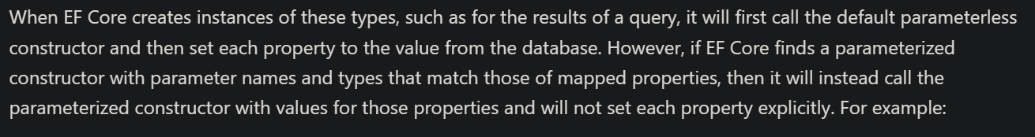

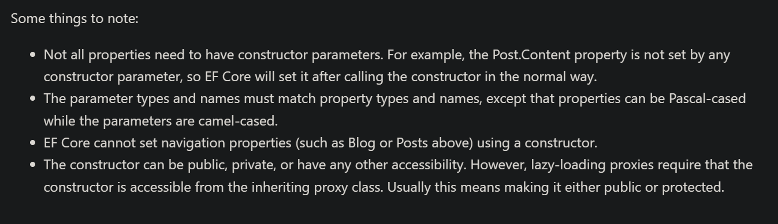


Domain classes and EFC Power Tools

Slide 15
Domain classes and EFC Power Tools
A way around the ”gotcha” is to not define any parameterized constructors at all
Remember objects can always be created like this:
Drink d = new Drink()
{
Name = ”Gin and Tonic”;
AlcoholicPartId = 5;
AlcoholicPartAmount = 3;
NonAlcoholicPartId = 11;
NonAlcoholicPartAmount = 15;
};

Slide 16
Domain classes and EFC Power Tools
Alternative to previous style could be to use the Factory Method pattern, e.g. by defining a static Create method:
public static Drink Create(string name,
int? alcoPartId, int? alcoPartAmount,
int? nonAlcoPartId, int? nonAlcoPartAmount)
{
return new Drink()
{
Name = name;
AlcoholicPartId = alcoPartId;
AlcoholicPartAmount = alcoPartAmount;
NonAlcoholicPartId = nonAlcoPartId;
NonAlcoholicPartAmount = nonAlcoPartAmount;
};
}

Slide 17
Domain classes and EFC Power Tools
public partial class Ingredient
{
…
// Navigation properties for ”many”- relationship
// Auto-generated, but we might never load them…
[InverseProperty("AlcoholicPart")]
public virtual ICollection<Drink> DrinkAlcoholicParts { get; set; }
[InverseProperty("NonAlcoholicPart")]
public virtual ICollection<Drink> DrinkNonAlcoholicParts { get; set; }
}

Slide 18
DbSet<…> properties
For each table chosen for auto-generation, we get
An auto-generated domain class
A DbSet<…> property in the context class
public partial class EFCDrinkDBContext : DbContext
{
…
public virtual DbSet<Drink> Drinks { get; set; }
public virtual DbSet<Ingredient> Ingredients { get; set; }

Slide 19
DbSet<…> properties
A DbSet<…> property mirrors a table in the database
Can do CRUD-operations directly on property!
NB: Changes are not persisted to database, until we call SaveChanges on the context object.

Slide 20
Data access with DbSet<…> properties
using EFCDrinkDBContext context = new EFCDrinkDBContext();
// Get All
List<Drink> allDrinks = context.Drinks.ToList();
// Create
Drink d = new Drink() { … };
context.Drinks.Add(d);
context.SaveChanges();

Slide 21
Data access with DbSet<…>() properties
using EFCDrinkDBContext context = new EFCDrinkDBContext();
// Read
Drink? dRead = context.Drinks.Find(d.Id);
// Update
if (dRead != null)
{
dRead.Name = "New Name";
context.Drinks.Update(dRead); // NB: Not saved yet!
}
// Delete
if (dRead != null)
{
context.Drinks.Remove(dRead); // NB: Not saved yet!
}

Slide 22
Set<…>() method
Very easy to work with DbSet<…> properties.
Drawback: not easy to generalize CRUD code…
Alternative: use Set<…>() method.
Calling Set<T>() on context object returns all objects of type T
Essentially, DbSet<T> and Set<T>() are equivalent

Slide 23
Data access with Set<…>() method
using EFCDrinkDBContext context = new EFCDrinkDBContext();
// Get All
List<Drink> allDrinks = context.Set<Drink>().ToList();
// Create
Drink d = new Drink() { … };
context.Set<Drink>().Add(d);
context.SaveChanges();

Slide 24
Data access with Set<…>() method
using EFCDrinkDBContext context = new EFCDrinkDBContext();
// Read
Drink? dRead = context.Set<Drink>().Find(d.Id);
// Update
if (dRead != null)
{
dRead.Name = "New Name";
context.Set<Drink>().Update(dRead); // NB: Not saved yet!
}
// Delete
if (dRead != null)
{
context.Set<Drink>().Remove(dRead); // NB: Not saved yet!
}

Slide 25
Data sets and LINQ
Very easy to get all of objects of type T (context.Set<T>())
What about a subset of objects…?
LINQ available for more refined queries (context.Set<T>().Where(…))
Can also process data with loops, etc..

Slide 26
Essence of EF Core
Create new context object with the using syntax
Get collection of objects of type T from the context object, either by
Accessing a property of type DbSet<T>, or
Calling Set<T>() method
Query data directly on property (or Set<T>() return value)
Change data directly on property (or Set<T>() return value)
Save to database by calling SaveChanges() on context object

Slide 27
Essence of EF Core
// Create new context object with the ”using” syntax
using EFCDrinkDBContext context = new EFCDrinkDBContext();
// Get collection of objects from context object, by calling Set<..>() method
List<Drink> allDrinks = context.Set<Drink>().ToList();
// Change data directly on Set<..>() return value
Drink d = new Drink() { … };
context.Set<Drink>().Add(d);
// Save changes to database by calling SaveChanges on the context object
context.SaveChanges();

Slide 28
Essence of EF Core
// Create new context object with the ”using” syntax
using EFCDrinkDBContext context = new EFCDrinkDBContext();
// Get collection of objects from context object, by calling Set<..>() method
List<Drink> allDrinks = context.Set<Drink>().ToList();
// NB: This will NOT work!!
Drink d = new Drink() { … };
allDrinks.Add(d);
// Save changes to database by calling SaveChanges on the context object
context.SaveChanges();

Slide 29
Object reference resolution
Very easy to get all – or subset – of objects of type T
What if the individual objects refer to other objects…?
The referred-to objects are not ”resolved” per default.

Slide 30
Object reference resolution
[Table("Drink")]
public partial class Drink // auto-generated
{
…
public int? AlcoholicPartId { get; set; }
public int? NonAlcoholicPartId { get; set; }
[ForeignKey("AlcoholicPartId")]
[InverseProperty("DrinkAlcoholicParts")]
public virtual Ingredient AlcoholicPart { get; set; }
[ForeignKey("NonAlcoholicPartId")]
[InverseProperty("DrinkNonAlcoholicParts")]
public virtual Ingredient NonAlcoholicPart { get; set; }
}

Slide 31
Object reference resolution
using EFCDrinkDBContext context = new EFCDrinkDBContext();
// Get all Drink objects, but object references NOT resolved.
List<Drink> allDrinksA = context.Set<Drink>()
.ToList();
// Get all Drink objects, with object references resolved.
List<DrinkFlat> allDrinksB = context.Set<DrinkFlat>()
.Include(d => d.AlcoholicPart)
.Include(d => d.NonAlcoholicPart)
.ToList();

Slide 32
Object reference resolution
using EFCDrinkDBContext context = new EFCDrinkDBContext();
// Deeper level of object reference resolution
List<Cocktail> allCocktails = context.Set<Cocktail>()
.Include(c => c.CocktailIngredients)
.ThenInclude(ci => ci.Ingredient);

Slide 33
EFCore Power Tools extension
Download from: https://marketplace.visualstudio.com/items?itemName=ErikEJ.EFCorePowerTools
Download
Shut down all running instances of Visual Studio
Install

Slide 34
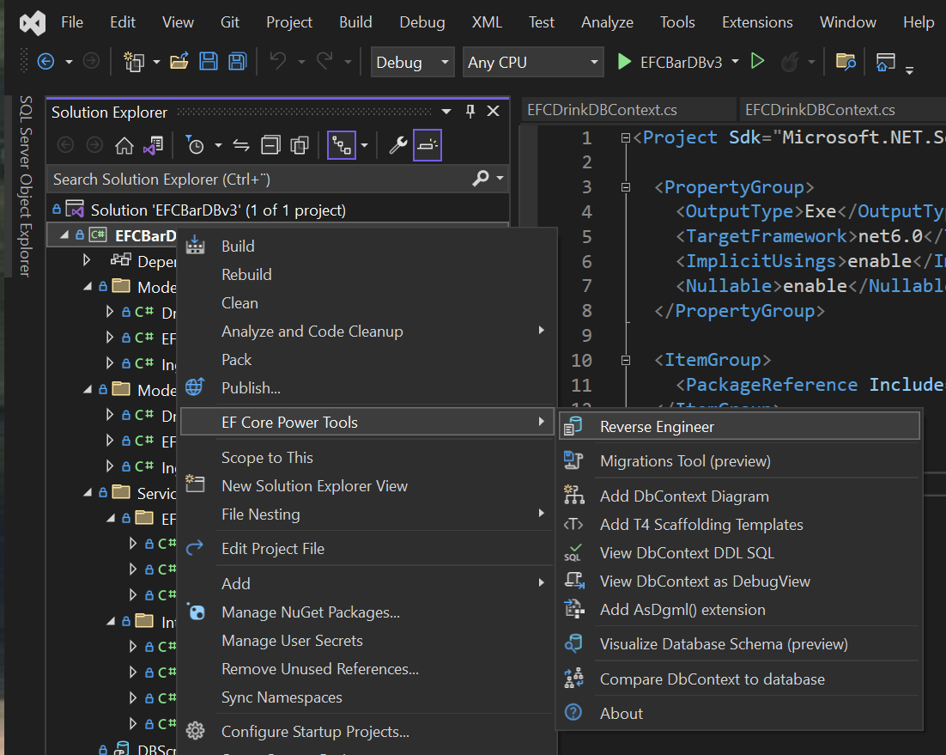
EFCore Power Tools extension
Right-click on project (not solution)
Choose EF Core Power Tools | Reverse Engineer in menu
Select project and right-click

Slide 35
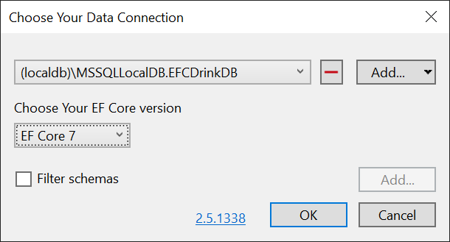
EFCore Power Tools extension
Add a reference to a database
Local database: (localdb)\ MSSQLLocalDB.NameOfDB
If you are not running on a local database, specify your specific database instance instead.
Click OK to proceed.

Slide 36
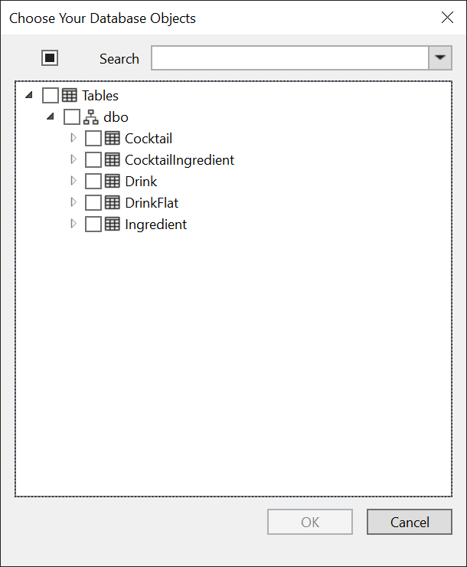
EFCore Power Tools extension
Expand Tables/dbo
You should see a list of tables in the chosen database.
Check off tables for which to generate classes
Click OK to proceed.

Slide 37
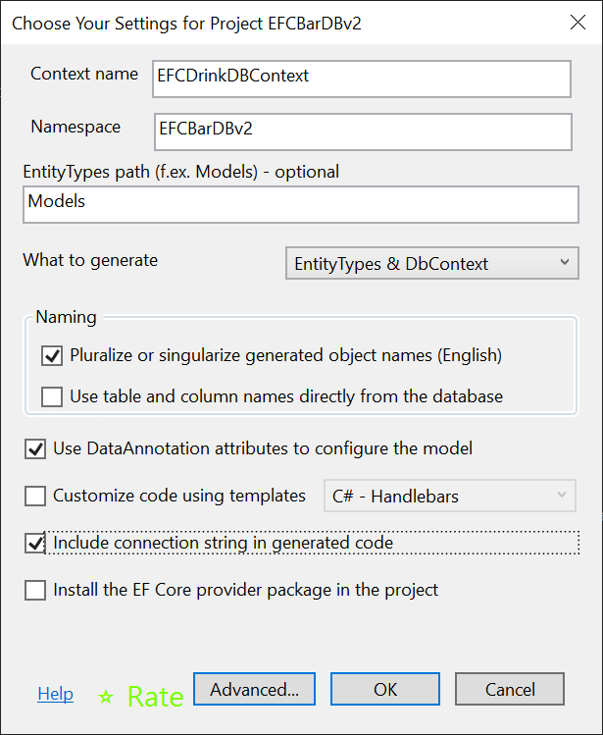
EFCore Power Tools extension
Delete text in the EntityTypes path text box
Check off
Pluralize…
Use DataAnnotation…
Include connection…
Install the EF Core… (only first time)
Click OK to proceed.
NB: Delete
First time

Slide 38
EFCore Power Tools extension
EFC Power Tools will now auto-generate:
A context class derived from DbContext
A class for each chosen table
NB: All classes generated with namespace. Feel free to strip away namespaces and/or move the classes to other folders.
But be aware that this needs to be done every time classes are regenerated…

Slide 39
Documentation
https://learn.microsoft.com/en-us/ef/core/
…but exercises should provide a learning-by-example experience.

