Slide 1
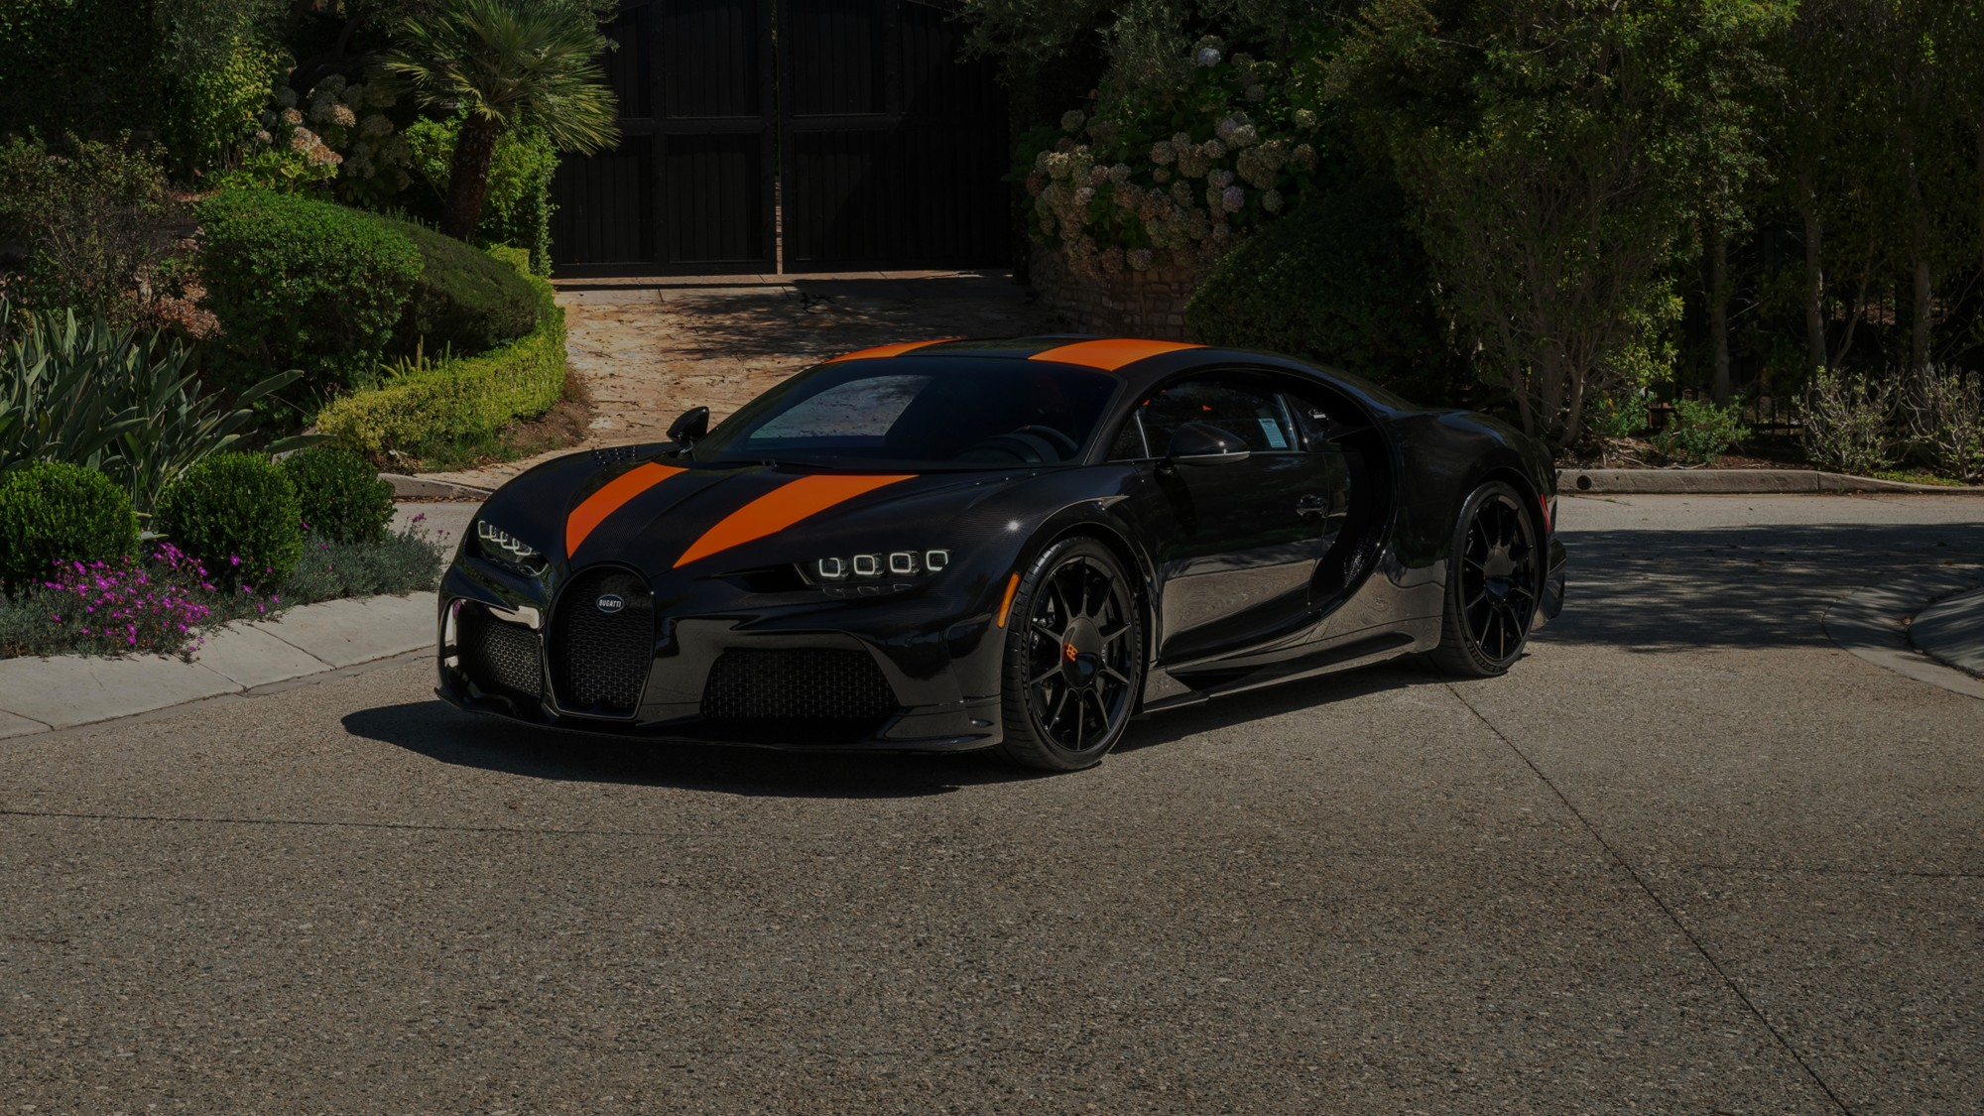
MARVELS OF
THE
Bugatti Chiron Super
Sport 300+
1600 horsepower (quad-turbo W16)
490 km/h recorded run (304.77 mph)
0–400 km/h in ~32 seconds
440 km/h electronically limited for customers
ENGINEERING
CALVIN DSOUZA
NNM24CB015

Slide 2
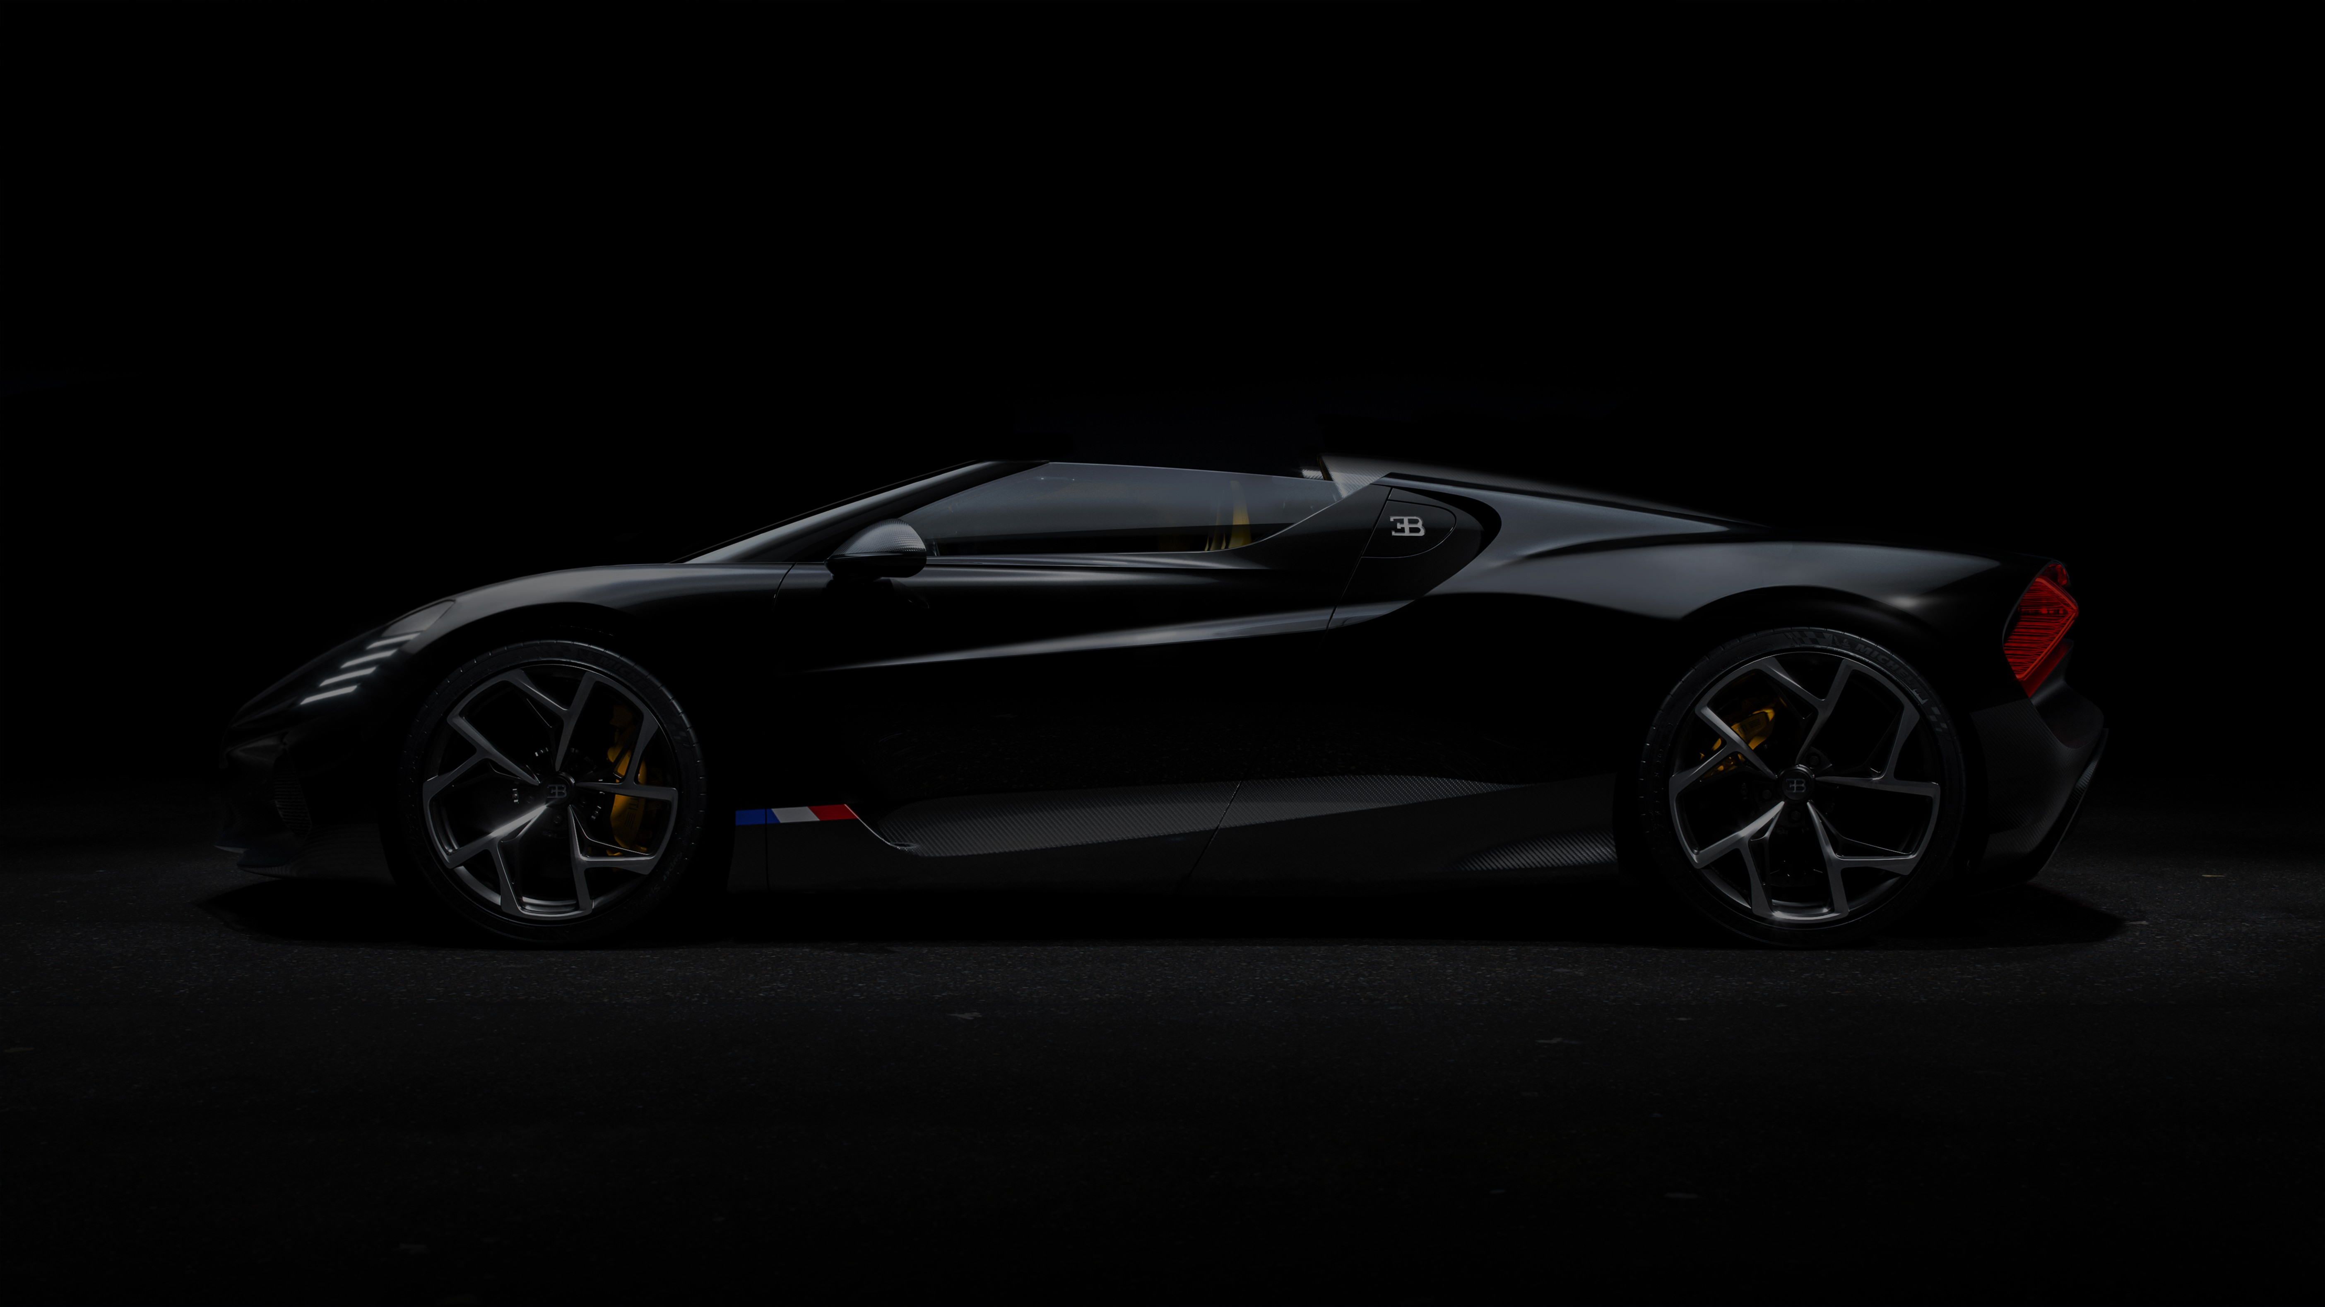
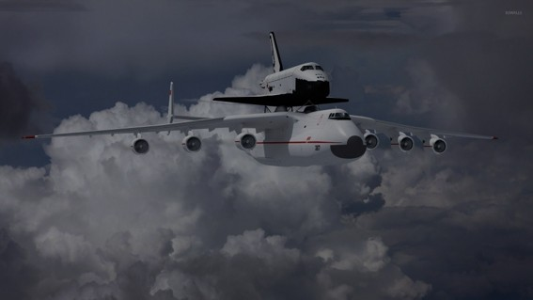
MARVELS OF
THE
ENGINEERING
Bugatti Chiron Super
Sport 300+
Antonov An-225
1600 horsepower (quad-turbo W16)
490 km/h recorded run (304.77 mph)
0–400 km/h in ~32 seconds
440 km/h electronically limited for
6 Turbofan engines producing ~1,370 kN of total thrust
Landing gear: 32 wheels.
Antonov max take-off weight: 640 tons.
Wingspan: 88 meters — wider than a football field.
CALVIN DSOUZA
NNM24CB015

Slide 3
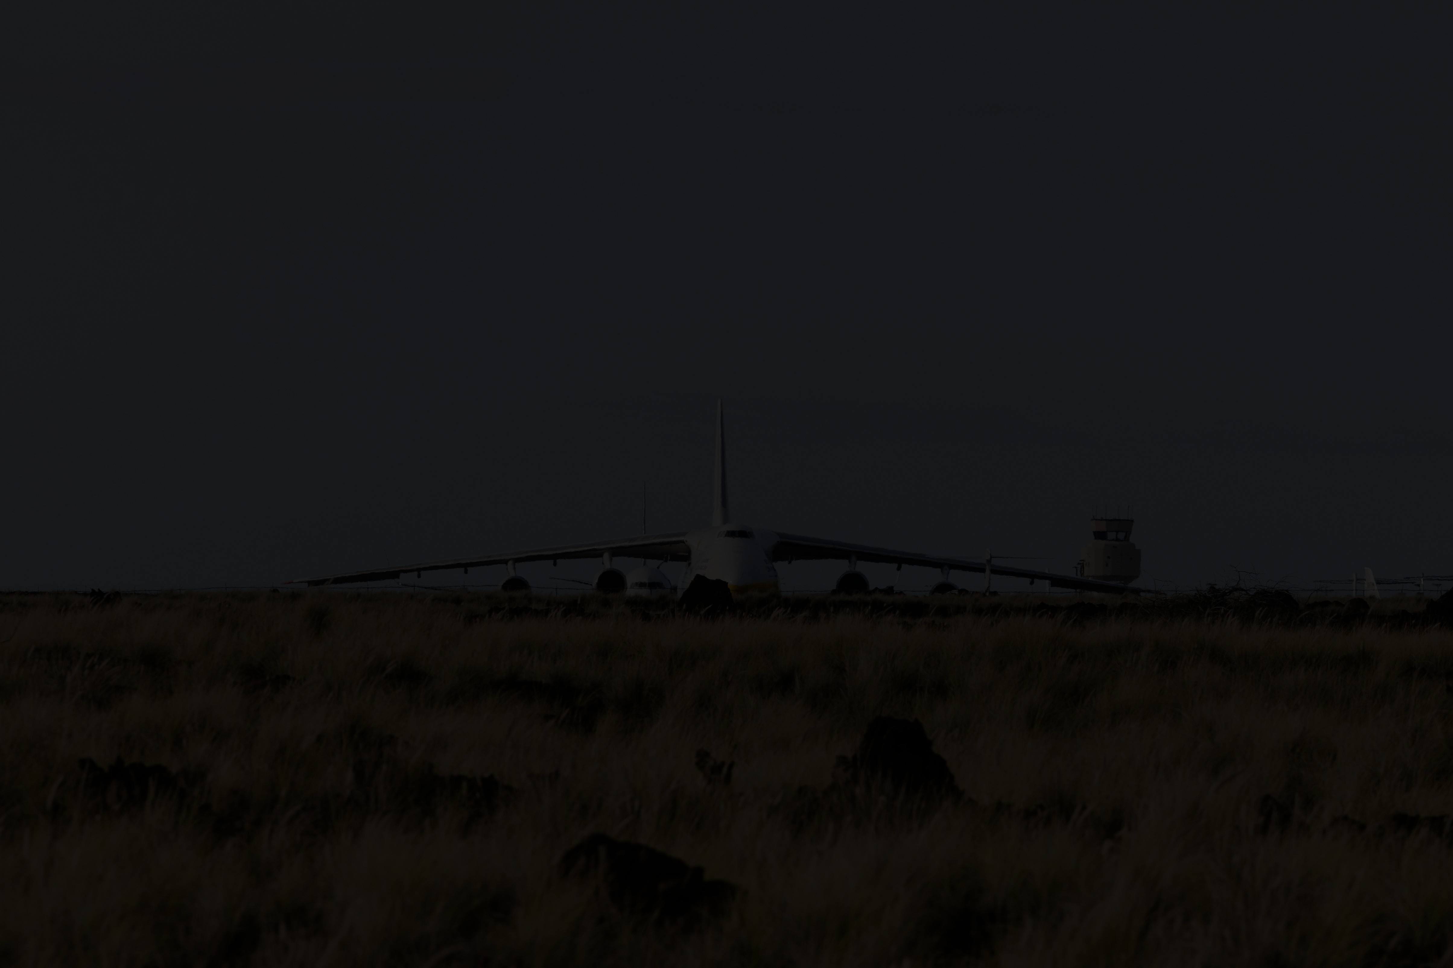
MARVELS OF
THE
ENGINEERING
Antonov An-225
Bugatti Chiron Super
Sport 300+
F-117 Nighthawk
6 Turbofan engines ~1,370 kN of total thrust
Landing gear: 32 wheels
Antonov max take-off weight: 640 tons
Wingspan: 88 meters
1600 horsepower (quad-turbo W16)
490 km/h recorded run (304.77 mph)
0–400 km/h in ~32 seconds
440 km/h electronically limited for customers
Radar cross-section ≈ 0.001 m²
• Top speed: ~993 km/h (Mach 0.92)
• Combat radius: ~930 km
3

Slide 4
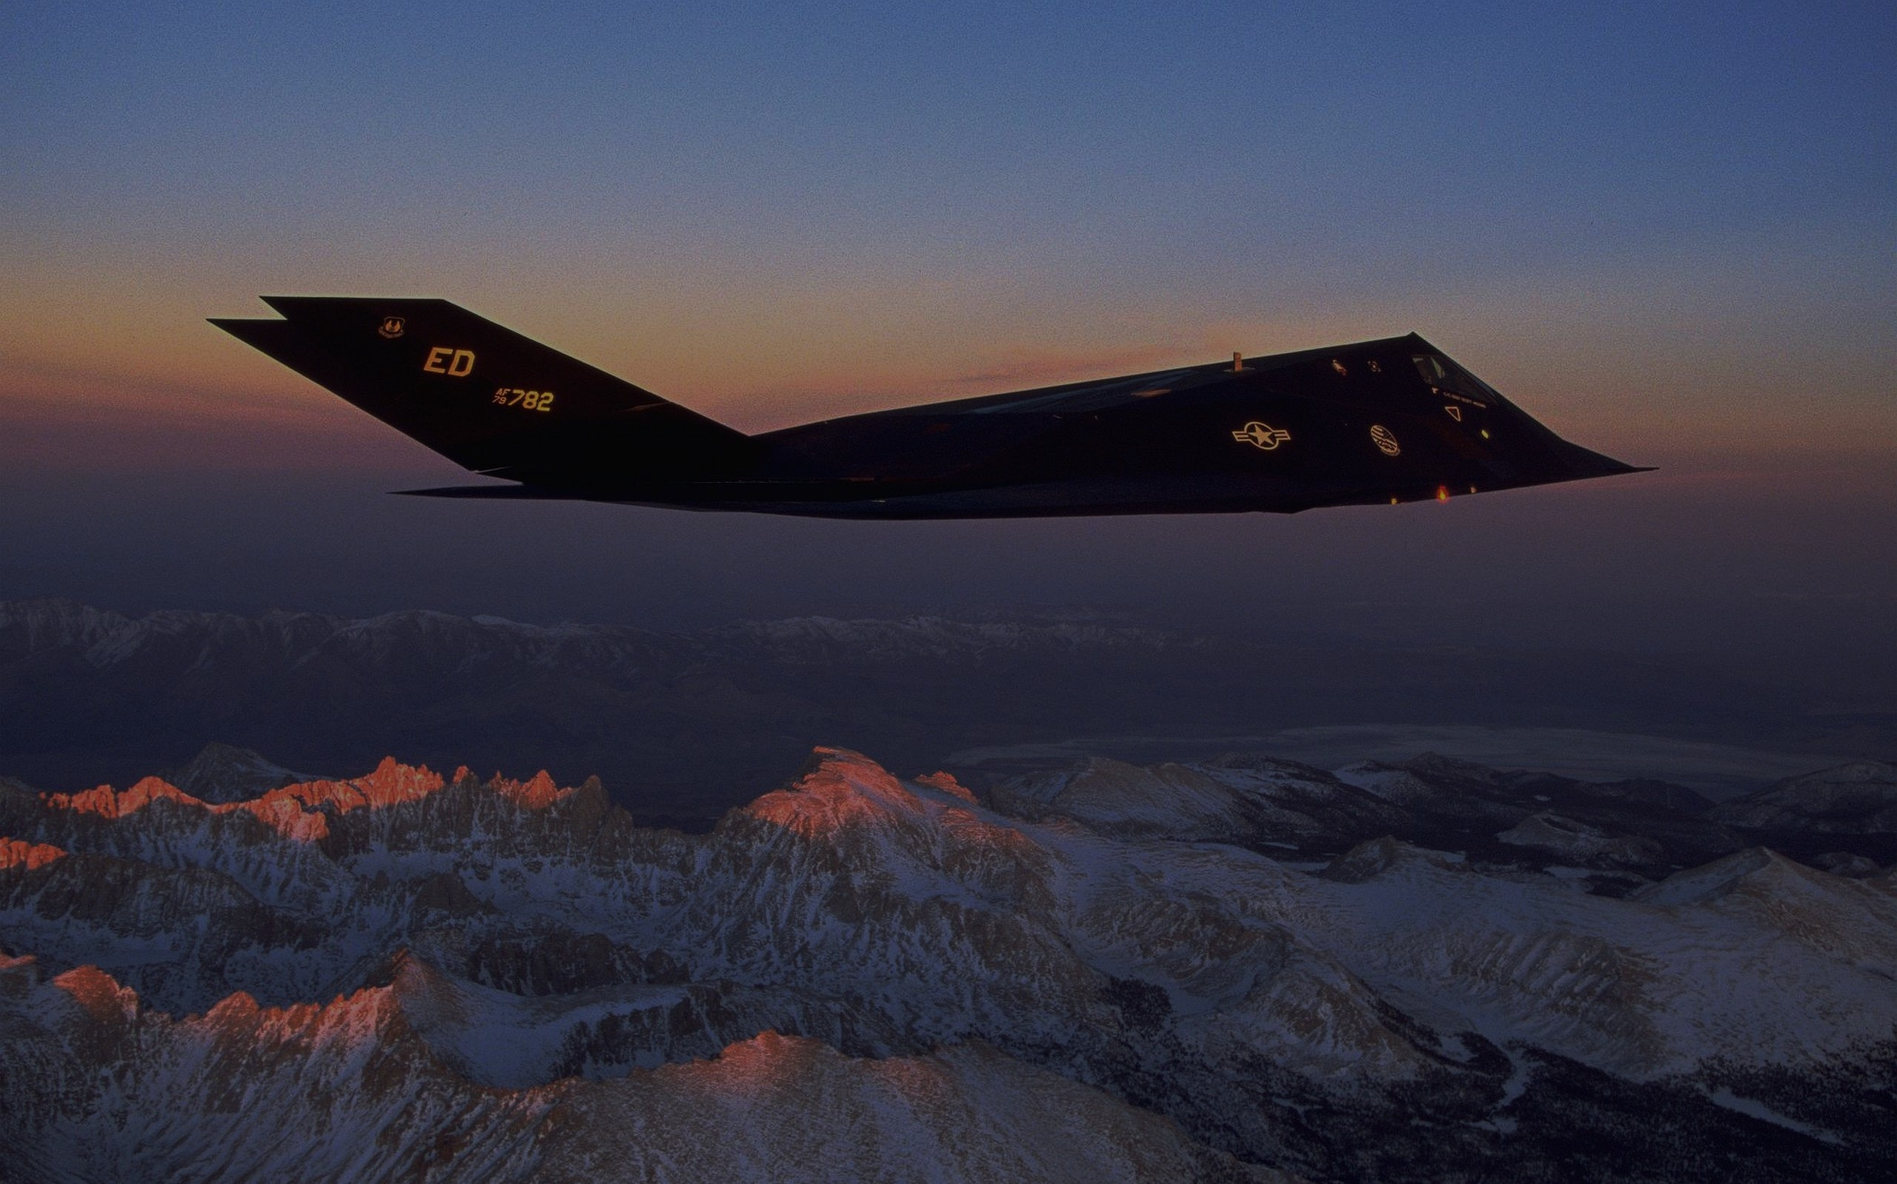
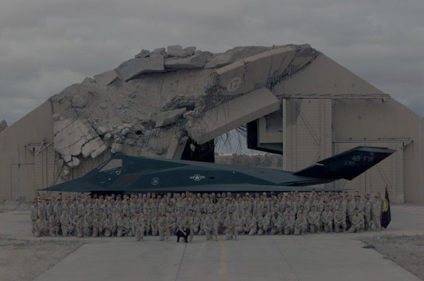
MARVELS OF
THE
ENGINEERING
Antonov An-225
Taipei 101
Bugatti Chiron Super
Sport 300+
F-117 Nighthawk
ASML EUV Lithography
6 massive turbofan engines.
Landing gear:
32 wheels.
Antonov max take-off weight: 640 tons.
Wingspan: 88 meters — wider than a football field.
Radar cross-section ≈ 0.001 m²
Subsonic speed (~993 km/h, Mach 0.92)
Designed for precision ground-attack missions
Used in Panama, Gulf War, and Kosovo
1600 horsepower (quad-turbo W16)
490 km/h recorded run (304.77 mph)
0–400 km/h in ~32 seconds
440 km/h electronically limited for customers
Shrinking transistors below the size of a virus couldn’t be done with older techniques. So engineers invented a light source that’s way smaller than the atoms it images.
Without it, modern computing simply can’t advance.
Height: 508 meters.
That’s taller than 3 Qutub Minars stacked.
The damper ball weighs as much as 130 African elephants.

Slide 5
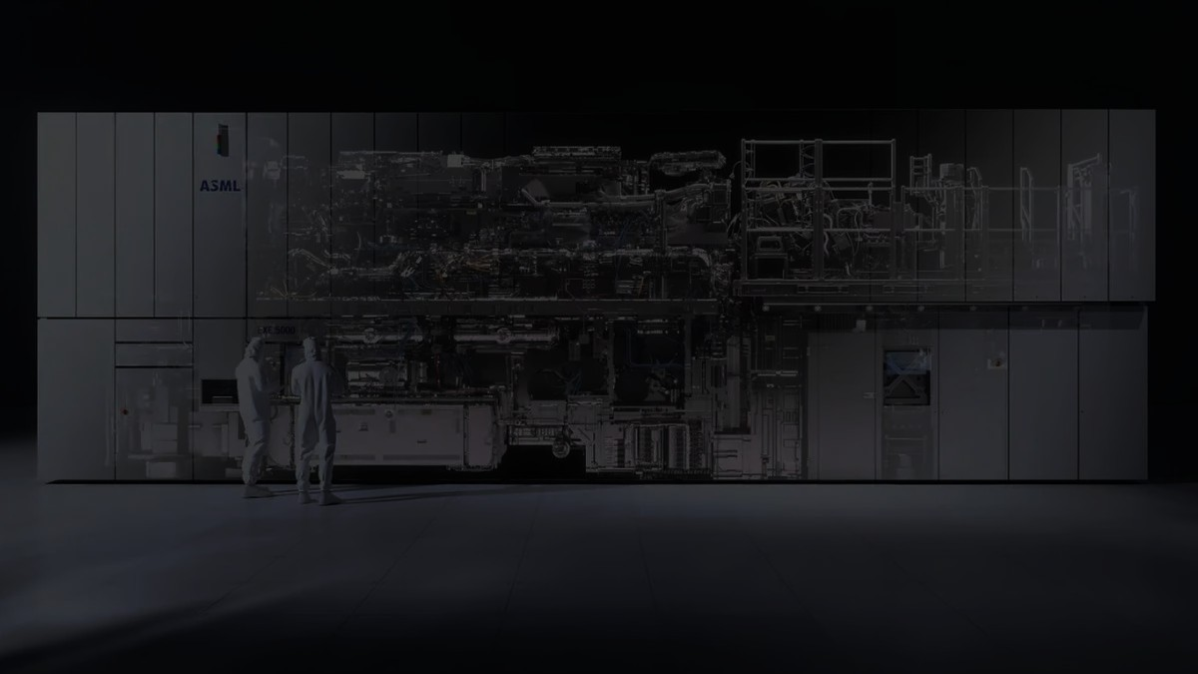
MARVELS OF
THE
ENGINEERING
Large Hadron Collider
ASML EUV Lithography
Antonov An-225
Taipei 101
Bugatti Chiron Super
Sport 300+
F-117 Nighthawk
Uses extreme ultraviolet light (13.5 nm wavelength)
Enables fabrication of advanced chips (5 nm, 3 nm nodes)
Developed by ASML for high-precision chip patterning
Critical for modern processors, AI, and smartphones
6 massive turbofan engines.
Landing gear:
32 wheels.
Antonov max take-off weight: 640 tons.
Wingspan: 88 meters — wider than a football field.
1600 horsepower (quad-turbo W16)
490 km/h recorded run (304.77 mph)
0–400 km/h in ~32 seconds
440 km/h electronically limited for customers
Height: 508 meters.
That’s taller than 3 Qutub Minars stacked.
The damper ball weighs as much as 130 African elephants.
Built by over 10,000 scientists from 100+ countries. One of the most expensive scientific instruments ever created (~$9 billion construction).
Temperature inside magnets: –271°C (colder than outer space).
Produces conditions similar to the first trillionth of a second after the Big Bang.
Discovered the Higgs Boson in 2012.
THANK YOU

