Slide 1

LUCENT.AI
REBUILDING TRUST IN A SYNTHETIC WORLD

Slide 2

PROBLEM STATEMENT
THE ZERO-DAY DEEPFAKE CRISIS
THE DEATH OF DIGITAL TRUTH
The Fakes are Too Perfect: Modern AI (like Sora or Midjourney) no longer makes obvious visual mistakes. Because the fakes look flawless, standard detection software is completely blind to them.
The $40 Billion Fraud Crisis: Scammers are using deepfakes to impersonate executives and trick banks, turning a social media nuisance into a massive corporate financial threat.
The "Liar's Free Pass": Because fakes are so realistic, criminals or corrupt figures caught on actual video can now simply lie and claim, "That isn't me, it's an AI deepfake."

Slide 3
THE SOLUTION
LUCENT:
A multi-layered AI forensic platform that cross-references visual, physical, and temporal signals to expose deepfakes. It goes beyond simple "Real/Fake" labels by generating a 5-point forensic audit that stands up in legal and professional investigations.
THE PRODUCTS
The Enterprise Dashboard: A high-fidelity web platform for banks and newsrooms to run deep forensic audits, generating court-admissible PDF reports.
The Browser Guard: A lightweight, real-time extension that acts as a live shield over Zoom, Teams, and social media, instantly flagging synthetic media.
THE MAGIC
The Fusion Engine: Older tools look for visual mistakes; we look for mathematical truth. LUCENT uses an ensemble of Dockerized AI microservices to analyze a file from multiple isolated angles simultaneously. By cross-referencing hidden physical geometry, human biological signals (rPPG), and the file's generative DNA (DIRE), we eliminate the single point of failure. It doesn't just output a "Real or Fake" label—it generates an irrefutable cryptographic audit.

Slide 4
1.THE FIRST PASS (PRE-TRAINED VISUAL MODELS)
2.DIRE (REVERSE-ENGINEERING)
THE ANATOMY OF TRUTH (THE 5-PILLAR MATRIX)
What it is: A lightweight, off-the-shelf AI model (like a small Vision Transformer).
The Purpose: Instantly scans for obvious visual mistakes (blurry edges, weird lighting).
Why It acts as a bouncer. It catches 80% of cheap, low-effort fakes instantly, saving our massive GPU power for the dangerous stuff.
What it is: We turn the AI against itself.
The Purpose: We destroy the image with static noise, then ask an AI to rebuild it.
Why it works: An AI perfectly rebuilds its own generated art. Real-world photos get messed up in the reconstruction.
THE FINAL VERDICT (THE META-JUDGE)
What it is: A lightweight AI trained specifically to be the "Judge" in the courtroom.
The Purpose: It doesn't analyze the image; it analyzes the 5 scores from the experts above.
How it decides (The Secret): It doesn't just average the numbers. It assigns weighted trust.
If the visual scan is unsure (50%), but the DIRE math says it's 99% fake, the Judge is trained to know that math doesn't lie. It overrules the visual scan and instantly flags the fraud.
3.FFT (FREQUENCY/FOURIER)
4.PROVENANCE (THE DIGITAL DNA)
What it is: We convert the image into a mathematical frequency map.
The Purpose: To find the invisible rendering grid.
Why it works: High-end AI models (like Midjourney) leave behind microscopic "checkerboard" patterns that human eyes can't see, but math can.
What it is: A deep scan of the file's hex code and sensor noise.
The Purpose: Hunting for hidden watermarks (C2PA) or missing camera lens scratches.
Why it works: If Adobe or OpenAI secretly stamped it, or if it lacks the chaotic noise of a physical camera lens, we flag it instantly.

Slide 5

THE INFRASTRUCTURE
SCALABLE FORENSIC INFRASTRUCTURE
The AI & Vision Core
The Data Foundation
TECH: PYTORCH + OPENCV + HUGGINGFACE DIFFUSERS.
The Build: High-throughput tensor math (PyTorch) fused with pixel-perfect frame extraction (OpenCV).
The Flex: We don't rely on basic APIs. We run custom Vision Transformers and reverse-diffusion pipelines locally on dedicated GPU clusters.
DATASETS: FACEFORENSICS++, GENIMAGE, & WILDDEEPFAKE.
The Build: We don't just train on sterile lab data. We inject heavily compressed, real-world social media fakes.
The Flex: By training on adversarial datasets, our Meta-Judge learns to detect the boundary where manipulation starts, not just memorize a specific AI generator's style.
Orchestration & Speed
The Deployment Pipeline
TECH: FASTAPI + REDIS TASK QUEUES.
The Build: LUCENT is entirely asynchronous.
The Flex: When a video is uploaded, Redis chunks the frames and FastAPI routes them to all 5 forensic branches simultaneously. We deliver sub-second analysis without freezing the browser.
TECH: WSL (UBUNTU) $\RIGHTARROW$ DOCKER MICROSERVICES.
The Build: Rapid local prototyping via WSL seamlessly ports to isolated Docker containers.
The Flex: Zero "dependency hell." Because every model is containerized, we can deploy LUCENT entirely "air-gapped" behind a bank's private firewall.

Slide 6
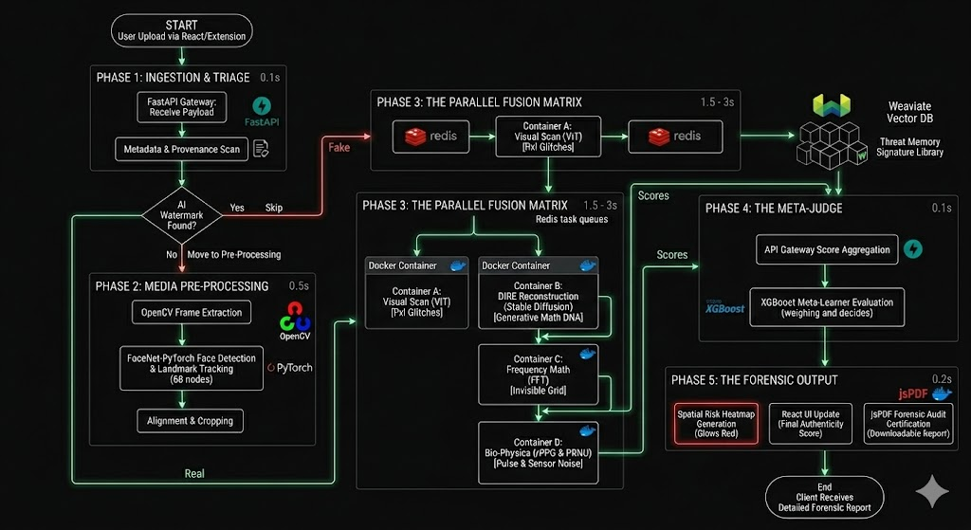
WORKING & FUNCTIONALITY

Slide 7
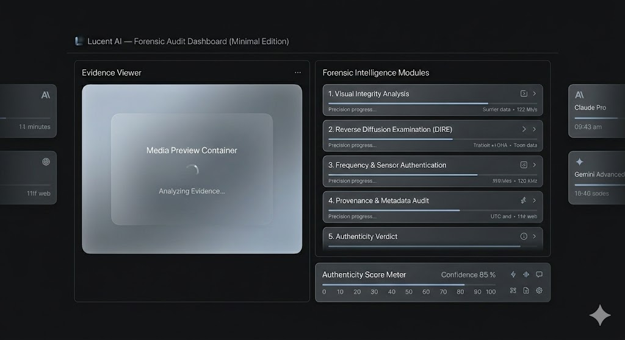

DEMO& SNEAK PEAK

Slide 8
Banking & Finance: Securing KYC (Know Your Customer) pipelines against identity fraud.
Enterprise: Neutralizing live "CEO Fraud" on Zoom/Teams.
Legal/OSINT: Delivering court-admissible digital evidence.
API Gateway (Volume): Micro-transaction fees per automated video scan.
Enterprise Shield (Seats): Annual licenses for our browser extension.
On-Premise (High-Ticket): Premium, air-gapped deployments behind a client's private firewall.
Mandated Markets: Upcoming AI regulations (like India IT Rules 2026) make deepfake auditing a legal requirement. We aren't just security; we are mandatory compliance.
TARGET SECTORS
REVENUE STREAMS
COMPLIANCE GOALS
MARKET FOCUS & FUTURE TRAJECTORY
“DESIGNED FOR ORGANIZERS, BUILT FOR SAFETY”

