Slide 1
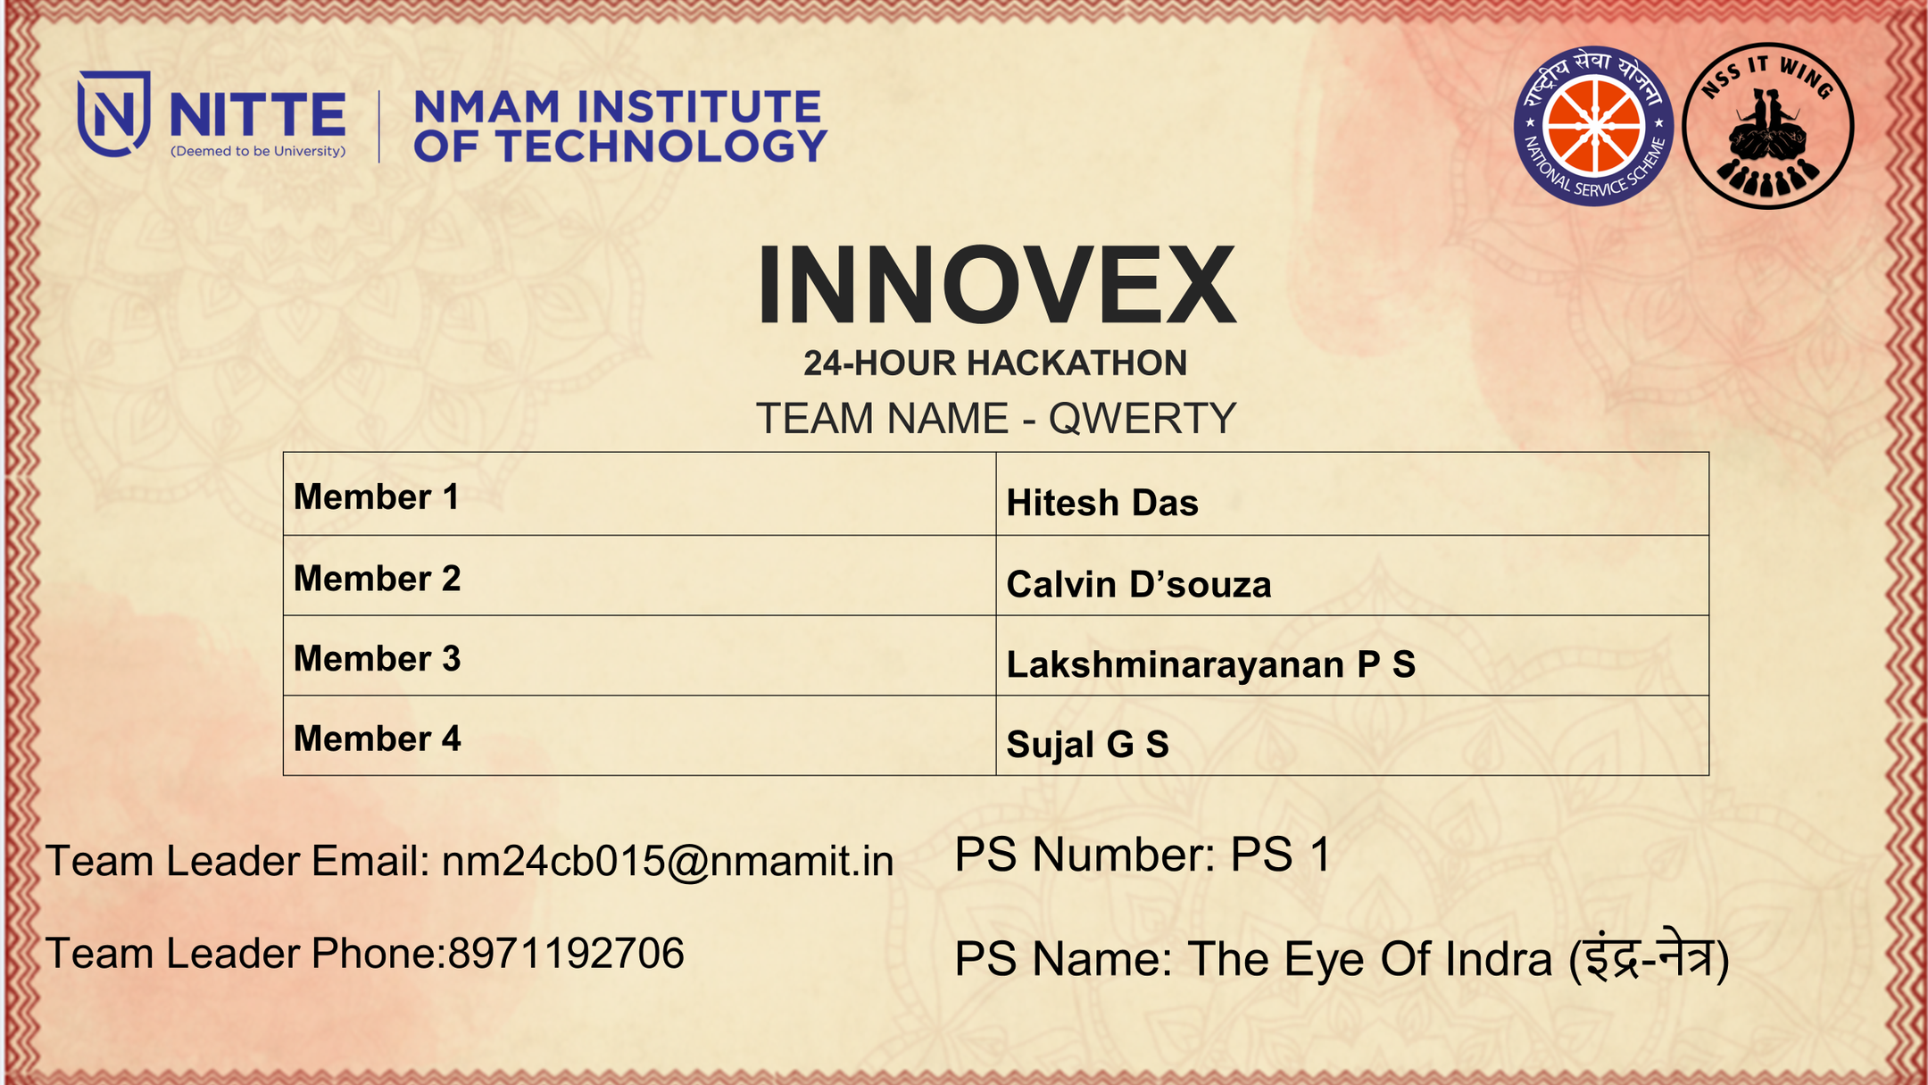

Slide 2



PROBLEM STATEMENT
PS 1
01
02
PREVENT STAMPEDES & SMART CROWD SAFETY
THE OBJECTIVE:
The central issue is the significant danger posed by large, dense crowds. When a crowd becomes too large or panic sets in, it can lead to surges, crushing, and stampedes, often resulting in serious injuries and fatalities.
Monitor: Keep track of crowd density, flow, and sentiment in real-time.
Detect: Identify early warning signs of potential danger, such as panic, bottlenecks, or surges.
Manage: Provide tools for security or event staff to respond quickly and effectively to prevent an incident or manage one as it unfolds.

Slide 3
PROPOSED SOLUTION
PS 1
MASSED.EX:
is an AI-powered SaaS platform that automates event planning and crowd management.
It analyzes venue layouts, crowd size, and volunteer data to instantly generate optimized maps, schedules, and safety plans — all in one click.
AI LAYOUT CO-PLANNER
REAL-TIME CROWD INTELLIGENCE
PRIMARY FEATURE)
ATTENDEE DASHBOARD (PUBLIC PORTAL)
Upload blueprint → AI generates optimized event layout
Auto-places gates, stalls, VIP zones, washrooms
Computes crowd flow paths & evacuation routes
Fully editable with Konva.js canvas
Auto-generated PDF safety report
YOLO-based people detection
Heatmap density calculation
Danger-zone alerts & real-time warnings
Entry/exit counting
Volunteer navigation & waypoint commands
Event map + facilities
Food, activities, performer lineup
Nearest exits, parking, transport
QR-scannable event info page

Slide 4

CRAFTING YOUR BRAND MESSAGE
PS 1
TECHNICAL APPROACH
Frontend
Backend
Exports && Integrations
REACT / NEXT.JS — FAST, INTERACTIVE DASHBOARD
KONVA.JS – EDITABLE BLUEPRINT CANVAS
MAPBOX / GOOGLE MAPS – GEO-CONTEXT & PARKING
FASTAPI — HIGH-SPEED API BACKBONE
OPENCV + PYTORCH — BLUEPRINT ANALYSIS & DENSITY MODELS
PYTHON (FASTAPI)
YOLOV8 + BYTETRACK — PEOPLE DETECTION
OPENCV — HEATMAPS
GPT API — AI LAYOUT JSON GENERATION
SUPABASE — EVENT INFO + PUBLIC DASHBOARD
S3 Bucket — blueprint storage
HTML2CANVAS + JSPDF → PDF GENERATION

Slide 5
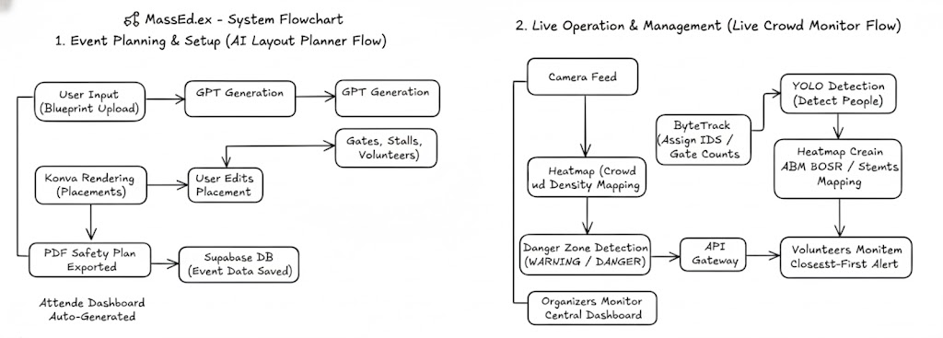
WORKING
& FUNCTIONALITY
PS 1

Slide 6
TARGET AUDIENCE:
MONETIZATION STRATEGY
SAAS MODEL:
LONG-TERM POTENTIAL:
FUTURE GOALS:
Event organizers & college fest committees
Expo centers & large venues
Police, disaster-response units
Municipal event authorities
Free Tier: AI layout planner + PDF export
Pro Tier: Live heatmaps + CV tracking + alerts
Pay-Per-Event: One-time planning tool for festivals
City-wide crowd analytics for mass gatherings
Integrations with CCTV, IoT sensors & drones
Predictive safety intelligence for future events
Live Volunteer tracking + automated alerts
Real-time gate load balancing
Volunteer navigation app
Smart city event command center
MARKET FOCUS & FUTURE TRAJECTORY
“DESIGNED FOR ORGANIZERS, BUILT FOR SAFETY”
PS 1

Slide 7
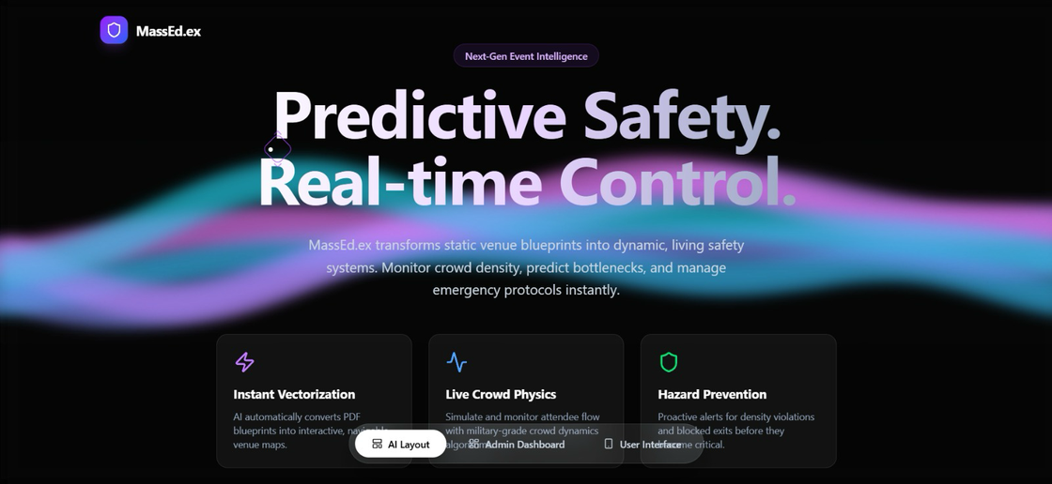
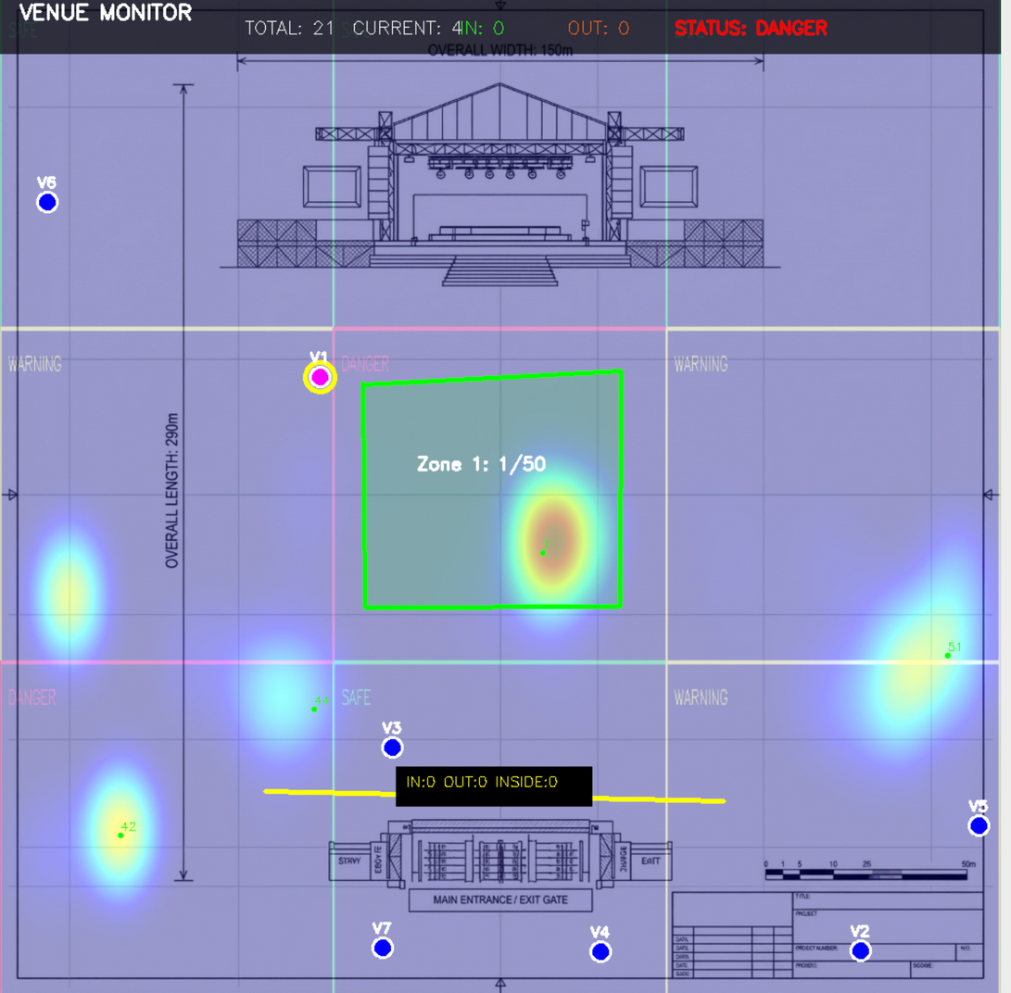
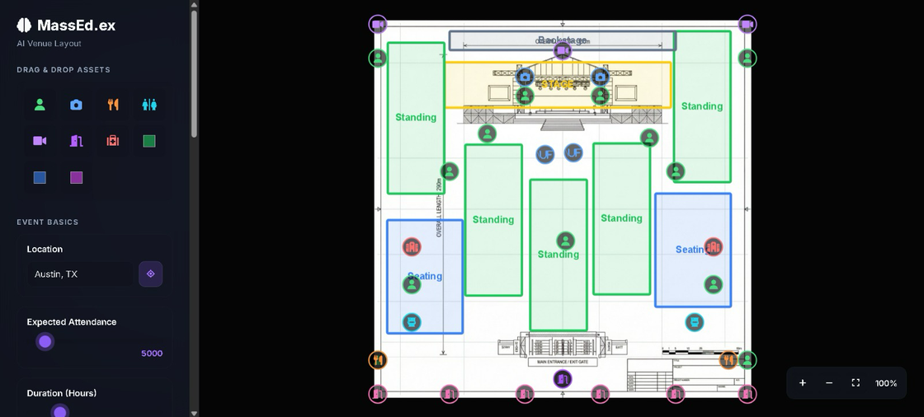
DEMO& SNEAK PEAK
PS 1
LANIDNG PAGE
AI LAYOUT BUILDER
LIVE HEATMAP

