Slide 1
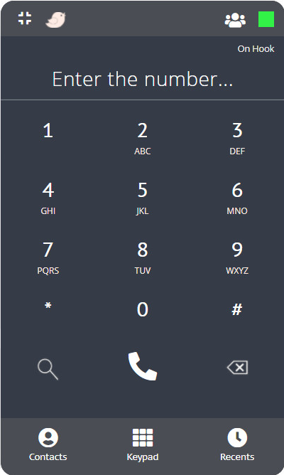

Omnichannel
Custom 3CX Dialer
Powered by mConnectapps

Slide 2
Why Omnichannel Custom 3CX Dialer ?
Omnichannel 3CX Dialer is an open platform technology that helps to provide realtime communication for the web on top of an open standard. It will be available in all the browsers and can support video, voice and data.
We are not talking about a replacement to MR.VoIP here. But integrating SIP with Mr.VoIP means a better communication without interruption. Making calls, sending and receiving messages within the browsers and application platforms have been made simple and cost-effective.
The open source platform provides the power of browsex`r to browser communication without using any other special plugins. It offers high scalability with in-built security features that help in improved overall performance of communication even when there is an increase in communication.
The SIP protocol is a very pocket friendly solution. There is no upfront investment needed and there is no requirement of additional hardware or software.

Slide 3
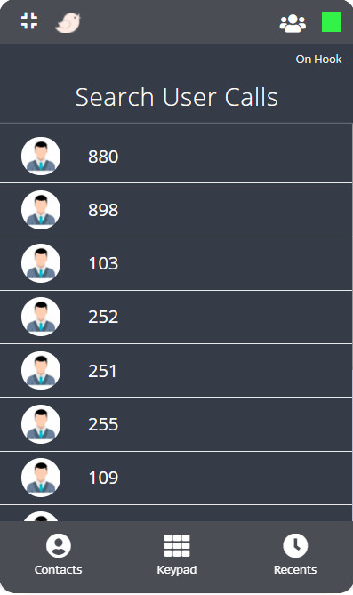
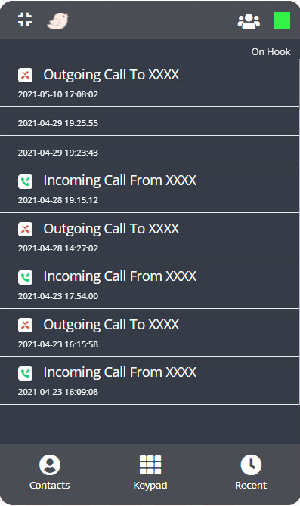
Contact Management
Recent Calls

Slide 4
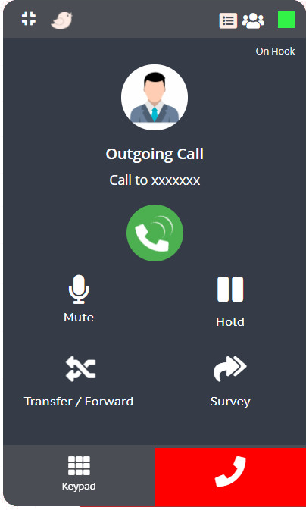

Outgoing Call
Incoming Call

Slide 5
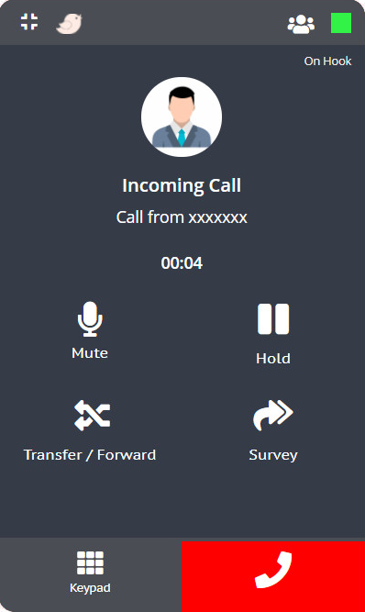
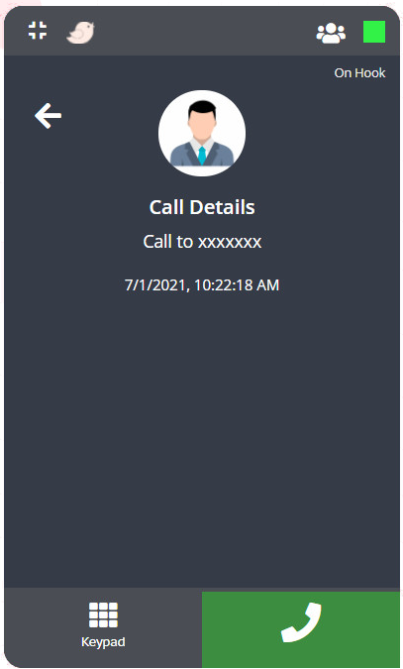
Ongoing Call
End Call Details

Slide 6
Special Call Features
Queue Login / Logout
Extension Status
Mute / Unmute
Call Hold
Call Transfer /
Call Forward
Transfer to
Survey Report

Slide 7
Thanks!
Any questions?
support@mconnectapps.com

