Slide 1
NLP 220 Data Science and Machine Learning Fundamentals Lecture 11
Jalal Mahmud
jumahmud@ucsc.edu

Slide 2
Regular Expressions

Slide 3
Regular Expressions
In computing, a regular expression, also referred to as "regex" or "regexp", provides a concise and flexible means for matching strings of text, such as particular characters, words, or patterns of characters.
A regular expression is written in a formal language that can be interpreted by a regular expression processor.
http://en.wikipedia.org/wiki/Regular_expression

Slide 4
Understanding Regular Expressions
Really clever "wild card" expressions for matching and parsing strings.
Very powerful and quite cryptic
Fun once you understand them
Regular expressions are a language unto themselves
A language of "marker characters" - programming with characters
It is kind of an "old school" language - compact

Slide 5
Regular Expressions
Use regular expressions to:
Search a string (search and match)
Replace parts of a string (sub)
Break strings into smaller pieces (split)

Slide 6
Regular Expression Quick Guide
^ Matches the beginning of a line
$ Matches the end of the line
. Matches any character
\s Matches whitespace
\S Matches any non-whitespace character
* Repeats a character zero or more times
*? Repeats a character zero or more times (non-greedy)

Slide 7
Regular Expression Quick Guide
+ Repeats a character one or more times
+? Repeats a character one or more times (non-greedy)
[aeiou] Matches a single character in the listed set
[^XYZ] Matches a single character not in the listed set
[a-z0-9] The set of characters can include a range
( Indicates where string extraction is to start
) Indicates where string extraction is to end

Slide 8
Regular Expression Syntax
Most characters match themselves
The regular expression “test” matches the string ‘test’, and only that string
[x] matches any one of a list of characters
“[abc]” matches ‘a’,‘b’,or ‘c’
[^x] matches any one character that is not included in x
“[^abc]” matches any single character except ‘a’,’b’,or ‘c’

Slide 9
Regular Expression Syntax
“.” matches any single character
Parentheses can be used for grouping
“(abc)+” matches ’abc’, ‘abcabc’, ‘abcabcabc’, etc.
x|y matches x or y
“this|that” matches ‘this’ and ‘that’, but not ‘thisthat’.

Slide 10
Regular Expression Syntax
x* matches zero or more x’s
“a*” matches ’’, ’a’, ’aa’, etc.
x+ matches one or more x’s
“a+” matches ’a’,’aa’,’aaa’, etc.
x? matches zero or one x’s
“a?” matches ’’ or ’a’
x{m, n} matches i x‘s, where m<i< n
“a{2,3}” matches ’aa’ or ’aaa’

Slide 11
Regular Expression Syntax
“\d” matches any digit; “\D” any non-digit
“\s” matches any whitespace character; “\S” any non-whitespace character
“\w” matches any alphanumeric character; “\W” any non-alphanumeric character
“^” matches the beginning of the string; “$” the end of the string
“\b” matches a word boundary; “\B” matches a character that is not a word boundary

Slide 12
The Regular Expression Module in Python
Before you can use regular expressions in your program, you must import the library using "import re”
You can use re.search() to see if a string matches a regular expression similar to using the find() method for strings
You can use re.findall() extract portions of a string that match your regular expression

Slide 13
Using re.search() like find()
import re
hand = open('mbox-short.txt')
for line in hand:
line = line.rstrip()
if re.search('From:', line) :
print line
hand = open('mbox-short.txt')
for line in hand:
line = line.rstrip()
if line.find('From:') >= 0:
print line
http://www.py4inf.com/

Slide 14
Using re.search() like startswith()
import re
hand = open('mbox-short.txt')
for line in hand:
line = line.rstrip()
if re.search('^From:', line) :
print line
hand = open('mbox-short.txt')
for line in hand:
line = line.rstrip()
if line.startswith('From:') :
print line
We fine-tune what is matched by adding special characters to the string
http://www.py4inf.com/

Slide 15
Wild-Card Characters
The dot character matches any character
If you add the asterisk character, the character is "any number of times"
Match the start of the line
Many times
^X.*:
Match any character

Slide 16
Exercise
Find all the numbers from -
My favorite numbers are 19 and 42 and 67
I want to drive 60 miles per hour

Slide 17
Matching and Extracting Data
The re.search() returns a True/False depending on whether the string matches the regular expression
If we actually want the matching strings to be extracted, we use re.findall()
>>> import re
>>> x = 'My 2 favorite numbers are 19 and 42'
>>> y = re.findall('[0-9]+',x)
>>> print(y)
['2', '19', '42']

Slide 18
Matching and Extracting Data
When we use re.findall() it returns a list of zero or more sub-strings that match the regular expression
>>> import re
>>> x = 'My 2 favorite numbers are 19 and 42’
>>> y = re.findall('[0-9]+’,x)
>>> print(y)
['2', '19', '42’]
>>> y = re.findall('[AEIOU]+',x)
>>> print(y)
[]

Slide 19
Warning: Greedy Matching
The repeat characters (* and +) push outward in both directions (greedy) to match the largest possible string
One or more characters
>>> import re
>>> x = 'From: Using the : character'
>>> y = re.findall('^F.+:', x)
>>> print(y)
['From: Using the :']
^F.+:
First character in the match is an F
Last character in the match is a :
Why not 'From:'?

Slide 20
Non-Greedy Matching
Not all regular expression repeat codes are greedy! If you add a ? character
One or more characters but not greedily
>>> import re
>>> x = 'From: Using the : character'
>>> y = re.findall('^F.+?:', x)
>>> print(y)
['From:']
^F.+?:
First character in the match is an F
Last character in the match is a :

Slide 21
Fine Tuning String Extraction
You can refine the match for re.findall() and separately determine which portion of the match that is to be extracted using parenthesis
From stephen.marquard@uct.ac.za Sat Jan 5 09:14:16 2008
\S+@\S+
>>> y = re.findall('\S+@\S+',x)
>>> print(y)
['stephen.marquard@uct.ac.za’]
At least one non-whitespace character

Slide 22
Fine Tuning String Extraction
Parenthesis are not part of the match - but they tell where to start and stop what string to extract
From stephen.marquard@uct.ac.za Sat Jan 5 09:14:16 2008
>>> y = re.findall('\S+@\S+',x)
>>> print(y)
['stephen.marquard@uct.ac.za']
>>> y = re.findall('^From (\S+@\S+)',x)
>>> print(y)
['stephen.marquard@uct.ac.za']
^From (\S+@\S+)

Slide 23
Fine Tuning String Extraction
21
31
From stephen.marquard@uct.ac.za Sat Jan 5 09:14:16 2008
>>> data = 'From stephen.marquard@uct.ac.za Sat Jan 5 09:14:16 2008'
>>> atpos = data.find('@')
>>> print atpos
21
>>> sppos = data.find(' ',atpos)
>>> print sppos
31
>>> host = data[atpos+1 : sppos]
>>> print host
uct.ac.za
Extracting a host name - using find and string slicing.

Slide 24
The Double Split Version
Sometimes we split a line one way and then grab one of the pieces of the line and split that piece again
From stephen.marquard@uct.ac.za Sat Jan 5 09:14:16 2008
words = line.split()
email = words[1]
pieces = email.split('@')
print pieces[1]
stephen.marquard@uct.ac.za
['stephen.marquard', 'uct.ac.za']
'uct.ac.za'

Slide 25
The Regex Version
From stephen.marquard@uct.ac.za Sat Jan 5 09:14:16 2008
import re
lin = 'From stephen.marquard@uct.ac.za Sat Jan 5 09:14:16 2008'
y = re.findall('@([^ ]*)',lin)
print(y)
['uct.ac.za']
'@([^ ]*)'
Look through the string until you find an at-sign

Slide 26
The Regex Version
From stephen.marquard@uct.ac.za Sat Jan 5 09:14:16 2008
import re
lin = 'From stephen.marquard@uct.ac.za Sat Jan 5 09:14:16 2008'
y = re.findall('@([^ ]*)',lin)
print y
['uct.ac.za']
'@([^ ]*)'
Match non-blank character
Match many of them

Slide 27
The Regex Version
From stephen.marquard@uct.ac.za Sat Jan 5 09:14:16 2008
import re
lin = 'From stephen.marquard@uct.ac.za Sat Jan 5 09:14:16 2008'
y = re.findall('@([^ ]*)',lin)
print y
['uct.ac.za']
'@([^ ]*)'
Extract the non-blank characters

Slide 28
Even Cooler Regex Version
From stephen.marquard@uct.ac.za Sat Jan 5 09:14:16 2008
import re
lin = 'From stephen.marquard@uct.ac.za Sat Jan 5 09:14:16 2008'
y = re.findall('^From .*@([^ ]*)',lin)
print y
['uct.ac.za']
'^From .*@([^ ]*)'
Starting at the beginning of the line, look for the string 'From '

Slide 29
Even Cooler Regex Version
From stephen.marquard@uct.ac.za Sat Jan 5 09:14:16 2008
import re
lin = 'From stephen.marquard@uct.ac.za Sat Jan 5 09:14:16 2008'
y = re.findall('^From .*@([^ ]*)',lin)
print y['uct.ac.za']
'^From .*@([^ ]*)'
Skip a bunch of characters, looking for an at-sign

Slide 30
Even Cooler Regex Version
From stephen.marquard@uct.ac.za Sat Jan 5 09:14:16 2008
import re
lin = 'From stephen.marquard@uct.ac.za Sat Jan 5 09:14:16 2008'
y = re.findall('^From .*@([^ ]*)',lin)
print y['uct.ac.za']
'^From .*@([^ ]*)'
Start 'extracting'

Slide 31
Even Cooler Regex Version
From stephen.marquard@uct.ac.za Sat Jan 5 09:14:16 2008
import re
lin = 'From stephen.marquard@uct.ac.za Sat Jan 5 09:14:16 2008'
y = re.findall('^From .*@([^ ]*)',lin)
print y['uct.ac.za']
'^From .*@([^ ]*)'
Match non-blank character
Match many of them

Slide 32
Even Cooler Regex Version
From stephen.marquard@uct.ac.za Sat Jan 5 09:14:16 2008
import re
lin = 'From stephen.marquard@uct.ac.za Sat Jan 5 09:14:16 2008'
y = re.findall('^From .*@([^ ]*)',lin)
print y['uct.ac.za']
'^From .*@([^ ]*)'
Stop 'extracting'

Slide 33
Exercise
Find all the email address from -
Hello from shubhamg199630@gmail.com to priya@yahoo.com about the meeting @2PM

Slide 34
Regular Expression Quick Guide
^ Matches the beginning of a line
$ Matches the end of the line
. Matches any character
\s Matches whitespace
\S Matches any non-whitespace character
* Repeats a character zero or more times
*? Repeats a character zero or more times (non-greedy)
+ Repeats a chracter one or more times
+? Repeats a character one or more times (non-greedy)
[aeiou] Matches a single character in the listed set
[^XYZ] Matches a single character not in the listed set
[a-z0-9] The set of characters can include a range
( Indicates where string extraction is to start
) Indicates where string extraction is to end

Slide 35
Escape Character
If you want a special regular expression character to just behave normally (most of the time) you prefix it with '\'
>>> import re
>>> x = 'We just received $10.00 for cookies.'
>>> y = re.findall('\$[0-9.]+',x)
>>> print y
['$10.00']
At least one or more
\$[0-9.]+
A real dollar sign
A digit or period

Slide 36
Search and Match
The two basic functions are re.search and re.match
Search looks for a pattern anywhere in a string
Match looks for a match staring at the beginning
Both return None (logical false) if the pattern isn’t found and a “match object” instance if it is
>>> import re
>>> pat = "a*b”
>>> re.search(pat,"fooaaabcde")
<_sre.SRE_Match object at 0x809c0>
>>> re.match(pat,"fooaaabcde")
>>>

Slide 37
Match Object
A: an instance of the match class with the details of the match result
>>> r1 = re.search("a*b","fooaaabcde")
>>> r1.group() # group returns string matched
'aaab'
>>> r1.start() # index of the match start
3
>>> r1.end() # index of the match end
7
>>> r1.span() # tuple of (start, end)
(3, 7)

Slide 38
What got Matched
Here’s a pattern to match simple email addresses
\w+@(\w+\.)+(com|org|net|edu)
>>> pat1 = "\w+@(\w+\.)+(com|org|net|edu)"
>>> r1 = re.match(pat,"finin@cs.umbc.edu")
>>> r1.group()
'finin@cs.umbc.edu’
We might want to extract the pattern parts, like the email name and host

Slide 39
What got Matched
We can put parentheses around groups we want to be able to reference
>>> pat2 = "(\w+)@((\w+\.)+(com|org|net|edu))"
>>> r2 = re.match(pat2,"finin@cs.umbc.edu")
>>> r2.group(1)
'finin'
>>> r2.group(2)
'cs.umbc.edu'
>>> r2.groups()
r2.groups()
('finin', 'cs.umbc.edu', 'umbc.', 'edu’)
Note that the ‘groups’ are numbered in a preorder traversal of the forest

Slide 40
What got Matched
We can ‘label’ the groups as well…
>>> pat3 ="(?P<name>\w+)@(?P<host>(\w+\.)+(com|org|net|edu))"
>>> r3 = re.match(pat3,"finin@cs.umbc.edu")
>>> r3.group('name')
'finin'
>>> r3.group('host')
'cs.umbc.edu’
And reference the matching parts by the labels

Slide 41
More re functions
re.split() is like split but can use patterns
>>> re.split("\W+", “This... is a test,
short and sweet, of split().”)
['This', 'is', 'a', 'test', 'short’,
'and', 'sweet', 'of', 'split’, ‘’]
re.sub substitutes one string for a pattern
>>> re.sub('(blue|white|red)', 'black', 'blue socks and red shoes')
'black socks and black shoes’
re.findall() finds all matches
>>> re.findall("\d+”,"12 dogs,11 cats, 1 egg")
['12', '11', ’1’]

Slide 42
Exercise
Find phone number from -
Call Mr. Jeff at 449-647-1200

Slide 43
Data Cleanup

Slide 44
Why Data Cleanup?
Cleaning up your data is not the most glamourous of tasks, but it’s an essential part of data wrangling.
Python is well designed for data cleanup; it helps you to eliminate repetitive work.
Some data may come to you properly formatted and ready to use. If this is the case, consider yourself lucky!
Most data, even if it is cleaned, has some formatting inconsistencies or readability issues

Slide 45
Why Data Cleanup?
Data scientists spend a large amount of their time cleaning datasets and getting them down to a form with which they can work.
In fact, a lot of data scientists argue that the initial steps of obtaining and cleaning data constitute 80% of the job.
It is important to be able to deal with messy data, whether that means missing values, inconsistent formatting, malformed records, or nonsensical outliers.

Slide 46
How does data gets dirty?
Missing data.
Inconsistent data.
Duplicate data.
To name a few things that can go wrong. There is an endless list of ways that data can end up very messy.
Sometimes there are insufficient validation checks when the data is entered in the first place.

Slide 47
Data Cleaning Advantage
Cleaning your data makes for easier storage, search, and reuse.
It’s much easier to store your data in proper models if it’s cleaned first.
Imagine if you had columns or fields in your dataset which should be saved as a particular datatype (such as dates or numbers or email addresses).
If you can standardize what you expect to see and clean or remove records that don’t fit, then you ensure your data’s consistency and eliminate hard work later when you need to query assets in your dataset.

Slide 48
Text Cleaning is Task Specific

Slide 49
Text Cleaning Is Task Specific
The first step in cleaning up text data is to have a strong idea about what you’re trying to achieve, and in that context review your text to see what exactly might help.
Split by Whitespace
file = open(filename, 'rt')
text = file.read()
file.close()
# split into words by white space
words = text.split()

Slide 50
Text Cleaning Is Task Specific
Select Words
Another approach might be to use the regex model (re) and split the document into words by selecting for strings of alphanumeric characters (a-z, A-Z, 0-9 and ‘_’).
file = open(filename, 'rt')
text = file.read()
file.close()
# split based on words only
import re
words = re.split(r'\W+', text)
print(words)

Slide 51
Text Cleaning Is Task Specific
Split by Whitespace and Remove Punctuation
Python offers a function called translate() that will map one set of characters to another.
We can use the function maketrans() to create a mapping table.
We can create an empty mapping table, but the third argument of this function allows us to list all of the characters to remove during the translation process.
table = str.maketrans('', '', string.punctuation)

Slide 52
Text Cleaning Is Task Specific
Split by Whitespace and Remove Punctuation
Python string method maketrans() returns a translation table that maps each character in the intabstring into the character at the same position in the outtab string.
Then this table is passed to the translate() function.
str.maketrans(intab, outtab)

Slide 53
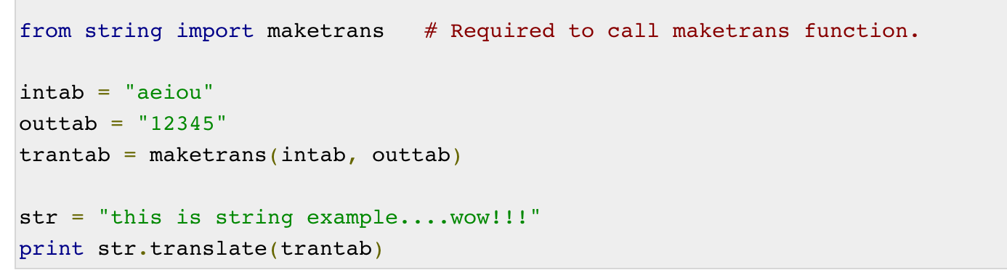
Text Cleaning Is Task Specific
str.maketrans(intab, outtab)
https://www.tutorialspoint.com/python/string_maketrans.htm

Slide 54
Text Cleaning Is Task Specific
Split by Whitespace and Remove Punctuation
We may want the words, but without the punctuation like commas and quotes.
file = open(filename, 'rt')
text = file.read()
file.close()
# split into words by white space
words = text.split()
# remove punctuation from each word
import string
table = str.maketrans('', '', string.punctuation)
stripped = [w.translate(table) for w in words]
print(stripped[:100])

Slide 55
Normalizing Text
file = open(filename, 'rt')
text = file.read()
file.close()
# split into words by white space
words = text.split()
# convert to lower case
words = [word.lower() for word in words]
print(words[:100])

Slide 56

Removing Stop-words
NLTK provides a list of commonly agreed upon stop words for a variety of languages, such as English.
They can be loaded as follow

Slide 57
A small pipeline of text preparation

Slide 58
A small pipeline of text preparation
Load the raw text.
Split into tokens.
Convert to lowercase.
Remove punctuation from each token.
Filter out remaining tokens that are not alphabetic.
Filter out tokens that are stop words.

Slide 59
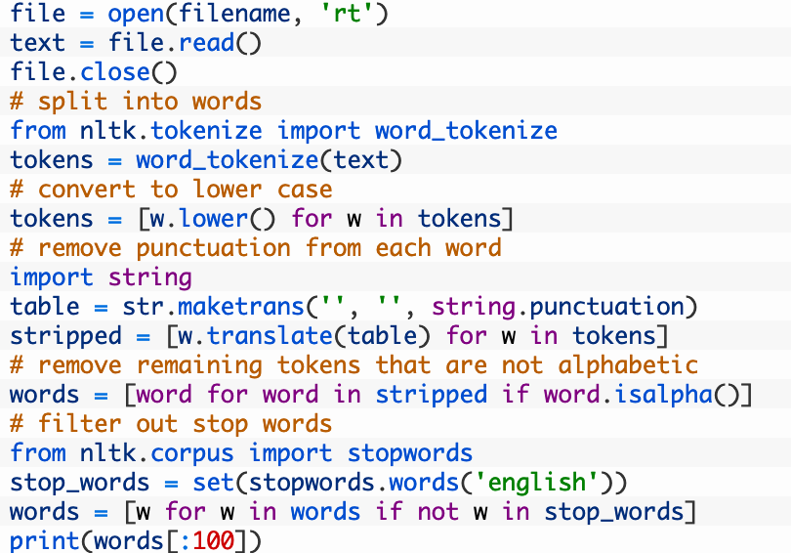
A small pipeline of text preparation

Slide 60
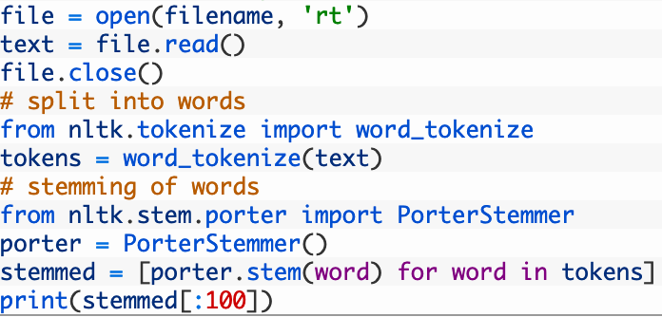
Stemming Words

Slide 61
Case Study – NLP Data Preparation
https://medium.com/datadriveninvestor/preparing-text-for-natural-language-processing-f93b11bfb3fe

Slide 62
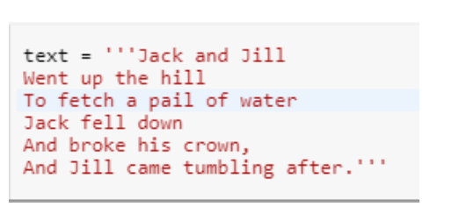


Data Preparation – selecting unique words

Slide 63
Data Preparation – create document vectors
We can use a simple scoring model of presence of word or absence of word using a boolean value of 0 for absent or 1 for present.
“Jack and Jill”
‘hill’ =0 ‘And’=0 ‘came’=0 ‘a’=0 ‘crown’=0 ‘fell’=0 ‘To’=0 ‘Jack’=1 ‘down’=0 ‘and’=1 ‘water’=0 ‘up’=0 ‘the’=0 ‘Jill’=1 ‘tumbling’=0 ‘pail’=0 ‘his’=0 ‘Went’=0 ‘fetch’=0 ‘after.’=0 ‘of’=0 ‘broke’=0
jack and jill is vectorised into 1 and 0 as (of length 22)[0,0,0,0,0,0,0,1,0,1,0,0,0,1,0,0,0,0,0,0,0,0]

Slide 64
Managing Vocabulary
As the vocabulary size increases so does the vector representation of document,
in the previous example , the length of the document vector is equal to the number of known words.
However , this has an issue for a very large corpus , such as thousands of books , the length of the vector might be thousands or millions of positions.
Also the document may contain very few words from the known vocabulary This results in a a sparse matrix.

Slide 65
Do you see this as an Issue? How can you improve?

Slide 66
Managing Vocabulary
Sparse matrix requires a lot of zeros
Sparse matrix requires more memory and computation resources when modelling
The vast number of positions or dimensions can make the modelling very challenging.
Therefore there is a need to reduce the vocabulary size when using Bag of words model.

Slide 67
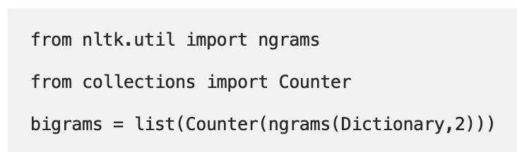
Managing Vocabulary
There is a need to reduce the vocabulary size when using Bag of words model.
More text cleaning by way of
Ignoring case.
Ignoring punctuation.
Ignoring frequent words that don’t contain much information, called stop words, like a, of,etc.
Fixing misspelled words.
Reducing words to their stem (e.g. play from playing) using stemming algorithms.
And /or a more sophisticated approach for bag of words where we group the words of to form a vocabulary.

Slide 68
Text Data Preparation

Slide 69
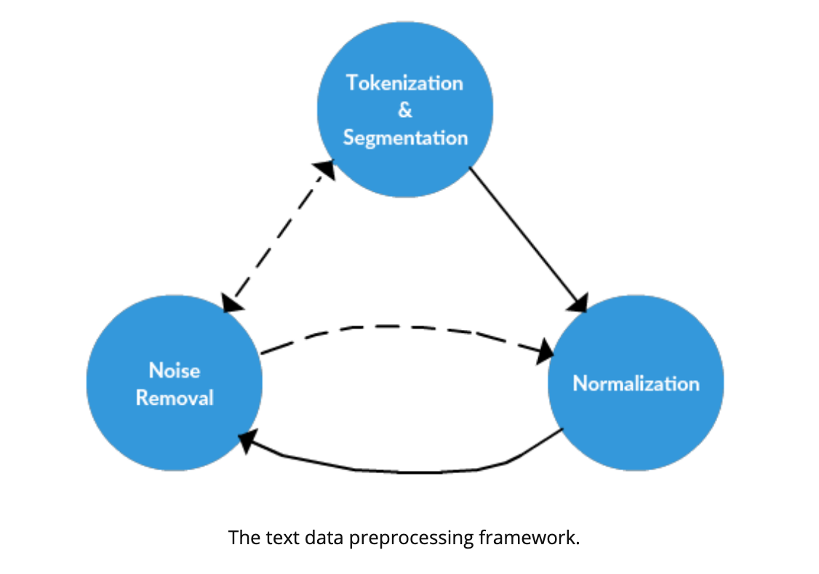
Text Data Preparation
https://www.kdnuggets.com/2017/12/general-approach-preprocessing-text-data.html

Slide 70
Text Data Preparation
Normalization
Normalization generally refers to a series of related tasks meant to put all text on a level playing field:
converting all text to the same case (upper or lower),
removing punctuation,
converting numbers to their word equivalents, and so on.
Stemming
Stemming is the process of eliminating affixes (suffixed, prefixes, infixes, circumfixes) from a word in order to obtain a word stem.
running → run
https://www.kdnuggets.com/2017/12/general-approach-preprocessing-text-data.html

Slide 71
Text Data Preparation
Lemmatization
Lemmatization is related to stemming, differing in that lemmatization is able to capture canonical forms based on a word's lemma.
Stemming just removes or stems the last few characters of a word, often leading to incorrect meanings and spelling. Lemmatization considers the context and converts the word to its meaningful base form, which is called Lemma
For example, stemming the word "better" would fail to return its citation form (another word for lemma); however, lemmatization would result in the following:
better → good
https://www.kdnuggets.com/2017/12/general-approach-preprocessing-text-data.html

Slide 72
Text Data Preparation
Normalization
set all characters to lowercase
remove numbers (or convert numbers to textual representations)
remove punctuation (generally part of tokenization, but still worth keeping in mind at this stage, even as confirmation)
strip white space (also generally part of tokenization)
remove default stop words (general English stop words)
https://www.kdnuggets.com/2017/12/general-approach-preprocessing-text-data.html

Slide 73
Text Data Preparation
Noise Removal
noise removal is a much more task-specific.
Let's assume we obtained a corpus from the world wide web, and that it is housed in a raw web format. We can, then, assume that there is a high chance our text could be wrapped in HTML or XML tags.
Remove text file headers, footers remove HTML, XML, etc. markup and metadata extract valuable data from other formats, such as JSON, or from within databases
https://www.kdnuggets.com/2017/12/general-approach-preprocessing-text-data.html

Slide 74

Another Data Cleaning Example
https://www.analyticsvidhya.com/blog/2014/11/text-data-cleaning-steps-python/

Slide 75
Text Data Preparation
Escaping HTML characters
Data obtained from web usually contains a lot of html entities like &lt; &gt; &amp; which gets embedded in the original data.
It is thus necessary to get rid of these entities.
One approach is to directly remove them by the use of specific regular expressions.
Another approach is to use appropriate packages and modules (for example htmlparser of Python), which can convert these entities to standard html tags.
For example: &lt; is converted to “<” and &amp; is converted to “&”.

Slide 76
Text Data Preparation
Decoding Data
This is the process of transforming information from complex symbols to simple and easier to understand characters.
Text data may be subject to different forms of decoding like “Latin”, “UTF8” etc.
Therefore, for better analysis, it is necessary to keep the complete data in standard encoding format.
UTF-8 encoding is widely accepted and is recommended to use.

Slide 77
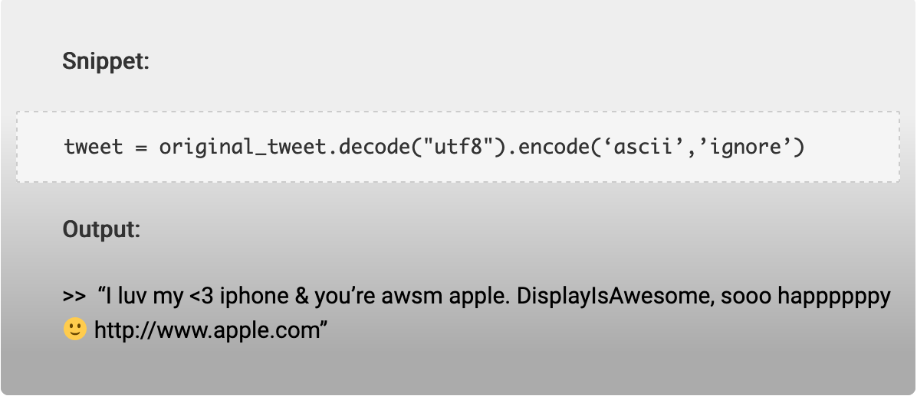
Text Data Preparation
Decoding Data

Slide 78
Text Data Preparation
Apostrophe Lookup:
To avoid any word sense disambiguation in text, it is recommended to maintain proper structure in it and to abide by the rules of context free grammar.
When apostrophes are used, chances of disambiguation increases.
For example “it’s is a contraction for it is or it has”.
All the apostrophes should be converted into standard lexicons. One can use a lookup table of all possible keys to get rid of disambiguates.

Slide 79
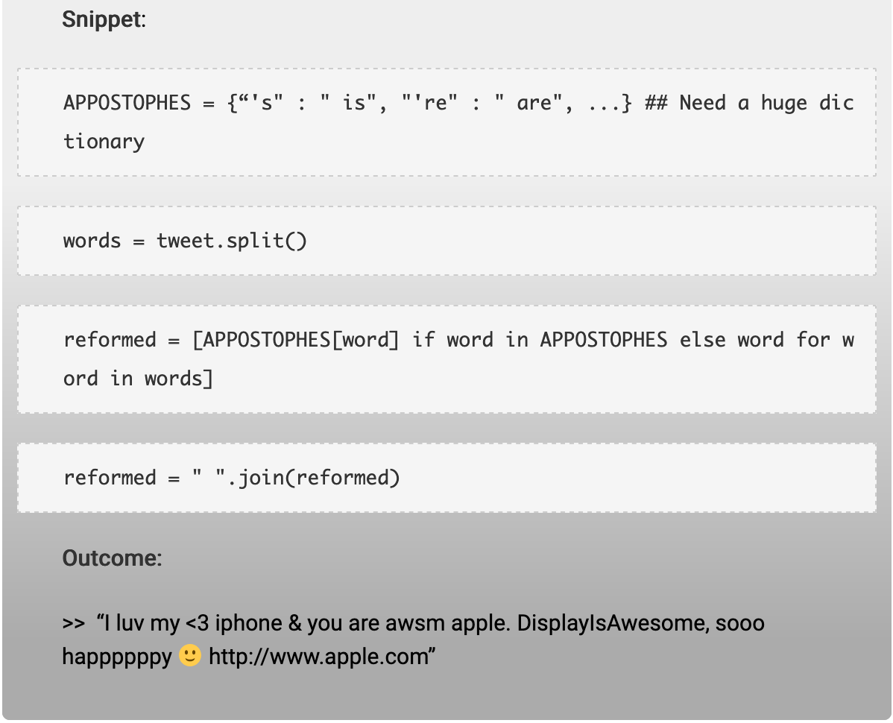
Text Data Preparation
Apostrophe Lookup:

Slide 80
Text Data Preparation
Removal of Stop-words:
When data analysis needs to be data driven at the word level, the commonly occurring words (stop-words) should be removed.
Removal of Punctuations:
All the punctuation marks according to the priorities should be dealt with. For example: “.”, “,”,”?” are important punctuations that should be retained while others need to be removed.

Slide 81
Text Data Preparation
Removal of Expressions:
Textual data (usually speech transcripts) may contain human expressions like [laughing], [Crying], [Audience paused].
These expressions are usually non relevant to content of the speech and hence need to be removed.
Split Attached Words:
Most of the tweets are accompanied with multiple attached words like RainyDay, PlayingInTheCold etc.
These entities can be split into their normal forms using simple rules and regex.

Slide 82
Text Data Preparation
Slangs lookup:
Again, social media comprises of a majority of slang words.
These words should be transformed into standard words to make free text.
The words like luv will be converted to love, Helo to Hello.
The similar approach of apostrophe look up can be used to convert slangs to standard words.
A number of sources are available on the web, which provides lists of all possible slangs.
This would be your holy grail and you could use them as
lookup dictionaries for conversion purposes.

Slide 83
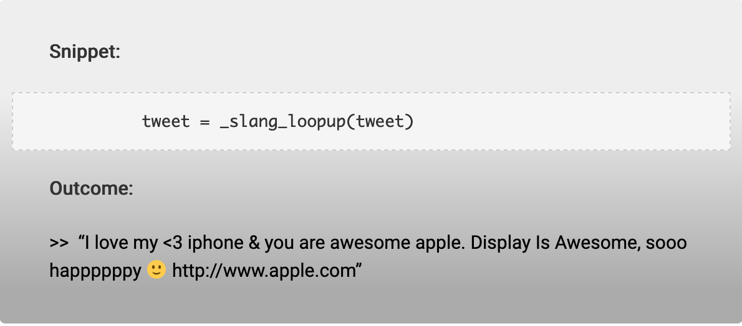
Text Data Preparation

Slide 84
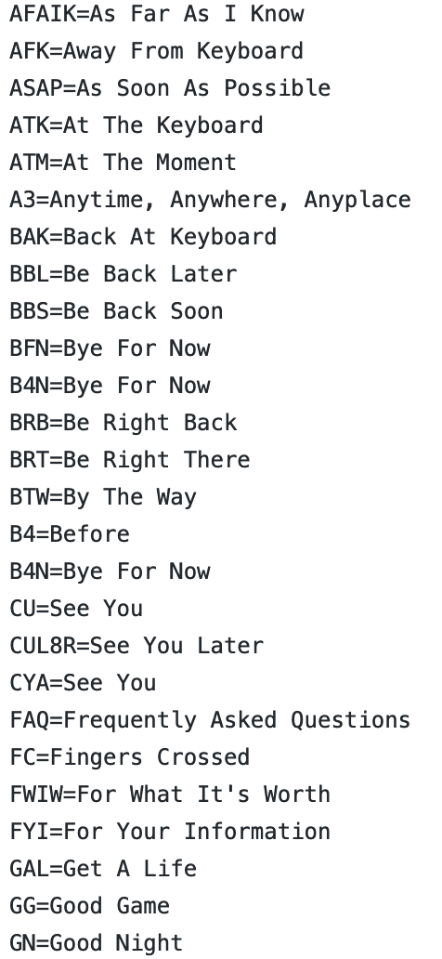
Slang Lookup
Slang lookup:
https://github.com/rishabhverma17/sms_slang_translator/blob/master/slang.txt

Slide 85
Slang Lookup
#open the fle slang.txt
file=open("slang.txt","r")
slang=file.read()
#seperating each line present in the file
slang=slang.split('\n')
tweet_tokens=tweet.split()
slang_word=[]
meaning=[]
#store the slang words and meanings in different lists
for line in slang:
temp=line.split("=")
slang_word.append(temp[0])
meaning.append(temp[-1])
#replace the slang word with meaning
for i,word in enumerate(tweet_tokens):
if word in slang_word:
idx=slang_word.index(word)
tweet_tokens[i]=meaning[idx]
tweet=" ".join(tweet_tokens)
print("After slang replacement the tweet is:-\n{}".format(tweet))

Slide 86
Text Data Preparation
Standardizing words:
Sometimes words are not in proper formats.
For example: “I looooveee you” should be “I love you”. Simple rules and regular expressions can help solve these cases.
Removal of URLs:
URLs and hyperlinks in text data like comments, reviews, and tweets should be removed.

Slide 87
Advanced Data Cleaning
Grammar checking: Grammar checking is majorly learning based.
Huge amount of proper text data is learned and models are created for the purpose of grammar correction.
There are many online tools that are available for grammar correction purposes.
Spelling correction: In natural language, misspelled errors are encountered.
One can use algorithms like the Levenshtein Distances, Dictionary Lookup etc. or other modules and packages to fix these errors.

Slide 88
Class Exercise
tweet="I enjoyd the event which took place yesteday & I lovdddd itttt ! The link to the show is http://t.co/4ftYom0i It's awesome you'll luv it #HadFun #Enjoyed BFN GN”
Remove hyperlink and hashtags
Standardize the words

Slide 89
Data Cleaning:
Another Example

Slide 90
Another Example
I enjoyd the event which took place yesteday &amp; I luvd it ! The link to the show is http://t.co/4ftYom0i It's awsome you'll luv it #HadFun #Enjoyed BFN GN
https://www.geeksforgeeks.org/python-efficient-text-data-cleaning/

Slide 91
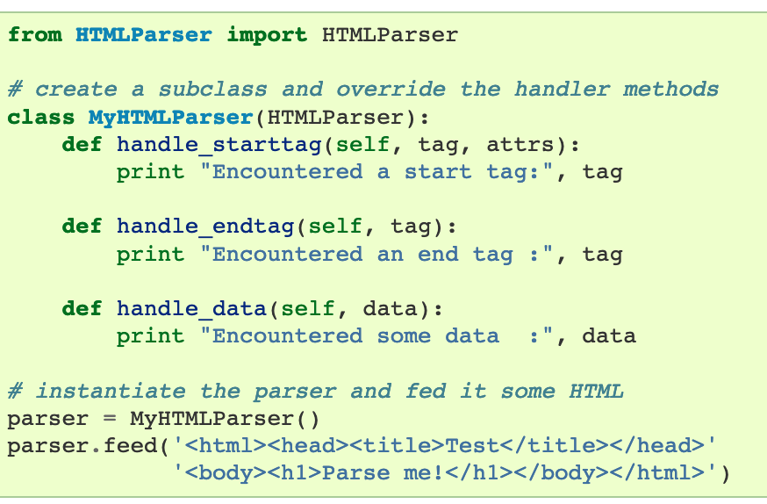
HTML Parser - Background

Slide 92
HTML Parser - Background
# import html
import html
s = '<html><head></head><body><h1>This is python</h1></body></html>'
temp = html.escape(s)
# Using html.unescape() method
gfg = html.unescape(temp)
print(gfg)
https://www.geeksforgeeks.org/html-unescape-in-python/

Slide 93
Another Example
Clear out HTML characters
#Escaping out HTML characters
from html.parser import HTMLParser
tweet="I enjoyd the event which took place yesteday & I lovdddd itttt ! The link to the show is http://t.co/4ftYom0i It's awesome you'll luv it #HadFun #Enjoyed BFN GN"
tweet=HTMLParser().unescape(tweet)
print("After removing HTML characters the tweet is:-\n{}".format(tweet))

Slide 94

Encoding & Decoding
Using string's encode() method, you can convert unicoded strings into any encodings supported by Python.
By default, Python uses utf-8 encoding.
it takes two parameters:
encoding - the encoding type a string has to be encoded to
errors - response when encoding fails.

Slide 95
Another Example
Encoding & Decoding Data
We should keep our data in a standard encoding format. The most common format is the UTF-8 format.
#Encode from UTF-8 to ascii
encode_tweet =tweet.encode('ascii','ignore')
print("encode_tweet = \n{}".format(encode_tweet))
#decode from ascii to UTF-8
decode_tweet=encode_tweet.decode(encoding='UTF-8')
print("decode_tweet = \n{}".format(decode_tweet))

Slide 96
Removing URLs, Hashtags, Styles
Removing URLs, Hashtags and Styles
#library for regular expressions
import re
# remove hyperlinks
tweet = re.sub(r'https?:\/\/.\S+', "", tweet)
# remove hashtags
# only removing the hash # sign from the word
tweet = re.sub(r'#', '', tweet)
# remove old style retweet text "RT"
tweet = re.sub(r'^RT[\s]+', '', tweet)
print("After removing Hashtags,URLs and Styles the tweet is:-\n{}".format(tweet))

Slide 97
Contraction Replacement
Contraction Replacement
Few of the contractions used are:-
n't --> not 'll --> will 's --> is 'd --> would 'm --> am 've --> have 're --> are
#dictionary consisting of the contraction and the actual value
Apos_dict={"'s":" is","n't":" not","'m":" am","'ll":" will",
"'d":" would","'ve":" have","'re":" are"}
#replace the contractions
for key,value in Apos_dict.items():
if key in tweet:
tweet=tweet.replace(key,value)
print("After Contraction replacement the tweet is:-\n{}".format(tweet))

Slide 98
Split Attached Words & Lower Casing
Split Attached Words
import re
#separate the words
tweet = " ".join([s for s in re.split("([A-Z][a-z]+[^A-Z]*)",tweet) if s])
print("After spliting attached words the tweet is:-\n{}".format(tweet))
Convert to lower case:
#convert to lower case
tweet=tweet.lower()
print("After converting to lower case the tweet is:-\n{}".format(tweet))

Slide 99
Slang Lookup
Slang lookup:
There are many slang words which are used nowadays, and they can be found in the text data.
So we need to replace them with their meanings.
asap --> as soon as possible
b4 --> before
lol --> laugh out loud
luv --> love
wtg --> way to go

Slide 100
Standardize and Spell Check
There might be spelling errors in the text or it might not be in the correct format.
For example – “drivng” for “driving” or “I misssss this” for “I miss this”.
#install autocorrect library
pip install autocorrect
import itertools
#One letter in a word should not be present more than twice in #continuation
tweet = ''.join(''.join(s)[:2] for _, s in itertools.groupby(tweet))
print("After standardizing the tweet is:-\n{}".format(tweet))

Slide 101
Spell Check
from autocorrect import Speller
spell = Speller(lang='en')
#spell check
tweet=spell(tweet)
print("After Spell check the tweet is:-\n{}".format(tweet))

Slide 102
Remove Stopwords
Remove Stopwords:
import nltk
#download the stopwords from nltk using
nltk.download('stopwords')
#import stopwords
from nltk.corpus import stopwords
#import english stopwords list from nltk
stopwords_eng = stopwords.words('english')
tweet_tokens=tweet.split()
tweet_list=[]
#remove stopwords
for word in tweet_tokens:
if word not in stopwords_eng:
tweet_list.append(word)
print("tweet_list = {}".format(tweet_list))

Slide 103
Remove Punctuation
Remove Punctuation
import string
clean_tweet=[]
#remove punctuations
for word in tweet_list:
if word not in string.punctuation:
clean_tweet.append(word)
print("clean_tweet = {}".format(clean_tweet))

Slide 104
Text Vectorization Applied Text Analysis with Python: Enabling Language-Aware Data Products with Machine Learning, Bengfort, Benjamin

Slide 105
Text Vectorization
Machine learning algorithms operate on a numeric feature space, expecting input as a two-dimensional array where rows are instances and columns are features.
In order to perform machine learning on text, we need to transform our documents into vector representations such that we can apply numeric machine learning.
This process is called vectorization

Slide 106
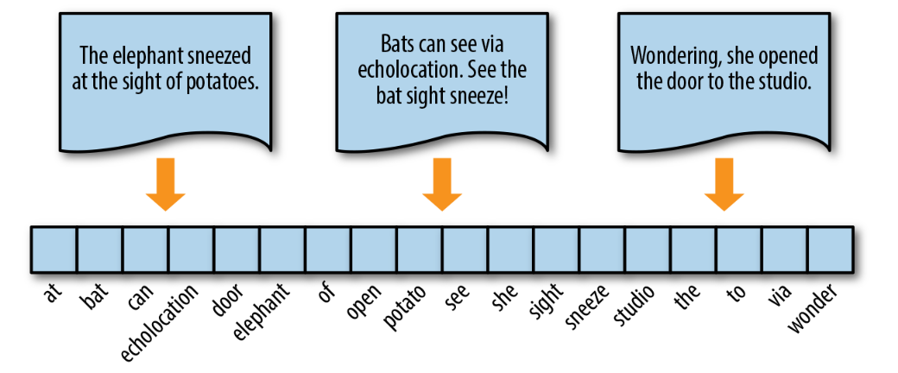
Words in Space

Slide 107
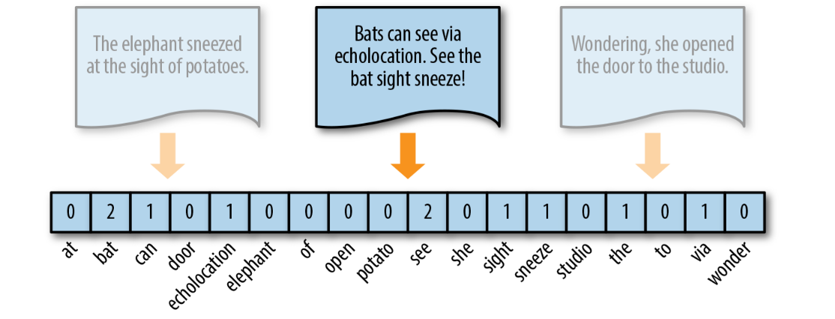
Words in Space - Frequency Vectors
The simplest vector encoding model is to simply fill in the vector with the frequency of each word as it appears in the document.
In this encoding scheme, each document is represented as the multiset of the tokens that compose it and the value for each word position in the vector is its count.

Slide 108
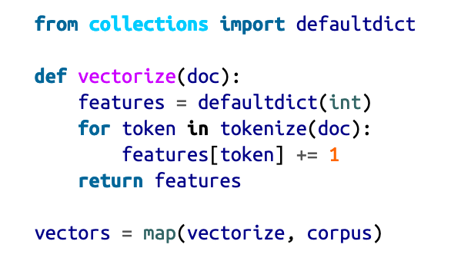
Words in Space - Frequency Vectors

Slide 109
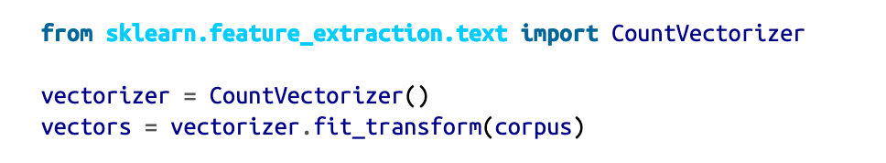
Words in Space - Frequency Vectors
The CountVectorizer transformer from the sklearn.feature_extraction model has its own internal tokenization and normalization methods.
The fit method of the vectorizer expects an iterable or list of strings or file objects, and creates a dictionary of the vocabulary on the corpus.
When transform is called, each individual document is transformed into a sparse array whose index tuple is the row (the documentID) and the token ID from the dictionary, and whose value is the count

Slide 110
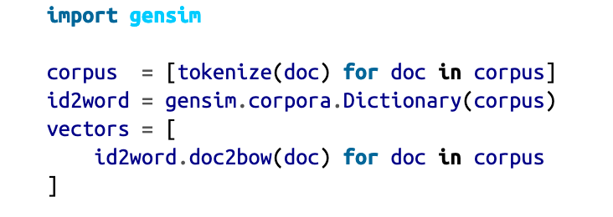
Words in Space - Frequency Vectors
Gensim’s frequency encoder is called doc2bow. To use doc2bow, we first create a Gensim Dictionary that maps tokens to indices based on observed order (eliminating the overhead of lexicographic sorting).
The dictionary object can be loaded or saved to disk, and implements a doc2bow library that accepts a pre-tokenized document and returns a sparse matrix of (id, count) tuples where the id is the token’s id in the dictionary.

Slide 111
Words in Space - Frequency Vectors
Vectors can become extremely sparse, particularly as vocabularies get larger, which can have a significant impact on the speed and performance of machine learning models.
For very large corpora, it is recommended to use the Scikit-Learn HashingVectorizer, which uses a hashing trick to find the token string name to feature index mapping.

Slide 112
Words in Space - One-Hot Encoding
Because they disregard grammar and the relative position of words in documents, frequency-based encoding methods suffer from the long tail, or Zipfian distribution, that characterizes natural language.
As a result, tokens that occur very frequently are orders of magnitude more “significant” than other, less frequent ones.
This can have a significant impact on some models (e.g., generalized linear models) that expect normally distributed features.

Slide 113
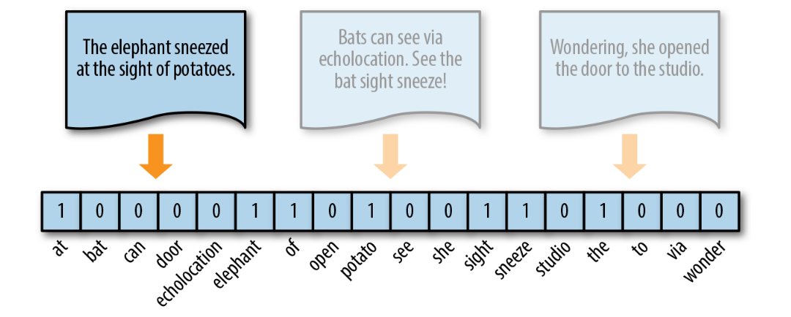
Words in Space - One-Hot Encoding
A solution to this problem is one-hot encoding, a boolean vector encoding method that marks a particular vector index with a value of true (1) if the token exists in the document and false (0) if it does not.

Slide 114
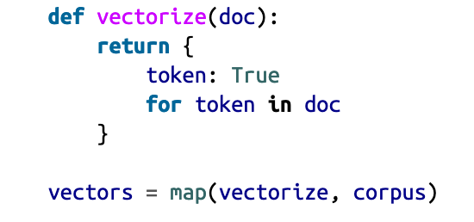
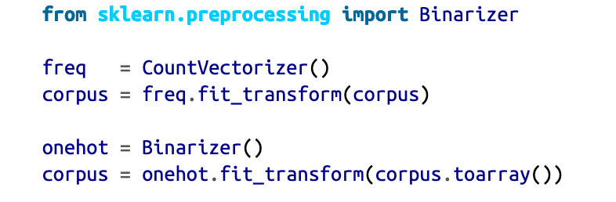
Words in Space - One-Hot Encoding
One-hot encoding reduces the imbalance issue of the distribution of tokens, simplifying a document to its constituent components.
This reduction is most effective for very small documents (sentences, tweets) that don’t contain very many repeated elements, and is usually applied to models that have very good smoothing properties

Slide 115
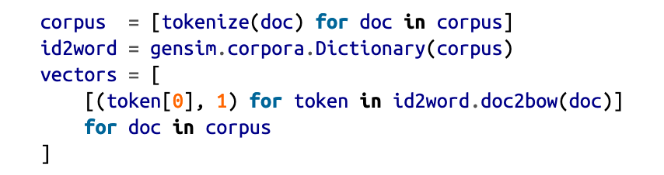
Words in Space - One-Hot Encoding
While Gensim does not have a specific one-hot encoder, its doc2bow method returns a list of tuples that we can manage on the fly.

Slide 116
Words in Space - One-Hot Encoding
One-hot encoding represents similarity and difference at the document level, but because all words are rendered equidistant, it is not able to encode per-word similarity.
Moreover, because all words are equally distant, word form becomes incredibly important; the tokens “trying” and “try” will be equally distant from unrelated tokens like “red” or “bicycle”!

Slide 117
Words in Space - One-Hot Encoding
Normalizing tokens to a single word class, either through stemming or lemmatization, ensures that different forms of tokens that embed plurality, case, gender, cardinality, tense, etc., are treated as single vector components.
This reduces the feature space and makes models more performant.

Slide 118
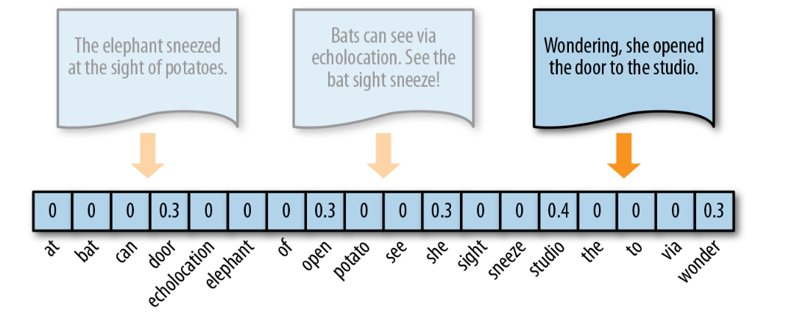
Words in Space - Term Frequency–Inverse Document Frequency
TF–IDF, term frequency–inverse document frequency, encoding normalizes the frequency of tokens in a document with respect to the rest of the corpus. This encoding approach accentuates terms that are very relevant to a specific instance

Slide 119
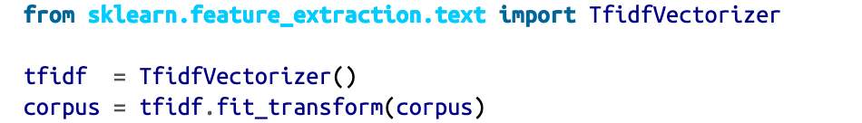
Words in Space - Term Frequency–Inverse Document Frequency
TF–IDF is computed on a per-term basis, such that the relevance of a token to a document is measured by the scaled frequency of the appearance of the term in the document, normalized by the inverse of the scaled frequency of the term in the entire corpus.

Slide 120
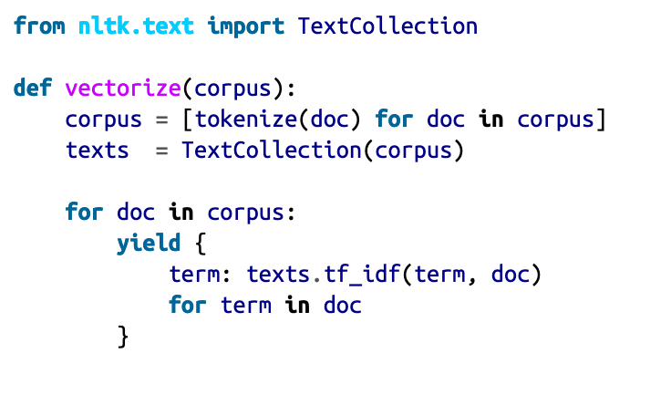
Term Frequency–Inverse Document Frequency
To vectorize text in this way with NLTK, we use the TextCollection class, a wrapper for a list of texts or a corpus consisting of one or more texts.
This class provides sup‐port for counting, concordancing, collocation discovery, and more importantly, computing tf_idf.

Slide 121
Term Frequency–Inverse Document Frequency
The Gensim way
In Gensim, the TfidfModel data structure is similar to the Dictionary object in that it stores a mapping of terms and their vector positions in the order they are observed, but additionally stores the corpus frequency of those terms so it can vectorize documents on demand.
Gensim allows us to apply our own tokenization method, expecting a corpus that is a list of lists of tokens.
We first construct the lexicon and use it to instantiate the TfidfModel, which computes the normalized inverse document frequency.

Slide 122
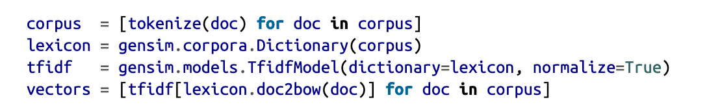
Term Frequency–Inverse Document Frequency
The Gensim way

Slide 123
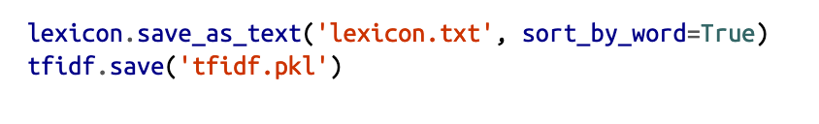
Term Frequency–Inverse Document Frequency
The Gensim way
Gensim provides helper functionality to write dictionaries and models to disk in a compact format, meaning you can conveniently save both the TF–IDF model and the lexicon to disk in order to load them later to vectorize new documents.
It is possible (though slightly more work) to achieve the same result by using the pickle module in combination with Scikit-Learn. To save a Gensim model to disk:
This will save the lexicon as a text-delimited text file, sorted lexicographically, and the TF–IDF model as a pickled sparse matrix.

Slide 124
Term Frequency–Inverse Document Frequency
One benefit of TF–IDF is that it naturally addresses the problem of stop words, those words most likely to appear in all documents in the corpus (e.g., “a,” “the,” “of ”, etc.), and thus will accrue very small weights under this encoding scheme.
This biases the TF–IDF model toward moderately rare words. As a result TF–IDF is widely used for bag-of-words models, and is an excellent starting point for most text analytics

Slide 125
Distributed Representation
Frequency, one-hot, and TF–IDF encoding enable us to put documents into vector space.
However, it is often useful to also encode the similarities between documents in the context of that same vector space.

Slide 126
Distributed Representation
When document similarity is important in the context of an application, we instead encode text along a continuous scale with a distributed representation.
This means that the resulting document vector is not a simple mapping from token position to token score.
Instead, the document is represented in a feature space that has been embedded to represent word similarity.

Slide 127
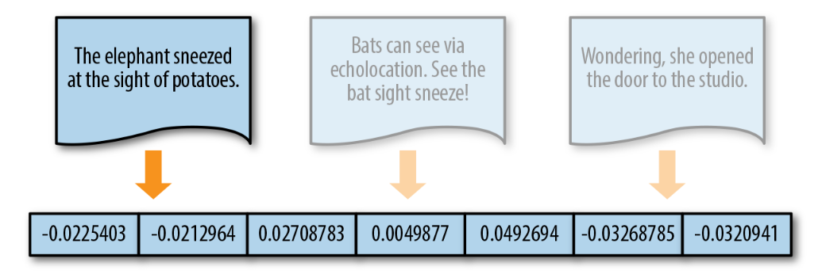
Distributed Representation

Slide 128
Distributed Representation
Word2vec, created by a team of researchers at Google.
This implements a word embedding model that enables us to create these kinds of distributed representations.
The word2vec algorithm trains word representations based on either a continuous bag-of-words (CBOW) or skip-gram model.
words are embedded in space along with similar words
based on their context.
Gensim’s implementation uses a feedforward network.

Slide 129
Distributed Representation
Word embedding is one of the most popular representation of document vocabulary.
It is capable of capturing context of a word in a document, semantic and syntactic similarity, relation with other words, etc.
Word2Vec is one of the most popular technique to learn word embeddings using shallow neural network

Slide 130
Distributed Representation
Word2Vec original paper:
Distributed Representations of Words and Phrases and their Compositionality
https://arxiv.org/pdf/1310.4546.pdf

Slide 131
Distributed Representation
Why do we need them?
Intuitively, we introduce some dependence of one word on the other words.
The words in context of this word would get a greater share of this dependence.
In one hot encoding representations, all the words are independent of each other, as mentioned earlier.
https://towardsdatascience.com/introduction-to-word-embedding-and-word2vec-652d0c2060fa

Slide 132
Distributed Representation
Why do we need them?
Consider the following similar sentences:
Have a good day and Have a great day.
They hardly have different meaning.
If we construct an exhaustive vocabulary (let’s call it V),
it would have V = {Have, a, good, great, day}.
https://towardsdatascience.com/introduction-to-word-embedding-and-word2vec-652d0c2060fa

Slide 133
Distributed Representation
Why do we need them?
Now, let us create a one-hot encoded vector for each of these words in V.
Length of our one-hot encoded vector would be equal to the size of V (=5).
We would have a vector of zeros except for the element at the index representing the corresponding word in the vocabulary.
That particular element would be one. The encodings below would explain this better.
Have = [1,0,0,0,0]`; a=[0,1,0,0,0]` ; good=[0,0,1,0,0]` ; great=[0,0,0,1,0]` ; day=[0,0,0,0,1]`
https://towardsdatascience.com/introduction-to-word-embedding-and-word2vec-652d0c2060fa

Slide 134
Distributed Representation
Why do we need them?
If we try to visualize these encodings, we can think of a 5 dimensional space, where each word occupies one of the dimensions and has nothing to do with the rest (no projection along the other dimensions).
This means ‘good’ and ‘great’ are as different as ‘day’ and ‘have’, which is not true.
Our objective is to have words with similar context occupy close spatial positions.
Mathematically, the cosine of the angle between such vectors should be close to 1, i.e. angle close to 0.
https://towardsdatascience.com/introduction-to-word-embedding-and-word2vec-652d0c2060fa

Slide 135
Distributed Representation
Why do we need them?
Here comes the idea of generating distributed representations.
Intuitively, we introduce some dependence of one word on the other words.
The words in context of this word would get a greater share of this dependence.
In one hot encoding representations, all the words are independent of each other, as mentioned earlier.
https://towardsdatascience.com/introduction-to-word-embedding-and-word2vec-652d0c2060fa

Slide 136
Distributed Representation
How Does Word2Vec work?
Word2Vec is a method to construct such an embedding. It can be obtained using two methods (both involving Neural Networks): Skip Gram and Common Bag Of Words (CBOW).
CBOW Model: This method takes the context of each word as the input and tries to predict the word corresponding to the context.
Skip-Gram model: This looks like multiple-context CBOW model.
Skip Gram works well with small amount of data and is found to represent rare words well.
On the other hand, CBOW is faster and has better representations for more frequent words.
https://towardsdatascience.com/introduction-to-word-embedding-and-word2vec-652d0c2060fa

Slide 137
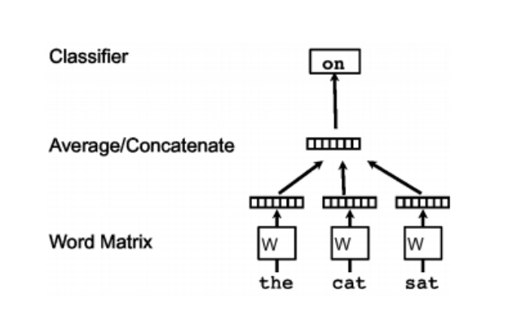
Distributed Representation
How Does Word2Vec work?
Continuous bag of words
Continuous bag of words creates a sliding window around current word, to predict it from “context” — the surrounding words. Each word is represented as a feature vector. After training, these vectors become the word vectors.
https://towardsdatascience.com/introduction-to-word-embedding-and-word2vec-652d0c2060fa

Slide 138
Distributed Representation
How Does Word2Vec work?
Skip gram
The second algorithm is actually the opposite of CBOW: instead of prediciting one word each time, we use 1 word to predict all surrounding words (“context”).
Skip gram is much slower than CBOW, but considered more accurate with infrequent words.
https://medium.com/wisio/a-gentle-introduction-to-doc2vec-db3e8c0cce5e

Slide 139
Distributed Representation
The doc2vec algorithm is an extension of word2vec.
The goal of doc2vec is to create a numeric representation of a document, regardless of its length.
But unlike words, documents do not come in logical structures such as words, so the another method has to be found.
It proposes a paragraph vector—an unsupervised algorithm that learns fixed-length feature representations from variable length documents.
This representation attempts to inherit the semantic properties of words such that “red” and “colorful” are more similar to each other than they are to “river” or “governance”.

Slide 140
Distributed Representation
The paragraph vector takes into consideration the ordering of words within a narrow context, similar to an n-gram model.
The combined result is much more effective than a bag-of-words or bag-of-n-grams model because it generalizes better.

Slide 141
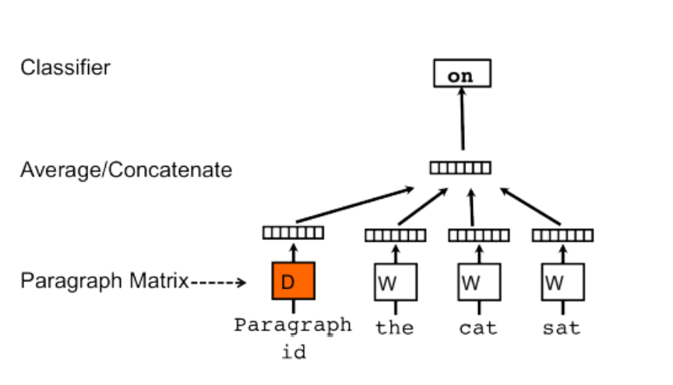
Distributed Representation
The concept that Mikilov and Le have used was simple, yet clever: they have used the word2vec model, and added another vector (Paragraph ID below), like so:
https://medium.com/wisio/a-gentle-introduction-to-doc2vec-db3e8c0cce5e

Slide 142
Distributed Representation
It is a small extension to the CBOW model.
But instead of using just words to predict the next word, we also added another feature vector, which is document-unique.
So, when training the word vectors W, the document vector D is trained as well, and in the end of training, it holds a numeric representation of the document.
https://medium.com/wisio/a-gentle-introduction-to-doc2vec-db3e8c0cce5e

Slide 143
Distributed Representation – Gensim’s Implementation

Slide 144
Distributed Representation – Gensim’s Implementation
Neither NLTK nor Scikit-Learn provide implementations of these kinds of word embeddings.
Gensim’s implementation allows users to train both word2vec and doc2vec models on custom corpora and also conveniently comes with a model that is pretrained on the Google news corpus.
To use Gensim’s pretrained models, you’ll need to download the model bin file, which is about 1.5 GB.

Slide 145
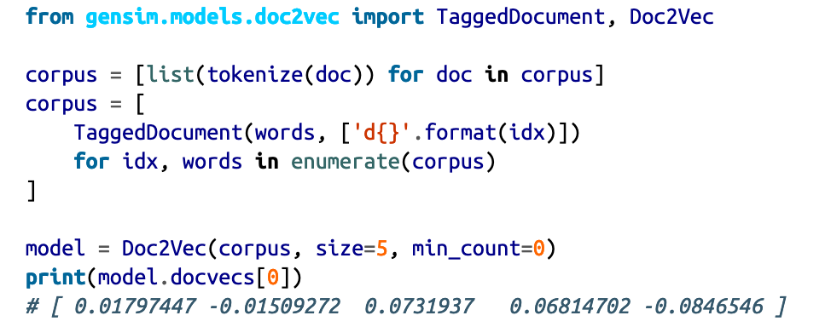
Distributed Representation – Gensim’s Implementation

Slide 146
Distributed Representation – Summary
Distributed representations will dramatically improve results over TF–IDF models when used correctly.
The model itself can be saved to disk and retrained in an active fashion, making it extremely flexible for a variety of use cases.

Slide 147
Distributed Representation – Summary
However, on larger corpora, training can be slow and memory intensive, and it might not be as good as a TF–IDF model with Principal Component Analysis (PCA) or Singular Value Decomposition (SVD) applied to reduce the feature space.
In the end, however, this representation is breakthrough work that has led to a dramatic improvement in text processing capabilities of data products in recent years.

Slide 148
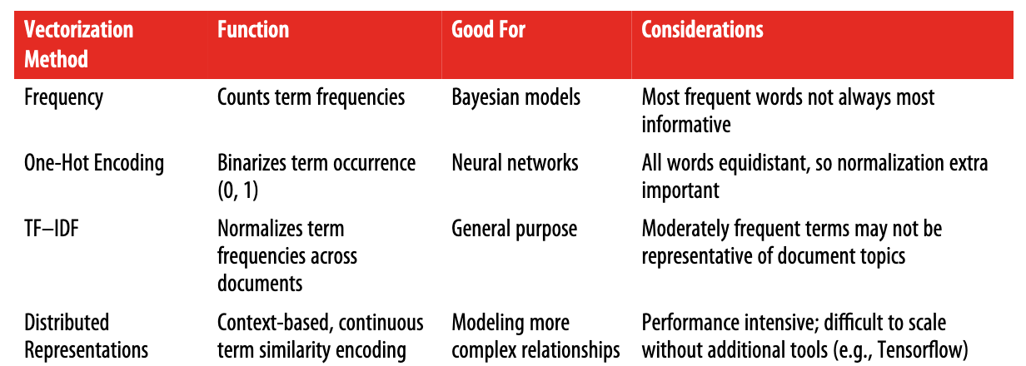
Overview of Text Vectorization Methods

