Slide 1
NLP 220 Data Science and Machine Learning Fundamentals
Fall 2024
Lecture 2
Jalal Mahmud

Slide 2
Outline for Today
Review of CSV Parsing
NLP Toolkits

Slide 3
CSV Parsing
You don’t have to build your own CSV parser from scratch.
There are several perfectly acceptable libraries you can use.
The Python csv library will work for most cases.
If your work requires lots of data or numerical analysis, the pandas library has CSV parsing capabilities as well.

Slide 4
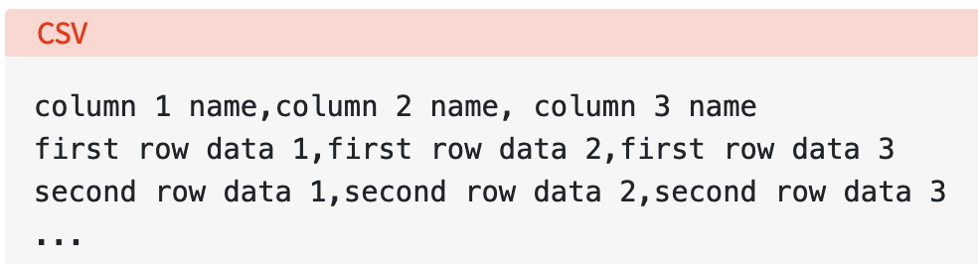
CSV Parsing
The separator character is called a delimiter, and the comma is not the only one used.
Other popular delimiters include the tab (\t), colon (:) and semi-colon (;) characters.
Properly parsing a CSV file requires us to know which delimiter is being used.
https://realpython.com/python-csv/

Slide 5
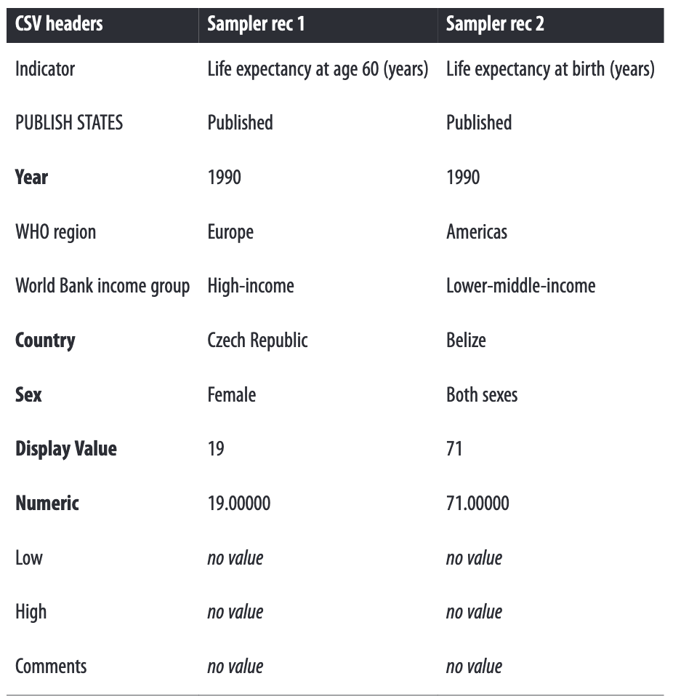
CSV Example

Slide 6
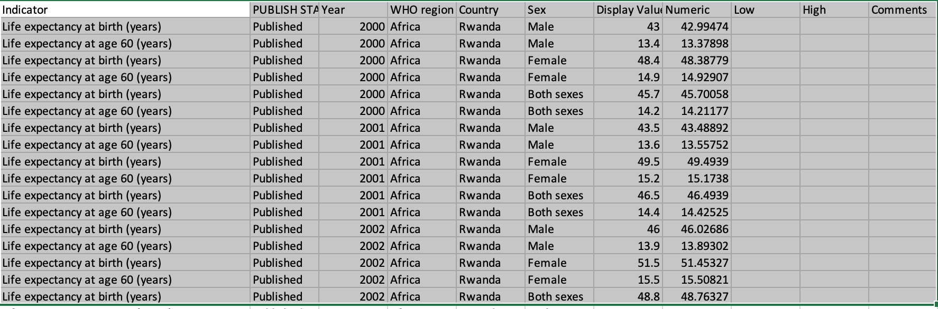
CSV Example
https://github.com/jackiekazil/data-wrangling/blob/master/data/chp3/data-text.csv

Slide 7
Python CSV Module
The csv module’s reader and writer objects read and write sequences.
Programmers can also read and write data in dictionary form using the DictReader and DictWriter classes.
https://docs.python.org/3/library/csv.html

Slide 8
How to Import CSV Data
import csv
csvfile = open('data-text.csv', 'rb’)
reader = csv.reader(csvfile)
for row in reader:
print(row)

Slide 9
Using Dictionary Reader
Instead of dealing with a list of individual String elements, you can read CSV data directly into a dictionary
import csv
csvfile = open('data-text.csv', 'rb’)
reader = csv.DictReader(csvfile)
for row in reader:
print row
{ 'Indicator': 'Healthy life expectancy (HALE) at birth (years)', 'Country': 'Zimbabwe', 'Comments': '', 'Display Value': '49', 'World Bank income group': 'Low-income', 'Numeric': '49.00000', 'Sex': 'Female', 'High': '', 'Low': '', 'Year': '2012’, 'WHO region': 'Africa', 'PUBLISH STATES': 'Published'}

Slide 10
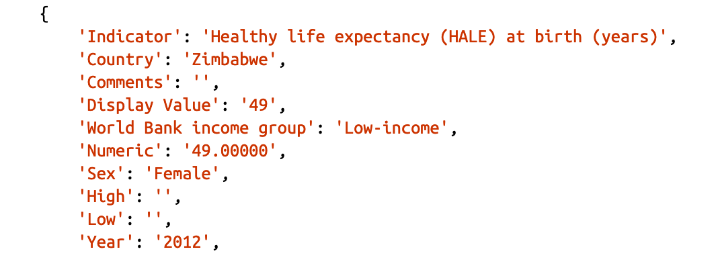

How to Import CSV Data: Using Dictionary Reader

Slide 11
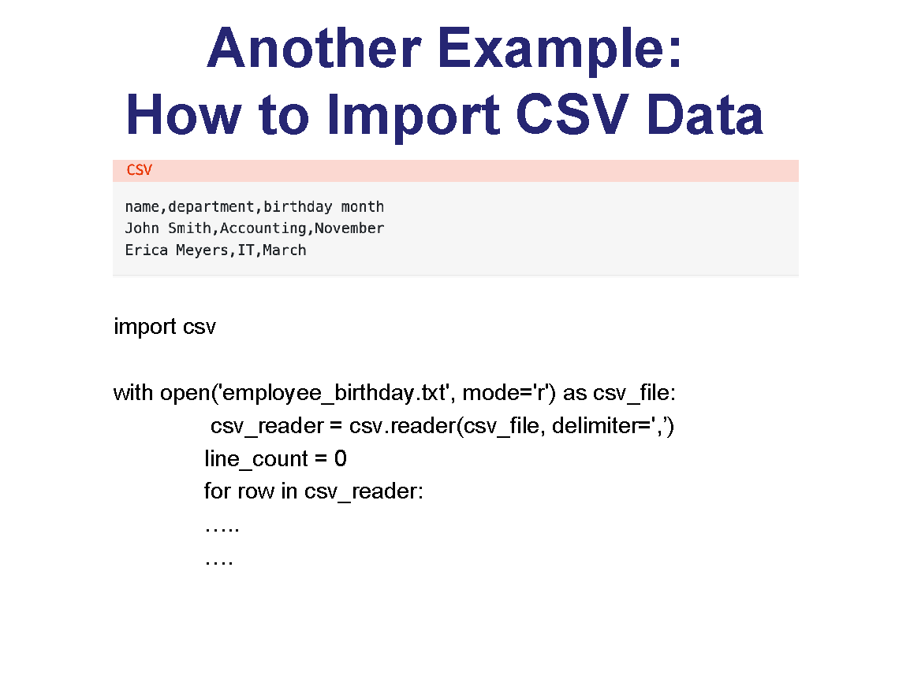
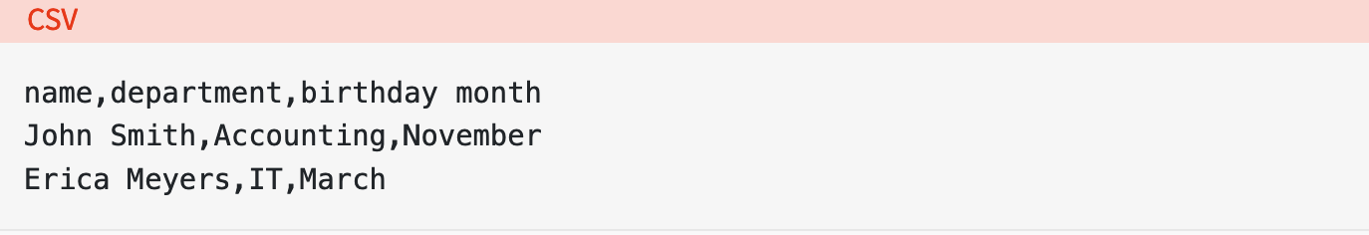
Another Example: How to Import CSV Data
import csv
with open('employee_birthday.txt', mode='r') as csv_file:
csv_reader = csv.reader(csv_file, delimiter=',’)
line_count = 0
for row in csv_reader:
…..
….
https://realpython.com/python-csv/

Slide 12
Using Dictionary Reader: How to Import CSV Data
import csv
with open('employee_birthday.txt', mode='r') as csv_file:
csv_reader = csv.DictReader(csv_file)
line_count = 0
for row in csv_reader:
…..
….

Slide 13
Optional Python CSV reader Parameters
The reader object can handle different styles of CSV files by specifying additional parameters, some of which are shown below:
delimiter specifies the character used to separate each field. The default is the comma (',').
quotechar specifies the character used to surround fields that contain the delimiter character. The default is a double quote (' " ').
escapechar specifies the character used to escape the delimiter character, in case quotes aren’t used. The default is no escape character.

Slide 14
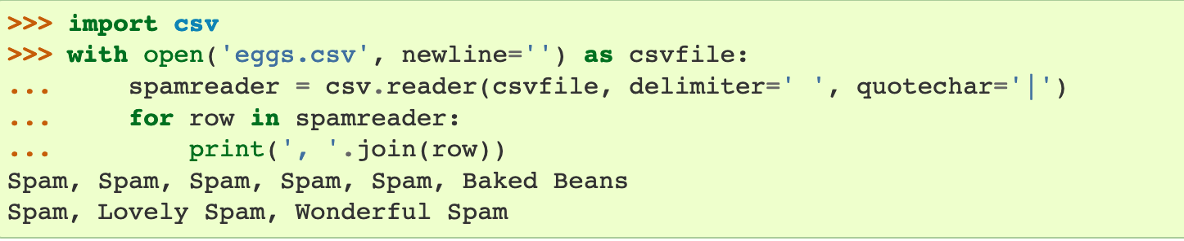
Optional Python CSV reader Parameters

Slide 15
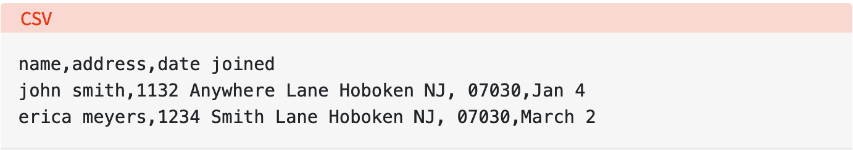
Optional Python CSV reader Parameters
This CSV file contains three fields: name, address, and date joined, which are delimited by commas.
The problem is that the data for the address field also contains a comma to signify the zip code.

Slide 16
How to handle this when data also contains the delimiter?
Use a different delimiter
The comma can safely be used in the data itself. You use the delimiter optional parameter to specify the new delimiter.
Wrap the data in quotes
The special nature of your chosen delimiter is ignored in quoted strings.
Therefore, you can specify the character used for quoting with the quotechar optional parameter.
As long as that character also doesn’t appear in the data, you’re fine.

Slide 17
How to handle this when data also contains the delimiter?
Escape the delimiter characters in the data
Escape characters work just as they do in format strings, nullifying the interpretation of the character being escaped (in this case, the delimiter).
If an escape character is used, it must be specified using the escapechar optional parameter.

Slide 18
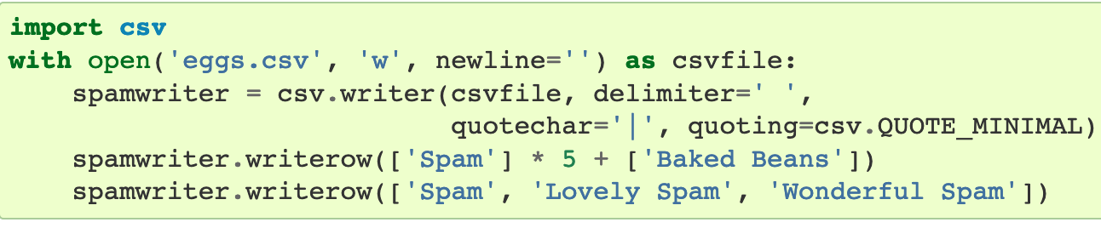
Writing to CSV File
csv.writer

Slide 19
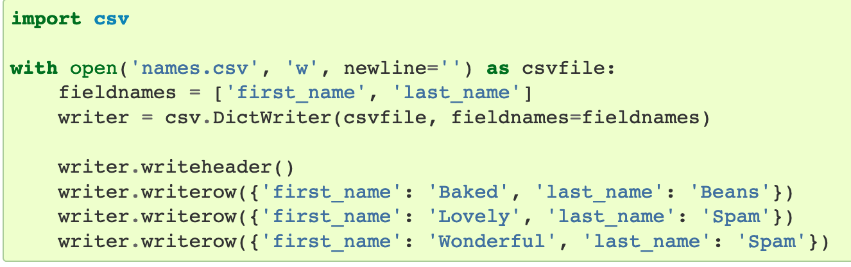
Writing to CSV File
csv.DictWriter

Slide 20
Using Python Pandas Library
Pandas is an open-source Python library that provides high performance data analysis tools and easy to use data structures.
Pandas is available for all Python installations
It is highly recommended if you have a lot of data to analyze.
install pandas
pip install pandas

Slide 21
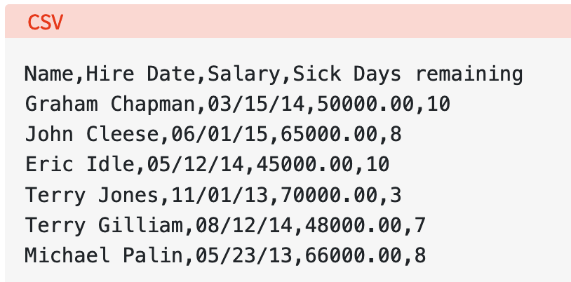
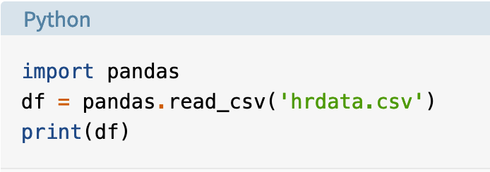
Reading a CSV File using Pandas

Slide 22
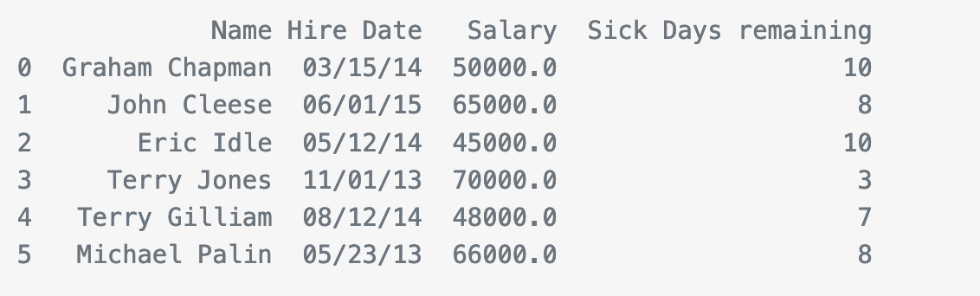
Reading a CSV File using Pandas
pandas.read_csv() opens, analyzes, and reads the CSV file provided, and stores the data in a DataFrame

Slide 23
Reading a CSV File using Pandas
Pandas recognized that the first line of the CSV contained column names, and used them automatically.
However, pandas is also using zero-based integer indices in the DataFrame. That’s because we didn’t tell it what our index should be.

Slide 24
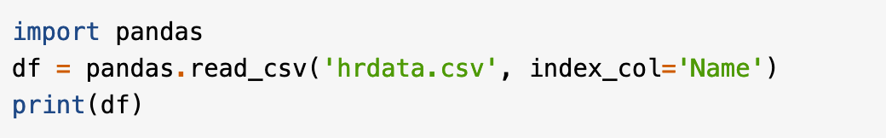
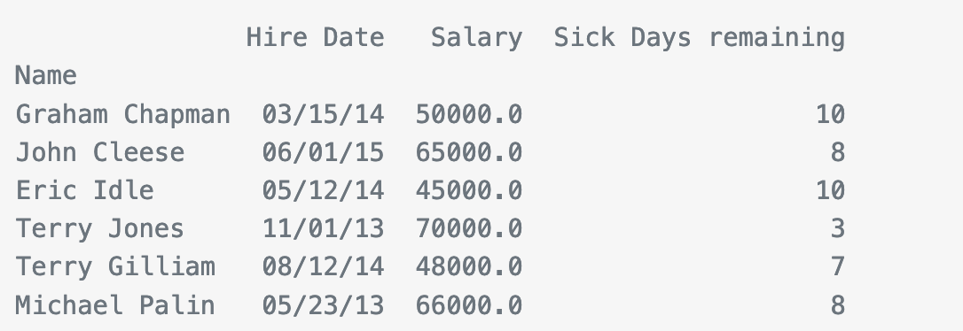
Reading a CSV File using Pandas
To use a different column as the DataFrame index, add the index_col optional parameter:

Slide 25
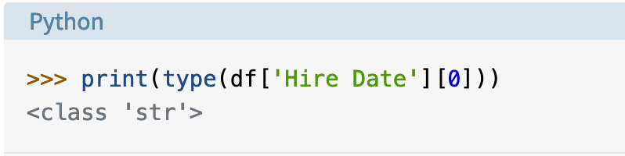
Reading a CSV File using Pandas
Pandas has properly converted the Salary and Sick Days remaining columns to numbers, but the Hire Date column is still a String.

Slide 26
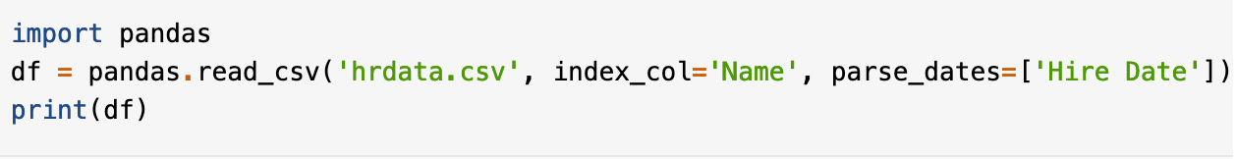
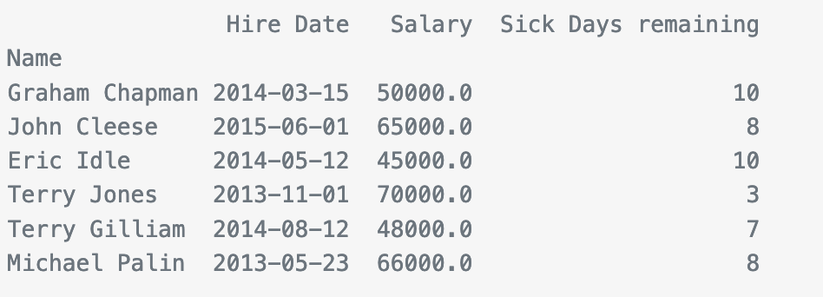
Reading a CSV File using Pandas
We can fix the data type of the Hire Date field.
We can force pandas to read data as a date with the parse_dates optional parameter, which is defined as a list of column names to treat as dates

Slide 27
Reading a CSV File using Pandas
If your CSV files doesn’t have column names in the first line, you can use the names optional parameter to provide a list of column names.
You can also use this if you want to override the column names provided in the first line.
In this case, you must also tell pandas.read_csv() to ignore existing column names using the header=0 optional parameter

Slide 28
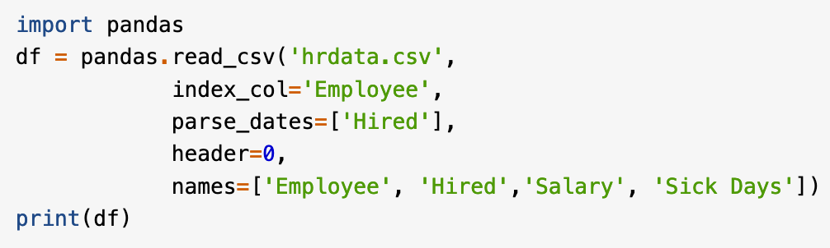
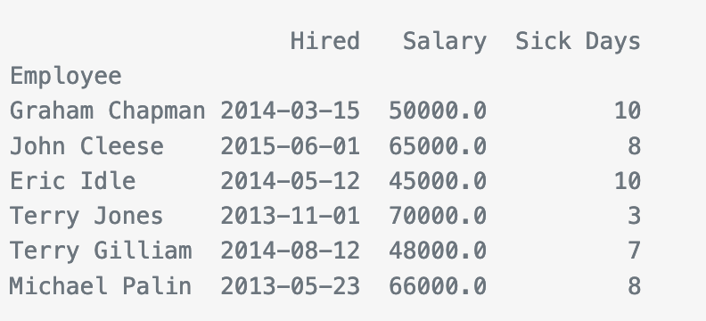
Reading a CSV File using Pandas

Slide 29
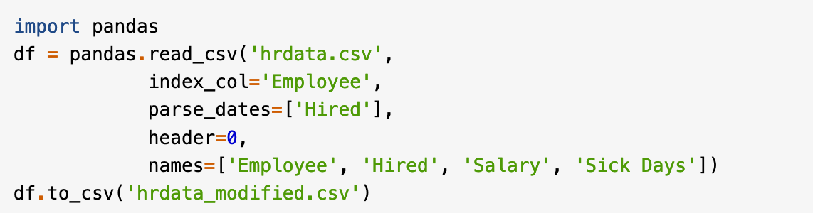
Writing a CSV File using Pandas

Slide 30
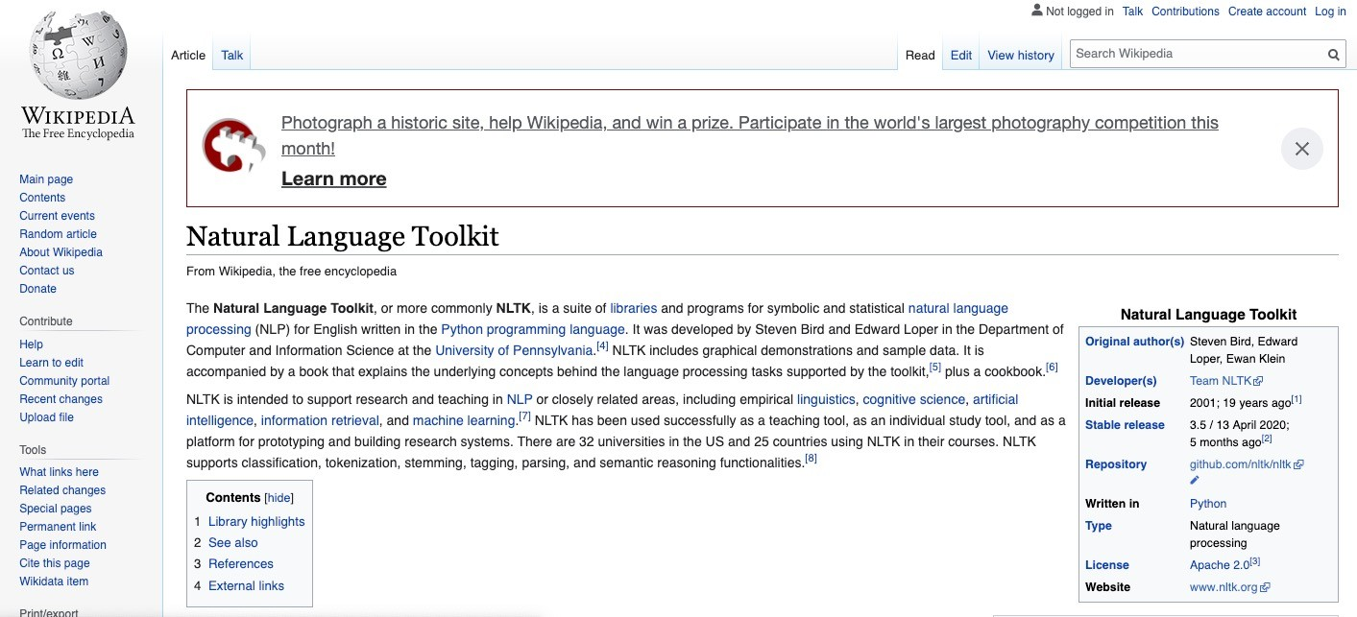
NLP Basic Terminology
Corpus (plural, corpora): Large body of natural language data, (usually raw) text.
Examples include Brown corpus, Google Books corpus, Wikipedia, etc.
Break into sentences and words

Slide 31

Natural Language Toolkit (NLTK)
https://www.nltk.org
Sentence Segmentation: breaking text down into its sentences.
Tokenization: breaking text down into its tokens (words, numbers, punctuation).
Sentence:
Something ending with a ., ?, ! (and sometimes also :)
Most ambiguities are from abbreviations, for example:
The house located on Main St. was owned by the son.
The new U.N. decisions about 3.5 years of …
Nested sentences:
“You reminded me,” she remarked, “of your mother.”
Note the .”

Slide 32
Natural Language Toolkit (NLTK)
https://www.nltk.org
Sentence Segmentation: breaking text down into its sentences.
Tokenization: breaking text down into its tokens (words, numbers, punctuation).
Tokens:
an indivisible sequence of characters
carry elementary meaning
reusable in different contexts
More challenging than expected:
“He’s” versus “he is”

Slide 33
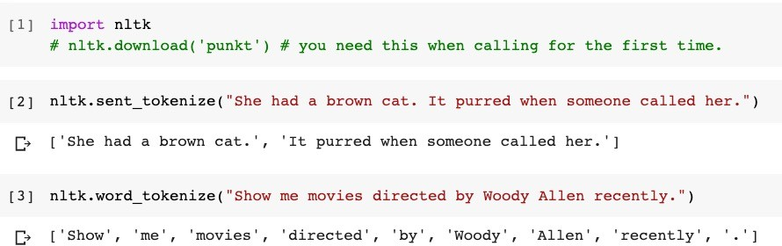
Natural Language Toolkit (NLTK)
https://www.nltk.org
Sentence Segmentation: breaking text down into its sentences.
Tokenization: breaking text down into its tokens (words, numbers, punctuation).

Slide 34
Punkt Sentence Segmenter
https://www.nltk.org
NLTK uses the Punkt sentence segmenter (Kiss and Strunk, 2006)
Assumption: a large number of ambiguities in the determination of sentence boundaries can be eliminated once abbreviations have been identified.
Uses 3 simple rules to identify them
look for very tight collocation consisting of a truncated word and a final period
Abbreviations are usually short
Abbreviations can contain internal periods
Language independent.

Slide 35
Sentence Segmentation as Classification
D. Gillick. Sentence boundary detection and the problem with the U.S., NAACL, 2009.
Fully statistical system, publicly available at: https://code.google.com/archive/p/splitta/
For every word boundary with a candidate token:
<preceding word>. <following word>
such as “St. was”, a set of features are computed.
For example: len(<preceding word>)
Uses Support Vector Machine classifiers to train a model that would estimate if the boundary is a sentence boundary or not, given the associated features.
Just one example!

Slide 36
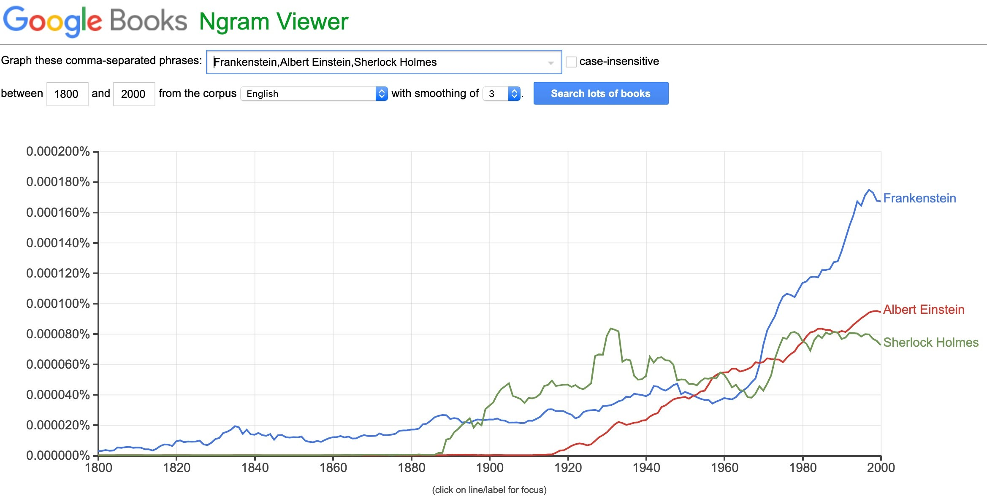
NLP Basic Terminology (cont.)
Word unigrams: show, me, movies, directed, …
Bigrams: show me, me movies, movies directed, …
Trigrams: show me movies, me movies directed, …
https://books.google.com/ngrams

Slide 37
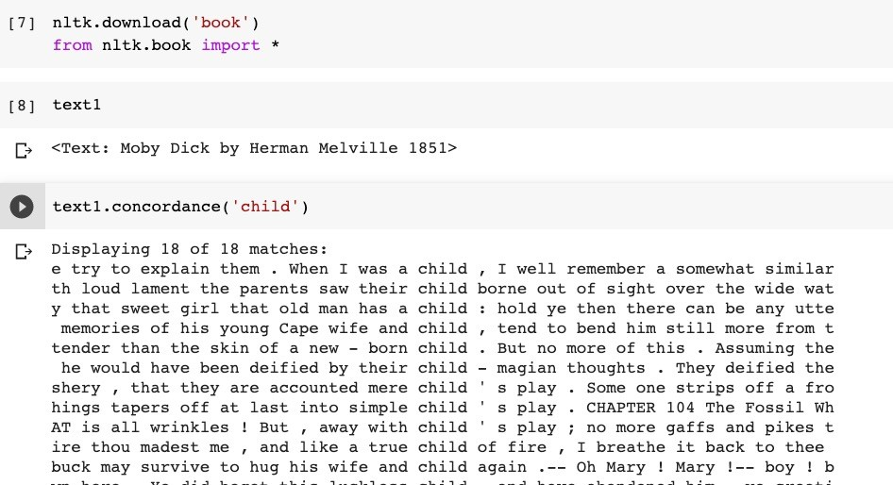
Counting in NLTK
Word frequencies, etc.
Corpora in NLTK!

Slide 38
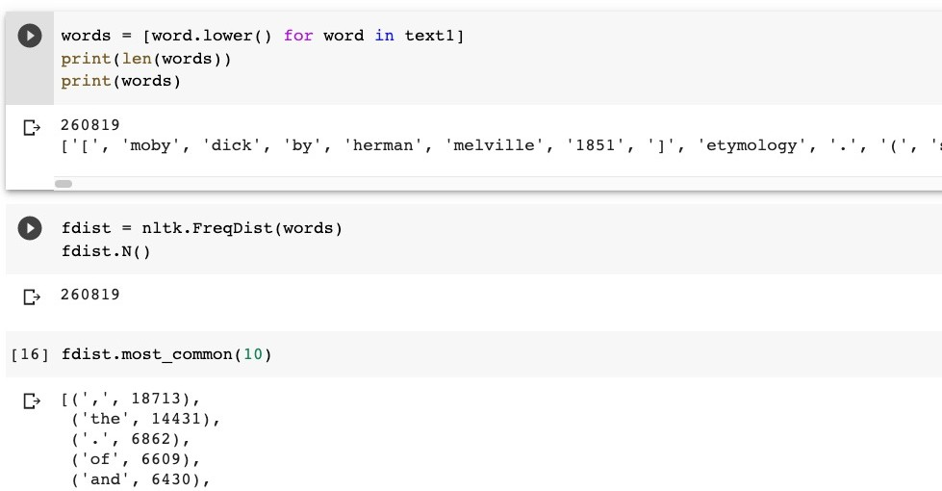
Counting in NLTK (cont.)

Slide 39
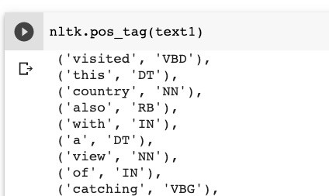
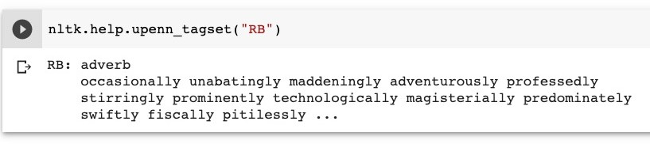
Part-of-speech Tagging in NLTK
Sometimes lexical items are too specific:
Don't generalize well
Sparse data problems
Grouping words into a small set of word classes or lexical categories can be useful for many applications
Part-of-speech is a common method of categorizing words
Grounded in linguistic theory

Slide 40

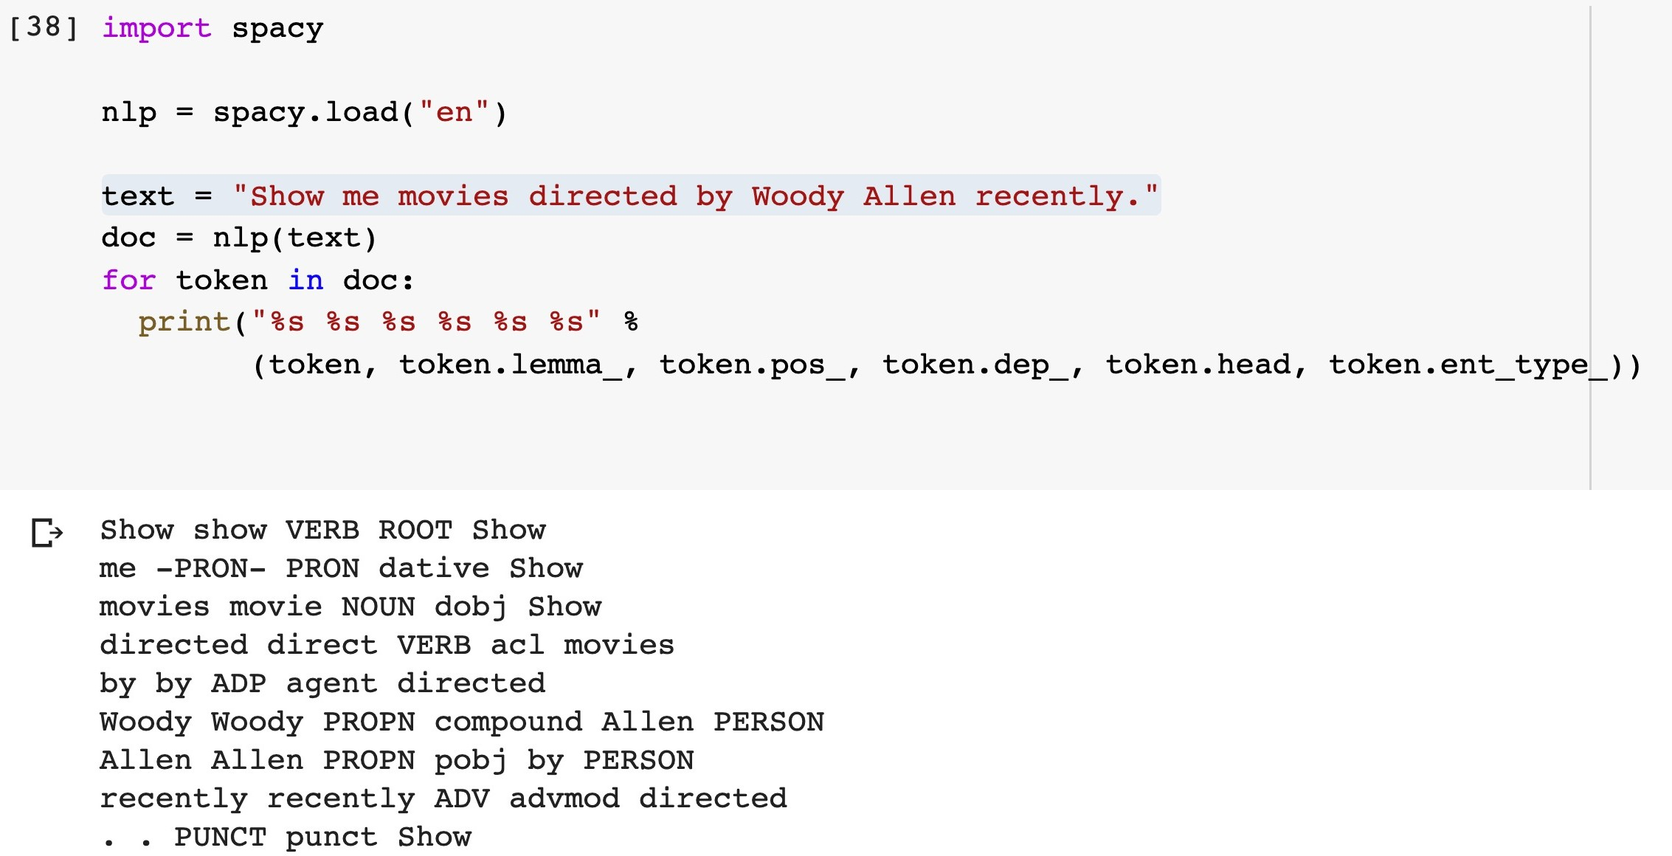
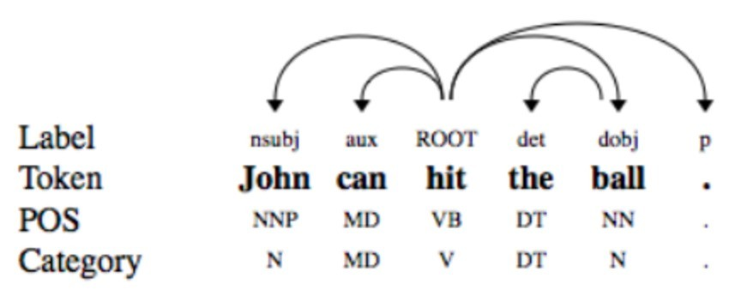
NLP Basic Terminology (cont.)
https://spacy.io/
Using Spacy
POS tags, dependency parse tree, named entities

Slide 41
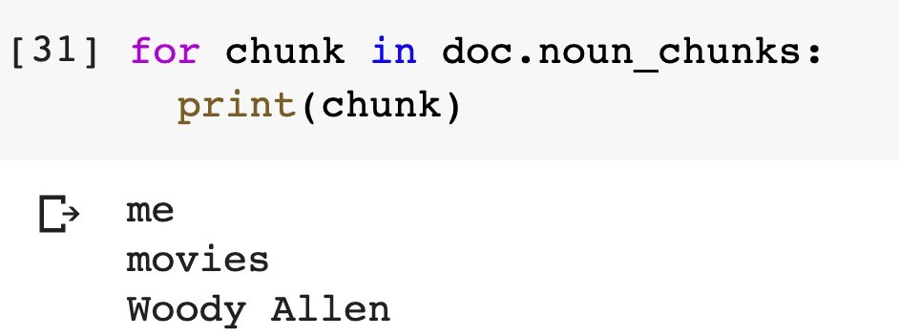
NLP Basic Terminology (cont.)
Chunking
“Show me movies directed by Woody Allen recently.”
Chunking
breaking down a diﬃcult text into more manageable pieces
i.e., noun phrases

Slide 42
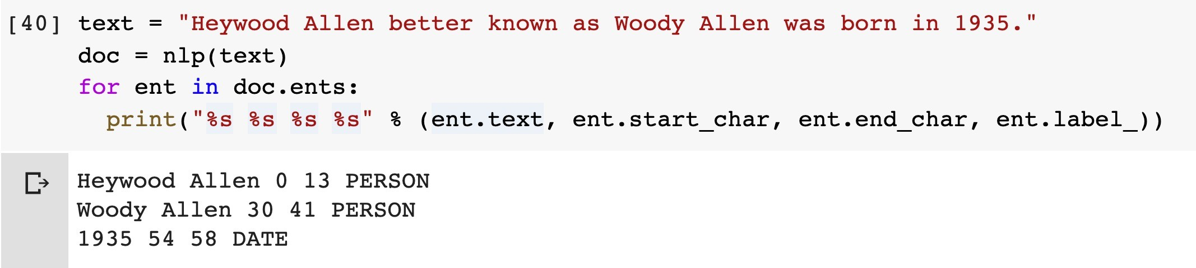
NLP Basic Terminology (cont.)
Named entity tagging
Named entities:
Person, location, organization, date, number, etc.

Slide 43
Introduction to NLTK (cont.)
Text material
Raw text
Annotated Text
Tools
Part of speech taggers
Semantic analysis
Resources
WordNet, Treebanks

Slide 44
NLTK
corpus readers
tokenizers
stemmers
taggers
parsers
wordnet
semantic interpretation
clusterers
evaluation metrics
….

Slide 45
Installing NLTK
Download and Install
http://nltk.org/install.html
Download NLTK data
>>> import nltk
>>> nltk.download()
You will need to import the necessary modules to create objects and call member functions
import ~ include objects from pre-built packages
FreqDist, ConditionalFreqDist are in nltk.probability
PlaintextCorpusReader is in nltk.corpus

Slide 46
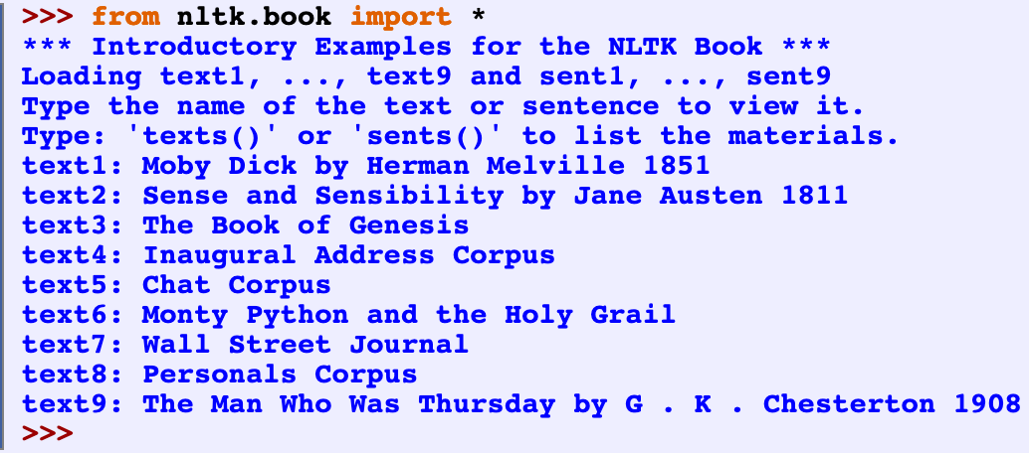
Using NLTK

Slide 47
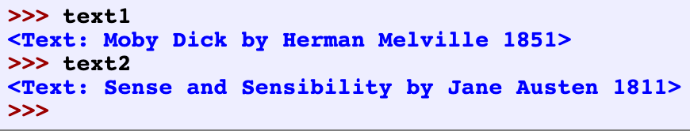
Using NLTK
Counting Vocabulary
>>> sorted(set(text3))
['!', "'", '(', ')', ',', ',)', '.', '.)', ':', ';', ';)', '?', '?)', 'A', 'Abel', 'Abelmizraim', 'Abidah’,
'Abide', 'Abimael', 'Abimelech', 'Abr', 'Abrah', 'Abraham', 'Abram', 'Accad’,
'Achbor', 'Adah', ...]
>>> len(set(text3))
2789
>>>

Slide 48
Tokenization
The simplest way to represent a text is with a single string.
Often, it is more convenient to work with a list of tokens.
The task of converting a text from a single string to a list of tokens is known as tokenization.
Tokenization is harder that it seems
I’ll see you in New York.
The aluminum-export ban.

Slide 49
Tokenization Example
The simplest approach is to use “graphic words” (i.e., separate words using whitespace)
Another approach is to use regular expressions to specify which substrings are valid words.
sent = "The cat is very cute"
tokens = nltk.word_tokenize(sent)
print(tokens)

Slide 50
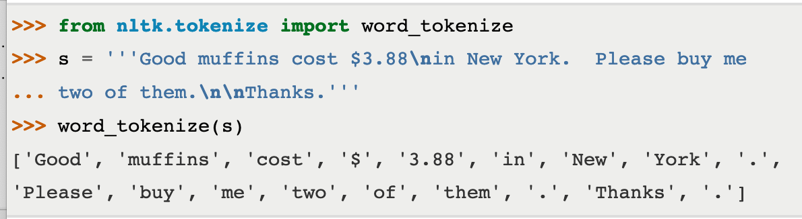
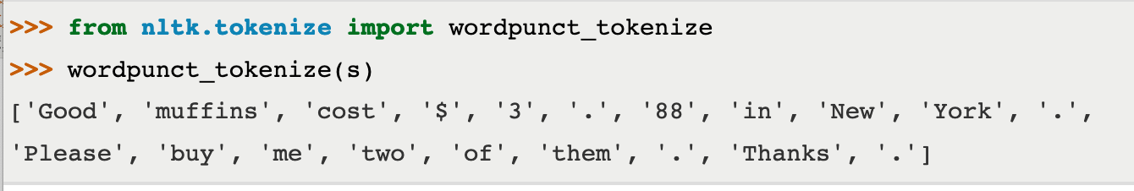
Tokenization Example

Slide 51
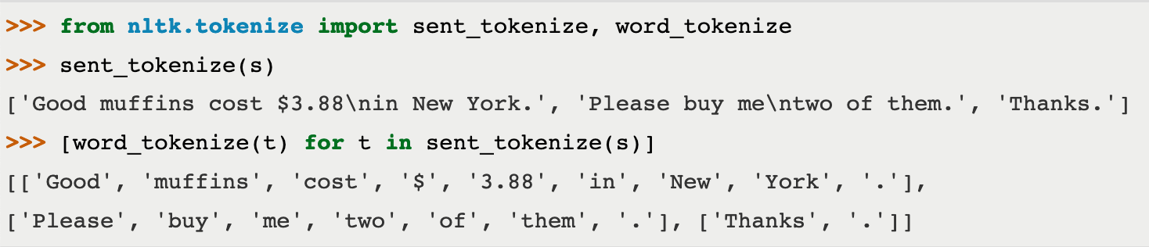
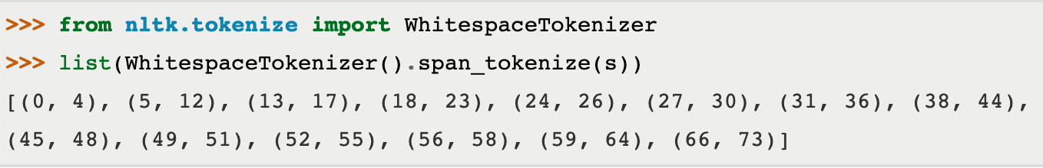
Tokenization Example
Operate at the level of sentences
Token Spans

Slide 52
Tokenization Example
Tokenizer for tweets
>>> from nltk.tokenize import TweetTokenizer
>>> tknzr = TweetTokenizer()
>>> s0 = "This is a cooool #dummysmiley: :-) :-P <3 and some arrows < > -> <--"
>>> tknzr.tokenize(s0)
['This', 'is', 'a', 'cooool', '#dummysmiley', ':', ':-)', ':-P', '<3', 'and', 'some', 'arrows', '<', '>', '->', '<--']

Slide 53
Tokenization Example
using strip_handles and reduce_len parameters:
>>> from nltk.tokenize import TweetTokenizer
>>> tknzr = TweetTokenizer(strip_handles=True, reduce_len=True)
>>> s1 = '@remy: This is waaaaayyyy too much for you!!!!!!’
>>> tknzr.tokenize(s1)
[':', 'This', 'is', 'waaayyy', 'too', 'much', 'for', 'you', '!', '!', '!']

Slide 54
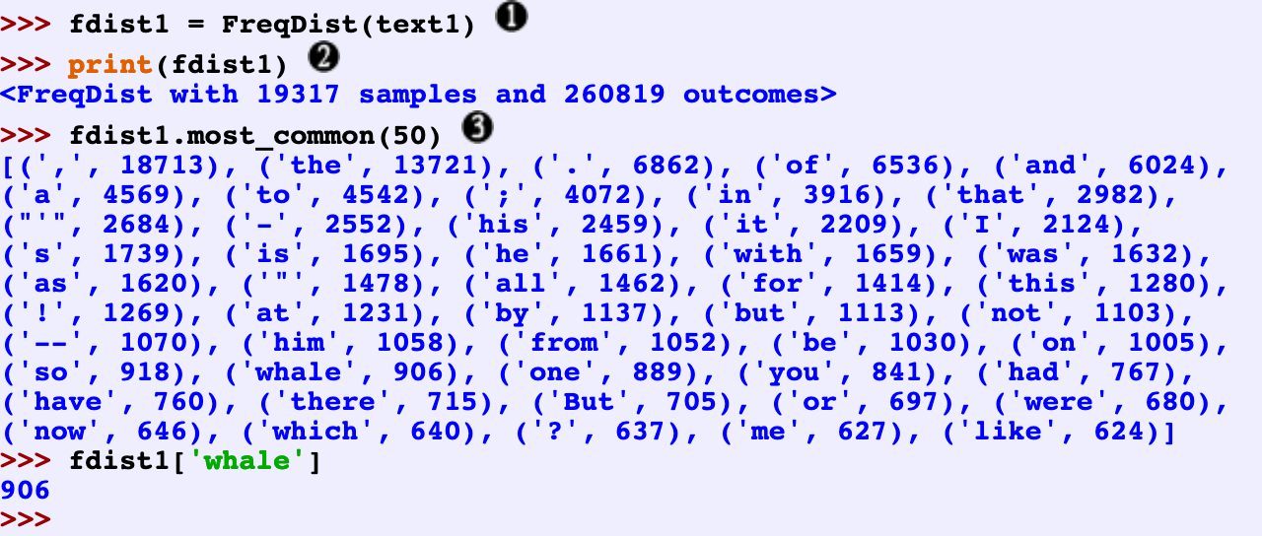
Simple Statistics with NLTK
Frequency Distributions
https://www.nltk.org/book/ch01.html

Slide 55
Sentence Polarity
The Sentence Polarity dataset contains 5331 positive and 5331 negative processed sentences.
>>> from nltk.corpus import sentence_polarity
>>> sentence_polarity.sents()
[['simplistic', ',', 'silly', 'and', 'tedious', '.'], ["it's", 'so', 'laddish', 'and', 'juvenile', ',', 'only', 'teenage', 'boys', 'could', 'possibly', 'find', 'it', 'funny', '.'], ...]
>>> sentence_polarity.categories() ['neg', 'pos’]
>>> sentence_polarity.sents()[1]
["it's", 'so', 'laddish', 'and', 'juvenile', ',', 'only', 'teenage', 'boys', 'could', 'possibly', 'find', 'it', 'funny', '.']

Slide 56
Twitter Corpus
NLTK's twitter corpus currently contains a sample of 20k Tweets retrieved from the Twitter Streaming API.
>>> from nltk.corpus import twitter_samples
>>> twitter_samples.fileids()
['negative_tweets.json', 'positive_tweets.json', 'tweets.20150430-223406.json’]
>>> twitter_samples.strings('tweets.20150430-223406.json’)
['RT @KirkKus: Indirect cost of the UK being in the EU is estimated to be costing Britain \xa3170 billion per year! #BetterOffOut #UKIP', ...]
>>> twitter_samples.tokenized('tweets.20150430-223406.json’)
[['RT', '@KirkKus', ':', 'Indirect', 'cost', 'of', 'the', 'UK', 'being', 'in', ...], ['VIDEO', ':', 'Sturgeon', 'on', 'post-election', 'deals', 'http://t.co/BTJwrpbmOY'], ...]

Slide 57
Reading Materials
Reading: Chapter 2 from Natural Language Annotation for Machine Learning: A Guide to Corpus-Building for Applications, Pustejovsky, James https://www.oreilly.com/library/view/natural-language-annotation/9781449332693/

Slide 58
References
Leech, G
2005 ‘Adding Linguistic Annotation’, in M. Wynne, Developing Linguistic Corpora: a Guide to Good Practice (Oxford: Oxbrow Books), pp. 17-29
[http://ahds.ac.uk/linguistic-corpora/]
Hunston, S.
2002 Corpora in Applied Linguistics (Cambridge: Cambridge University Press)
McEnery, A
2003 ‘Corpus Linguistics’, in R. Mitov (ed.), The Oxford Handbook of Computational Linguistics (Oxford: Oxford University Press), pp. 448-463
https://www.nltk.org/book/

Slide 59
Another NLP Toolkit - Spacy

Slide 60
Spacy
spaCy is a free, open-source library for advanced Natural Language Processing (NLP) in Python.
It can be used to build information extraction or natural language understanding systems, or to pre-process text for deep learning.
https://spacy.io/

Slide 61
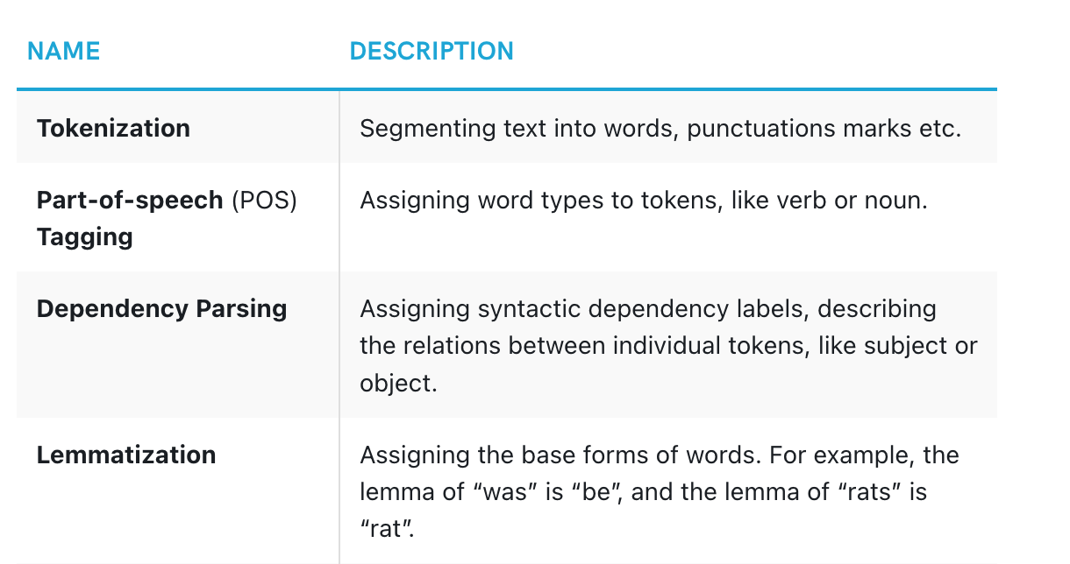
Spacy
https://spacy.io/

Slide 62
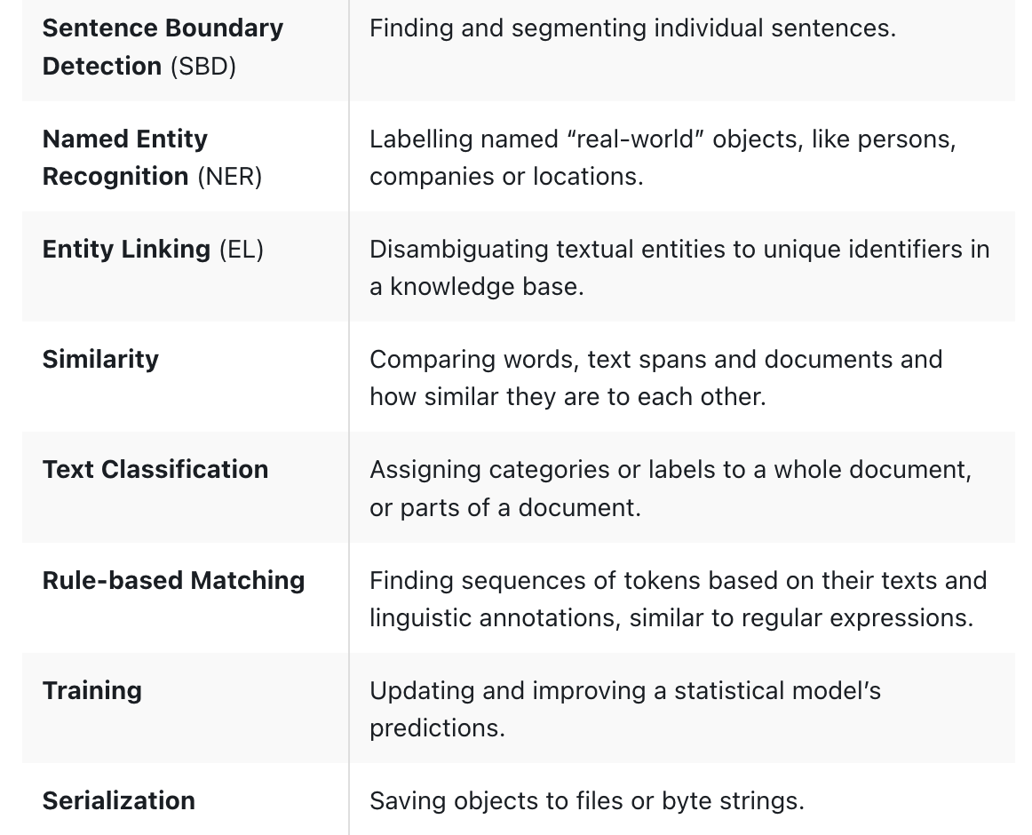
Spacy
https://spacy.io/

Slide 63
Spacy - Statistical Models
While some of spaCy’s features work independently, others require trained pipelines to be loaded, which enable spaCy to predict linguistic annotations – for example, whether a word is a verb or a noun.
A trained pipeline can consist of multiple components that use a statistical model trained on labeled data. spaCy currently offers trained pipelines for a variety of languages, which can be installed as individual Python modules.
For a general-purpose use case, the small, default packages are always a good start. They typically include the following components:
https://spacy.io/

Slide 64
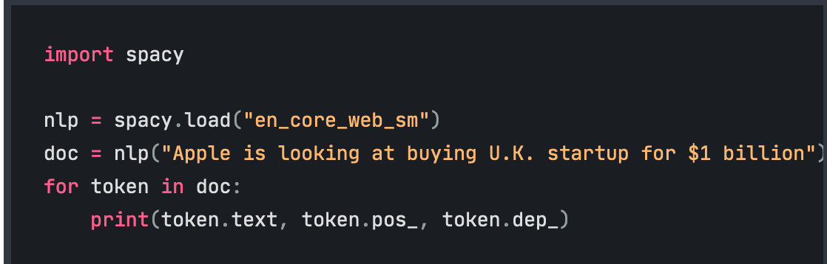
Spacy – Linguistic Annotations
spaCy provides a variety of linguistic annotations to give you insights into a text’s grammatical structure. This includes the word types, like the parts of speech, and how the words are related to each other.
https://spacy.io/

Slide 65
Spacy - Tokenization
First, the raw text is split on whitespace characters, similar to text.split(' '). Then, the tokenizer processes the text from left to right. On each substring, it performs two checks:
Does the substring match a tokenizer exception rule? For example, “don’t” does not contain whitespace, but should be split into two tokens, “do” and “n’t”, while “U.K.” should always remain one token.
Can a prefix, suffix or infix be split off? For example punctuation like commas, periods, hyphens or quotes.
https://spacy.io/

Slide 66
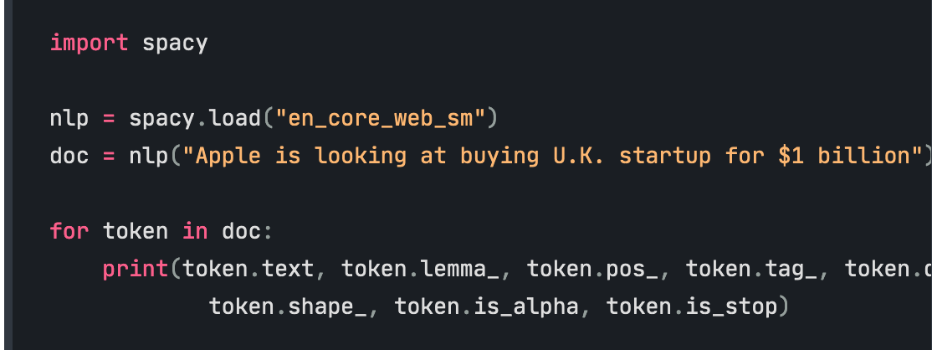
Spacy – POS Tagging
After tokenization, spaCy can parse and tag a given Doc. This is where the trained pipeline and its statistical models come in, which enable spaCy to make predictions of which tag or label most likely applies in this context.
https://spacy.io/

Slide 67
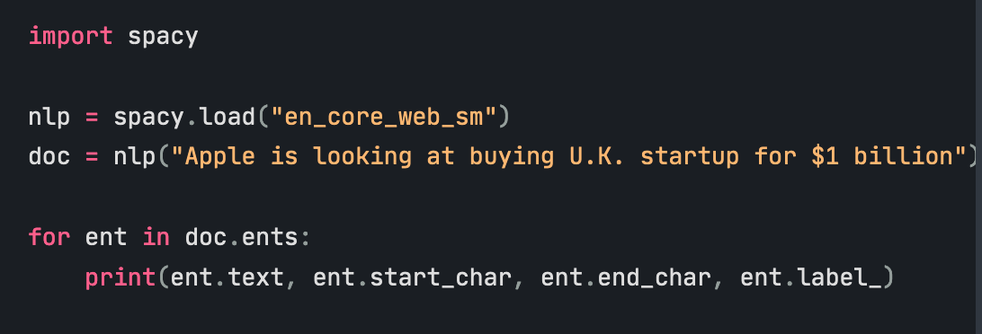
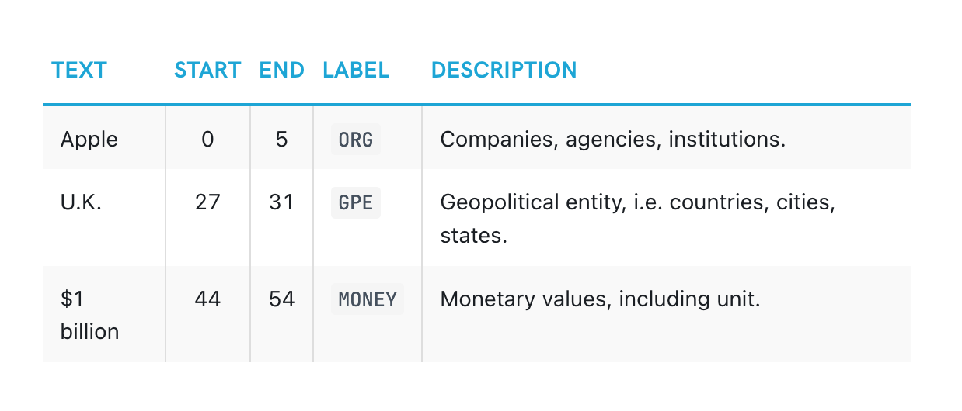
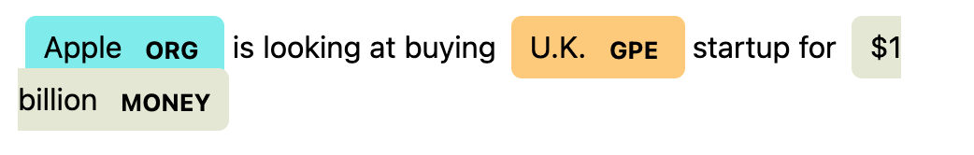
Spacy – Named Entities
https://spacy.io/

Slide 68
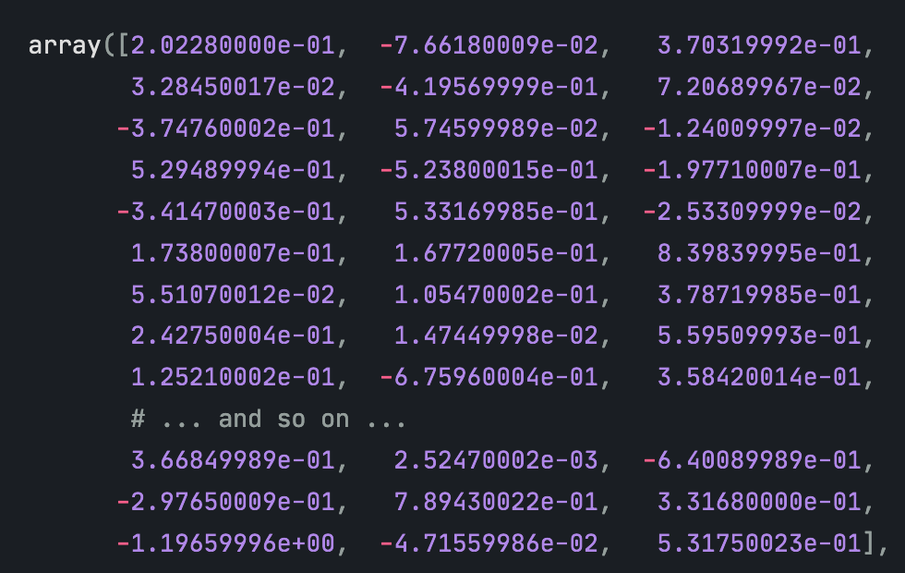
Spacy – Word Vectors & Similarity
Similarity is determined by comparing word vectors or “word embeddings”, multi-dimensional meaning representations of a word.
https://spacy.io/

Slide 69
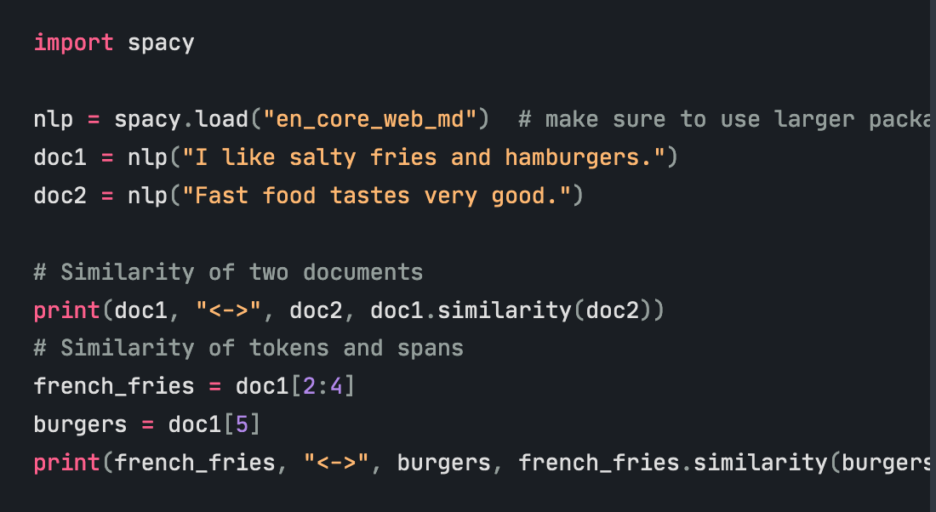
Spacy – Word Vectors & Similarity
Similarity is determined by comparing word vectors or “word embeddings”, multi-dimensional meaning representations of a word.
https://spacy.io/

Slide 70
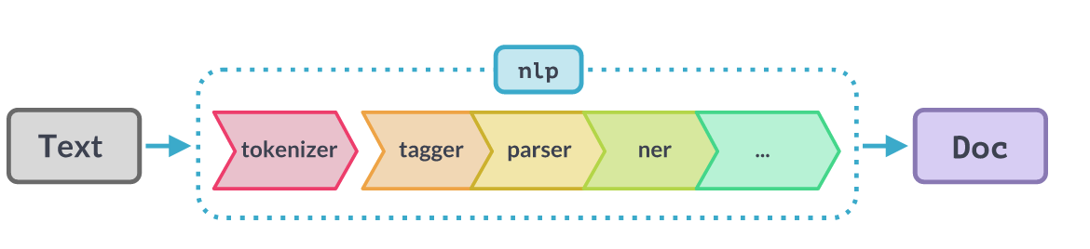
Spacy – Pipelines
https://spacy.io/

Slide 71
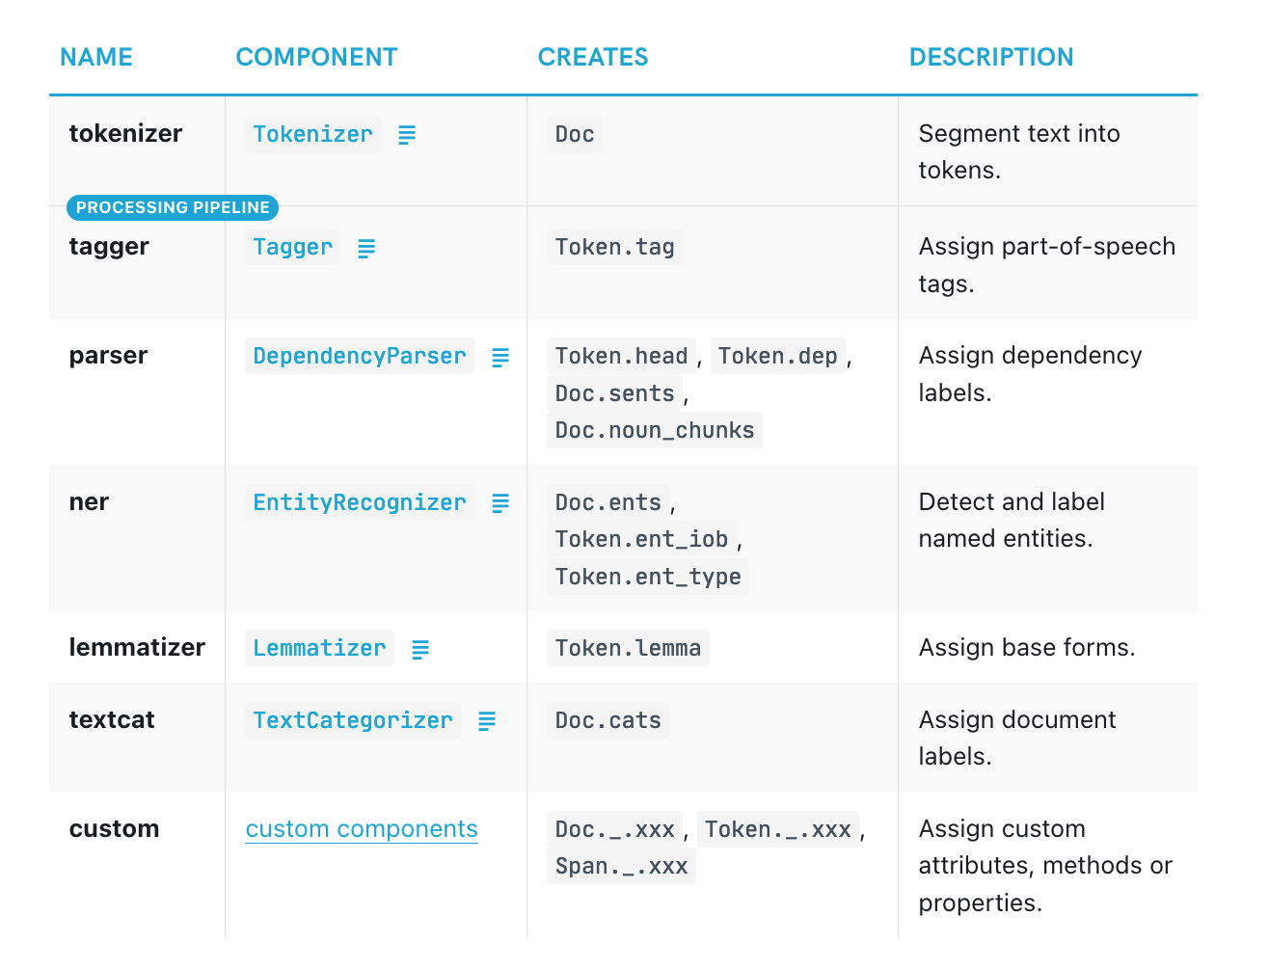
Spacy – Pipelines
https://spacy.io/

