Slide 1
NLP 220 Data Science and Machine Learning Fundamentals
Fall 2022 Lecture 4 Jalal Mahmud
Including slides adapted from Marilyn Walker, Dan Jurafsky, Mu Li and Alex Smola

Slide 2
Outline for Today
Naïve Bayes Classification
Decision Trees
Support Vector Machines
Optional Readings:
http://web.mit.edu/zoya/www/SVM.pdf
https://www.di.ens.fr/~mallat/papiers/svmtutorial.pdf

Slide 3
Naïve Bayes Intuition
Simple (“naïve”) classification method based on Bayes rule
Relies on very simple representation of document: Bag of words
it 6
I 5
the 4
to 3
and 3
seen 2
yet 1
would 1
whimsical 1
times 1
sweet 1
satirical 1
adventure 1
genre 1
fairy 1
humor 1
have 1
great 1
… …
I love this movie! It's sweet, but with satirical humor. The dialogue is great and the adventure scenes are fun... It manages to be whimsical and romantic while laughing at the conventions of the fairy tale genre. I would recommend it to just about anyone. I've seen it several times, and I'm always happy to see it again whenever I have a friend who hasn't seen it yet!
fairy
it and
always love_{to} ^{it} whimsical it
I
seen
are
anyone
friend
happy
dialogue
adventure
recommend
satirical
_{who}sweet of _{movie}
it I
it ^{I} but ^{to} romantic
several
yet it
again
the
humor
the
seen
would
to scenes I
the manages
fun ^{the} times _{and}
I
and
about
whenever
have
while
conventions with

Slide 4


Naïve Bayes Intuition (cont.)
The bag of words representation
seen | 2
sweet | 1
whimsical | 1
recommend | 1
happy | 1
... | ...
f(
)=c

Slide 5
Bayes’ Rule Applied to Documents and Classes
For a document d and a class c
_{P(c | d) =} P(d | c)P(c)
P(d)

Slide 6





Naïve Bayes Classifier (I)
c_{MAP} = argmax P(c | d)
MAP is “maximum a posteriori” = most likely class
c∈C
P(d | c)P(c)
= argmax
c∈C
Bayes Rule
P(d)
= argmax P(d | c)P(c)
c∈C
Dropping the denominator

Slide 7


Naïve Bayes Classiﬁer (II)
c_{MAP} = argmax P(d | c)P(c)
c∈C
= argmax P(x₁, x₂,…, x_{n} | c)P(c)
c∈C
Document d represented as features x1..xn

Slide 8

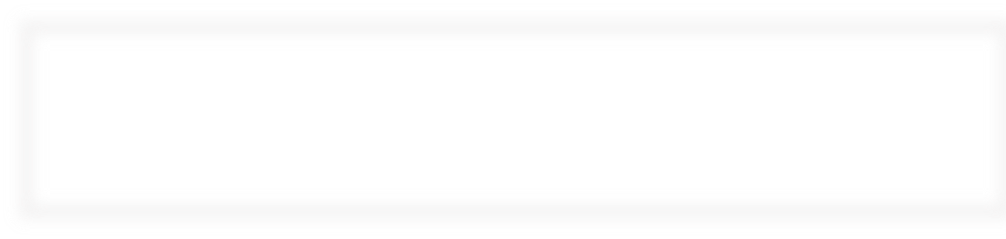


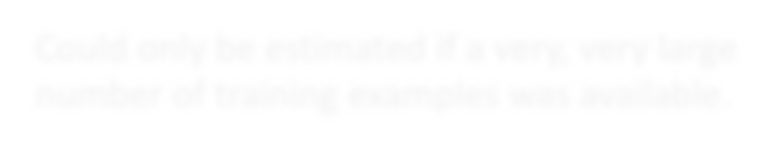
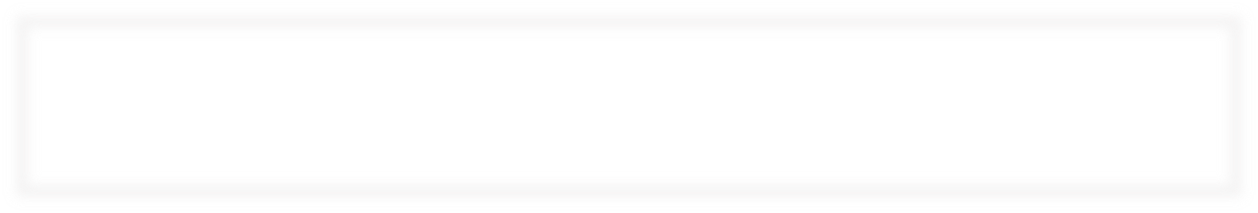
Naïve Bayes Classifier (III)
c_{MAP} = argmax P(x₁, x₂,…, x_{n} | c)P(c)
c∈C
How often does this class occur?
We can just count the relative frequencies in a corpus
O(|X|^{n}•|C|) parameters
Could only be estimated if a very, very large number of training examples was available.

Slide 9
Multinomial Naïve Bayes Independence Assumptions
P(x₁, x₂,…, x_{n} | c)
P(x₁,x₂,…,x_{n} | c) = P(x₁ | c) • P(x₂ | x₁,c)• … • P(x_{n} | x₁, x₂, …,x_{n-1},c)
Bag of Words assumption: Position doesn’t matter
Conditional Independence: Assume the feature probabilities
P(x_{i}|c_{j}) are independent given the class c.
P(x₁,…, x_{n} | c) = P(x₁ | c)• P(x₂ | c)• P(x₃ | c)•... • P(x_{n} | c)

Slide 10
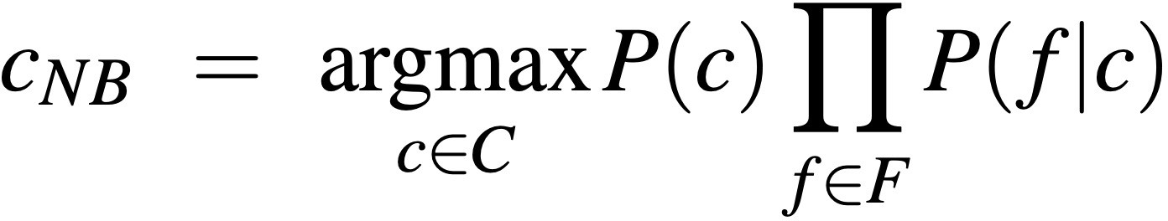
Multinomial Naïve Bayes Classifier
c_{MAP} = argmax P(x₁, x₂,…, x_{n} | c)P(c)
c∈C

Slide 11
Applying Multinomial Naive Bayes Classiﬁers to Text Classiﬁcation
positions ¬ all word positions in test document
∏
c_{NB} = argmax P(c_{j} )
P(x_{i} | c_{j} )
c_{j}∈C
i∈ positions

Slide 12
Learning the Multinomial Naïve Bayes Model
First attempt: maximum likelihood estimates
simply use the frequencies in the data
Counting!
doccount(C = c )
ˆ
j
P(c ) =
j
N
doc
count(w_{i}, c_{j} )
P^{ˆ}(w_{i} | c_{j} ) =
∑ count(w, c )
j
w∈V

Slide 13
Parameter estimation
count(w_{i}, c_{j} )
fraction of times word w_{i} appears among all words in documents of topic c_{j}
P^{ˆ}(w_{i} | c_{j} ) =
∑ count(w, c )
j
w∈V
Create mega-document for topic j by concatenating all docs in this topic
Use frequency of w in mega-document

Slide 14
Problem with Maximum Likelihood
What if we have seen no training documents with the word fantastic
and classiﬁed in the topic positive (thumbs-up)?
Zero probabilities cannot be conditioned away, no matter the other evidence!
count("fantastic", positive)
P^{ˆ}("fantastic" positive) =
∑ count(w, positive)
w∈V
= 0
c_{MAP} = argmax_{c} P^{ˆ}(c)∏ P^{ˆ}(x_{i} | c)
i

Slide 15
Laplace (add-1) smoothing for Naïve Bayes
No more zero probabilities!
count(w_{i}, c)
count(w_{i}, c) +1
P^{ˆ}(w | c) =
∑ (count(w, c))
w∈V
P^{ˆ}(w | c) =
∑ (count(w, c) +1)
w∈V
i
i
count(w_{i}, c) +1
=
# &
% ∑ count(w, c)₍ + V
∃w∈V
′

Slide 16
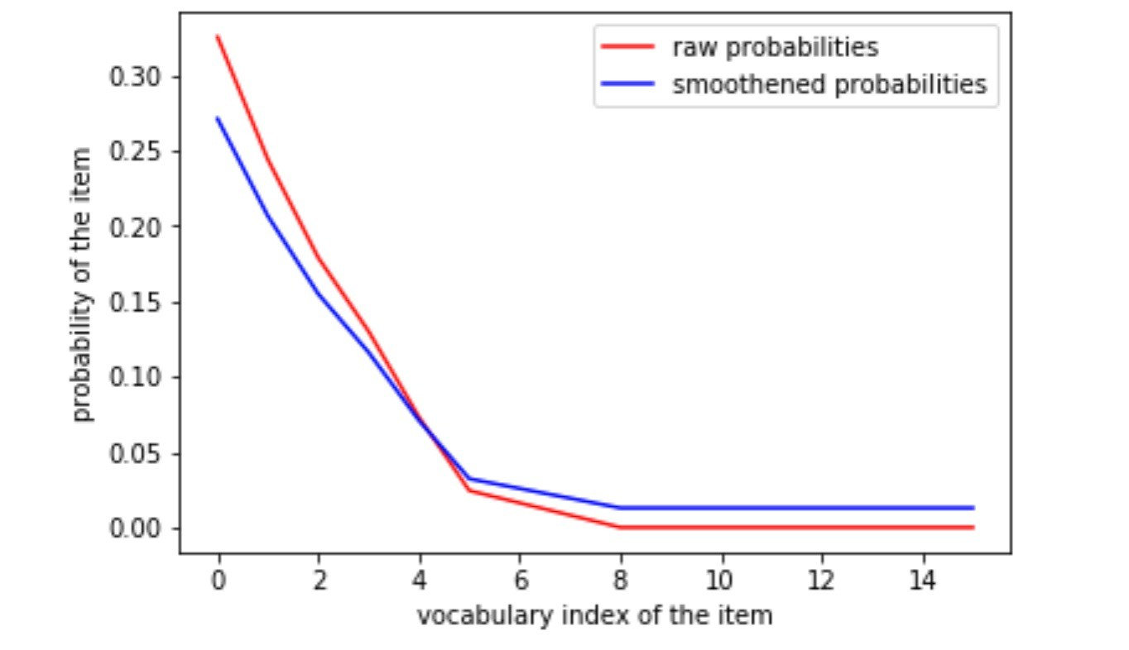
Laplace (add-1) smoothing for Naïve Bayes (Depiction)
Non-zero probabilities after smoothing.
* Items (samples) are sorted in order of decreasing probability
Zero probabilities

Slide 17
Multinomial Naïve Bayes: Learning
From the training corpus, extract Vocabulary
Calculate P(c_{j}) terms
For each c_{j} in C do
docs_{j} ¬ all docs with class =c_{j}
| docs_{j} |
P(c ) ←
j
| total # documents|
Calculate P(w_{k} | c_{j}) terms
Text_{j} ¬ single doc containing all docs_{j}
For each word w_{k} in Vocabulary
n_{k} ¬ # of occurrences of w_{k} in Text_{j}
n_{k} + α
P(w_{k} | c_{j} ) ←
Add ⍺
n + α | Vocabulary |

Slide 18
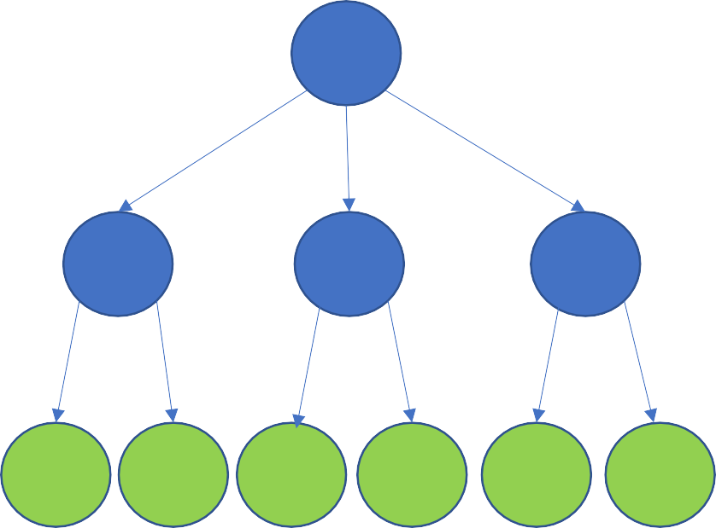
Decision Trees
Decision tree is a classifier in the form of a tree structure, where each node is either:
Decision node - specifies some test to be carried out on a single attribute-value, with one branch and sub-tree for each possible outcome of the test
Leaf node - indicates the value of the target attribute (class) of examples
A decision tree can be used to classify an example by starting at the root of the tree and moving through it until a leaf node, which provides the classification of the instance.

Slide 19
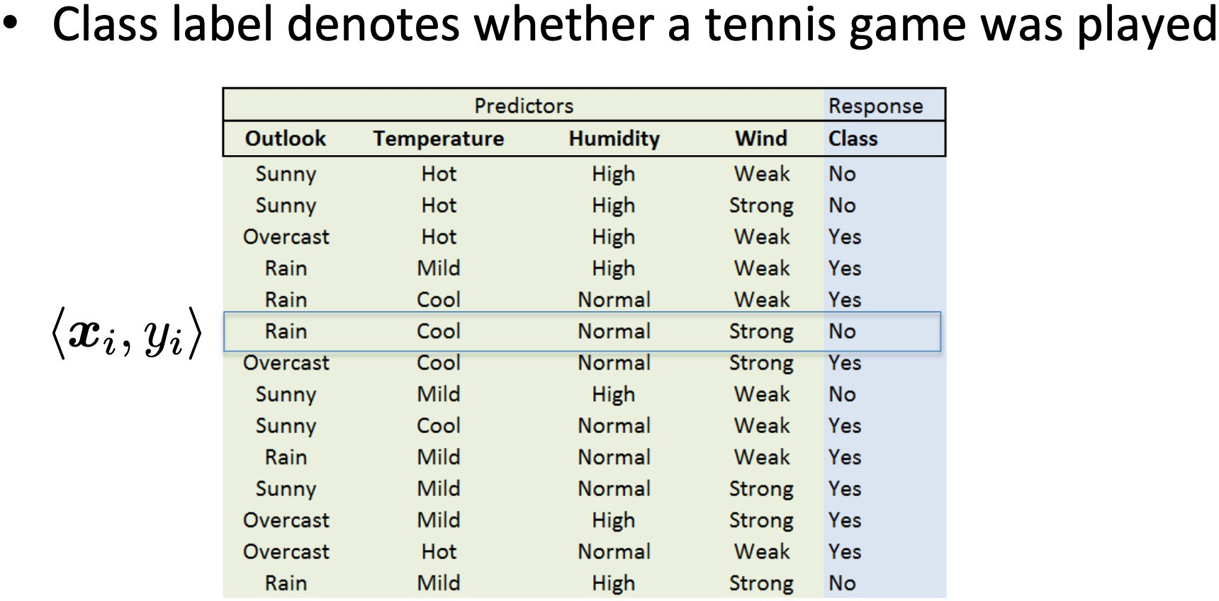
Decision Trees
Example from Eric Eaton, UPENN

Slide 20
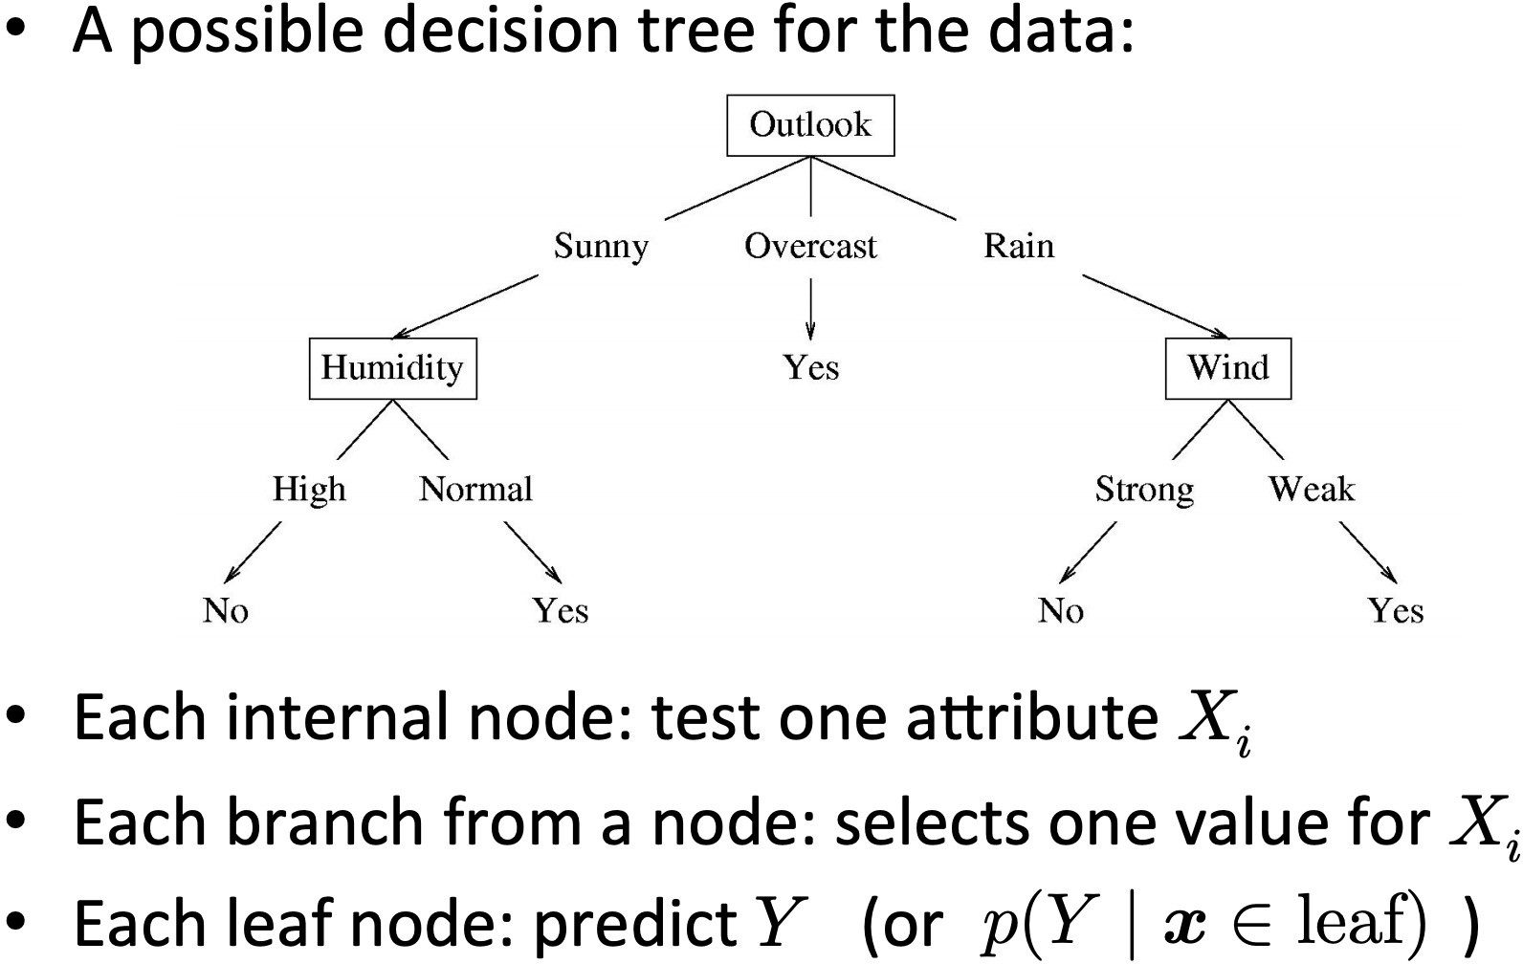
Decision Trees (Examples)
Example from Eric Eaton, UPENN

Slide 21
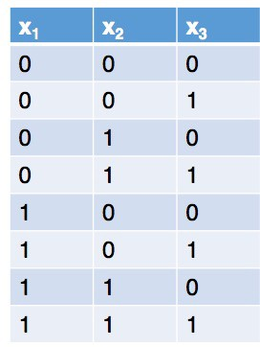
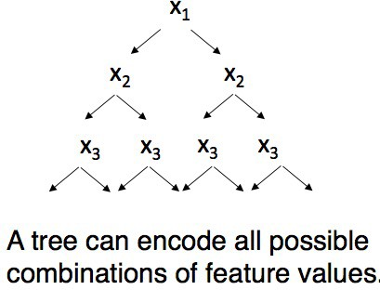
Decision Trees
Do you think decision tree learners explore all possible trees?

Slide 22
Decision Trees
Algorithm decides at each step what to split on next
Usually greedy

Slide 23















What are these classifiers doing?
An intuitive picture of the problem
f₂
Two features: f₁ and f₂ Two classes: + and - Depiction of all examples in the training set.
f₁

Slide 24
What classifier to use?
There may be a simple separator (e.g., a straight line in 2D or a hyperplane in general) or there may not
There may be “noise” of various kinds
There may be “overlap”
Some classifiers explicitly represent separators (e.g., straight lines), while for other classifiers the separation is done implicitly
Some classifiers just make a decision as to which class an object is in; others estimate class probabilities

Slide 25
Many different classification methods
Probabilistic models:
Naïve Bayes
Decision Models:
Decision Trees
Linear Models:
Support Vector Machine (SVM)
Linear regression
K-nearest neighbors
And many many more

Slide 26

















Linear versus non-linear algorithms
Linearly separable data: if all the data points can be correctly classified by a linear (hyperplanar) decision boundary
f₂
Two features: f₁ and f₂ Two classes: + and - Depiction of all examples in the training set.
f₁
Linear decision boundary

Slide 27




















Non-linearly separable data
f₂
Two features: f₁ and f₂ Two classes: + and - Depiction of all examples in the training set.
f₁
Set of linear classifiers

Slide 28
Non-linearly separable data
f₂
Two features: f₁ and f₂ Two classes: + and - Depiction of all examples in the training set.
f₁
Non-linear classifiers

Slide 29
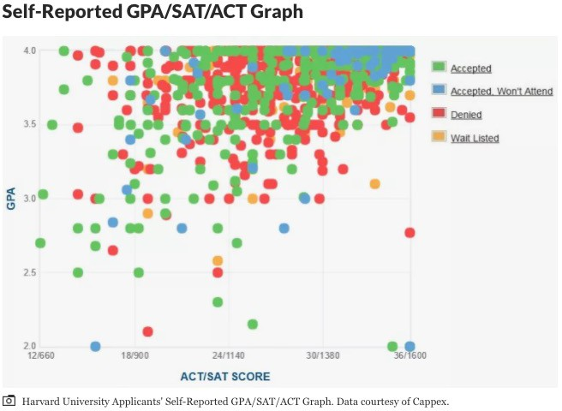
Example: College Admission
Plot from Thoughtco.com

Slide 30
Linear versus Non-linear algorithms
Linear or Non linear separable data?
We can find out empirically
Linear algorithms (algorithms that find a linear decision boundary)
When we think the data is linearly separable
Advantages
Simpler, less parameters
Disadvantages
High dimensional data (like for NLP) is usually not linearly separable
Example: Linear Regression, SVM
Note: we can use linear algorithms also for non linear problems

Slide 31
Linear versus Non-linear algorithms
Non-linear algorithms
When the data is non linearly separable
Advantages
More accurate
Disadvantages
More complicated, more parameters
Example: Decision Trees

Slide 32
Decision Trees
f₂
Two features: f₁ and f₂ Two classes: + and - Depiction of all examples in the training set.
f₁

Slide 33
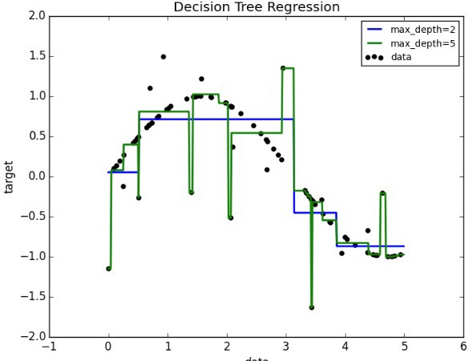
Decision tree can fit a nonlinear function

Slide 34
Building Decision Trees - Decision Stump
Decision tree with a single node
Decides how to classify examples with a single feature.
f <1200?
Which feature should be used?
Simplest solution:
Build a decision stump for each feature
Select according to accuracy on data
1
yes
no

Slide 35
Building Decision Trees
The central focus of the decision tree growing algorithm is selecting which attribute to test at each node in the tree. The goal is to select the attribute that is most useful for classifying examples.
Top-down, greedy search through the space of possible decision trees.
That is, it picks the best attribute and never looks back to reconsider earlier choices.

Slide 36
Building Decision Trees
Splitting criterion
Finding the features and the values to split on
for example, why test first “past tense” and not “negative emotion”?
Split that gives us the maximum information gain (or the
maximum reduction of uncertainty)
Stopping criterion
When all the elements at one node have the same class, no need to split further
In practice, one first builds a large tree and then one prunes it back (to avoid overfitting)

Slide 37
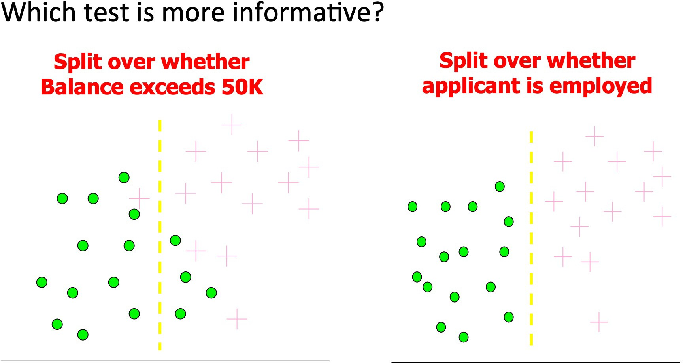
Information Gain
Imagine you need to determine who a bank can safely give credit to?
Based on slide by Pedro Domingos, UW.

Slide 38
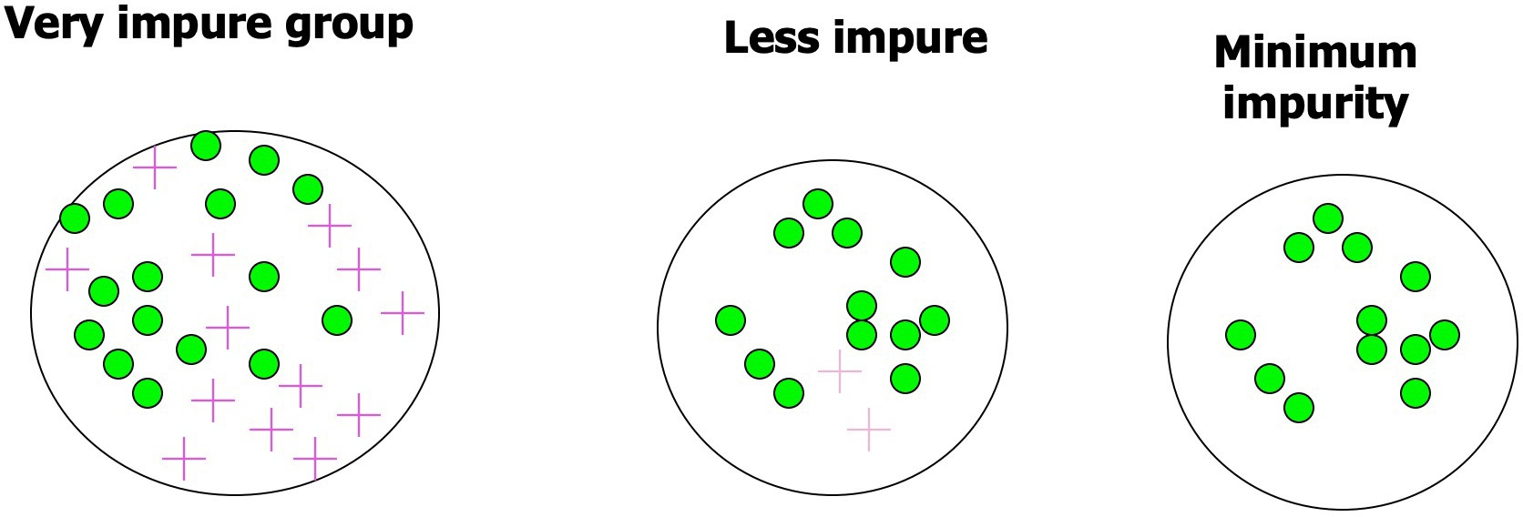
Impurity
Based on slide by Pedro Domingos, UW.

Slide 39
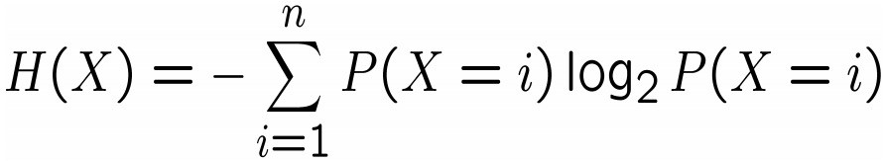
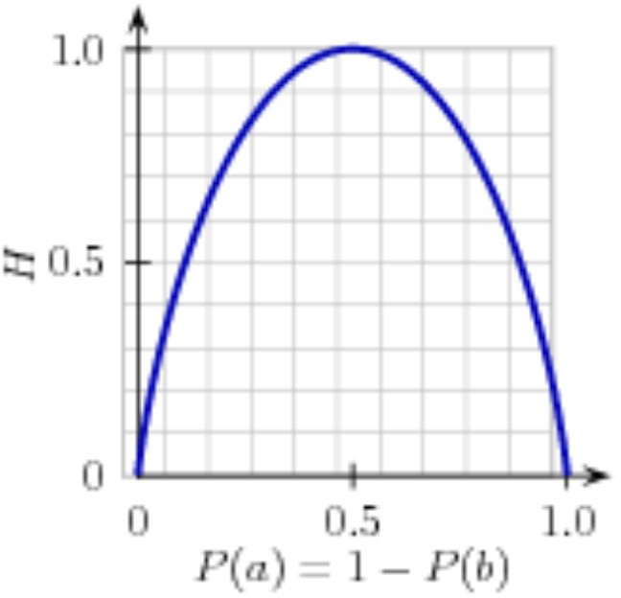
Entropy: A way to measure impurity
Entropy H(X) of a random variable X:
Binary Classification example, classes are a and b:
For a set of examples, P(a) is the proportion of examples of type a.

Slide 40
Entropy: A way to measure impurity
Entropy H(X) of a random variable X:
Binary Classification example, classes are a and b:
If P(a=0) => P(b) = 1
H(X) = -(0* log₂ 0 + 1 * log₂ 1) = 0
Same for P(a=1)! If P(a) = 0.5
H(X) = -(½ * log₂ ½ + ½ * log₂ ½ )
= 1 (½ * -1 + ½ * -1) = 1

Slide 41
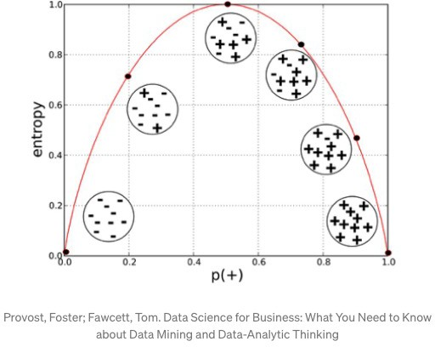
Entropy: A way to measure impurity
Entropy H(X) of a random variable X:

Slide 42
From entropy to information gain
How much more organized the labels become once we apply the decision stump?
We calculate the entropy for each of the decision stump's leaves, and take the average of those leaf entropy values (weighted by the number of samples in each leaf)
The information gain is then equal to the original entropy minus this new, reduced entropy.

Slide 43
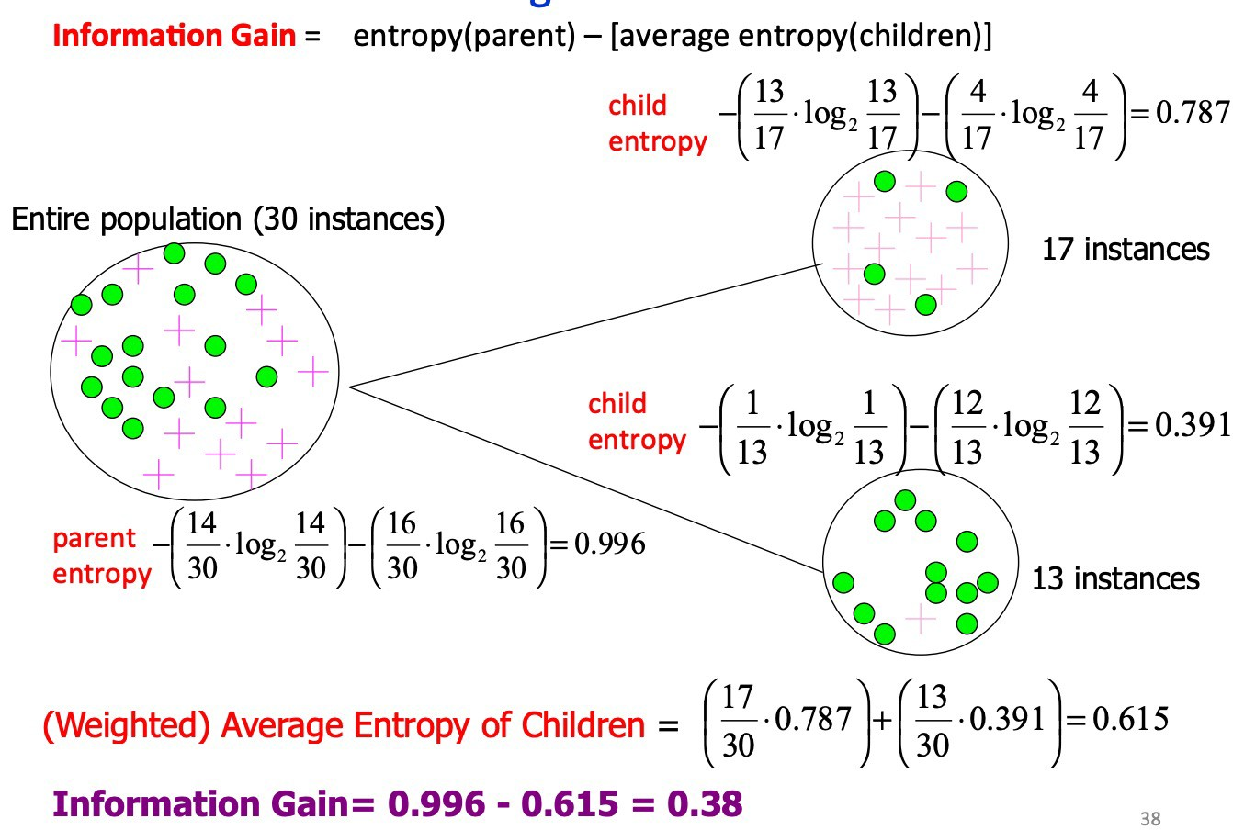
Calculating Information Gain
Based on slide by Pedro Domingos, UW.

Slide 44
Calculating Information Gain
Based on slide by Pedro Domingos, UW.

Slide 45
Impurity and Entropy
High Entropy
Medium Entropy
Low Entropy

Slide 46
Decision Trees: Strengths
Decision trees are able to generate understandable rules.
Decision trees perform classification without requiring much computation.
Decision trees are able to handle both continuous and categorical variables.
Decision trees provide a clear indication of which features are most important for prediction or classification.

Slide 47
Decision Trees: Weaknesses
Decision trees are prone to errors in classification problems with many classes and relatively small number of training examples.
Since each branch in the decision tree splits the training data, the amount of training data available to train nodes lower in the tree can become quite small.
Decision tree can be computationally expensive to train.
Need to compare all possible splits

Slide 48
Decision Trees: Weaknesses
Most decision-tree algorithms only examine a single field at a time. This leads to rectangular classification boxes that may not correspond well with the actual distribution of records in the decision space.
The fact that decision trees require that features be checked in a specific order limits their ability to exploit features that are relatively independent of one another.
Naive Bayes overcomes this limitation by allowing all features to act "in parallel."

Slide 49
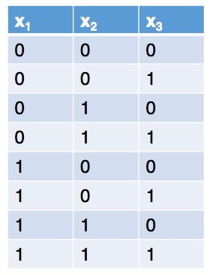
Decision trees can easily overfit
Two common techniques to avoid overfitting:
Restrict the maximum depth of the tree
Restrict the minimum number of instances that must be remaining before splitting further
If you stop creating a deeper tree before all instances at that node belong to the same class, use the majority class within that group as the final class for the leaf node.

Slide 50
Shallow Decision Tree
Shallow decision trees - trees that are too shallow might lead to overly simple models that can’t fit the data.
A model that is underfit will have high training and high testing error. Hence, bad performance on training and test sets indicates underfitting which means the set of hypotheses are not complex enough (decision trees that are shallow ) to include the true but unknown prediction function.
The shallower the tree the less variance we have in our predictions

Slide 51
Can we average the output of multiple decision trees?
Averaging out the predictions of multiple classifiers will drastically reduce the variance.
Averaging is not specific to decision trees; it can work with many different learning algorithms. But it works particularly well with decision trees.
Why averaging?
If two trees pick different features for the very first split at the top of the tree, then it’s quite common for the trees to be completely different.
So decision trees tend to have high variance. To fix this, we can reduce the variance of decision trees by taking an average answer of a bunch of decision trees.

Slide 52
Pruning a Decision Tree
The reason for pruning is that the trees prepared by the base algorithm can be prone to overfitting as they become incredibly large and complex.
Pruning is a technique in machine learning and search algorithms that reduces the size of decision trees by removing sections of the tree that provide little power to classify instances.
Pruning reduces the complexity of the final classifier, and hence improves predictive accuracy by the reduction of overfitting.

Slide 53
High Variance
A model has high variance if it is very sensitive to (small) changes in the training data.
Decision trees are generally unstable considering that a small change in the data set can result in a very different set of splits. This results in high variance.
This is mainly due to the hierarchical nature of decision trees, since a change in split points in the initial stages will affect all the subsequent splits.

Slide 54
Support Vector Machines

Slide 55
Support Vector Machines
Data: <x_{i},y_{i}>, i=1,..,|D|
x_{i} Ε R^{d}
y_{i} Ε {-1,+1}
f(x)
=-1
=+1
All hyperplanes in R^{d} are parameterized by a vector (w) and a constant b (bias). Hence, they can be expressed as w•x+b=0 (remember the equation for a hyperplane from algebra!)
Our aim is to find such a hyperplane f(x)=sign(w•x+b), that can correctly classify our data.

Slide 56


Support Vector Machines (SVM)
Another family of linear algorithms
Intuition (Vapnik, 1965)
If the classes are linearly separable:
Separate the data
Place hyper-plane “far” from the data:
large margin
Statistical results guarantee good generalization
BAD
From Gert Lanckriet, Statistical Learning Theory Tutorial

Slide 57
SVM: Large margin classifier
Another family of linear algorithms
Intuition (Vapnik, 1965)
If the classes are linearly separable:
Separate the data
Place hyper-plane “far” from the data:
large margin
Statistical results guarantee good generalization
GOOD
➔ Maximal Margin Classifier
From Gert Lanckriet, Statistical Learning Theory Tutorial

Slide 58
SVM: Large margin classifier
If not linearly separable
Allow some errors
Still, try to place hyperplane “far”
from each class
From Gert Lanckriet, Statistical Learning Theory Tutorial

Slide 59
SVM: Large Margin Classifiers
Advantages
Theoretically better (better error bounds)
Limitations
Computationally more expensive, large quadratic programming

Slide 60
So, what if it’s a non-linear problem?
f₂
Two features: f₁ and f₂ Two classes: + and - Depiction of all examples in the training set.
f₁
Set of linear classifiers

Slide 61
So, what if it’s a non-linear problem?
f₂
Two features: f₁ and f₂ Two classes: + and - Depiction of all examples in the training set.
f₁
Non-linear classifiers

Slide 62






So, what if it’s a non-linear problem?
=-1
=+1
What if the decision function is not a linear?
Slide from Pierre Dönnes.

Slide 63
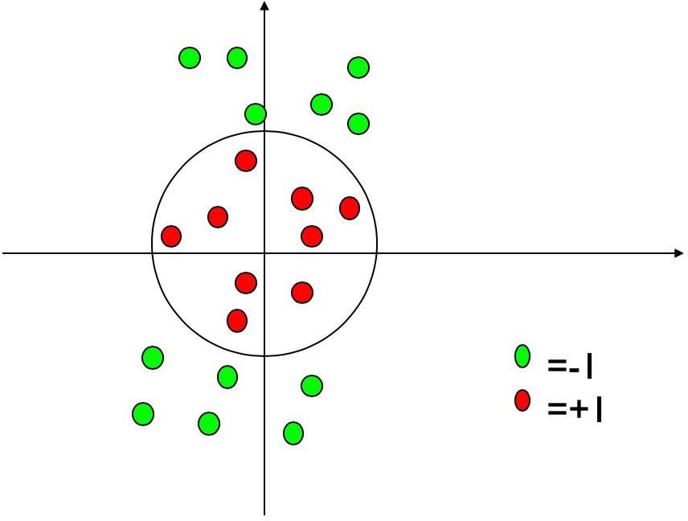
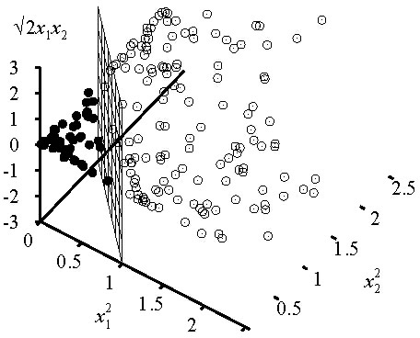
Kernel Trick
General idea: The original feature space can always be mapped to some higher-dimensional feature space where the training set is separable.
Φ: x → φ(x)
Slide from Pierre Dönnes.

Slide 64
So, what if it’s a non-linear problem?
Kernel methods: A family of non-linear algorithms
Transform the non linear problem in a linear one (in a different feature space)
Use linear algorithms to solve the linear problem in the new space
There are SVM learners in Scikit-Learn that have a kernel that does this kind of transform
http://scikit-learn.org/stable/modules/svm.html - svm-kernels
classifier = SklearnClassifier(svm.SVC()).train(train_sets)
class sklearn.svm.SVC(C=1.0, kernel=’rbf’, degree=3, gamma=’auto’, coef0=0.0, shrinking=True, probability=False, tol=0.001, cache_size=200, class_weight=None, verbose=False, max_iter=-1, decision_function_shape=’ovr’, random_state=None)
From Gert Lanckriet, Statistical Learning Theory Tutorial

Slide 65
Evaluation – F1-measure
Harmonic mean of recall and precision
For example, for the example utterance:
What movies has Tom Cruise has been in recently
If the classifier returns: movie.starring.actor, movie.genre, and movie.directed_by
TARGET SET
RETURNED SET
True Positives = {movie.starring.actor}
False Positives = {movie.directed_by,
movie_genre}
False Negatives = {movie.initial_release_date}
Movie. starring
.actor
Movie. Directed_by
Movie. Initial_release_date
Movie.genre

Slide 66
Evaluation – F1-measure (cont.)
In NLP we are always dealing with these kinds of errors.
Reducing the error rate for an application often involves two antagonistic efforts:
Increasing precision (minimizing false positives)
Increasing recall (minimizing false negatives)
Precision = TP / TP + FP
Recall = TP / TP + FN
F1 = (2 X Precision X Recall) / (Precision + Recall)

Slide 67
Evaluation – F1-measure (cont.)
Recall = ½ = 0.50 Precision = 1/3 = 0.33 F1 = 0.40
TARGET SET
RETURNED SET
True Positives = {movie.starring.actor}
False Positives = {movie.directed_by,
movie_genre}
False Negatives = {movie.initial_release_date}
Movie. starring
.actor
Movie. Directed_by
Movie. Initial_release_date
Movie.genre

Slide 68
Decision Tree – Additional Details

Slide 69
Construction of decision trees from data
We was how the decision tree classifies an example
We saw that a decision tree corresponds to a logical formula
So, instead of learning formulas, we can learn decision trees
But how can we learn decision trees?
That is, given the table with the examples, how can we automatically create a decision tree?
It should be consistent with the examples
And we also seek to build a small tree
Next, we present the ID3 tree building algorithm of Quinlan (1986)
It builds the tree recursively, from the root to the leaves
It seeks to build a small tree by a greedy attribute-picking strategy
It has several extented versions (see later)

Slide 70
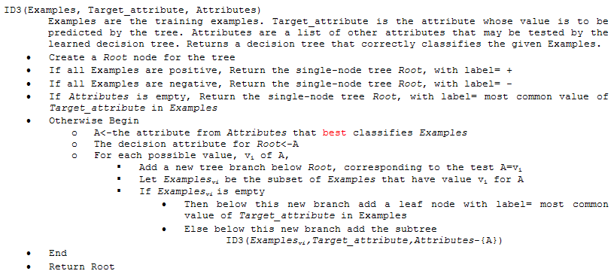
The ID3 algorithm

Slide 71
The ID3 algorithm - Summary
We select an attribute for each node
We create branches according to the possible values of this attribute
We also divide the data items according to the actual value of this attribute
We recursively repeat the algorithm for each branch and the corresponding data items
Stopping criterions:
All the data in the branch are positive – create a leaf with label positive
All the data in the branch are negative – create a leaf with label negative
No data in the branch – create a leaf with the most common label at the parent node
No more attributes to test (this means that the data in this branch is contradictory ) – create a leaf with the most common label

Slide 72
How to select the attribute for a node?
We want to build a small (shallow) tree
Building stops when the data in all branches is “clean” – that is, the positive and negative examples do not mix
Our heuristics will be to chose the attribute that gives the largest decrease in the “impurity” of the data
There are many possible ways to formally define the impurity
One possibility is to use the notion of entropy
We will define the information gain as the expected reduction of entropy
At each node, we will calculate the information gain for each attribute, and select the one that gives the largest information gain

Slide 73
Main properties of ID3
It was invented for discrete features (involving binary features)
It does not restrict the hypothesis space in advance (has no “modeling assumption”) , so it can create a consistent decision tree for any dataset that contains no contradicting samples
It has a “preference bias”, that is, it tries to put the attributes with high information gain close to the root

Slide 74
Main properties of ID3
The decision for the best attribute is greedy, and there is no backtracking, so the resulting tree is not guaranteed to be optimal (the smallest possible)
The result is easily interpretable for humans (e.g. the tree can be directly displayed or converted to a set of IF-THEN rules)
Not too sensitive to noise (erroneous labels), as the decision for the attributes (the entropy measure) is statistical (uses all data in the branch)
Though it becomes more and more sensitive as we get closer to the leaves

Slide 75
The pruning of decision trees
As we move down in the decision tree, fewer and fewer data samples remain in each branch
We make decisions based on fewer and fewer samples, so individual samples have a larger and larger influence
The chance of making a wrong decision due to e.g. a noisy (incorrectly labeled) example increases
If the data contains no mistakes (e.g. incorrectly labeled samples), the tree building stops only when a perfect decision tree is build for the training data (training error is 0%)
This tree is likely to be overly complex, with many of the leaves assigned based on only a couple of examples
It will quite probably overfit the training data
These are the two main reasons for pruning the tree

Slide 76
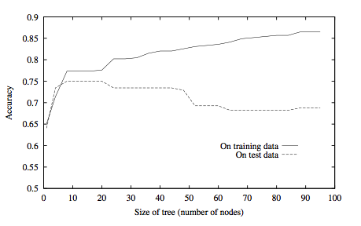
Overfitting example

Slide 77
The pruning of decision trees
There are two main approaches to reduce overfitting
In both cases we reduce the size of the tree
1. approach: early stopping of tree building
E.g. do not split a node further when the number of examples in the given branch is below a given limit
Assign a leaf corresponding to the majority of labels
2. approach: allow the tree to build fully, then post-prune the tree
Try to prune each node by replacing it by a leaf that is labeled according to the majority of labels
Measure the effectiveness of pruning on a validation set
Remove the node that gives the largest increase in the classification accuracy on the validation set
Stop pruning when there is no increase in accuracy

Slide 78
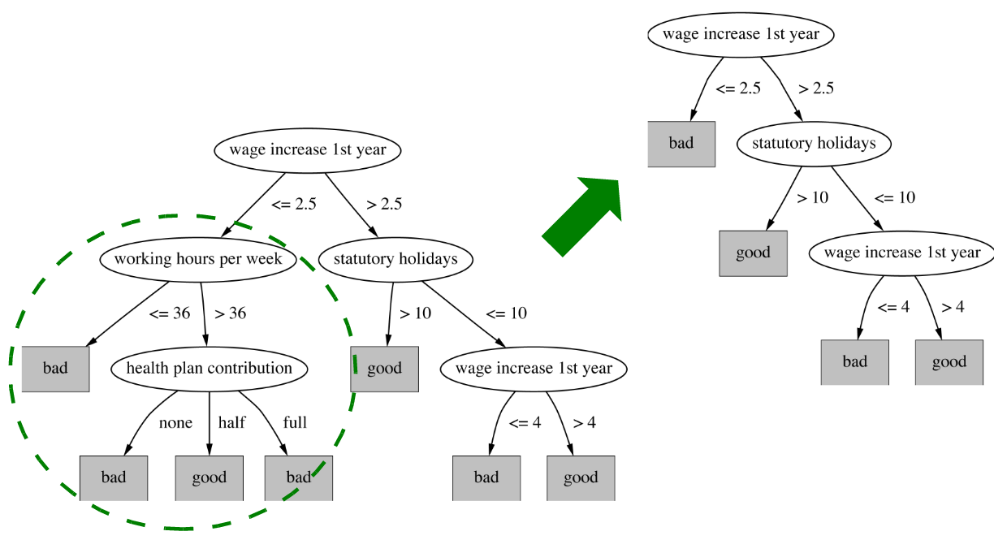
Pruning example

Slide 79
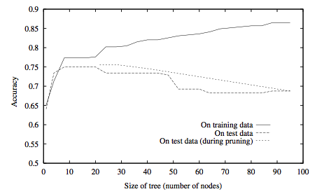
Post-pruning example

Slide 80
Extensions of decision trees
Extension to continuous attributes
Alternative measures of information gain
Handling training examples with missing attributes
Handling examples with different costs
Most of these improvements are present in the most popular implementation of decision trees called C4.5 (Quinlan, 1993)

Slide 81
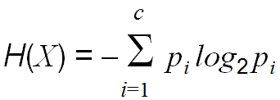
Extension to more classes
Fortunately, entropy is defined for more classes
Let X be a discrete random variable with c possible values. Then its entropy is defined as
With this, we can easily modify the information gain function to work for more classes. The other parts of the algorithm require only minimal modifications
Extension to probability estimation
Remember that the (pruned) tree assigns labels to leaves based on the majority of the samples in the given branch
We can easily modify this to return probability estimates for each class, estimated as the ratio of the samples belonging to the given task within the branch

Slide 82
Extension to continuous attributes
We can discretize a continuous variable using thresholds like: (Temperature>10)∧(Temperature<30)
This way the decision tree building algorithm works just as before
But how can we select the thresholds automatically?
Example for the earlier training data set – with continuous temperature values
Let’s order the examples according to the values of the attribute we want to discretize, and the target label:
Candidate thresholds: the average of the values where the label changes
We add (Temperature<54), (Temperature>54), …to the attribute set
We let the information gain select from these during tree building

Slide 83
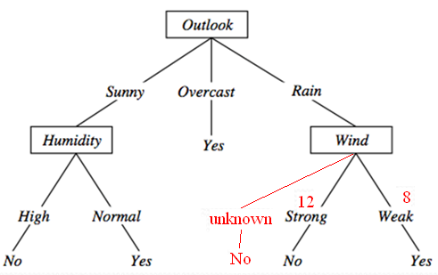
Extension to missing features
What can we do if a feature is missing during testing?
During tree building, we count the number of occurrences for each branch
After building the tree, we create an additional “unknown” path, and label it with the label of the most frequent path
What can we do if there are missing features during training (tree building)?
Let’s build the tree without using the samples that have missing features (we assume that these correspond to the majority of the samples)
From the occurrences of each branch we can create probability estimates (similarly to the method shown above)
We assign the most probable value to each missing feature, then we update the tree by using also the samples with the missing features
There are many other methods for this – more or less sophisticated

Slide 84
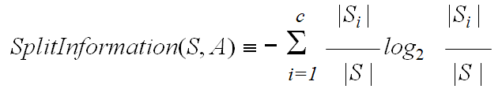
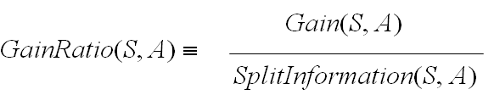
Gain ratio
We introduce Split Information:
It measures the entropy of the partitioning of S.
More subsets and more uniform division among the subsets results in higher values
Example: SplitInformation for n equally distributed classes:
It increases as n increases
We introduce a new attribute selection metric as:
GainRatio penalizes attributes that create many small subsets

Slide 85

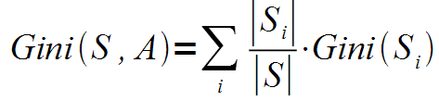
Classification and regression trees (CART)
This is the other most popular implementation besides C4.5
The biggest difference is that instead of entropy, is uses the Gini index as the impurity measure
Gini impurity is a measure of how often a randomly chosen element from the set would be incorrectly labeled if it was randomly labeled according to the distribution of labels in the subset.
And the average Gini index is calculated as
Finally, the Gini gain is calculated similarly to the information gain
Other difference: it can use multivariate decisions
Decisions that are built on more attributes, not just one

Slide 86
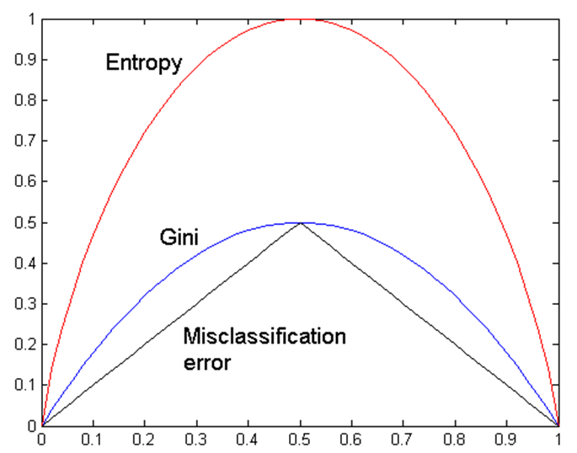
The classification error splitting criterion
Another popular splitting criterion
It measures of how often a randomly chosen element from the set would be incorrectly labeled if it was labeled according to the maximum a posteriori decision rule (i.e. the Bayes decision rule)
A Comparison of the Entropy, Gini and classification error criteria for the case of two classes
The curves have similar shapes, and peak at 0.5

Slide 87

Regression trees
How to use decision trees for regression, that is, when the target labels are not classes, but numeric values?
Modifications required to obtain regression trees:
Leaf nodes will return the average value of all instances in this leaf
Splitting criterion:
We minimize the variance of the values within each subset S_{i}
The splitting criterion will be the standard deviation reduction (remember that we have no class labels!)
Early stopping of tree building (don’t want single points in each leaf)
Lower bound on the standard deviation in each node
Lower bound on the number of examples in each node
Pruning: with numeric error measures like the mean squared error

Slide 88
Naïve Bayes Variants

Slide 89
Naïve Bayes Variants
Gaussian Naive Bayes
Gaussian Naive Bayes is a machine learning classification technique based on a probablistic approach that assumes each class follows a normal distribution.
To classify each new data point x the algorithm finds out the maximum value of the posterior probability of each class and assigns the data point to that class. E.g, classify iris dataset using gaussian nb.
Bernoilli Naive Bayes
Multi-nomial Naive Bayes

Slide 90
Naïve Bayes Variants
Bernoilli Naive Bayes
Bernoulli Naive Bayes is a part of the Naive Bayes family. It is based on the Bernoulli Distribution and accepts only binary values, i.e., 0 or 1. If the features of the dataset are binary, then we can assume that Bernoulli Naive Bayes is the algorithm to be used.
Multi-nomial Naive Bayes

Slide 91
Naïve Bayes Variants
Bernoilli Naive Bayes
The Bernoulli Naive Bayes (BNB) algorithm is a machine learning classifier that is used for binary classification tasks, such as text analysis and spam detection:
Disease detection: The BNB classifier can be used to determine if a person has a disease based on given data.
Spam detection: The BNB classifier can be used to determine if an SMS is spam or not spam.
Text classification: The BNB classifier can be used to classify text data. For example, emails can be categorized as spam or not spam based on the presence or absence of specific words or phrases.
Multi-nomial Naive Bayes

Slide 92
Naïve Bayes Variants
The BNB algorithm is a probabilistic model that is known for its speed and efficiency. It performs well with small datasets and high-dimensional spaces.
Bernoili naive bayes vs. multi nomial naive bayes
Use Bernoulli Naive Bayes instead of Multinomial Naive Bayes when your features are primarily binary (meaning they can only take on two values, like "yes" or "no") or boolean (true/false), while Multinomial Naive Bayes is better suited for situations where features represent discrete counts, like the frequency of words in a text document

Slide 93
Naïve Bayes Variants
Example scenarios:
Bernoulli Naive Bayes:
Classifying emails as spam or not spam where each word is considered as either present (1) or absent (0) in the email.
Predicting whether a customer will purchase a product based on binary features like "visited website" or "added to cart".
Multinomial Naive Bayes:
Classifying news articles based on topic where features represent the count of each word in the article.
Analyzing customer reviews where features are the count of positive, negative, and neutral words.

