Slide 1

CalCOFI Automation
Progress Report: December 2025 – June 2026 Integrating, serving & visualizing America's oldest ocean-ecosystem time series Ben Best (ben@oceanmetrics.io)
Ocean Metrics LLC

Slide 2
The Vision
Maximize the value of CalCOFI data within the SCCOOS / IOOS ocean-observing ecosystem.
1) Increase accessibility & transparency across CalCOFI data constituents.
2) Accelerate adoption across California ocean-management entities.
3) Strengthen integration with the network of CA ocean-observation programs.
Three components of work: ① INGEST → ② VISUALIZE → ③ SHARE.
Built on open standards: Parquet + DuckDB + reproducible notebooks — the same stack as GBIF & OBIS.

Slide 3
Pipeline & Architecture
Source files (CSV/XLSX) curated in Google Drive → long-term archive in Google Cloud Storage (rclone).
calcofi4db ingest notebooks (Quarto) normalize each dataset to a shared schema with referential integrity.
Versioned, frozen DuckLake: Parquet on GCS + reproducible recreation from source + a changelog.
One release fans out to portals — ERDDAP, OBIS, EDI — and to apps + an interactive schema site.
Self-tracking, AI-assisted loop: explore → generate-metadata → ingest → validate → publish (Claude Code skills).

Slide 4
Release v2026.06.08 — by the numbers
Metric | Value
Datasets integrated | 10
Tables | 44
Records | 133,807,311
Frozen size (Parquet/GCS) | 3.7 GB
ERDDAP datasets served | 6 (5 live, CTD syncing)
Apps | schema site · ctd-viz · datacheck
Workflow commits since Dec 2025 | 81

Slide 5
① INGEST
Component 1 of 3

Slide 6
Datasets ingested into the integrated database
Dataset | Headline | SOW
Ichthyoplankton (eggs & larvae) | 830K+ records | must ✓
Bottle (hydro chemistry) | 11M+ measurements | must ✓
CTD casts | ctd_thin 5.5M (234M source) | must ✓
DIC / carbonate chemistry | 8.3K measurements | must ✓
Krill / euphausiids | 10K tows | must ✓
Zooplankton tows | 99.5K tows | ◑ biovol pending
Underway CUFES | 49.5K samples | ✓
Lobster phyllosoma | 1.9K tows | must ✓
Seabird & mammal census | 60.7K observations | ✓
Phytoplankton (Venrick) | 159.8K measurements | must ✓

Slide 7
Ingest — engineering highlights
Prescriptive schema: a canonical field dictionary + schema-lint enforce names/types/units across datasets.
UUID-first primary keys minted at sea (stable through QA/QC); natural keys (cruise_key) where appropriate.
Cross-dataset relationships registry — every dataset links to the shared cruise / ship / grid tables.
CTD adaptive thinning (Douglas–Peucker): 15+ GB → 258 MB while preserving every profile inflection.
Hardest ingest — phytoplankton: region-pooled grain (no per-station position), cross-tab Excel, WoRMS taxonomy.
Reusable spatial/temporal match helpers resolve cross-dataset joins (site+datetime, nearest-depth).

Slide 8
A repeatable, self-tracking ingest loop
Claude Code skills pipeline: explore-dataset → generate-metadata → ingest-new → validate-ingest → publish.
Every workflow records ranked follow-up questions for data providers (per-dataset questions.csv).
A dataset_status tracker + cross-dataset relationship registry make the pipeline auditable.
Each new dataset auto-discovers into the release — no manual wiring.
Result: 81 commits since December turning 11 raw sources into one coherent, documented database.

Slide 9
② VISUALIZE
Component 2 of 3

Slide 10
Visualize — interactive products
Schema site (calcofi.io/schema): interactive ERD, table & column browser, cross-dataset filter — data-driven from GCS sidecars.
ctd-viz app: ODV-style interpolated CTD transects with bathymetry, linked map/table/plot.
datacheck app (NEW): cross-dataset observations for any cruise on a map/table/plot, with deep-linkable URLs for provider questions.
Integrated app (app.calcofi.io/int): H3 hexagon summaries; new cached endpoint serves hexes on-the-fly by map extent & zoom.
Management areas of interest (sanctuaries, MPAs, BOEM wind) — in progress.

Slide 11
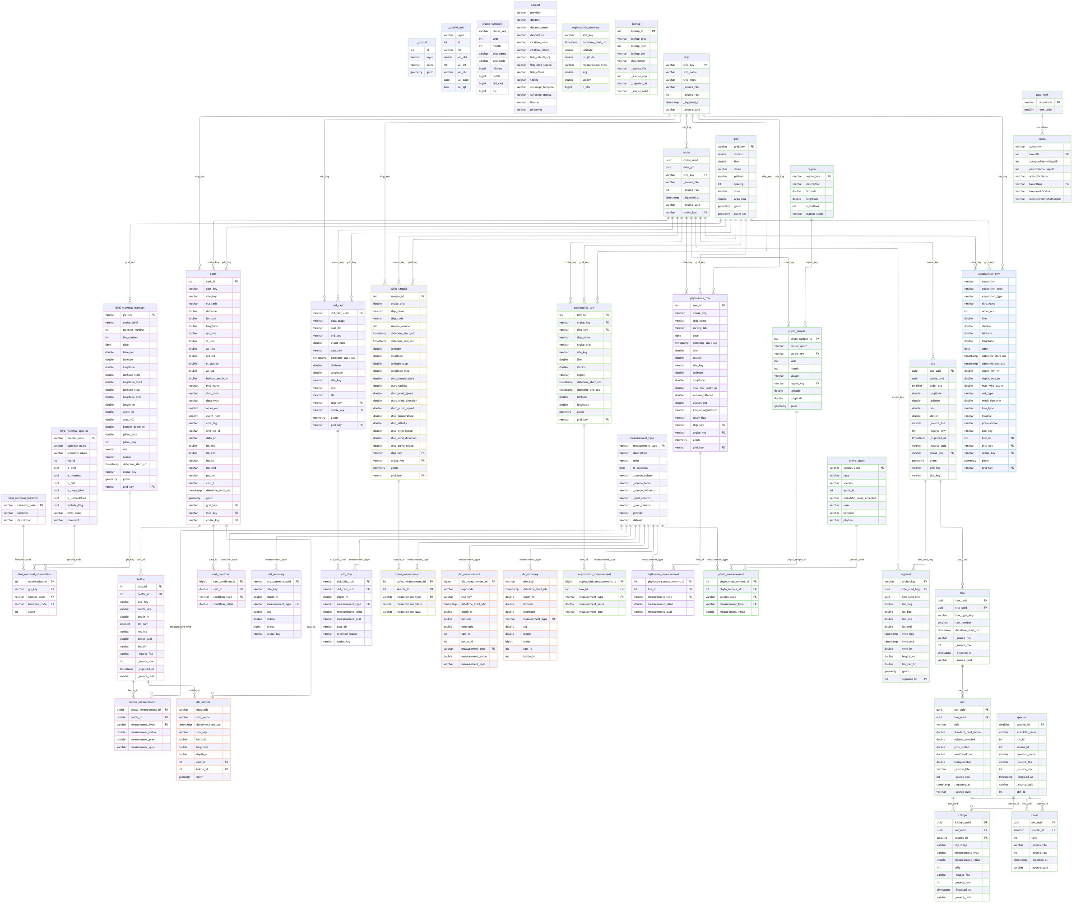
One integrated, referentially-intact schema
Entity–relationship diagram of release v2026.06.08 (44 tables across 10 datasets)

Slide 12
③ SHARE
Component 3 of 3

Slide 13
Share — publishing to standards portals
Portal | Dataset | Status
ERDDAP | CTD · Bottle · DIC · Krill · Zooplankton · Phytoplankton | 5 live, CTD syncing
OBIS (Darwin Core) | Ichthyoplankton (eggs/larvae) | done
EDI | Zooplankton | planned (#42)
EDI | Phytoplankton | planned (#62)
OBIS | Seabirds & Marine mammals | planned (#43/#44)

Slide 14
Status vs. Statement of Work
✓ ALL must-complete INGESTS delivered: Bottle, Fish eggs & larvae, Krill, CTD, Cephalopods, Phytoplankton, DIC, Phyllosoma.
✓ Must-complete SHARE delivered: CTD & Bottle → ERDDAP, Fish eggs & larvae → OBIS, DIC → ERDDAP.
✓ Integrated database versioned & reproducible (frozen DuckLake, v2026.06.08).
◑ Remaining ingest: ZooDb & ZooScan (blocked on Ohman/DataZoo portal export), PRODO, acoustic mammals.
◑ Remaining share: seabirds/mammals → OBIS, zooplankton/phytoplankton → EDI, underway MET → ERDDAP.

Slide 15
What's next
Unblock ZooDb / ZooScan via an Ohman-lab / DataZoo data export (the one external dependency).
Finish the publish side: seabird & mammal → OBIS, zooplankton & phytoplankton → EDI, underway MET → ERDDAP.
Bring calcofi_ctd fully live on ERDDAP (944 MB ctd_wide).
Expand H3 hexagon summaries across the newly ingested datasets in the integrated app.
Deliver the live, recorded webinar series — a CalCOFI.io product showcase (this deck is the starting point).

Slide 16
From 11 raw sources to one living, versioned, served database.
Ben Best · Ocean Metrics LLC · ben@oceanmetrics.io · calcofi.io

