Slide 1
CalConnect: Fighting Calendar Spam
Arne Allisat, 1&1 Mail&Media GmbH
05.06.2018
Munich, Germany

Slide 2
M³AAWG is a Trusted Environment
This slide is for Moderators’ and Chairs’ slide deck template only – not presenters.
*Presenters remove this note before using this slide
What happens in M³AAWG stays in M³AAWG
What occurs here cannot be shared outside the membership without the written permission of the Executive Director, unless we state the specific session is open to the press and social media
See the M³AAWG Meeting Policy at www.m3aawg.org/MeetingPolicy
Treat Everyone with Respect
Treat all attendees respectfully in and out of sessions. No less will be tolerated.
See the M³AAWG Conduct Policy at https://www.m3aawg.org/conduct-policy
You agreed to these policies when you registered for the meeting
For questions, please contact Jerry Upton at: jerry.upton@m3aawg.org
Contribute to a Productive Meeting
Please silence all electronic devices; be courteous to those listening to the presentations
DO NOT LEAVE YOUR BELONGINGS UNATTENDED. Be aware and cautious at all times

Slide 3






Reminders for Our Worldwide Friends
All meeting content is confidential: No photos, no video, no recording. See staff with questions.
L’ensemble du contenu de la réunion est confidentiel : les photos, vidéos et enregistrements sont interdits. Pour toute question, demandez conseil au personnel.
This slide is for Moderators and Chairs slide deck template only – not presenters.
*Presenters remove this note before using this slide
Todo el contenido de la reunión es confidencial: No está permitido sacar fotografías ni grabar vídeo o audio. Consulte con el personal si tiene alguna pregunta.
Der gesamte Inhalt des Meetings ist vertraulich: Keine Fotos, kein Video, keine Tonaufzeichnung. Bei Fragen wenden Sie sich an die Mitarbeiter.
会議の内容はすべて機密扱いです。 写真やビデオの撮影、録音は禁止されています。質問がある方は、スタッフまでご連絡ください。
所有会议内容均为保密信息：禁止拍照、录像、录音。如有疑问，请咨询职员。
회의에서 다루는 모든 내용은 기밀입니다. 사진 및 동영상 촬영과 녹음은 금지됩니다. 질문이 있으시면 직원에게 문의해 주십시오.

Slide 4
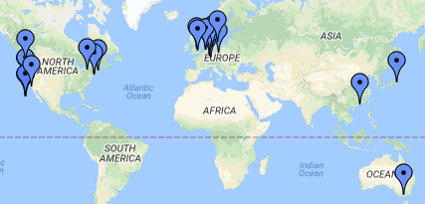
CalConnect – background
Formed to improve Calendaring & Scheduling technologies and products in 2004
iCalendar, vCard standards used on over 2.5 billion devices
Only Calendaring & Scheduling venue
About 30 members from all over the world (US, EU, Asia, Australia) which meet 3 times a year

Slide 5
CalConnect & M3AAWG & calendar spam
first panel discussion @ M3AAWG 40
Guest @ M3AAWG 41
joined work in TC CALSPAM started
Definition of calendar spam @CalConnect
official liaison announced
Jan 2017
June 2017
Oct 2017
Feb 2018
April 2018

Slide 6
TC CALSPAM
Goal:
The goal of this TC is to better protect users from receiving undesired information delivered through calendar systems, which currently range from spam to phishing attacks.
Deliverable:
Provide best common practice for mail and calendar service providers
Charter:
https://github.com/CalConnect/public/blob/master/charter/charter-TC-CALSPAM.md

Slide 7
Who is engaged?
Chair and main editor:
Thomas Schäfer (1&1/CalConnect)
Active participation:
Jesse Thompson (UW Madison/M3AAWG)
Arne Allisat (1&1/M3AAWG)
Andrey Maevsky (Cyren/M3AAWG)
Andrew Laurence (UC Irvine/CalConnect)
Bron Gondwana (FastMail/M3AAWG/CalConnect)

Slide 8
calendar spam is different
Events are often automatically inserted in calendar for convenience reasons
Events can be placed in the future
Hard to tell, where and when events originated and were delivered
Contain or trigger notifications/alarms in clients
Can include recurrence -> multiply the annoyance

Slide 9
Some numbers
Definition | UW Madison (MS 360) | Cyren
Ratio calendar spam/spam | 0,004 % | 0,036 %
Ratio clean calendar/mail | 0,2 % | 0,12 %
Ratio calendar spam/spam | 0,7 % | 11 %
Explanation:
UW: end-user / forwarding traffic
Cyren: traffic mainly within big provider as suspected (calendaring systems used for sending calendar spam to the same system for reputation reasons)
Based on 1 week traffic analysis at UW and cyren.

Slide 10
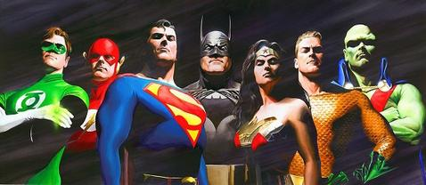
No chance to be a hero
https://en.wikipedia.org/wiki/Justice_League

Slide 11
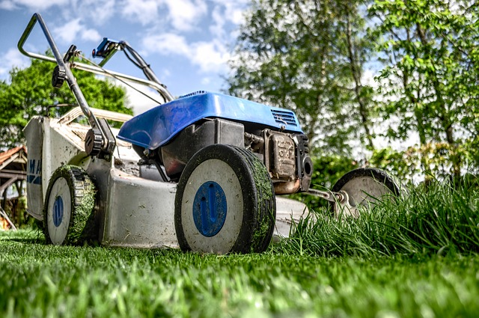
It’s all about prevention and dirt work
inspect and adapt
pixabay

Slide 12
Current status
Draft of BCP document has been created
We would like you to comment on the document to further improve it
https://goo.gl/bMbjXT

Slide 13
Your input
Anything missing from mail system point of view?
What is the common practice invite in your system for the email containing an invite after inserting the event into the users calendar?
What actions should be triggered in mail system, when user marks an event as spam in calendar?
to support actions e.g. FeedbackLoop (FBL), what information needed from calendaring system (MailID?, ...) to allow receiving mail systems to inform sending system about abuse (maybe even days/weeks after the incident happened)?
…

Slide 14
Next steps
Discuss current proposal also at CalConnect conference on Thursday among calendar service providers
Improve BCP and push first version to M3AAWG document repository
Interested in engaging yourself?
Contact chair of TC:
Thomas Schäfer at thomas.schaefer@calconnect.org

Slide 15
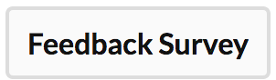
Session Feedback
This slide is for Moderators and Chairs slide deck template only – not presenters.
*Presenters remove this note before using this slide
Please share your comments on this session with M³AAWG – good, could-be-better or new ideas – to help improve our meetings
Click on the session title in SCHED then
use the button above the description
Thanks! Your comments are appreciated.

Slide 16
Presenter’s Action Reminders
Delete this slide before your presentation.
Preparation
Use the provided M³AAWG PowerPoint template for your slides
Order flipcharts or other logistical support at least 1 week before your session from Yadira Orellana at yadira@m3aawg.org
At the Meeting
No commercials allowed – No selling your products or services
Do not read your slides verbatim
Not all attendees are native speakers; please speak at a reasonable pace
Arrive at the assigned room 10 minutes before your presentation
Give your final PPT or PDF presentation file to your session chair or send it to slides@m3aawg.org for posting on the members-only meeting archive page
Bring your own laptop and adapter: We will supply an HDMI cable to the projector but you need to supply the presentation device (laptop, smartphone, tablet, etc.) and any needed adapters to hook up to the HDMI connector.
See the M³AAWG Speakers Guidelines for more details

Slide 17
For Better Readability, We Recommend:
Delete this slide before your presentation.
Use 24 Pt. or Larger Font for Top Level Bullets
Do Not Use Fonts Smaller than 20 Pt. for Sub-Bullets or Other Text on Your Slides
Smaller Fonts Are Difficult to Read in Large Meeting Rooms
Add 6 Pts. or More of Vertical Spacing between Bullets
From Formatting, Select Paragraph & Set “Spacing”
This Slide Has 18 Pts. of Vertical Spacing
Remember: Do Not Read Your Slides during Your Talk

