Slide 1
Assault on our Calendars
Jesse Thompson (University of Wisconsin-Madison)
Wednesday, October 10
Brooklyn, New York, USA

Slide 2
M³AAWG is a Trusted Environment
This slide is for Moderators’ and Chairs’ slide deck template only – not presenters.
*Presenters remove this note before using this slide
What happens in M³AAWG stays in M³AAWG
What occurs here cannot be shared outside the membership without the written permission of the Executive Director, unless we state the specific session is open to the press and social media
See the M³AAWG Meeting Policy at www.m3aawg.org/MeetingPolicy
Treat Everyone with Respect
Treat all attendees respectfully in and out of sessions. No less will be tolerated.
See the M³AAWG Conduct Policy at https://www.m3aawg.org/conduct-policy
You agreed to these policies when you registered for the meeting
For questions, please contact Jerry Upton at: jerry.upton@m3aawg.org
Contribute to a Productive Meeting
Please silence all electronic devices; be courteous to those listening to the presentations
DO NOT LEAVE YOUR BELONGINGS UNATTENDED. Be aware and cautious at all times

Slide 3






Reminders for Our Worldwide Friends
All meeting content is confidential: No photos, no video, no recording. See staff with questions.
L’ensemble du contenu de la réunion est confidentiel : les photos, vidéos et enregistrements sont interdits. Pour toute question, demandez conseil au personnel.
This slide is for Moderators and Chairs slide deck template only – not presenters.
*Presenters remove this note before using this slide
Todo el contenido de la reunión es confidencial: No está permitido sacar fotografías ni grabar vídeo o audio. Consulte con el personal si tiene alguna pregunta.
Der gesamte Inhalt des Meetings ist vertraulich: Keine Fotos, kein Video, keine Tonaufzeichnung. Bei Fragen wenden Sie sich an die Mitarbeiter.
会議の内容はすべて機密扱いです。 写真やビデオの撮影、録音は禁止されています。質問がある方は、スタッフまでご連絡ください。
所有会议内容均为保密信息：禁止拍照、录像、录音。如有疑问，请咨询职员。
회의에서 다루는 모든 내용은 기밀입니다. 사진 및 동영상 촬영과 녹음은 금지됩니다. 질문이 있으시면 직원에게 문의해 주십시오.

Slide 4
Our Panel
Panelists in Our Q&A Session:
Panelist 1 Title, Affiliation
Panelist 2 Title, Affiliation
List Additional Panelists, As Needed
Moderators-please update this slide with panelists’ and session information; show it during the Q&A at the end of your session.
*Remove this note before using this slide

Slide 5
CalConnect & M3AAWG & calendar spam
discussion @ M3AAWG 40
Guest @ M3AAWG 41
Definition @ CalConnect
recent re-occurrence
Nov 2016
Jan 2017
June 2017
Oct 2017
joined work in TC CALSPAM started
official liaison announced
first draft of BCP
last call on document
Feb 2018
April 2018
June 2018
Oct 2018

Slide 6
TC CALSPAM @ CalConnect
Goal:
The goal of this TC is to better protect users from receiving undesired information delivered through calendar systems, which currently range from spam to phishing attacks.
Deliverable:
Provide best common practice for mail and calendar service providers
Charter:
https://github.com/CalConnect/public/blob/master/charter/charter-TC-CALSPAM.md

Slide 7
Who is engaged?
Chair and main editor:
Thomas Schäfer (1&1/CalConnect)
Active participation:
Jesse Thompson (UW Madison/M3AAWG)
Arne Allisat (1&1/M3AAWG)
Andrey Maevsky (Cyren/M3AAWG)
Andrew Laurence (UC Irvine/CalConnect)
Bron Gondwana (FastMail/M3AAWG/CalConnect)

Slide 8
calendar spam is different
Events are often automatically inserted in calendar for convenience reasons
Events can be placed in the future
Hard to tell, where and when events originated and were delivered
Contain or trigger notifications/alarms in clients
Can include recurrence -> multiply the annoyance

Slide 9
Some numbers
Definition | UW Madison (MS 360) |  | Cyren
 | May 18 | Sept 18 | May 18 | Sept 18
Ratio clean calendar/mail | 0,2 % | 0,2 % | 0,12 % | 0,09 %
Ratio calendar spam/clean | 0,7 % | 0,07 % | 11 % | 5 %
Ratio mail spam/clean | 25,0 % | 14,8 % | 35,3 % | 13,5 %
Explanation:
UW: end-user / traffic varies depending on time of the year
Cyren: traffic mainly within big provider (as suspected calendaring systems used for sending calendar spam to the same system for reputation reasons but also because of being a bigger target group)
Based on 1 week traffic analysis at UW and cyren in May and September 2018.

Slide 10
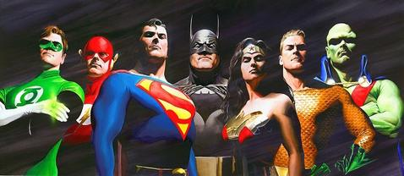
No chance to be a hero
https://en.wikipedia.org/wiki/Justice_League

Slide 11
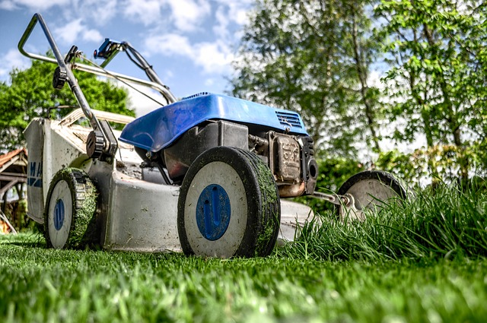
It’s all about prevention and dirt work
inspect and adapt
pixabay

Slide 12
Current status
Draft of BCP document has been created and feedback from CalConnect and M3AAWG received and integrated
We would like to go to last call directly after the conference and if the publishing process has been moved forward
This is how it looks at the moment:
https://goo.gl/bMbjXT or direct at
https://github.com/CalConnect/TC-CALSPAM/tree/master/BP_workingdraft (private repo)

Slide 13
Decisions made
Publish best practice document as CalConnect document (M3AAWG will cross-reference it)
Two interesting topics identified to be followed up at CalConnect:
Event origin
Generic calendar spam client/server interaction
-> both discussed in Abuse audit draft discussion in working session last CalConnect conference

Slide 14
Feedback from Abuse audit session
Event origin
Divide into channels
Create: user, Timestamp (TS), IP, client (HTTP header?)
Email: sender email, TS, message id
Subscription: URL, TS
Import: TS, (file name?)
iTIP: TS
Other: TS
Abuse audit draft
Delete status (GOOD, WARNING, BAD) as included in score
Client -> server: PROPPATCH calls

Slide 15
Next steps
Finalize CalConnect document process
Move on to last call on document
Interested in engaging yourself?
Contact chair of TC @ CalConnect:
Thomas Schäfer at thomas.schaefer@1und1.de

Slide 16
Open for discussion!

Slide 17
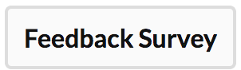
Session Feedback
This slide is for Moderators and Chairs slide deck template only – not presenters.
*Presenters remove this note before using this slide
Please share your comments on this session with M³AAWG – good, could-be-better or new ideas – to help improve our meetings
Click on the session title in SCHED then
use the button above the description
Thanks! Your comments are appreciated.

Slide 18
Presenter’s Action Reminders
Delete this slide before your presentation.
Preparation
Use the provided M³AAWG PowerPoint template for your slides
Order flipcharts or other logistical support at least 1 week before your session from Yadira Orellana at yadira@m3aawg.org
At the Meeting
No commercials allowed – No selling your products or services
Do not read your slides verbatim
Not all attendees are native speakers; please speak at a reasonable pace
Arrive at the assigned room 10 minutes before your presentation
Give your final PPT or PDF presentation file to your session chair or send it to slides@m3aawg.org for posting on the members-only meeting archive page
Bring your own laptop and adapter: We will supply an HDMI cable to the projector but you need to supply the presentation device (laptop, smartphone, tablet, etc.) and any needed adapters to hook up to the HDMI connector.
See the M³AAWG Speakers Guidelines for more details

Slide 19
For Better Readability, We Recommend:
Delete this slide before your presentation.
Use 24 Pt. or Larger Font for Top Level Bullets
Do Not Use Fonts Smaller than 20 Pt. for Sub-Bullets or Other Text on Your Slides
Smaller Fonts Are Difficult to Read in Large Meeting Rooms
Add 6 Pts. or More of Vertical Spacing between Bullets
From Formatting, Select Paragraph & Set “Spacing”
This Slide Has 18 Pts. of Vertical Spacing
Remember: Do Not Read Your Slides during Your Talk

