Slide 1
CalConnect: Fighting Calendar Spam
Arne Allisat, 1&1 Mail&Media GmbH
05.06.2018
Munich, Germany

Slide 2
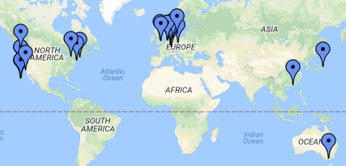
CalConnect – background
Formed to improve Calendaring & Scheduling technologies and products in 2004
iCalendar, vCard standards used on over 2.5 billion devices
Only Calendaring & Scheduling venue
About 30 members from all over the world (US, EU, Asia, Australia) which meet 3 times a year

Slide 3
CalConnect & M3AAWG & calendar spam
first panel discussion @ M3AAWG 40
Guest @ M3AAWG 41
joined work in TC CALSPAM started
Definition of calendar spam @CalConnect
official liaison announced
Jan 2017
June 2017
Oct 2017
Feb 2018
April 2018

Slide 4
TC CALSPAM
Goal:
The goal of this TC is to better protect users from receiving undesired information delivered through calendar systems, which currently range from spam to phishing attacks.
Deliverable:
Provide best common practice for mail and calendar service providers
Charter:
https://github.com/CalConnect/public/blob/master/charter/charter-TC-CALSPAM.md

Slide 5
Who is engaged?
Chair and main editor:
Thomas Schäfer (1&1/CalConnect)
Active participation:
Jesse Thompson (UW Madison/M3AAWG)
Arne Allisat (1&1/M3AAWG)
Andrey Maevsky (Cyren/M3AAWG)
Andrew Laurence (UC Irvine/CalConnect)
Bron Gondwana (FastMail/M3AAWG/CalConnect)

Slide 6
calendar spam is different
Events are often automatically inserted in calendar for convenience reasons
Events can be placed in the future
Hard to tell, where and when events originated and were delivered
Contain or trigger notifications/alarms in clients
Can include recurrence -> multiply the annoyance

Slide 7
Some numbers
Definition | UW Madison (MS 360) | Cyren
Ratio calendar spam/spam | 0,004 % | 0,036 %
Ratio clean calendar/mail | 0,2 % | 0,12 %
Ratio calendar spam/spam | 0,7 % | 11 %
Explanation:
UW: end-user / forwarding traffic
Cyren: traffic mainly within big provider as suspected (calendaring systems used for sending calendar spam to the same system for reputation reasons)
Based on 1 week traffic analysis at UW and cyren.

Slide 8
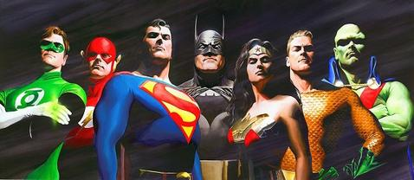
No chance to be a hero
https://en.wikipedia.org/wiki/Justice_League

Slide 9
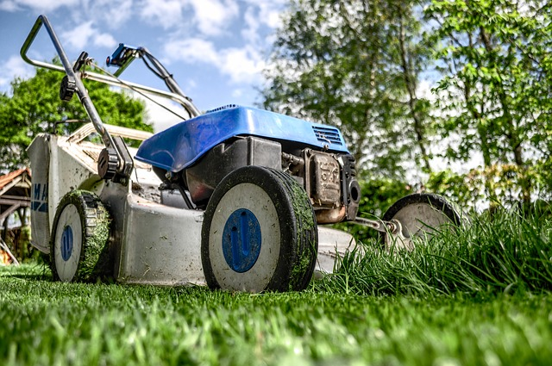
It’s all about prevention and dirt work
inspect and adapt
pixabay

Slide 10
Current status
Draft of BCP document has been created
We would like you to comment on the document to further improve it
https://goo.gl/bMbjXT

Slide 11
Your input
Anything missing from mail system point of view?
What is the common practice invite in your system for the email containing an invite after inserting the event into the users calendar?
What actions should be triggered in mail system, when user marks an event as spam in calendar?
to support actions e.g. FeedbackLoop (FBL), what information needed from calendaring system (MailID?, ...) to allow receiving mail systems to inform sending system about abuse (maybe even days/weeks after the incident happened)?
…

Slide 12
Next steps
Discuss current proposal also at CalConnect conference on Thursday among calendar service providers
Improve BCP and push first version to M3AAWG document repository
Interested in engaging yourself?
Contact chair of TC:
Thomas Schäfer at thomas.schaefer@calconnect.org

Slide 13
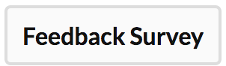
Session Feedback
This slide is for Moderators and Chairs slide deck template only – not presenters.
*Presenters remove this note before using this slide
Please share your comments on this session with M³AAWG – good, could-be-better or new ideas – to help improve our meetings
Click on the session title in SCHED then
use the button above the description
Thanks! Your comments are appreciated.

