Slide 1
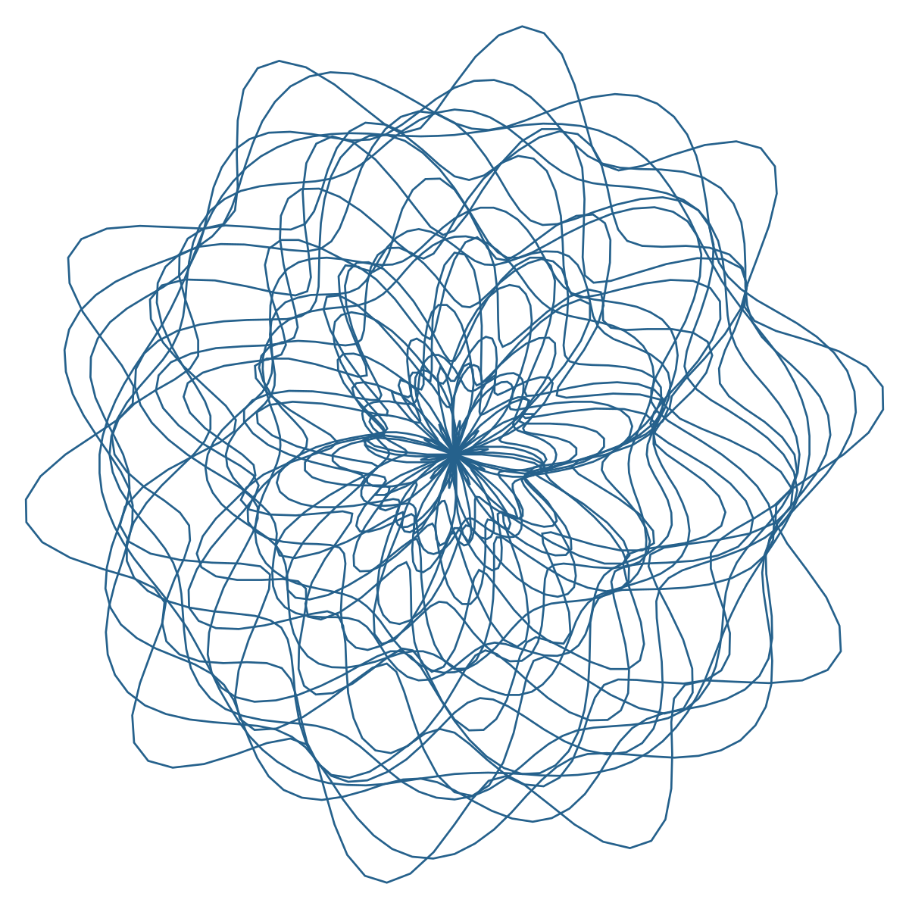

A CALCONNECT WORK ITEM · ISO/TC 154 · WORKING DRAFT
SIGNATIF
Trust infrastructure framework for verifiable artifacts
Sealed · Interoperable · Graduated · Non-repudiable · Anchored ·
Trust · Infrastructure · Framework
From Latin signare — to mark with a seal.
Trustworthiness is established by what is verifiably signed, not by who is trusted.
www.signatif.org

Slide 2
THE PROBLEM
In regulated industries, a certificate is evidence
It carries legal, economic, and safety consequences — and it must remain verifiable across organizational boundaries, jurisdictional boundaries, and decades of time, by verifiers who never met its issuer.
LEGAL METROLOGY
PHARMACEUTICALS
FOOD SAFETY
DEFENSE PROCUREMENT
Calibration and type-approval certificates, verifiable at inspection fifteen years later, offline.
Batch release under track-and-trace mandates — manufacturer, operator, conditions, and time each attested.
Inspection and provenance records crossing many authorities between farm and shelf.
Component provenance with authorization that can be withdrawn — provably, retroactively.
“The key was valid” is not evidence — the operator, the conditions, the time, and the place of production are the claims that must be verifiable.
CalConnect · SIGNATIF — Trust infrastructure for verifiable artifacts
02

Slide 3
THE EXISTING LANDSCAPE
Each incumbent solves one problem well
TRADITIONAL PKI
Binds keys to identities — not artifacts to production conditions. Binary path validation; revocation reaches the key, not the work.
CODE-SIGNING TRANSPARENCY
One ecosystem log per community; inclusion exists, but no dimensional attestations, no scope, no graduation.
BLOCKCHAIN ATTESTATION
Membership replaces authorization: “was it logged on our chain”. No scope enforcement; append-only by design.
W3C VERIFIABLE CREDENTIALS
The issuer signs the claims — but one proof, issuer-asserted trust, no convergence semantics, no mandatory transparency.
CalConnect · SIGNATIF — Trust infrastructure for verifiable artifacts
03

Slide 4
THE GAP
No existing framework combines all of these properties
01
Multi-dimensional convergence
Authority, person, time, location, environment — independent co-signatures meeting on one record.
02
Graduated assessment
An objective, deterministic coverage report mapped to labels by published policies — not valid/invalid.
03
Revocation that reaches artifacts
Withdrawing an authorization provably invalidates every artifact bound to it, across all dimensions.
04
Offline equality
The same classification label online and at a border post — from the anchor bundle alone.
05
Cross-domain without bridges
Co-signatures from independent roots ride the artifact; the verifier’s own anchors decide.
CalConnect · SIGNATIF — Trust infrastructure for verifiable artifacts
04

Slide 5
THE FRAMEWORK
The name is the architecture — eight normative properties
S
Sealed
I
Interoperable
G
Graduated
N
Non-repudiable
Co-signatures over a canonical payload, one per trust dimension.
One pipeline and report format; scheme rules enter through registries.
Coverage report, classification label, acceptance decision.
Threshold quorum, ceremony records, transparency logs.
A
Anchored
T
Trust
I
Infrastructure
F
Framework
Every path ends at a declared trust anchor — fully offline.
Establishment, assessment, and withdrawal of confidence — a lifecycle.
Shared anchors, logs, and registries beneath any application.
Requirements that conforming implementations and profiles share.
CalConnect · SIGNATIF — Trust infrastructure for verifiable artifacts
05

Slide 6
THE TRUST MODEL
A trust graph over signed artifacts
ROOT (3-OF-5)
→
NMI
→
LAB
→
MODEL
→
INSTRUMENT
→
MEASUREMENT
threshold quorum
national authority
accredited body
instrument model
individual device
the trusted artifact
At every delegation link the authorization scope narrows monotonically — widening any dimension is a hard verification failure, checkable from the signatures alone.
▪ Threshold at every level — a quorum of key holders exercises root, delegated, and federated authorities; no single point of cryptographic compromise.
▪ Federated authorities — threshold groups of independent organizations share one aggregate key; cross-organizational recognition is built in.
▪ Machine-readable scope — a signed field with executable conditions evaluated at verification time, not a policy document a human must read.
CalConnect · SIGNATIF — Trust infrastructure for verifiable artifacts
06

Slide 7
THE TRUSTED ARTIFACT
Convergence, not single-signer authority
AUTHORITY
TIME
delegation chain
time authority
CANONICAL PAYLOAD
deterministic byte serialization
PERSON
LOCATION
certified operator
attestation tree
ENVIRONMENT
sensor co-signature
Each dimension leaves its own co-signature on the same bytes — five independent attestations, one verifiable record. The coverage report states exactly which dimensions attest, and how independently.
CalConnect · SIGNATIF — Trust infrastructure for verifiable artifacts
07

Slide 8
VERIFICATION
Three separable decisions — no party silently bundles them
01 · COVERAGE REPORT
02 · CLASSIFICATION LABEL
03 · ACCEPTANCE
The evidence
The grade
The decision
Objective facts, computed deterministically. Hard checks short-circuit to rejected; soft checks accumulate.
→
The scheme’s published policy maps report fields to labels — a pure function in the deployment manifest.
→
The verifier’s own risk policy turns the label into a decision for its context — explicit, auditable.
HARD CHECKS — FAILURE REJECTS
SOFT CHECKS — COVERAGE ACCUMULATES
Format validity · Signature validity · Chain integrity · Scope narrowing · Scope conditions · Revocation status
Transparency inclusion · Time anchor freshness · Cross-domain co-signatures · Multi-log attestation quorum
CalConnect · SIGNATIF — Trust infrastructure for verifiable artifacts
08

Slide 9
TRUST AS A LIFECYCLE
Granted, assessed, withdrawn — all first-class operations
MANDATORY TRANSPARENCY
Every artifact and certificate is provably in an append-only Merkle log. M-of-K independent logs per artifact — no single operator controls the record; gossip and mirrors make split views detectable.
EXTERNAL TIME ANCHORING
Signing time is established by independent time sources and anchored tree heads — never the signer’s clock alone.
REVOCATION PROPAGATION
Withdrawing authority state invalidates every transitively bound artifact, across all dimensions and chains — hash-bound into verification.
CEREMONY RECORDS
Key generation, resharing, and rotation are recorded in signed, transparently-logged transcripts — auditable end to end.
CalConnect · SIGNATIF — Trust infrastructure for verifiable artifacts
09

Slide 10
HOW IT DIFFERS
Structural properties, not implementation maturity
CAPABILITY | TRADITIONAL PKI | CODE-SIGN TRANSPARENCY | BLOCKCHAIN | W3C VC | SIGNATIF
Authorization boundary | Policy-defined | Ecosystem policy | Out of scope — membership model | Issuer-asserted | Cryptographic, hard check at every link
Attestations per object | One signature | One + log entry | One ledger entry | One proof | N co-signatures, one per dimension
Threshold protection | Root only, optional | N/A | Consensus, not signing | N/A | Mandatory at every authority level
Transparency | Optional (web only) | Single log | The ledger itself | Not required | Inclusion required; M-of-K log quorum
Revocation reach | The certificate | N/A | Out of scope — append-only | The credential | All transitively bound artifacts
Offline verification | Freshness-sensitive; not the design case | Not the design case | Requires the chain | Proofs only | First-class: same label except freshness
Cross-domain | Bridge CAs | One ecosystem | One chain | Per-issuer trust | Independent roots co-sign the artifact
Trust assessment | Policy classes at best | Binary | Logged or not | Valid or invalid | Objective report, graduated labels
CalConnect · SIGNATIF — Trust infrastructure for verifiable artifacts
10

Slide 11
POSITION IN THE STANDARDS LANDSCAPE
It composes — the incumbents are special cases or payloads
PKI is the degenerate configuration
Single-signer end authorities, one dimension, binary acceptance — behaves exactly like traditional PKI. Migration is graduated, not a rewrite.
W3C VCs compose as payloads
A verifiable credential becomes the canonical payload; its single proof is replaced by dimensional co-signatures (informative Annex G).
EU Digital Product Passport rides the substrate
QR delivery, decentralized registry intent, decade-plus lifetimes — a DPP deployment is a Signatif scheme (informative Annex H).
Built on established standards
ISO/IEC 14888 and 11770 concepts, RFC 6962/9162 transparency, ISO/IEC 19790 HSMs — referenced, not reinvented. Scheme registries keep national algorithm choices out of the international text.
CalConnect · SIGNATIF — Trust infrastructure for verifiable artifacts
11

Slide 12
WHY ISO
The regulatory pull is already written into law
EU DIGITAL PRODUCT PASSPORT
US DSCSA
OIML DIGITAL CERTIFICATES
Ecodesign for Sustainable Products Regulation — verifiable product lifecycle data for regulated goods.
Track-and-trace mandates for pharmaceutical serialization and saleable-return verification.
Machine-verifiable metrological conformity for legal metrology.
▪ A neutral infrastructure layer — shared anchors, logs, and registries that no single vendor or jurisdiction controls; exactly what an International Standard is for.
▪ Mutual recognition is standardized — cross-recognition between regimes as signed credentials, so one artifact verifies across borders without bilateral policy negotiation.
▪ Domain choices stay local — schemes own registries, scope dimensions, and classification policies; the international text specifies the machinery, testably.
▪ Timing — the mandates above arrive through 2027–2030 delegated acts; the substrate they will need is being decided now.
CalConnect · SIGNATIF — Trust infrastructure for verifiable artifacts
12

Slide 13
BUILT TO BE TESTABLE
“Conforming” is a testable claim, not an adjective
14
118
118
8
REQUIREMENTS CLASSES
REQUIREMENTS
ABSTRACT CONFORMANCE TESTS
INFORMATIVE ANNEXES
▪ Every requirement is machine-addressable — /req/<class>/<fragment> identifiers in structured YAML, rendered into the clauses and Annex A.
▪ Every class has a conformance twin — /conf classes with abstract tests targeting each requirement, ready for test-suite implementation.
▪ The annexes do the practical work — PKI comparison (B), scheme registries (C), a worked pharma profile (D), a reference technology instantiation (E), cross-technology interop (F), VC composition (G), DPP composition (H).
CalConnect · SIGNATIF — Trust infrastructure for verifiable artifacts
13

Slide 14
STATUS AND INVITATION
Join the work item
SIGNATIF is a CalConnect work item, drafted as an ISO/TC 154 working draft — 20 normative clauses, 8 annexes, open source on GitHub.
REVIEW
Read the working draft and comment — every clause is traceable to a requirements class.
PARTICIPATE
Join CalConnect and shape the scheme registries, profiles, and conformance testing.
PILOT
Instantiate a scheme — food traceability, electronic components, DPP — on the reference stack.
github.com/CalConnect/cc-signatif · www.signatif.org
CalConnect · SIGNATIF — Trust infrastructure for verifiable artifacts
14

