Slide 1
CC 36010: Lightweight document — Document metamodel
ISO/TC 154 · CalConnect
Published by CalConnect · fast-track showcase
Ronald Tse
Aug 31, 2026

Slide 2
Commerce exchanges everything except the document's text
Every framework standardizes its data — none standardizes the rich text that carries the obligations.
TRADE DATA
PUBLISHING FORMATS
MARKUP SYNTAXES
ELEMENT STANDARDS
EDIFACT, UBL, e-invoicing: structured fields, standardized — rich text rides as escaped HTML blobs.
HTML, RTF, DOCX: what documents look like — presentation contracts, not shared semantics.
Markdown, AsciiDoc, RST: convenient to type — no common meaning between them.
ISO 8601 time, ISO 639/15924/3166 language, ISO 690 citations — the pieces exist; the carrier does not.
Exchange degrades to plain text: emphasis, terms, notes, tables and change intent lost on every hop.
02

Slide 3
The missing layer: a metamodel of what documents mean
Complete structure and semantics; presentation excluded by design and relegated to rendering.
Document
identifier · bibdata (ISO 690 lineage) · attribute register
Sections
hierarchical · prefatory · references
Blocks
paragraphs · tables · lists · figures · source · admonitions · amend
Inline elements
emphasis · stem · ruby · media · references · variables
One strict rule — nesting within a tier, never across tiers — is why every markup maps cleanly and rendering is predictable.
03

Slide 4
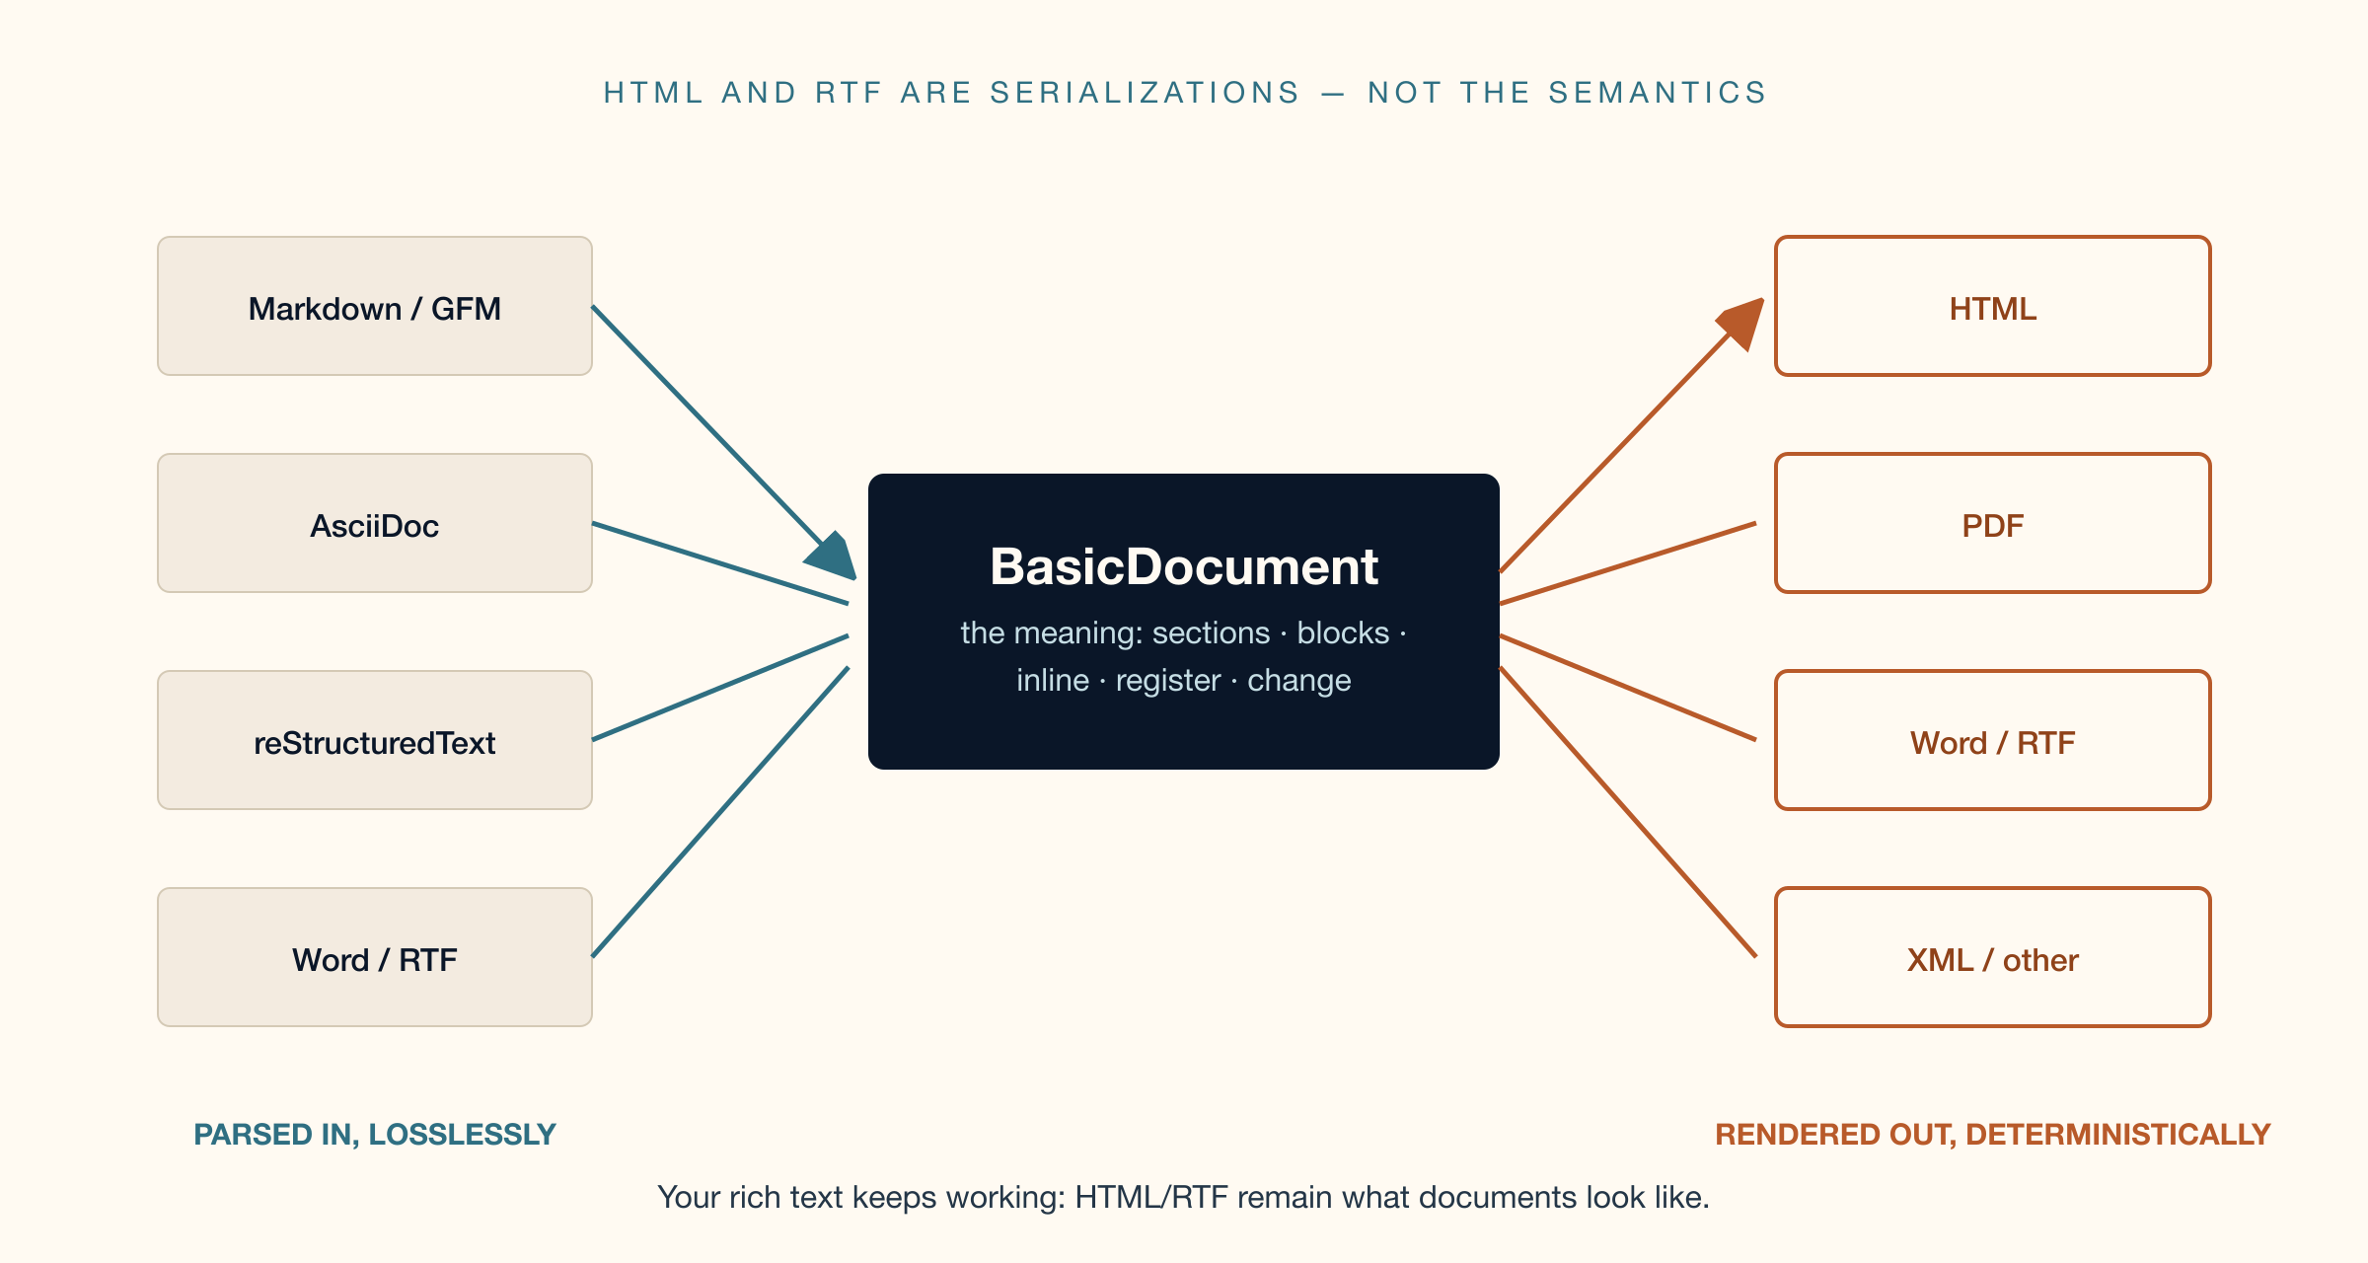
Model-driven: any serialization, zero-loss transforms
The model binds to no format. XML and YAML are reference serializations; twins of identical content prove interchange.
Conformance is to the model — any language, any format; round-trip equivalence to a reference serialization is the test.
04

Slide 5
Harmonized coverage, clause by clause (Annex A)
Normative mapping tables: every construct of the principal markups has a home.
ASCIIDOC
MARKDOWN · GFM · PANDOC
RST · SPHINX
admonitions → Admonition+type
continuations → relaxed list items
passthroughs → FormattedString
{attr} → variable reference
GFM tables → TableBlock
{#id .class} → attribute register
fenced divs → register + container
raw HTML → format-qualified strings
directives → register + relaxed content
substitutions → variable reference
field lists → document register
danger/error → type specializations
Unlisted constructs are covered by the conformance formula: construct · type-specialization · register + relaxed or opaque content.
05

Slide 6
Communities adopt it three ways — none touch the base
Open-closed by construction: the published basis is never modified, only specialized, extended, or profiled.
SPECIALIZE — add
EXTEND — carry
TAILOR — subtract
Type values, not parallel classes.
Attribute overrides: add, remove,
retighten. Subclasses under the
construct roots. — Annex B
Open attribute register: dialect keys
on any construct, zero model change.
Raw, variables, unknown directives
all carried losslessly. — Annex C
Profiles: ~20 lines of YAML declare
your subset. Narrowing only — the
machine rejects any widening. A
profile document is always valid.
legalexchange/1.0 ships as the worked profile: excluded constructs, narrowed cardinalities, closed key vocabulary — validated in CI.
06

Slide 7
A standard you can run (Annex D)
Conformance classes map one-to-one to gates that run on every change — the suite is the standard's proof.
MODEL INTEGRITY
Names resolve, every attribute carries visibility and a definition — checked on the definition modules.
DIAGRAM PARITY
Every diagram view is provably the model: includes and associations in closure, no class bodies under views.
TWIN INSTANCE SUITES
Identical XML and YAML reference instances exercise every construct — validated against schema and parsed model.
PROFILE CONFORMANCE
Narrowing-only enforced mechanically; profile instances carry no excluded construct and permitted keys only.
“A construct without a serializable instance is unfinished” — enforced, not aspired to.
07

Slide 8
Extracted from production, not written for a committee
The model underlies real standards authoring and publishing across 30+ document flavours today.
LIVE ECOSYSTEM
REGISTRY INTEGRATION
PUBLIC ARTIFACTS
GOVERNED
relaton-models and standoc-models consume it in lockstep; grammars compile and pass regeneration parity in their CI.
Localized strings identify ISO 24229 spelling systems; romanization schemes by system code.
Model atlas with full definitions and hyperlinked types; grammar packages site; open repositories throughout.
Versioning policy with deprecation cycle, standardization snapshots, and a public register-key registry.
Six years in production, then standardized — the reverse of the usual order.
08

Slide 9
TC 154's portfolio already standardizes the document's elements
Processes, data elements and documents in commerce — this is the layer the portfolio is missing.
ISO 8601
ISO 6523
E-BUSINESS FRAMEWORKS
ISO 690 · 5127 (TC 46)
when — time and date
who — organization identifiers
structured trade data — rich text punted on
what is cited — consumed, not duplicated
The missing piece: WHAT THE DOCUMENT SAYS — the rich-text layer.
Orders, invoices, contracts, specifications: every business document is lightweight rich text.
Time, parties, trade data, citations — standardized. The document carrying them: CC 36010 completes the stack.
09

Slide 10
PUBLISHED AND READY
Adopt CC 36010 as the base text
for a fast-track DIS
PUBLISHED
STAGED
MAINTAINED
CC 36010 published by CalConnect, 2026-08-31 — stable base text with machine-checked annexes.
The ISO copy stands at DIS stage 40.00 — identical sources, two flavours, fast-track ready.
Open repositories, executable test suite, versioning policy — the maintenance vehicle exists today.
calconnect.github.io/cc-lightweight-doc · metanorma.github.io/basicdoc-models
CalConnect TC VCARD · Ronald Tse
10

