Slide 1
PROPOSAL FOR A DRAFT INTERNATIONAL STANDARD
Lightweight document —
Document metamodel
The missing interoperability layer for structured text
Proposed by CalConnect (TC VCARD)
Base text CC/ISO 36010 · proof: 6+ years in production · every claim machine-checked

Slide 2
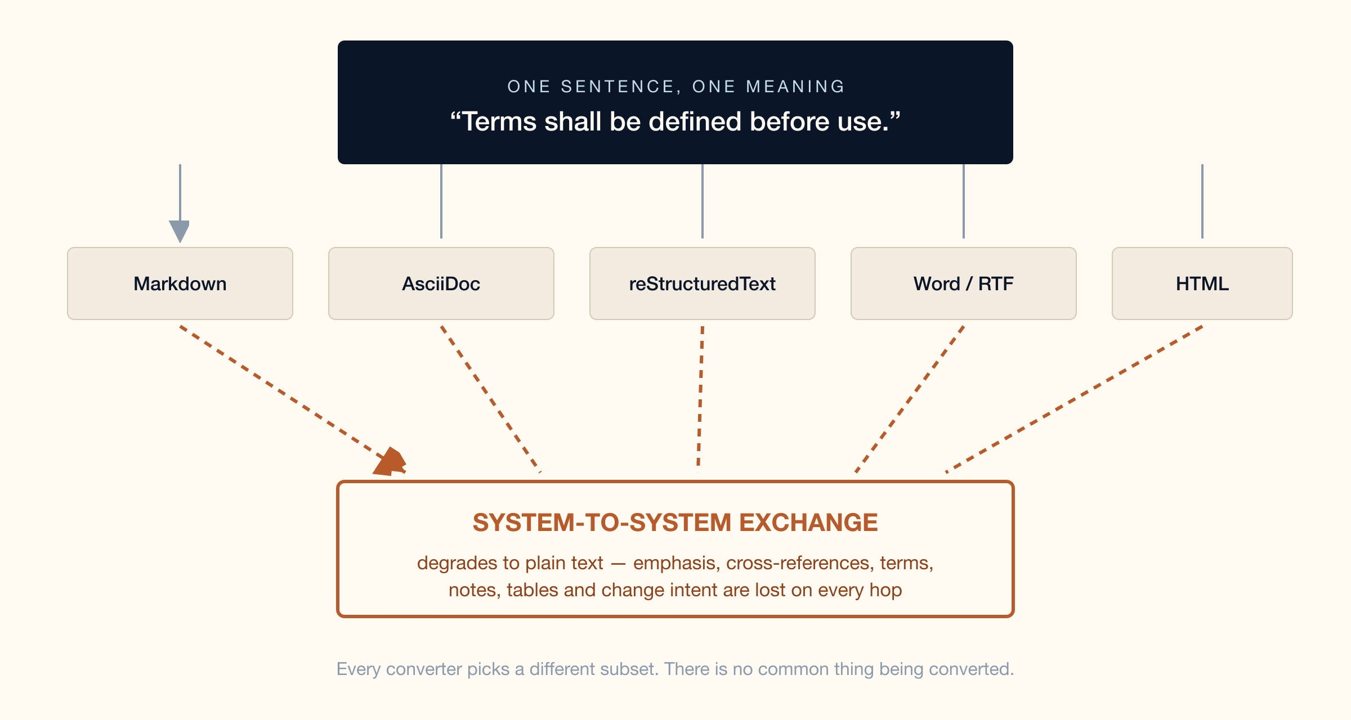
THE PROBLEM EVERY TEAM KNOWS
Same meaning, five languages — and none of them travel
CalConnect → ISO/TC 154 · CC/ISO 36010 · 2

Slide 3
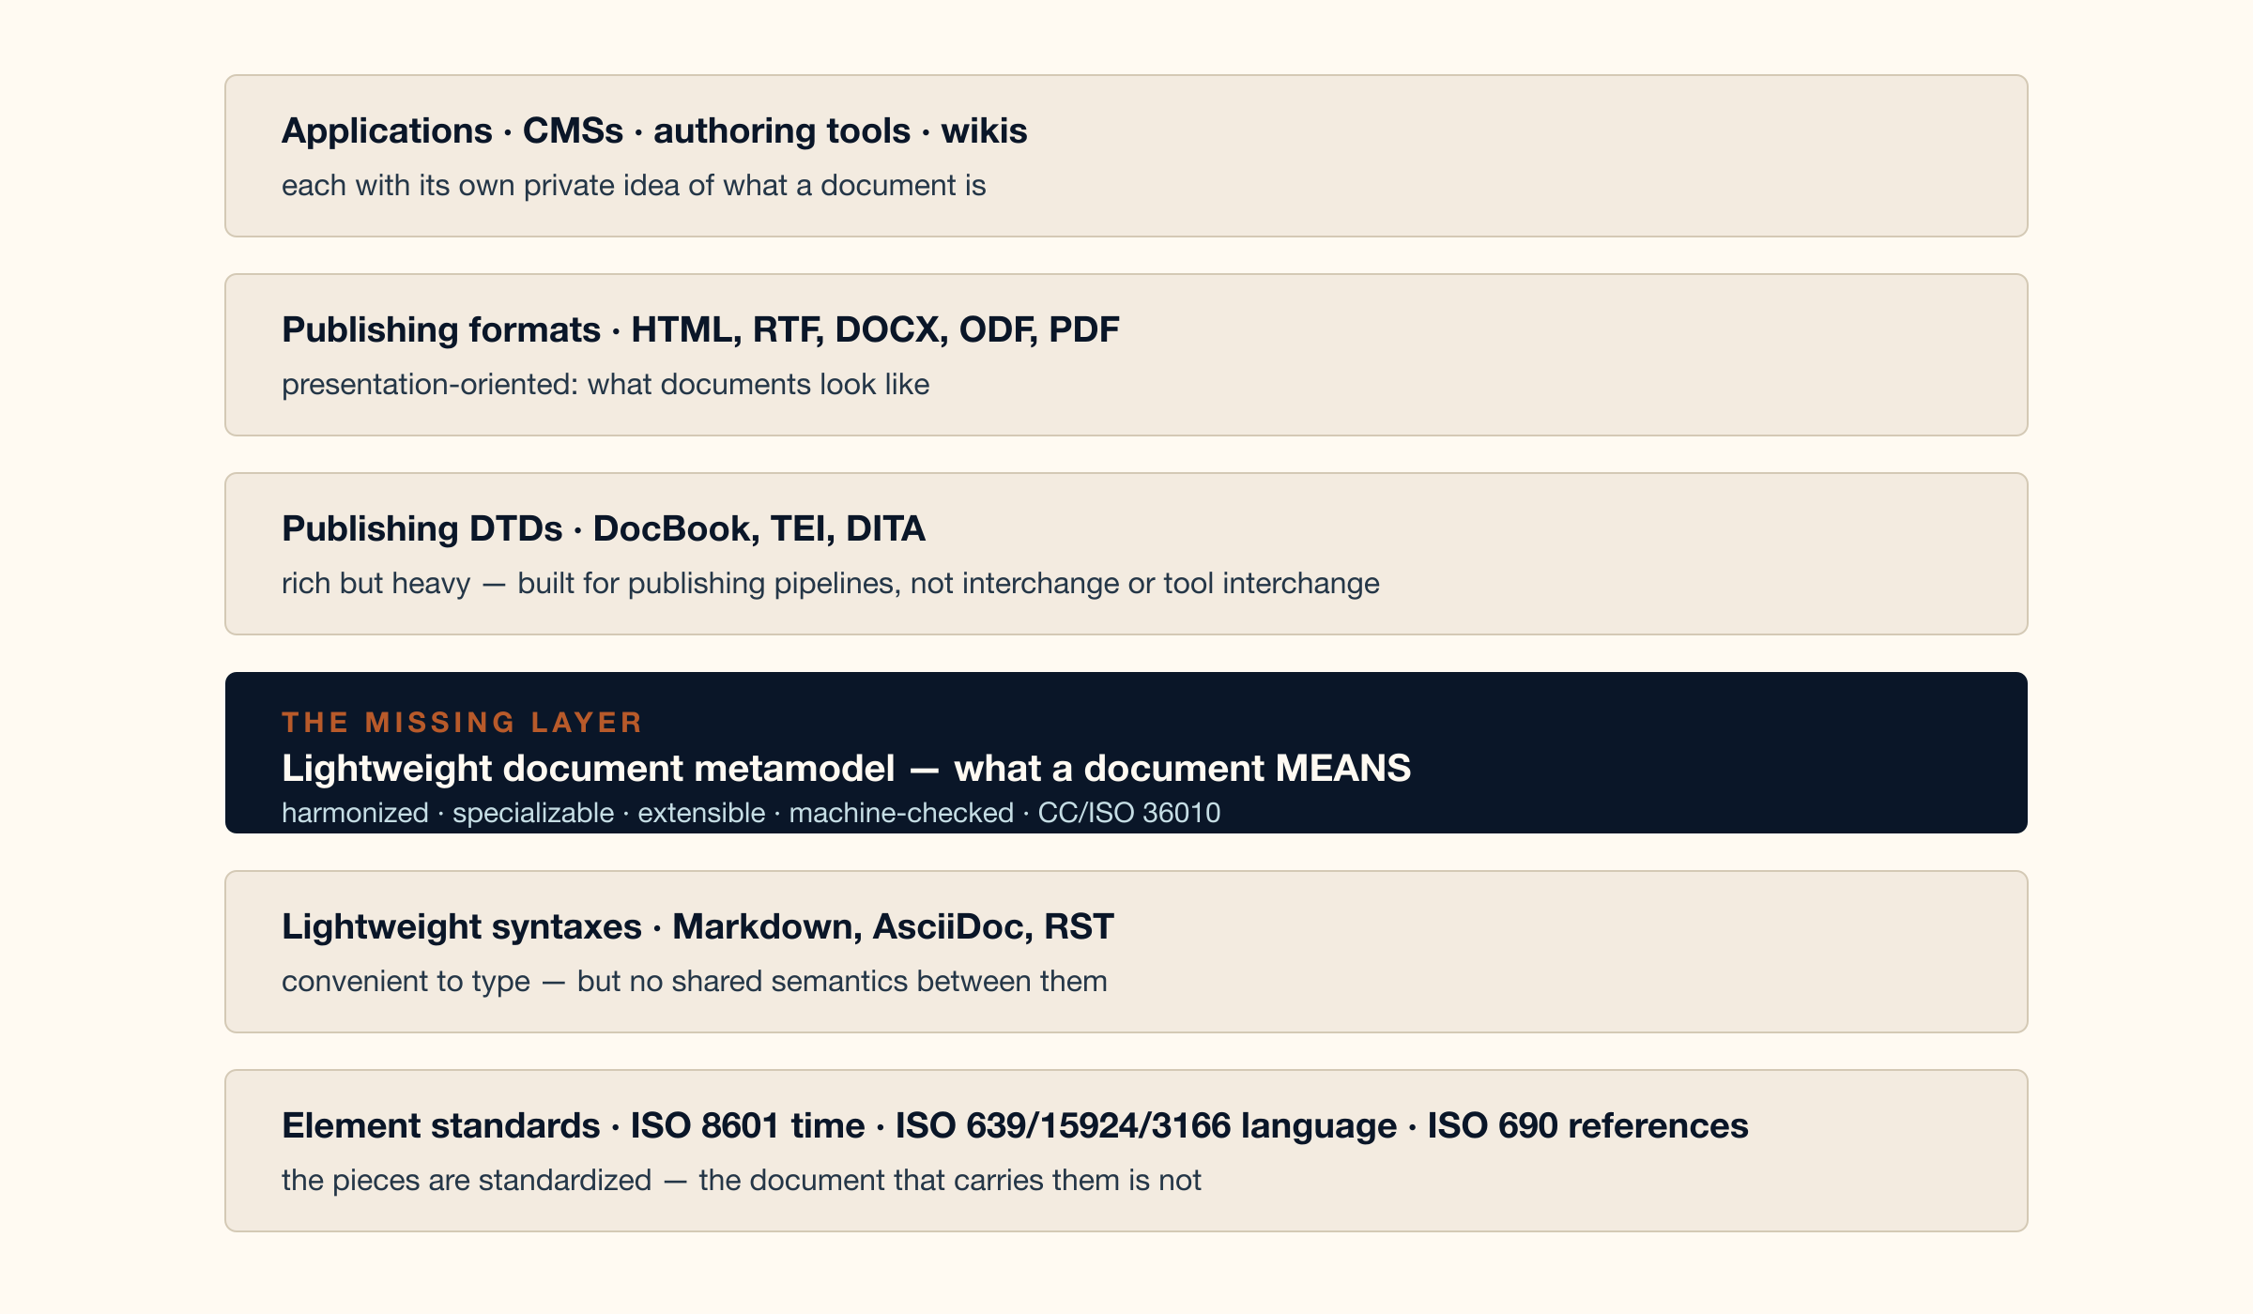
“DOESN’T SOMETHING LIKE THIS EXIST?”
No. Every layer exists — except the one that carries meaning
CalConnect → ISO/TC 154 · CC/ISO 36010 · 3

Slide 4
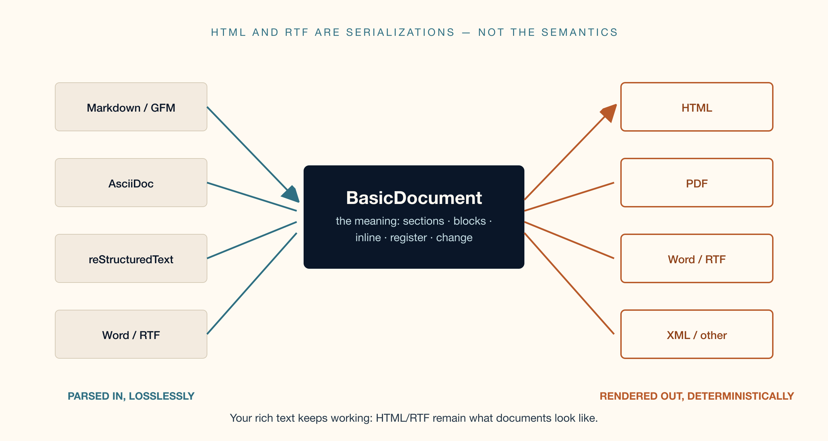
“AREN’T HTML AND RTF ALREADY THAT LAYER?”
HTML and RTF say how text looks — not what it means
The metamodel is what all of them mean. Rendering stays exactly where it is.
CalConnect → ISO/TC 154 · CC/ISO 36010 · 4

Slide 5
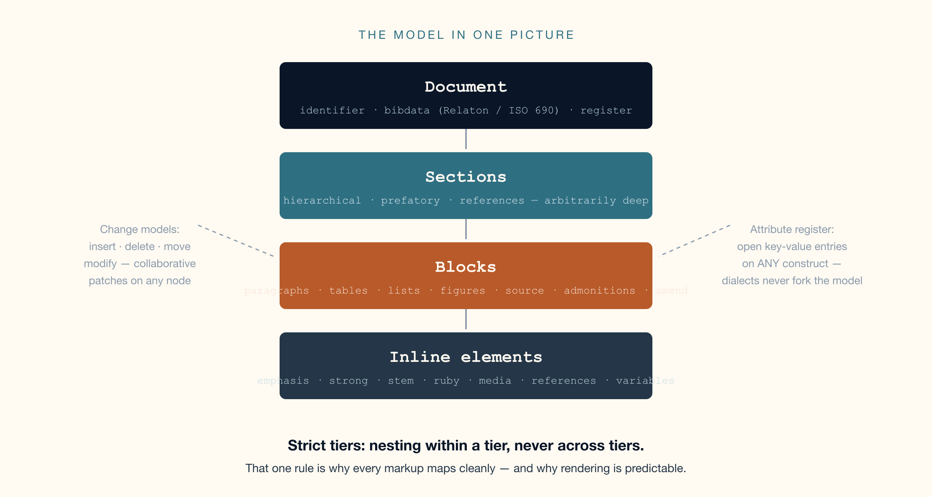
THE ANSWER
One small model, deliberately lightweight
CalConnect → ISO/TC 154 · CC/ISO 36010 · 5

Slide 6
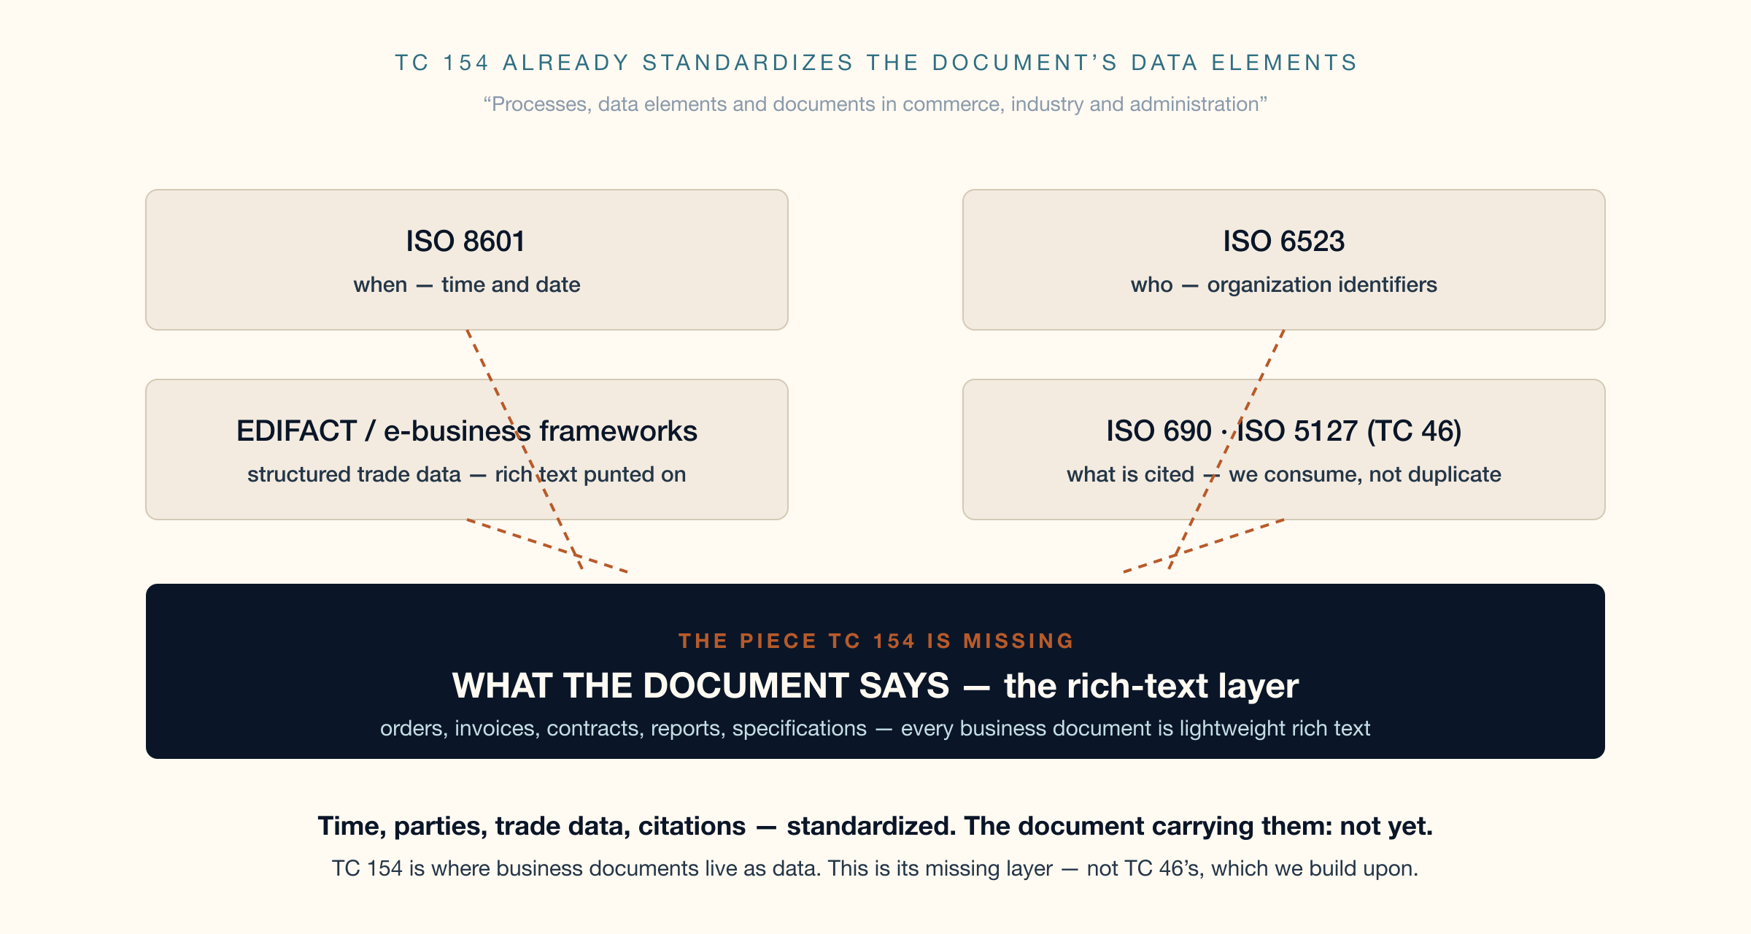
WHY TC 154 — AND NOT ANOTHER TC?
Because TC 154 is where documents are data
CalConnect → ISO/TC 154 · CC/ISO 36010 · 6

Slide 7
WHY HAS THIS NOT EXISTED UNTIL NOW?
Syntaxes competed; consortia standardized the pieces
Standards bodies standardized elements, not documents
ISO gave us time (8601), language (639), scripts (15924), references (690). The document carrying them was always someone’s tool, never a standard.
Format wars had no neutral referee
Markdown vs AsciiDoc vs RST is a tooling debate. A metamodel below all of them was in no vendor’s interest to build.
It took a standards producer to need it
CalConnect/Metanorma authors standards IN lightweight markup and renders to ISO-grade output — the exact round-trip everyone else gave up on. The model was extracted from production, not invented.
Now that it is proven, it can be neutral
Six years, 30+ document flavours, executable conformance — ready to hand to ISO as a public good.
CalConnect → ISO/TC 154 · CC/ISO 36010 · 7

Slide 8
HARMONIZED — ANNEX A, NORMATIVE
Every markup construct has a home: proven, clause by clause
AsciiDoc
Markdown · GFM · Pandoc
reStructuredText
header → bibdata + register
admonitions → AdmonitionBlock + type
continuations → relaxed ListItem
passthroughs → FormattedString
{attr} → ReferenceToVariable
GFM tables → TableBlock
{#id .class} → attribute register
::: divs → register + any container
$math$ → StemElement (LaTeX)
raw HTML → FormattedString + format
directives → register + relaxed content
|substitution| → ReferenceToVariable
roles → text specializations
field lists → document register
danger / error / hint → type extensions
Conformance formula — a foreign construct is covered iff it maps to: a construct · a type-specialization · register + relaxed or opaque content.
Anything unlisted is answerable in one line. That is what “complete superset” means, testably.
CalConnect → ISO/TC 154 · CC/ISO 36010 · 8

Slide 9
SPECIALIZE AND EXTEND — ANNEXES B AND C
Dialects arrive without ever forking the model
SPECIALIZE
EXTEND
· Type values, not parallel classes —
admonition kinds, list numeration,
stem languages, document classes
· Attribute overrides: add, remove,
retighten (e.g. no hanging paragraphs)
· Subclassing under the construct roots
· Constraint specialization:
PureTextElement recursion guarantees
· Attribute register: open key-value
entries on any construct — dialect
keys (checkbox, option), no model change
· Raw stays lossless: FormattedString,
format-qualified blocks
· Unknown directives (all of Sphinx)
decompose into register + relaxed content
· A document is a block: whole documents
compose as child content
Open-closed by construction: the basis is defined once and never modified — only specialized upon.
CalConnect → ISO/TC 154 · CC/ISO 36010 · 9

Slide 10
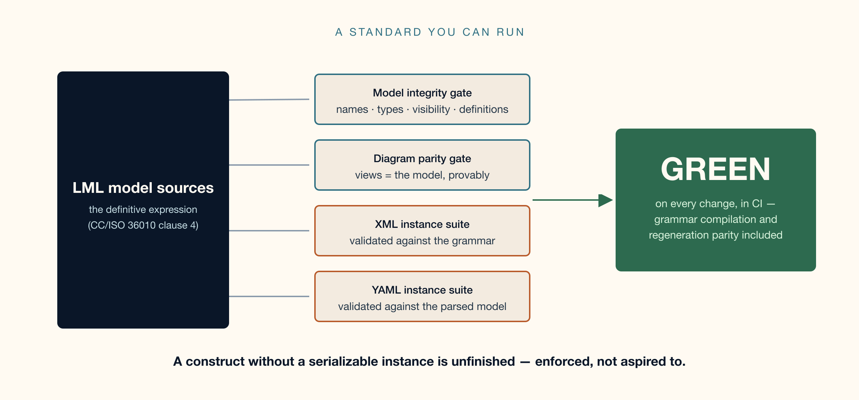
EXECUTABLE CONFORMANCE — ANNEX D
Not “trust us” — a standard with a passing test suite
CalConnect → ISO/TC 154 · CC/ISO 36010 · 10

Slide 11
EVIDENCE
Extracted from production, not invented for a committee
30+ document flavours
Metanorma authors and publishes real standards on this model today (relaton-models, standoc-models consumers, all pinned in lockstep)
ISO-grade outputs
The model renders to ISO/IEC-standard layouts — HTML, PDF, Word — proving the model→presentation direction daily
Registry-native
Localized strings are ISO 24229 spelling systems; romanization schemes carry ISO 24229 system codes as register schemes
Open artifacts
Model sources, grammars, twin instances, gates, atlas site — public at metanorma/basicdoc-models; every merge runs the suite
Live model atlas
metanorma.github.io/basicdoc-models — every plate with full definitions, hyperlinked types, deep links
CalConnect → ISO/TC 154 · CC/ISO 36010 · 11

Slide 12
THE ASK
Adopt CC/ISO 36010 as the base text
for a Draft International Standard
→ Recognize the lightweight document metamodel as the interchange layer for structured text
→ Progress it at TC 154: NP → WD → CD → DIS — the base text is complete and tested today
→ Designate the public repository and its executable conformance suite as the maintenance vehicle
→ CalConnect (TC VCARD) continues as proposer and editor, liaising with TC 46 — we consume ISO 690 and ISO 5127, we do not duplicate them
metanorma.github.io/basicdoc-models · github.com/metanorma/basicdoc-models · CC/ISO 36010

