Slide 1
ISO 36100 Standardization documents — Metamodel
Dr. Nick Nicholas CalConnect

Slide 2
Motivation of a harmonized information model
Standardization deliverables are created to:
express a set of normalized requirements and
express information associated with those requirements.
Standardization deliverables play a crucial role in today’s activities:
Rule-based enforcements from the organization of markets, conformance of products to the compliance of regulation and requirements, all depend on content expressed through standardization deliverables.

Slide 3
Addressing efficiency and effectiveness challenges
Rigorous, detailed rules around information structure are manually validated leads to mixed and inconsistent results
Document editing revolves around standardizing use of particular software instead of requirements, leading to non-interoperable information
Workflows conflate information structure and presentation, significant amounts of time wasted on formatting instead of content.
Exchange mechanisms focus on appearance or superficial structure, not intended for use.
Standardization bodies dictate incompatible workflows. Submitting identical content or cross-publishing to multiple standardization bodies require heavy replication of work.

Slide 4
Harmonizing standardization deliverable content across SDOs
The StandardDocument document metamodel [*] treats a standardization deliverable as a set of standardized data structures, used to enable an end-to-end standardization document production process.
The metamodels focuses on semantics and encompasses core similarities between standardization documents of different standardization bodies.
[*] a metamodel is a language used to create information models

Slide 5
ISO 36100 metamodels proven compatible with many SDOs
ISO and IEC
ISO/IEC DIR 1, DIR 2
ISO and IEC Supplements
ISO House Style
ITU-T / ITU-R
CalConnect
CC/DIR 10001
CC/DIR 10002
IETF
RFC 7749
RFC 7991
OGC
OGC 05-020r26
NIST Special Publications
NIST Publication Guide
BIPM
IHO
BSI
BS 1
Chinese National Standard

Slide 6

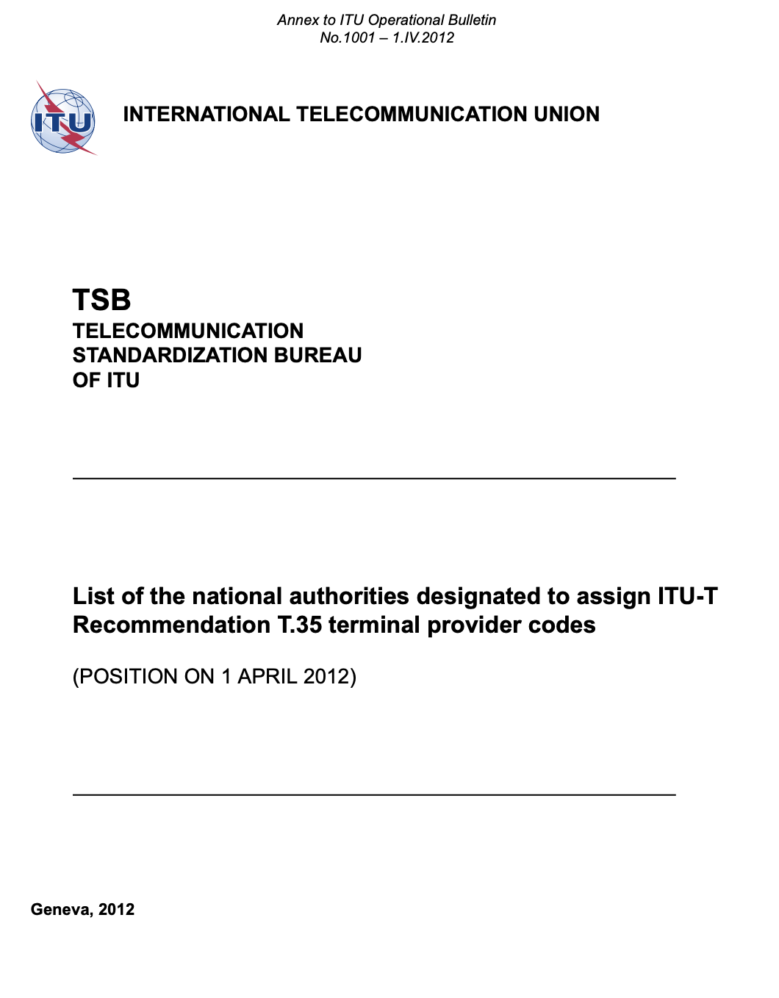
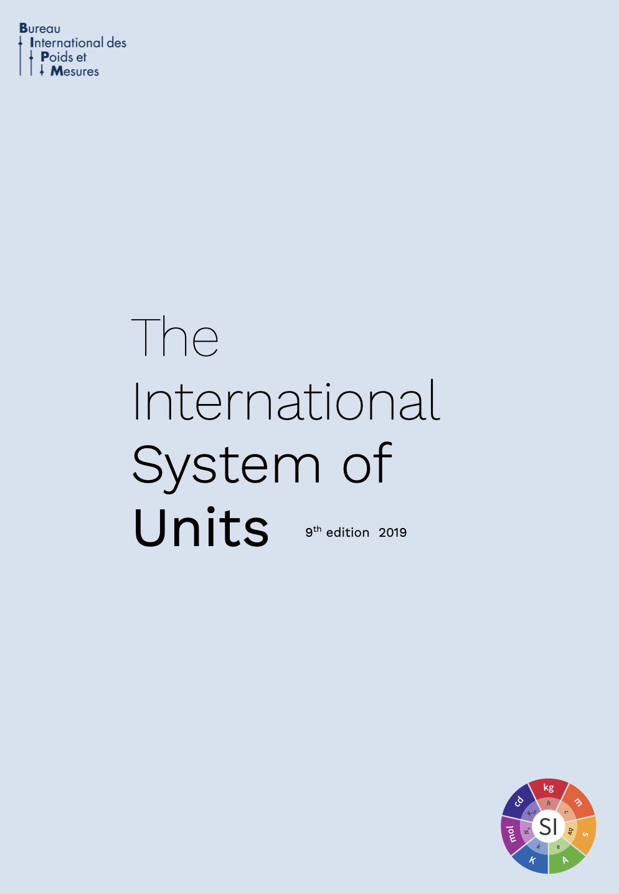
Standardization deliverables created with 36100 models

Slide 7
Standardization deliverables are composed of 5 core types of information
Standardization metadata
Standardization information (e.g., stage, validity)
Publication information
Textual elements
Rich text representation
Requirements and conformance tests
Compliance validation
Test methods
Test outcomes
References and citations
Links to external resources
Internal links
Concepts and terminology
Defined concepts
External concepts (e.g. IEV)

Slide 8
36100 metamodels information models architecture
* simplified
organizational deliverable schema
implements
ISO 36100 metamodels
Metadata
Textual representation
Requirements
CC 36010
Concepts / Terminology
References / Citations
ISO 10241-1 / ISO 704
ISO 690

Slide 9
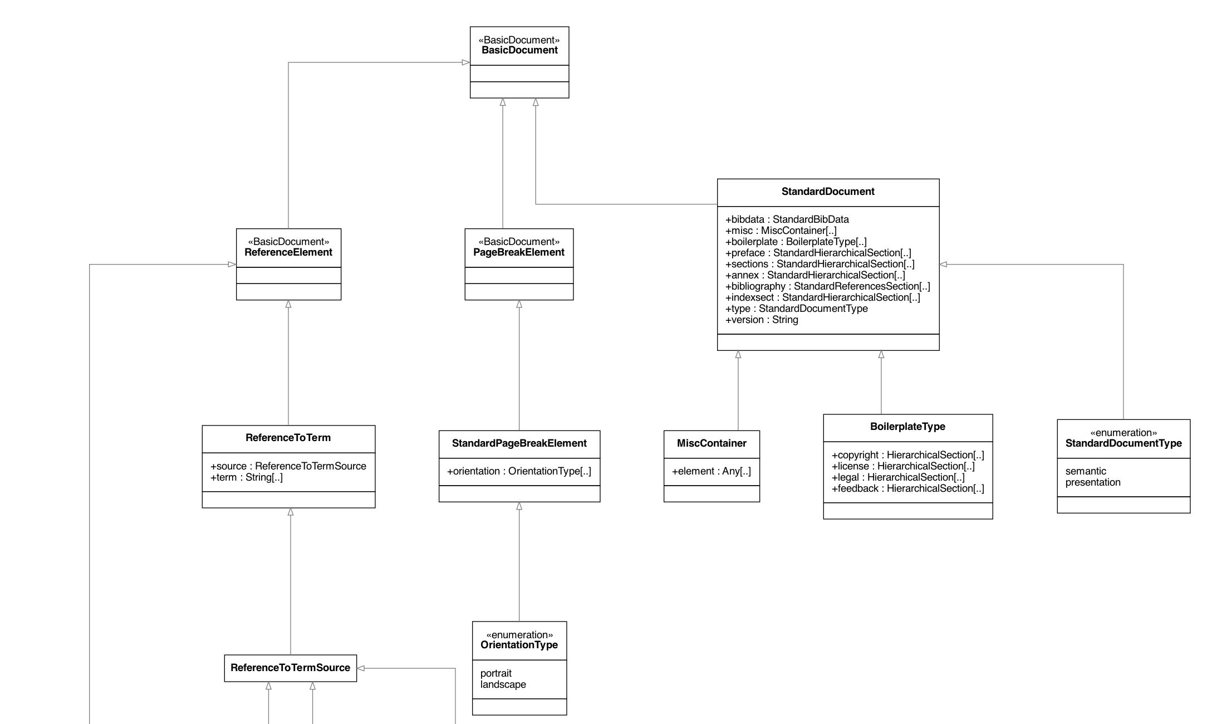
Excerpt from ISO 36100 StandardDocument model

Slide 10
Benefits of adopting 36100’s data-centric, model-based approach
Enables an end-to-end, author-to-publishing workflow, allows document management processes to be centered around data.
Semantic metamodel (and its specialized models) abstracts away presentation, allows authoring and editorial processes to focus on content.
Structural and content requirements can be subject to formal validation as they are fully captured in the deliverable models.
Deliverable model harmonized across different standardization documents and bodies, and therefore the content can be easily repurposed for different standardization bodies with minimal effort.

Slide 11
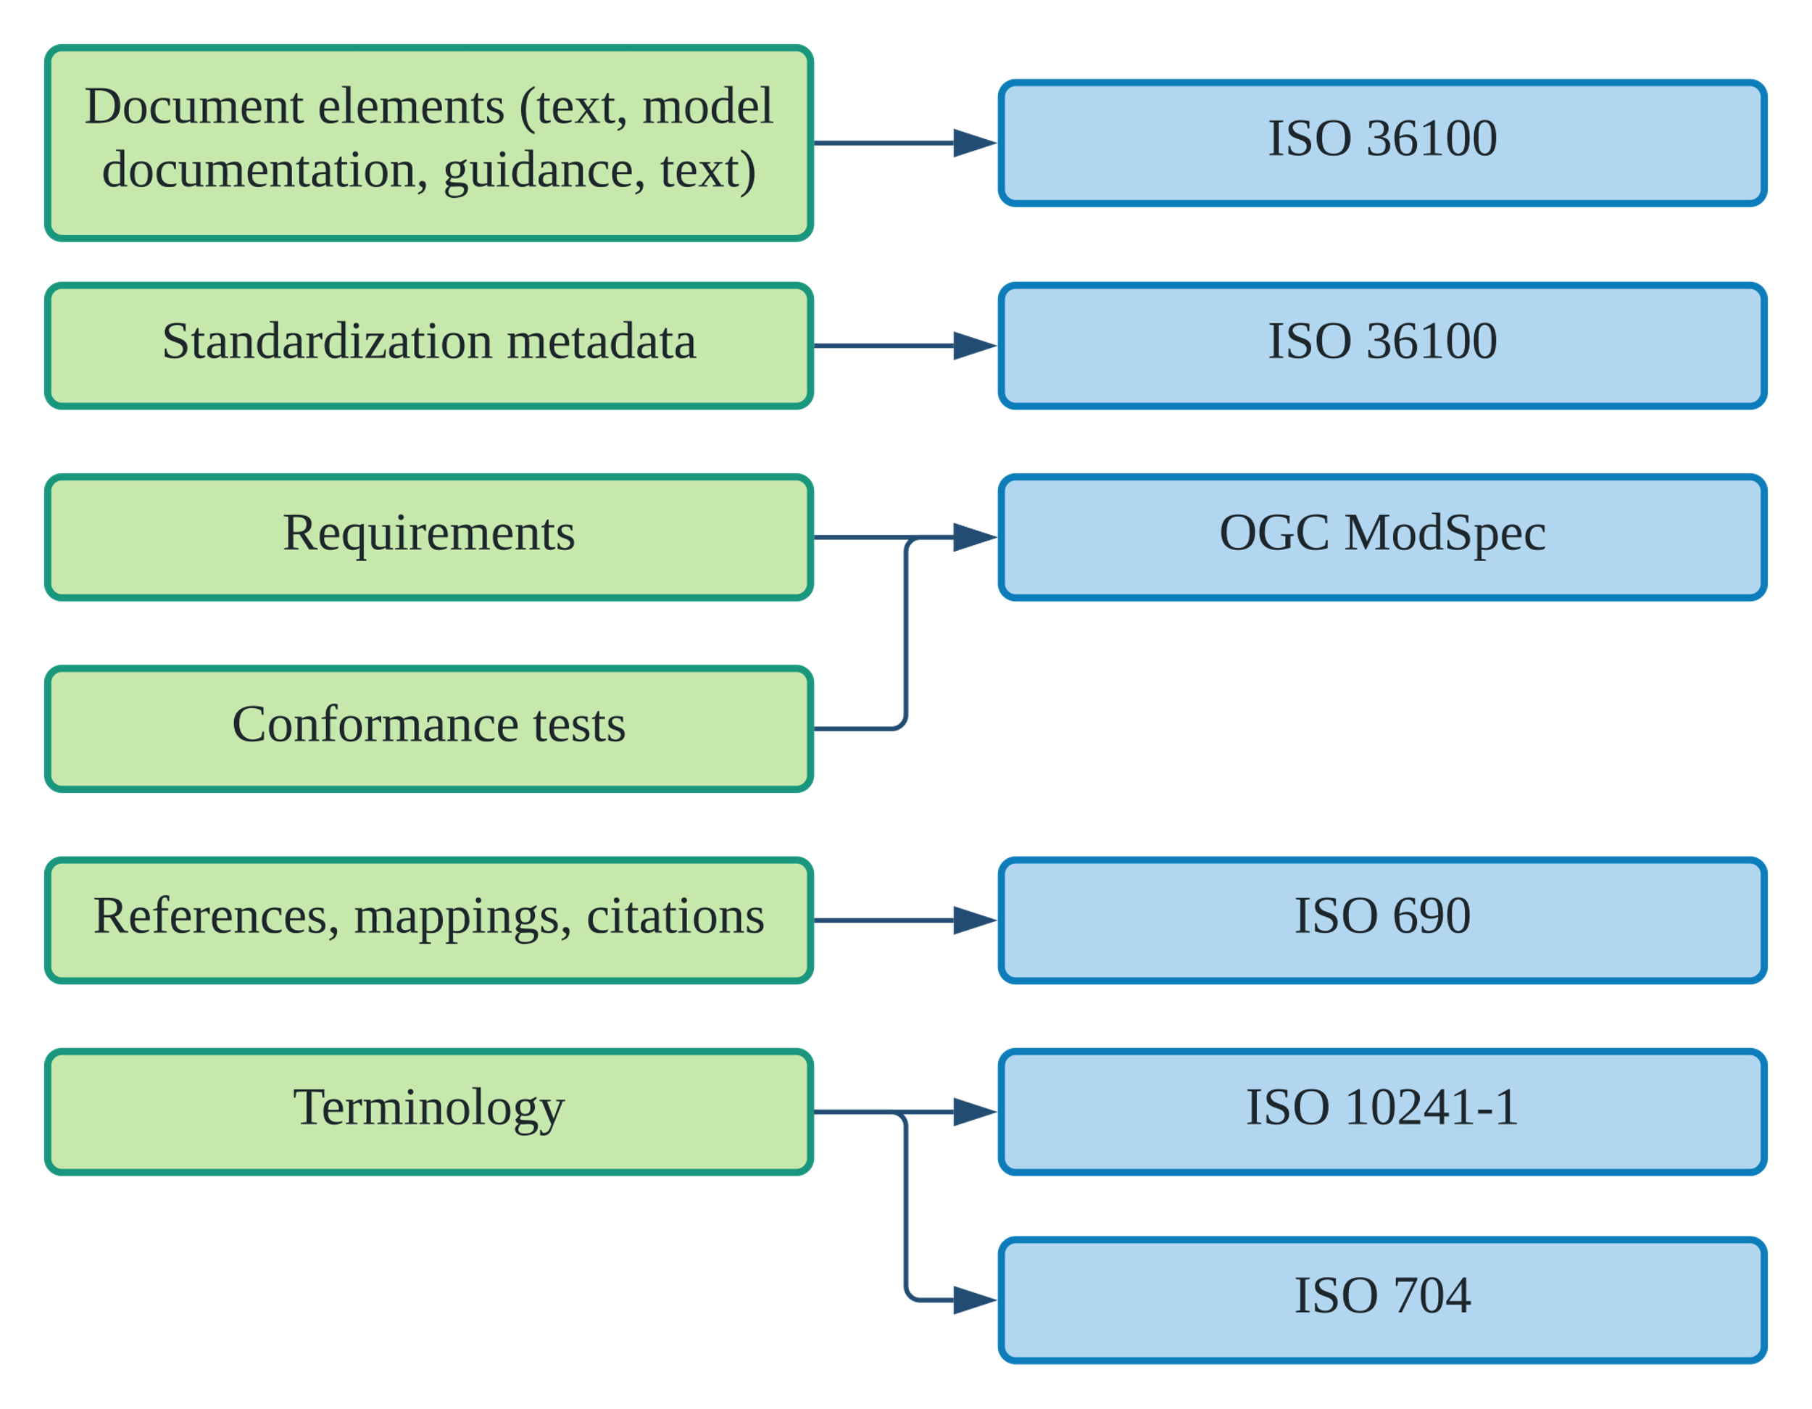
OGC realization of 36100 metamodels (in use today)
OGC 21-035r1 “Model-Based Standards”, Figure 16

Slide 12
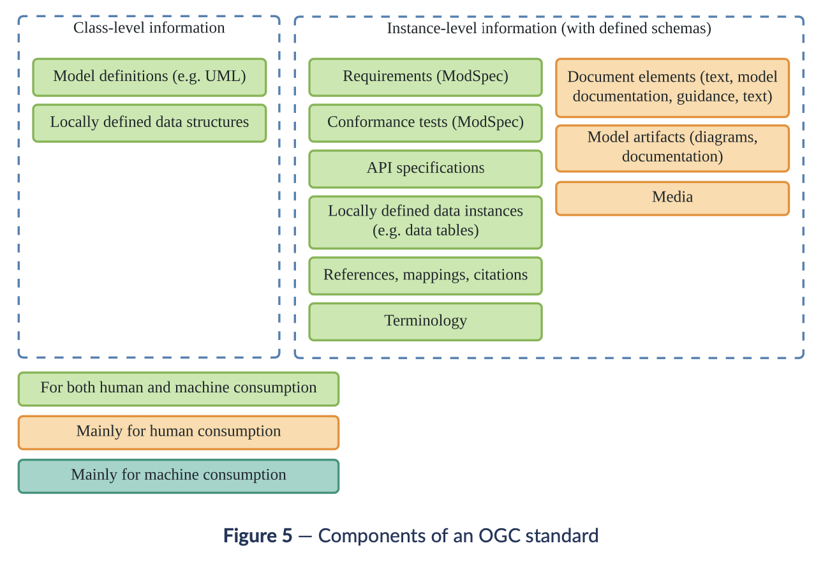
OGC standard information models in detail
OGC 21-035r1 “Model-Based Standards”, Figure 5

Slide 13
Machine-readable requirements modelling and testing
ISO 36100 provides an abstract metamodel of requirements:
compatible with OGC’s ModSpec
enables machine-readable requirements
Battle tested: in use in OGC for over 10 years, applies to all OGC standards!
OGC 08-131r3 “The Specification Model — A Standard for Modular specifications” (ModSpec)
Enables interoperability of implementations, test validation across implementations
Language to specify requirements for software, services or data structures.
Achieves the above by providing a standardized set of information models for requirements and tests

Slide 14
Requirements basic information models architecture
* simplified
test subject
validates
implements
satisfies
Requirements class
tests
Conformance class
belongs to
belongs to
Requirement
tests
Conformance test

Slide 15
Requirements basic information models details
* simplified
Requirement
URI
Requirements class
Obligation (e.g., requirement, recommendation, permission)
Dependencies
Target type
Purpose
Parts
Conformance test
URI
Conformance suite
Corresponding requirement
Dependencies
Purpose
Test method
Test subject
Test parts
Test steps
Results to validate against
Executable portions

Slide 16
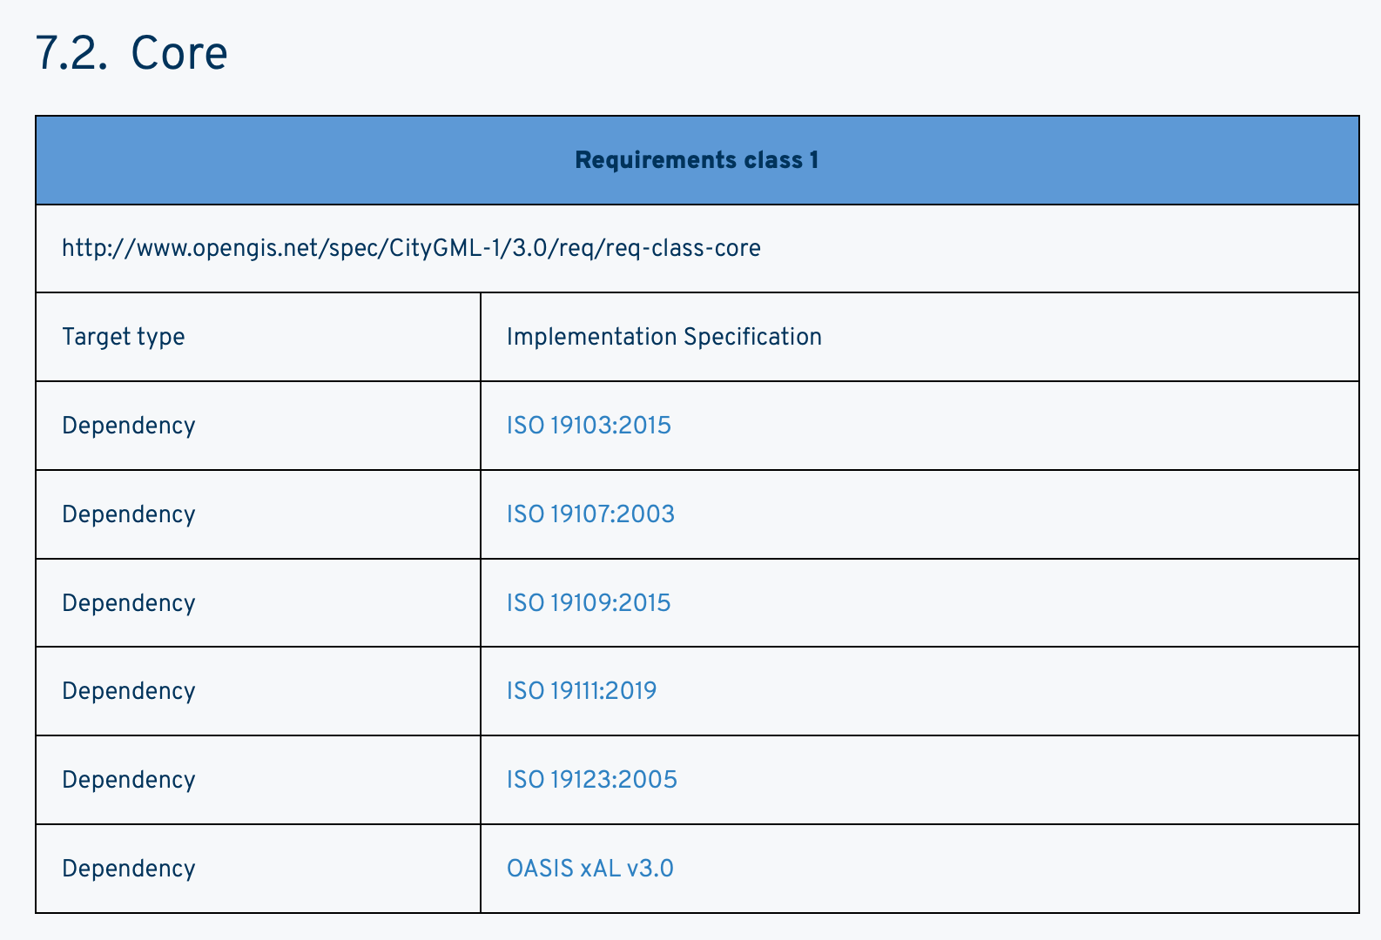
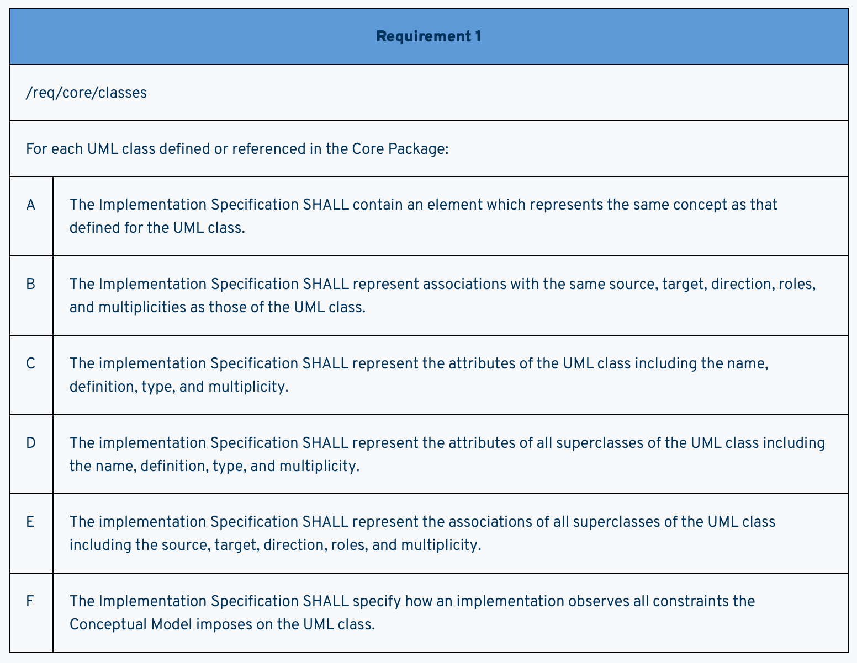
Requirements class and requirements samples

Slide 17
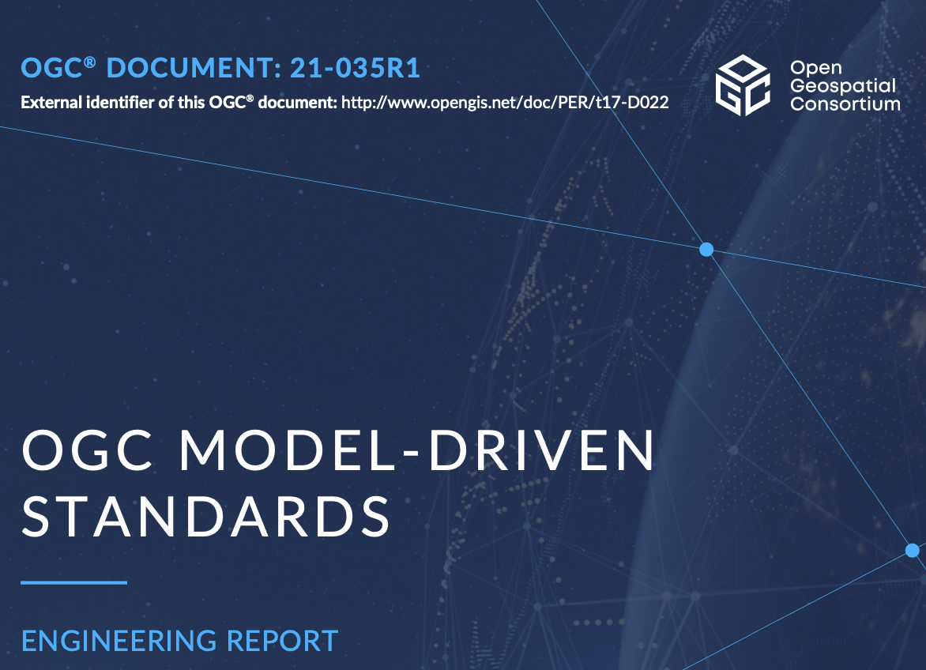
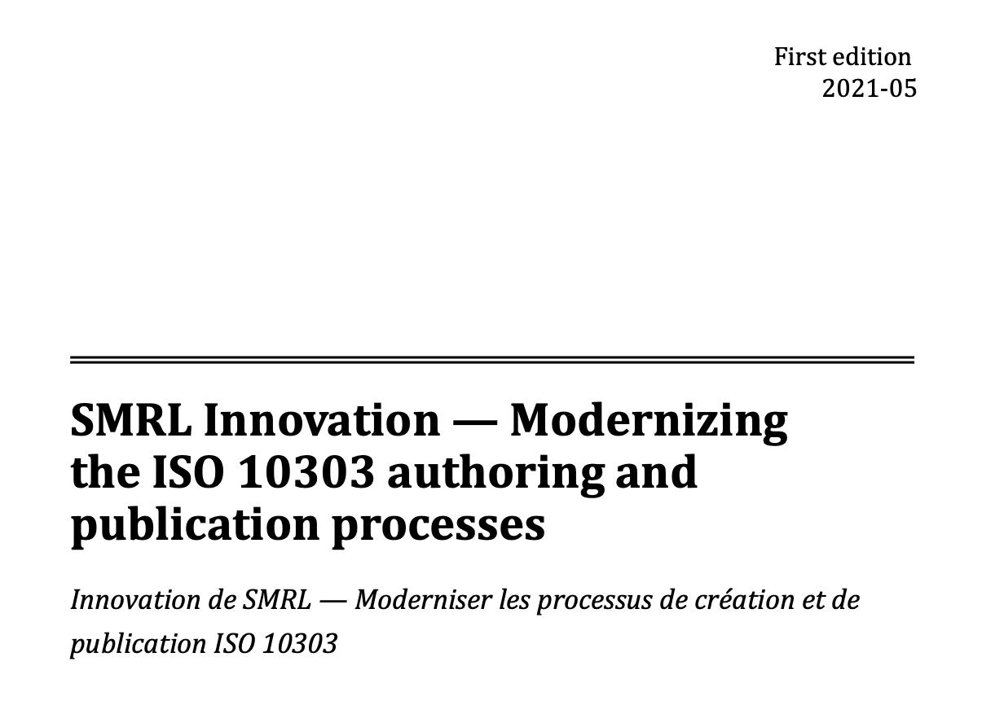
Advanced: Model-based standards possible with 36100
OGC 21-035r1
OGC Model-Driven Standards (2022)
ISO/TC 184/SC 4 SMRL Innovation -- Modernizing the ISO 10303 authoring and publication processes” (2021)

Slide 18
Advanced: Machine-readable Amendments/Corrigendum
standard deliverable
content
content
change 1
updated deliverable
content + change
change 2
content + change

Slide 19
What’s next?
Can provide detailed information model presentation on ISO 36100 metamodels
Provide information on how machine-readable requirements are used
Partake in discussions on what information models can adequately represent standards
Anything else?

Slide 20
Thank you, questions welcome!

