Slide 1
SMARTSTIMA FOR ENERGY EFFICACY & ELECTRICITY COST SAVING
TEAM MEMBERS;
Joy Muntet
Calvin Kinyanjui
Evaline Moseti
Ginah Njoroge

Slide 2
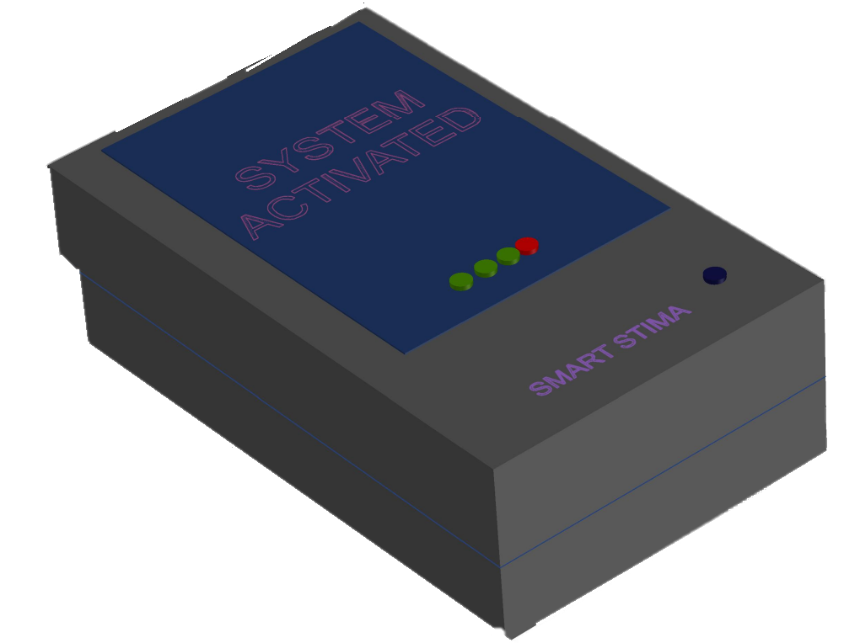
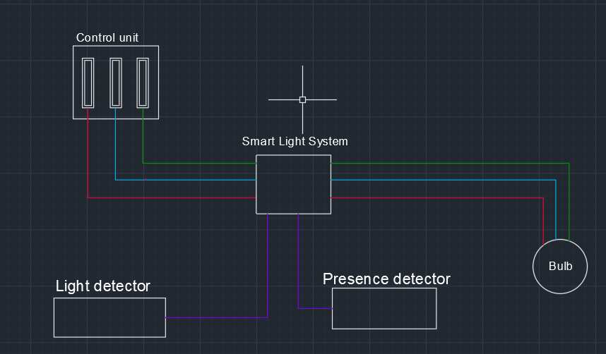
BRIEF INTRODUCTION
Smart Stima is an Energy Saving System that allows the user to control their energy consumption by allowing light bulbs to be used only when necessary. It does this by detecting the amount of sunlight and the presence of people by use of motion and infrared sensors.

Slide 3
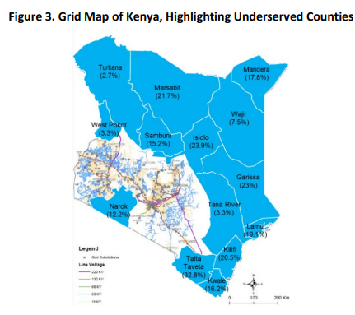
PROBLEM STATEMENT
KETRACO’S vision is to be a leading interconnector in Africa while KPLC’s vision is to power lives by innovatively securing business stability.
By and large, their respective visions have made massive strides!
However, the already established networks have unmet demands thus they keep upgrading the networks in sectors they have already set-up.

Slide 4
KEY PERFORMANCE INDICATORS (KPI’s)
Some of the reasons for these unmet demands are due to irresponsible use of energy such as:
Unnecessary use of lights
Unnecessary use of heating for instance in companies
Unnecessary energy consumption in cooling of air conditioning

Slide 5
STRATHMORE UNIVERSITY CASE STUDY
Number of bulbs | 6
Power (Watts) | 20
Hours | 24
KWH per day | 2.88
Cost | Ksh. 72
Monthly energy consumption | 86.4 KWH
Monthly bills | Ksh. 2,160
Annual energy consumption | 1,036 KWH
Annual bills | Ksh. 25,900

Slide 6
SMARTSTIMA IMPACT
Number of bulbs | 6
Power(Watts) | 20
Hours | 10
KWH per day | 1.2
Cost | 30
Monthly energy consumption | 36 KWH
Monthly bills | Ksh. 900
Annual energy consumption | 432 KWH
Annual bills | Ksh. 10,800
Approximate saving is around 60%

Slide 7
VALUE PROPOSITION
Network expansion
Reduce Network opex through reduction of overloading of the line
Cost Saving

Slide 8




IDENTIFIED STAKEHOLDERS FOR UTILIZATION

Slide 9



IDENTIFIED STAKEHOLDERS FOR PRODUCT DEVELOPMENT

Slide 10
PROPOSED BUDGET
S/N | ITEM | QUANTITY | UNIT | PRICE | AMOUNT(Ksh.)
1 | LDR Sensor | 10 | PCS | 50 | 500
2 | Infrared Sensor | 3 | PCS | 1000 | 3000
3 | Channel Relay Module | 2 | PCS | 400 | 800
4 | Arduino Uno | 1 | PCS | 2000 | 2000
5 | Signal Cable | 1 | ROLL | 3000 | 3000
6 | PCB Board | 1 | PCS | 500 | 500
7 | Casing | 1 | PCS | 2000 | 2000
8 | LCD | 1 | PCS | 2500 | 2500
9 | Connectors | 1 | PKTS | 700 | 700
 | TOTAL |  |  |  | 15000

Slide 11
BUSINESS ANALYSIS
If we were to identify the total number of households in Nairobi and reduce their energy consumption then this energy can be used to supply other areas.
To Nairobi household owners, they will be able to cut on their bills and re-direct this saved money to set-up businesses and hence provide more employment opportunities

Slide 12


